Slide 1
RIIRIS401d Apply Site risk management system
Presentation 1

Slide 2

1.1 INTRODUCTION
Welcome to this course, based on the national unit of competency RIIRIS401D: Apply Site Risk Management System.
The information in this unit is appropriate for those people working in supervisory or risk management roles within:
Civil construction.
Coal mining.
Drilling.
Extractive industries.
Metalliferous mining.

Slide 3

1.1 INTRODUCTION
The unit covers the application of the site risk management system in these industries, and includes:
Providing information to the work group.
Applying and monitoring participative
arrangements.
Procedures for providing training.
Identifying hazards and assessing risks.
Controlling risks.
Maintaining records.

Slide 4
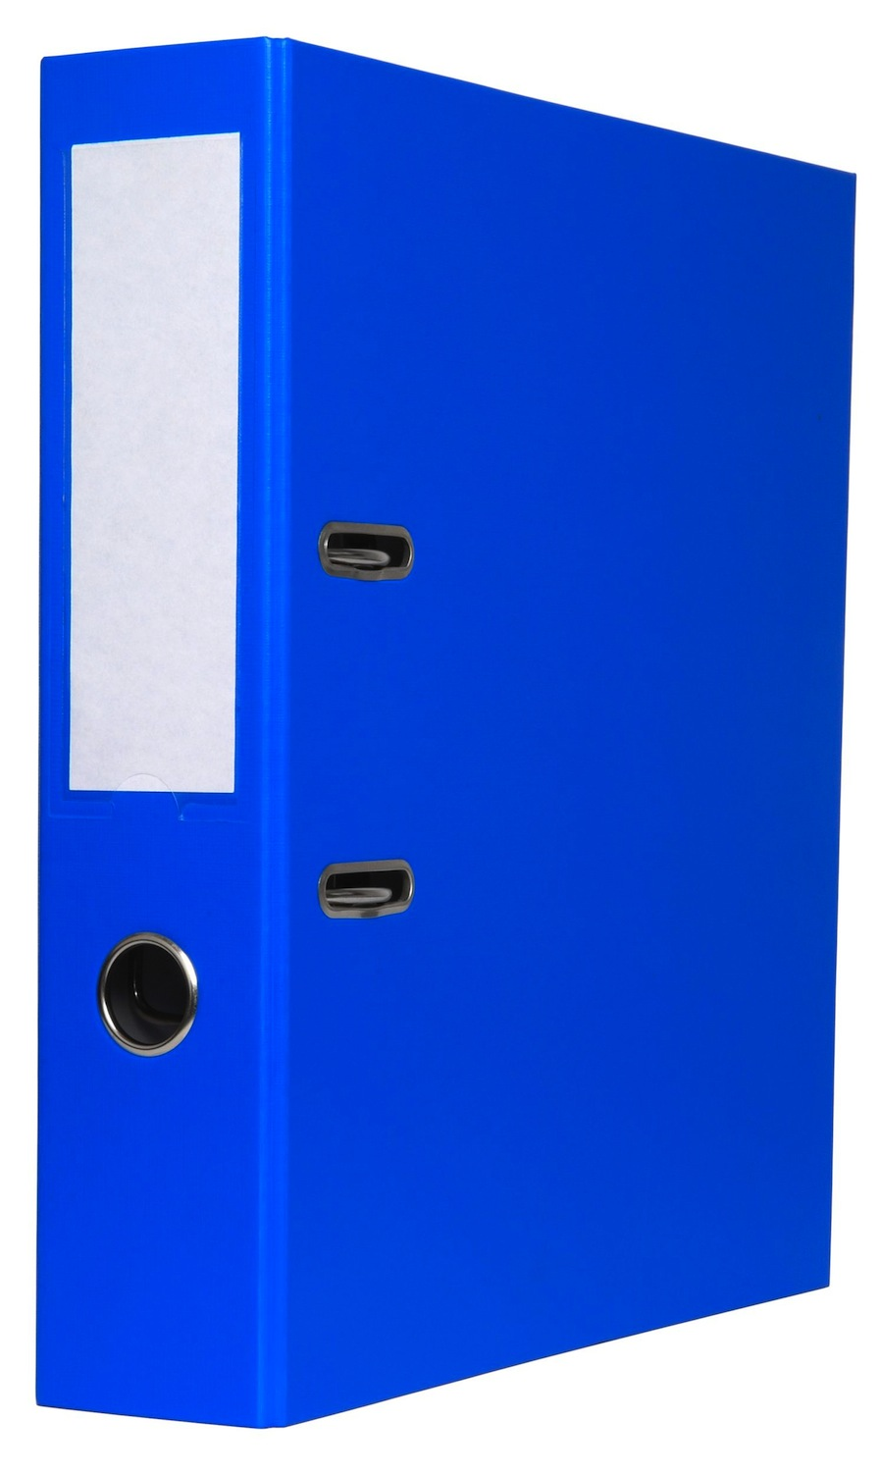
1.2 COMPLIANCE DOCUMENTATION
Risk management activities are bound by a range of compliance requirements, which will be outlined in a variety of documents.
Compliance documentation states the requirements that must be met while on all worksites.
All of these documents will be found in the site risk management system, which is based on the organisational risk management system.
The organisational system will account for all relevant legislative and regulatory requirements.

Slide 5

1.2 COMPLIANCE DOCUMENTATION
Compliance documentation could include the following:
Manufacturers’ guidelines and specifications.
Legislative requirements.
Organisational requirements.
Codes of practice.
Australian standards.
Harmonisation of Occupational Health &
Safety/Work Health & Safety (OHS/WHS)
legislation.
Applying legislation.
Wider interpretation of risk.

Slide 6

1.2.1 legislative requirements
Legislative requirements are detailed in OHS/WHS Acts and regulations.
Examples of legislative requirements that will apply on worksites could include employment and workplace relations, equal employment opportunity and disability and discrimination legislation.

Slide 7

1.2.1 legislative requirements
Statutory rules and regulations may apply to different job sites, a task within a site or an entire industry or sub-industry.
As these statutory guidelines are set by government agencies, it is essential that you research and identify these requirements.

Slide 8

1.2.1 legislative requirements
Each of the levels of government, state/territory and federal, can apply requirements to your worksite which, can affect overall business operations.
It is important you are aware of all of legislation that applies and you have fully researched what is required of you.

Slide 9

1.2.2 ORGANISATIONAL requirements
These documents could include company-wide requirements and/or site-specific procedures.
Organisations must have a commitment from management to ensure the health and safety of all persons in the workplace including employees/workers, contractors, visitors and the general public.
The OHS/WHS policy should clearly reflect this and the intent should not be ambiguous.

Slide 10
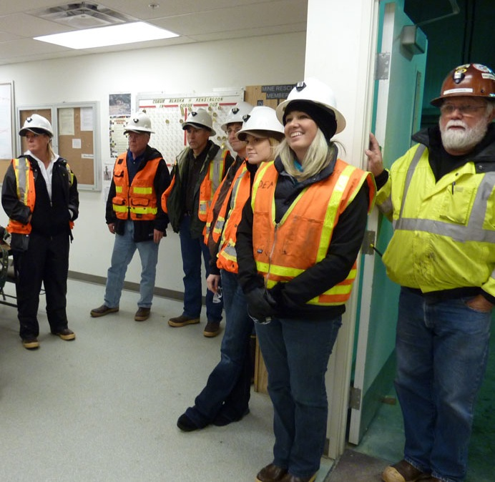

1.2.2 ORGANISATIONAL requirements
Each site will have specific requirements that need to be met. These individual or unique requirements will be included in your site induction.
As a supervisor or risk management specialist, you may be required to assist in the creation of these induction or site and equipment safety documents.

Slide 11

1.2.2 ORGANISATIONAL requirements
Organisations that are in a “Principal Contractor” role are responsible for ensuring that each sub-contractor under their supervision has adequate systems in place to maintain OHS/WHS standards.

Slide 12

1.2.3 MANUFACTURERS’ GUIDELINES AND SPECIFICATIONS
These requirements will be documented in owner manuals, equipment specifications and operator instructions. Designers and manufacturers have a responsibility under OHS/WHS legislation to ensure that plant and equipment meets strict criteria for the safe operation and protection of workers.

Slide 13

1.2.4 AUSTRALIAN STANDARDS
Australian standards requirements detail how tasks should be completed.
Specific standards such as ISO 31000: 2009 Risk Management and AS/NZS 3806:2006 Compliance Programs assist in the formation of risk management strategies and plans.

Slide 14

1.2.5 CODES OF PRACTICE
These Codes define and provide guidance to organisations where activities containing some elements of risk are encountered.
These also provide consistency across the industry or industries so that organisations are referencing the same materials to maintain their compliance to the relevant standards.
Industry Codes of Practice (federal or state or both) must be consulted and kept up to date.

Slide 15
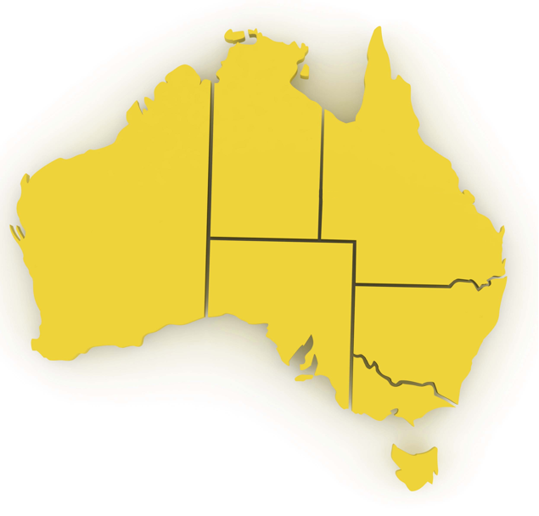
1.2.6 HARMONISATION OF WORK HEALTH & SAFETY LEGISLATION
In response to industry calls for greater national consistency, the Commonwealth, states and territories have agreed to implement nationally harmonised Work Health & Safety (WHS) legislation to commence on 1 January 2012.
While not all states and territories have actually implemented the model WHS legislation as of the start of 2012, it is important to be aware of these changes, as all states and territories will eventually implement them.

Slide 16

1.2.6 HARMONISATION OF WORK HEALTH & SAFETY LEGISLATION
Harmonisation aims to develop consistent, reasonable and effective safety standards and protections for all Australian workers through uniform WHS laws, regulations and codes of practice.

Slide 17

1.2.6 HARMONISATION OF WORK HEALTH & SAFETY LEGISLATION
Key Elements Of The Work Health & Safety Legislation
The following key elements of the WHS legislation will impact the way you do your job, and the responsibilities of your workplace:
There is a primary duty of care requiring persons conducting a business or undertaking (PCBU) to ensure, so far as is reasonably practicable, the health and safety of workers and others who may be affected by the carrying out of work.
1
2
A requirement that officers of corporations and unincorporated bodies exercise due diligence to ensure compliance.
3
Workers must exercise reasonable care that their acts or omissions do not adversely affect the health and safety of persons at a workplace.

Slide 18

1.2.6 HARMONISATION OF WORK HEALTH & SAFETY LEGISLATION
The legislation also outlines requirements for:
The reporting requirements for notifiable incidents.
Licences, permits and registrations (e.g. for
persons engaged in high risk work or users of
certain plant or substances).
Provision for worker consultation, participation and
representation at the workplace.
Provision for the resolution of health and safety
issues.
Protection against discrimination.

Slide 19

1.2.6 HARMONISATION OF WORK HEALTH & SAFETY LEGISLATION
Many specific details relating to WHS will be negotiated within the workplace in accordance with the legislation.
It is important that you speak with your Health and Safety Representative or supervisor for more information on how these elements will effect your day-to-day operations, or if you have any concerns relating to health and safety.

Slide 20

1.2.7 APPLYING COMPLIANCE DOCUMENTATION
Applying compliance documentation involves meeting the requirements and following the instructions contained in the documents.
Regulatory bodies such as WorkSafe or WorkCover will not accept “It seemed like a good idea at the time” or “I don’t know” as excuses in the event of prosecution.
Business managers and supervisors should have detailed OHS/WHS plans in place to ensure they have implemented sufficient requirements to cover their duty of care in the workplace.

Slide 21

1.2.7 APPLYING COMPLIANCE DOCUMENTATION
Organisational and site requirements for risk management must be applied in every situation.
These requirements should be detailed in the management plans for each site and should encompass the legal responsibilities of all individuals and parties on the site.

Slide 22
1.2.7 APPLYING COMPLIANCE DOCUMENTATION
Risk management planning should also include how a risk or hazard could impact the business in terms of the following:
Impacts on the business may include:
Financial Obligations | For example, the cost of safety, cost of rehabilitation, workers compensation, fines, fees or charges.
Compliance Requirements | The legislation, specifications, standards and codes of practice that need to be met.

Slide 23
1.2.7 APPLYING COMPLIANCE DOCUMENTATION
Impacts on the business may include:
Personal Risks | This could include the reputation of the business or the people involved, the risk to the people in the organisation or the hazards caused by people.
Equipment Risks | Risks posed by the use of equipment during the completion of tasks or the risk/hazard that associated substances may cause. Site-specific policies and procedures will outline the risks, hazards and risk control measures associated with the equipment. During your initial site induction you will be introduced to the types of equipment found on the site and given full details of potential hazards and how any risks are controlled.
A wider interpretation of risk will make it easier to apply the safe work instructions, directions or methods.

Slide 24

1.2.8 WIDER INTERPRETATION OF RISK
Risk should not simply be limited to OHS/WHS aspects. Risk management must include contingency planning for the workplace and for business operations. It is particularly valuable to have a ‘what if’ system in place when determining risk. Contingency plans can then be made to manage the answers to the ‘what if’ question.

Slide 25

1.3 PROVIDE INFORMATION ON COMPLIANCE AND RISK MANAGEMENT
As a supervisor it is your task to explain the relevant compliance documentation to your work team and to provide information on the organisation’s risk management policies, procedures and programs.

Slide 26

1.3.1 EXPLAINING COMPLIANCE DOCUMENTATION
When explaining the requirements of compliance documentation to your team, accuracy is essential.
You must give detailed and concise information to ensure the team is able to complete all tasks in accordance with site, organisational and legal requirements.
When giving information, you need to plan what you want to say before you start.
This allows you to ensure you will give the right information and communicate it in an effective way, so that everyone can understand you. Any supporting documentation should be prepared before time.

Slide 27
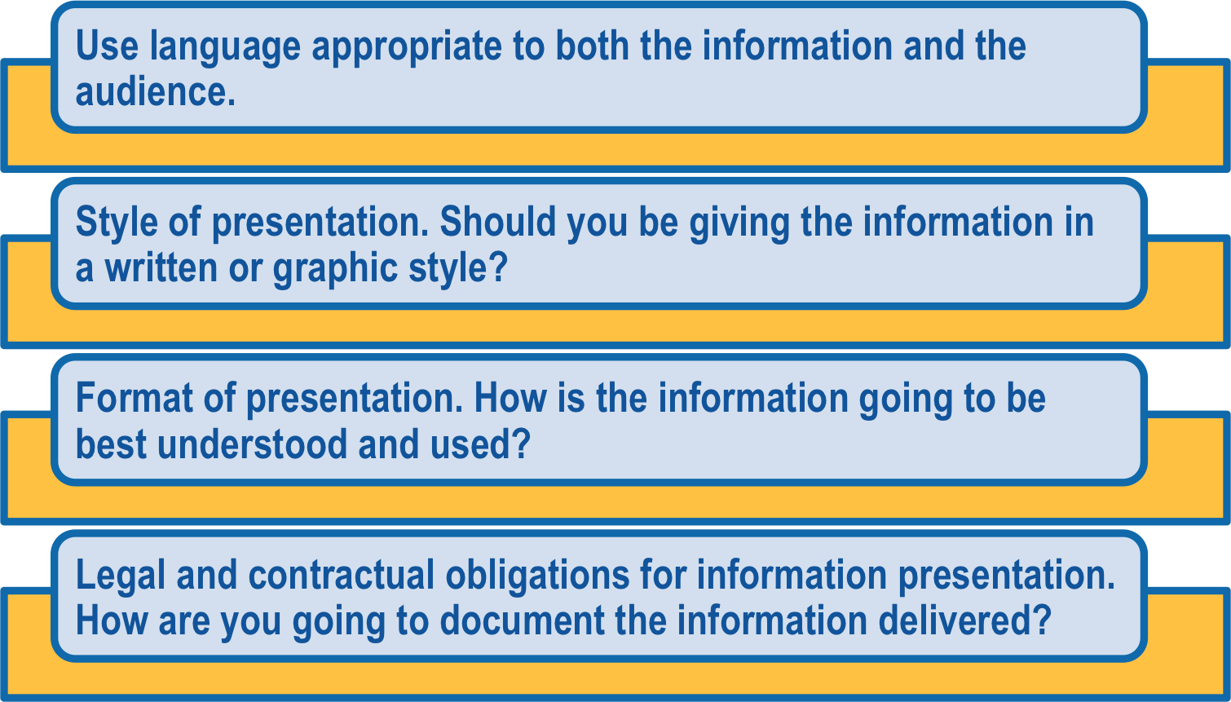
1.3.1 EXPLAINING COMPLIANCE DOCUMENTATION
At all times you should remember:

Slide 28
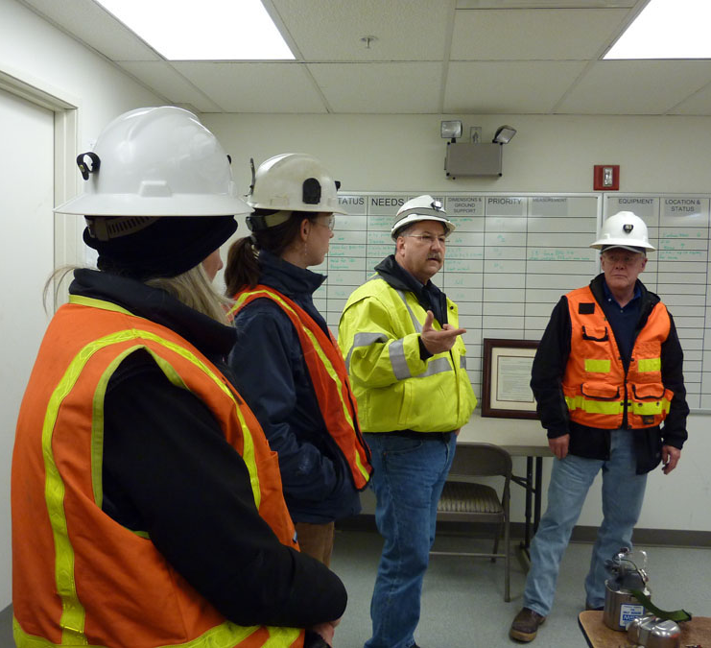
1.3.1 EXPLAINING COMPLIANCE DOCUMENTATION
Commonly information on worksites is presented in:
Inductions and induction booklets.
Reports.
Documentation such as policies and
procedures.
Toolbox meetings.
Pre-start meetings.

Slide 29

1.3.1 EXPLAINING COMPLIANCE DOCUMENTATION
All information that is presented on the site will need to be documented, so you can show the information has been delivered to meet the legal obligations. This documentation could come from:
Minutes of meetings.
Copies of documents and reports.
Attendance records and agendas from toolbox or pre-start meetings.
Audio files and recording of the meetings.
Other methods acceptable on site.

Slide 30

1.3.2 PROVIDING RISK MANAGEMENT INFORMATION
Your organisation’s risk management policies, procedures and programs will outline how risk management tasks will be undertaken.
This system encompasses identifying and determining the most appropriate risk management system for your worksite.
In applying the risk management system for your site, you and your work group will:
Identify the risks or hazards.

Slide 31

1.3.2 PROVIDING RISK MANAGEMENT INFORMATION
Estimate the likelihood of an incident, situation or accident.
Identify the consequences.
Calculate the severity of the consequences.
Calculate the cost of the consequences.
Prioritise the identified risks – the higher the likelihood and consequence, the higher the priority.

Slide 32

1.3.2 PROVIDING RISK MANAGEMENT INFORMATION
You need to make sure that your work group understands the guiding principles and practices of risk management, which aim to reduce or manage the risks when working with a hazard or in a hazardous situation.
All staff need to recognise that the identification and control of hazards and risks is a fundamental part of keeping any workplace or situation ‘safe’.

Slide 33
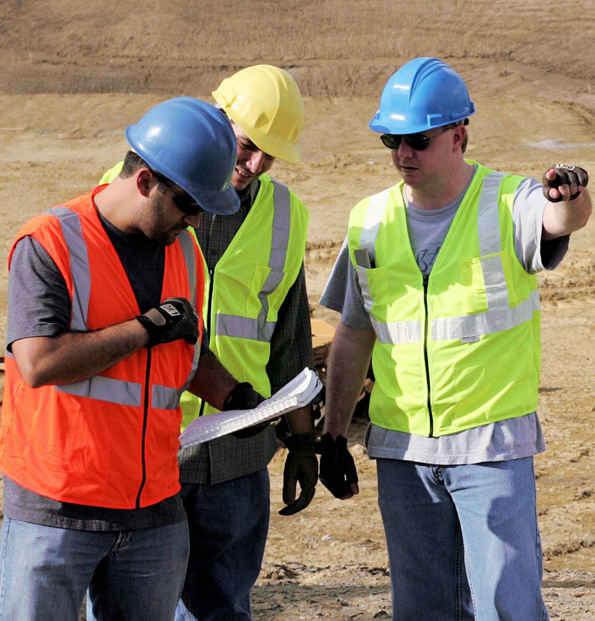
1.3.2 PROVIDING RISK MANAGEMENT INFORMATION
Information about risk management for your organisation and/or worksite may include:
Risk management policy.
Site procedures and work instructions for hazard identification, risk assessment, selection and implementing of controls.
Site incident and accident investigation, risk audits and reporting requirements.
Site consultative arrangements for employees/workers in the work area.
.
Site hazard management and reporting procedures, including procedures and work instructions for hazardous substances use and storage, dangerous goods transport and storage

Slide 34

1.3.2 PROVIDING RISK MANAGEMENT INFORMATION
Policy, procedures and instructions for:
  Site operations.
  Emergencies and evacuations.
  Purchasing.
  Plant and equipment maintenance and use.
  Site access.

Slide 35
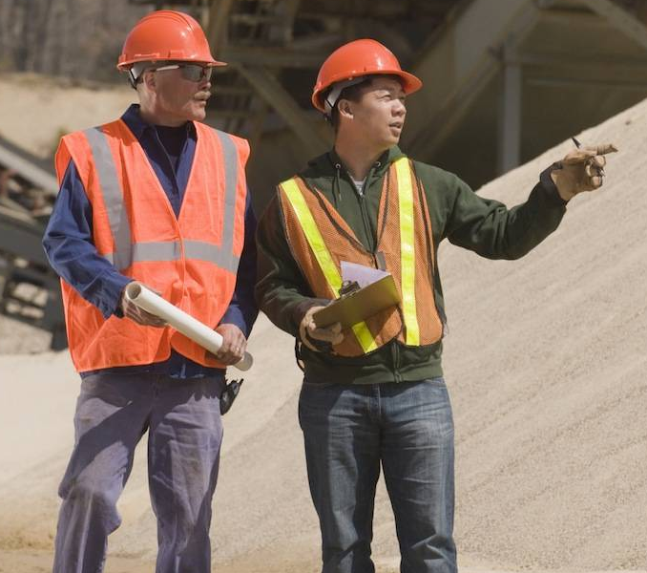
1.3.2 PROVIDING RISK MANAGEMENT INFORMATION
Site fire response arrangements.
Site OHS/WHS arrangements for on-site contractors, visitors and members of the public.
Site First Aid provisions, medical practitioner contacts and instructions about medical attention.

Slide 36
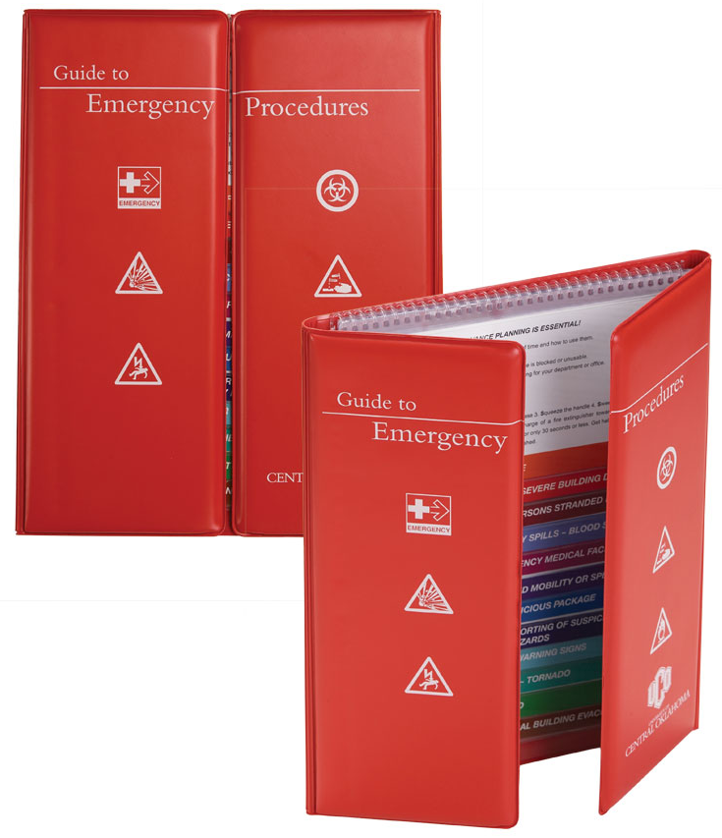
1.3.2 PROVIDING RISK MANAGEMENT INFORMATION
Policies and procedures should be specific to the site on which you are working.
This is particularly important for those policies and procedures that deal with fire emergencies, hazard management and evacuation as well as incident and accident investigation and reporting.
At all times it is vital they reflect the practices on the site.

Slide 37

1.3.2 PROVIDING RISK MANAGEMENT INFORMATION
Programs relating to activities undertaken on the site can sometimes be managed and administrated from a distance. These include:
Employee/worker support programs.
Relocation programs.
Return-to-work programs.
Other organisational programs.

Slide 38

1.3.3 LEGAL RESPONSIBILITIES
OHS/WHS legislation requires employers/PCBUs to protect anyone at the workplace against any risks to their health or safety.
This is done by eliminating or reducing risks as much as is reasonably practicable.
Specific legislative requirements may also apply to employers/PCBUs in certain industry types or locations.

Slide 39

1.3.3 LEGAL RESPONSIBILITIES
Legal responsibilities include:
Employers/PCBUs should: | Monitor the health of employees/workers to minimise risks and OHS/WHS issues. Exchange information about OHS/WHS risks and controls with OHS/WHS representatives and employees/workers. Work with OHS/WHS representatives and employees/workers to resolve issues within the workplace in accordance with the agreed procedure.

Slide 40
1.3.3 LEGAL RESPONSIBILITIES
Legal responsibilities include:
Employees/Workers should: | Be represented by an OHS/WHS representative when raising OHS/WHS issues or have a defined system so that there is communication with management to resolve issues. Follow measures put in place to protect their safety, such as using and caring for Personal Protective Equipment (PPE) or follow safe operating procedures. Exchange information about OHS/WHS risks and controls with their employer/PCBU and OHS/WHS representative. Work with their employer/PCBU to resolve OHS/WHS issues within the workplace in accordance with the agreed procedure.

Slide 41
1.3.3 LEGAL RESPONSIBILITIES
Legal responsibilities include:
The OHS/WHS representative should: | Represent employees/workers in relation to health and safety issues in the workplace. Attempt to resolve OHS/WHS issues for those employees/workers they represent.
Employers/PCBUs and employees/workers may request intervention by external parties such as authorities or inspectors when OHS/WHS issues are unable to be resolved.

Slide 42

1.3.4 EXPLAINING HAZARD AND RISK INFORMATION
All identified hazards and the appropriate risk assessment and control measures will need to be explained clearly to the work group.
By providing team members with the information on how to control the risks and the risk assessment outcomes, you are ensuring they are aware of what to do when they encounter the risk.

Slide 43

1.4 DESIGN OF RISK MANAGEMENT SYSTEMS
All risk management systems should be designed around the following factors:
Is the business likely to be held responsible for any
actions?
Will the reputation of the business be affected?
Is there a possibility that personal liability may occur?
Have designers and manufacturers taken all steps
practical to ensure safe plant and equipment?

Slide 44

1.4 DESIGN OF RISK MANAGEMENT SYSTEMS
What financial impacts are possible in the event of something going wrong?
How is the business going to cope if there is a disaster? – “What if …”
Will there be impacts on the business and management if legislative requirements change?
Can management improve the systems over time?

Slide 45

1.4 DESIGN OF RISK MANAGEMENT SYSTEMS
Effective mechanisms for promoting consultation and participation by all stakeholders are vital in managing risk. Consulting and working as a group will help to design a better risk management system, because everyone thinks differently and perceives different situations, equipment and items as a risk.
Where possible use committees to either create or edit the risk management system to ensure as wide an interpretation of risk and hazards as possible.
It is important for everyone on a worksite to contribute to the risk management system, as it ensures each member takes the system seriously.

Slide 46
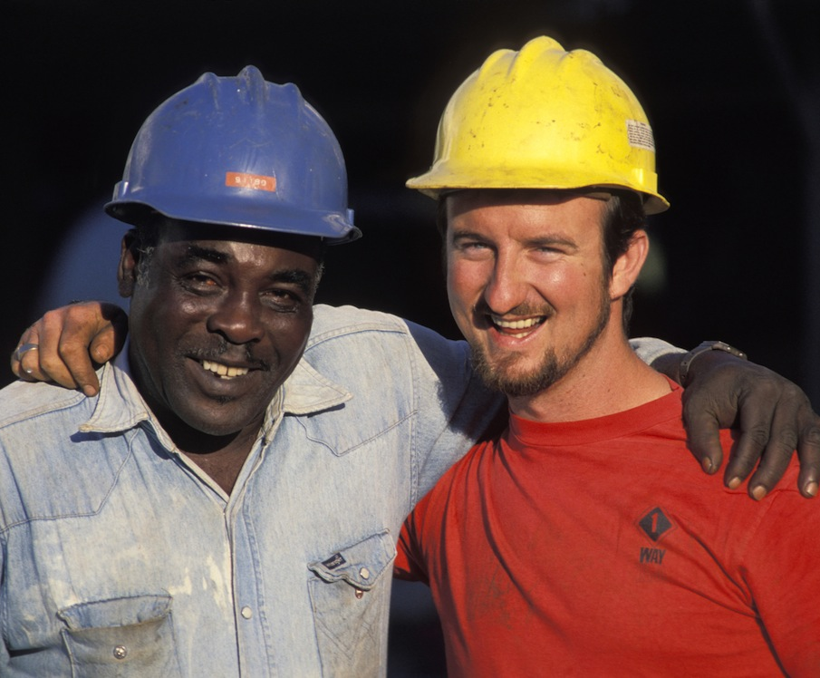
1.4.1 INTERPERSONAL SKILLS
It is important for you to be able to relate to individuals and parties from a range of social, cultural and ethnic backgrounds, as well as people with diverse physical and mental abilities when working on a site.
Always treat other members of your team equally and in the manner you would want to be treated, regardless of your personal feelings about the individual.

Slide 47

1.4.1 INTERPERSONAL SKILLS
Also be aware of how you and others communicate during the consultation process.
Messages must be presented in a manner that everyone understands so you should tailor your method of communication to the needs of your audience.
Think about their specific language needs and abilities, which can sometimes create verbal or non-verbal barriers to communication.

Slide 48

1.4.1 INTERPERSONAL SKILLS
For workers with limited English abilities you could consider:
Individual sessions.
Practical demonstrations.
Group sessions with extra time for questions.
Holding meetings in the relevant language.
Written translations.
Translated safety signs.

Slide 49

1.4.1 INTERPERSONAL SKILLS
It is important that you have a good understanding of the diverse range of backgrounds and abilities of all individuals and parties in the workplace to help with communication and consultation.
Be courteous and polite and remember that the person you are communicating with may have different meanings, understandings or social norms for communication.

Slide 50

1.5 IMPLEMENT CONSULTATIVE PROCESSES
Risk management works best when OHS/WHS consultative procedures are used to identify and determine the best management systems.
As a supervisor you need to conduct and monitor risk management discussions and meetings.
This will ensure participation by all members of your work group is effective and individuals, and parties aren’t being pressured by particular views or people.

Slide 51

1.5 IMPLEMENT CONSULTATIVE PROCESSES
When facilitating consultation and participation in the risk management process, make sure you have a good mix of characteristics in your work group.
You need a variety of views to ensure each segment of the site is represented and any relevant risk management issues can be raised.
Each department or work area should have a representative.

Slide 52

1.5 IMPLEMENT CONSULTATIVE PROCESSES
Characteristics you should look for include:
Willingness to participate.
Understanding and commitment to risk
management.
Willingness to listen to other views.
Consultative outlook.
Commitment to site safety.
Willingness to abide by policies and
procedures.

Slide 53
1.5 IMPLEMENT CONSULTATIVE PROCESSES
Risk management consultative processes could include:
Consultation Method | Process/Technique Details
Employee/Worker Meetings | Meetings that encourage people to raise issues are one of the best ways of developing a workplace culture that raises OHS/WHS issues as they occur. In some industries toolbox meetings are used to raise issues. Toolbox meetings are short meetings that are held to keep each person in the team aware of what is happening in the workplace.
OHS/WHS Committees | By having an OHS/WHS committee you are encouraging a greater number of people to be approachable. This allows for flexibility in how issues are raised and employees/workers can approach a person they feel comfortable with.

Slide 54
1.5 IMPLEMENT CONSULTATIVE PROCESSES
Consultation Method | Process/Technique Details
Low Technology Methods | These can be suggestion boxes, surveys and checklists. The option of low technology methods allows for those members of your workplace who are not comfortable with technology to raise issues.
Hazard Alerts | Alerts of hazards can be from manufacturers, suppliers or government agencies.
Informal Discussions | Can management improve the systems over time?
Discussion With Team Members | This can allow employees/workers to raise OHS/WHS issues before they become large problems.
Inputting To Safety Processes | These safety processes could include safety audits, hazard identifications and risk assessment processes.
Technology | Using technology can allow for the anonymous raising of issues if necessary.

Slide 55

1.5 IMPLEMENT CONSULTATIVE PROCESSES
Regardless of how risk management issues are raised within an organisation, it is important that everyone feels comfortable in having their say.
While the processes listed above are valid, they should not be considered to be the only options.
Your organisation should develop a system for raising risk management issues that meets the needs and culture of the workplace.

Slide 56

1.5.1 MONITORING OHS/WHS CONSULTATIVE ARRANGEMENTS
Once you have developed OHS/WHS consultative and participative arrangements, it is essential that you evaluate and monitor their effectiveness.
You need to examine how well the processes are working within the risk management system. To do this you should:
Examine if the outcomes are what was required,
wanted or expected.
Examine how each process has worked. Was it a
smooth process? What problems arose during the
process?

Slide 57

1.5.1 MONITORING OHS/WHS CONSULTATIVE ARRANGEMENTS
Monitoring and evaluation of OHS/WHS consultative and participative processes must be tailored to the workplace or organisation.
Any logical and sequential system will work for monitoring and evaluation if it is documented and applied consistently across the organisation.

Slide 58

1.5.1 MONITORING OHS/WHS CONSULTATIVE ARRANGEMENTS
When determining a monitoring and evaluation system, you should be considering the:
Culture of the organisation.
System being monitored and evaluated.
Timeframes available.
Legislative and regulatory requirements.
Reporting requirements.
The most important part of any monitoring and evaluation process is ensuring the system works for you as the risk management professional and for your organisation.

Slide 59

1.6 ADDRESS RISK MANAGEMENT ISSUES
Once a risk management issue has been raised, it is essential that it be dealt with promptly in accordance with organisational consultation procedures and processes.

Slide 60

1.6 ADDRESS RISK MANAGEMENT ISSUES
Some of the relevant processes or procedures could include:
Involvement of employees/workers in
management and planning meetings.
Health and safety committees or emergency
management committees.

Slide 61

1.6 ADDRESS RISK MANAGEMENT ISSUES
Early response to employee/worker suggestions, requests, reports and concerns put forward to management. By promptly responding to employee/worker concerns, you will be assisting to develop an organisational culture that values their interactions.
  Formal and informal meetings to discuss any further issues or developments.
  Counselling or disciplinary processes for a situation where there is an ‘at-fault’ employee/worker or contractor.
  Other committees, for example, planning and purchasing.

Slide 62
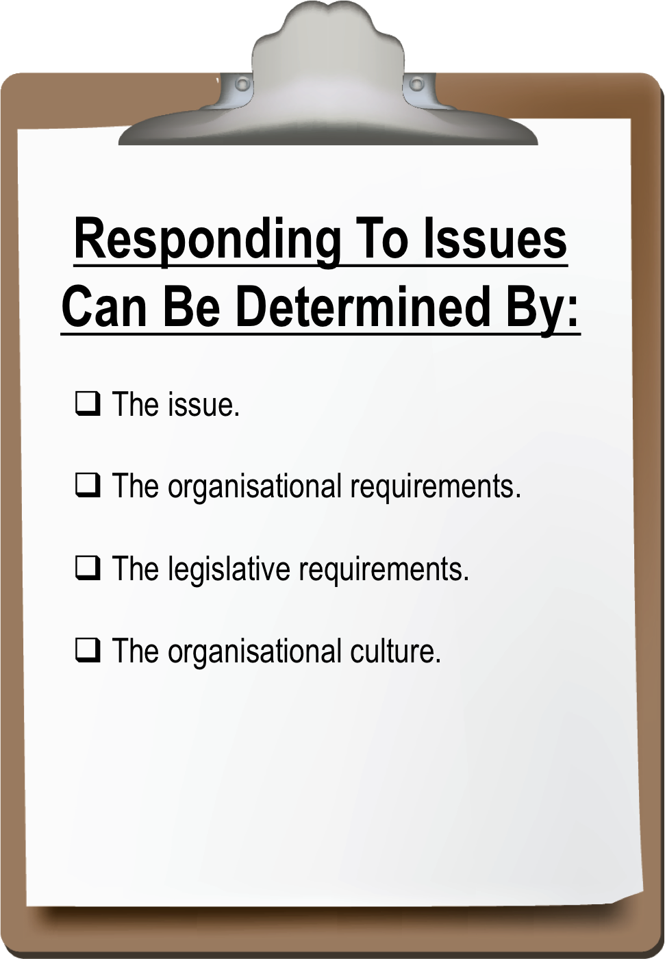
1.6 ADDRESS RISK MANAGEMENT ISSUES
The way you respond to issues that have been raised during the consultation process will be determined by:

Slide 63

1.6 ADDRESS RISK MANAGEMENT ISSUES
People involved in the consultation process who may raise risk management issues could include:
Contractors.
Regulatory authorities.
Tenderers.
Project managers.

Slide 64

1.6 ADDRESS RISK MANAGEMENT ISSUES
Employees/workers.
Community members.
Customers.
Suppliers.
Any other individuals or parties involved in the process.

Slide 65

1.6 ADDRESS RISK MANAGEMENT ISSUES
Any issue is serious and needs your full attention, but the response could vary considerably depending on the type of issue that has been raised. All contributing factors will need to be assessed to determine how they impact on the possible response.

Slide 66
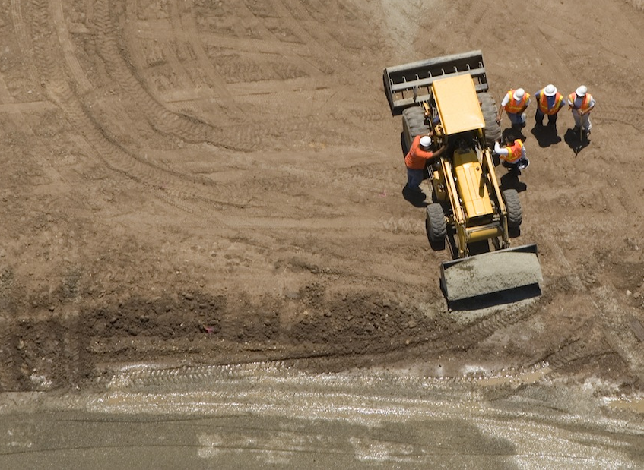
1.7 REPORT OUTCOMES OF CONSULTATION
Once the consultation process is complete, it is essential that the outcomes are recorded and communicated to the work group.
It is a legislative requirement that any issues raised during the consultation process are responded to in some manner as quickly as possible.

Slide 67

1.7 REPORT OUTCOMES OF CONSULTATION
When communicating to others the outcomes of the risk management consultation process it is important to use a format that is easily understood.
You must meet the needs of the information being conveyed, the organisation and the individuals or parties receiving the information.

Slide 68

1.7 REPORT OUTCOMES OF CONSULTATION
When communicating outcomes make sure that you:
Summarise the situation or issues that have been
raised.
Outline all the considerations.
Explain the identified risks or hazards.
Provide details as to how the risks or hazards will
be, or are being, controlled.
Provide information on developing problems if any
have been raised.

Slide 69

1.7 REPORT OUTCOMES OF CONSULTATION
The main methods of recording and communicating this information are presentations, summaries and written reports.

Slide 70

1.7.1 PRESENTATIONS
Well-designed presentations can be used in group situations and can also be put on CDs and provided to employees/workers who work different shifts or are in different locations.
You can contract a professional to create your presentation, or you can create it in-house.

Slide 71

1.7.1 PRESENTATIONS
When preparing a presentation yourself, there are some basic principles to keep in mind:
Keep the presentation relevant and lively.
Create notes and hand these out at the end. Inform attendees at the start that they will receive notes. This way they can stay focused on what you are saying rather than taking notes.
Explain at the beginning how you will take and respond to questions: either as they come up, at the end of topics, or at the end of the presentation.

Slide 72

1.7.1 PRESENTATIONS
Don’t create overheads or PowerPoint slides that simply repeat what you are saying.
Use graphics that illustrate what you are saying. Use any knowledge of screen design and apply this to your slides. This includes the use of appropriate colours, fonts and letter sizes to fit the audience.
Watch the reaction of the attendees during your presentation and react by slowing down if they look confused or speeding up if they look bored.

Slide 73

1.7.1 PRESENTATIONS
Before starting to make a presentation it is important to plan what you are going to say and how you are going to say it.
You should make your presentation in accordance with your plan but be prepared to deviate if necessary to answer questions from the audience or respond to feedback.

Slide 74
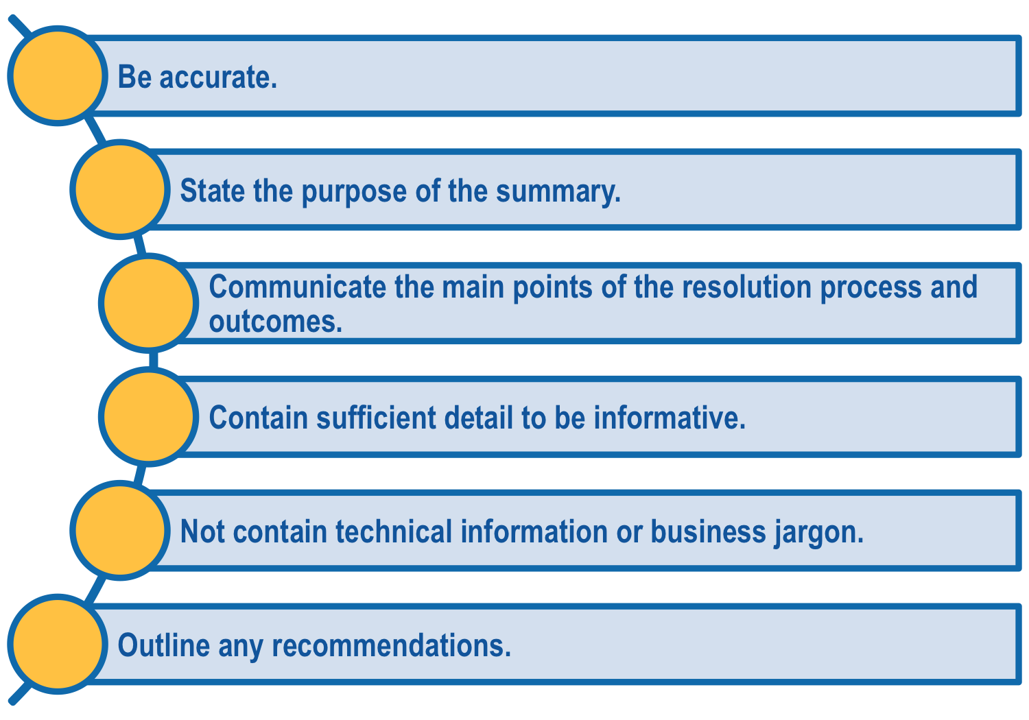
1.7.2 SUMMARIES
Your workplace risk management policies may require you to prepare an executive summary for senior managers. An executive summary is critical as it may be the reader’s only source of information about the resolution outcomes. Your summary should:

Slide 75
1.7.3 WRITTEN REPORTS
You workplace may have report templates that you are required to use. If not, when reporting on consultation outcomes your report should:
  Be written in clear, easy to read, plain English.
  Be easy to understand.
  Contain complete but concise information.
  Flow in a logical order.
When you present a report it is best to use a format that ensures the findings, causes, available options and courses of action will be readily understood by your audience.

