Slide 1
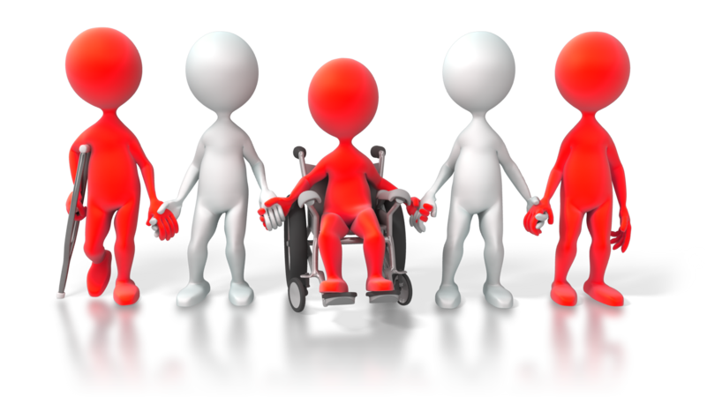
CHCDIV001
Work with diverse people

Slide 2

Reflect on your own perspectives
1.1 Identify and reflect on own social and cultural perspectives and biases

Slide 3

Diversity
Diversity may include:
Ethnicity, race and culture
Language
Religion, beliefs and customs
Personal history and experience
Gender and gender relationships
Age
Disability and special needs.
Sexuality.

Slide 4

Culture, race and ethnicity
You may have to consider:
Culture: A person’s way of life, including their customs and beliefs
Race: A person’s biological or genetic group, which is most often determined by their skin colour
Ethnicity: A person’s identification with a social or cultural group based on shared experiences, tradition or nationality.

Slide 5
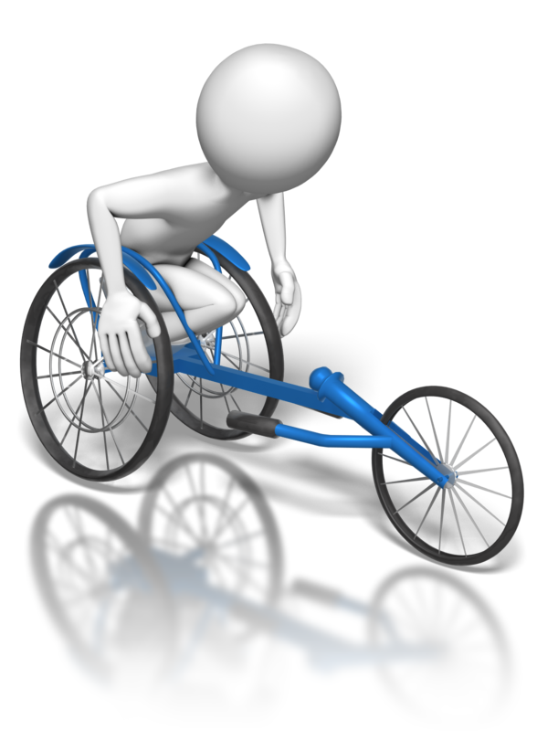
Disabilities
Types of disabilities include:
Mobility and physical impairments
Spinal cord disabilities
Head or brain injuries
Vision issues
Hearing issues
Cognitive or learning disabilities
Psychological disorders
Invisible disabilities.

Slide 6
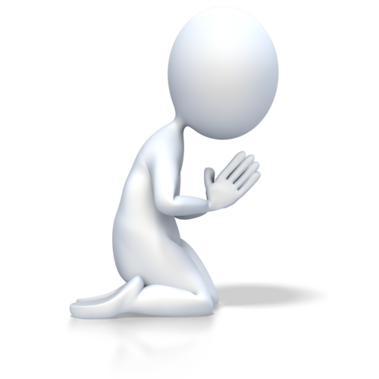
Religious or spiritual beliefs
People may express their religion through:
Prayer, which have certain requirements such as time or place
Dress, such as turbans or religious symbols
Food
Pilgrimages
Charity work or donations.

Slide 7

Gender
Gender is how people view themselves, either male or female. Note that while sex is biological, gender is cultural or social. Some people may identify as the opposite gender to the one they were born as, and are known as transgender.
The term intersex issued to describe people whose biology doesn’t clearly fit into either gender.

Slide 8
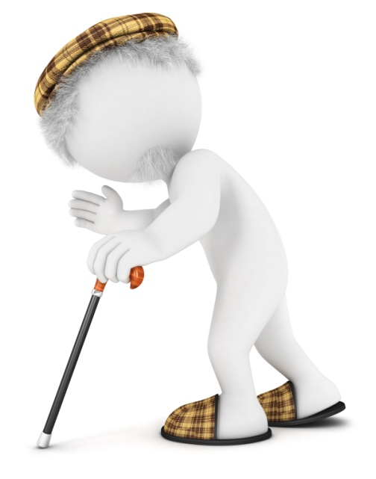
Generations
People in Australian society are often divided by age into generations including:
Teenagers/millennials.
Young married couples
Generation X
Vietnam Veterans
Older people
Retirees
Baby Boomers.

Slide 9

Sexual orientation
A person’s sexual orientation is who they are sexually attracted to. It is commonly divided into heterosexual (opposite sex), homosexual (same sex) or bisexual (both sexes.) Although a person’s orientation rarely causes issues in the workplace, other people may take offence to it and discriminate against them because of it. This is known as homophobia.

Slide 10

Indigenous Australians
Aboriginal and Torres Strait Islander people are not a homogenous group; they are diverse and culturally different within themselves and have unique customs, cultural beliefs, languages, family structures and ceremonies. This may mean adapting what you offer and how you behave to meet their needs and preferences.

Slide 11
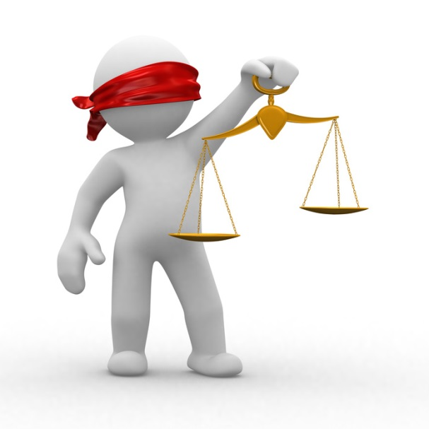
Human rights
Human rights are the universal rights which all people are entitled to. If you cannot resolve a case of discrimination or racial hatred, you need to make a complaint to the Australian Human Rights Commission.
The Racial Discrimination Act 1975 ensures that Australians of all backgrounds are treated equally and afforded the same opportunities.

Slide 12
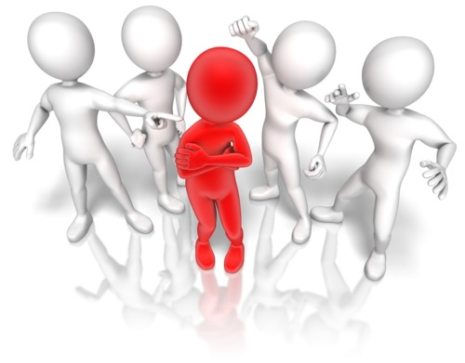
Social perspective and biases
A person’s social perspective is how they view the world around them. It is learned as a result of their experiences and influences, such as family and friends.
Bias may manifest in various ways, including:
Discrimination
Unfair workplace treatment
Stereotyping
Racial or offensive language.

Slide 13
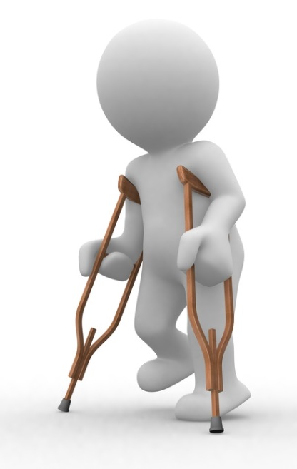
Identifying bias
Often biases are unconscious and we act on them without thinking. To identify the bias, you need to become conscious of them. One method of doing this is using word association to describe various people. Write down the first thing that comes to mind.
Cues for the word associate may include:
A person with crutches
An Aboriginal man
A gay couple.

Slide 14
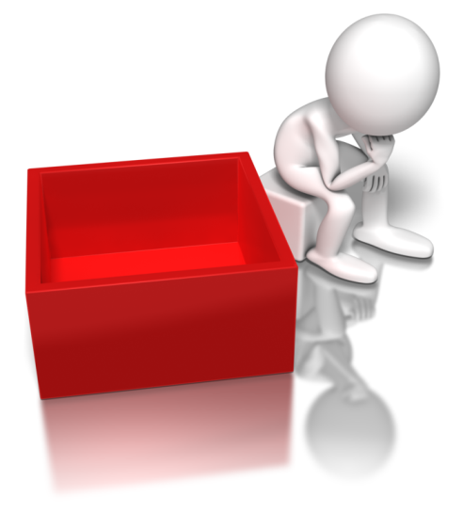
Reflecting on bias
You could adapt the cues for people you are likely to encounter in your role, or have another person suggest them.
Continue to identify your thoughts whenever you meet someone of a different race, culture, sexuality, religion or gender. Ask yourself why you think this way and whether it’s fair.

Slide 15

Activity 1A

Slide 16
Reflect on your own perspectives
1.2 Work with awareness of own limitations in self and social awareness

Slide 17

Limits in awareness
You should always try to be aware that:
There may be subjects of which you don’t have sufficient or up-to-date knowledge
Other people may have different perspectives to you;
People have social biases of their own
Society changes and what is considered a bias will evolve.

Slide 18

Limits in awareness
Social awareness may include:
Various groups’ history
Groups’ current situation and the issues facing them now
Common ways of life and values within the group
Taboos and offensive topics to the group.

Slide 19
Activity 1B

Slide 20
Reflect on your own perspectives
1.3 Use reflection to support own ability to work inclusively and with understanding of others

Slide 21
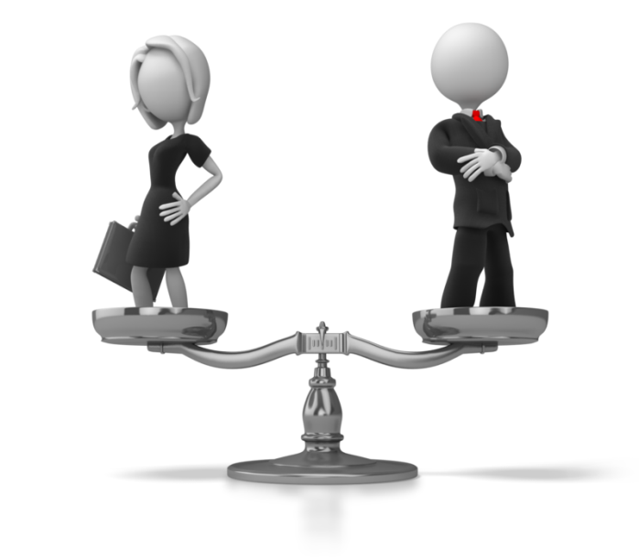
Reflecting on abilities
During interactions with clients or other employees in the workplace, you should refrain from imposing your values, beliefs or attitudes on them. It is important to maintain non-judgemental practice. This means you don’t make moral judgements (e.g. “That is wrong or immoral”) that don’t affect the person’s wellbeing.

Slide 22
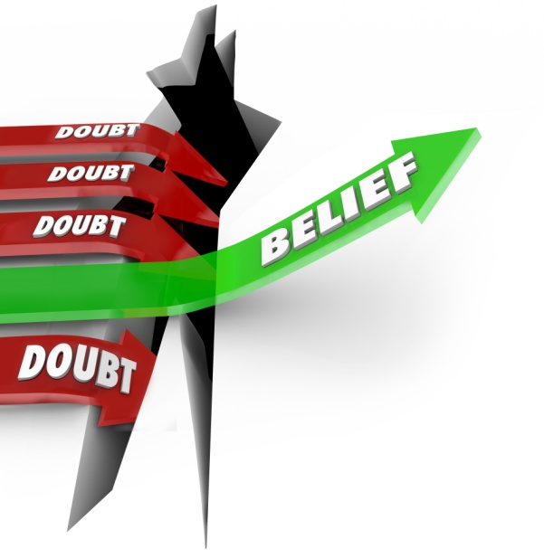
Reflecting on abilities
Values and beliefs may come from:
Religion
Culture and traditions
Life events
Employment
Education
Media
Lifestyle choices
Political beliefs.

Slide 23
Activity 1C

Slide 24
Reflect on your own perspectives
1.4 Identify and act on ways to improve own self and social awareness

Slide 25

Improving awareness
Strategies to improve bias include:
Cross cultural work teams
Cross cultural employee representation on committees
Workplace free of culturally insensitive literature, posters, signage
Inclusion in decision-making.

Slide 26
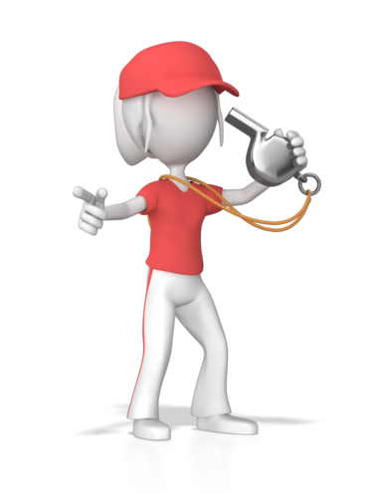
Professional development opportunities
Professional development opportunities are opportunities for improving perspective provided by the organisation. They may help you to work more inclusively with people.
These may include:
Coaching/mentoring
Skills training
Professional development schemes.

Slide 27
Activity 1D

Slide 28
Appreciate diversity and inclusiveness, and their benefits
2.1 Value and respect diversity and inclusiveness across all areas of work

Slide 29
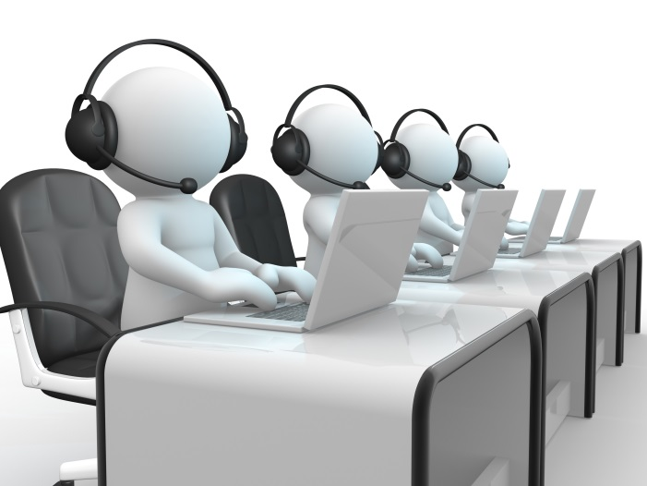
Benefits of diversity
Diversity has many benefits in the workplace. It allows people from different backgrounds with various skills to contribute.
For example, in a customer service organisation, having people of different cultures can allow them to relate easier to a wider range of customers.

Slide 30

Benefits of diversity
You can respect diversity by:
Acknowledging its importance in the workplace
Supporting initiatives to promote and utilise diversity
Encouraging inclusive hiring practices
Getting to know others in the workplace and their experiences/potential.

Slide 31

Inclusiveness
A workplace that is inclusive makes all its employees feel welcome, regardless of their race, religion, disabilities or sexuality.
Behaviour that is inclusive will ensure that all work members are involved in relevant work tasks without discrimination. For example, a work meeting that is supposed to include all members of a work team should not exclude team members due to age/race/gender, etc.

Slide 32
Activity 2A

Slide 33
Appreciate diversity and inclusiveness, and their benefits
2.2 Contribute to the development of work place and professional relationships based on appreciation of diversity and inclusiveness

Slide 34
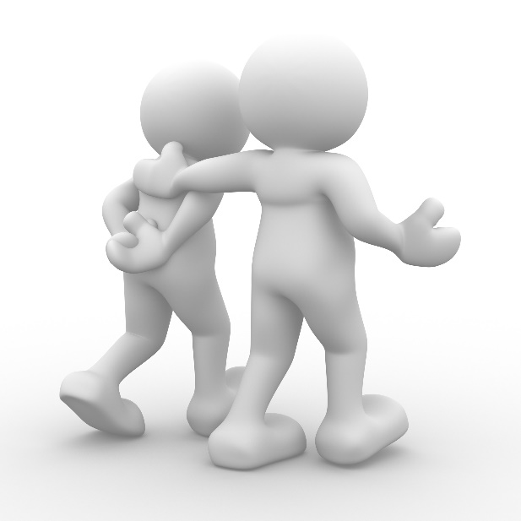
Workplace relationships
Professional relationships are the building blocks of communication in the workplace, regardless of diversity.
Important characteristics of workplace relationships are:
Trust
Mutual respect
Mindfulness
Effective communication.

Slide 35
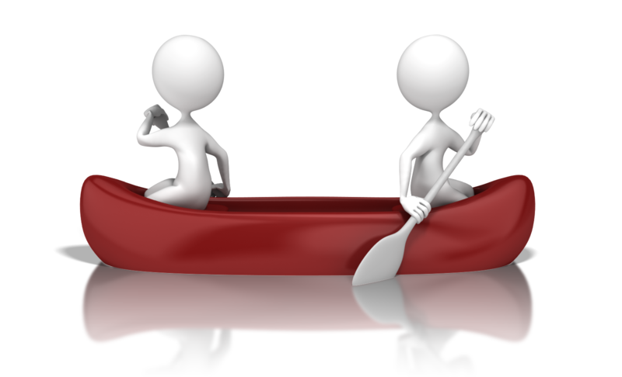
Workplace relationships
To coach others to develop better professional relationships, you could:
Encourage employees to spend more time with each other
Talk about their experience and areas of expertise
Resolve disagreements properly.
Develop their active-listening and teamwork skills

Slide 36
Activity 2B

Slide 37
Appreciate diversity and inclusiveness, and their benefits
2.3 Use work practices that make environments safe for all

Slide 38

Safe work practices
Your own workplace may or may not be a culturally safe place. Therefore, you will need to evaluate the extent to which it implements culturally safe practices. Is the workforce educated on different cultures, and are there policies and procedures in place to prevent discrimination?

Slide 39

Safe work practices
Work practices that you should ensure are suitable may include:
Dealing with persons of diverse race, ethnicity, class, ability, sexual preference and age
Compliance with duty of care policies of the organisation
Collection and provision of information
Communication
Provision of assistance
Contact with families and carers.

Slide 40

Safe work practices
Cultural safety is the principle of making all people feel safe in the workplace, regardless of race, ethnicity or any other factor.
Culturally unsafe practices are those which diminish, demean or disempower the cultural identity and wellbeing of an individual.

Slide 41
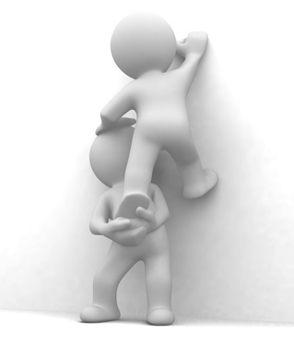
Safe work practices
The principles of cultural safety are:
Improve the health and wellbeing of others
Empower the users of a service
Recognising inequalities in various areas
Avoid bias towards certain cultures.

Slide 42
Activity 2C

Slide 43
Communicate with people from diverse backgrounds and situations
3.1 Show respect for diversity in communication with all people

Slide 44

Demonstrating respect
It is important to demonstrate respect whenever you communicate with people. This could be the difference between somebody coming away feeling satisfied with the communication and them feeling as though you didn’t value their communication at all. This applies for all forms of communication.

Slide 45

Demonstrating respect
Methods of demonstrating respect include:
Getting spellings/pronunciation correct
Acquiring necessary aids
Using generic language
Learning cultural standards.

Slide 46
Activity 3A

Slide 47
Communicate with people from diverse backgrounds and situations
3.2 Use verbal and non-verbal communication constructively to establish, develop and maintain effective relationships, mutual trust and confidence

Slide 48

Communication
Barriers to communication include:
Resistance due to lack of trust
Preconceptions
Attitude differences
Stress
Illness or pain
Lack of common ground
Lack of empathy for the other person
Cultural, religious and social differences.

Slide 49

Communication
Be aware of how you should vary communication for different groups.
For example, when talking with Aboriginal people, you should avoid:
Persistent questioning
Direct questioning
Loud voices
Lengthy eye contact
Invading their personal space.

Slide 50
The RESPECT strategy
Recognise how what you’re saying is coming across
Eliminate negative words and phrases from your vocabulary
Speak with people, not at them.
Practice appreciation.
Earn respect from others by modelling respectful behaviours yourself
Consider others’ feelings before speaking and acting
Take time to listen. Don’t interrupt.

Slide 51
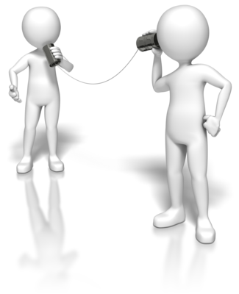
Communication
To display respect, you should:
Actively listen and respond to their needs
Respect all people and involve them in important decision-making situations
Respect people’s cultural values, protocols and methods of doing business
Use appropriate language.

Slide 52
Activity 3B

Slide 53
Communicate with people from diverse backgrounds and situations
3.3 Where a language barrier exists, use effective strategies to communicate in the most efficient way possible
3.4 Seek assistance from interpreters or other persons according to communication needs

Slide 54
Good cross cultural communication
Learn and use key words in the person’s own language
Use visual aids, gestures and physical prompts
Use only qualified language interpreters
Provide all information relating to key service delivery contexts in the person’s own language
Accept that it may be necessary to use alternative forms of communication
Understand that limited proficiency in English does not reflect an individual’s level of intelligence.

Slide 55

Communication checklist
Make the environment conducive to communication – avoid places with too much background nose, distractions or likely interruptions
Speak clearly, but do not raise your voice
Speak slowly, repeat if necessary, and check the person’s understanding
Adapt the pace of conversation to suit the person’s needs.

Slide 56
Communication checklist
Use words your listener is likely to know and avoid jargon and slang
Do not speak ‘pidgin English’ – this can actually make it harder for the person to understand you
Avoid jokes, irony, satire and sarcasm, as these may be lost in translation and misunderstood
Use the active rather than the passive voice.

Slide 57
Communication checklist
Give instructions in clear, logical sentences and present one topic at a time
Gauge how much people are likely to remember
Give the speaker plenty of time to respond at their own pace
Listen.

Slide 58
Communication checklist
Give clues through your body language
Do not exclude the person from discussion because others with better English are present
Be considerate of the person as an individual.
Working Cross Culturally: A Guide, Multicultural Communities Council of SA Inc. and Multicultural Aged Care Inc. (September 2005)

Slide 59
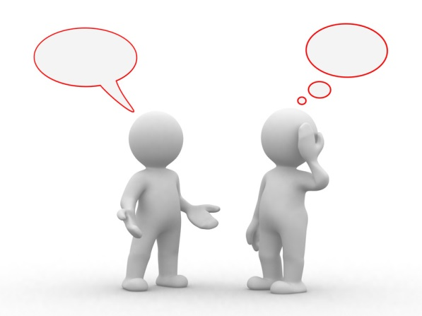
Interpreters
With increasing diversity in Australian society, it is more common to come across people who you don’t share a language with or who aren’t fluent in your language. In these situations, you may be able to rely on interpreters.
You will need to know the available interpreter resources available to your organisation and its needs, so you can employ them as necessary.

Slide 60

Interpreters
The Translating and Interpreting Service (TIS) National provides free interpretation services to non-English speaking Australian citizens or permanent residents who need to communicate with approved groups and individuals.

Slide 61

Interpreters
Resources for interpreters may include:
Laptops
Tablet computers
Augmentative and alternative communication aids
Projectors/monitors
Mobile phones
Internet.

Slide 62
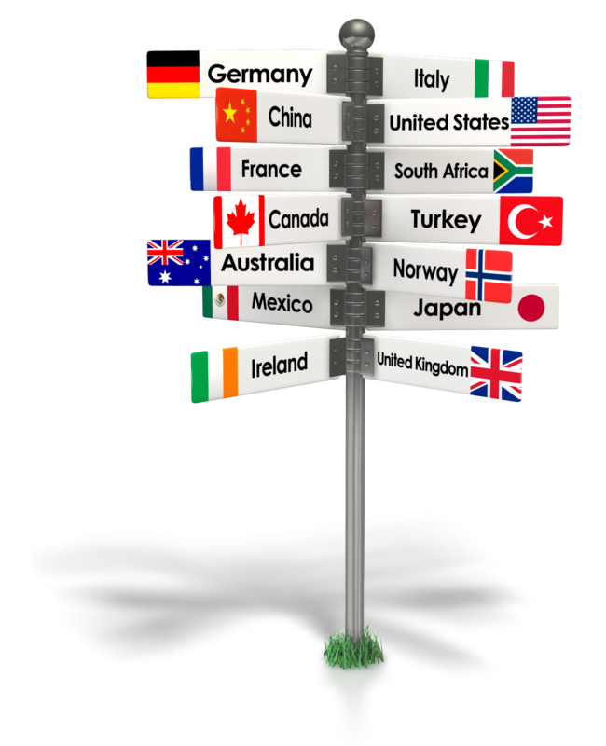
Interpreters
A cultural broker is someone who facilitates people form one culture crossing over to another. In other words they act as a mediator between people/groups of different cultures, to enable effective communication and reduce conflict. They act as more than just an interpreter; in colloquial terms, they would be known as a "middle man".

Slide 63
Activity 3C

Slide 64
Promote understanding across diverse groups
4.1 Identify issues that may cause communication misunderstandings or other difficulties
4.2 Where difficulties or misunderstandings occur, consider the impact of social and cultural diversity

Slide 65

Communication difficulties
Due to people’s diverse backgrounds, you may encounter communication problems or misunderstandings.
Issues that cause problems may include:
Jargon and slang
Unclear organisation rules and protocols
Written information
Variations in expected behaviour.

Slide 66
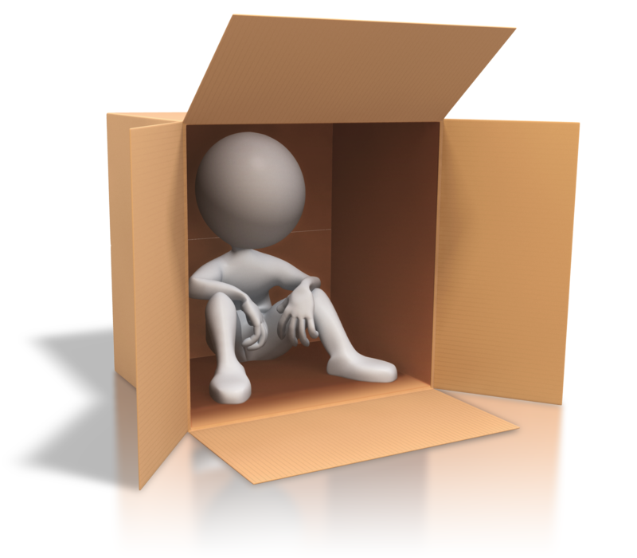
Impact of diversity
People who are in minorities are more vulnerable to a range of issues that may affect their communication.
Consider whether they’ve experienced:
Discrimination
Racism, sexism or homophobia
Bullying
Physical or mental health problems
Unemployment
Homelessness.

Slide 67

Impact of diversity
Influences on Australian society that may affect people’s response to diversity may include:
Religion
Media
Recent news
People’s individual upbringing
Communities
Changing attitudes.

Slide 68

Protective factors
The following are protective factors that can reduce the risk of threats often faced by marginalised groups:
Education
Employment
Supportive family and community
Understanding the language
Ability to practice their culture openly
Writing and reading skills.

Slide 69
Activity 4A

Slide 70
Promote understanding across diverse groups
4.3 Make an effort to sensitively resolve differences, taking account of diversity considerations
4.4 Address any difficulties with appropriate people and seek assistance when required

Slide 71
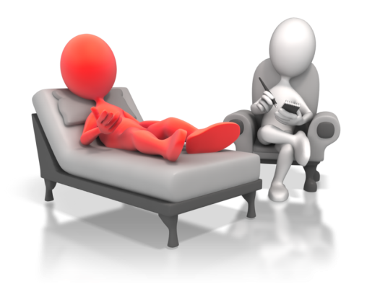
Resolving difficulties
Strategies to resolve difficulties may include:
Negotiation of culturally appropriate guidelines
Identification of appropriate mediators
Negotiating a workplace code of practice.

Slide 72

Resolving difficulties
You may need to seek additional resources, such as:
Language interpreters
Cultural interpreters
The person’s family, friends or carers
Communication training
Diversity awareness programs.

Slide 73
Activity 4B

Slide 74
Summative Assessments
Summative assessments consist of:
Skills assessment
Knowledge assessment
Performance assessment.
Your assessor will provide you with further guidance on how and where to complete these assessments.

Slide 75

Summary and Feedback
Did we meet our objectives?
How did you find this session?
Any questions?

