Slide 1

PSYCHOSOCIAL HEALTH AND SAFETY
WORK HEALTH AND SAFETY OFFICER

Slide 2
Assessment Criteria
Describe the legislative requirements relating to psychological health and safety
Understand the hazards and factors that impact on psychological health and safety
Understand the outcomes and implications of poor psychological health and safety in the workplace
Understand processes for eliminating and minimising risks to psychological health and safety.

Slide 3
Who has WHS duties in relation to psychological health?
A PCBU has the primary duty under the WHS Act to manage risks associated with exposure to hazards arising from work that could result in physical or psychological harm.
Workers have a duty to take reasonable care of their own health and safety and not adversely affect other people’s health and safety.

Slide 4
Relevant Legislation
Anti-Discrimination Act 1991
Fair Work Act 2009
Information Privacy Act 2009
In the event of a work-related psychological injury
Workers Compensation and Rehabilitation Act 2003

Slide 5

High job demands
Sustained high physical, mental and or emotional effort is required to do the job
  Long work hours
  High workloads
  Low periods of vigilance
  Emotional effort
  Shift work

Slide 6
Low job demands
Sustained low levels of physical, mental and or emotional effort is required to do the job
  Too little to do
  Highly repetitive or monotonous tasks

Slide 7

Low job control
Level of autonomy
Freedom to make decisions about how work tasks are carried out and when
Work flexibility

Slide 8

Poor support
Tasks or jobs were workers have inadequate:
emotional support from supervisors and co-workers
information or training to support their work performance, or
tools, equipment and resources to do the job.

Slide 9


Poor workplace relationships
Jobs where there is:
workplace bullying, aggression, harassment
poor relationships
conflict between workers and their managers, supervisors or co-workers
lack of fairness and equity in dealing with organisational issues or where performance issues are poorly managed

Slide 10

Role clarity
Clear work roles, responsibilities and reporting lines
Role conflict e.g. role overlap, conflict with personal values, incompatible job demands

Slide 11

Poor change management
Workplaces where there is inadequate:
consideration of the potential WHS and performance impacts during change
inadequate consultation and communication with key stakeholders and workers about major changes, or
not enough practical support for workers during transitions times.

Slide 12

Low recognition and reward
Jobs where:
there is a lack of positive feedback
there is an imbalance between workers’ efforts and formal and informal recognition and rewards
there is lack of opportunity for skills development, or
skills and experience are underused.

Slide 13

Poor organisational justice
Workplaces where there is:
inconsistent application of policies and procedures
unfairness or bias in decisions about allocation of resources and work, or
poor management of underperformance.

Slide 14
Poor environmental conditions
Exposure to poor quality or hazardous work environments. Examples include:
hazardous manual tasks
poor air quality
high noise levels
extreme temperatures, or
working near unsafe machinery.

Slide 15
Remote and isolated work
Remote work: Work at locations where access to resources and communications is difficult and travel times may be lengthy
Isolated work: Work where there are no or few other people around where access to help from others especially in an emergency may be difficult.

Slide 16
Violent or traumatic events
Violent events: An workplace incident involving exposure to abuse, the threat of, or actual harm that causes fear and distress and can lead to stress an or a physical injury.
Traumatic incidents: A workplace incident that may invoke trauma or stress including being witness to a fatality, or investigating a serious injury/fatality.

Slide 17
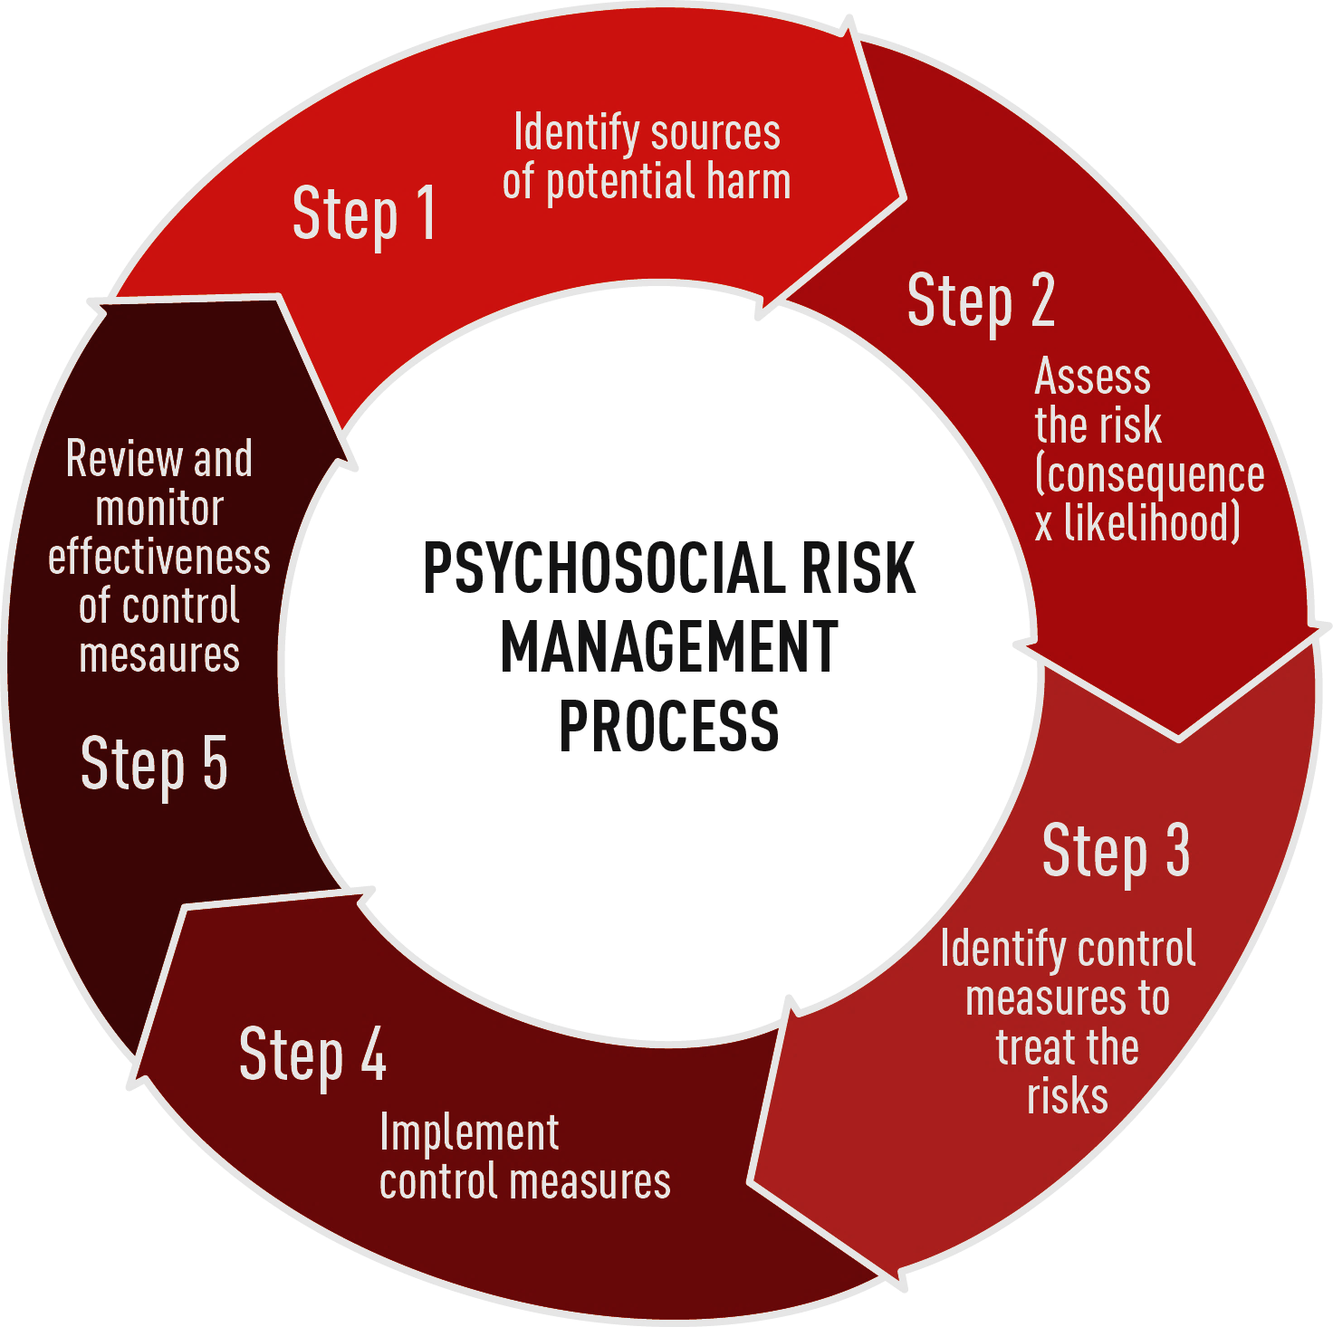
Risk management process
Whilst it may not always be as
intuitive and straightforward as
managing physical hazards,
psychosocial hazards can be
managed using the same
processes.
Most important is ensuring that
workers understand
Psychosocial hazards, and that
there are good practices in place
to ensure hazards are identified.

Slide 18
Determine controls
Determine solutions based on root causes (e.g. stress management training versus workload management)
Identify appropriate courses of action - plan for long term solutions
Ensure that the solution is feasible, realistic and effective
Engage the right people in implementing the solution
Monitor solutions to ensure they haven’t resulted in adverse outcomes or failed to yield anticipated outcomes
Multi-layered and multi-pronged approaches are most effective

Slide 19
Processes for implementation, monitoring and review
Use established consultative processes to seek feedback from workers
Increase ongoing awareness raising at the workplace
Ensure regular follow-ups with workers/ supervisors
Monitor grievances, absences, turnover
Review effectiveness of controls

Slide 20


