Slide 1
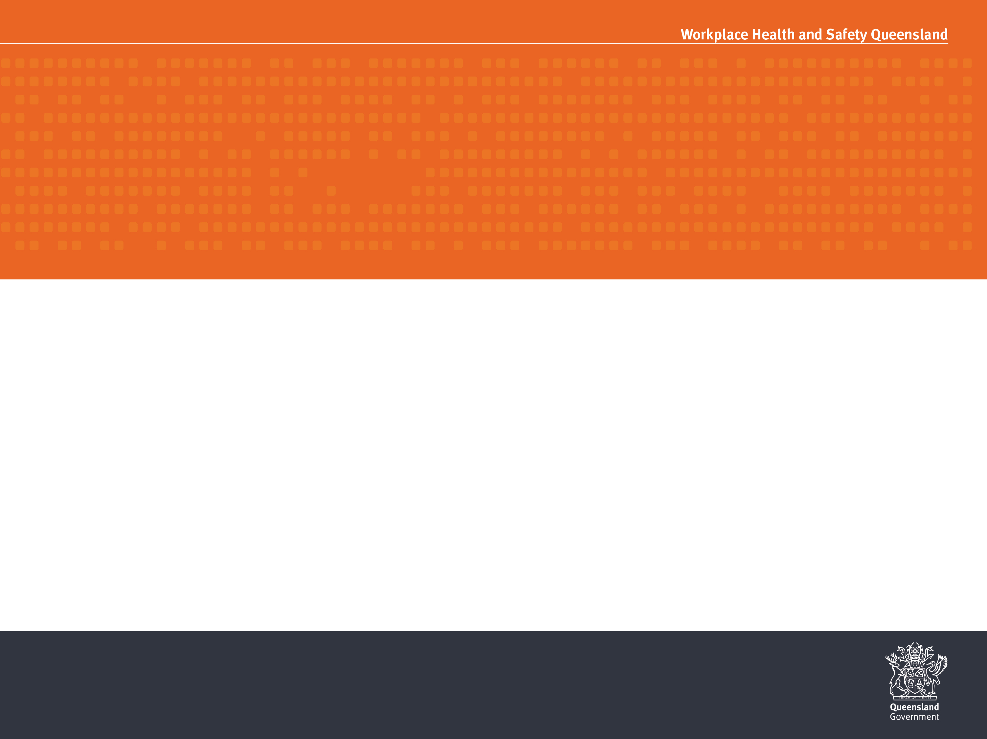
TILT-UP AND PRE-CAST CONSTRUCTION
WORK HEALTH AND SAFETY OFFICER

Slide 2
Assessment criteria
Describe the statutory and minimum requirements relating to tilt-up and pre-cast construction.
List the hazards that are associated with the processes of tilt-up and pre-cast construction.
Describe the control measures that are available to minimise or remove the risk associated with these hazards.

Slide 3
Tilt-up and pre-cast
Tilt-up wall panels and pre-cast concrete construction is where concrete structures are constructed ahead of their intended use and erected as part of a structure by lifting them into their final position by crane.
WHS Regulation 2011 s291 defines high risk construction work as involving the use of tilt-up or precast concrete.
A safe work method statement (SWMS) must be prepared for high risk construction work.

Slide 4
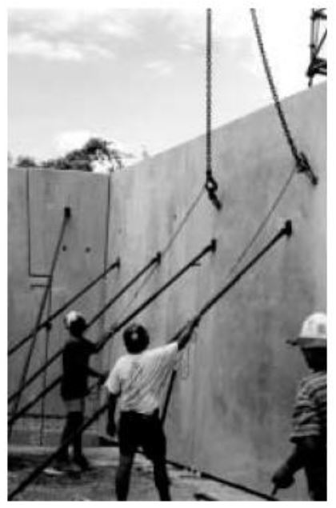
Duties
PCBU
Officers
Workers

Slide 5
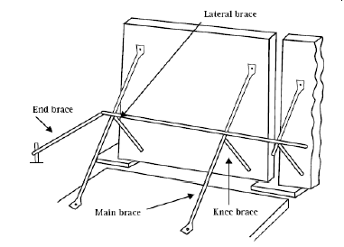
Braces
The safe erection of concrete panels relies on the integrity of braces and their correct installation. The different types of bracing for wall panels are:
Lateral brace
End brace
Main brace
Knee brace

Slide 6
Hazards
Specific hazards include:
site features such as slopes, holes etc.;
working near overhead power lines;
exposure to weather conditions;
working at heights;
working near mobile plant
hazardous manual tasks;
working with hazardous chemicals; and
traffic at or near the site

Slide 7
Engineer and verification issues
Engineers should provide specific signed statements about the compliance of the system with AS 3850.
The total design of the panel erection system should be overseen by engineer(s). This includes design of the panels, temporary bracing systems and securing of panels prior to removal of braces.

Slide 8
Exclusion zones for tilt-up panel erection
Only persons directly involved with the erection of panels should be located in the area while lifting is taking place and such persons should avoid being in a position where they could be struck in the event of a crane or panel falling over.
All persons not involved in the erection of the panels should be prevented from accessing the erection zone.

Slide 9
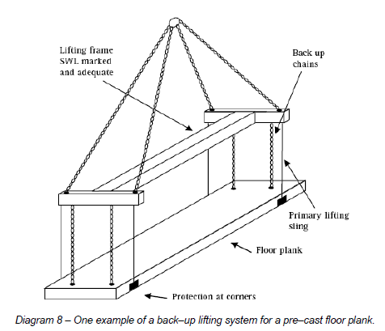
Lifting pre-cast elements over workers
Lifting of pre-cast panels over workers is permitted in limited situations, it is not a preferable method, and other erection methods should be investigated prior to its acceptance.

Slide 10
Operation of plant near braces and panels
The use of mobile plant close to panel braces can be extremely hazardous due to the risk of the braces being struck and panels collapsing.
Braces that are struck by mobile plant are likely to collapse in a very rapid and uncontrolled fashion and there can be a very high risk of fatalities occurring both to persons operating the plant and to other persons located in the area.

Slide 11
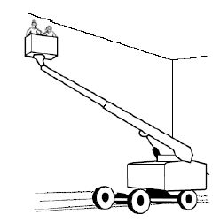
Working at height
In tilt-up and pre-cast construction, persons are required to work at height to perform the following activities:
attaching the panels to one another or to structural steelwork prior to removal of the braces
attachment and removal of braces to and from panels
application of caulking to the vertical joints between panels, and
patching work.

Slide 12
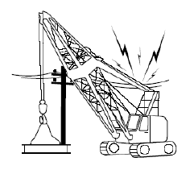
Proximity to overhead power lines
Contact with overhead powerlines can pose a major risk on tilt-up sites due to the height of the panels, the use of mobile cranes and other plant and because workers are required to work at a height where contact with power lines may be more likely.

Slide 13
Licensing
The panel erection crew must be holders of intermediate rigging (RI) or advanced rigging (RA) licence classes or be trainees. Trainees must be supervised and logbooks showing previous training must be kept.
Crane operators and persons performing dogging duties must hold appropriate licences.
Any person operating a boom type EWP with a boom length of 11 metres or more must hold a WP type licence class.
Persons erecting scaffolding where a person or object could fall 4 metres or greater must hold at least a Basic Scaffolding SB licence class or be trainees.

Slide 14


