Slide 1

BSBSMB402
Plan small business finances

Slide 2

Housekeeping
Emergency Procedures
Mobiles, Security Issues
Break times / Smoking policy
This course is “interactive” – ask questions
Respect, Confidentiality, Practice
Ground Rules:

Slide 3
Objectives
Demonstrate how to identify costs, calculate prices and prepare profit statement
Determine how to develop a financial plan
Identify how to acquire finance
Gain skills and knowledge required for the unit

Slide 4

Identify costs, calculate prices and prepare profit statement
1.1. Identify and document costs associated with production and delivery of the business products/services

Slide 5

Costs may include:
Direct/indirect costs
Fixed, variable, semi-variable costs
Overheads and employee costs

Slide 6

Identify and document costs
Direct Costs
Direct material costs
Indirect materials
Indirect labour

Slide 7

Fixed or variable
In this case, if the salary is a monthly or annual salary and does not change based on production, it is a fixed cost.

Slide 8

Overheads are indirect costs
Data and transmitted data used for carrying routing information and error correcting and operational instructions.
Energy or water lost during delivery from the generating or production plant to the end user

Slide 9

Activity 1a

Slide 10
Identify costs, calculate prices and prepare profit statement
1.2. Calculate prices based on costs and profit margin, as an hourly charge-out rate for labour or unit price for products

Slide 11
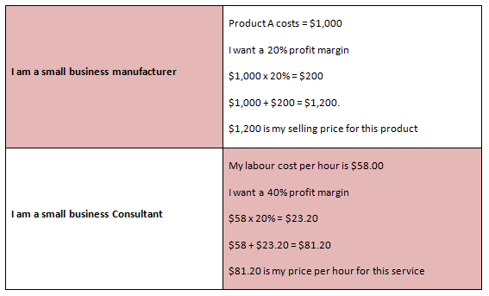
Identify costs, calculate prices and prepare profit statement

Slide 12
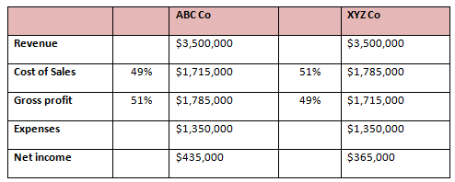
The gross profit margin
Gross profit margin refers to the difference between revenue and gross profit.

Slide 13
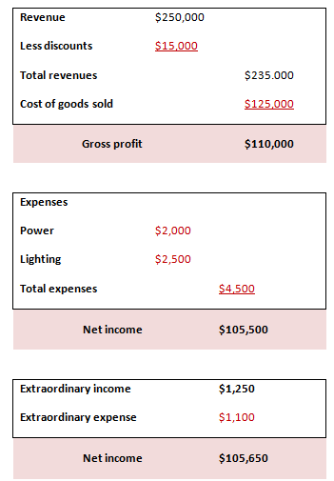
The gross profit margin

Slide 14
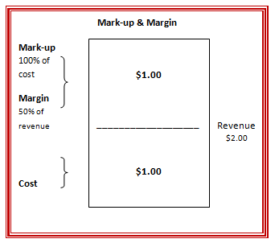
Margin and mark-up:
Two ways of looking at the same thing

Slide 15

Margin and mark-up:
How to use margin and mark-up to become more profitable

Slide 16
Identify costs, calculate prices and prepare profit statement
1.3. Calculate break-even sales point to establish business viability and profit margins

Slide 17
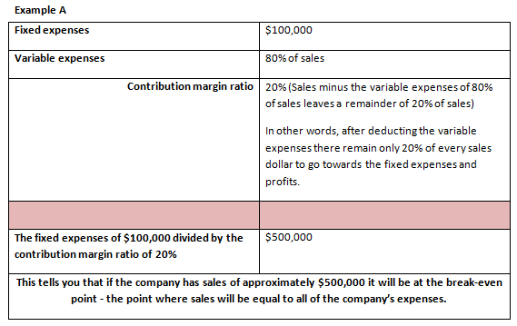
Calculate break-even sales point

Slide 18
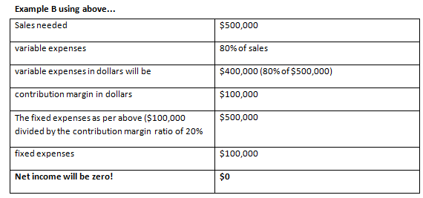
Calculate break-even sales point

Slide 19

Calculate break-even sales point
Expenses will change
Sales will increase or decrease
Some expenses will increase as sales increase
Some expenses will not change as sales increase or decrease

Slide 20

Fixed Expenses
Fixed expenses do not increase when sales increase.
Fixed expenses do not decrease when sales decrease.
Fixed expenses such as rent will not change when sales increase or decrease

Slide 21
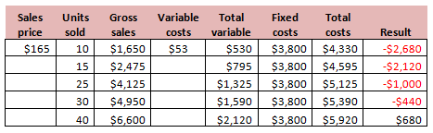
Revenues (or sales)
As the result of its pricing, if 10 cars are serviced its revenues (or sales) is $1,650. If it services 100 cars, its revenues will be $16,500

Slide 22
Activity 1b

Slide 23
Identify costs, calculate prices and prepare profit statement
1.4. Identify appropriate pricing strategies in relation to market conditions to meet business profit targets

Slide 24

Avoid launching products or services that cannot sustain profitable prices in the market

Slide 25

Pricing goals
We wish to increase short-term and long-term profits
We wish to stabilise prices
We wish to increase the cash flow
We wish to better compete with the competition

Slide 26

Pricing strategies
Pricing strategies in relation to market conditions to meet business profit targets encompasses:

Slide 27

Pricing strategies
Pricing strategies may include:
See learner Guide

Slide 28
Activity 1c

Slide 29
Identify costs, calculate prices and prepare profit statement
1.5. Prepare projected profit statement to supplement the business plan

Slide 30

Identify costs, calculate prices and prepare profit statement
Financial statements
(EXAMPLE TEMPLATES)
Other important statements include:
Balance Sheet
Statement of Cash Flows

Slide 31
Activity 1d

Slide 32
Develop a financial plan
2.1. Set profit targets/goals to reflect owners desired returns
2.2. Identify working capital requirements necessary to attain profit projections
2.3. Identify non-current asset requirements and consider alternative asset management strategies
2.4. Prepare cash flow projections to enable business operation in accordance with business plan and legal requirements
2.5. Identify capital investment requirements accurately for each operational period
2.6. Select budget targets to enable ongoing monitoring of financial performance

Slide 33

Profit targets/goals may include:
Break-even point
Cost of goods/services sold
Gross profit/net profit
Desired actual/notional salary for owners/managers
Desired return on investment
Sales turnover/gross fees or income

Slide 34
The first step in developing a financial plan
Definitions/Examples
Set profit targets/goals
Identify working capital
Identify non-current asset requirements
Prepare cash flow projections
Identify capital investment requirements
Select budget targets

Slide 35

Executing the financial plan model
Always consult your Accountant and business adviser to get an independent review of your Financial Plan.

Slide 36
Activity 2a

Slide 37
Acquire finance
3.1. Identify start-up and ongoing financial requirements according to financial plan/budget
3.2. Identify sources of finance, including potential financial backers, to provide required liquidity for the business to complement business goals and objectives
3.3. Investigate cost of securing finance on optimal terms
3.4. Identify strategies to obtain finance as required to ensure financial viability of the business

Slide 38
These questions should be already covered in Activity 2A:
Calculate your business establishment (start-up) costs and working capital required to operate your business.
Outline your plan for finance sourcing. What credit products will you use, if any? What documents will you need to support your application for finance? Prepare the documents you require to apply for finance.

Slide 39

Acquire finance
Definitions/Examples
Start-up and ongoing financial requirements
Sources of finance, e.g., Backers
Cost of securing finance
Strategies to obtain finance as required

Slide 40
Activity 3a

Slide 41
Skills and Knowledge Activity

Slide 42
Major Activity
This activity should take anywhere between an 1-2 hours to complete and can be found at the end of your workbook.
Your instructor will let you know whether they wish for you to complete it in session time or your own time.

Slide 43

Feedback
Did we meet our objectives?
How did you find this session?
Any questions?

Slide 44

Congratulations!
You have now finished the unit…
‘Plan small business finances’

