Slide 1
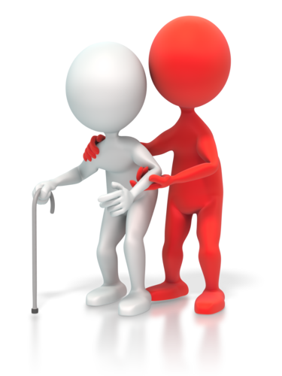
CHCAGE005
Provide support to people living with dementia

Slide 2

Housekeeping
Emergency procedures
Mobiles and security issues
Break times and smoking policy
This course is interactive – ask questions
Practise respect and confidentiality
Ground rules

Slide 3
Objectives
Discover how to prepare to provide support to those affected by dementia
Know how to use appropriate communication strategies
Learn how to provide activities for maintenance of dignity, skills and health
Understand how to identify behaviours of concern and potential triggers
Recognise how to complete documentation
Develop the skills to implement self care strategies
Gain the skills and knowledge required for this unit

Slide 4

Prepare to provide support to those affected by dementia
1.1 Apply person-centred care approaches to all interactions with the person living with dementia

Slide 5

Person-centred approach
If you can hone in on a client’s individual interests, needs, preferences, qualities and abilities, you can deliver a much more personal and tailored service.
Care homes that practise person-centred care are aiming to make the experience of each person with dementia who lives there.

Slide 6
Brooker (2007)
Valued – the person with dementia and their carers must feel valued.
Individuals – they must be treated as individuals.
Perspective – use the perspective of the person with dementia to understand their needs.
Social – the person's social environment must be positive and relationships maintained.

Slide 7

Activity 1A

Slide 8
Prepare to provide support to those affected by dementia
1.2 Interpret individualised plan and familiarise self with the specific needs and wants of the person living with dementia

Slide 9

Care plans
Individual care plans for people with dementia living in care homes are essential.
They should contain information about the individual care needs of the person and how staff can meet these

Slide 10
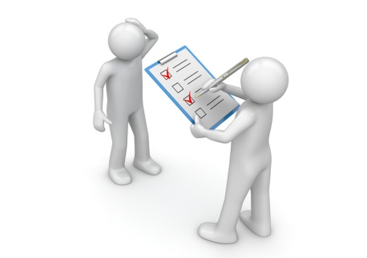
Choice of care
Dementia patients should be included in decisions about their care, with support provided to help them make choices such as:
Food
Clothes
Activities
Likes/dislikes.

Slide 11
Quality of life
Ensuring they have enough to eat and drink
Maintaining personal care (washing, personal grooming etc.)
Participating in group activities
Participating preferred activities
Social opportunities
Maintain relationships with family and friends outside of care.

Slide 12
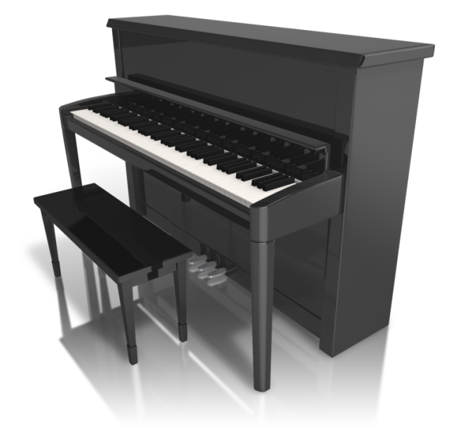
Care home environment
Should be made as homely as possible
Clear labelling of areas
Opportunities to get involved with household tasks
There should be things that stimulate the interests of the residents e.g. instruments, books, pictures, puzzles etc.

Slide 13
Palliative approach
If dementia is terminal, a palliative approach should be made available. This includes:
Encouraging the person to live life as normally as possibly, while accepting the inevitability of death (not seeking to quicken or slow down the process)
Treating distressing symptoms
Maintaining quality of life
Holistic care
Combining spiritual, biological, spiritual and social care.

Slide 14
Activity 1B

Slide 15
Prepare to provide support to those affected by dementia
1.3 Identify and address person’s needs for a stable and familiar environment

Slide 16
Stable and familiar environments
Taking familiar items from home such as:
  Ornaments
  Furniture
  Photographs
Ensuring a routine is kept familiar e.g. times to wake, sleep, eat etc.
Serve familiar food – find out client’s favourites
Restricting the number of different carers involved in client’s personal care
Encouraging visits from family at regular/similar times.

Slide 17
Activity 1C

Slide 18
Prepare to provide support to those affected by dementia
1.4 Recognise signs consistent with financial, physical or emotional abuse or neglect of the person and report to an appropriate person

Slide 19

Types of abuse
Financial exploitation
Physical abuse
Emotional abuse
Sexual abuse
Neglect/abandonment
Healthcare fraud

Slide 20

Signs of abuse
Symptoms can be difficult to recognise as they may mirror those of dementia or frailty, but can include:
Arguments
Changes in personality of the elderly person
Odd behaviour
Bruises
Being left unclean
Weight loss.

Slide 21

Acting on elder abuse
There are three things you must do to prevent elder abuse:
Listen to elders and caregivers
Intervene when you suspect abuse e.g. report
Educate others on how to identify and report elder abuse.

Slide 22
Activity 1D

Slide 23
Use appropriate communication strategies
2.1 Use verbal and non verbal communication strategies to maximise engagement of the person with dementia

Slide 24
Encouraging communication
Make eye contact
Short simple statements
Speak slowly and clearly
Don't interrupt them or try to finish their sentences
Encourage them to join in conversations with others
Don't speak on behalf of the person
Don't patronise/ridicule them
Don't dismiss what they say, even if it is irrelevant
If they don't appear to understand you, rephrase it.

Slide 25
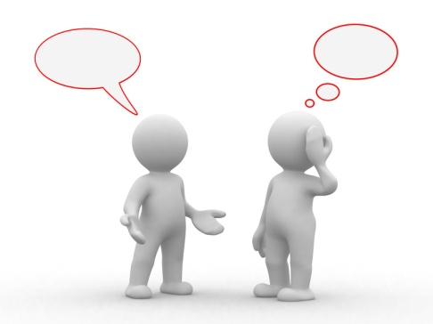
Body language/contact
Gentle touch
Using a friendly and positive tone
Not standing too close/invading their personal space when talking to them.
Eye contact.

Slide 26
Activity 2A

Slide 27
Use appropriate communication strategies
2.2 Gain cooperation and provide reassurance as appropriate by using reality orientation

Slide 28

Reality orientation therapy
Reality orientation is a type of therapy that reduces memory loss and confusion.
It involves group sessions where reminders of the date and day; the location of the room etc. are put on a whiteboard.
The group then complete tasks aimed at providing mental stimulation.

Slide 29

Reassuring words, phrases and body language
Examples of reassuring words, phrases and body language include:
Praise
Jokes (not at their expense)
Facing them when you talk to them
Smiling
Maintaining eye contact.

Slide 30
Activity 2B

Slide 31
Use appropriate communication strategies
2.3 Use a range of validation strategies to relieve distress and agitation in the person

Slide 32

Validation therapy
This works by accepting the values, beliefs and reality that the person with dementia believes.
Rather than disagree with them, the carer agrees with what they suggest and redirects them to something else.

Slide 33

Advantages and disadvantages
Advantages of validation therapy:
Not confrontational
No-one is told off
No-one is shouted at
No-one is told they are wrong.
Disadvantages of validation therapy:
It promotes lies
Can be difficult for caregivers and family to lie.

Slide 34
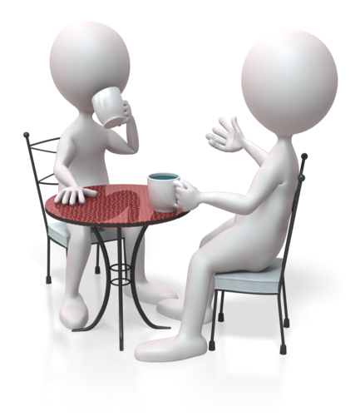
Reminiscence therapy
Encouraged to recall memories from their distant past
it can prove therapeutic
They meet with a group and share their stories
It can also help resolve thoughts from their past and help them connect to the present.

Slide 35
Activity 2C

Slide 36
Provide activities for maintenance of dignity, skills and health
3.1 Organise activities which aim to maintain independence, using familiar routines and existing skills

Slide 37

Activities to maintain independence
Doing laundry
Going shopping
Grooming
Craft and creative activities
Travelling by private and public transport
Preparing meals.

Slide 38

Determining skills and abilities
You need to determine clients’ current skill levels and abilities:
General mobility
Memory
Ability to use stairs
Coordination
Senses (sight, hearing etc.)
Strength.

Slide 39
Activity 3A

Slide 40
Provide activities for maintenance of dignity, skills and health
3.2 Ensure the safety and comfort of the person balanced with autonomy and risk taking

Slide 41
Common risks
Common risks are associated with dementia relating to ability to:
Find their own way
Negotiate traffic
Safely prepare, cook and store food and drink
Control temperature of water
Use home appliances
Maintain personal and home security
Manage own finances
Recognise dangers in their environment
Recognise the safety of others.

Slide 42
Activity 3B

Slide 43
Provide activities for maintenance of dignity, skills and health
3.3 Access information about the person’s reminiscences and routines with family and carers

Slide 44

Learning their life story
Previous jobs
Domestic interests
Recreational pastimes
Religious views
Family members
Family history
Homes and neighbourhoods
Nationality and countries of residence.

Slide 45

Using their life story to plan activities
Activities should be, wherever possible, based upon the life experiences and interests of the patients.
If you find out that they used to work in a food preparation, you can base activities on this e.g. cooking and baking activities.

Slide 46
Activity 3C

Slide 47
Provide activities for maintenance of dignity, skills and health
3.4 Provide support and guidance to family, carers and/or significant others where appropriate

Slide 48
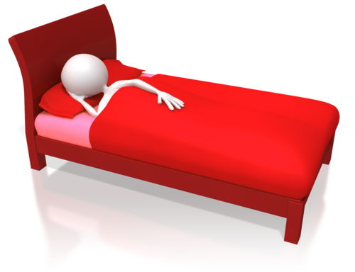
Providing support and guidance
Problems that carers experience can include:
Depression
Physical exhaustion
Emotional exhaustion
Social isolation
Financial hardship
Resentment.

Slide 49

Caring for someone with dementia
People may need help with:
Bathing
Dressing
Sleep disturbances
Emotional support
Paying bills
Cooking meals
Household chores

Slide 50
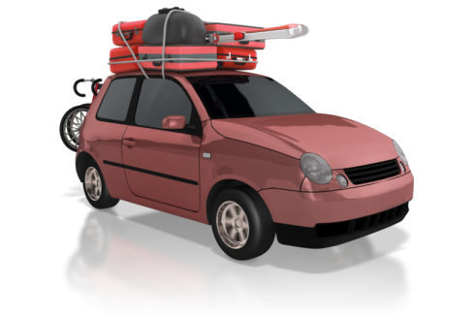
Financial implications
For family carers, the financial burdens of looking after someone with dementia can be huge:
Transport costs
Utility costs
Care costs
Giving up/reducing work to care for someone
Inadequate benefits.

Slide 51
Activity 3D

Slide 52
Provide activities for maintenance of dignity, skills and health
3.5 Implement strategies which minimise the impact of behaviours of concern

Slide 53

Behavioural and psychological symptoms of dementia
Physical aggression
Psychosis (hallucinations/delusions)
Social withdrawal
Verbal disruption
Repetitive actions or questions
Resistance to personal care
Sexually inappropriate behaviour
Refusal to accept services
Problems associated with eating
Socially inappropriate behaviour
Wandering or intrusiveness
Sleep disturbances.

Slide 54

Behavioural triggers
Unfamiliar environments
Changes in routines
Difficulty understanding what's happening to them
Feeling humiliated/frightened
Frustration about communication difficulties
Physical effects of dementia
Loss of inhibitions and awareness of rules
Trying to communicate unmet needs.

Slide 55
Activity 3E

Slide 56
Identify behaviours of concern and potential triggers
4.1 Contribute to team discussions on support planning and review

Slide 57

Team discussions
Discussions should involve carers, care home managers, family carers and the person with dementia themselves.
The aim should be to create a care plan that addresses and resolves the triggers.

Slide 58
Activity 4A

Slide 59
Identify behaviours of concern and potential triggers
4.2 Take action to minimise the likelihood of and reduce the impact of behaviours on the person and others

Slide 60

Take action to minimise behaviours of concern
Distraction
Current events
Reminiscences
Music, dancing
Walking
Talking reassuringly about familiar and favourite topics
Behaviour modification (if appropriate)
Addressing physical triggers to behaviour including pain
Alternative therapies.

Slide 61
Psychosocial strategies
Validation therapy
Exercise therapy
Multi-sensory stimulation
Scheduled reassurance therapy (SRT)
Aromatherapy
Spirituality
Pet therapy
Music therapy
Bright light therapy
Reality orientation therapy
Spaced retrieval
Doll therapy
Simulated presence therapy
Dementia friendly environments

Slide 62

Pharmacological strategies
Psychotropic medicines
Antipsychotics
Benzodiazepines
Anticholinesterases
N-methyl-D-aspartate (NMDA) antagonist
Anticonvulsants
Antidepressants.

Slide 63
Activity 4B

Slide 64
Identify behaviours of concern and potential triggers
4.3 Evaluate implemented strategies with support planning team to ensure effectiveness in minimising behaviours

Slide 65

Evaluating strategies
You will need to observe the client for a nominated amount of time and make a record of what you find.
It is important to share your findings with your team so they can be prepared to handle the behaviour either differently, (if behaviour strategies did not work) or the same (if they did work).

Slide 66

Event samples
Event samples are good for assessing concerns about behaviour:
The event number
The date/time
The context of the situation e.g. family visited, going to bed
Who was involved? e.g. family members, carers
Dialogue/incident.

Slide 67

ABC method
You can use the ABC method for analysing behaviour in dementia clients:
A = Antecedent: the event that happened directly before the client became upset
B = Behaviour: the upsetting behaviour
C = Consequence: the events happening as a response to the behaviour.

Slide 68
Activity 4C

Slide 69
Complete documentation
5.1 Comply with the organisation’s reporting requirements, including reporting observations to supervisor

Slide 70

Organisation’s reporting requirements
Documentation should be completed as soon after any incident
Progress notes are legal documents. They must be filled out in a particular way

Slide 71

Written documents
Active voice
Concise
Objective
By exception
Appropriate in language (no slang, unless recording direct speech)
Include only necessary information

Slide 72

Verbal reports
These can be done face-to-face or over the telephone.
You should use this method of reporting when communication is required urgently, or in an emergency situation.

Slide 73

Incident reports
The essential elements to an incident report involve answering the following questions about the incident:
Who?
What?
When?
Where?
How and why?

Slide 74
Activity 5A

Slide 75
Element title
5.2 Complete, maintain and store documentation according to organisation policy and protocols

Slide 76

Making records identifiable
You might need to include the following information:
Unique identifier e.g. medical record number
Client’s full name
Date of birth/age
Sex.

Slide 77
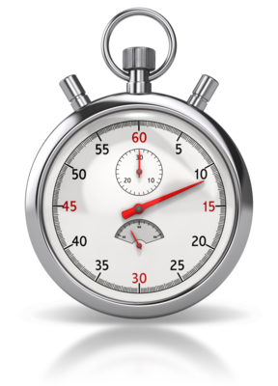
Frequency of documentation
For example:
By each carer to give care to client/each session
Significant changes to the client’s condition
Significant changes to treatment/activities/preferences
Reviews.

Slide 78
Sorting and storing information
Established procedure this may be implemented by organisational stipulation or through how your workplace works.
Organisational stipulation is in place to ensure that legal obligations are met and that a uniform system is used across the company.
Workplaces may have their own system that revolves around the space, layout and staffing of the office.

Slide 79
Activity 5B

Slide 80
Implement self care strategies
6.1 Monitor own stress level in relation to working with people with dementia

Slide 81
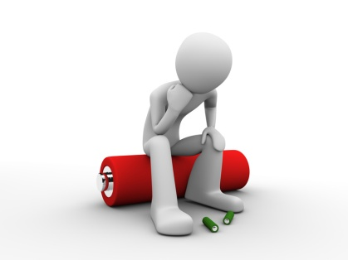
Signs of stress
Denial
Anger
Depression
Anxiety
Social withdrawal
Sleeplessness
Exhaustion
Irritability
Health problems
Trouble concentrating

Slide 82

Managing stress
Develop a consistent schedule
Educate yourself on the effects of dementia and strategies for managing it
Talk to family, friends, or other people in a similar situation
Manage your diet, take regular exercise and maintain a social life
Be realistic about your ability to carry out tasks.

Slide 83
Activity 6A

Slide 84
Implement self care strategies
6.2 Use appropriate self care strategies and seek support if required

Slide 85
Self-care strategies
Express feelings e.g. crying
Talking (sharing feelings can be cathartic)
Keep a journal
Perform comforting rituals/behaviours
Think carefully before you make any decisions on your feelings
Find a balance between the negative feelings and positive ones in life
Rediscover your sense of humour.

Slide 86
Resources/support systems
Aged Care Assessment Teams
Aged Care Information Line
Commonwealth Respite and Carelink Centres
Carer Advisory and Counselling Service
Doctors
Local councils
Local community health centre
Alzheimer's Australia
My Aged care
Cognitive Dementia and Memory Service clinics
Carers Victoria
Dementia Behaviour Management Advisory Service

Slide 87
Activity 6B

Slide 88
Skills and Knowledge Activity

Slide 89
Major Activity
This activity should take anywhere between an 1-2 hours to complete and can be found at the end of your workbook.
Your instructor will let you know whether they wish for you to complete it in session time or your own time.

Slide 90

Summary and Feedback
Did we meet our objectives?
How did you find this session?
Any questions?

Slide 91

Congratulations!
You have now finished the unit…
‘Provide support to people living with dementia ’

