Slide 1
RIIRIS401d Apply Site risk management system
Presentation 2

Slide 2

2.1 IDENTIFY RISK MANAGEMENT TRAINING NEEDS
Training is important to ensure that each member of the workplace is able to complete tasks in accordance with risk management requirements.
It is important to ensure you have identified any gaps in the OHS/WHS risk management training of both individuals and departments.

Slide 3
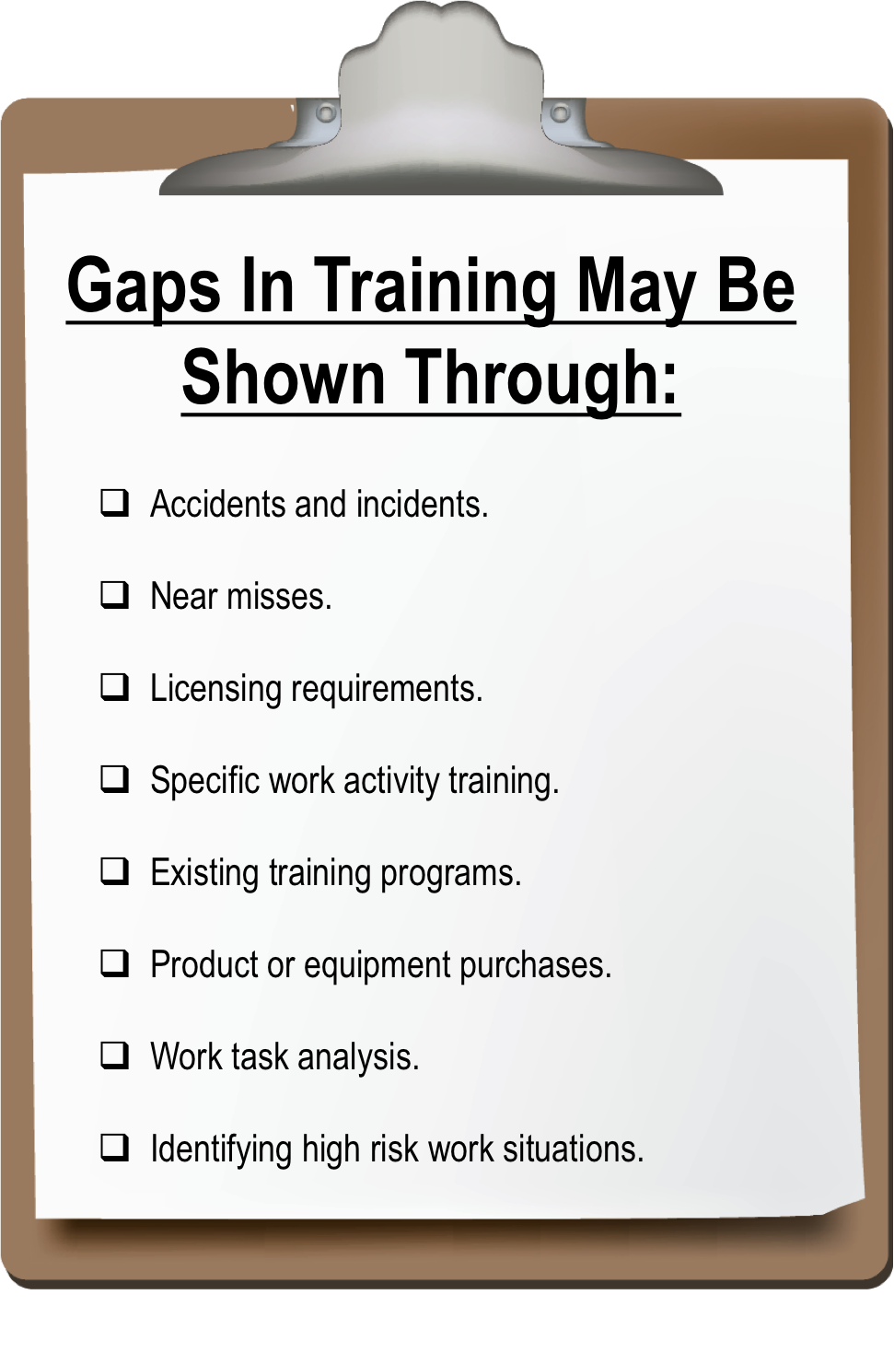
2.1 IDENTIFY RISK MANAGEMENT TRAINING NEEDS
The following lists some examples of where gaps in training can be shown:

Slide 4

2.1 IDENTIFY RISK MANAGEMENT TRAINING NEEDS
Risk management training may be applied to:
Statutory compliance.
OHS/WHS.
Environment.
Quality.
Property security.

Slide 5

2.1 IDENTIFY RISK MANAGEMENT TRAINING NEEDS
Business risks such as;
  Credit management.
  Capital expenditure.
  Sales and marketing.
  Finance and accounting.
Any other area of the worksite that requires risk management training.
At all times you will need to abide by your site and organisational training procedures and policies.

Slide 6

2.1.1 DOCUMENTING OHS/WHS TRAINING
OHS/WHS risk management training needs must be documented to ensure it is adequately provided and monitored.
Most organisations will create a skills or training matrix which outlines what training is needed and when any licensing or certifications are due for renewal.
It is advisable to appoint a designated training officer who is responsible for the management and documentation of all aspects of OHS/WHS training.

Slide 7
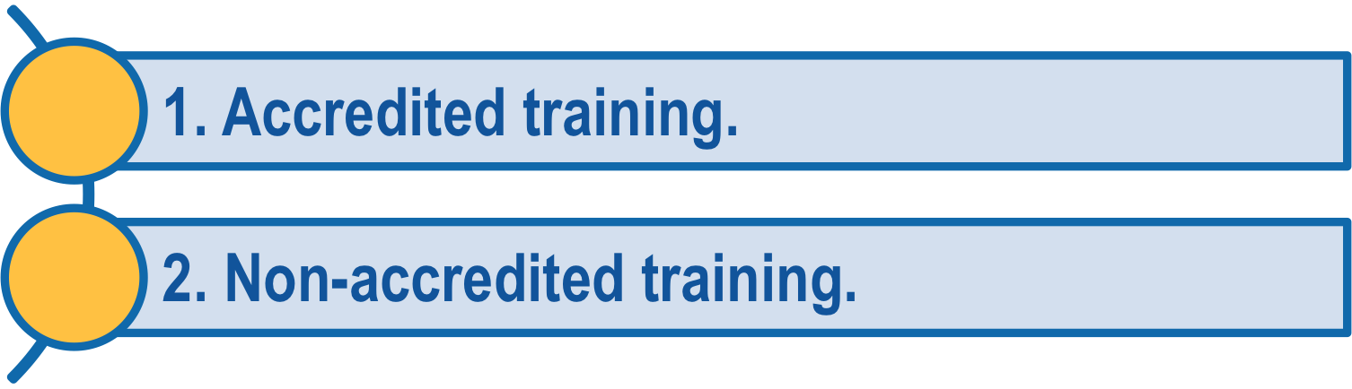
2.2 ARRANGE RISK MANAGEMENT TRAINING
Once you have identified a training need or knowledge gap, you need to organise training opportunities to overcome these gaps. A training opportunity will come in 2 main forms:
Accredited training is a form of training where an individual will be issued a recognised certification. Accredited training is provided by training organisations, which are approved and accredited by the government. These could include TAFE, or private Registered Training Organisations (RTOs).

Slide 8

2.2 ARRANGE RISK MANAGEMENT TRAINING
Accredited training could encompass an entire qualification such as the Certificate IV in Work Health and Safety or could be simply a statement of attainment for one particular subject.
For example if you are only studying this subject you will receive a statement of attainment because this is an accredited course.

Slide 9

2.2 ARRANGE RISK MANAGEMENT TRAINING
Unaccredited training is a form of informal training that is conducted in-house.
Normally unaccredited training addresses specific subjects or issues.
Common forms of unaccredited training could include how to implement a procedure for an item of machinery, or training in the use of company policies and procedures.

Slide 10

2.2 ARRANGE RISK MANAGEMENT TRAINING
Before determining the best solution for the identified training need, you will need to consult with a variety of people.
These people could be:
Supervisors.
Managers.
Training officers, either in-house or
specialist outside trainers.
Individuals undertaking the training.

Slide 11

2.2 ARRANGE RISK MANAGEMENT TRAINING
Training cannot fix every problem. By consulting with affected personnel/workers you will be able to determine if the issue is one that can be fixed with a training opportunity or if the solution to the problem needs to come from a different direction.

Slide 12

2.3 PROVIDE LEARNING OPPORTUNITIES
Every workplace has a responsibility to provide learning opportunities for the members of the team who need training or support. These opportunities could come through:
Coaching.
Mentoring.
Instruction activities.
Practice of skills learnt.
Assessment of skills acquired.
Time to attend classes.

Slide 13

2.3 PROVIDE LEARNING OPPORTUNITIES
By providing these opportunities, you are assisting the team as well as each individual member to achieve identified goals.
It also helps ensure the skills of the team are current and usable and that team members are challenged and engaged.
With busy work schedules it can be difficult to remember to ensure learning opportunities are made available.
Having a regular schedule of learning opportunities is one way of overcoming this.

Slide 14

2.3 PROVIDE LEARNING OPPORTUNITIES
To maximise the number of training opportunities available to your work group, you will need to ensure that management ‘buys-in’ to the benefits of training.
Managers, other supervisors and senior staff will then be willing to provide time for staff to undertake the training.

Slide 15

2.3.1 COACHING AND MENTORING
Coaching and mentoring of colleagues is a process of providing support in an informal manner.
When working in a coaching or mentoring situation, you will need to be relaxed and calm with a good knowledge of what you are trying to achieve.
Coaching is generally thought to involve the teaching or demonstration of a skill or skill set. The development of the skill in the other person then allows them to complete tasks unaided.

Slide 16

2.3.1 COACHING AND MENTORING
Mentoring is a more long term process. It assists the other person by providing:
A sounding board and someone to talk
through problems with.
Another person who is willing to assist them
to achieve personal and professional goals and
aspirations.

Slide 17

2.3.1 COACHING AND MENTORING
The ability to listen is essential as both a coach and a mentor.
Active listening is the process of concentrating on the speaker and listening to them, rather than just waiting for a break in the conversation for you to respond.

Slide 18

2.4 IDENTIFY AND REPORT TRAINING COSTS
Once all training needs have been identified and the training or learning opportunities have been arranged, it is necessary to report the associated costs to management for inclusion in the financial plans for the business.
You may need to report these figures to your:
Site project manager.
Site training manager.
Other designated persons.

Slide 19

2.4 IDENTIFY AND REPORT TRAINING COSTS
These costs will usually be complied into a written report so they can be conveyed to management easily. Hidden costs should be included where known.
Any funding options that may be available to your organisation should also be identified and included in your report.
These funding options could include traineeships, funded training places for skills shortage areas, apprenticeships and other government incentives.

Slide 20
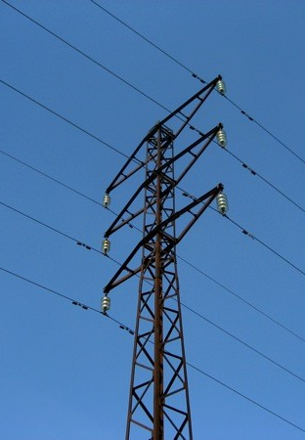
2.5 IDENTIFY AND REPORT HAZARDS AND RISKS
The types of hazards will depend on the specific workplace and the activities conducted. To identify possible risks and hazards walk all around the work area and check:
Up High
Hazards may include:
Power lines.
Obstructions.
Trees.
Scaffolding.
Cranes.

Slide 21
2.5 IDENTIFY AND REPORT HAZARDS AND RISKS
Eye Level
Hazards may include:
Hazardous materials.
Other workers.
Equipment.
Machines.
Obstructions.

Slide 22
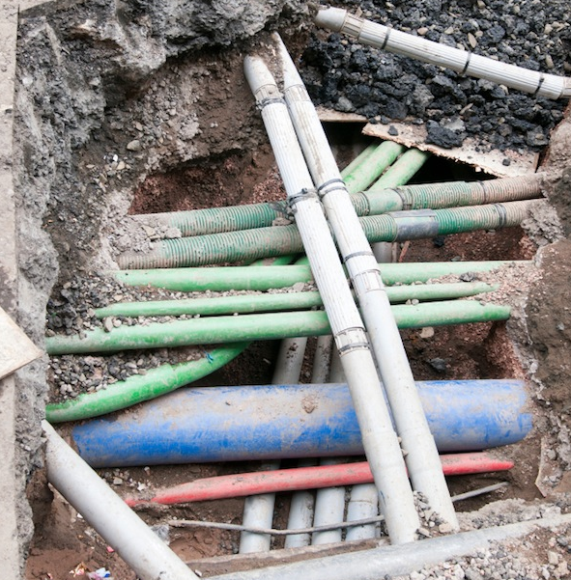
2.5 IDENTIFY AND REPORT HAZARDS AND RISKS
Down Low
Hazards may include:
Underground services.
Unsafe ground.
Adjoining pit walls.
Road conditions.
Spills.
Rocks and potholes.
Debris.
Weight bearing ability.

Slide 23

2.5 IDENTIFY AND REPORT HAZARDS AND RISKS
Make a note of any hazard you identify in the area. Remember, a hazard can also be a situation so keep an eye on how the people around you are working too.

Slide 24
2.5.1 IDENTIFYING AND ANALYSING HAZARDS AND RISKS
Hazards and risks in the workplace can change from day to day. In order to effectively manage them, the work area and work conditions need to be inspected and analysed on a regular basis. Hazards and risks may be identified in the following ways:
The way hazards and risks are identified can include:
Workplace Inspections And Observation | Conduct personal ‘walk-throughs’, develop employee/worker surveys and carry out workplace inspections. Review the outcomes to identify any possible ineffective or non-existent controls. Also look for other factors such as inadequate training, working procedures, instruction, supervision, or lack of information about dealing with hazards. Use your knowledge of OHS/WHS legislation and workplace policies and practices to make sure employees/workers are following safe work practices.

Slide 25
2.5.1 IDENTIFYING AND ANALYSING HAZARDS AND RISKS
The way hazards and risks are identified can include:
Consulting Work Team Members | The effectiveness of your workplace risk management is dependent on good consultation between managers, supervisors and employees/workers.
Housekeeping | Will assist in minimising hazards and will identify new hazards.
Risk Audits And Review Of Audit Reports | Look for immediate potential causes of injuries or illness, and make sure your information is complete and correct. Supervisors and employees/workers are your best source of information about what is taking place during work processes.

Slide 26
2.5.1 IDENTIFYING AND ANALYSING HAZARDS AND RISKS
The way hazards and risks are identified can include:
Daily Informal Consultation And Regular Formal Meetings | This allows the identification of employee/worker concerns. A simple consultation process will assist you to comply with risk management requirements. Input of managers, OHS/WHS representatives, OHS/WHS committees and others through consultative processes can also assist in risk management.
Checking Equipment Before And During Work | Most equipment and machinery contain hazard identification checklists that you can modify for your workplace. These will sometimes need to be completed at numerous stages during the day.
Review | Examine health, safety, environmental quality and other risk-related records.

Slide 27
2.5.1 IDENTIFYING AND ANALYSING HAZARDS AND RISKS
The way hazards and risks are identified can include:
Interviews | Use personal interviews with employees/workers to encourage them to identify hazards in the workplace. Some people are more likely to give information on hazards and risks in a private setting.
Investigations | Review any previous OHS/WHS investigations that have been conducted in your workplace to determine what major incidents have taken place, what corrective action was required and if that action has been taken.

Slide 28
2.5.1 IDENTIFYING AND ANALYSING HAZARDS AND RISKS
The way hazards and risks are identified can include:
Simulations | Use modelling tools in your workplace, or access experts who can provide the tools, to simulate possible hazards and incidents in your workplace.
Timelines Of Actions And Events | Ensure your workplace has inspection routines, risk management practices and reporting systems in place and that employees/workers are aware of their responsibilities and reporting requirements. Hazard identification must be carried out regularly as well as whenever changes are made in the workplace, new equipment is installed, or new employees/workers start.

Slide 29

2.5.1 IDENTIFYING AND ANALYSING HAZARDS AND RISKS
Worksite hazards can also be analysed by:
Looking in-depth at a situation or the way a job is
carried out by other workers.
Examining records of injuries and incidents.
Checking safety tags.
Reading Material Safety Data Sheets (MSDS).
Staying informed about OHS/WHS trends and
developments.

Slide 30

2.5.1 IDENTIFYING AND ANALYSING HAZARDS AND RISKS
A useful tool to use for analysing hazards is a table where you can list the type and scope of each hazard and its likely impact.
You can then look at the potential of the hazard and make an assumption that a person will be exposed to it when the harm actually occurs.
The possible levels of harm need to be understood.

Slide 31

2.5.2 REPORTING HAZARDS
Hazards, once identified, will need to be reported in accordance with workplace requirements.
These requirements will vary depending on the size of the organisation but could include:
Written reports.
Verbal reports.
Checklist completion.
Recording in a hazard register.
A request for improvement form.

Slide 32

2.5.2 REPORTING HAZARDS
When hazard reports are created by team members make sure they include all details of the hazard such as:
Location.
The type of hazard.
Number of people affected by the hazard.
Risk category if possible, e.g. is it life –
threatening?
Who has reported it.
When it was located – date, time.

Slide 33

2.5.2 REPORTING HAZARDS
It is very important that hazards are identified, reported, assessed and acted on as quickly as possible and within organisational policies or procedures.

Slide 34
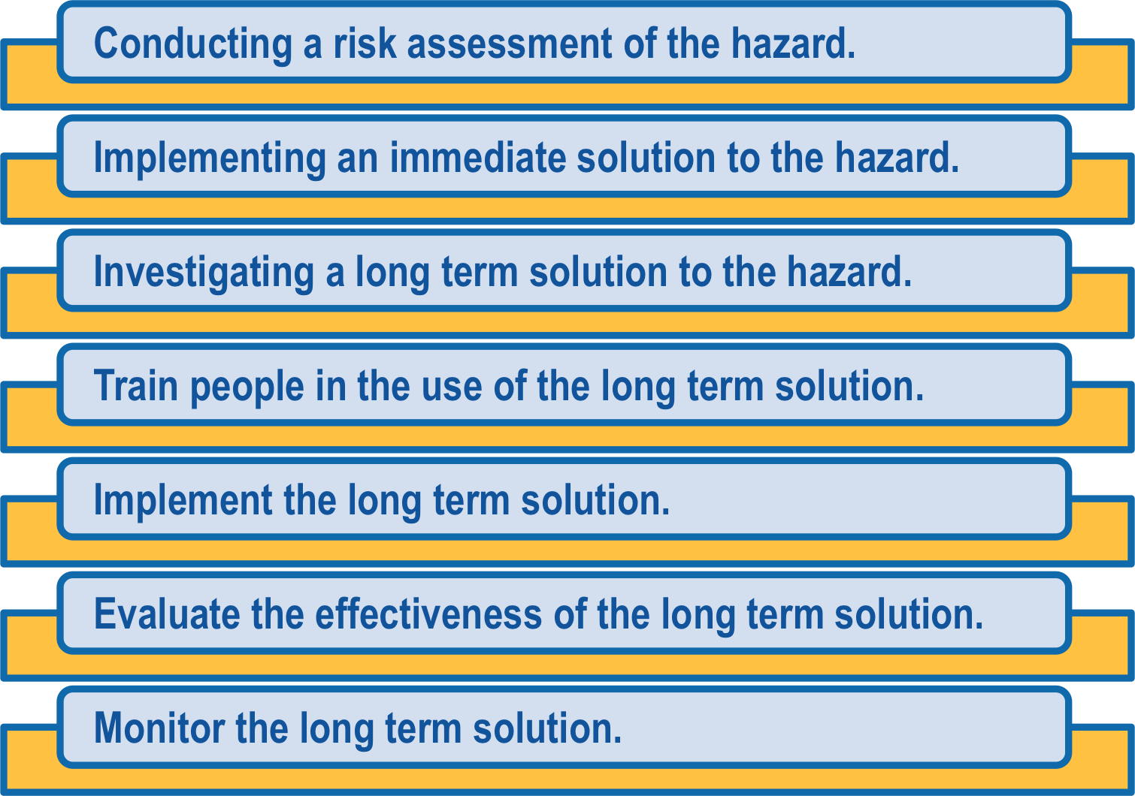
2.6 ACT ON HAZARD REPORTS
As a supervisor or risk management technical specialist, you need to ensure that you action team members’ hazard reports quickly and in accordance with workplace procedures and policies. The action you need to take could include:

Slide 35

2.6 ACT ON HAZARD REPORTS
It is difficult to define how you should respond to reported hazards.
This is because each risk situation will need to be assessed individually and a tailored risk control measure created to meet the specific environmental and other factors that will impact the workplace.

Slide 36

2.6.1 ASSESSING RISKS
A risk assessment involves completing a risk analysis and a risk evaluation.
By assessing the likelihood and consequence of the risk, you are able to understand the situation better and respond by applying the appropriate risk control procedures.

Slide 37
2.6.1.1 RISK ANALYSIS
Risk analysis involves considering what are the causes and sources of risks and comprises 3 factors:
Consequence | What would be the outcome of the event occurring? How severe would the outcome be?
Likelihood | What is the chance of the event/consequence occurring? Has the event happened before? Is it likely to happen again?
Risk Level | The combined result of likelihood and consequence.

Slide 38
2.6.1.1 RISK ANALYSIS
Using a table similar to the one shown here you can apply your analysis skills to assess how high the risk is.
LIKELIHOOD | CONSEQUENCE
 | Insignificant | Minor First Aid Required | Moderate Medical Attention and Time Off Work | Major Long Term Illness or Serious Injury | Severe Kill or Cause Permanent Disability or Illness
Almost Certain | M | H | H | VH | VH
Likely | M | M | H | H | VH
Possible | L | M | H | H | VH
Unlikely | L | L | M | M | H
Rare | L | L | M | M | M

Slide 39

2.6.1.2 RISK EVALUATION
Risk evaluation is based upon the outcomes and results of the risk analysis.
Risk evaluation involves further assessment and analysis to make decisions about which risks need to be treated and the order in which it should be done.

Slide 40

2.6.1.2 RISK EVALUATION
Risk evaluation should take into consideration the context of the risks in relation to:
The organisation.
The worksite.
The relevant laws.
Regulations.
Other policies, procedures and
requirements.

Slide 41
2.6.1.2 RISK EVALUATION
Using a table similar to the one shown you can evaluate how soon you should act to remove or control the hazard to achieve an acceptable level of risk.
RISK LEVEL | ACTION
VERY HIGH | Act immediately: The proposed task or process activity must not proceed. Steps must be taken to lower the risk level to as low as reasonably practicable using the hierarchy of risk controls.
HIGH | Act today: The proposed activity can only proceed, provided that: The risk level has been reduced to as low as reasonably practicable using the hierarchy of risk controls. The risk controls must include those identified in legislation, Australian Standards, Codes of Practice etc. The risk assessment has been reviewed and approved by the Supervisor. A Safe Working Procedure or Safe Work Method has been prepared. The supervisor must review and document the effectiveness of the implemented risk controls.

Slide 42
2.6.1.2 RISK EVALUATION
RISK LEVEL | ACTION
MEDIUM | Act this week: The proposed task or process can proceed, provided that: The risk level has been reduced to as low as reasonably practicable using the hierarchy of risk controls. The risk assessment has been reviewed and approved by the Supervisor. A Safe Working Procedure or Safe Work Method has been prepared.
LOW | Act this month: Managed by local documented routine procedures, which must include application of the hierarchy of controls.
Any task with a Very High risk level is absolutely unacceptable to carry out. Steps must be taken to reduce the risk level.

Slide 43

2.7 APPLY RISK CONTROL PROCEDURES
Once hazards have been identified and risks analysed and evaluated, risk treatment options need to be considered and applied, in line with your site risk management system.
Risk treatment involves selecting one or more options to modify a risk and then implementing the selected option/s. Risk treatments should be recorded in a risk treatment plan.
Once an option has been implemented it may be referred to as a risk control.

Slide 44

2.7 APPLY RISK CONTROL PROCEDURES
Each organisation should have risk control procedures that reflect:
State and federal legislative requirements,
including relevant regulations, Codes of
Practice and Australian standards.
The nature of the risks on that worksite.
The culture of the site.
Industry standards and norms.

Slide 45

2.7 APPLY RISK CONTROL PROCEDURES
Manufacturers’ specifications.
Community expectations or requirements.
Environmental factors.
Other requirements specific to the site or organisation.
Regardless of how a risk is controlled and managed it must be done in accordance with organisational requirements and the hierarchy of hazard control.

Slide 46

2.7.1 HIERARCHY OF HAZARD CONTROL
The Hierarchy of Hazard Control is the name given to a range of control methods used to eliminate or control hazards in the workplace.
It is widely used within OHS/WHS management systems in all industries.

Slide 47
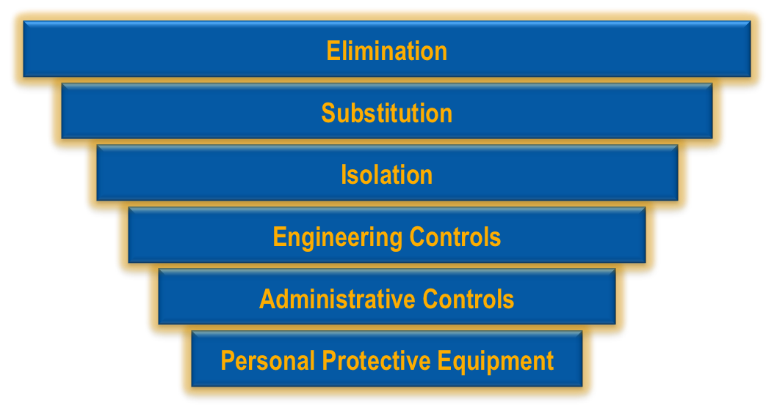
2.7.1 HIERARCHY OF HAZARD CONTROL
The Hierarchy has 6 levels, shown below from most effective to least effective:

Slide 48

2.7.1 HIERARCHY OF HAZARD CONTROL
Hierarchy Level | Description and examples of controls
1. Eliminate | Removing the hazard will always be the preferred option but is often not possible. Simple ways of removing a hazard could include: Removing dangerous materials from the site. Repairing defective equipment. Ensuring there is adequate storage so boxes and debris are not left blocking doorways and passage ways. Ensuring adequate emergency lighting and signage. Provision of uninterruptable power supply units (UPS) to avoid the work loss due to power supply problems.

Slide 49
2.7.1 HIERARCHY OF HAZARD CONTROL
Hierarchy Level | Description and examples of controls
2. Substitute | Substitute the materials being used or that are causing the hazard. It could also mean doing the task differently or purchasing alternative materials
3. Isolate | Isolate the hazard or risk by restricting access to it through the use of barriers, fences or lock-out devices.

Slide 50
2.7.1 HIERARCHY OF HAZARD CONTROL
Hierarchy Level | Description and examples of controls
4. Engineering Controls | This involves installing equipment to minimise the hazard or risk, such as a ventilation system or hand rails on steps. It could also mean re-designing a task, work process or the workplace. The re-design could include: Providing mechanical handling equipment. Rearranging materials flows, timing, schedules. Changing the height of work platforms. Re-arranging furniture to make better use of available space. Creating different work schedules so that different tasks are completed at different times of day, e.g. cleaners doing their work before or after everyone else.

Slide 51
2.7.1 HIERARCHY OF HAZARD CONTROL
Hierarchy Level | Description and examples of controls
5. Administrative Controls | This involves using safe work practices to minimise risks, such as safe operating procedures, Safe Work Method Statements or rosters to spread the risk.
6. Personal Protective Equipment (PPE) | PPE is the equipment that can be worn by an individual to protect them from hazards. It may include hard hats, safety boots, eye and hearing protection. PPE is the least preferred method of controlling a hazard and should be used in conjunction with other methods, not on its own.

Slide 52

2.7.1 HIERARCHY OF HAZARD CONTROL
It is important to consider all of the options available when deciding on the best course of action.
Not all options are feasible or possible under some circumstances. You may need to use a number of control strategies in combination to reduce the risk to an acceptable level.

Slide 53

2.7.2 ASSESSING RESOURCES
As you are working your way through the hierarchy of hazard control, you need to be assessing the resources that are available in your workplace.
Check that the resources correspond with the selected risk control measures and that they are accessible and functional.

Slide 54

2.7.2 ASSESSING RESOURCES
Resources for implementing risk control measures could include:
Time resources – a perfect solution that
takes weeks to use or implement will not
assist in immediate control of the risks.
Human resources – personnel/workers to
implement the controls.

Slide 55

2.7.2 ASSESSING RESOURCES
Financial resources – to purchase anything required.
Training resources – does your team have the training to implement the controls?
All other resources.

Slide 56

2.8 REPORT AND MONITOR INADEQUACIES IN RISK CONTROL
Where control strategies are already in place, it is your job to analyse whether they are appropriate and adequate.
For example, are they based on existing Regulations, Codes of Practice and current standards?

Slide 57
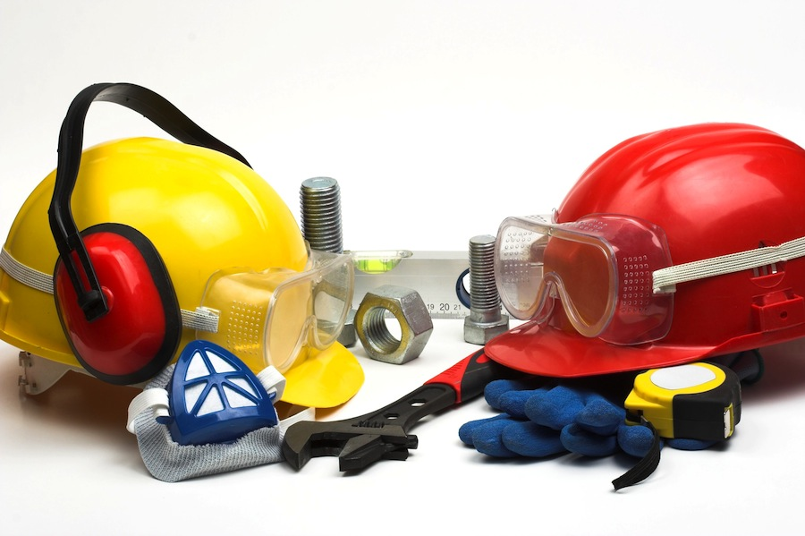
2.8 REPORT AND MONITOR INADEQUACIES IN RISK CONTROL
Existing control measures and risk treatments should not be regarded as adequate simply because an incident hasn't occurred.
This particularly applies where the existing control measures are only administrative controls (e.g. training, safety procedures, safety signs) or PPE.

Slide 58

2.8 REPORT AND MONITOR INADEQUACIES IN RISK CONTROL
These types of controls rely heavily on human behaviour, i.e. people always doing the right thing.
Any deviation in behaviour (e.g. employees/workers not following the safety procedures) could cause injury, illness or disease.

Slide 59

2.8 REPORT AND MONITOR INADEQUACIES IN RISK CONTROL
Occasionally in applying the hierarchy of hazard control you will become aware of inadequacies in existing risk control measures.
These inadequacies need to be reported and acted upon in accordance with the established system of policies and procedures for your organisation.

Slide 60

2.8 REPORT AND MONITOR INADEQUACIES IN RISK CONTROL
A risk control measure could prove to be inadequate because:
It is inappropriate for the risk.
It has been out-dated by newer technology.
It is creating additional risks or hazards that were
unforeseen.
It is complex and creating too many additional steps in
the process therefore is not being used.
It is being used incorrectly or inappropriately.

Slide 61

2.8 REPORT AND MONITOR INADEQUACIES IN RISK CONTROL
Inadequacies in risk control measures are the reason monitoring and review are an important part of a site risk management system and should be planned for at every stage.

Slide 62

2.8 REPORT AND MONITOR INADEQUACIES IN RISK CONTROL
Monitoring and review should:
Ensure that risk controls are effective and
efficient.
Aim to improve risk assessment through
obtaining further information.
Be used to analyse events and changes that
have occurred through the implementation of
risk control measures and any lessons that
may be learned from this.
Be used to detect any changes, including
changes to risks, which may require revision of
control measures, or the emergence of new
risks.

Slide 63

2.8 REPORT AND MONITOR INADEQUACIES IN RISK CONTROL
When reviewing risk control measures you should use the hierarchy of control from level 1 down to determine if any changes or improvements need to be made.

Slide 64

2.8.1 monitoring outcomes of reports
Having identified and reported any inadequacies in existing risk control measures, you need to ensure that senior management responds promptly.
Where possible you should formally monitor the organisational response to the reported inadequacy.
Monitoring means checking, supervising, critically observing or recording the progress of an activity, action or system on a regular basis in order to identify changes.

Slide 65

2.8.1 monitoring outcomes of reports
This may only be possible if it is part of your:
Job role.
Level of responsibility.
Degree of autonomy.
Job authority.
If you do not have the ability to monitor the outcome formally, you can still monitor the situation informally.

Slide 66
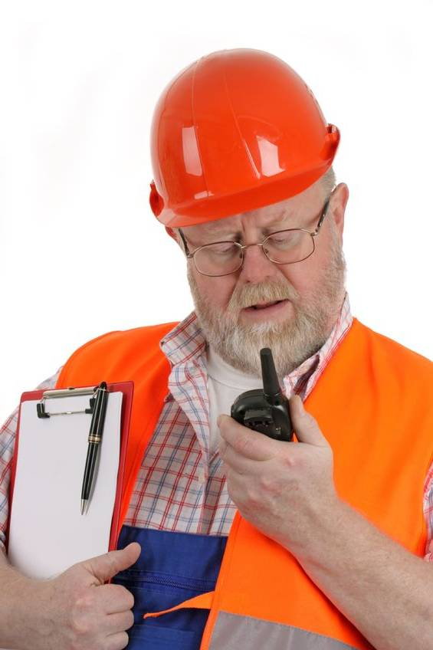
2.8.1 monitoring outcomes of reports
Informal monitoring of the progress of responding to an inadequacy can be done through:
Repeated reporting of the problem.
Daily checking for progress.
Requesting assistance from the OHS/WHS
representative in the workplace.
Discussing the problem with a supervisor or
manager and gaining support.

Slide 67

2.8.1 monitoring outcomes of reports
It is important to follow the processes, policies and procedures within your organisation to report and rectify any risk management issues. By using the correct processes and protocols, you ensure the problem is documented correctly and is actionable.

Slide 68

2.9 COMPLETE RISK MANAGEMENT RECORDS
Keeping records is important as they can help ensure that any risk management activities are traceable.
Records also provide a basis for improving methods and tools in the risk management process, as well as improving the overall risk management system for your site.

Slide 69

2.9 COMPLETE RISK MANAGEMENT RECORDS
Risk management records of incidents in the work area must be completed accurately and in a timely manner.
These documents will need to be completed for any situation, issue, incident or accident.

Slide 70

2.9 COMPLETE RISK MANAGEMENT RECORDS
Risk management records may include:
Audit and inspection reports.
Hazard registers.
Risk analysis records.
Minutes of meetings (risk management,
OHS/WHS, environmental etc).

Slide 71

2.9 COMPLETE RISK MANAGEMENT RECORDS
Induction, instruction, training and assessment.
Manufacturers and suppliers information.
Dangerous goods and hazardous substances registers.
Plant and equipment maintenance and testing reports.
Workers compensation and rehabilitation records.

Slide 72

2.9 COMPLETE RISK MANAGEMENT RECORDS
First aid and medical records.
Major incident and emergency response instruction.
Emergency contact lists.
Financial records.
Contract documents.

Slide 73

2.9 COMPLETE RISK MANAGEMENT RECORDS
Risk management records, reports and other documents will need to be kept within the organisational and/or site records management system. This could be computerised or a smaller paper-based system.
Regardless of how risk management records are stored and managed it is essential that the system is appropriate both for the level of risks and hazards you are dealing with and the needs of the business and the government.

Slide 74

2.9 COMPLETE RISK MANAGEMENT RECORDS
Literacy skills are important when dealing with risk management records.
Your language and literacy skills will enable you to read, understand and interpret risk management information as well as to research and review a range of other useful documents.

Slide 75

2.9 COMPLETE RISK MANAGEMENT RECORDS
Your skills will help you to analyse information and organise it into a logical sequence when you are completing your own reports or writing clear, easy-to-follow instructions, if necessary.
If you need assistance with literacy and numeracy, speak with your supervisor or site training officer.

Slide 76

2.10 USE WORKPLACE INFORMATION
Information about workplace hazards and risks is invaluable in applying, maintaining and improving the site risk management system.
Supervisors, managers and OHS/WHS staff will be able to use the information to ensure that risk management policies and procedures can be implemented and/or adapted effectively. It will also allow them to respond appropriately when incidents or situations arise.
Workplace records can also help to identify hazards and implement risk controls before the hazards become obvious.

Slide 77
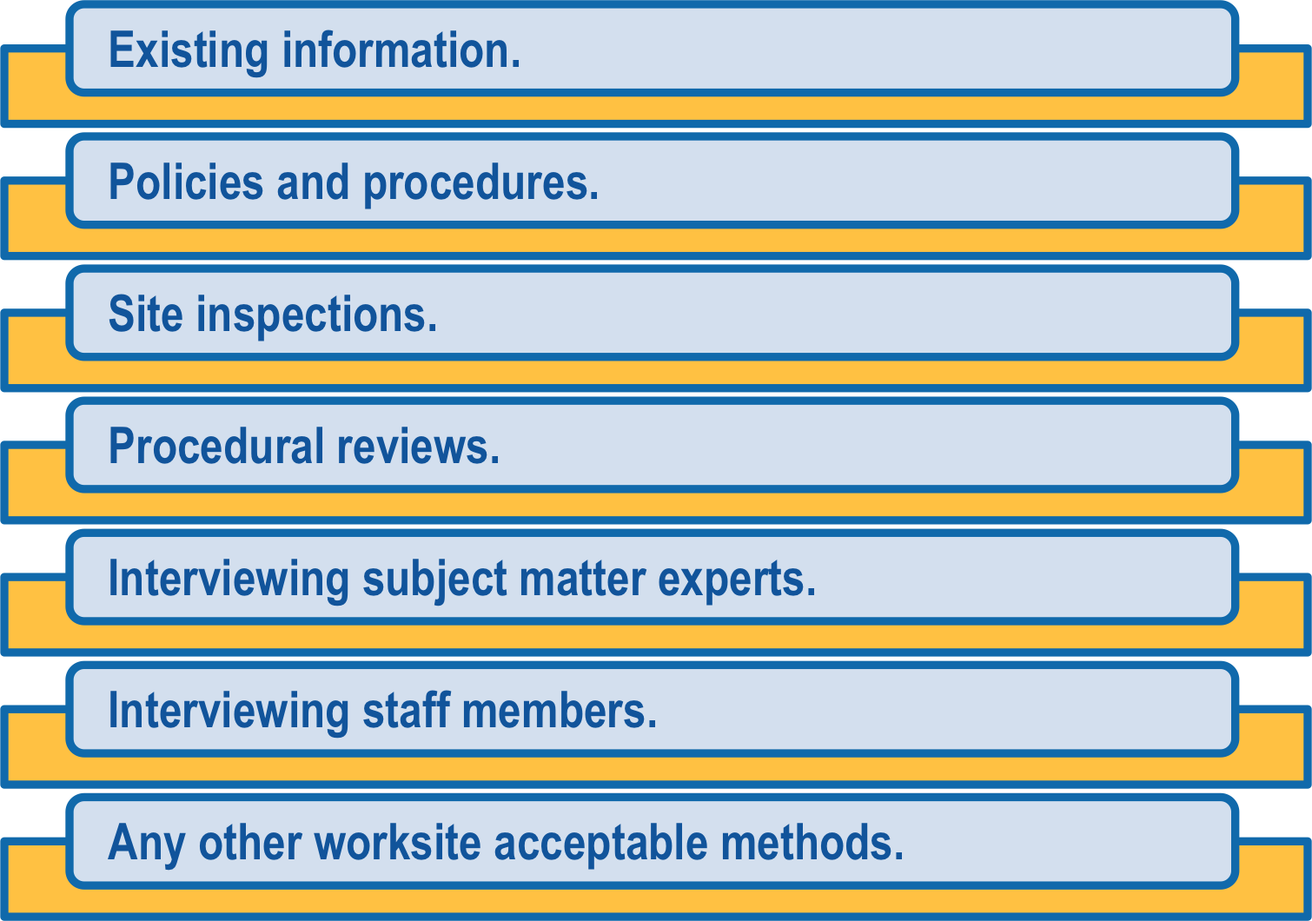
2.10 USE WORKPLACE INFORMATION
You will need to determine what information and data is needed to identify hazards and monitor the risk control procedures. This information and data could come from:

Slide 78
2.10.1 REVIEWING EXISTING INFORMATION
Reviewing your workplace practices by collecting information and conducting inspections is important and will allow you to identify valuable sources of further information. These sources of further information could include:
Information Type | Possible Information Sources
Performance Data | Incident reports. Environmental and health monitoring results. Compensation statistics which will show anecdotal information on health and safety programmes within the organisation. Rehabilitation data (this data can show the success of the return to work scheme operated by your organisation). Absenteeism statistics (this can be used to determine the level of unacceptable stresses within the workforce).

Slide 79
2.10.1 REVIEWING EXISTING INFORMATION
Information Type | Possible Information Sources
Performance Data (continued) | Workplace inspection statistics. OHS/WHS committee meeting data and information. Induction and training output data (this is the end of course and induction evaluations done by participants to show how relevant the information was). Lost time injury data. Classification of type of injuries / incidents e.g. Long term, Medium term, Short term, First Aid, disability, etc. Also, looking at the trends for particular types, frequency, etc.

Slide 80
2.10.1 REVIEWING EXISTING INFORMATION
Information Type | Possible Information Sources
Records And Reports | Inspection reports. Investigation reports. OHS/WHS committee meeting minutes. Risk assessments. Job safety analyses (JSA). Task Instruction Method Statement (TIMS), a standard way of doing low risk tasks. Medical records. Certificates, registrations and licences. Correspondence. This could include general letters, bulletins, memos or other written information on hazards and risks.

Slide 81
2.10.1 REVIEWING EXISTING INFORMATION
Information Type | Possible Information Sources
Hazard Control Information | Material safety data sheets. The information that comes from the manufacturer that details all relevant safety information. OHS/WHS manuals. Computer databases that contain information on risks and hazards. Hazard registers. Codes of practice that may outline minimum requirements. Previous risk assessments. Historical data. Trend over time graphs. Corrective and preventative actions.

Slide 82
2.10.1 REVIEWING EXISTING INFORMATION
Information Type | Possible Information Sources
OHS/WHS Requirements | Legal databases. Subscriptions services. Company policy manuals. Standard operating procedures. Reporting forms. Schedules of changes or updates. Government websites.

Slide 83

2.10.2 RECORDING INFORMATION AND ANALYSING DATA
The information you collect can be recorded in a spreadsheet and used to help analyse the current risk management status of your site.
It is necessary to ensure you record all information on the types of hazards found and the risks these hazards pose.
If you don’t enter these records into the recording system used within your workplace, you will not have an effective overview of what is occurring with the risks and hazards on site.

Slide 84

2.10.2 RECORDING INFORMATION AND ANALYSING DATA
Data analysis is the process of taking the raw information you have gathered and highlighting the sections that are useful to your purpose.
You can then interpret the information and use it to draw conclusions, make recommendations and support decision-making.

Slide 85

2.10.2 RECORDING INFORMATION AND ANALYSING DATA
Data that you may need to analyse could be contained in information gathered from:
Incident monitoring.
Environmental monitoring.
Evaluation of the effectiveness of risk
control measures.
Data and information that you have collected can then be used to develop risk management procedures and policies.
This will, in turn, allow you to manage the risk control process and ensure that all legislative, regulatory and organisational obligations are met.

