Slide 1
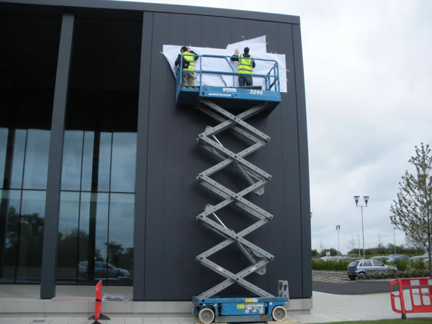
BSBWHS408 Practical Task
Contractor Services (Past & Present):
Signage Install
Site Security Systems
Site Cleaning
Traffic Control
Pest Control
WHS Arrangements
All contractors to fulfill their obligations as a Worker, as defined in the WHS Act 2011
All contractors must follow reasonable instructions from the PCBU to ensure general health and safety
All contractors must follow reasonable PCBU procedures and processes in the interests of general health and safety

Slide 2

Contractor WHS Workplace Policies, etc.
Contractors are to follow the same requirements for WHS as other subcontractors or ‘workers’ on site
For example, jump form signage install is specialist work but requires the contractor to submit SWMS, show VOCs and HRWLs as required (for EWPs etc.)
Contractors must follow PCBU procedures, such as Plant Induction, etc.
Best Practice Requirements
The current internal policies, procedures and processes do not clearly delineate subcontractors and contractors
To minimise ambiguity on the situation, these terms and definitions can be added

Slide 3
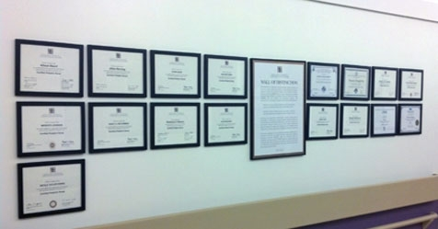
Improvements to Existing Contractor Management
The updated documents including the distinction between contractors and subcontractors should be uploaded to the internal network superseding previous revisions
The documents can then be distributed to the whole organisation with a note on the update now incorporating contractors, and printed out at the project level

