Slide 1

CHCECE022
Promote children's agency

Slide 2

Establish a learning environment that reflects children’s interests
1.1 Provide opportunities for children to plan and/or modify their indoor and outdoor environments
1.2 Design indoor and outdoor environments that are vibrant, flexible and support children’s learning

Slide 3
Establish a learning environment that reflects children’s interests
1.3 Ensure design of indoor and outdoor environments is responsive to the interests and abilities of each child

Slide 4
Standard 3.1 | The design of the facilities is appropriate for the operation of a service.
Element 3.1.1 | Fit for purpose | Outdoor and indoor spaces, buildings, fixtures and fittings are suitable for their purpose, including supporting the access of every child.
Element 3.1.2 | Upkeep | Premises, furniture and equipment are safe, clean and well maintained.

Slide 5
Standard 3.2 | The service environment is inclusive, promotes competence and supports exploration and play-based learning.
Element 3.2.1 | Inclusive environment | Outdoor and indoor spaces are organised and adapted to support every child's participation and to engage every child in quality experiences in both built and natural environments.
Element 3.2.2 | Resources support play-based learning | Outdoor and indoor spaces are organised and adapted to support every child's participation and to engage every child in quality experiences in both built and natural environments.
Element 3.2.3 | Environmentally responsible | The service cares for the environment and supports children to become environmentally responsible.

Slide 6

National Law and Regulations
The National Law and Regulations determine that all approved services provide an educational program that:
Is based on the developmental needs, interests and experiences of each child
Takes into account the
individuality of each child.

Slide 7

Learning outcomes
Learning frameworks include:
Children have a strong sense of identity
Children are connected with and contribute to his or her world
Children have a strong sense of wellbeing
Children are confident and
involved learners
Children are effective
communicators.

Slide 8

Indoor environments
These may include:
Classroom
Music room/recording suite
Theatre/dance studio
Gymnasium/sports centres and facilities
Kitchen
ICT suite / Technology work shop
Scientific laboratory
Museums
Libraries.

Slide 9

Outdoor environments
These may include:
Playground
Parks and woodland areas
Beach/sandpit
Swimming pool
Local community
Multi-sensory gardens
Mazes
Excursions
Field trips.

Slide 10

Natural elements
Natural elements include:
Vegetable/flower/plant/tree gardens
Sand pits and dirt for digging
Cultural areas within the local community
Water courses
Plants and trees with edible features
Trees to provide shade
Compost areas
Water play areas.

Slide 11

Vibrant and flexible indoor environments
These may include:
Distinct physical spaces
A variety of activities
Sensory detail
Physical challenge
Flexible and manipulable
objects and accessories.

Slide 12
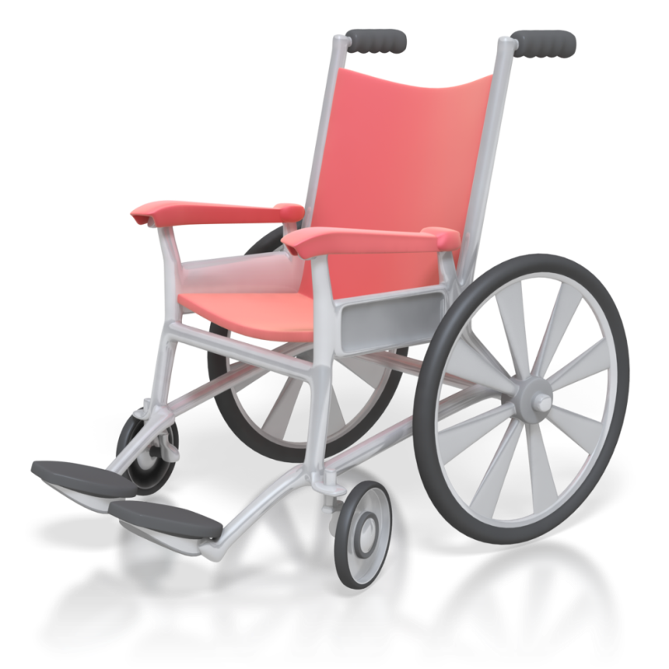
Abilities of each child
These may be affected by:
Hearing impairment
Visual impairment
Physical disability that restricts movement
Allergies
Medical conditions
Learning difficulties.

Slide 13

Interests
Interests might include:
Expressive arts
Sport and physical games
Role-play
Cooking
Construction
Wildlife and nature
Messy play
Memory games
Humanities
Reading.

Slide 14

Activity 1A

Slide 15
Establish a learning environment that reflects children’s interests
1.4 Provide materials and resources that are natural and familiar
1.5 Give children access to materials and resources that provoke interest

Slide 16

Open-ended, natural and found materials
These may include:
Old clothing and other materials
Empty and discarded packaging
Waste paper
Kitchen wares
Adhesives and connecting materials
Natural materials
Dried food substances
Found materials
Paints, crayons, clay, plasticine, pencils etc.

Slide 17

Benefits of using open-ended materials
Benefits include:
Sense of well-being and competence
Understanding is enhanced by direct experience
Creative group work supports team work and learning from peers
Children learn literacy, numeracy
and science whilst experimenting
with materials
Children learn to make their
own connections
Inspiration and satisfaction for educators.

Slide 18

Materials and resources that provoke interest
These may include:
Computers and new technologies
Scientific equipment
Foods from different countries
Historical objects and materials
Visitors
Measuring equipment
Different types of clothing and
uniforms particularly relating to
roles of authority
Musical instruments.

Slide 19
Activity 1B

Slide 20

Ownership and responsibility
Ways of supporting children may include:
Start young
Let them help you
Demonstrate
Model responsibility
Praise them
Don’t criticise
Avoid rewards
Provide a structure and routine
Use consistent consequences.

Slide 21
Provide opportunities that stimulate learning and development
2.1 Allow children to direct their own play and leisure experiences with peers
2.2 Create possibilities for peer scaffolding

Slide 22
Provide opportunities that stimulate learning and development
2.4 Create opportunities for learning through play and intentional teaching
2.5 Support play experiences initiated by children

Slide 23

Children directing their own play
Consider the following:
Allowing children to direct their own play means that their motivation is intrinsic
The selection process requires independent thought and consideration
The motivation to complete the activity comes from within
The reward is personal satisfaction
Motivation is much higher in children when it is intrinsic
Concentration levels last longer.

Slide 24

Choosing their own play mates
Consider the following:
Play should be unstructured, fun, relaxing, and undertaken with those with whom children feel comfortable
Children are more likely to take risks by trying new activities and pushing themselves further if they have the support of their friends
Communication skills and
social interactions are also
more likely to be developed
with friends.

Slide 25

Observations from play
These may include:
Play preferences
Social skills/personality
Physical ability
Motivation/perseverance
Behaviour and attitude to learning
Tolerance levels of other children
Additional needs
Strengths and interests
Learning styles.

Slide 26
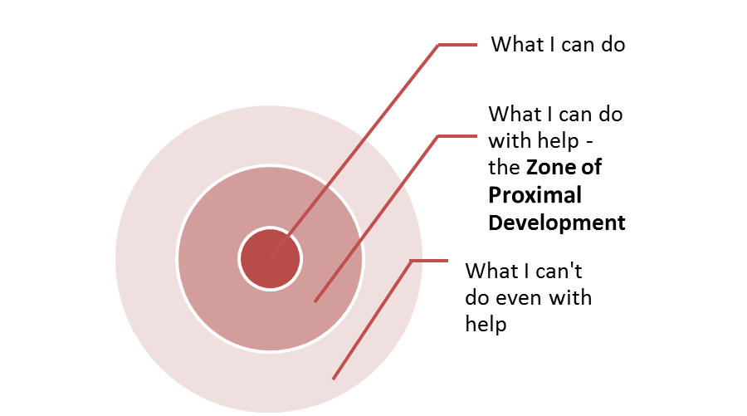
Zone of Proximal Development

Slide 27

Intentional teaching
Strategies include:
Modelling and demonstrating
Open questioning
Speculating
Explaining
Using shared thinking
Problem solving.

Slide 28
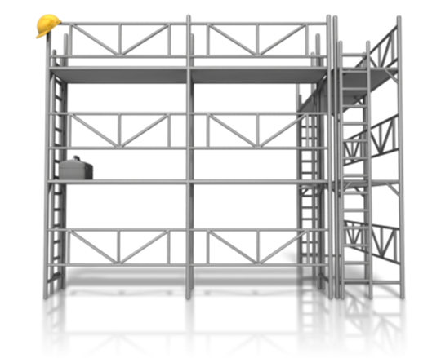
Peer scaffolding
Steps may involve:
Model a demonstration and give an explanation
Let the other child have a go on their own
Acknowledge successes and point out mistakes, showing the child again how to do it
Naturally remove the support
as the other child starts to
master the activity
Participate in and enjoy the
activity together as they are
now both proficient.

Slide 29
Activity 2A

Slide 30
Provide opportunities that stimulate learning and development
2.3 Encourage children to gain skill and competence by persevering with a developmentally significant activity

Slide 31

Developmentally significant activities
These include:
Physical development
Social and emotional development
Intellectual development
Language development
Moral development.

Slide 32

Stages of development
Stages include:
Birth
3 months
6 months
9 months
1 year
15 months
18 months
2-6 years
6-12 years.

Slide 33
Activity 2B

Slide 34
Provide opportunities that stimulate learning and development
2.6 Organise routines in ways that maximise opportunities for each child’s learning

Slide 35

National Quality Framework
Factors that set out how educational programs should be delivered include:
The current knowledge, ideas, culture, abilities and interests are the foundation of the curriculum
Routines are embedded into the curriculum to organise children’s learning
The curriculum is inclusive of all children
The curriculum encourages individual thought, creativity and decision making
Children’s work is assessed regularly.

Slide 36

Routines
Routines can promote and reinforce the learning and understanding of:
Attendance and punctuality
Organisational skills
Appropriate behaviour
Health and safety
Assessment, feedback, and
critical reflection
Dinner time ‘show and tell’
Language.

Slide 37
Activity 2C

Slide 38
Design, implement and evaluate learning experiences for children
3.1 Use children’s observations and their views to guide the program

Slide 39
Standard 1.1 | The educational program enhances each child’s learning and development.
Element 1.1.1 | Approved learning framework | Curriculum decision-making contributes to each child’s learning and development outcomes in relation to their identity, connection with community, wellbeing, confidence as learners and effectiveness as communicators.
Element 1.1.2 | Child-centred | Each child’s current knowledge, strengths, ideas, culture, abilities and interests are the foundation of the program.
Element 1.1.3 | Program learning opportunities | All aspects of the program, including routines, are organised in ways that maximise opportunities for each child’s learning.

Slide 40
Standard 1.2 | Educators facilitate and extend each child’s learning and development.
Element 1.2.1 | Intentional teaching [Newly delineated concept] | Educators are deliberate, purposeful, and thoughtful in their decisions and actions.
Element 1.2.2 | Responsive teaching and scaffolding | Educators respond to children’s ideas and play and extend children’s learning through open-ended questions, interactions and feedback.
Element 1.2.3 | Child directed learning | Each child's agency is promoted, enabling them to make choices and decisions that influence events and their world.

Slide 41
Standard 1.3 | Educators facilitate and extend each child’s learning and development.
Element 1.3.1 | Assessment and planning cycle | Each child’s learning and development is assessed or evaluated as part of an ongoing cycle of observation, analysing learning, documentation, planning, implementation and reflection.
Element 1.3.2 | Critical reflection | Critical reflection on children’s learning and development, both as individuals and in groups, drives program planning and implementation.
Element 1.3.3 | Information for families | Families are informed about the program and their child's progress.

Slide 42

Children’s views and observations
Views could be gained on:
Specific interests and preferred activities
Time of day
Location in which the activity takes place
Educator taking the activity
Other children in the group
Duration of the activity
Assessment methods
Content and
delivery/teaching styles.

Slide 43
Activity 3A

Slide 44
Design, implement and evaluate learning experiences for children
3.2 Develop the curriculum in consultation with educators and stakeholders

Slide 45
Standard 7.1 | Effective leadership promotes a positive organisational culture and builds a professional learning community.
Element 7.1.1 | Service philosophy and purpose | A statement of philosophy guides all aspects of the service’s operations.
Element 7.1.2 | Management systems | Systems are in place to manage risk and enable the effective management and operation of a quality service.
Element 7.1.3 | Roles and responsibilities | Every effort is made to promote continuity of educators and coordinators at the service.

Slide 46
Standard 7.2 | There is a commitment to continuous improvement.
Element 7.2.1 | Continuous improvement | There is an effective self-assessment and quality improvement process in place.
Element 7.2.2 | Educational leadership | The educational leader is supported and leads the development and implementation of the educational program and assessment and planning cycle.
Element 7.2.3 | Development of professionals | Educators, co-ordinators and staff members’ performance is regularly evaluated and individual plans are in place to support learning and development.

Slide 47

Learning outcomes
Learning frameworks include:
Children have a strong sense of identity
Children are connected with and contribute to his or her world
Children have a strong sense of wellbeing
Children are confident and
involved learners
Children are effective
communicators.

Slide 48

Considerations
You should consider:
Statement of philosophy and code of ethics
Needs and capabilities of the educators
Available and realistic resources
Budget
Abilities and interests of children
Input from children
regarding the curriculum
Relevant cultural requirements.

Slide 49
Activity 3B

Slide 50
Design, implement and evaluate learning experiences for children
3.3 Design and implement learning experiences to foster learning and development, and to reflect children’s interests
3.4 Ensure the program is sufficiently flexible to respond to unplanned children’s interests

Slide 51
Design, implement and evaluate learning experiences for children
3.6 Ensure the program provides opportunities to follow-up activities of high interest

Slide 52

Areas to be covered
Activities within the program must cover the following areas:
Personal, social, and emotional development
Communications, language, and literacy
Problem solving, reasoning, and numeracy
Knowledge and understanding of the world
Physical development
Creative development.

Slide 53

Example learning experiences
Learning experiences may include:
Choosing an item of interest from the outdoor learning environment
Group discussion on items of interest
Recreate item of interest
Construct a model of a
given item of interest
Critical reflection and peer assessment.

Slide 54
Activity 3C

Slide 55
Design, implement and evaluate learning experiences for children
3.5 Assess and evaluate planned and unplanned teaching and learning

Slide 56

Inclusive assessment practices
The following should be designed to align with the intended learning outcomes and objectives:
Variety of different forms of assessment
Timing
Preparation for assessment
Reasonable adjustments
Appropriate assessment
Marking.

Slide 57

Assessment of teaching – reflective practice
Self assessment could involve:
Educator diary
Peer observations
Recording lessons/activities
Feedback from children.

Slide 58

Improve own practices
Ask yourself the following questions:
What am I doing?
Why am I doing it that way?
How effective is it?
How do the children respond?
What could I do better?
How can I do it better?

Slide 59
Activity 3D

Slide 60
Support children to participate
4.1 Consult with children about the experiences and materials to be made available
4.2 Acknowledge each child’s uniqueness in positive ways
4.3 Support children’s efforts, assisting and encouraging as appropriate

Slide 61

United Nations Convention on the Rights of the Child
The following articles are basic rights of the child:
Article 2: Non-discrimination
Article 3: Best interests of the child
Article 28: Education
Article 29: Aims of education
Article 30: Minority groups
Article 31: Recreation.

Slide 62

Acknowledge uniqueness of children in positive ways
Inclusive practices may include:
Differentiation and appropriate scaffolding for each child
Keeping up-to-date in your knowledge of cultural groups
Close liaison with parents/carers
Activities that promote and embrace equal opportunities
Holding individual conversations
with each child
Acknowledging effort and achievement.

Slide 63

Support children’s efforts
Ways in which you can support children’s efforts include:
Praise
Encouragement
Timely marking and feedback
Rewards.

Slide 64
Activity 4A

Slide 65
Support children to participate
4.4 Develop awareness and respond to children who may require additional support or attention

Slide 66

Additional needs
These may include:
Specific learning difficulty/difficulties
Physical impairment/disability
Medical condition
Mental health/emotional issues
Behavioural issues
Extenuating domestic
circumstances
Cultural/language barriers.

Slide 67

Causes and origins of additional need
These may include:
Domestic circumstances
Barriers to learning
Personal and social needs
Physical environment
Curriculum shortcomings.

Slide 68

Additional support
Additional support and attention might include:
Generic support strategies
Learning mentor/classroom assistant
Peer mentor
Time-out card
Praise book/report card
Specialist equipment
Reduced time-table
Work in smaller group settings
Referral to external agencies or bodies.

Slide 69
Activity 4B

Slide 70
Support children to participate
4.5 Encourage each child to participate in a variety of experiences
4.6 Demonstrate respect for a child’s choice not to participate

Slide 71

Children’s input
Children can be involved in the following processes:
Designing and planning in their indoor and outdoor learning environments
Allowing children to direct their own play and leisure experiences with peers
Using children’s observations and their views to guide the program
Responding to unplanned children’s interests.

Slide 72

Reluctance to participate
Long-term reasons for reluctance might include:
Shyness
Language difficulties
Physical disabilities
Medical conditions such as asthma
Religious observances
Poor ability and low self-confidence
Emotional issues
Self-awareness of unique physical appearance
Dislike of the activity.

Slide 73

Reluctance to participate
Short-term reasons for reluctance might include:
Domestic issues
Breakdown in friendship group
Medical condition, such as broken bones
Illness
Tiredness
Negative emotional state.

Slide 74
Activity 4C

Slide 75
Summative Assessments
Summative assessments consist of:
Skills Activity
Knowledge Activity
Performance Activity.
Your assessor will provide you with further guidance on how and where to complete these assessments.

Slide 76

Summary and Feedback
Did we meet our objectives?
How did you find this session?
Any questions?

