Slide 1
Safety management system
CONSULTATION GUIDE

Slide 2
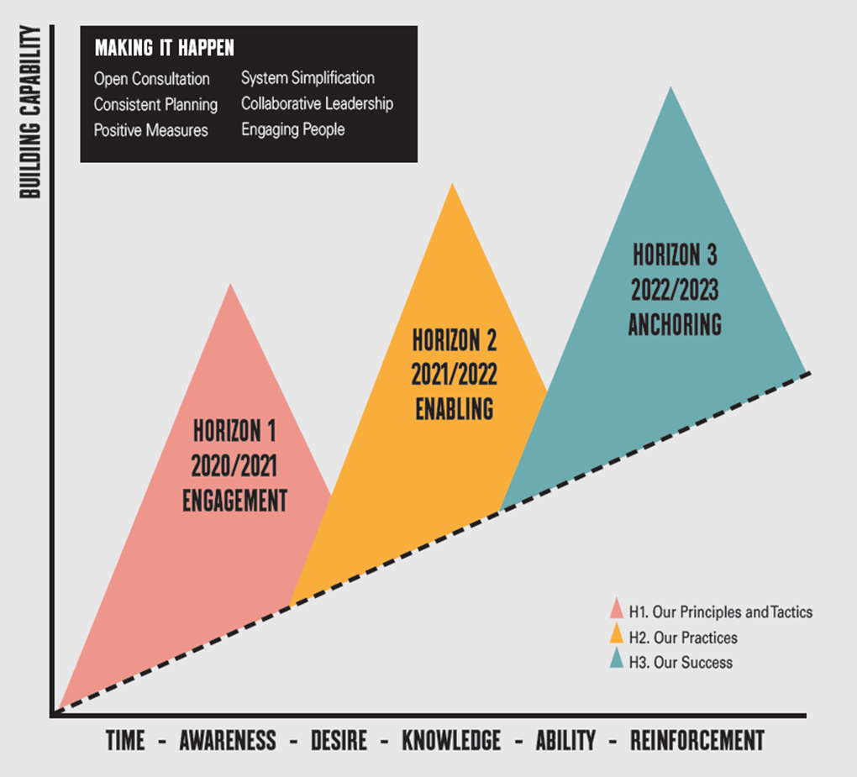
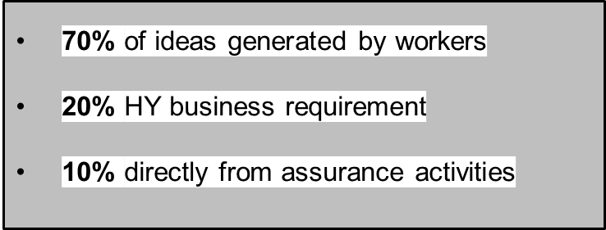
Work differently
In 2020, we embarked on our 3 year HSEQ Roadmap to Greater Success.
Based on a Start, Stop, Continue exercise capturing feedback from a cross section of workers across our projects.
The roadmap is all about empowering our people to work differently.
It’s about creating an environment that encourages and rewards innovative thinking, combined with safe practices and risk-prevention initiatives.
$500K
$500K
Notes:
At the beginning of the 3 year Journey, our workers participated in the Start Stop Continue exercise which captured feedback from our workers all across the country. We asked what we should Start, stop, and continue to do as a business and the feedback was that we need to Start Simplifying our HSEQ System which is where our focus is for this session.
As Kurt mentioned yesterday, the system wasn’t broken in any way, but there has been a desire amongst our people to make the system work for our people and support work as done.

Slide 3
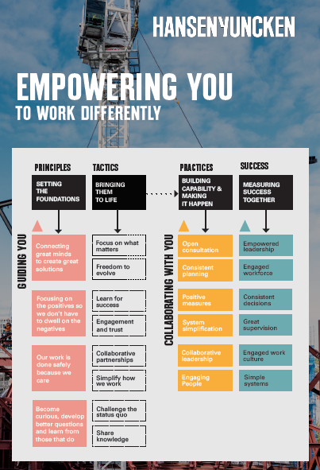
Work differently
FLIPPING TRADITIONAL THINKING ON ITS HEAD
As such, a large part of the roadmap success is dependent on the involvement of our workers. We can’t do this without you!
Consultation, communication and change management is a key component and feature at all stages and implementation of the roadmap.
In doing so, we ensure that:
Everyone is part of the conversation
Knowledge and experience is shared
Our decisions and actions are right for HY
Notes:
Consultation, communication and change management is a key component of all stages of the roadmap.
None of this would be possible without you. The expertise and experience of our people is the most valuable resource we have to ensure the consultation process is successful. We will ensure that everyone is part of the conversation, our knowledge and experience is shared, and that our decisions are right for our work.

Slide 4




Work differently
CONSULTATION STAGE 1 – PRINCIPLES (COMPLETED)
Stage 1 – Principles
Workers spoke, HY listened and our workers created our Principles of Work Differently including their definitions.
These four Principles guide everything that we do in the HSEQ Roadmap to Greater Success.
Notes:
During the Roadmap to Greater Success, Stage 1 of consultation was actually our Work Differently principles. As Kurt touched on yesterday, these are the words of our people that reflect our values. These are the foundations of our work, and the foundations of the new safety management system.

Slide 5
Work differently
CONSULTATION STAGE 2 – ENABLING CURIOSITY (COMPLETED)
Our Worker Tools:
Worker Insights
Worker Success
Worker Learning Team
Worker Have a Go
HSEQ Dashboards:
Established operational requirements
Dashboard User Acceptance Testing
HY WorkZone:
Internet page wireframe complete
Concurrent development with system consultation
WORK DIFFERENTLY
Enables curiosity about Work As Done
OUR WORKER TOOLS
HOW TO GET INVOLVED
STAYING INFORMED
WORK AS DONE
RISK MANAGEMENT
HYER STANDARDS
SUPPORTING MATERIAL
PROCEDURES
Notes:
Stage 2 of consultation was the tools we have that enable curiosity – These make up the “top half” of the diamond structure. So the consultation around the selection of our worker tools (the hello fresh cards), the introduction of the Power BI dashboards, and the development of HY Workzone – our publicly facing HSEQ management system – all things that allow us to get involved and stay informed.

Slide 6
Work differently
CONSULTATION STAGE 3 – SYSTEM SUPPORTS (CURRENT)
WORK DIFFERENTLY
OUR WORKER TOOLS
HOW TO GET INVOLVED
STAYING INFORMED
WORK AS DONE
Supporting Work as Done is the HY safety management system
The system has been simplified and restructured in order to better:
Support decision making based on risk
Meet the needs of all stakeholders
Enable learning and curiosity
This is the next stage for consultation (Stage 3)
RISK MANAGEMENT
System that supports Work As Done
HYER STANDARDS
SUPPORTING MATERIAL
PROCEDURES
Simplifying our HSEQ system of work was the No 1. voted item from the Start, Stop, Continue across the business
Notes:
Stage 3 is what we’re up to now – this is the “bottom half” of the diamond – the system that supports work as done.
Over

Slide 7
Stage 3
CONSULTATION Process

Slide 8
CONSULTATION PROCESS
CONSULTATION RIGHTS, RESPONSIBILITIES, DUTIES
In developing the new HSEQ Risk Management Procedure, HY has dual duties as a PCBU, and as workers.
Duties and Responsibilities as a PCBU:
Ensure relevant information and guidance is provided to facilitate the process
Provide reasonable opportunities and for people to express their views
Take these views into account when making decisions
Relay outcomes to those who are affected by the decisions
Workers rights regarding consultation:
You have the right to involve HSRs/committees in this review
You may request more information if desired
You may request alternative avenues to access information or provide feedback if desired
This cohort is encouraged to consult with anyone the individual feels is necessary to be involved or would provide valuable insight, including external parties. Please make comments on the document on their behalf.

Slide 9





CONSULTATION PROCESS
BASIS OF THE SYSTEM
The system has been drafted to ensure the procedures:
Follow a consistent structure
Are written to current legislation, OFSC criteria, and are aligned with our ISO accreditations. Independent expert legal review & report upon completion.
Take a national approach with content, inclusive of applicable state legislative requirements where appropriate
Can be provided to external stakeholders such as clients and auditors
Include detail that would be used by a small number of users of the safety management system

Slide 10
CONSULTATION PROCESS
SYSTEM CONTENT TEST CRITERIA
Aim – to enable flexibility within the system to support our work on all scales
Default - our system has been developed on the basis of national consistency to support our workers, client experience, OHS/WHS due diligence and the organisation’s growth.
    Exception - our system will have differences by state or projects by answering YES to one of SYSTEM CONTENT TEST CRITERA
SYSTEM CONTENT TEST CRITERA:
Is this a legislative requirement?
Is this a Client contractual requirement?
Is this a commonly accepted industry practice?
Wherever possible, if you can locate source information, please link it or refer to the source in your comment. (i.e. Section and clause numbers).

Slide 11
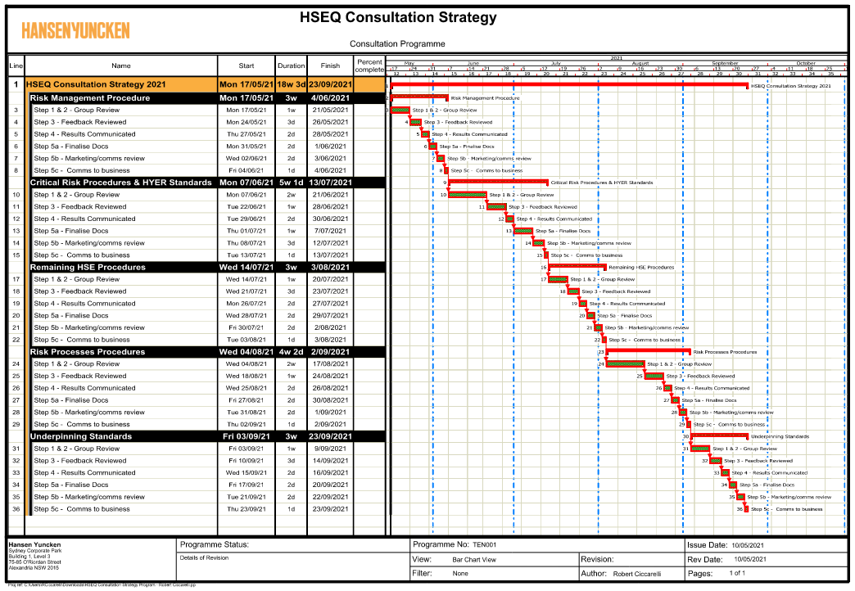
System consultation
CONSULTATION PROGRAM
Approximately 22 week program from commencement
If allocated time for feedback is not sufficient we will extend time on a case by case basis. Please be mindful that it will extend the overall project timeframe allocated
To participate in the consultation process you must achieve awareness of this presentation and the HY Work Differently & System Support presentation. These presentations will provide an understanding of the system structure, purpose and operational practice including what is being asked of you in participating in the consultation
You will have to make time outside your normal operational activities and consultation forums to progress this project. Please discuss these requirements with your line manager before committing to a particular round in the consultation process.
You are encouraged to include others in the consultation process. You will have to act on their behalf as the nominated consultation member. Please be mindful of the points above.

Slide 12




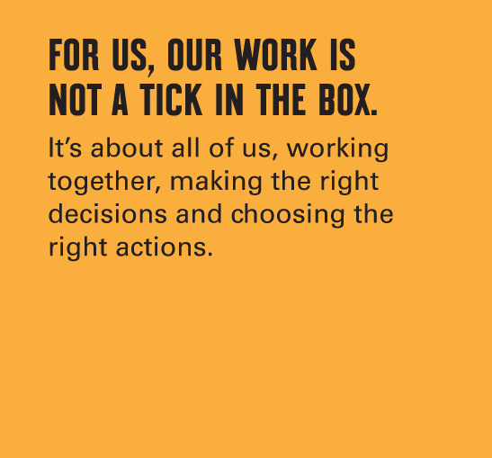
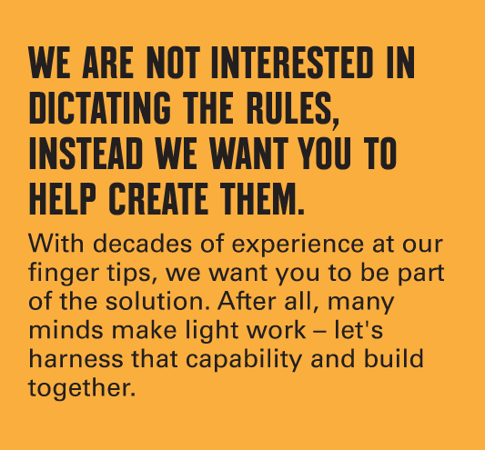
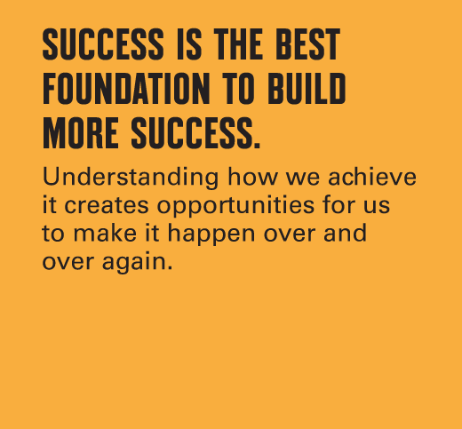

CONSULTATION PROCESS
When reviewing the system, keep the principles in mind, refer back to them, and ask curious questions
REFLECT & APPLY THE PRINCIPLES DURING CONSULTATION
Is this box ticking
Does it help someone to make a decision
Is this dictating rules
Does it help people to create solutions
Does this help to set people up for success
Does it help to understand success
Does it help foster curiosity and learning
Does it help people to share knowledge

Slide 13
CONSULTATION PROCESS
REVIEW AND CONSULTATION PROCESS FLOW
Reviewers will be invited to National HSEQ Consultation in Teams. Reviewers will receive an Email when there are new documents to review
Drafted documents locked for editing and will contain:
- Overview & review end date
- Procedure
- Related documents
These documents are best viewed in Word
Make comments using the Review tab, and feel free to reply to others
Apply the “System Content Test Criteria” and “Principles” when reviewing and add sources/links wherever possible so info can be verified
Comments will be collated, tabled and presented to the COs/BFW Chairs in the first instance to determine next steps. Comms plan to be discussed.
Docs will be progressed on a case by case basis depending on the nature of comments - some topics may require further SMEs input
A feedback summary will be provided in MS Teams to those involved in the consultation.
Where appropriate, subsequent meetings will be set up with the review group & SMEs to discuss topics/changes
STEP 1 INVITATION TO CONSULT
STEP 2 PROVIDE FEEDBACK
STEP 3 FEEDBACK REVIEWED
STEP 4 RESULTS COMMUNICATED
See Next Page for Post-Review Process

Slide 14
CONSULTATION PROCESS
POST-CONSULTATION PROCESS
Content Owners/BFW Chair will approve the content for finalisation. Documents will be finalised and formatted.
“Final docs” will be provided to comms/marketing team to approve look & feel & images prior to “going live”
Communications to wider business advising next steps. Includes guidance material, support, and feedback avenues.
New documents to go live (website, or SP in interim)
Scheduled 6 month system updates will take place, as required (not adhoc.)
Feedback will be collected from around the business. Implementation & adjustment period will be monitored for effectiveness
STEP 5 DOCUMENTS FINALISED
STEP 6 SOFT LAUNCH

Slide 15
CONSULTATION PROCESS
INTERACTION WITH THE DOCUMENTS
(STEP 3 – FEEDBACK REVIEWED)
STEP 2 PROVIDE FEEDBACK
STEP 4 RESULTS COMMUNICATED
Reviewers to receive:
- Introductory Quick Guide/Overview
- Procedure
- Associated Docs (HYer Sts)
Reviewers to receive:
- Collated feedback/comments
Users to receive:
- Summary of key points of difference for each document (live document will be available on the homepage)
Users to receive:
- The final document (published)
Key Points of Difference Doc:
Will be live, updated after each document is finalised
Will be hosted on the homepage
Will be downloadable and shareable
Will correspond with the Consultation Program
STEP 6 SOFT LAUNCH
STEP 5 DOCUMENTS FINALISED

Slide 16
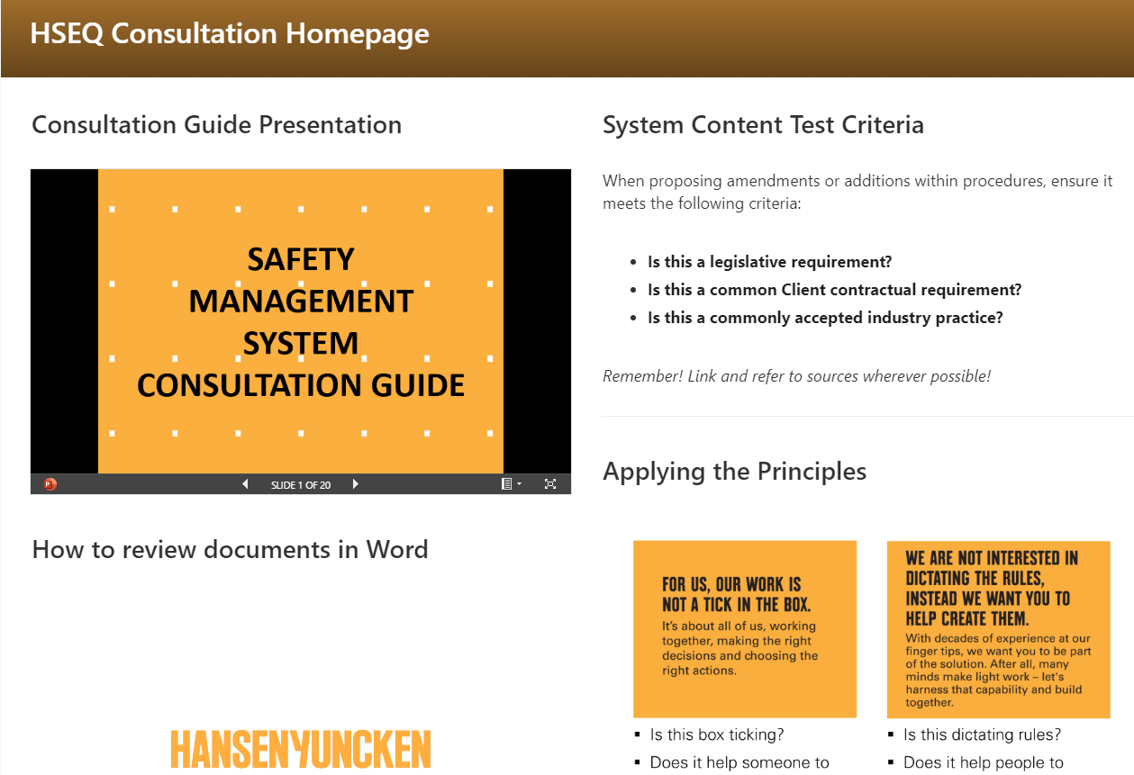
CONSULTATION PROCESS
CONSULTATION HOMEPAGE

Slide 17
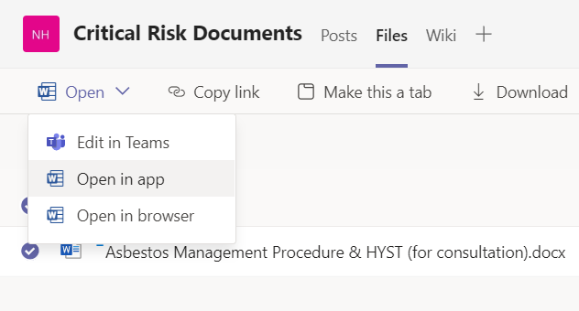
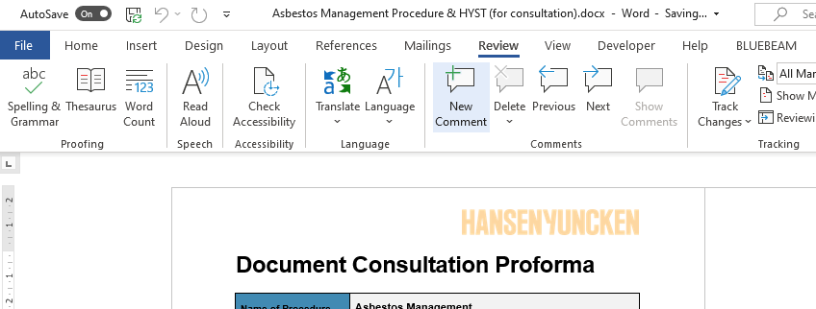
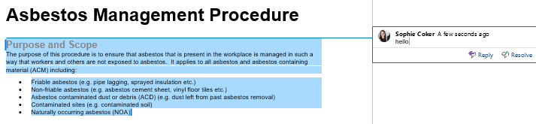
CONSULTATION PROCESS
REVIEWING THE DOCUMENTS IN WORD
1
To open the Document from Teams:
Select the document
Click “Open”
Select “Open in app”
2
To make a new comment:
Click on the “Review” tab
Highlight the document text you want to comment on
Click on the “New Comment” button.
3
Your comment box will pop up. Type your comment and click away from the box to save it.
You can also reply to others’ comments by clicking “reply” at the bottom of other comments.

Slide 18
System consultation rounds

Slide 19

System consultation
SAFETY MANAGEMENT SYSTEM
Consultation on the Safety Management System will be in rounds as follows:
Round 1 – HSEQ Risk Management Procedure
Round 2 – HYer Standards and Critical Risk Procedures (e.g. Demolition, Excavation, Working at Heights etc.)
Round 3 – Remaining Risk Procedures (e.g. Hazardous Chemicals, Fitness for Work etc.)
Round 4 – Procedures covering processes (e.g. Incident Management, Emergency Management Procedure etc.)
Round 5 – Underpinning Standards & Support Documents (i.e. Management Plans, Permits)

Slide 20
System consultation
(ROUND 1) HSEQ RISK MANAGEMENT PROCEDURE
The purpose of a company-wide Risk Management framework is to support Work as Done. It supports decision making based on the level of risk by providing:
Simple and consistent methodology for the identification, assessment and escalation of risks and assessing effectiveness of controls
Descriptions of potential consequences that cover a range of impacts (i.e. health & safety, environment, quality, client, compliance, financial, our reputation, and operations)
A 5 x 5 risk matrix that can be used across the entire lifecycle of a project
A clear escalation process for risks that are assessed as being high or extreme, providing greater transparency on actual and potential risks
Common language for Risk Management for HSEQ
The Risk Management framework should be viewed as a company-wide process, not just for use during the construction phase of a project (i.e. more broad than the Project Risk Assessment process)

Slide 21
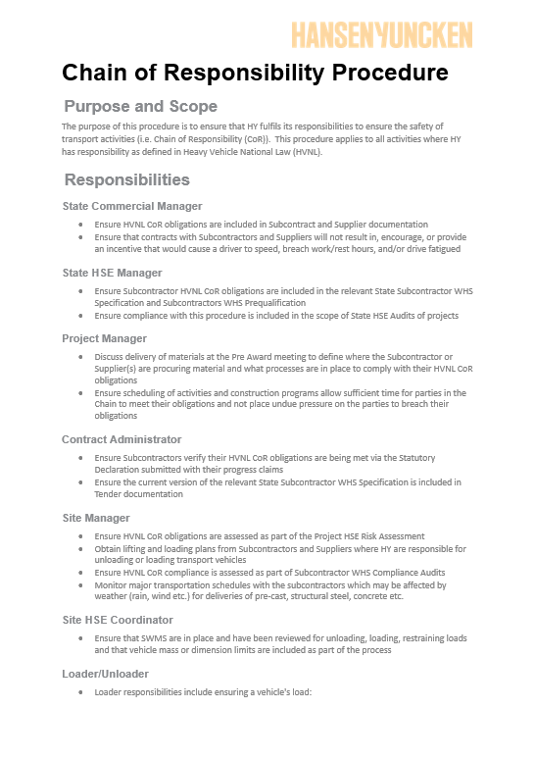
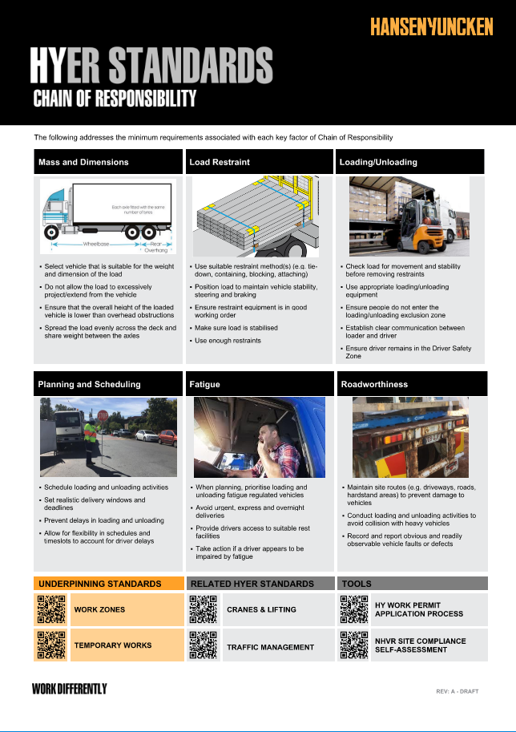
System consultation
(ROUND 2) HYER STANDARDS & CRITICAL RISK PROCEDURES
The purpose of HYer Standards is to document the controls required to manage critical risks at site. They are written primarily for people that do, plan, review and supervise high risk construction work. There are 14 HYer Standards.
Each critical risk is also covered by a procedure. Procedures describe all the aspects related to the critical risk. They are written primarily for the small number of users who are interested in how HY manages the critical in its entirety (e.g. clients, auditors, specialists etc.).
The critical risk procedures are national documents that are predominantly based on legislative requirements (including state specific requirements).

Slide 22
System consultation
(ROUND 2 CONT.) HYER STANDARDS & CRITICAL RISK PROCEDURES
RISK PROCEDURES | What it is: Procedures for managing risk-related activities. How to use it: Risk procedures can be used as planning tools as they provide in-depth and more technical info.
HYER STANDARDS | What it is: Documents that reflect the risk procedures. They outline the key requirements for managing risk on site. How to use it: These will be the go-to documents for site based workers (including subcontractors) as these contain critical first-stop information required for planning risk-related activities.
RISK PROCEDURE NAME: | HYER STANDARD NAME:
Asbestos Management | Asbestos Management (HYST)
Demolition | Demolition (HYST)
Confined Spaces | Confined Spaces (HYST)
Excavation | Excavation (HYST)
Underground and Overhead Services | Underground and Overhead Services (HYST)
Electrical Supply and Equipment | Electrical Supply and Equipment (HYST)
Mobile Plant | Mobile Plant (HYST)
Chain of Responsibility | Chain of Responsibility (HYST)
Traffic Management | Traffic Management (HYST)
Cranes and Lifting | Cranes and Lifting (HYST)
Precast and Tilt Up | Precast and Tilt Up (HYST)
Temporary Works | Temporary Works (HYST)
Work at Height | Work at Height (HYST)
Work on or Near Water | Work on or Near Water (HYST)
Critical risk procedure key principles:
Align the system to legislative and external requirements (OFSC, ISO 45001)
Take a national approach, though include state specific legislative requirements where appropriate

Slide 23
System consultation
(ROUND 3) REMAINING RISK PROCEDURES & (ROUND 4) PROCEDURES COVERING PROCESSES
The remainder of the procedures will be reviewed in Round 3 & 4.
Round 3 will cover the remaining of the risk procedures. These are, at a minimum:
Fitness for Work and Health
Hazardous Chemicals
Hazardous Manual Tasks
Health Surveillance and Workplace Monitoring
Isolation
Plant and Equipment
Work Permits
Round 4 will cover the procedures that describe processes. These are, at a minimum:
Change Management
Communication and Consultation
Emergency Management
HSE Inspections and Audits
Incident Management
Onboarding, Induction and Training
Subcontractor HSE Management

Slide 24
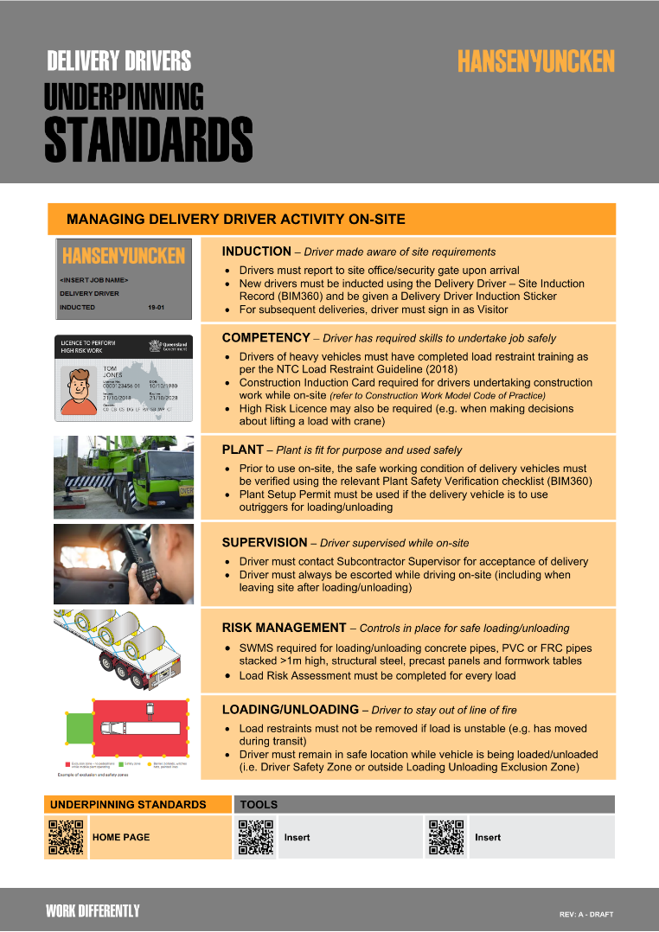
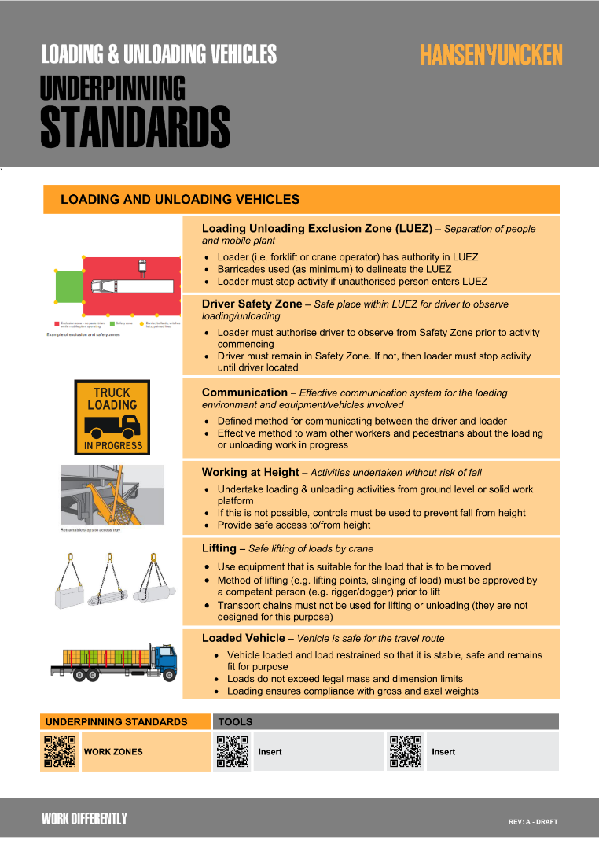
System consultation
ROUND 5 – UNDERPINNING STANDARDS & SUPPORT DOCUMENTS
Underpinning Standards are used to document guidance material. They are designed to be simple quick guides that:
Provide information that is supplementary to procedures (e.g. scaffolding)
Can be used to document information that doesn’t require a procedure (e.g. PPE)
Draw together a number of critical risks (e.g. piling)
Can be used to provide guidance to workers who are not experts on a topic (e.g. how to conduct an incident investigation)
Underpinning Standards can be used outside of the scope of Safety
Supporting project documentation such as Management Plans and Permits will be drafted at this stage to align with the finalised procedures.

Slide 25



System consultation
FEEDBACK – WE ARE LISTENING & ACT ON WHAT YOU HAVE TO SAY
During the consultation period, there will be a post on the Channel where you can comment and ask any general questions for all to see!
Please refer to the Homepage at any time where you will find contacts for Help and Support
This is Round One of consultation, so let us know how this process goes!
What works well?
What doesn’t work?
Has this guide been useful and informative?
What should we do different for the next round of reviews?
Reviewers will be sent a link to complete a short survey to provide feedback at the end of each Round of consultation. Thank you for participating!

