Slide 1

BSBMKG413
Promote Products and Services

Slide 2

Housekeeping
Emergency procedures
Mobiles and security issues
Break times and smoking policy
This course is interactive – ask questions
Practise respect and confidentiality
Ground rules.

Slide 3
Objectives
Show how to plan promotional activities
Determine how to coordinate promotional activities
Demonstrate how to review and report on promotional activities
Gain skills and knowledge required for this unit

Slide 4

Plan Promotional Activities
1.1 Identify and assess promotional activities to ensure compatibility with organisational requirements

Slide 5

Promotional Activities
Promotional activities may include:
Advertisements
Client functions
Employee functions
Media announcements
Product launches
Web pages.

Slide 6

Define your advertising budget
Hunt for affordable opportunities:
Weekly newspapers
Metropolitan papers
National magazines
Handbills and flyers
Bargain broadcasting
Radio or just local TV stations
Advertising together.

Slide 7

Conducting Client Functions
Show your appreciation to existing customers.
Captured audience for promotions.

Slide 8

Both small and large events can be Successful
Choose a reason for doing it.
Choose a venue, time and date.
Create a budget.

Slide 9
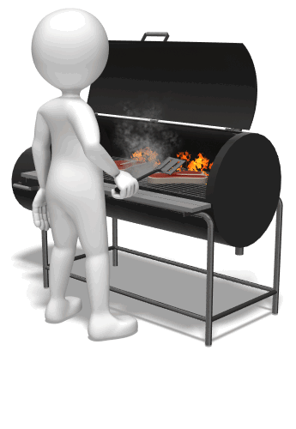
Timing, in Market Terms
If the budget is acceptable and the date/time options are workable, then the only other initial consideration is the type in accordance with your objective.

Slide 10

Employee Functions
We are not talking the Christmas party or Melbourne Cup race day!

Slide 11

Staff Promotional Activities
There are other staff promotional activities held in both a social environment and an office/meeting setting:
Brainstorming meetings.
Team-building.
Creativity discussions or planning.
Management staff decision-making and problem-solving.

Slide 12

Media Announcements
As part of planning promotional activities, media announcements also fall under the Public Relations sub-heading.

Slide 13

Product Launches
There is much similarity between planning and conducting a Product Launch and holding a client function.

Slide 14

Website
Can also allow you to:
List testimonials.
List current and previous press releases.
Detail special awards or staff achievements.
Create message boards, blogs and news groups.
Advertise promotional activities, such as free offers.
Release price lists or important offer details.

Slide 15

Activity 1A

Slide 16
Plan Promotional Activities
1.2 Plan and schedule promotional activities according to the marketing needs of the organisation

Slide 17
Activity 1B

Slide 18
Plan Promotional Activities
1.3 Determine overall promotional objectives in consultation with designated individuals and groups

Slide 19

Plan Promotional Activities
Internal communication.
Contractors and external groups.

Slide 20
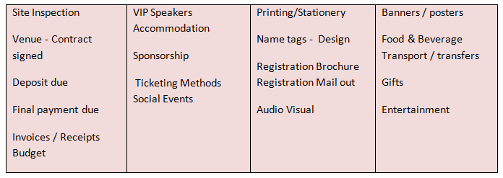
Examples:

Slide 21
Activity 1C

Slide 22
Plan Promotional Activities
1.4 Ensure that timelines and costs for promotion of activities are realistic and consistent with budget resources

Slide 23
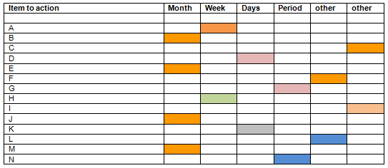
CPS (Critical Path Schedules)

Slide 24
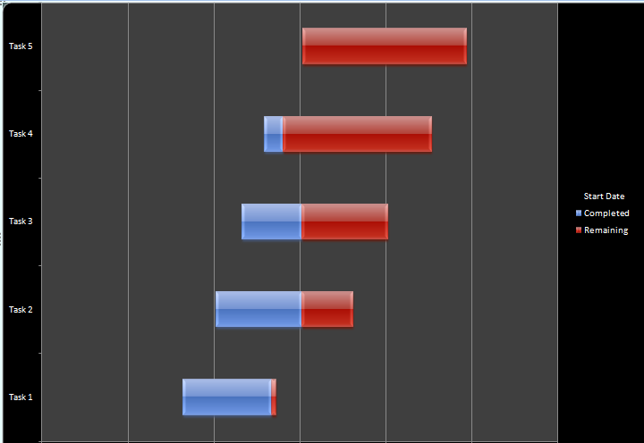
GANTT Charts

Slide 25
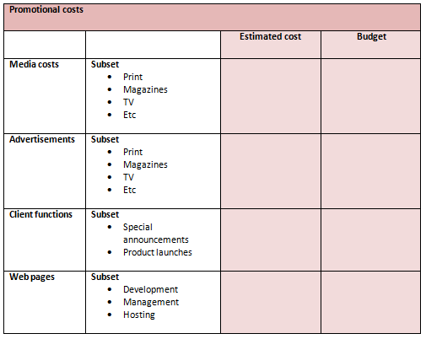
Costs for promotion of activities

Slide 26
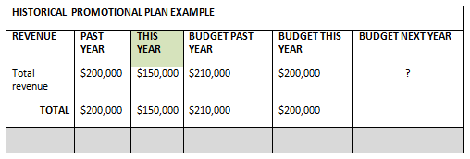
Budget Resources

Slide 27
Activity 1D

Slide 28
Plan Promotional Activities
1.5. Develop action plans to provide details of products and services being promoted

Slide 29
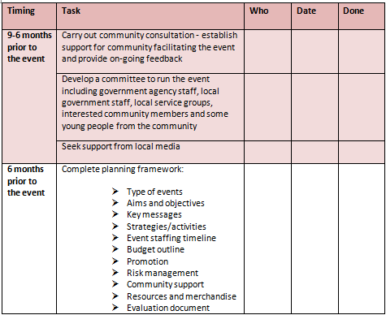
The Action Plan
The action plan will closely link to your CPS and/or GANTT or PERT chart

Slide 30
Activity 1E

Slide 31
Coordinate Promotional Activities
2.1 Ensure personnel and resources to support promotional activities are identified and prepared to facilitate the achievement of promotional goals

Slide 32
Personnel or Resource
ITEM | PERSONNEL (Tick) | RESOURCE (Tick) | WHO / WHAT / WHY? (your comments)
Site inspection of Venue
Contract signed and returned
Invitations designed
AV contractor hired
Mailing of invitations
Update of website
Deposit due
AV contractor hired
Speakers confirmed
Menu selections
Dietary Requirements of attendees
Meet on-site before Event
Thank you letter

Slide 33
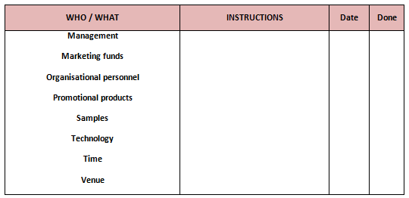
Facilitate Promotional Goals

Slide 34
Coordinate Promotional Activities
2.2 Identify and agree roles and responsibilities for delivery of promotional services and allocate to relevant personnel

Slide 35

Planning
In planning the best outcome for any promotional activity; agreed roles and responsibilities are fundamental to avoid confusion and to deploy a group who are aware of each other’s responsibilities.

Slide 36

Other areas of roles and responsibilities
Code of Conduct.
Job description and employment arrangements.
Organisational policy.
Skills, training and competencies.
OHS.

Slide 37

Examples of roles and responsibilities
Teams range in size; however, experience tells us effective teams have averaged about ten people.

Slide 38
Activity 2A

Slide 39
Coordinate Promotional Activities
2.3 Establish and conduct relationships with targeted groups in a manner which enhances the positive image of the organisation
2.4 Use networks to assist in the implementation of promotional activities

Slide 40

Networking
Does the organisation have a strategy?
Company.
Customer.
Internal.
Media and promotional.
Professional.
Social.

Slide 41

Costs
Many businesspeople argue that business networking is a more cost-effective method of generating new business than advertising or public relations efforts. This is because business networking is a low-cost activity that involves more personal commitment than company money.

Slide 42

Access
Computer access and open source information activity achieves the same outcome using online groups of like-minded businesspeople who recognise, create and act upon business opportunities, either together or individually.

Slide 43
Activity 2B

Slide 44
Review and report on promotional activities
3.1 Analyse audience feedback and data to determine the impact of the promotional activity on the delivery of products and services
3.2 Assess effectiveness of planning processes to identify possible improvements in future activities
3.3 Collect feedback and provide to personnel and agencies involved in promotional activity

Slide 45

Feedback
As with many other aspects of business, when a company undertakes promotion, events and public relations, feedback (surveys or any other method) is now regarded as essential, especially when making informed decisions and planning for the future.

Slide 46
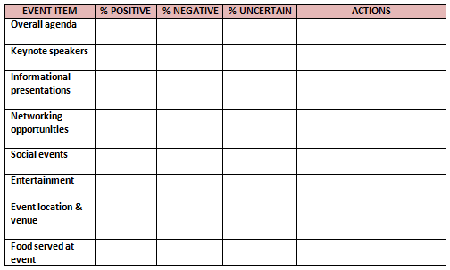
Extracting the information

Slide 47
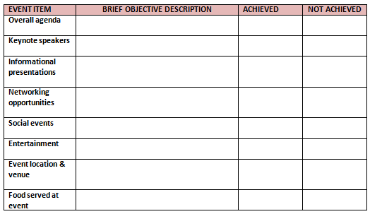
Compare objectives with feedback results

Slide 48

Messaging
TIP: blogs and social media sites
are cost effective and are being
accepted more and more for
business feedback distribution;
however, they are also public
platforms and can be open to
criticism, which also can get
picked up and distributed.

Slide 49
Review and report on promotional activities
3.4 Analyse costs and time lines to evaluate the benefits accruing from the promotional activities

Slide 50

Using the event information
Depending on the type of promotion, there are varying ratios to express success, based on:
Industry expectations
Your expectations.

Slide 51

Evaluate the benefits accruing from the promotional activities
Costs /Budgets:
These are fairly obvious assessments, as they can be expressed in bottom line results or in either profit or loss.

Slide 52

Know the objectives of the promotion
How will you measure the success?
Make sure methods can measure.
Have a means to track each aspect.
Consider the long-term.

Slide 53
Review and report on promotional activities
3.5 Prepare conclusions and recommendations from verifiable evidence and provide constructive advice on future directions of promotional activities

Slide 54
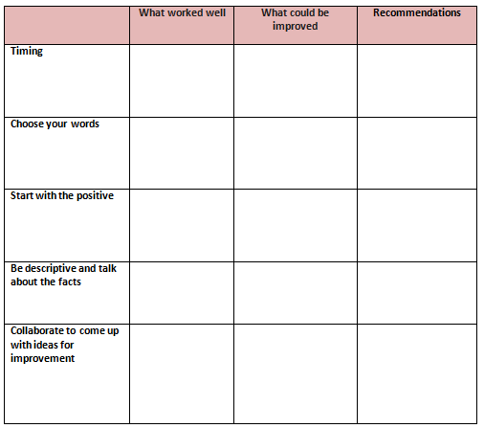
Constructive Advice

Slide 55
Activity 3A

Slide 56

Skills and Knowledge Activity

Slide 57
Major Activity
This activity should take 1-2 hours to complete and can be found at the end of your workbook.
Your instructor will let you know whether they wish for you to complete it in session time or your own time.

Slide 58

Summary and Feedback
Did we meet our objectives?
How did you find this session?
Any questions?

Slide 59

Congratulations!
You have now finished the unit…
‘Promote products and services’

