Slide 1
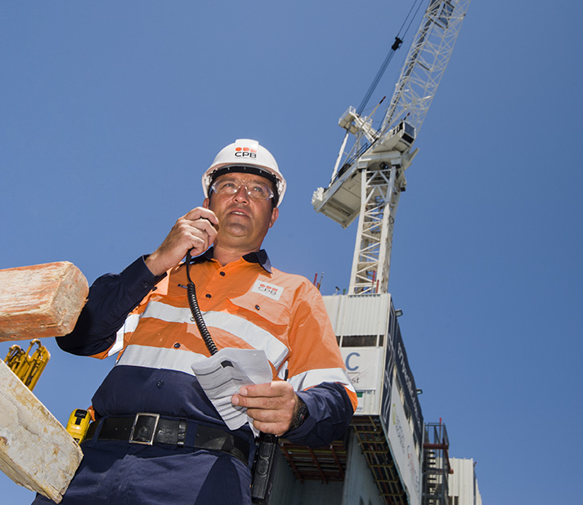
Working at Heights

Slide 2
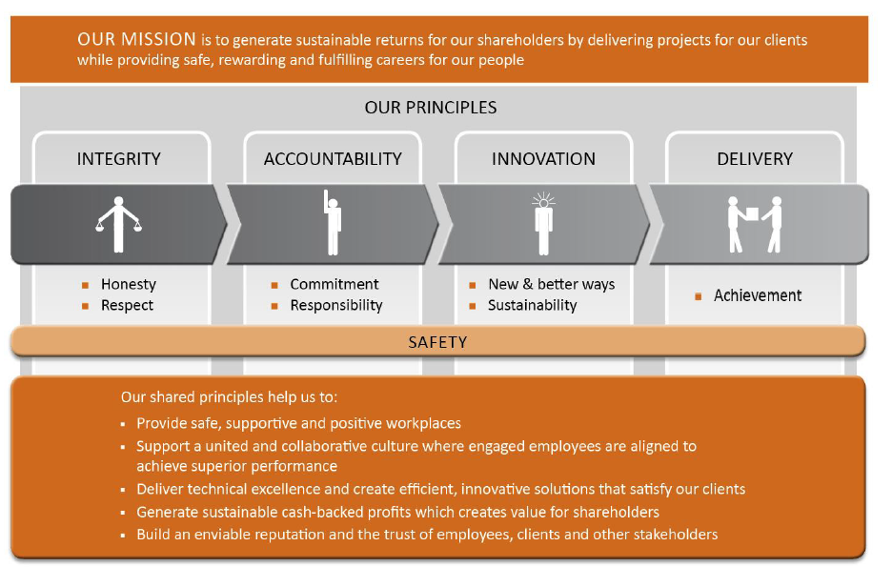
Our Mission and Principles

Slide 3
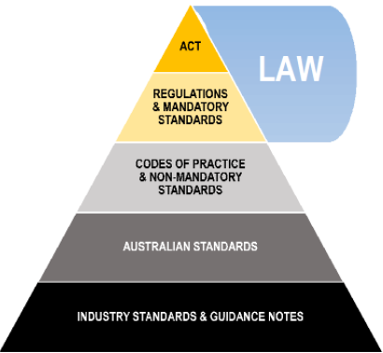
Legislative Framework

Slide 4
References
Work Health and Safety Act 2011: https://www.legislation.gov.au/
Work Health and Safety Regulations 2011: https://www.legislation.gov.au/
WorkSafe Qld: Home | WorkSafe.qld.gov.au
CPB Contractors CMS internal policies and procedures: internal home intranet

Slide 5
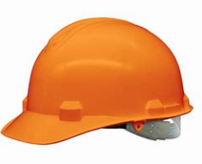
Workers Duties & Rights – Where to find them
Workers Duties:
Take reasonable care for their own safety and health, take steps to ensure their actions or omissions do not harm the health and safety of others
Comply, if able, with any reasonable instruction from the person conducting business
Cooperate with any policy or procedure that is reasonable, from the person conducting business regarding health or safety that the worker/s has been told about
Work Health and Safety Regulation 2011, section 28; Work Health and Safety (Construction work) Code of Practice 2015, Section 2.3 & 2.4; Work Health and Safety Act 2011, Section 84
Workers Rights:
A worker may refuse to carry out or cease work if the worker has a genuine concern that the work could expose them to serious risk or the workers’ health and safety, from contact with an immediate hazard
The right to a safe and healthy workplace, include safe machinery and structures
Workers’ compensation
Be given training
Consultation about safety in the workplace
Worksafe Qld; Work Health and Safety Regulation 2011, section 83-89

Slide 6
Workers Obligations - Where to find them
Workers Obligations:
Take reasonable care of yourself and others
Follow WHS instructions
Follow workplace WHS polices and procedures
Work safely
Use personal protective equipment (PPE) as correctly trained and not mistreat anything provided for your health and safety at work.
Report injuries and unsafe situations to a supervisor or health and safety representative
Construction card induction training card must be available for inspection
Worksafe Qld; Work Health and Safety (Construction work) Code of Practice 2015, Section 2.3

Slide 7
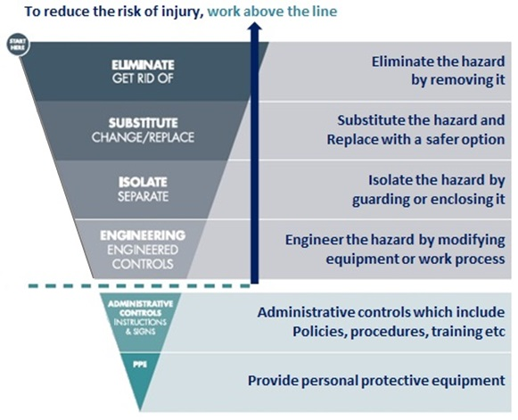
Hierarchy of Controls
Above the Line:
Whenever a worker/s are performing a high risk task, everyone MUST have an Above the Line Control as the main control.
If you do not have that, you must have a Safety Essentials Exception signed by the Business Unit (BU) General Manager.

Slide 8
What is Working at Heights?
Working at Heights relates to any task where there is a risk of:
Workers falling from batters, drains or slopes
An object falling from a height
Remember - Work above 2 metres, requires you to follow the Working At Heights policies and procedures, work below 2 metres requires you to consider the controls that must be put in place.

Slide 9
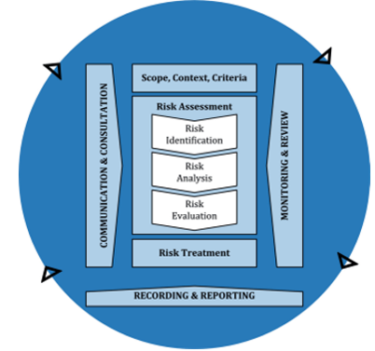
Working at Heights
Risk Management Process
Communicate and consult
Establish scope, context and criteria
Assess risk:
  Identify risk
  Analyse risk
  Evaluate risk
  Treat risk
  Monitor and review
Reference: Work Health and Safety Act 2011, Section 20-26 & Section 27-29 & Section 30-34 & Section 35-39: https://www.legislation.gov.au/

Slide 10

Training & Operator Competence
All operators working at heights must have completed the applicable regulatory Work safety at heights training, and be validated by a CPB Contractors supervisor as being competent.

Slide 11
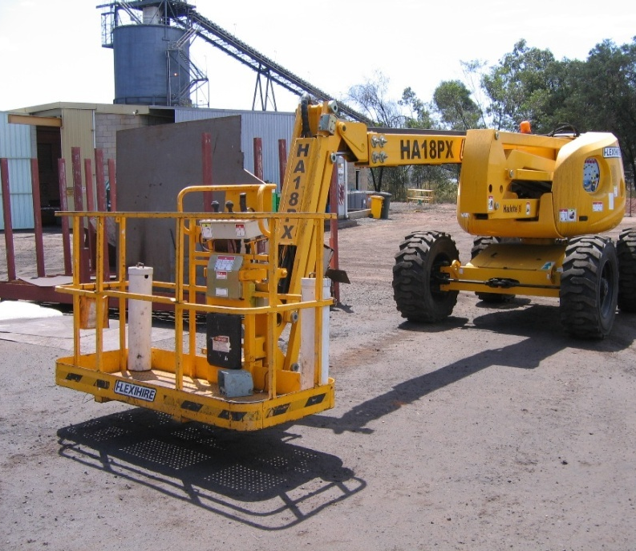
Mobile Elevating Work Platforms (MEWP)
Have SECONDARY Protection
Trained & competent
Guard rail system
Minimum 1 meter clearance of top handrail and fixed structure for travel
Fall arrest device connected to a dedicated anchor point
Not use anything in the basket platform to stand or sit on

Slide 12
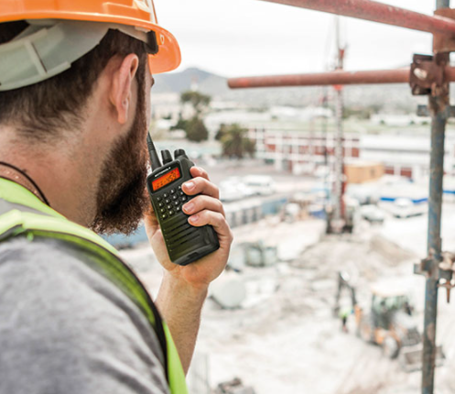
Communication
Lines of communication must stay open between all workers, before work commences and while the work is carried out. The minimum requirements include, but are not limited to:
UHF radios available to all mobile plant and light vehicles
All supervisors, leading hands and spotters to have hand held radios
Test all areas of the project that radio coverage is working or make alternative arrangements if there are dead zones. These areas must be marked clearly on the site map.
All documents from the Work Packs must be kept at the designated zone and available for all workers to review. These document include but are not limited to:
  Work Packs
  Safe Work Method Statements (SWMS)
  Permits
  Pre-Start Briefing cards

Slide 13

Control Measures
Using the Hierarchy of Controls is the easiest way to make sure we keep our workers safe.
Have you checked?
Elimination – Can you undertake the work on the ground?
Substitution – Can you substitute plant for workers?
Isolation – Can you use Mobile Elevating Work Planforms (MEWP)?
Engineering – Has edge protection and guard rails been installed?
Administration – Are signs set up at entry points?
Do you understand all the control measures that are in place? Have you read and signed the SWMS?
Remember, speak up and ask questions if you are unsure, and cease work if it is unsafe!

Slide 14
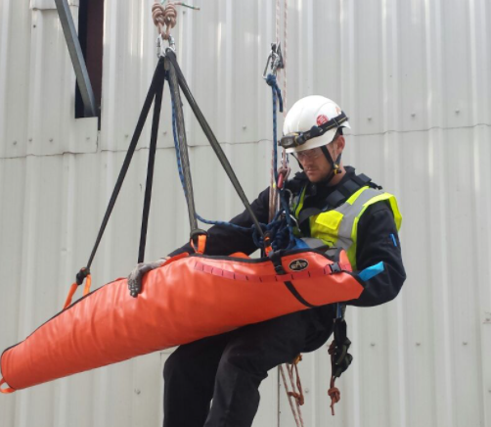
Emergency Response
In the event of an emergency the site emergency procedure shall be followed:
Stop work, ensure your safety
Call "emergency, emergency, emergency" on your radio over the UHF work channel
Await a response, and give the following information:
  Your name
  Your location
  The nature of the emergency
  Number of people involved
  Resources required
  Any other hazard information
Stay on the radio and await further instructions
Other people onsite stop work, maintain radio silence and be prepared to evacuate or help pending instruction from CPB supervisors

Slide 15
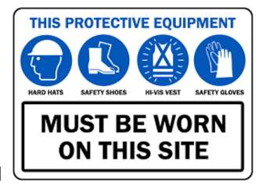
Personal Protective Equipment (PPE)
Mandatory
Reflective high visibility long sleeved shirt
Long Trousers / jeans
Lace-up Steel Cap Boots
Industrial Safety helmet – white
Hard Hat and (Brims available)
Safety Glasses, prescription if necessary
Gloves must be carried on the persons at all times and used as required for suitable activities, FINGERLESS GLOVES ARE NOT PERMITED

Slide 16
Incident Reporting
Reporting
All incidents, near misses and hazards must be reported to your supervisor, no matter how minor
Non- Disturbance
In some instance it is an offence to disturb an incident scene before regulators have given the all clear – on this site, incident scenes must be preserved until cleared by the safety department
Investigations
Incident investigations will be undertaken in accordance with CPB Contractors requirements
What if you injure yourself outside of work?
You must contact your supervisor prior to leaving and returning to work
You must NOT return to work until you are “fit for duty” or for ‘suitable duties’
For medical conditions a clearance from a doctor will be required
Approval must be obtained by the Project Manager if you return to work with a non-work related injury

Slide 17
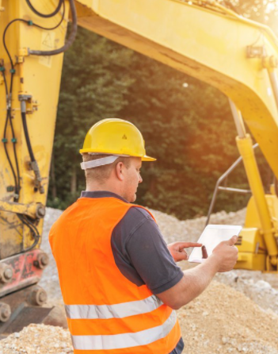
Monitoring All Workers and Works
Supervisors, leading hands and engineers are required to undertake regular monitoring of all work tasks to ensure that each zone is effectively established and controlled.
Task observations are required to be conducted to meet compliance and ensure all control measures are effective. If a change occurs during works (e.g., a new hazard), a review must be completed by the responsible Supervisor to ensure the safety of workers and that CPB Contractors requirements and compliance are met.
Monitoring requirements (not limited to):
Monitoring and documentation
Leadership visits
Task observations
Plant and equipment inspected

Slide 18
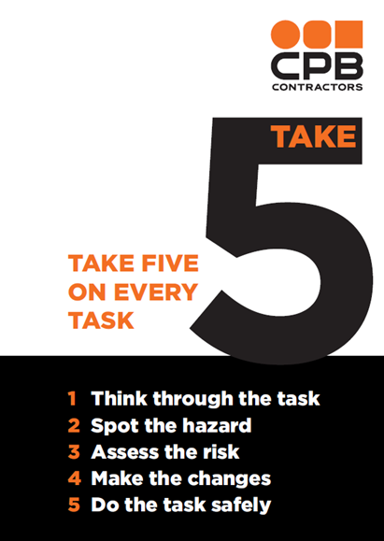
Take 5
Monitoring is not just the responsibility of the supervisor, leading hands and engineers. We must all monitor and “take 5” to assess our personal safety.
Take 5 allows you to look around and take into account your work environment, identify hazards before you start work, manage any hazards and make changes to any control measure.
Why?
It will help protect you and your workmates from harm and potential injury.
We want you to get home safe to the things you love and enjoy!

Slide 19
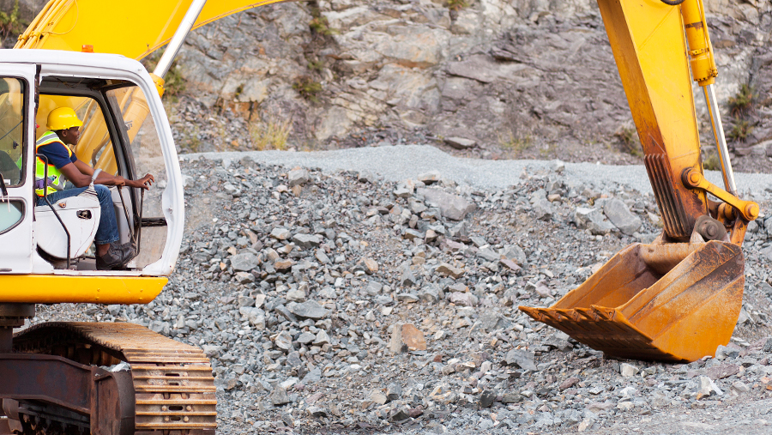
Questions

