Slide 1

BSBFIA303
Process accounts payable and receivable

Slide 2

Housekeeping
Emergency procedures
Mobiles and security issues
Break times and smoking policy
This course is interactive – ask questions
Practise respect and confidentiality
Ground rules

Slide 3
Objectives
Understand how to maintain financial journal systems
Know how to prepare bank reconciliations
Show how to maintain accounts payable and accounts receivable systems
Demonstrate the process payments for accounts payable
Show how to prepare statements for accounts receivable
Explain how to follow up outstanding accounts
Gain the skills and knowledge required for this unit

Slide 4

Maintain financial journal systems
1.1 Check source documents for accuracy and appropriate authorisation

Slide 5

Source documents
Source documents are original records containing details to verify transactions.
They should be kept for future audits and reviews. Without source documents, an organisation cannot prove it didn’t fabricate or change the details of a transaction.

Slide 6

Source documents
Source documents may include:
Invoices
Cheques
Adjustment notes
Purchase orders
Receipts
Requisition forms
Employee time cards
Receiving tickets.

Slide 7

Source documents
Information on the source documents may include:
The amount transferred
The reason for the transfer
The date
The parties involved
The details of items.

Slide 8
Maintain financial journal systems
1.2 Refer errors and discrepancies in source documents for resolution in accordance with organisational policy and procedures

Slide 9

Errors and discrepancies
Discrepancies may include:
Changes in amounts
Errors involving the parties
Incorrect payments
Incorrectly recorded entries in a ledger
Changes in dates.

Slide 10

Errors and discrepancies
Whenever you discover an error, it is important to refer it for resolution. You may have an appropriate person or department in your organisation that deals with these.
Security and confidentiality requirements may also apply, as often do when working with sensitive financial information.

Slide 11

Activity 1A

Slide 12
Maintain financial journal systems
1.3 Enter transactions into cash and credit journal system in accordance with organisational policy and procedures and relevant legislation and compliance requirements

Slide 13

Transactions
Transactions may include:
Sales
Purchases
Expenses
Transfers
Interest revenue or charges
Payments received and collected
Returns
Withdrawals of cash.

Slide 14

Legislation
Legislation that could apply to you may include:
Privacy
Consumer credit
Industry codes of practice
E-payments code
Accounting standards
Suspicious transfers.

Slide 15

Journals
You can record information about transactions in journals, such as:
Cash payments journal
Cash receipts journal
Purchases journal
Sales journal.

Slide 16
Maintain financial journal systems
1.4 Total credit journals in accordance with organisational policy and procedures

Slide 17

Journals
Transactions are recorded in journal entries. Each entry has a debit and credit side and both sides must always balance.
Most journal record keeping is now done with computer software to improve accuracy and efficiency.

Slide 18
Journals
Account type | Increase | Decrease
Assets (e.g. bank accounts, petty cash, accounts receivable) | Debit | Credit
Revenue (e.g. sales, profits) | Debit | Credit
Equity (e.g. capital) | Credit | Debit
Liabilities (e.g. salaries payable, wages payable, interest payable) | Credit | Debit
Expenses (e.g. bills, costs) | Credit | Debit

Slide 19

Journals
When accounts are neither increasing nor decreasing, they are considered the type when they are increasing. For example, if assets are considered a debit when not changing, while equity is considered credit.

Slide 20
Journals
Credit and debit should always balance in double-entry bookkeeping.
Account | Debit | Credit
Expenses | $500
Bank |  | $500
Account | Debit | Credit
Accounts payable | $2000
Cash |  | $2000

Slide 21
Activity 1B

Slide 22
Prepare bank reconciliations
2.1 Check cash journals against bank statements to identify differences
2.2 Update cash journals with relevant data from bank statement/s

Slide 23
Prepare bank reconciliations
2.3 Identify discrepancies and refer to appropriate staff member, organisation or agency
2.4 Total cash journals in accordance with organisational policy and procedures
2.5 Prepare regular reconciliation reports within designated timelines

Slide 24

Reconciliation
Reconciliation is the process of ensuring that entries in separate records don’t conflict with each other. It is used to prove the accuracy of the accounts. Reconciliation needs to be done a regular basis.

Slide 25
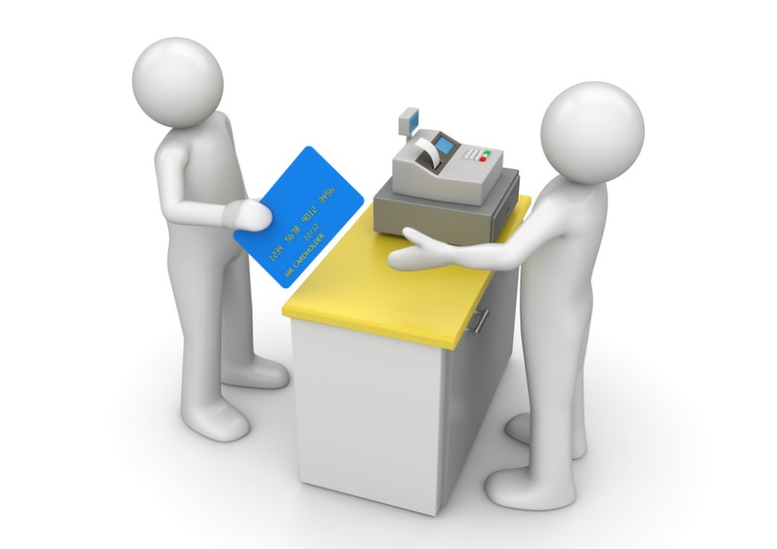
Reconciliation
Before starting, you should have the balance of the bank statement and the accounting ledger.
To perform a bank reconciliation:
Identify deposits in transit
Outstanding cheques
Identify errors
Create a bank reconciliation statement.

Slide 26

Identify deposits in transit
Deposits recorded by the company but not yet by the bank are deposits in transit. You can identify these by comparing the deposits listed on company statements with the deposits on company records.
You can add missing ones to the bank’s balance.

Slide 27

Outstanding cheques
Repeat the process for cheques to identify outstanding ones that the bank hasn’t registered yet. Deduct outstanding cheques from the bank’s balance.

Slide 28

Identify errors
In the previous steps, you may have identified errors either on the company’s or the bank’s part.
For example, the statements may have different amounts for entries. Determine which one is correct using the source documents.
Identify any other items that haven’t appeared on both statements.

Slide 29

Create a bank reconciliation statement
Record the original balance on the bank statement and list any outstanding deposits or cheques. The figures in the statement and journal should now agree.
If they don’t, repeat the process, looking for any errors or bank charges you may have missed.
Finally, prepare a statement to show where the ‘missing’ money was.

Slide 30
Reconciliation
Bank reconciliation
Dates covered: | 1/2/2015 – 1/3/2915
Bank statement balance: | $1200
Outstanding deposits 10/2/2015 - $50 15/2/2015 - $25 | $1275
Outstanding cheques 20/2/2015 - $200 | $1075
Errors found | $0
Total | $1075
Cash books balance: | $1075

Slide 31
Activity 2A

Slide 32
Maintain accounts payable and accounts receivable systems
3.1 Enter transactions into individual accounts payable and accounts receivable in accordance with organisational policy and procedures and accounting requirements

Slide 33

Accounts payable
You may be required to help fulfil the company’s obligations in transferring money to accounts payable and accounts receivable. This may be wages, costs or other expenses.

Slide 34

Accrual accounting
Accrual accounting differs from cash accounting in that expenses are recorded when the expense occurs, not when the expense is reimbursed.
For example, a company buys supplies in September but doesn’t pay until October.

Slide 35
Accrual accounting
September:
October:
Account | Debit | Credit
Accounts receivable | $750
Revenue |  | $750
Account | Debit | Credit
Cash | $750
Accounts receivable |  | $750

Slide 36
Maintain accounts payable and accounts receivable systems
3.2 Prepare schedules of accounts payable and accounts receivable for reconciliation purposes and in accordance with organisational requirements

Slide 37

Account reconciliation
Accounts need to be reconciled at different times:
High activity accounts (e.g. accounts receivable, accounts payable) should be reconciled monthly
Medium activity accounts (e.g. long term debt) should be reconciled once per quarter
Low activity accounts (e.g. owner’s capital) should be reconciled yearly.

Slide 38

Account reconciliation
When choosing staff to perform the account, consider:
Legal ramifications
Available and qualified staff
Audit requirements
Organisational policy.

Slide 39

Account reconciliation
Once the account has been reconciled, it should be recorded and filed away. Support documents should be attached for future reference.

Slide 40
Maintain accounts payable and accounts receivable
3.3 Reconcile accounts payable and accounts receivable schedules with journal data or general ledger and in accordance with organisational requirements

Slide 41

Journal data
Information contained within journals may include:
Accounts payable
Accounts receivable
Purchases and purchases returns journal totals
Sales and sales returns journal totals.

Slide 42

General ledgers
The general ledger will contain information on every account in a company.
Whenever information is recorded in journals, it will need to be copied into the ledger. This will help to prepare financial statements and identify errors or fraud.

Slide 43

General ledgers
There are effectively two types of accounts in a ledger:
Accounts telling you how much the company owes
Accounts telling you how much the company owns or is owed.

Slide 44
Activity 3A

Slide 45
Process payments for accounts payable
4.1 Reconcile accounts payable statements with accounting records and in accordance with organisational policy and procedures

Slide 46

Reconciling accounts
If the accounts don’t balance:
Review the items in greater to detail
Look for items that are recorded in one ledger but not the other
Identify items that may have recorded incorrectly.

Slide 47
Process payments for accounts payable
4.2 Check payment documentation for accuracy of information and discrepancies and rectify errors in accordance with organisational requirements

Slide 48

Payment documentation
You may have to check documents such as:
Remittance advice (letters from customers to suppliers, informing them an invoice has been paid)
Discount calculation
Invoices and statements
Cheque data to confirm their accuracy
Purchase orders to validate any purchases made.

Slide 49
Supplier statements
Supplier statement 5/3/2015
[Business name] To: Company X For the month of February
Reference | Description | Amount | Date | Balance
 | Balance from previous month |  |  | $3000
Invoice #721 | Sales | $225 | 10/2/2015 | $3225
Invoice #735 | Sales | $550 | 20/2/2015 | $3775
Cheque | Payment | $3300 | 25/2/2015 | $475
 |  |  | Total balance: | $475
Terms: Payment is due within in 30 days.

Slide 50
Supplier statements
Check statements against relevant invoices.
Invoice #721
[Business name] [Address] [Contact details] To: Company X
Description | Amount | Total
Product A | $100 | $100
Product B | $110 | $210
 | Total: | $210

Slide 51

Supplier statements
For example, when you cross-reference the statement and invoice, you will find the company has been charged different amounts.
If you find a mistake, contact the supplier with the relevant evidence. Check previous account statements, payment history, remittance letters and any itemised details.

Slide 52

Supplier statement
To ensure payments are made to suppliers, authorise payment with the appropriate person in your company.
Payments over a certain amount may need to be escalated higher.

Slide 53
Activity 4A

Slide 54
Prepare statements for accounts receivable
5.1 Produce and check accounts receivable statements for accuracy in accordance with organisational policy and procedures

Slide 55
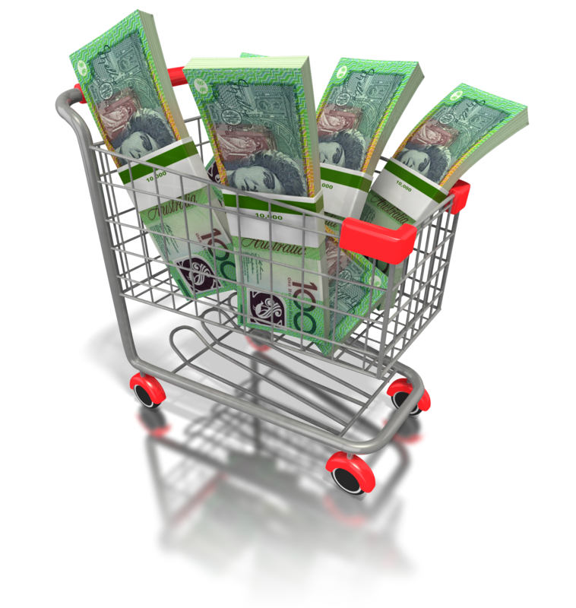
Accounts receivable
Cash flow is important for a healthy company. If several customers are late paying, the company may struggle to purchase new equipment. Therefore, it’s important to make sure customers pay debts in time.

Slide 56
Accounts receivable
Invoice number #125 27/4/2015 |  | Date due: 30/4/2015
[Business name]
Description |  | Amount
Balance at start of month |  | $425
Product X |  | $200
Product Y |  | $175
Late fees |  | $15
 | Total balance: | $815
Terms: Payment is due in three days.

Slide 57

Accounts receivable
On statements showing customer’s debts, show:
The balance of the account at the start of the month
Any additional purchases they have made
Any payments received
Adjustments for missed payments
The balance that is currently owed
A due date.

Slide 58
Prepare statements for accounts receivable
5.2 Rectify discrepancies and statements despatched within designated timelines

Slide 59

Discrepancies
A discrepancy may be something that doesn’t match the other records.
Check the totals at the start and end of the month to see if they were correct.
If you find an error, go back and correct the discrepancy. If you can’t find it, record the different as ‘reconciliation discrepancies.’

Slide 60
Activity 5A

Slide 61
Follow up outstanding accounts
6.1 Maintain accounts receivable ledger system in accordance with organisational requirements and to reflect current credit situation

Slide 62

Accounts receivable ledger system
The ledger system should record customers’:
Debts
Transaction history
Contact details
Invoices
Credit notes.
This makes it easier to manage customers’ information.

Slide 63

Accounts receivable ledger system
The system can also generate reports and invoices.
A page is typically devoted to each customer in the system.

Slide 64
Follow up outstanding accounts
6.2 Conduct aged-analysis of accounts receivable to identify outstanding accounts and to determine collection procedures in accordance with organisational requirements

Slide 65
Aged-analysis
Aged-analysis looks at how much time is left until the debt is or was due.
1-30 days aged-analysis
Date: 30th May 2015
Customer | Date due | Days overdue | Total due
Mr M. Smith | 27th May 2015 | 3 | $171
Company X | 20th May 2015 | 10 | $2310
Mrs Jones | 2nd May 2015 | 28 | $249

Slide 66

Aged-analysis
Aged-analysis is divided into 30 day categories.
When this information is determined, steps can be taken to recover the debts.

Slide 67

Outstanding accounts
You should have clearly defined the customer or organisations’ payment responsibilities: when and how much they should pay.
Responsibilities for collecting debts could be divided up by product, salesperson or geographic area.

Slide 68

Disputes
There could be reasons the customer hasn’t paid:
They have forgotten. Send them invoices to remind them
They have a dispute, such as a product arrived broken or they were incorrectly billed.

Slide 69

Customer relationship manager
Customer relationship manager (CRM) software can record all communication with a customer.
This ensures:
Multiple employees can interact with them
The customer receives good service
Money can be recovered quicker.

Slide 70
Customer relationship manager
Customer relationship management
Customer name: | Mr John Cooper
Contact details: | [Phone number]
Date: | Form of contact | Details
22nd February 2015 | Phone | Rang Mr Cooper regarding his overdue payment. He said he had lost his copy of the invoice and requested another one to be sent as soon as possible.
23rd February | Post | Sent Mr Cooper a copy of the invoice.
26th February | Phone | Mr Cooper rang to say he had received the invoice, but he believed details on it were wrong. I said I would ring back when I had investigated the matter.
27th February | Email | I emailed Mr Cooper copies of the original purchase order he signed, which had the same details as the invoice.
29th February | Email | Mr Cooper emailed back, agreeing to pay within the next two days.

Slide 71

Incentives
To make customers pay within the deadline, you could use:
Discounts for early payment
Penalties for late payment.

Slide 72
Follow up outstanding accounts
6.3 Report or follow up outstanding accounts in accordance with organisational policy and procedures

Slide 73

Disputes
If there is a dispute, you should:
Listen to the reason for the dispute
If necessary, make arrangements for goods to be exchanged, invoices to be corrected or any other corrections
Come to a resolution with the customer and confirm this in writing.

Slide 74
Disputes
Reason for late payment | Follow-up action
The company has stopped trading. | Find out who is handling the liquidation and contact them as soon as possible. You will be listed as a creditor so are entitled to recover your money. The company may have to pursue legal action in order to get its money back.
The customer/company didn’t receive an invoice. | Confirm their contact details and send them another one as soon as possible Offer them an extension if necessary Always ensure invoices have the correct information.
The company is paying other suppliers first. | Request immediate payment or you will pursue legal action.

Slide 75
Disputes
Reason for late payment | Follow-up action
The customer is currently changing banks. | Request that they pay by credit card or any other method of getting funds.
The person authorised to make payment is out of the business. | Enquire whether anyone else can authorise the payment Confirm when the employee will be back and follow-up with the business on that date to ensure payment.
The company has cash flow problems. | Enquire whether customers could make part-payments that could be used to pay the organisation Confirm a date when you will be paid by.

Slide 76
Follow up outstanding accounts
6.4 Monitor and review credit terms in accordance with credit policy and procedures

Slide 77
Payment options
Payment options could include:
Credit card payment
Electronic transfer (by online banking or other means)
Cash.

Slide 78

Credit check
The organisation should make a credit check before they offer a customer credit. This will give the organisation confidence that they can trust the customer to make payment.
If they have a history of debts and missed payments, it may be wiser to insist on payment by another method.

Slide 79

Credit check
The organisation may offer different credit terms to a customer who would have difficulty paying normally.
These could include:
Payment X days after the invoices is received
Cash on delivery
Payment in stages.

Slide 80
Activity 6A

Slide 81
Skills and Knowledge Activity

Slide 82
Major Activity
This activity should take anywhere between an 1-2 hours to complete and can be found at the end of your workbook.
Your instructor will let you know whether they wish for you to complete it in session time or your own time.

Slide 83

Summary and Feedback
Did we meet our objectives?
How did you find this session?
Any questions?

Slide 84

Congratulations!
You have now finished the unit…
‘Process accounts payable and receivable’

