Slide 1

MANAGING WORK HEALTH AND SAFETY IN CONSTRUCTION
WORK HEALTH AND SAFETY OFFICER

Slide 2
Assessment Criteria
Describe the statutory and minimum requirements relating to construction workplaces;
List the hazards that are associated with construction workplaces;
Describe the control measures that are available to minimise or remove the risk associated with these hazards.

Slide 3
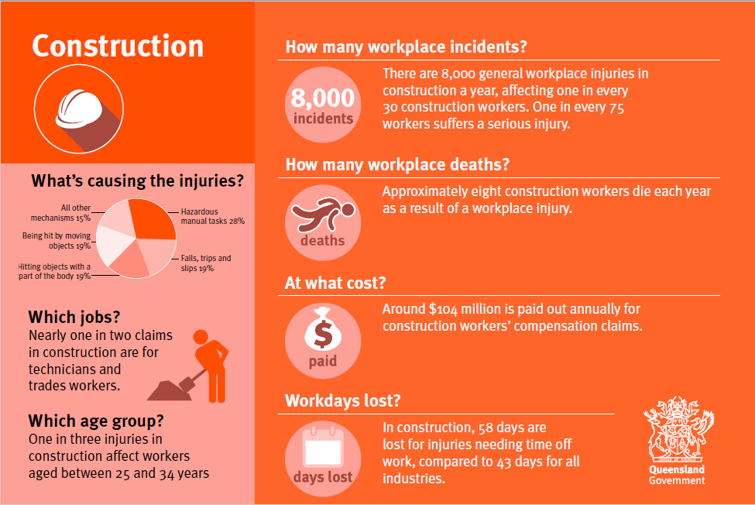

Slide 4
Construction work
WHS Regulation 2011 s289:
Construction work means any work carried out in connection with the construction, alteration, conversion, fitting-out, commissioning, renovation, repair, maintenance, refurbishment, demolition, decommissioning or dismantling of a structure.

Slide 5
Principal contractor
WHS Regulation 2011 s293:
1. The principal contractor for construction work is the person appointed by the person that commissions the construction project, as the principal contractor for the construction work.
2. If the owner does not appoint a principal contractor for the construction work, the owner is taken to be the principal contractor for the construction work.

Slide 6
Person in control of the construction work
The person with control of a construction project must ensure the identification of hazards arising from:
the construction site;
any design relating to the construction project;
working at height;
hazardous substances, including the handling, use, storage, and on-site transport or disposal of hazardous substances;
the presence of asbestos;
systems of work;
plant, including the on-site transport, installation, erection, commissioning, use, repair, maintenance, dismantling, storage or disposal of plant;
manual handling (including the potential for occupational overuse injuries);
the layout and condition of the construction site; and
the physical working environment

Slide 7
What laws apply?
General health and safety obligations
Workers compensation
What you must do
If the Work Health and Safety Regulation 2011 describe how to prevent or minimise a risk at your workplace, you must do what the regulation says. If there is a code of practice that describes how to prevent or minimise a risk at your workplace you must do what the code says or adopt and follow another way that gives the same level of protection against the risk.

Slide 8
Specific regulations
principal contractor WHS Management Plans;
safe work method statements for high-risk construction activities including demolition work and asbestos removal;
general construction induction;
housekeeping practices;
safety of plant provided for common use;
excavations (including trenches);
falls (including work on roofs, from ladders and trestle ladder platforms, and work to erect or dismantle scaffolding);
protecting people from falling objects;
workplace amenities.

Slide 9
Health hazards
Solar radiation from outdoor work.
Airborne contaminants including dust, fumes, vapours and gases from cutting, grinding, sanding, welding, engine exhausts, hazardous chemicals, spray painting and abrasive blasting.
Noise from operating plant, equipment and tools.
Hazardous chemicals such as cement cleaning agents, degreasers and detergents, paint and solvents.
Heat from outdoor work, high physical workloads, operating plant and equipment, and personal protective equipment and clothing.
Vibration to the whole body or hand and arms from plant and equipment such as grinders, drills, air tools, excavating machinery.

Slide 10


