Slide 1

CHCECE017
Foster the holistic development and wellbeing of the child in early childhood

Slide 2

Foster physical development
1.1 Assess and monitor children’s physical skills and development

Slide 3

What is physical development?
Physical development is the progress a child makes to control their bodies.
Development is a process that is governed by certain principles:
Development is continuous
Development is sequential.

Slide 4

Fine motor movements
Fine motor movements are small, more precise movements and can be split into two categories:
Fine manipulative skills – are those physical skills that are needed for writing, threading or doing puzzles
Fine motor skills – these are small movements that involve using hands and wrists e.g. turning a handle.

Slide 5

Gross motor movements
Gross motor movements are large and can also be split into two categories:
Gross motor skills – these movements use an entire limb e.g. catch a ball
Locomotive skills – these movements are broader still and help children to walk, run and jump.

Slide 6

Monitoring physical development
To observe a child you should wait until they are engaged in an activity – for example, doing a puzzle. Things to look out for when observing a physical activity include:
Whether they are using right or left hand
How confident they are with the task
If they ask or look around for help.

Slide 7

Activity 1A

Slide 8
Foster physical development
1.2 Plan and provide appropriate experiences and opportunities to foster each child’s fine and gross motor skills, and fundamental movement skills through play

Slide 9
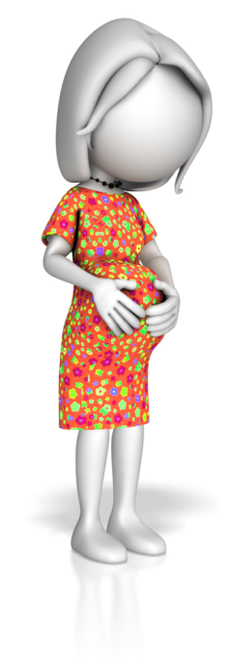
Influences on child development
Influences on child development include:
Antenatal (before birth) influences include health of mother and father and any hereditary conditions.
Perinatal (during birth) influences include a low birth weight of baby and a lack of oxygen.
Postnatal (after birth) influences can include diet, care quality, poverty, abuse or neglect, infections and accidents.

Slide 10

Outdoor play
Children should be given the chance to go outside and play at least once in a day, either at the centre or park.
You can take children on walks or nature trails.
Being outside contributes to a good spatial awareness and gross motor physical development.

Slide 11

Indoor play
When it is not possible to provide outdoor play, you can still provide the opportunity for gross motor movement inside.
Clear a space or set up activities, for example, musical statues or musical chairs/bean bags.
Indoor play also provides an opportunity to use fine motor movements.

Slide 12
Fine-manipulative activities
Fine-manipulative skills
Threading
Dressing self
Pouring
Tidying
Drawing

Slide 13
Activity 1B

Slide 14
Foster physical development
1.3 Plan and provide experiences which challenge the physical skills and abilities of children and promote physical fitness

Slide 15

Physical activity
Physical activities may include:
Obstacle course
Follow my leader
Playing music will encourage children to dance
Balloons, streamers and balls encourage activity
Trampolines
Chasing games
Hide and seek.

Slide 16

Steps to planning
Ask yourself:
What are the aims?
What is the reasoning?
What activities can you include?
What do you hope the children will learn?
What do you hope you will learn?

Slide 17
Activity 1C

Slide 18
Foster social development
2.1 Assess and monitor children’s social skills and development

Slide 19
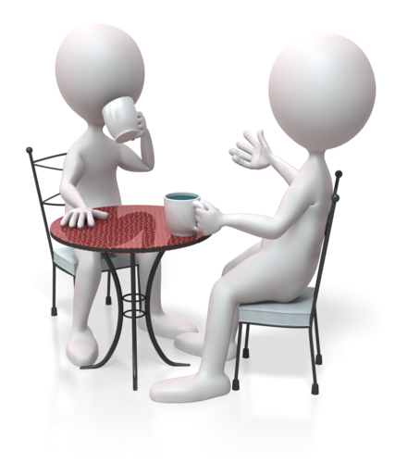
What is social development?
Social development refers to being able to build relationships with the people around us.
Social skills are an important life skill and carers need to be able to encourage socially accepted behaviour.

Slide 20

Theories of social development
It is generally agreed that both nature and nurture have an impact on an individual’s personality. This means that childcare workers need to have some knowledge of social development theories to encourage social skills.
These include:
Erick Erikson’s psychosocial stages
Jian Piaget’s moral development
Kohlberg’s stages of moral development.

Slide 21
Stages of social development
In order to assess and monitor development, you will need to know the different stages of development and how they are related and in what sequence they occur.
For example:
1 month | Makes eye contact and watches faces of those closest to them
3 months | Smiles and coos and enjoys a cuddle
6 months | Laughs

Slide 22

Assessing and monitoring social skills
Try to determine if children are gaining in confidence.
For example:
Are they joining in conversations?
Are they playing alongside others?
Do they lead play?
Are they smiling while they play?
Do they try new things?

Slide 23
Activity 2A

Slide 24
Foster social development
2.2 Plan and provide opportunities for different forms of social interaction between children during play with respect for each child’s interests, goals and development stage

Slide 25

Types of social interaction
There are different types of social interaction, including:
Greetings
Goodbyes
Manners
Socially accepted behaviour.

Slide 26

Planning activities
Your plan should go into specifics, for example:
The development stage and interests of each child
The equipment needed
Day and time
Any materials that you need for the activity
Who will help out or be involved with the activity.

Slide 27
Activity 2B

Slide 28
Foster social development
2.3 Create opportunities for children to participate in meaningful ways in group discussions and shared decision-making

Slide 29

Group discussions
Ideas for group discussions:
Sit down in a circle and open a topic of discussion
Set up equipment that will lead to the need to share
Be a good role model
Show and tell
Teddy bear picnic.

Slide 30

Shared decision-making
Shared decision-making is important as it empowers children and gives them autonomy.
Ideas for shared decision-making:
Ask a group of children what story they would like (give them a choice of two or three)
Ensure children have the opportunity each day to choose their own activities ‘free play’.

Slide 31

Inclusion
Children with disabilities or conditions should be given the opportunity to participate in conversations.
Try:
Small group discussions or play activities
Clear rules
Visual cues
Communication through sign language.

Slide 32
Activity 2C

Slide 33
Foster social development
2.4 Structure experiences in a way that promotes cooperation and conflict resolution

Slide 34
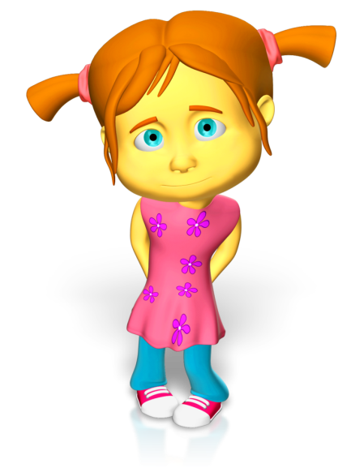
Conflict
Children apologising should:
Make eye contact
Say the name of the child they are apologising to
Say sorry
Say why they are sorry.
Example: ‘Jessica I am sorry I pushed you’.

Slide 35
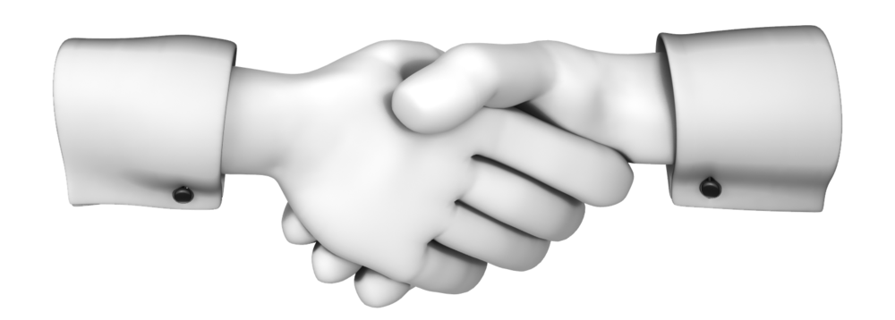
Promoting cooperation
Construction activities can be good for cooperation as children can build a tower or train track together.
Pretend play is good for role playing polite conversations.
Puppets and puppet shows can demonstrate cooperation to children (role play too).
You should reward children who are behaving appropriately.

Slide 36
Activity 2D

Slide 37
Foster social development
2.5 Promote a sense of community within the service

Slide 38

Promoting a sense of community
Promoting a sense of community is about identity and belonging.
Children need to feel secure and like they belong to part of the group.
They should feel accepted and it is important for childcare workers to treat every child equally.

Slide 39
Communicating to parents/carers
How can you best communicate with parents/carers? For example:
Are all parents/carers literate?
Have they any special requirements?
Can your setting or actions be adapted to meet the needs of parents/carers?
Do they have preferences that you need to take into account e.g. about routines feeding of children?

Slide 40
Activity 2E

Slide 41
Foster social development
2.6 Arrange the environment to encourage interactions between children as well as accommodating a child’s need for privacy, solitude or quiet

Slide 42
Arranging the environment
Encourage interactions
Outside area
Dressing up and role play e.g. home corner
Solitude and quiet
Nap area
Listening centre e.g. music or audio books
Book corner
Creative play, Water, sand, paint, etc.

Slide 43

Quiet area
The quiet area should be:
Comfortable, such as:
  beanbags
  carpet and rugs
  blankets
  cushions
  soft toys
Private, such as:
  a corner of the room
  a tent
  a screen or bookcase that screens off the area.

Slide 44

Encouraging interaction
You should:
Be spacious enough to allow small group play
Include tables and chairs for sitting and carrying out set group activities
Have plenty of materials/toys.
Ensure it is stimulating e.g. bright colours.

Slide 45
Activity 2F

Slide 46
Foster social development
2.7 Provide opportunities for children to investigate ethical issues relevant to their lives and their communities

Slide 47

What are ethical issues?
Ethical issues may include:
What is right and wrong
Our responsibilities and rights
Our decisions and reactions.

Slide 48

Children and ethics
Children may have different levels of understanding when it comes to ethical issues.
Childcare workers should get children to think about their behaviour:
Why they reacted as they did?
Why should we do this?
Is this good or bad?
Is this right or wrong?
How would this make you feel?

Slide 49

A values system
Incorporating a values system, that children can understand, into experiences can help to guide them and develop a sense of morality.
For example:
We are kind to each other
We look after toys
We are helpful
We try our best.

Slide 50
Activity 2G

Slide 51
Foster emotional development
3.1 Assess and monitor children’s emotional development

Slide 52

Emotional development?
Emotional development is about how we manage our feelings of frustration, joy, anger, sadness, jealousy, etc.
It can also relate to how we see ourselves and how secure we feel in our surroundings.

Slide 53

Self concept and self esteem
Self-concept is what a person believes they are like or the way we see ourselves. The forming of an identity is something that has been theorised and has stages of development.
Self-esteem is formed through making comparisons about the person we want to be and the person we think we are.

Slide 54

Attachment theory
Attachment theory is about how children need to form a strong bond with their primary carer to develop relationships with others.
John Bowlby (1907-1990) developed an attachment theory and his theory opened people’s eyes to the idea that children need to form strong attachments and changed child care practices.

Slide 55
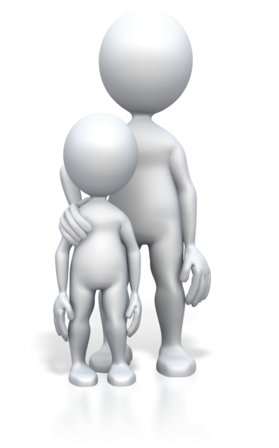
Assess for good attachment
You should record:
Is the child seeking their care giver?
Do they cry or get upset when the care giver leaves/cannot be seen?
Are they happy to see caregiver or show signs of relief when care giver reappears?
Do they pay attention to the care giver’s presence?

Slide 56

Emotions in children
You should try and gain an understanding about what is normal for a child or if there are any outside factors that could be having an impact on emotions.
Children can react to changes in routine and can sense when their care givers are emotional too. If a parent is stressed it can upset or worry a child.

Slide 57

Using event samples
Event samples are good for assessing concerns about emotions a child may be struggling to manage.
They focus on one type of behaviour, tracking it over a period of time (such as a week) to see how often this behaviour is displayed and the possible reasons behind it.

Slide 58
Activity 3A

Slide 59
Assess and monitor children’s emotional development
3.2 Create opportunities for children to experience individual strengths and successes during play

Slide 60

Strengths and successes
Providing a variety of activities for a range of abilities that use different skills will ensure that each child has the opportunity to use their strengths.
It is your responsibility to find out all you can about a child’s abilities so that you can plan appropriate activities for them and out equipment that they can use.

Slide 61
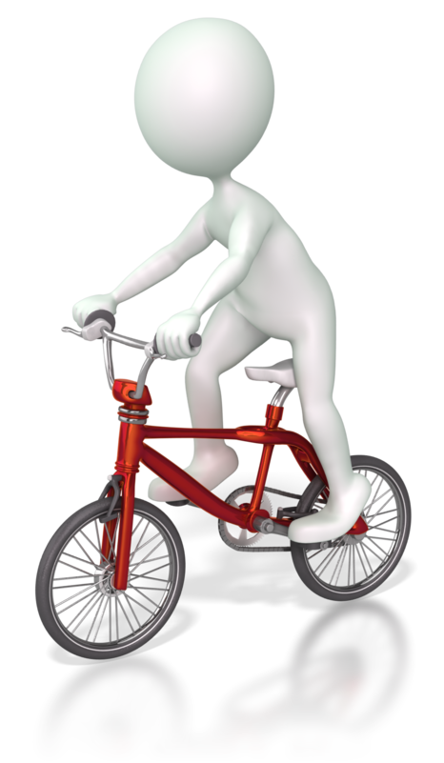
Equipment for different abilities
For example, some children may be able to ride a tricycle if they can pedal but others will not be able to pedal.
There should be equipment that enables children who cannot pedal to join in, for example, tricycles without pedals or ride-on cars for younger children.

Slide 62

Setting/environment
You should create an environment where children are able to do things for themselves. This means having facilities such as sinks, toilets, tables and chairs at a comfortable height.
Special considerations for children with disabilities should be given to help them manoeuvre around the setting.

Slide 63

Supporting children
With extra support children can sometimes have a successful experience.
For example, a child is holding a tennis racket the wrong way, helping them to turn it around and hold it correctly can help them to hit the ball.

Slide 64
Activity 3B

Slide 65
Assess and monitor children’s emotional development
3.3 Plan and provide opportunities through play that challenge children’s emerging skills and capabilities

Slide 66
Challenging emerging skills
Although you have to consider children’s strengths when deciding on activities, you should also try to challenge what they already know or can do.
Emerging skills | Skill area | Challenges
Nine month old baby can sit and reach for toys. | Physical skills – gross motor | Putting toys slightly out of reach

Slide 67

Building confidence
To take on a more challenging task, children need to:
Be confident enough to have a go at something more challenging
Have developed certain abilities for example children will not be able to read if they do not know the alphabet.

Slide 68
Activity 3C

Slide 69
Assess and monitor children’s emotional development
3.4 Provide opportunities for children to engage independently with tasks
3.5 Create opportunities for children to explore self-image and identity through play

Slide 70

Engaging independently with tasks
You could:
Provide free play time where children choose their own activities
Set up computers
Provide children with:
  a reading area
  colouring books and crayons
  jigsaw puzzles
  string and beads
Learn when to interact and when to not.

Slide 71

Exploring self-identity
Babies may like to suck their fingers and toes, look in mirrors, play peek-a-boo and look at friendly faces.
Toddlers may like to try on roles through imaginative play and dressing up and act out scenes that fill child with wonder or fear.

Slide 72
Activity 3D

Slide 73
Assess and monitor children’s emotional development
3.6 Provide opportunities for children to release feelings and express emotions through suitable experiences

Slide 74
Expressing feelings
Emotions
Anger
Joy
Jealousy
Fear
Sadness
Despair

Slide 75

Releasing emotions
Emotions can be released through:
Physical activity such as:
  running and dancing
  riding a trike
  jumping/trampolines
Imaginary play:
  dolls
  dressing up
Sensory play such as:
  water and sand
  dough/clay
  music.

Slide 76
Activity 3E

Slide 77
Foster cognitive development
4.1 Assess and monitor children’s cognitive skills and development

Slide 78

Cognitive development
Cognitive development is how children learn and think about their environment.
Cognitive development relies on:
Memory for following instructions and retaining information
Perception for learning about our environment
Concentration focusing.

Slide 79

Cognitive theories
Cognitive theories include:
Pavlov (1849-1936) devised thee theory of classical conditioning
Thorndike and Skinner’s theory of operant conditioning
Bandura (1977) social learning theory
Piaget (18896-1980) assimilation and accommodation
Bruner (1915) modes of thinking.

Slide 80
What does this mean for childcare settings?
Being a positive role model
Kind words
Be positive
Taking part in activities
Listening attentively
Giving praise

Slide 81

Observing and monitoring cognitive skills
Areas you should monitor include the ability to:
Memorise information – long term/short term memory
Learn new information (and how quickly)
Understand cause and effect
Problem solve
Concentrate on tasks.

Slide 82
Activity 4A

Slide 83
Foster cognitive development
4.2 Engineer and provide opportunities for children to participate in science, mathematics and technology experiences

Slide 84

Science activities
Science activities may include:
Baking
Sensory activities with different textures
Painting
Sticking and crafting
Racing
Water table/play
Clay and modelling
Tin can phone
Create a rain maker
Growing plants.

Slide 85
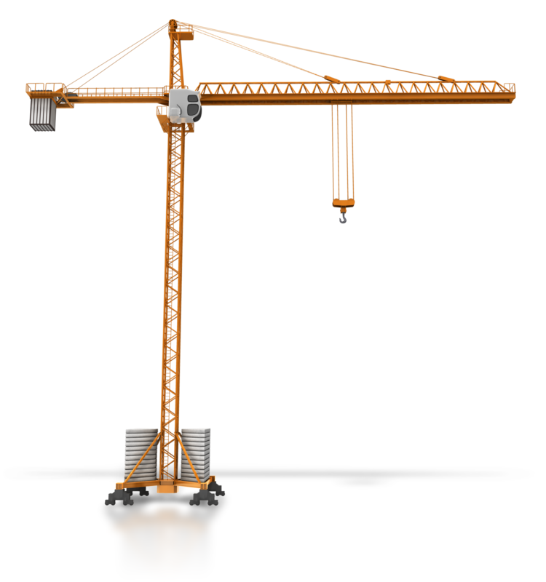
Mathematics activities
Mathematical activities may include:
Singing songs about numbers
Reading books with numbers and repetition
Playing with abacuses
Comparing size activities
Puzzles
Construction toys
Board games that involve counting spaces or rolling dice.

Slide 86

Technology activities
Technology activities may include:
Using computer equipment
Use television equipment to watch suitable videos relating to curriculum topics
Use cameras
Use stereos/radios
Play with robots.

Slide 87
Activity 4B

Slide 88
Foster cognitive development
4.3 Plan and provide opportunities through play for children to experience the consequences of their choices, actions and ideas

Slide 89

Consequences
Consequences are something that children need to be aware of, so that they can make informed decisions and learn to regulate their own behaviour.
Children in the childcare setting will only just be learning about how actions and choices can have consequences, both positive and negative.

Slide 90
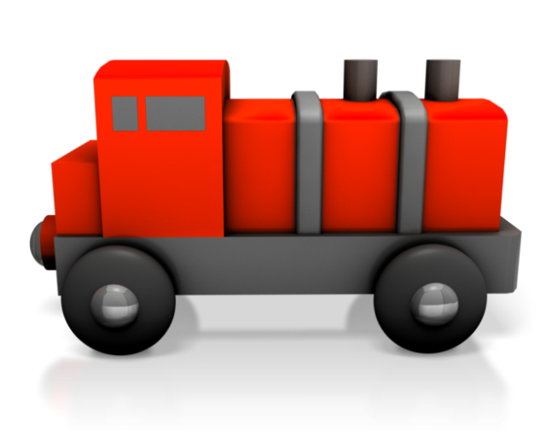
Play opportunities
Play opportunities may include cause and effect activities and toys e.g. water/sand wheels
Let children experience the natural consequences of their choices.
Socialisation with others including group activities where they can put forward ideas.

Slide 91
Activity 4C

Slide 92
Foster cognitive development
4.4 Create learning environments with appropriate levels of challenge where children are encouraged to explore, experiment and take appropriate risks in their learning

Slide 93
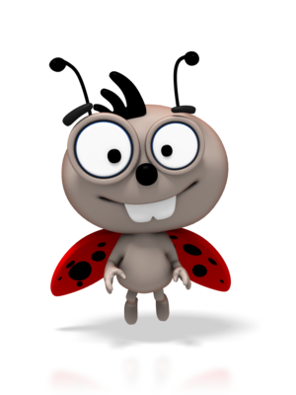
Learning environments
In general, the setting should have:
Toys and activities readily accessible
Themed areas for imaginative play
Eye-catching displays that support topics
Toys and activities for various abilities
Resources for finding out information.

Slide 94

Risks
Some risks are good for children to take, for example, answering a question.
When a child takes a risk and is successful, it boosts their confidence and enhances learning.

Slide 95

Risk thought process
You should:
Identify risks – physical, social, emotional, cognitive
Weigh negatives against positives of taking the risk
Think through actions needed to take risk
Evaluate whether it was successful or not.

Slide 96
Encourage risk taking
Be prepared to answer children’s questions (if you do not know the answer you should try to find out).
Allow children to play with items in ways that they were not designed/intended, e.g. a stick could be a wand.
Encourage a relaxed eating environment where babies can explore food, and encourage children to ask and answer questions.

Slide 97
Activity 4D

Slide 98
Foster cognitive development
4.5 Build opportunities for involvement in experiences that support the investigation of ideas, complex concepts and thinking, reasoning and hypothesising

Slide 99

Resources for inspiring ideas
Resources include:
Art materials, e.g. chalkboard and chalks, paints
Musical instruments, e.g. keyboards, shakers
Dress-up play, e.g. firefighter
Space to run around
Free-play time and outdoor play equipment, e.g. play house, trikes.

Slide 100
Investigating ideas
Challenge children to create something for example, with wooden blocks, stickle bricks, Duplo etc.
Ask children to find something (e.g. a house) from anywhere in the room – children can then pick out things e.g. toy houses, play house, pictures of houses, books with a house on, etc.
Challenge children to ‘move like a…e.g. snake, car, tree, etc.’

Slide 101

Concepts
Key concepts include:
Time
Space
Colour
Number
Mass
Temperature
Opposites
Length and height
Volume and capacity
Shape
Pattern
Speed
Symbolic representation.

Slide 102

Reasoning and hypothesising
People that are good at reasoning will be able to think logically about something in a variety of situations.
Children also need to be able to reason, so that they can overcome their strong emotions.
To encourage children to develop hypothesising and reasoning skills, you can ask questions to get them to think more carefully about their experiences.

Slide 103
Activity 4E

Slide 104
Foster cognitive development
4.6 Provide opportunities through play for children to explore concept development
4.7 Make opportunities for children to both construct and take apart, as a strategy for learning

Slide 105
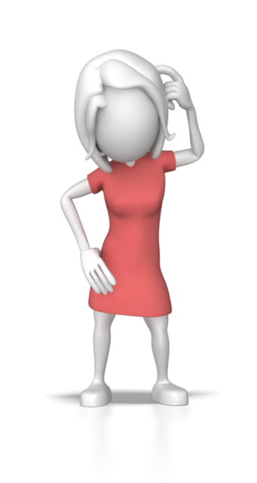
Concept development
Concepts provide a way of categorising and organising experiences; without them it would be difficult to retain and learn anything.
Concepts also have the following functions:
Identifying objects
Forming analogies
Making inferences
Building on knowledge.

Slide 106

Providing opportunities for concept development
Opportunities for concept development may include:
Matching and pairing games
Puzzles
Memory games
Threading beads/sewing activities
Construction toys
Sorting toys
Simon says
Sensory bag.

Slide 107

Creating opportunities for taking part
It is important that you encourage children to take part at every opportunity – for example, a child may say ‘I wish I could skip, but I can’t do it’.
Encourage children to take part by creating steps that get gradually more difficult.

Slide 108
Activity 4F

Slide 109
Foster cognitive development
4.8 Provide children with a wide range of everyday materials that they can use to create patterns and to sort, categorise, order and compare

Slide 110

Everyday materials
Everyday materials are materials that have not been specifically created for the use in early years’ settings, but can be adapted for:
Creating patterns
Sorting
Categorising
Ordering
Comparing activities.

Slide 111
Materials for creating patterns
Materials for creating patterns can involve the use of items like wood, pasta, coins, leaves and sponges.
For example:
You can use materials with paint like stamps to make imprints on paper
You can rub wax crayons over materials with different textures
You can stick items together to make patterns.

Slide 112

Materials for sorting, categorising
You can sort and categorise materials according to their properties, such as:
What they are made of
What they feel like
What colour they are
What shape they are
What function they have.

Slide 113

Materials for ordering and comparing
Materials can be ordered or compared by:
Size
Light or dark scale
Shiny or dull scale
Flexibility
Durability
Hard and soft
Magnetic scale
Translucidity.

Slide 114

Activities for learning about materials
Activities to learn about materials include:
Shadow puppets, which can help children to understand light and dark
Experiments, such as applying heat to materials to see what happens
Artistic activities, such as painting and sticking.

Slide 115
Activity 4G

Slide 116
Foster communication development
5.1 Assess and monitor children’s language skills and development

Slide 117

What is meant by language skills?
Language skills mean those skills that help a person communicate; it does not necessarily mean being able to talk.
Children need language to be able to socialise, express needs and develop thought processes.

Slide 118

Types of communication
There are many different ways that we communicate with each other, including:
Speech
Writing or drawing
Body language
Gestures
Sign language.

Slide 119

How do children use language?
Children use language by:
Socialising
Being assertive
Gaining help and reassurance
Self direction
Giving instructions
Asking questions
Describing things
Predicting events.

Slide 120

Stages of linguistic development
Stages of linguistic development include:
Pre-linguistic stage:
  0-3 months
  3-6 months
  6-12 months
Linguistic stage:
  1-2 years
  2-3 years
  4-8 years.

Slide 121

Language delay
Language delay can occur for a variety of reasons in children, for example:
Learning difficulties
Physical conditions
Hearing difficulties
Shyness
Lack of stimulation
If the child is learning more than one language.

Slide 122
Activity 5A

Slide 123
Foster communication development
5.2 Plan and provide developmentally appropriate experiences and opportunities to foster language and literacy development through play

Slide 124
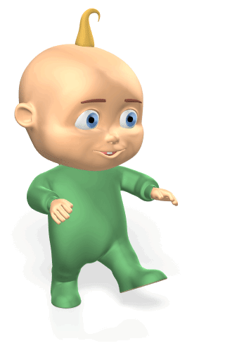
Ways to communicate with children
Think about the ways you can communicate with children at their level. This might be:
In a one-to-one scenario
In groups
Without an adult leading the conversation.

Slide 125

Activities for language development
Activities include:
Turn-taking and waiting games
Songs, rhyming and sounds
Stories
Activities to improve vocabulary.

Slide 126
Activity 5B

Slide 127
Foster communication development
5.3 Create opportunities for children to listen and respond to language

Slide 128

The importance of listening
Children need to be able to listen so that they can respond to someone appropriately.
Responding to people appropriately shows that you are keen to know what they are saying and improves relationships, helping you to retain friends.
It is also vital for retaining information and learning new things.

Slide 129
How can I listen actively?
Active listening
Nodding
'mmm, yes'
Asking questions
Repeating phrases back
Smiling (if appropriate)

Slide 130

Listening games
Games to encourage listening in children include:
Guess the sound
Red light green light
Musical statues
Do three things game
Find the sound game.

Slide 131
Activity 5C

Slide 132
Foster communication development
5.4 Value the child’s linguistic heritage and encourage the use and acquisition of home languages

Slide 133

Valuing linguistic heritage
You may have children in your setting that have different linguistic backgrounds.
It is often more difficult for bi-lingual or multi-lingual children to communicate.
It may take longer for them to speak fluently because they are trying to process two or more sets of grammatical rules at once.

Slide 134

Encourage use and acquisition of home languages
To encourage use of home, you could:
Employ someone with the same first language to come in
Ask family members to come in and talk about their culture
Celebrate any significant festivals or holidays
Have a themed area dedicated to the different cultures
Display information bilingually and translate information.

Slide 135

Considering preferences and being respectful
Considering a main carer’s preferences and being respectful towards carers, no matter what their background, will help children relax and enjoy their time at the setting.
If a child has familiar items around them, it will create a safe familiar place where they can concentrate on learning.

Slide 136

Handmade toys and natural resources
Some parents may like to see handmade or toys from natural resources being used.
For example:
Knitted animals
Handmade puppets
Garden area
Sand and water play
Wooden blocks and play sets.

Slide 137
Activity 5D

Slide 138
Foster communication development
5.5 Provide opportunities for children to engage with familiar and unfamiliar culturally constructed text
5.6 Create a literacy-enriched environment including displaying home languages and Standard Australian English

Slide 139
Foster communication development
5.7 Provide resources that encourage children to experiment with images and print

Slide 140

Culturally constructed texts
What is familiar and unfamiliar will differ depending on the child’s individual culture.
Things to try:
Ensure book corner is stocked with lots of culturally familiar and unfamiliar texts
Listen to audio stories of different cultures
Ask relatives to come in and tell a story.

Slide 141

Providing a literary-enriched environment
You can provide a literary-enriched environment through:
Indigenous stories
Atlases
Globes
Poster maps
Characters that represent various cultures
Flag matching games or puzzles
Alphabet and number frieze
Musical instruments
Different ways to move to music
Artwork from different cultures.

Slide 142

Encourage children to experiment with images and print
Using paint to create prints:
  finger, hand and foot printing
  printing with a variety of different objects
Using computers to design pictures and print them
Creating collages of different materials:
  tissue paper
  magazines
  card
  foil.

Slide 143
Age-appropriate books
It is important to think about the child’s age and ability when selecting a book. There are different aspects of books that children will enjoy as they develop.
Age | What children enjoy at this stage
0-6 months | Chunky books Large pictures and bright colours Bath-proof book
2-3 years | Books with familiar scenes Rhyming books Alphabet, shapes and sizes Character books

Slide 144
How can you share books with children?
You should:
Have regular routine for sharing books each day
Be expressive when reading
It does not matter if you cannot finish the story
Let children feel the books and turn pages
Talk about the pictures in the story
Ask questions about the story and encourage children to ask questions
Run your finger underneath them when reading.

Slide 145
Activity 5E

Slide 146
Foster an environment for holistic learning and development
6.1 Support and initiate inquiry processes, try new ideas and take on challenges
6.2 Provide resources and materials that offer challenge, intrigue and surprise

Slide 147

Holistic approach
It has become increasingly important for early years educators to think about development as a whole.
Holistic teaching is an approach that looks at and develops all areas that help children to reach their full potential.
These areas include physical, emotional and psychological wellbeing.

Slide 148
A holistic environment
To promote a holistic environment:
Provide opportunities to experiment
Provide free play opportunities
Promote a sense of community
Deal with children sensitively
Provide activities that allow children to cooperate
Encourage self-help skills
Mix outdoor play with indoor activities
Have a quiet area and quiet time.

Slide 149
Supporting and initiating inquiry processes
You should:
Be a good role model
Make comments about your environment
Plan activities around the interests of children
When asked a question, ask children what their thoughts are before answering
Use the library to explore books
Ask open ended questions
Encourage children to ask each other questions
Create an environment that promotes curiosity.

Slide 150

Try new ideas and take on new challenges
New ideas may include:
Trying new foods and ways to eat them, e.g. sharing, self-serving, chopsticks
Eating in different ways, e.g. picnics, at the table, at a BBQ
Create challenges for children, e.g. you notice a child can jump so you challenge them to hop on one foot.

Slide 151

Resources and materials
Resources may include:
Challenge:
  baby gyms
  puzzles
  beads
Intrigue:
  books with flaps
  natural materials
  cornflour and water experiment
Surprise:
  jack in the box
  pop-up books
  peek-a-boo games.

Slide 152
Activity 6A

Slide 153
Foster an environment for holistic learning and development
6.3 Assist to promote children’s sense of belonging and connectedness

Slide 154

Promote a sense of belonging and connectedness
To promote belonging, you may:
Make the surroundings welcoming
Host events for families to attend
Have an open door policy
Collaborate with families
Provide information on community events and support for families
Cover topics such as families, culture and geography
Ask children what they like
Build a bond with families.

Slide 155
Activity 6B

Slide 156
Foster an environment for holistic learning and development
6.4 Engage children in sustained shared conversations to extend their thinking

Slide 157

Sustained shared conversations
Sustained shared conversations are conversations that take place with one or more child that extend thinking surrounding a topic.
The topic could have been introduced by an educator or a child.

Slide 158

Ideas for engaging in sustained shared conversations
To engage in sustained shared conversations, you should:
Listen and watch carefully to what the child is saying
Show genuine interest through body language
Invite children to elaborate on their ideas
Repeating/clarifying what children have said
Sharing own experiences
Suggesting options
Reminding children to do things
Offer different perspectives
Use encouragement to promote thinking.

Slide 159
Activity 6C

Slide 160
Foster an environment for holistic learning and development
6.5 Provide the opportunity for scaffolding learning and development

Slide 161

What is scaffolding?
Scaffolding is a process where an early educator is able to encourage a child to think about their knowledge about a topic and build on this knowledge to:
Expand areas of thinking
Provide links
Solve problems.

Slide 162
Planning effectively
Planning effectively may require you to:
Anticipate problems and how you could overcome these
Test or evaluate the activity out beforehand
Identify individual needs and abilities of children
Modify activities to suit the needs of each child
Provide clear objectives to the children
Guide children when needed
Use assessment to give feedback
Create momentum to inspire children to learn.

Slide 163

Remember…
Remember to:
Keep resources stocked up
Check that items have batteries and ensure they do not have missing or broken parts.
It is incredibly frustrating and disappointing for a child who is trying to use something that is broken or has missing parts.

Slide 164
Activity 6D

Slide 165
Foster an environment for holistic learning and development
6.6 Assist children to see their mistakes as opportunities to learn and grow

Slide 166

Learning from mistakes
Making mistakes helps children learn, as they will think about why they got something wrong and work out how they can change what they did to correct it.
Offer praise for something specific a child did well and offer a suggestion for the child to improve.

Slide 167

Accepting mistakes
To teach children how to accept mistakes, you should:
Show children that you like them unconditionally
Help children to overcome mistakes on their own
Tell children of times you have made mistakes
Encourage children to own up to mistakes
Praise children when they admit mistakes
Do not focus on child’s past mistakes.

Slide 168
Self-reflection
When children are a bit older they may be able to self-reflect. Some educators ask children to use emoticons or colours to show how they think they did.
For example:
Smiley faces or green mean ‘I can do it’
Straight faces or yellow means ‘I need some more practice’
Sad faces or red means ‘I need more help/I didn’t understand’.

Slide 169
Activity 6E

Slide 170
Foster an environment for holistic learning and development
6.7 Facilitate families’ diverse contributions to the learning community

Slide 171

Facilitating families’ diverse contributions
Families and communities are diverse; this means that they are able to contribute a variety of different perspectives and skills to benefit the learning community.
When parents are involved with the setting and make contributions, children are happier and appear more settled.

Slide 172
What sort of contributions can families make?
Facilitate contributions
Fund raising
Helpers e.g. listen to reading
Share knowledge with children
Form groups or clubs
Workshops for other families - skill share

Slide 173

Methods of communicating with families
Methods of communicating include:
Face-to-face at the beginning or end of the day
Newsletters
Notice boards
Letters to parents
Parent days
Information days
Home books
Activity slips.

Slide 174
Activity 6F

Slide 175
Foster an environment for holistic learning and development
6.8 Share information with colleagues about child development and wellbeing

Slide 176
Good working relationships
Build good relationships
Respect
Empathy
Trust

Slide 177

Information sharing
Urgent information that should be immediately shared includes:
If a child becomes ill
If there is a danger to a child e.g. broken equipment
If a child goes missing.

Slide 178

Written communication
Less urgent communication can be written down and can be part of routine communication.
It should:
Be clear and concise
Be accurate and include only facts
Contain all relevant information
Contain only abbreviations that all staff are familiar with
Check spelling and punctuation.

Slide 179
Activity 6G

Slide 180
Foster an environment for holistic learning and development
6.9 Create learning environments where children are able to immerse themselves in self-directed play

Slide 181
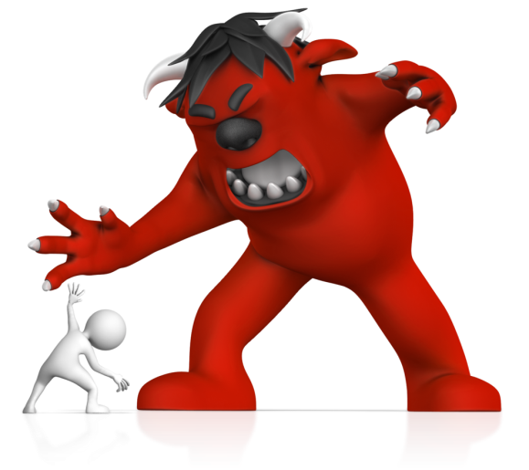
Self-directed play
Self-directed play or pretend play can help children:
Learn at their own pace
Try different roles out
Develop creativity skills and a good imagination
Can help to express built up feelings
Feel powerful.

Slide 182

Theories of play
Theories of play include:
Friedrich Froebel (1782-1852) child-centred approach
Margaret McMillan (1860-1931) direct experiences
Susan Isaacs (1885-1948) movement and opportunities for outdoor activities.

Slide 183

What can you do to encourage self-directed play?
To encourage self-directed play, you can:
Provide enough materials
Provide a safe environment
Provide age-appropriate materials that are safe
Avoid gender stereotyping
Create a themed area such as schools, offices etc.
Provide resources that reflect an array of cultures.

Slide 184
Activity 6H

Slide 185
Foster an environment for holistic learning and development
6.10 Recognise spontaneous teachable moments as they occur and use them to build on children’s learning
6.11 Ensure a balance between child-initiated and educator-supported learning

Slide 186

Recognise spontaneous teachable moments
Spontaneous teachable moments are moments where you can see an opportunity to teach a child something.
They are spontaneous, as you will not have planned it; the child will come to you with a question or look intently at something.

Slide 187

Tips for communicating with children
When communicating with children:
Try to use simple words
Use short sentences that give the opportunity for reflection
Use aids such as visual cues or videos
Use experiments or practical elements to demonstrate
Ask children if they have understood what you mean.

Slide 188
Balancing child-led and supported learning
Adult-led activities are activities that have been pre-planned as part of the curriculum and follow strict rules.
Child-led activities are activities that children will engage in without adult rules; they usually involve imaginative scenarios.
Child-led
Adult-led

Slide 189
Activity 6I

Slide 190
Foster an environment for holistic learning and development
6.12 Provide learning environments with appropriate levels of challenge where children are encouraged to explore, experiment and take risks in their learning

Slide 191

Providing a challenge
Once children have mastered a skill, it is important to help them develop it further.
Children are different and some will have less confidence when it comes to certain skills.
Never force children to take part as this can have a negative impact.

Slide 192

Challenging emerging skills
You will need a base line of what each child can do, so that you can plan for the next stage.
There is a fine balance between encouraging development of skills and setting children up to fail.

Slide 193
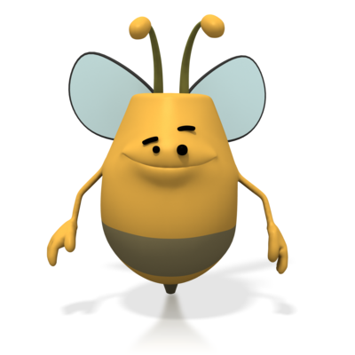
Learning environments
In general, the setting should have:
Toys and activities readily accessible
Themed areas for imaginative play
Eye-catching displays that support topics
Toys and activities for various abilities
Resources for finding out information.

Slide 194
Risks
Some risks are good for children to take for example, answering a question.
The thought processes involved in risk taking:
Risk identification – physical, social, emotional, cognitive
Weigh negatives against positives of taking the risk
Think through actions needed to take risk
Evaluate whether it was successful or not.

Slide 195

Risks
You should:
Be prepared to answer children’s questions
Allow children to play with items in creative ways
Encourage a relaxed eating environment, where babies can explore food
Encourage children to ask and answer questions.

Slide 196
Activity 6J

Slide 197
Foster an environment for holistic learning and development
6.13 Facilitate team collaboration of assessments and evaluation in relation to child development and wellbeing

Slide 198

Collaboration with colleagues
Colleagues may include those working with you at the setting, and those who are more removed but working in partnership.
The effective communication of information plays a highly important part in facilitating team collaboration.

Slide 199

Templates
You may use templates that help to communicate information in a structured and consistent way.
For example, assessment of learning outcomes templates are used when all necessary information has been collected from all sources over a period of time.

Slide 200

Early Years Framework’s learning outcomes
The EYF’s learning outcomes are:
Children have a strong sense of identity
Children are connected with and contribute to their world
Children have a strong sense of wellbeing
Children are confident and involved learners
Children are effective communicators.

Slide 201
Activity 6K

Slide 202
Summative Assessments
Summative assessments consist of:
Skills Activity
Knowledge Activity
Performance Activity.
Your assessor will provide you with further guidance on how and where to complete these assessments.

Slide 203

Summary and Feedback
Did we meet our objectives?
How did you find this session?
Any questions?

