Slide 1

Simply Clothing
Dwi Nugraha

Slide 2
Agenda
New Mission
What this means

Slide 3
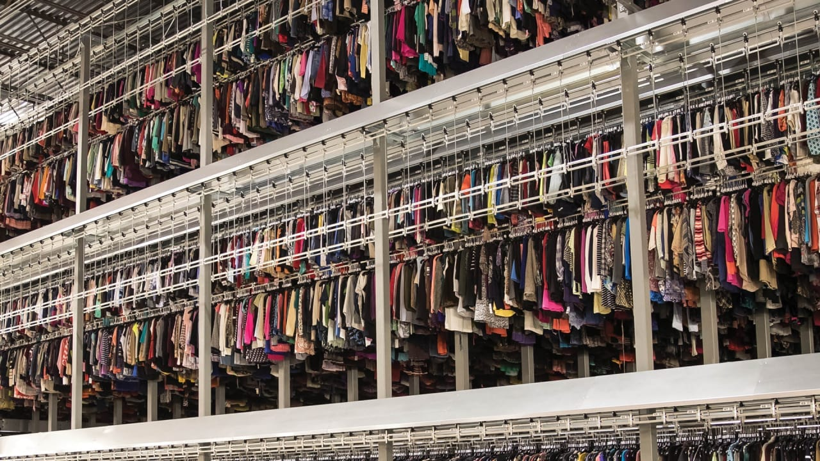
New Mission
Simply clothing are on the mission to reduce fast-fashion
We have found new suppliers who will provide us with ethically sourced clothing

Slide 4

What this means
Taking on new suppliers means that our prices are going to increase

