Slide 1

PLANT REGISTRATION AND HIGH RISK WORK LICENSING
WORK HEALTH AND SAFETY OFFICER

Slide 2
Assessment Criteria
Describe the general administrative requirements relating to the registration of plant and plant design.
Describe the requirements for the registration of plant.
Describe the statutory and minimum requirement relating to the licensing of a person.
List at least three High Risk Work Licence classes under the current Work Health and Safety Legislation

Slide 3
Plant Registration
The WHS Regulation prescribes registration requirements for certain types of plant. These registration requirements are broken up into two separate types of registration:
Registration of plant designs
Registration of plant.

Slide 4
Design Registration
pressure equipment, other than pressure piping, and categorised as hazard level A, B, C or D according to the criteria in Section 2.1 of AS 4343 Pressure equipment—hazard levels
gas cylinders covered by Part 1.1 of AS 2030.1 Gas cylinders—General Requirements
tower cranes including self-erecting tower cranes
lifts, including escalators and moving walkways
building maintenance units
hoists with a platform movement exceeding 2.4 metres, designed to lift people
work boxes designed to be suspended from cranes
amusement devices covered by Section 2.1 of AS 3533—Amusement Rides and Devices
concrete placing booms
prefabricated scaffolding
boom-type elevating work platforms
gantry cranes with a safe working load greater than 5 tonnes or bridge cranes with a safe working load of greater than 10 tonnes, and any gantry crane or bridge crane which is designed to handle molten metal or Schedule 11 hazardous chemicals
vehicle hoists
mast climbing work platforms
mobile cranes with a rated capacity of greater than 10 tonnes

Slide 5
Plant Registration
pressure vessels—pressure equipment, other than pressure piping, and categorised as hazard level A, B or C according to the criteria in section 2.1 of AS 4343:2005 (pressure equipment—hazard levels), except
  gas cylinders
  LP gas fuel vessels for automotive use
  serially produced vessels
  pressure equipment excluded from the scope of AS/NZS 1200:2000 stated in section 4(1)
concrete placing booms
mobile cranes with a rated capacity of greater than 10 t
tower cranes including self-erecting tower cranes
amusement devices classified by section 2.1 of AS 3533.1:2009 (Amusement Rides and Devices - Design and construction), except devices and structures stated in section 4(4)
lifts and escalators and moving walkways
building maintenance units
boilers categorised as hazard level A, B or C according to criteria in section 2.1 of AS 4343:2005 (Pressure equipment - Hazard levels).

Slide 6
Inspection Requirements
The PCBU that is in control of an item of registrable plant must keep a record of all tests, inspections, maintenance, commissioning, decommissioning, dismantling and alterations of plant for the period that the plant is used or until the person relinquishes control of the plant.
The maintenance, inspection and testing must be carried out:
in accordance with the manufacturers recommendations, if any; or
if there are no manufacturer's recommendations, in accordance with the recommendations of a competent person; or
in relation to inspection, if it is not reasonably practicable to comply with paragraph (a) or (b), annually

Slide 7
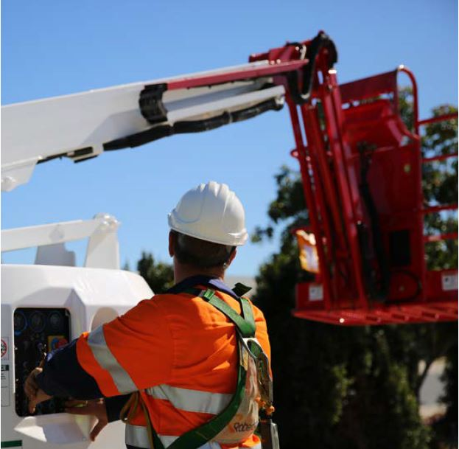
Additional Requirements
Amusement devices
Registered mobile cranes and tower cranes
applications

Slide 8
Licensing
Anyone carrying out high risk work must hold a high risk work licence.
High risk work licences:
Cranes and hoists
  As of 1 January 2017, the RS HRW licence class must be held for the operation of a reach stacker.
  The description for the licence class PB has altered and no longer refers to mobile truck-mounted concrete placing booms only.
Forklift truck
Rigging and dogging
Scaffolding
Pressure equipment
Boom-type elevating work platform with boom length of 11m or more
Concrete placing boom
Boilers, steam engines and steam turbines

Slide 9
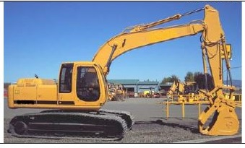
EPC
From 1 January 2012 earthmoving or particular crane (EPC) certificates are no longer required. Queensland will continue to facilitate and promote competency based training and assessment for these occupations.

Slide 10
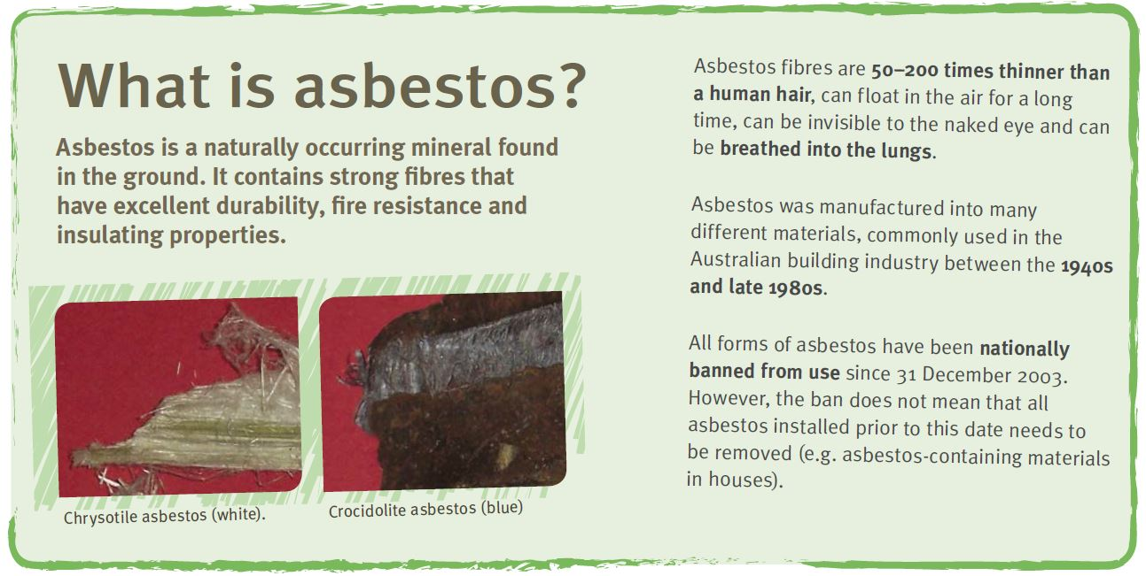
Asbestos Licence
There are two types of asbestos removal licences:
friable asbestos - class A
non-friable (bonded) asbestos - class B

Slide 11
Demolition Work
You must have a demolition work licence to demolish or dismantle a structure that:
contains pre-tensioned or post-tensioned structural components
involves use of load shifting equipment (e.g. use of combination front-end loader and backhoe, skid steer loader, excavator, crane).
involves the use of explosives or another induced collapse method.

Slide 12
Interstate Recognition
Only current HRW licences are recognised throughout Australia.

Slide 13


