Slide 1
Organising Workplace Information
Chad o’neill

Slide 2
Common Ways To Access Information
Method (i.e. computer | Process | Organisational requirements
Computer | Ask the manager to search the database on the computer | Make sure that you have the manager permission from the manager
Printed documents | If the document is in the office make sure to have permission from the manager to go into the office, if you can freely read it | Make sure that you have the managers permission
Through updates and White board | Look at noticeboard to see if anything relevant or new has appeared | None.

Slide 3
COLLECTED INFORMATION
Once you have collected information ensure that the information is clear, accurate and relevant to the task. For example the information needs to be written in a clear and concise way that in which someone outside of the organization is able to read it and correctly understand the information.

Slide 4
Example of effective formats
Organisational features | How does it aid organisation of information
Headers and footers | The may signpost the document and outline what is being addressed as well as displaying information in a formal way
Symbols | This may signpost the reader to particular elements of the analysis. Symbols may represent particular parts of the document that could be cross-referenced, and again, keeps it simple
Graphics and pictures | Images may help colleagues, or whoever is exposed to the information, to see information in a concise way. Sometimes it will convey the information far more effectively than describing data
Tables and charts | As aforementioned, this can be an easy way of displaying data. They are easy to use on the above applications and can be displayed in a variety of ways
Software applications | The software application will depend on your organisation, however plenty of applications are available that can help you organise information. A generic application will allow you to select information, format the data into graphs and charts etc
Legends | Legends can be used to provide more information alongside a chart

Slide 5
What is the purpose of collating information?
Collating information, in the context of business, is when you bring documentation together from a range of sources and compare, arrange and organise the documents.

Slide 6
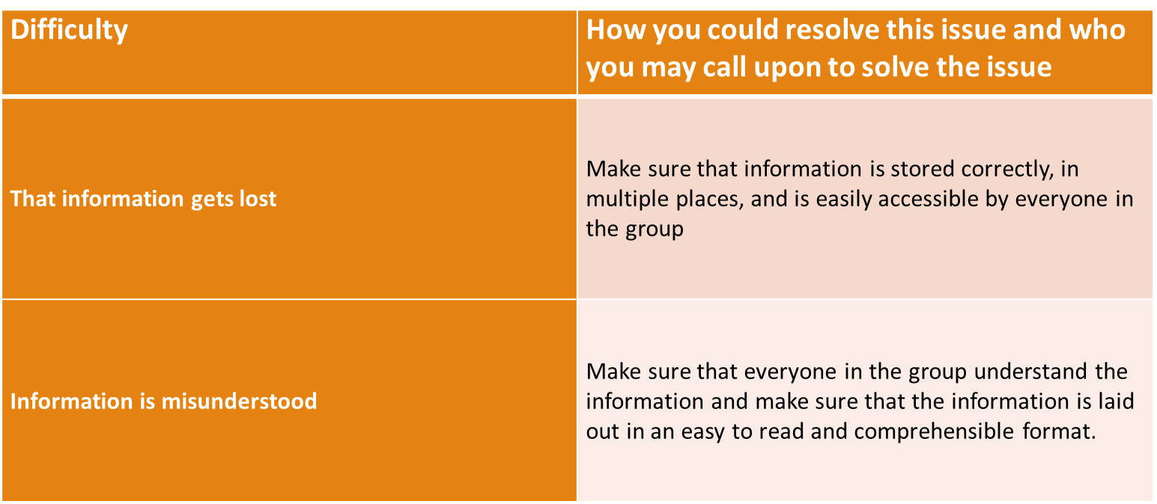
Example of possible difficulties

Slide 7
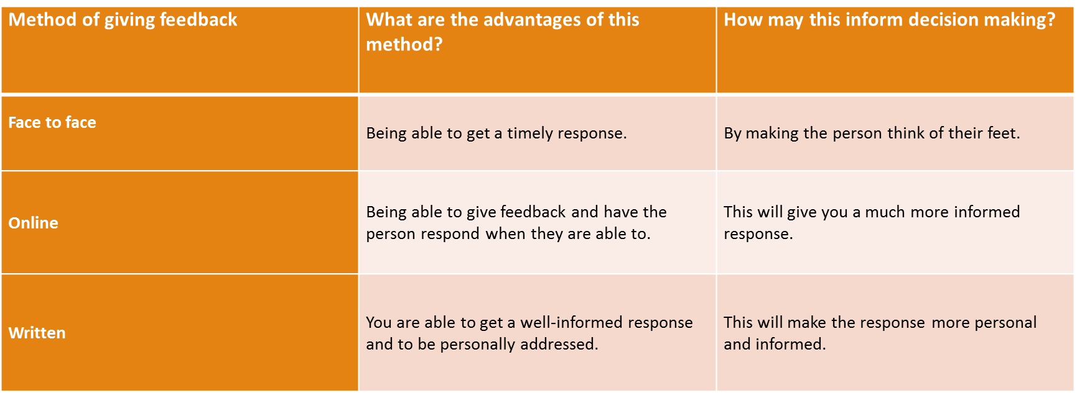
Feedback Opportunities

Slide 8
Legislation
Legislation is an important factor that needs to be considered when identifying information needs. When a business is aware of what they need to adhere to, they can operate effectively and will maintain credibility with the government. This in turn builds the reputatuion in the eyes of clients and customers .as legislation changes, companies also need to be aware that this would change business protocol.

