Slide 1
WHS Hazard Identification, Risk Assessment, and Control
Delta group qtmp

Slide 2
Purpose of Presentation
To identify 1 WHS hazard
assess and control the associated risks
Clarify the legal and organizational requirements.

Slide 3
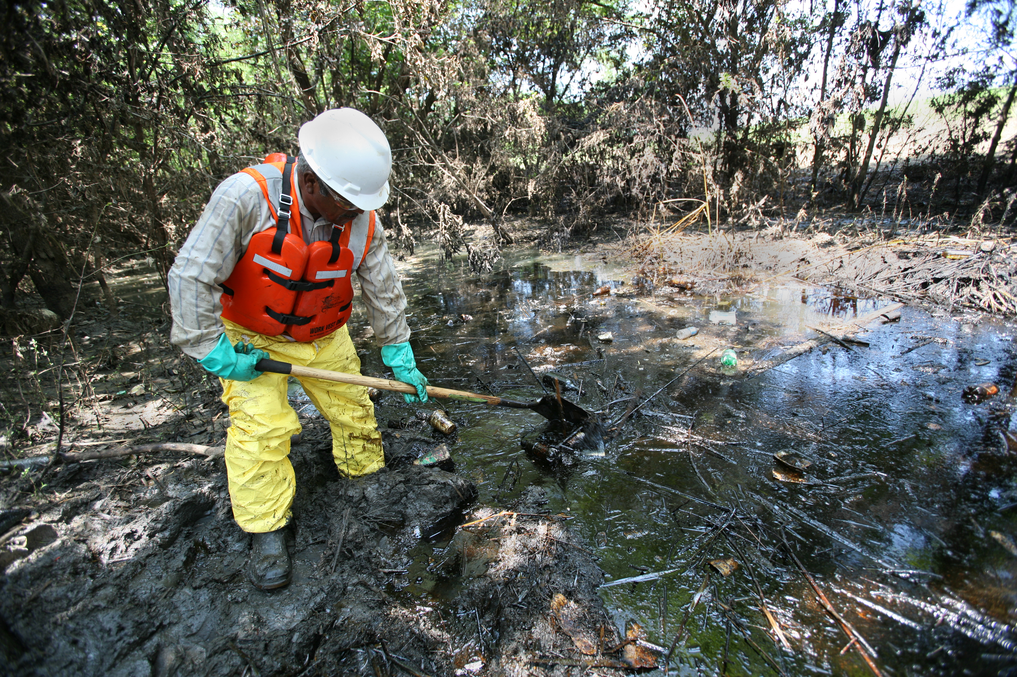
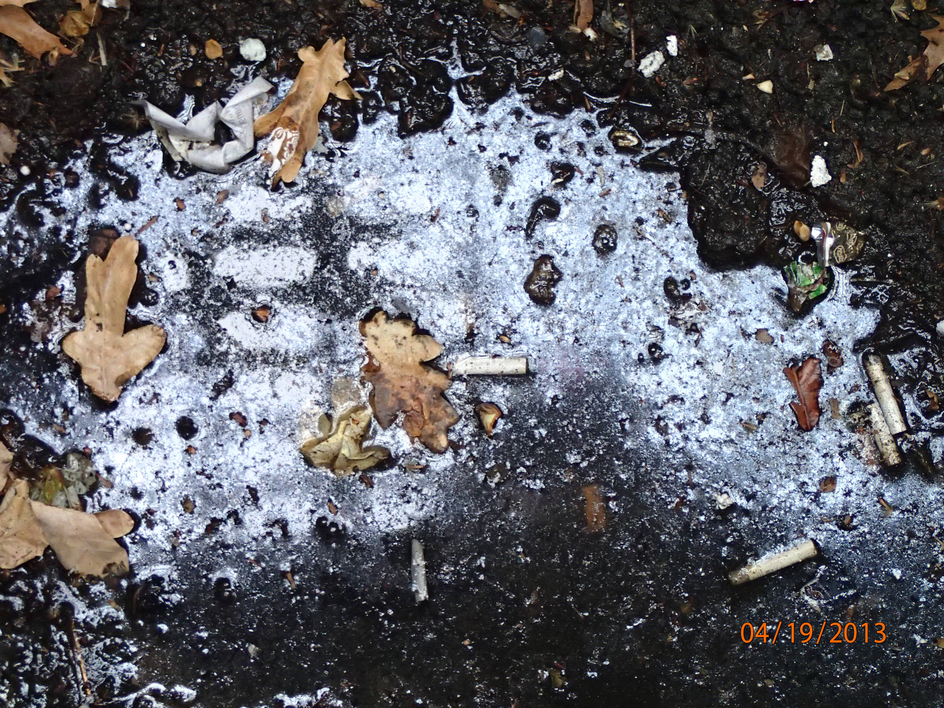
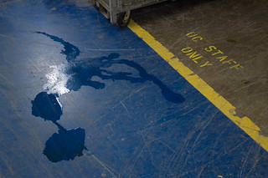

Hazard: Chemical Spill (Hazardous Substances)
Nature of Hazard: Spills of hazardous chemicals in the workplace.
Potential Risks: Chemical burns, respiratory problems, environmental contamination, slips and falls.

Slide 4
Legal and Organizational Requirements for Hazard Identification
WHS Act: Requires employers to ensure the health and safety of workers by eliminating or minimizing risks associated with hazards.
WHS Regulations: Mandates that hazardous substances be properly managed, with appropriate risk assessments conducted.
Organizational Policies: Delta Group QTMP’s health and safety policy outlines specific procedures for identifying and managing hazardous substances.

Slide 5
Risk Assessment Process
Identification Techniques:
Review Safety Data Sheets (SDS).
Conduct workplace inspections.
Employee feedback.
Assessment Tools:
Risk assessment matrix to evaluate likelihood and severity of chemical spills.

Slide 6
Risk Control Measures
Control Options:
Elimination: Substitute hazardous chemicals with safer alternatives.
Engineering Controls: Implement spill containment systems.
PPE Controls: Implement PPE requirements when handling hazardous chemicals
Monitoring: Workplace checklists to ensure compliance and effectiveness.

Slide 7
Responsibilities of the Audience (Chemical Spill)
Workers: Follow safe handling procedures, report spills immediately, attend training sessions.
Managers: Ensure proper training, conduct regular inspections, enforce compliance with safety protocols.
PCBU: Provide necessary resources, maintain a safe working environment, and ensure adherence to WHS regulations.

Slide 8
conclusion
Summary: Importance of identifying, assessing, and controlling WHS hazards to maintain a safe work environment.
Call to Action: We encourage all employees to participate actively in health and safety initiatives.

