Slide 1
Plan building and construction work
CPCCBC4007

Slide 2

Introduction
The information in this presentation has been designed to support you during your learning of the skills and knowledge required to plan building and construction work, including how to:
  Identify operational requirements
  Plan for construction operations
  Prepare project schedule
  Determine required resources
  Prepare and submit condition reports.

Slide 3
Acknowledgement of Traditional Owners and Elders
We respectfully acknowledge the Jagera people and the Turrbal people as the Traditional Custodians of Meanjin (Brisbane) lands, on which our office is located, and pay respects to Elders both past and present.
We also recognise those whose ongoing effort to protect and promote Aboriginal and Torres Strait Islander cultures will leave a legacy for future Elders and leaders.

Slide 4
Construction planning
The planning process is a central aspect that lasts until the closing of the project and needs a great deal of consideration. The design of projects is complex and lengthy, and projects vary in size and form
Planning for a building involves sequencing construction tasks, identifying appropriate skilled labour, physical resources and suppliers and assessing their availability, and developing documentation and advice for relevant authorities
The project manager (builder, site manager) must always understand the needs and expectations of the client so that the plan remains consistent with the project.

Slide 5
Building and construction regulations, codes and standards
In addition to the information on the drawings and specifications, you must also keep in mind that the project will need to comply with relevant building and construction regulations, codes, and standards
Some regulations only apply to specific states/territories, so it is essential to check what building and construction regulation applies to a construction project within the jurisdiction of your project
The Australian Government collaborates with state and territory governments to promote nationally consistent requirements through the National Construction Code (NCC).

Slide 6
National Construction Code (NCC)
The National Construction Code is the statutory reference for the minimum technical requirements for the design, construction, and performance of all new buildings and plumbing and drainage systems in Australia. It is important that you review the construction drawings and specifications in conjunction with the relevant sections of the NCC
A building's compliance with the NCC is dependent on whether it satisfies the General and relevant Performance Requirements specified in the NCC
General Requirements provide rules and instructions on applying the NCC to a construction project. Performance Requirements are the requirements of the NCC that must be met. It constitutes the minimum level that buildings and building elements must meet
Because of the NCC's performance-based nature, a choice of compliance pathways is opened for a construction project to comply with the NCC.
  A project may adopt either the Performance Solution or the Deemed-to-Satisfy (DTS) Solution.
  When a building complies with the NCC by using Assessment Methods provided in the NCC, this is called a Performance Solution.
  On the other hand, a DTS Solution follows the set recipe of what, when, and how to do something as prescribed in the NCC.

Slide 7
Standards
State and Commonwealth governments often refer to Australian Standards® (AS) or joint Australian/New Zealand Standards (AS/NZS) in their legislation. When this happens, these standards can become mandatory
Workplace health and safety standards are often provided in codes of practice
The NCC sets the minimum required level for the safety, health, amenity, accessibility and sustainability of certain buildings, if an Australian Standard is referenced in the NCC, then compliance with it becomes mandatory, as required under the NCC
An example of a standards used in the building and construction industry is:
AS 3959
Establishes the bushfire attack levels used to establish the requirements for construction
Bushfire attack levels: BAL Low, BAL 12.5, BAL 19, BAL 29, BAL 40, BAL FZ

Slide 8

Project plan
A project plan is a document that maps out the tasks, effort, timing, and resources needed to meet project goals within a predefined scope
It's often presented in the form of a Gantt chart because it's easy to visualise the project timeline and ensure work stays on track.

Slide 9
Basic operational requirements
A person conducting a business or undertaking (PCBU) in the construction industry must ensure that every employee has completed white card training under the model WHS Act, including those who have completed training in the past but have not done construction work in the last two years
Once an individual has completed the training, they can request a white card from a WHS regulator. In Australia, a white card issued in one state or territory or by the Commonwealth is recognised in all other states or territories
Contact the WHS Regulator in your state or territory or the Commonwealth for more information about white card preparation, cross-border identification, applications, and renewal of white cards
A high-risk work licence is required for certain high risk work, such as operating some types of cranes or carrying out scaffolding work. It is important that you ensure relevant workers and operators hold current licences.

Slide 10
Contract documents
Contract documents are written documents that specify the duties, obligations, and work of the construction contract and are legally binding on the parties to the contract (owner/client and contractor)
It is necessary for the person drafting the contracting specifications and other documents to clearly understand what the effects of the contract documentation do and do not constitute; failure to properly classify the contract documents may be a major contractual flaw
Following the contract-writing axiom ‘say it once in the right place’, what constitutes the contract documents should be indicated at only one venue (preferably the owner-contractor agreement). The listing of the contract documentation should be complete and unambiguous to maximise the potential for consistent interpretation and should not include any documents that should not rightfully constitute contract documents
  In this respect, common examples of vagueness include phrases such as: ‘the contract documents include all exhibits, attachments, supplements, and all other such documents used as contract modifications.’

Slide 11
Documents required as part of a contract
Contract document
  Documents that are designated in the agreement and altogether comprise the contract
Bidding document
  These are the proposed contract documents and all bidding requirements
  Bidding requirements
    These are the advertising or invitation to bid, instructions to bidders, bid bond or other bid protection, if any, the bid type, and the bid with any attachments
Drawings
  This is the section of the contract that describes the complexity, scope, and purpose of the work to be done by the contractor
Specifications
  The portion of the contract consisting of written content, equipment, processes, specifications, and workmanship criteria as applied to the work and certain administrative and procedural requirements relevant to the work.

Slide 12
Review the contract for unusual aspects of construction
Even if you use a standard type of contract, various aspects of construction that are out of the ordinary may be included in this contract
This may not be protected in the contract's wording, but you can see this distinct type of construction by looking at the plans and specifications. Read the plans and requirements so that every distinct aspect of construction can be confirmed. These are often explicitly noted in the contract, so read the agreement carefully
There are restrictions that are imposed on the forms of construction when constructing in some regions. There will be several different aspects of construction, including the use of materials and style of construction that would not be used in other fields, for example if building is in a bushfire-prone area
You may need to consult with others regarding construction aspects demonstrated in the contract and the plans.

Slide 13
Use of materials
The contract documentation may place limits on the use of certain materials or on the other hand may specify that certain materials must be used. The plans and/or specifications may note these materials and how they are to be used
Before starting the construction of the project, it is necessary to ascertain in the contract documentation what materials are to be used and how they are to be used. This then needs to be included when planning of the project.

Slide 14
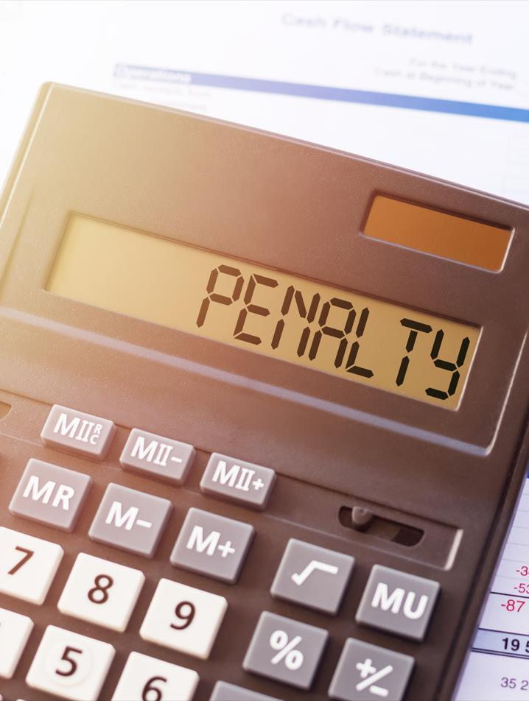
Penalties
The contract documentation may mention penalties that may be incurred in the construction process.
  For example, if a certain stage is not reached at the appropriate time, it may incur a penalty. If the project is not finished within a certain time, there may be penalties incurred because of this
Penalties may also be incurred if the wrong material is used for any number of reasons. These penalties must be mentioned in the contract documentation.

Slide 15
Finding workers and subcontractors
Advertise for trades and other workers
  If the organisation does not have enough manpower to accomplish tasks, depending on the need, it may need to hire additional trades, workers or other personnel
  It will be appropriate to advertise for this or pursue these employees from labour hire companies to find these extra employees.
  Whatever technique is used, it must be applied in compliance with workplace processes. As such, strategies for the interviewing of these potential workers must be in place so that the best qualified candidates are hired
Appoint project managers and/or supervisors
  The scope of the project will decide whether project managers or supervisors are needed
Subcontractor tenders
  If tenders have been received from subcontractors, the workplace will determine which subcontractor/s to use and contact them regarding the success of their tender
  These tenders will become part of the project's subcontractor contracts. The scheduling of the use of these subcontractors will continue after these contracts have been accepted and signed.

Slide 16
Subcontractor availability
You may have obtained quotes or prices from your subcontractors while you were preparing tender papers. Once you had obtained these rates, they would have been included in the tender documents which would have been included in the final price of the contract
The nominated sub-contractors must also be aware of the scheduling of their work on the site. They must know when they are supposed to start work and complete their work. There could be a need for certain sub-contractors to work at various stages of the project
  An example of this, is the plumber who is required to install the under-slab drainage and then return later to prepare pipework and drainage ready to be installed. The plumber is again expected to install the downpipes and stormwater pipes
If it is not possible for the subcontractor cited on the job to do the work, then you will have to select another subcontractor for the job
  It is crucial that subcontractors are available when they are needed
When preparing a project and working out the schedules you mut ensure availability for each different task so that the job can proceed smoothly and not be held up.

Slide 17
Other requirements from subcontractors
You must conduct comprehensive assessments of the subcontractors you work with, during your preconstruction phase
When selecting your subcontractors, consider their:
Build relationships with the best local subcontractors, keep records on each project of their success, and re-evaluate them and their work consistently.
Experience
Reputation
Accountability
Processes

Slide 18
Assess and confirm material availability
You may need to use suppliers from a preferred supplier list, or you may have to contact suppliers for the materials. By liaising with suppliers, you can ensure that the supplies for the project are available
Maintain contact with your suppliers to ensure that the supplies are not only available but are also confirmed for delivery.
Suppliers
It is important to appoint what suppliers you are going to use to supply these products before planning material schedules
Lead Time
You will need to integrate lead time into the plan if you are using a software application
Call Forward Sheets
You will need to prepare call forward sheets to allow you to have the materials ordered at the correct time
Arriving On-site
It is crucial to have your materials arrive on site. This helps the planned work to proceed

Slide 19
Identify alternatives for supplier
If a supplier is unable to procure the materials needed between the tendering period for the project and the signing of the contract for the project, it is important to find an alternate supplier
You will usually have found alternative suppliers during the estimation and tendering process
  If your first supplier option was not able to meet the specifications, you may go to these other suppliers
  Ensure these new vendors can deliver the materials at the time required for the project.

Slide 20
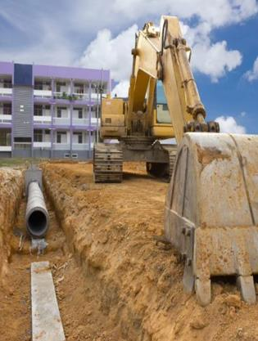
Identify site access requirements, organise site entry
Physical access to the site must be considered during planning
You need to consider this for the execution of the construction work, storage of materials, and facilities needed on site
There must be adequate access for plant to be safely used on site as well as assigned areas for the delivery of materials
Facilities that allow entry into the site must be established.

Slide 21
Site access requirements of individuals
Individuals entering a construction site must also have requirements to ensure their safety. Some sites will make use of turnstiles, security gates, and guards to ensure that only permitted staff can enter. This may include the use of control systems for electronic access such as:
  Codes with PIN
  Cards for magnetic identity
  Tokens for proximity
  Biometric appliances
Electronic access can also provide up-to-date and reliable accounting for on-site staff in addition to monitoring access and can help with health and safety regulation.

Slide 22
Limitations to site access
Construction sites can be hazardous areas, and access should be given only to approved personnel
  Furthermore, building sites may be vulnerable to vandalism, robbery, arson, etc. and the installation of temporary fencing may be needed
Site access may be hindered due to neighbouring properties, communication with neighbours may be required to assure access. Make agreements in writing when the need to access neighbouring properties or airspace is required.

Slide 23
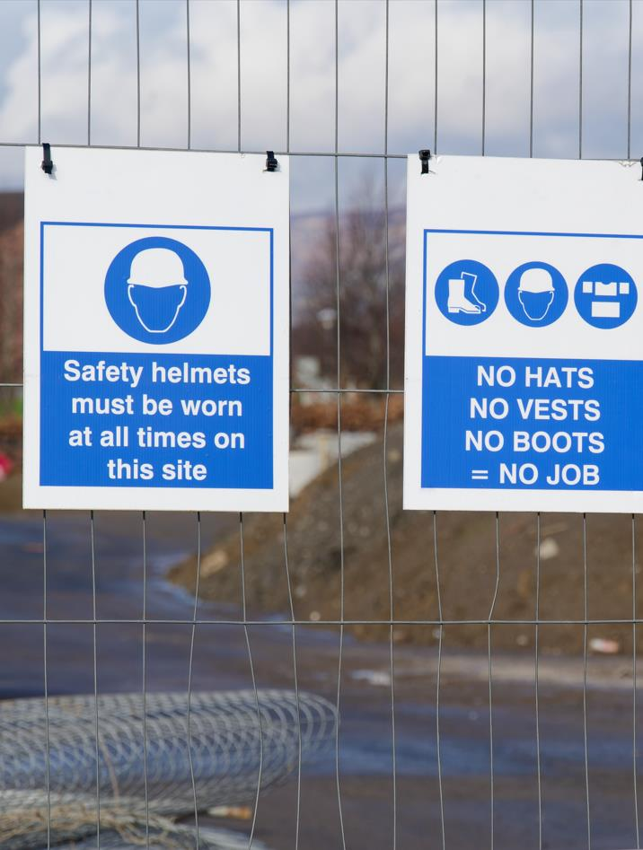
Organise site entry
construction sites will generally take perimeter security measures to control access, both for safety and to prevent injury, robbery, or vandalism. These include:
  Fencing and barriers
  Signage
  Traffic management
  Management systems.

Slide 24
Determine the project commencement date
The contract will include a provision for adding the project's start date. The project's completion date will depend on when it is started. This date is also an integral part of the contract. You will not fill in this date until you have all permissions in hand and are willing to set the start date positively
  There may be legal criteria that need to be fulfilled, such as obtaining planning permission, meeting planning conditions or planning responsibilities, and so on
The contractor may become responsible for insurance, protection of the site and so on at the beginning of the job and may be obligated to proceed consistently and faithfully with the work or to meet certain dates.

Slide 25
Contractual effects
Commencement can also have contractual effects, as the date of the contractor's possession of the site may be set out in the contract
  If the customer fails to give the contractor possession of the site, and there are no provisions for delay in the contract, they would be in violation of the contract. Even if the arrangement allows for a delay in giving the contractor possession of the site, the contractor will still be entitled to demand an extension of time and maybe damage and cost
  If no date for possession is included in the agreement, the site must be turned over to the contractor within a reasonable period after the contract has been signed.

Slide 26
Prepare and submit documentation for authorities
Approval or permits needed for projects can vary depending on project form, location, and project size
  To obtain the requisite approvals, you must efficiently recognise and communicate information with the relevant regulatory authorities(local council)
  Before construction can commence, all approvals and/or permits must be issued
Plans, drawings, and specifications included in the documents of the contract must be sent to the authorities for the approvals required. Depending on the type of project, the types of approvals required would differ
  Contact the local authority to see what applications you need to apply for your building or construction project
  Another approach is to hire a private certifier who will advise you on what applications for the project need to be submitted
Once you have been notified of the applications that need to be submitted, you can provide the plans, drawings, and other documents
  If the private certifier confirms the intended work is compliant with NCC and State building requirements and the plans, sketches and specifications are in line, they will generally issue approval for the start of work
Become familiar with the procedures and timeframes required for regulatory approvals during the planning phase. These must be considered for you to schedule a time for the start of work.

Slide 27

EPA approval
Some projects require that applications be submitted for approval to the Environmental Planning Authority (EPA)
  Until this permission has been given, work must not begin on the project
It is prudent to seek guidance from experts about the need for these and their timing when it comes to environmental applications.

Slide 28
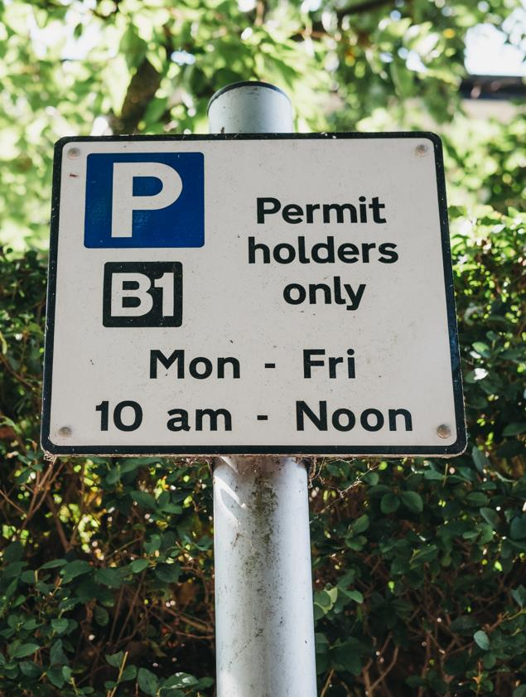
Parking restrictions
Parking limits are usually applicable to inner-city sites
You must, however, be careful of any parking limitations that apply to the vicinity of the project site
You can verify parking limitations with the local council, and request exemptions or parking permits for workers' vehicles in those areas.

Slide 29
Procedures for accepting and recording site deliveries
Review the workplace procedures for procurement, ordering and receipt of goods, this will also include procedures to ensure that the trucks and other transport that arrive at the site are monitored
  Quality control includes checking and verifying that the goods or supplies ordered for this project are the same as those delivered and in good order
Certificates are occasionally shipped with the materials
  These must be kept secure to enable you to provide them as required.

Slide 30
Accepting and recording site deliveries
Once the procured building materials have been delivered into the site, they must be checked against the standards and requirements specified in the construction specifications. This may be achieved by checking against the purchase order. You must:
Check that the delivered materials match with the materials in the specifications documents
Log received items into your workplace's deliveries system
Unpack and organise the received materials in the warehouse and safely store them
Confirm if materials delivered are for the construction project
Keep a record of each new delivery once it arrives
Check delivered materials for any damage or malfunction

Slide 31
Safe handling
It is important to get the materials properly and safely unloaded once they have arrived at the site. Many delivery trucks have a crane of their own for unloading goods. Others may arrange cranes to unload from trucks the materials. To unload the materials on site, forklifts are also used
Whatever procedure is used to unload these vehicles, it is important that the materials are handled appropriately and securely and that good work practices are used with the appropriate equipment
  The operators must be suitably qualified if cranes or forklifts are used, and the business must be covered for public liability
During unloading, care must be taken to correctly stack the goods so that when the lifting chains are released, there is no risk of the goods moving
  Often, the goods can arrive safely, but because of the stacking process, if they are not stacked correctly, they may be damaged.

Slide 32
Allocate appropriate storage for materials
The way materials are stored depends on the type of material that is being stored
Sufficient space for the material to be processed is the first thing that must be given. For the material to be unloaded into this area, access must be provided to ensure that the materials can be stored safely and correctly
  If there is a lot of material to be placed on the site at the same time, it might be prudent to draw up a schedule where you want the material stacked so that all staff are aware, and it can be put in the right position when the material arrives. It is important to consider materials that need to be accessed first for the project to have it readily available while working out this strategy
You must also consider the environmental effects on certain materials when storing
  To prevent rain from destroying certain material, materials need to be protected. To prevent dampness or run-off water from destroying the goods, they may need to be stacked on pallets
Sufficient on-site protection for the storage of materials must be provided
If there is no facility for storing goods, it is very necessary to arrange deliveries so that the inventory is not left unsecured.

Slide 33

Chemicals
Work with hazardous chemicals must be done in compliance with the “Managing Risks of Hazardous Chemicals in the Workplace Code of Practice 2021”.
If the material must be stored, it must be done so:
  In accordance with the manufacturer's requirements.
  You should be provided with a copy of these specifications or SDS.

Slide 34
Workplace health and safety
It is important that all activities undertaken at the site are conducted safely with the health and safety of workers and others in consideration
All workplace activities must be conducted in compliance with WHS legislation
Documenting a Site Safety Plan for construction work, will assist you to set out the arrangements to manage workplace health and safety on a construction project
  It sets out how you will identify, assess and control the risks related to the construction work you will undertake:
Hazard and risk assessment/Control Risk Management and Risk Register Emergency Procedures WHS training and induction WHS record-keeping Site Rules and behaviour | Dangerous Goods & Hazardous Substances Manual Handling Plant and equipment Personal Protective Equipment | Forms and checklist Emergency contacts Injury/Incident report form Induction Checklists (new workers, contractors) Training register Risk Register

Slide 35

Plan for construction operations
To ensure the effective operation of everyone involved in the project, all building projects need to have appropriate planning techniques implemented
Until construction starts, if plans are not in place, then things may be overlooked, which can result in time lost, injury and cost to the business.

Slide 36
Strategies for implementing construction operations
For effective construction management, set clear, quantifiable goals. This strategy involves defining specific targets such as project completion dates, budget adherence, and quality standards
You may need to adhere to workplace requirements relating to processes for planning/design, pre-construction, procurement, construction, and post-construction
Most construction projects have clear, documented processes in place often using appropriate software.

Slide 37
Review the workplace equipment hire procedures
It is important that the hire of plant and equipment is recorded, and the hire strategy is reviewed regularly.
A plant hire strategy should be vigorous. It should:
  Meet your project’s needs
  Identify types of machinery needed at different stages of the project and be included in the schedule
  Provide hire partner/s with:
    Good reputation and experience
    Equipment quality and variety
    Comply with safety standards and operators that are properly trained
    Support and maintenance service
    Flexible, negotiable terms
Regular reviews and adjustments are necessary to adapt to changing project demands and unforeseen challenges. Periodic assessments help:
  Evaluate Equipment Performance: Ensure hired equipment meets performance standards
  Adjust Hire Periods and Quantities: Modify hire periods and quantities based on project progress to optimise usage.

Slide 38
Hire processes may include
Ordering Procedure
Manufacturer Specifications
Proper Use of Plant
Equipment Managed and Tracked
Ensure that all equipment hired is managed and tracked so that it can be returned intact
Verification
Serial Numbers
Each hirer should have comprehensive serial numbers of each item
A verification is made when equipment is purchased to ensure that hirer information is accurate
Updated Records
It must be ordered using the ordering procedure of the company
Check that plant has been inspected and maintained in accordance with manufacturer specifications
Ensure that the supplier provides information about the proper use of the plant
It is critical that the records are updated when the equipment is returned

Slide 39
Review procedures for the removal of existing services and hazardous materials
Ensure procedures are compliant with current WHS Act and Environmental protection Act
Access the relevant codes of practice for guidance
When dangerous materials are involved and could impact the environment, the EPA has strict guidelines that must be followed
You must be particularly mindful that you will be regulated by EPA regulations if you remove polluted material from previous use of the land
Specialised training and licensing would be required to remove certain forms of harmful materials, such as asbestos.
Workplace processes for carrying out all the above work must be recorded.

Slide 40
Prepare a project schedule
A schedule is a listing of the goals, tasks, and deliverables of a project, usually with intended start and finish dates
These objects, connected by dependencies and scheduled activities, are often calculated in terms of resource allocation, budget, and time required
Scheduling often makes use of timetables such as Gantt charts to schedule and then report progress in the project setting
Initially, the scope of the project is specified, and the necessary methods are decided for completing the project
Following this step, the durations are identified and grouped into a work breakdown structure for the different tasks required to complete the work.

Slide 41
Work breakdown structure and Gantt chart
Work breakdown structures (WBS) show what you are making, and Gantt charts show when you are doing so in a bar chart. The WBS breaks down work hierarchically, from top to bottom. The Gantt chart is linear and displays time progression from left to right
  For example, when you are constructing a building, the work breakdown structure displays the component elements of the structure, such as the foundation, electrical system, and roof
  The Gantt chart focuses on dates, shows the order of project activities, and reflects any dependencies among tasks
  Dependencies are activity relationships in which the ability to start or finish one task relies on the progress or completion of another.
  For example, to paint a wall, you must first build it
Source: https://www.smartsheet.com/content/wbs-gantt

Slide 42
Work breakdown structure
Break down the job into the various building systems and components, including foundation, frame, roof, electrical, heating and cooling, water and sewage, and finishes. Then break down each component further (e.g., underneath “finishes,” list paint, flooring, and fixtures).
Depending on the complexity of the project, you may continue to decompose each component several more times, listing smaller milestones at each level. At the end, you will have a Gantt chart that includes milestones.
Source: https://www.smartsheet.com/content/wbs-gantt

Slide 43
Activity net work diagram
Using an activity network diagram that allows identification of the critical path, the logical dependencies between tasks are established
Using project management software, float or slack time can be determined in the schedule
The required resources can then be measured, and costs can be allocated to each resource for each task, providing the overall cost of the project
You can lean more about activity network diagrams at: https://www.edrawsoft.com/activity-network-diagram.html
Arrows show dependencies
Task 5 cannot begin until Task 3 and Task 4 have been completed.
Tasks are shown as boxes
Task 1
Task 3
Task 5
End
Start
Task 2
Task 4
Task 4 is a predecessor to Task 5 and a successor to Task 2.
There is both a start and an end to the project.

Slide 44
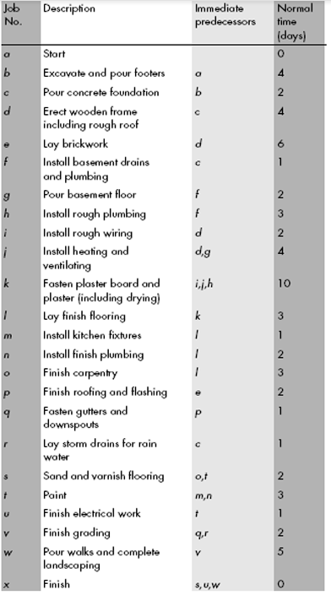
Refining critical path data for the project
Part of the approach expected to be adopted is to pursue the project’s critical path
The critical path can shift from time to time and you may have to refine the associated details
Start with the work breakdown structure
  Create a list of tasks
  Assign durations to each activity
  Connect the activities in a logical order

Slide 45
Set the task order and estimate the duration
Determine what tasks are dependent on another task first being completed
Identify the resources you need to complete the work, including personnel, materials, and equipment. These can factor into dependencies as well, such as when the person laying the flooring in the living room is also installing the floor in the kitchen. That means those two (2) tasks cannot proceed simultaneously unless you add another worker
After making these resource plans, estimate how long each activity will take. The time between the start and end is called the duration
Use appropriate software or a spreadsheet to create your Gantt chart. Enter each task on its own row. Assign one column for each day in the project lifespan. (For long-term projects, you may decide to use weeks or months.) Starting with the first task, shade in the cells across the row for each day you expect that activity will take place. Represent dependencies with arrows between the task rows. Doing so ensures that those potential schedule complications are clear.
Source: https://www.smartsheet.com/content/wbs-gantt

Slide 46
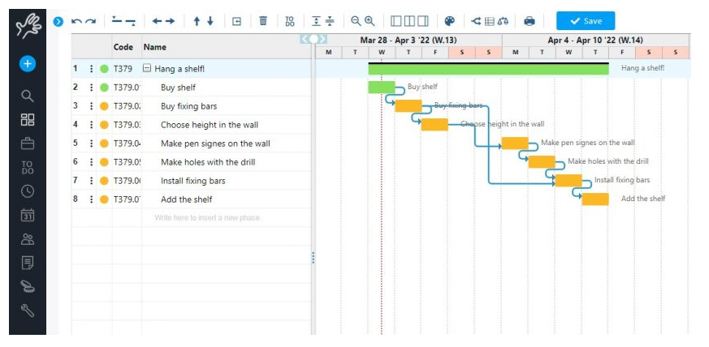
Example work breakdown structure and Gantt chart

Slide 47
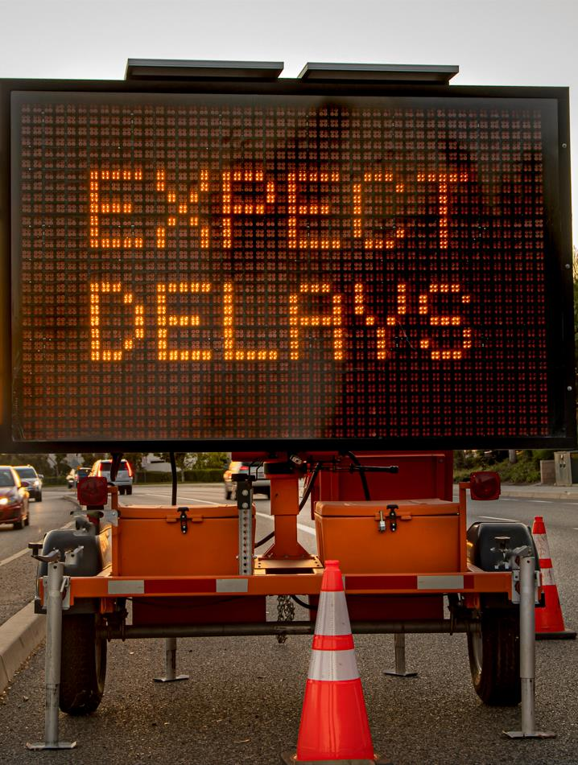
Adjust project timeframes to allow for anticipated delays
Delays can be expected right from the beginning of a project. Waiting for approvals from regulatory authorities is an example of this. Include allowance for delays in the project timeframes and preparation
There can occasionally be delays in the procurement of materials. This projected delay would also be included in the timetable and therefore in the timeframe for the project.

Slide 48
Factors impacting construction timeline
It can take anywhere from a few months to over a year to build a new residential house. It can take much longer, up to several years, for large-scale commercial building projects
Several factors can influence the timeline of your construction project, including:
Project Size and Difficulty
Weather/Season
Crew and Material Availability
Approvals, Licenses, and Inspections
Scope, Schedule, or Plan Changes
Custom Build vs. Pre-Fab Construction

Slide 49
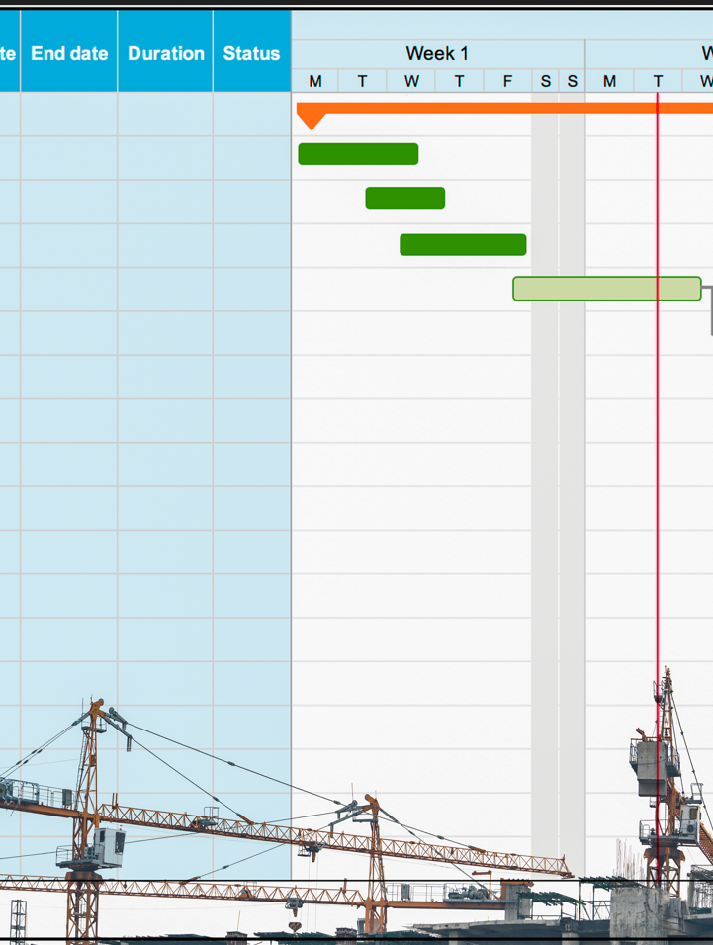
Benefits of developing a construction timeline
Allows you to communicate expectations to team members
Helps manage costs and time
Helps facilitate contractor/sub-contractor communication
Builds a work activity hierarchy.

Slide 50

Determine resources required
Projects can fall behind schedule without proper resource control or can become unprofitable. The goal is to ensure a sufficient and timely supply of resources, thus optimising the usage of resources between projects at the same time
Real-time visibility is central to resource management; what resources are necessary, what resources are available, where resources are located, and the capacity to reschedule those resources accordingly.

Slide 51
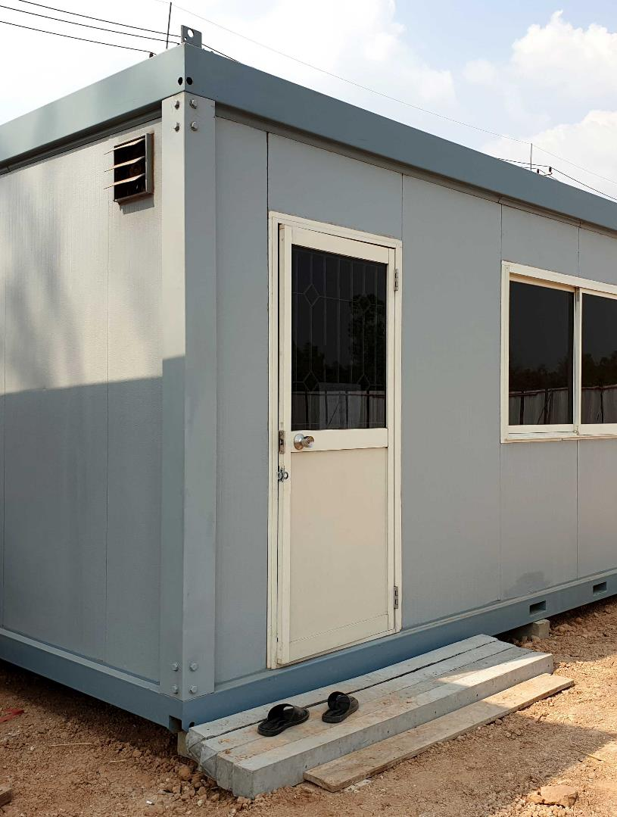
Temporary services
Consider and document the necessary temporary facilities and support services that the construction site requires such as:
  Temporary office
  Bathroom facilities
  Access to electricity
  Access to water
  Waste removal facilities
  Accommodation
  Storage facilities
  Site security.

Slide 52
Materials and plant requirements and availability
You will have determined materials and plant requirements as part of the schedule for the project and when these will be needed
To ensure materials, plant and equipment is available when required, you must communicate with suppliers and hire company
Record the materials and plant requirements and availability dates according to the contract documentation.

Slide 53
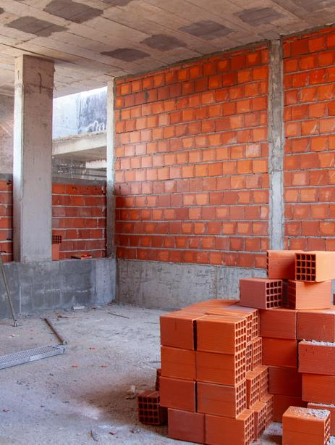
Purchasing methods for supplies or materials
You must ensure that protocols are in place for the procurement of these products from the selected suppliers
  This will generally involve organising accounts with these vendors and plans for payment. A 30-day account with its suppliers will be run by most builders and this would help with the project's cash flow.

Slide 54
Determine and document site labour requirements
Communicate with subcontractors in writing to confirm that they can fit in with your schedule. You may have a formal contract with the subcontractor
  It is important to have sub-contractors approved by the architect or owner, especially for commercial projects. This approval must be reported in such a way that all approved sub-contractors for the project have a record
It is necessary to have a written plan when using company labour so that this labour is available when needed for the project. If the company has several projects underway, and labour is to be divided amongst these projects, then those directing the allocation of work must be mindful of the time necessary for this work to be carried out on each project

Slide 55

Staff briefing
All contractors and workers involved in the contract must understand their role in the project
To achieve their objectives, they must be informed of plans and specifications, timelines and quality requirements relevant to their role
Communication may be in the form of email and documents
Face to face on-site meetings should be planned for.

Slide 56
Negotiate access to adjacent properties to inspect
In certain cases, property owners, property developers and builders will need access to adjacent properties to inspect the condition of existing structures and finishings of these adjacent properties
In the usual course, negotiations with the adjacent landowner should take place
Having a formal agreement in place will minimise the risk of withdrawal of consent, as well as help prevent conflicts either during the access process or until access is no longer necessary.

Slide 57
Condition report
Prior to construction, the condition report, soil report and engineer's drawings will need to be prepared as they contain:
  Information on the existing site such as the location of services
  Instructions for building complex structures
  An assessment on the bearing capacity of the soil
The condition report for the site is a record of details about the existing site, the buildings on adjacent boundaries and the setbacks of structures on adjacent properties
  It contains information about the condition of fences, any significant vegetation on the site on the boundaries and location of services
  It may contain photos as evidence of existing conditions on the site if disputes arise (e.g. if the footpath is cracked prior to work commencing and the council tries to charge you for the repair of the footpath).

Slide 58
A condition report will contain
State of site
Current state of the site, such as trees, vegetation, slope, north aspect
Services for removal or required
Existing services which need to be removed and services needed at site
Legal issues
Legal issues may arise from borders, such as a dispute over borders
Characteristics of adjacent properties
If excavation is to take place, any characteristics of adjacent properties that require attention and/or protection from potential damage claims, such as a pool close to the boundary, can require protection.
If you have compiled the condition report, before commencing construction, you will then forward it to the owners of the adjacent buildings. You will receive consent from them that this is the true state of these structures or buildings. Have the owner sign a copy of this agreement
This means that in the future, there is no confusion and no false allegations for damage to these buildings or infrastructure can be made
If there is a claim or damage to a building or structure that is not a valid claim, you should refer to the documents signed by them to show that it is not caused by construction on the project site.

Slide 59
Condition report example
Client: Address: |  |  | Council:
 | YES | NO | NOTES:
Check survey | ✓
Site clearing | ✓ |  | Small trees and shrubs
Rock |  | ✓
Fences | ✓ |  | Three sides, paling fences, good condition
Adjoining buildings | ✓ |  | Garage on west boundary
Water | ✓
Power | ✓ |  | OH
Gas | ✓ |  | Nature strip
Stormwater/ Sewer | ✓ |  | Rear S/E corner
Temporary fencing | ✓ |  | To front only, < 20 m
NOTES: | No space on-site for spoil stockpile. Adjacent garage may require protection. Advise deliveries to use Paine Road approach. Poor visibility along Helton Street - very busy road.

Slide 60

Copyright
[WARNING]
Some of this material may have been copied and communicated to you in accordance with the statutory licence in section 113P of the Copyright Act . Any further reproduction or communication of this material by you may be the subject of copyright protection under the Act. Do not remove this notice.

