Slide 1

BSBSUS501
Develop workplace policies and procedures for sustainability

Slide 2

Develop workplace sustainability policy
1.1 Define scope of sustainability policy
1.2 Gather information from a range of sources to plan and develop policy

Slide 3

Sources
Legislation and regulatory authorities – you will need to check to see if there is legislation your company needs to abide by
Voluntary schemes sometimes offer information and guides to help you e.g. Green office guide
Stakeholders.

Slide 4

Policy scope
Ecological foot printing
Energy Efficiency Opportunities Bill 2005
Global Reporting Initiative
Green office program
Green purchasing
Greenhouse challenge plus
Life cycle analyses
Product stewardship
Supply chain management
Sustainability covenants/compacts
Triple bottom line reporting.

Slide 5

Your approach
Are you going to focus on each aspect (environmental, economic or social) individually or integrate them?
How are you going to investigate particular business and market context of the industry/organisation?
What legislation do you have to consider?
What parts of the organisation is it to apply?

Slide 6

Activity 1A

Slide 7
Develop workplace sustainability policy
1.3 Identify and consult stakeholders as a key component of the policy development process

Slide 8

Who are your stakeholders?
Customers
Employees at all levels of the organisation
Government
Investors
Local community
Other organisations
Regulators
Suppliers.

Slide 9

Sustainability advice
Some companies offer sustainability advice that helps you to plan and develop your policy
For example, WWF’s sustainability advisors can recommend more sustainable ways to operate.

Slide 10
Activity 1B

Slide 11
Develop workplace sustainability policy
1.4 Include appropriate strategies in policy at all stages of work for minimising resource use, reducing toxic material and hazardous chemical use, and employing life cycle management approaches

Slide 12
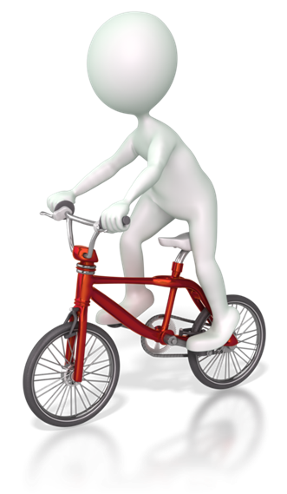
Raise awareness at work
Have a competition
Ask for volunteers to join an environmental group
Advertise lifts/ travel arrangements
Build showers and bike racks
Train staff in sustainability principles and techniques.

Slide 13

Minimise resource use
Make it easy to recycle in the workplace
Encourage staff to use crockery cups/glasses
Create a compost bin for food waste
Buy products that have minimal packaging
Think about restricting the ordering of stationary
Buy laptops rather than desktops as they use less energy
Reduce margin settings so that printer uses less paper
Print double-sided
Use electronic filing systems to save paper
Think about utilising video conferences.

Slide 14

Reduce toxic material and hazardous chemical use
Use environmentally friendly cleaning products
Buy natural soap for use in the bathrooms
Look for products with a reduction in chemicals
Use ink and toner saving settings on equipment such as printers and photocopiers.

Slide 15

Life-cycle management approaches
Think about ways to prolong the life of products
Buy Fairtrade products wherever possible e.g. canteen can buy Fairtrade tea, coffee and sugar
Buy products used in the workplace from other companies that are environmentally and socially aware.

Slide 16
Activity 1C

Slide 17
Develop workplace sustainability policy
1.5 Make recommendations for policy options based on likely effectiveness, timeframes and cost

Slide 18

Estimate time, cost and likely effectiveness
You will need to research the cost, timeframes and likely effectiveness of all of the proposed changes
Some changes will be more costly initially and you will need to be able to justify their value
Now you need to make recommendations for the best policy options.

Slide 19
Activity 1D

Slide 20
Develop workplace sustainability policy
1.6 Develop policy that reflects the organisation’s commitment to sustainability as an integral part of business planning and as a business opportunity

Slide 21

How can we demonstrate a commitment to sustainability?
You will need to ensure that you are constantly thinking about new ways to improve:
Products and services you supply
Products and services you use
The building you work in
Transportation
Procedures and efficiency
Training staff and staff incentives.

Slide 22

A business opportunity
Businesses that demonstrate a commitment to sustainability achieve:
A positive reputation
A more efficient/cost effective business
A more financially secure working environment
A culture of innovation.

Slide 23
Activity 1E

Slide 24
Develop workplace sustainability policy
1.7 Agree to appropriate methods of implementation, outcomes and performance indicators

Slide 25

Meet with managers and supervisors
Hold a staff meeting to discuss sustainability
Meet with staff again to discuss changes to responsibilities
Break the overall sustainability down into its components
Think about what you want to achieve as outcomes
Introduce implementation in phases
Discuss the time limit for the
implementation.

Slide 26
Activity 1F

Slide 27
Communicate workplace sustainability policy
2.1 Promote workplace sustainability policy, including its expected outcome, to key stakeholders

Slide 28

Promote sustainability policy
Does it reduce their costs?
Does it enhance their reputation?
Will it lead to recognition from the government?
Does it mean you are abiding by regulations?
Will it mean savings for the company that you can use elsewhere? (E.g. is there a pay rise for staff?)

Slide 29

Promotion ideas
Create a website or add a page to an existing website about your commitment to sustainability and your proposed changes
Write letters, emails or newsletters to investors, customers, suppliers and staff to keep them updated
Get involved with the local community somehow or advertise locally.

Slide 30
Activity 2A

Slide 31
Communicate workplace sustainability policy
2.2 Inform those involved in implementing the policy about expected outcomes, activities to be undertaken and assigned responsibilities

Slide 32

Expected outcomes
Be specific – set specific targets that are achievable and measurable e.g. we want to reduce our use of paper by 50%
Our current usage is 50 cases per month
The aim is clear here; you are aiming to reduce paper to 25 cases per month.

Slide 33

Activities to be undertaken
For the reduction of paper by 50% for example, staff need to be told to:
Only print or use the photocopier when necessary
Use scrap paper to jot or write notes on
Print double-sided
Use electronic communication wherever possible.

Slide 34
Activity 2B

Slide 35
Implement workplace sustainability policy
3.1 Develop and communicate procedures to help implement workplace sustainability policy

Slide 36

What is a procedure?
A procedure is a set of instructions informing you how to do something
It may specify who is responsible for the action i.e. manager or all employees
It often includes information about where and when.

Slide 37
An example:
Paper recycling boxes
Fill paper recylcing boxes at desk.
Once full take to paper wheelie bins located outside of your buidling.
Paper recycling bins
For confidential documents place in the lockable bin found outside your office.
In certain situations you may need to use a shredder - please ask your supervisor.

Slide 38
Activity 3A

Slide 39
Implement workplace sustainability policy
3.2 Implement strategies for continuous improvement in resource efficiency

Slide 40

What is continuous improvement?
Continuous improvement is the constant determination to improve products, services or processes. This can be a result of an idea and happen instantly or it can be a gradual progression over time.

Slide 41

Create the right culture
Train staff appropriately
Use constructive criticism
Rewards should be in place wherever possible
Promote the reward structure
Staff progression should be highlighted.

Slide 42
Activity 3B

Slide 43
Implement workplace sustainability policy
3.3 Establish and assign responsibility for recording systems to track continuous improvements in sustainability approaches

Slide 44

How to track continuous improvement
Regular audits and spot checks
Meetings with staff once a week about procedures
Ask staff regularly (e.g. at meeting once a week) for ways to improve
Complaints, feedback and suggestion forms
Staff incentives/rewards
Disciplinary for staff.

Slide 45

Assign responsibility
To assign responsibility you will need to decide if you need a team of people for recording data and tracking improvements
You will then need to decide on the tasks that need to be done and the people who will be doing them.

Slide 46
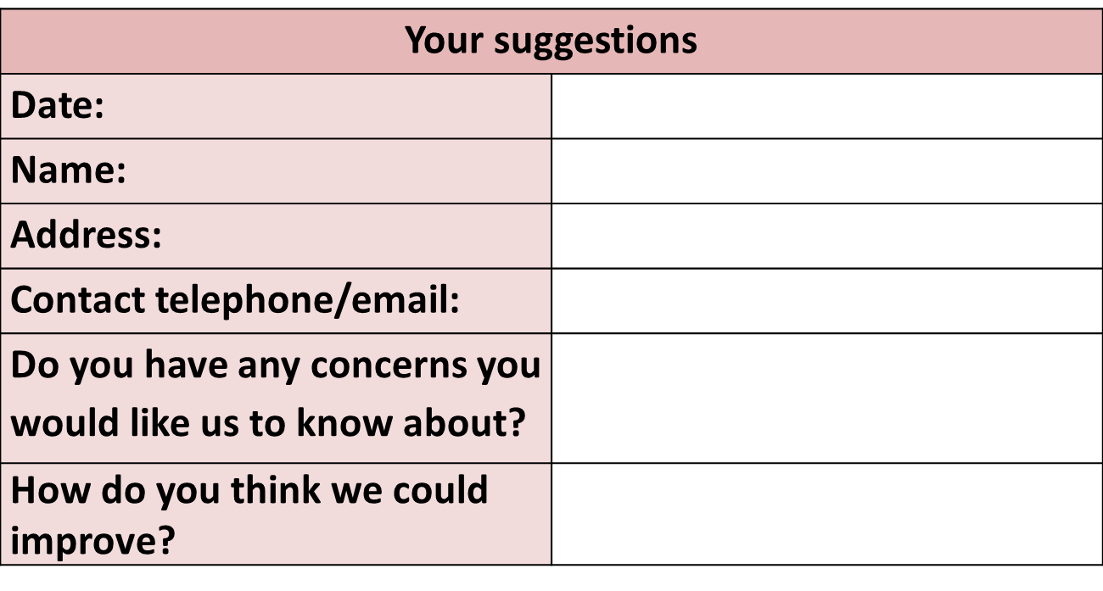
An example suggestion form:

Slide 47
Activity 3C

Slide 48
Review workplace sustainability policy implementation
4.1 Document outcomes and provide feedback to key personnel and stakeholders

Slide 49

Providing feedback
You may have to give feedback to stakeholders and key personnel regarding:
Complaints or suggestions
Audits
Changes to procedures
Rewards/disciplinary action outcomes.

Slide 50
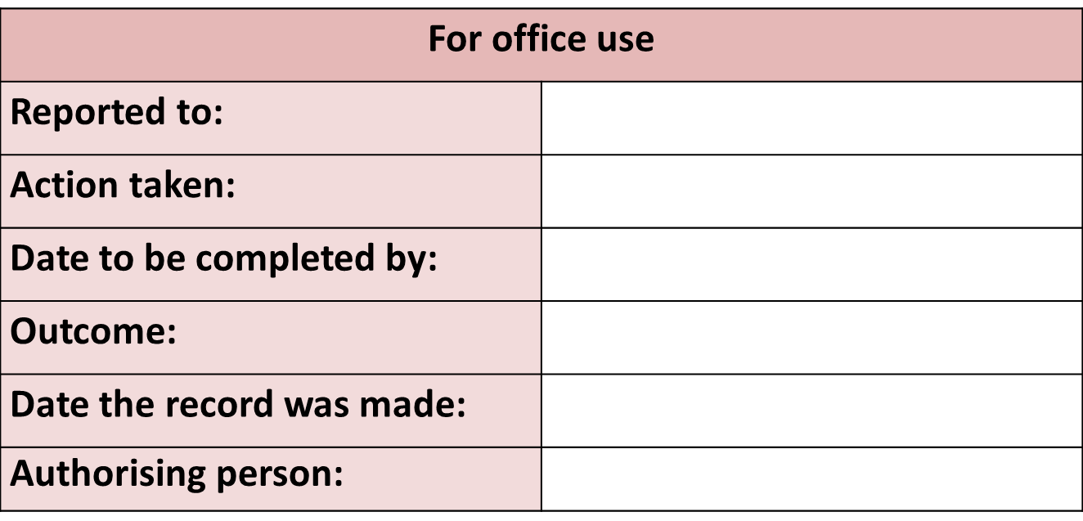
Example audit/complaint template

Slide 51
Activity 4A

Slide 52
Review workplace sustainability policy implementation
4.2 Investigate successes or otherwise of policy

Slide 53

Investigating successes or otherwise of the policy
Successes:
Positive feedback
What procedures are being completed?
Why people are being rewarded?
Improvement:
What procedures are not getting completed accordingly?
Negative feedback.
What people are complaining about?
Who is complaining?

Slide 54
Activity 4B

Slide 55
Review workplace sustainability policy implementation
4.3 Monitor records to identify trends that may require remedial action and use to promote continuous improvement of performance
4.4 Modify policy and/or procedures as required to ensure improvements are made

Slide 56

Monitor records and identify trends
You may identify a trend that the new procedures for electronic equipment are not working effectively:
Not turning computers off when they have finished working with them/overnight
Not reducing margin settings so that the printer uses less paper
Not printing double-sided.

Slide 57

Finding a solution
In this scenario you could perhaps consider:
Eliminating the need for a procedure e.g. Install EMO software to turn computers off automatically
Altering procedures to improve their clarity
Checking to see if all staff understand the procedures
Checking to see if all staff are capable of fulfilling the procedures e.g. are they trained to complete the task?

Slide 58
Activity 4C

Slide 59

Summative Assessments
Summative assessments consist of:
Skills assessment
Knowledge assessment
Performance assessment.
Your assessor will provide you with further guidance on how and where to complete these assessments.

Slide 60

Summary and Feedback
Did we meet our objectives?
How did you find this session?
Any questions?

