Slide 1
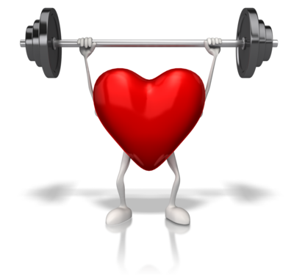
HLTAAP001
Recognise healthy body systems

Slide 2

Housekeeping
Emergency procedures
Mobiles and security issues
Break times and smoking policy
This course is interactive – ask questions
Practise respect and confidentiality
Ground rules

Slide 3
Objectives
Discover how to work with information about the human body
Know how to recognise and promote ways to support healthy functioning of the body
Gain skills and knowledge required for this unit

Slide 4

Work with information about the human body
1.1 Correctly use and interpret health terminology that describes the normal structure, function and location of the major body systems
1.2 Correctly use and interpret information that relates to the interrelationships between major components of each body system and other structures

Slide 5
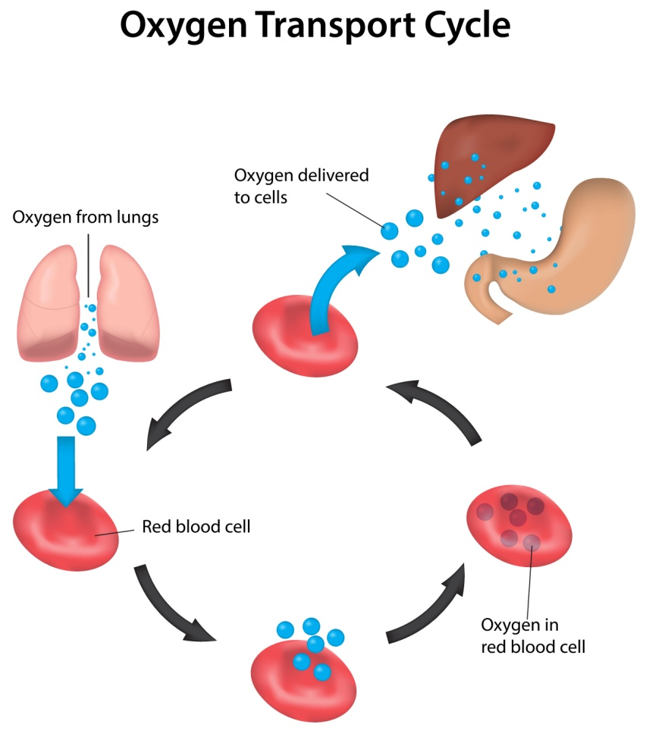
Cardiovascular system

Slide 6
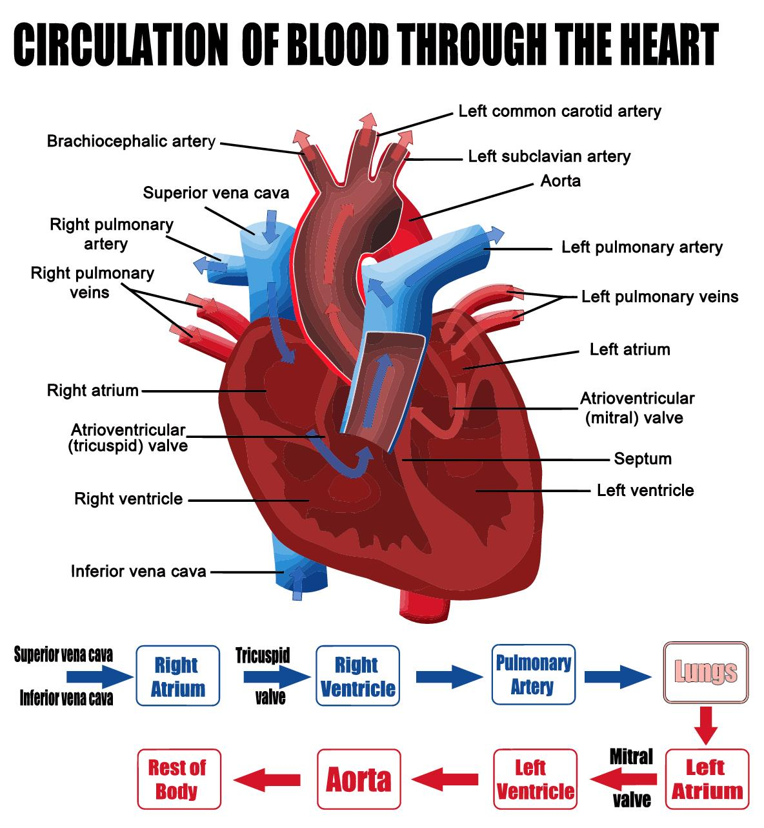
Cardiovascular system

Slide 7
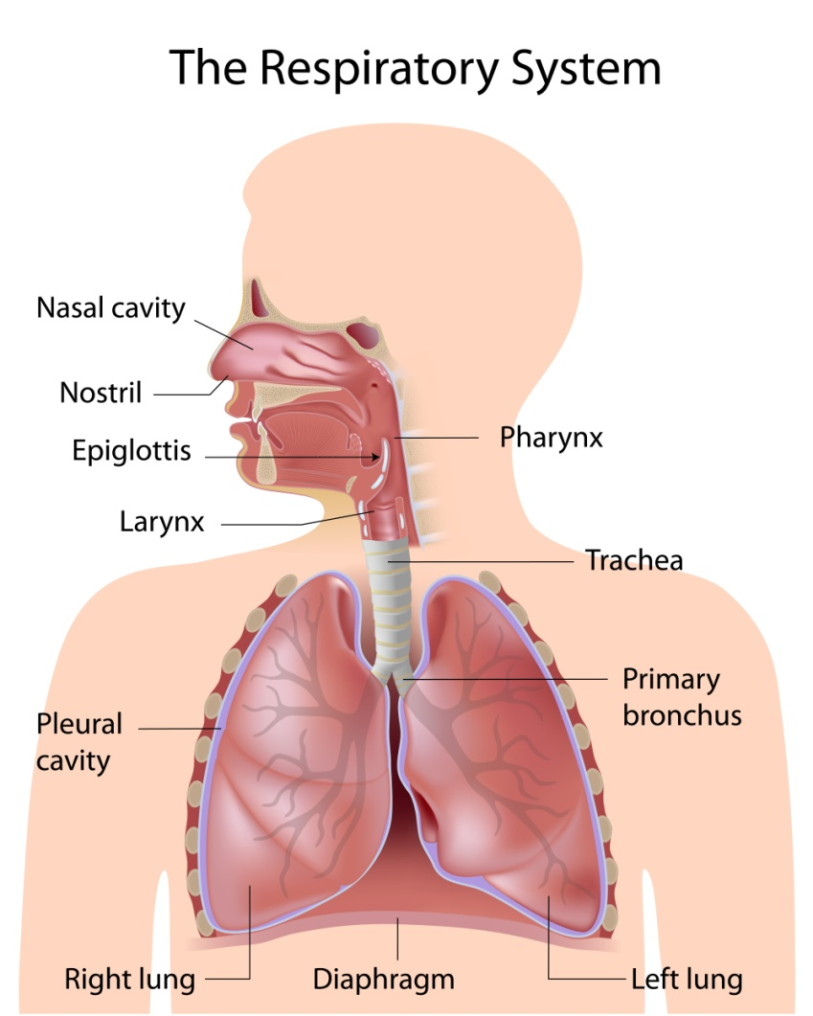
Respiratory system

Slide 8
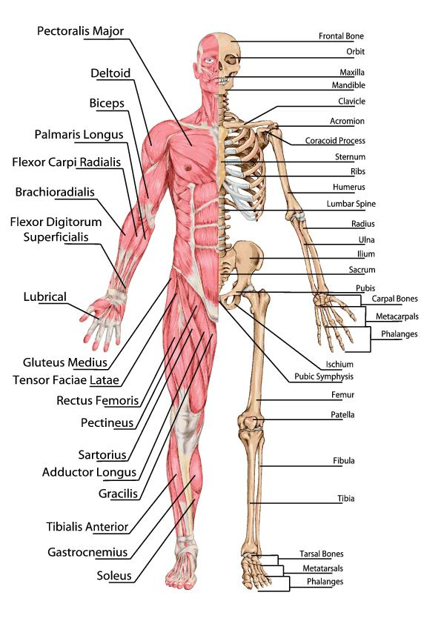
Musculo-skeletal system

Slide 9
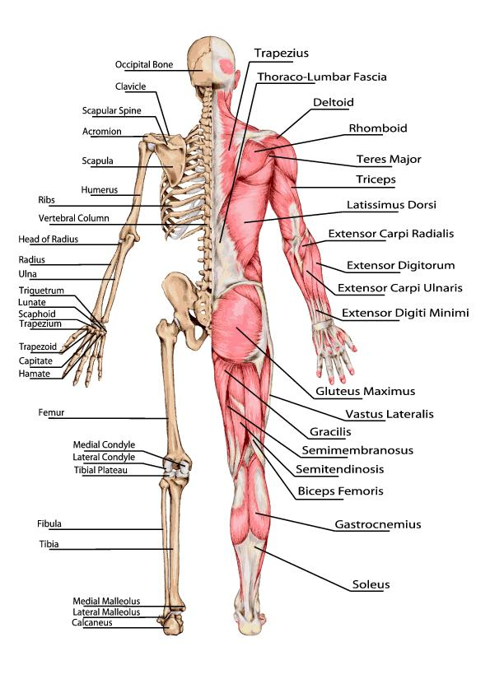
Musculo-skeletal system

Slide 10
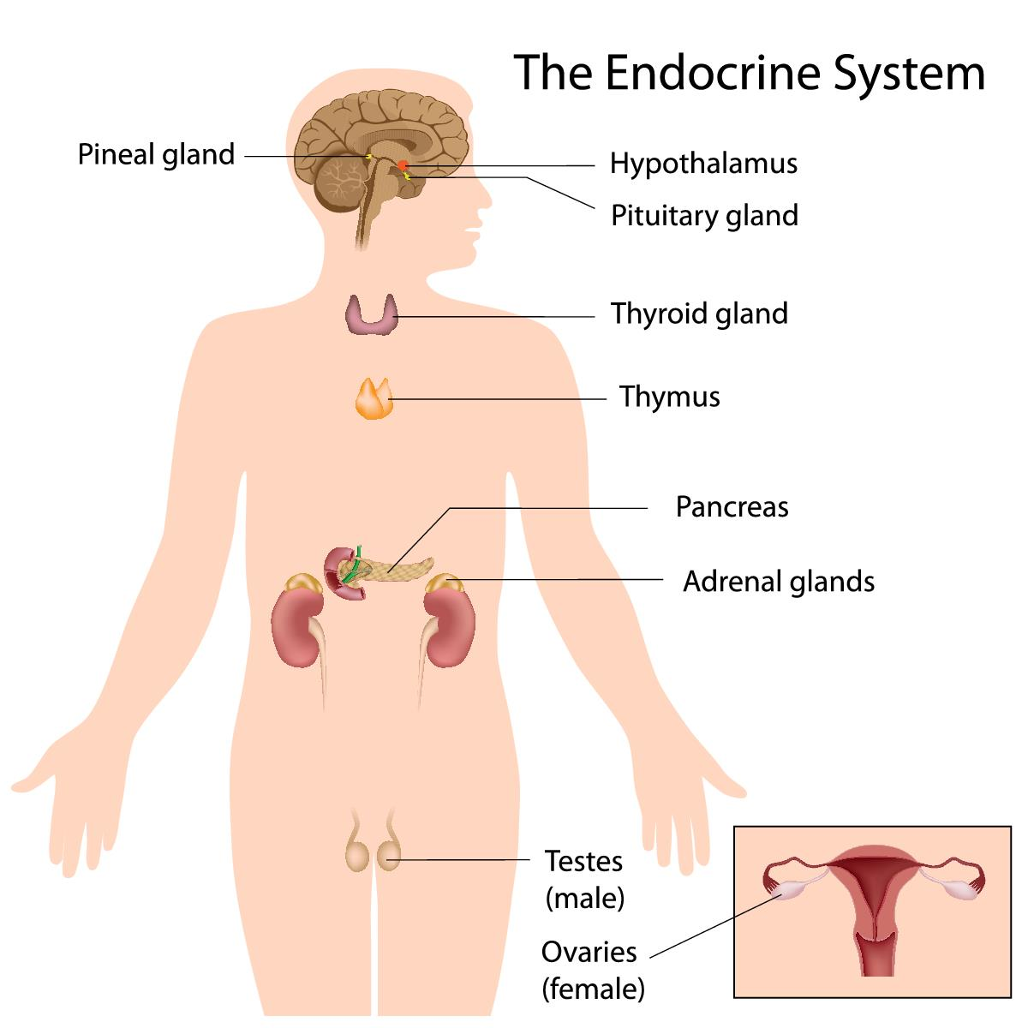
Endocrine system

Slide 11
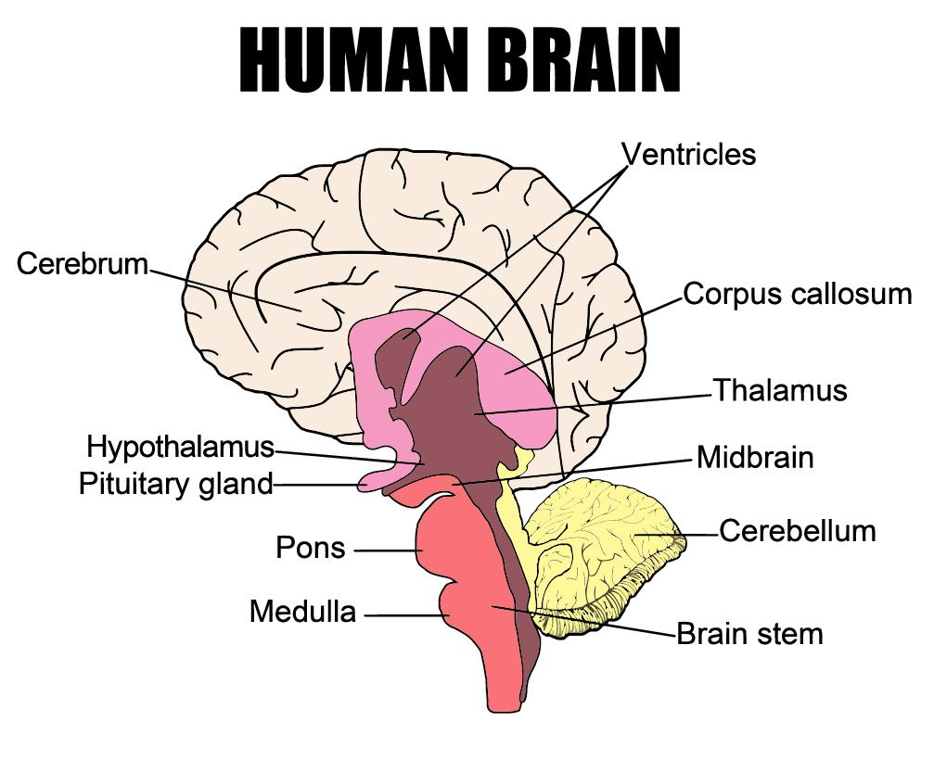
Nervous system

Slide 12
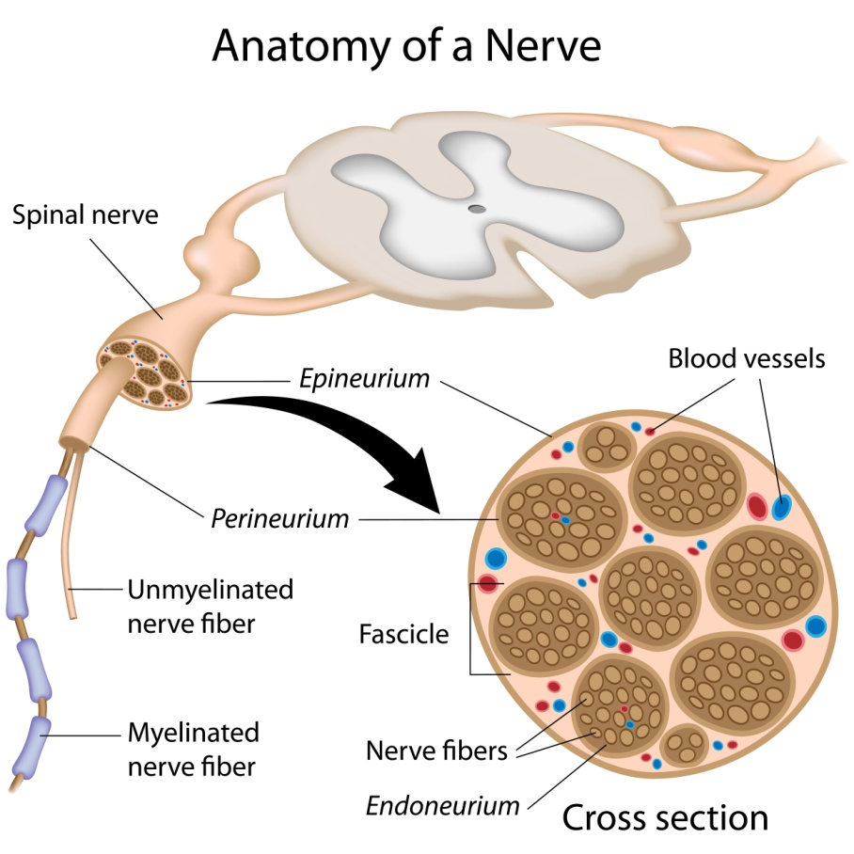
Nervous system

Slide 13
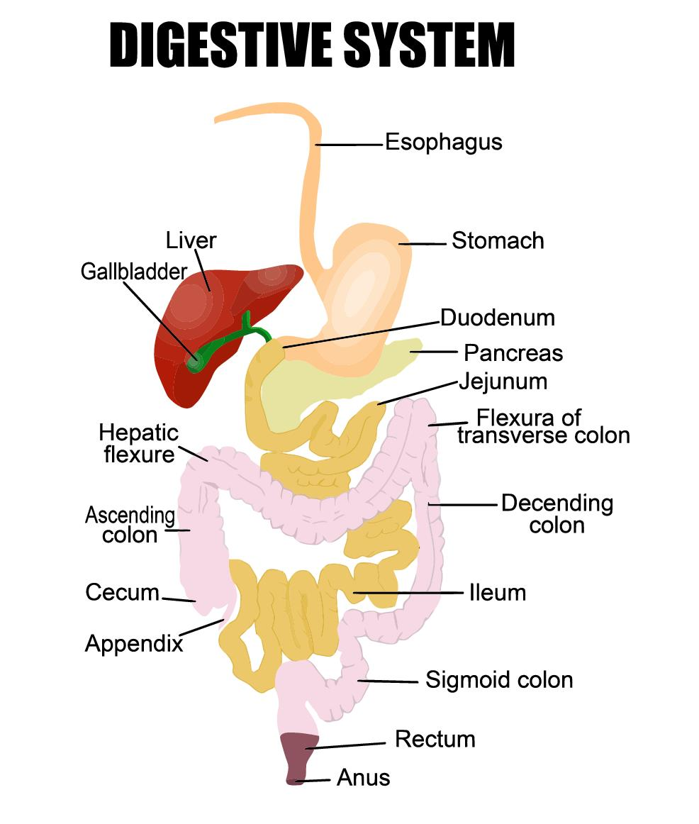
Digestive system

Slide 14
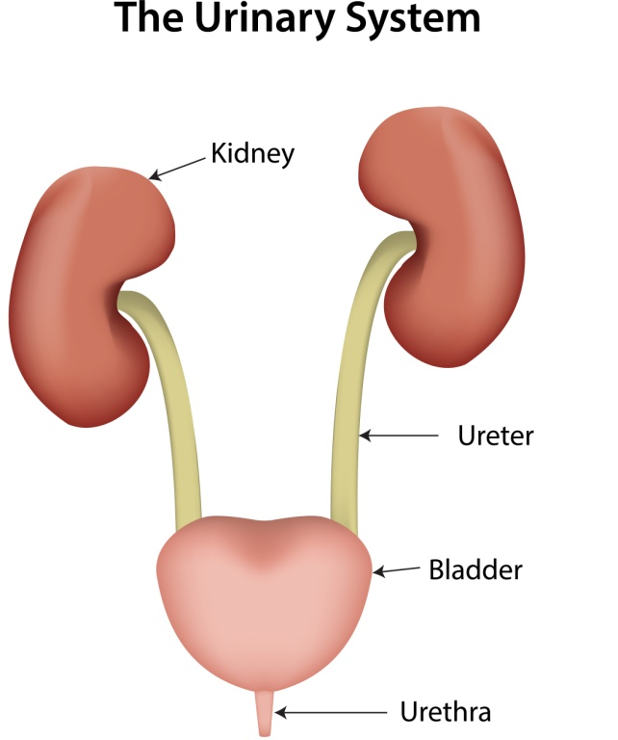
Urinary system

Slide 15
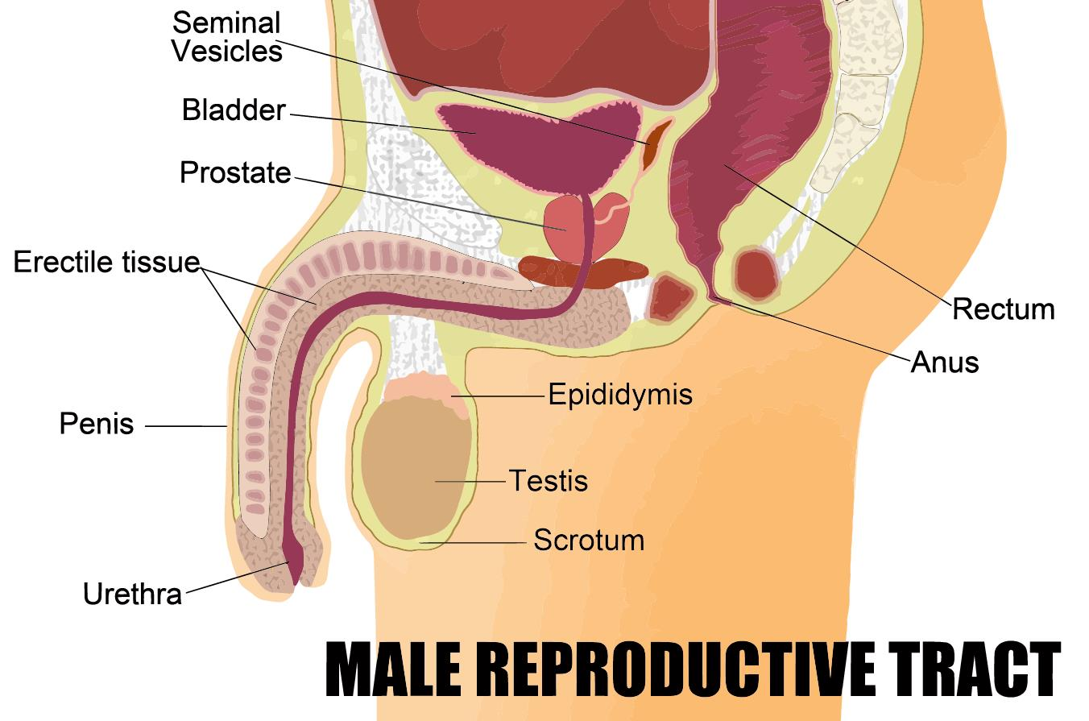
Reproductive system

Slide 16
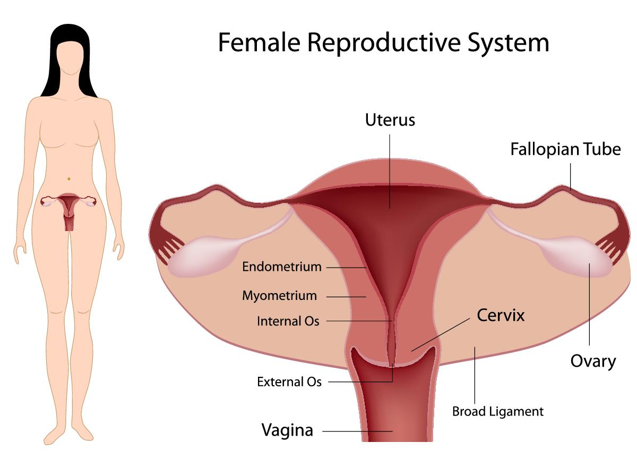
Reproductive system

Slide 17
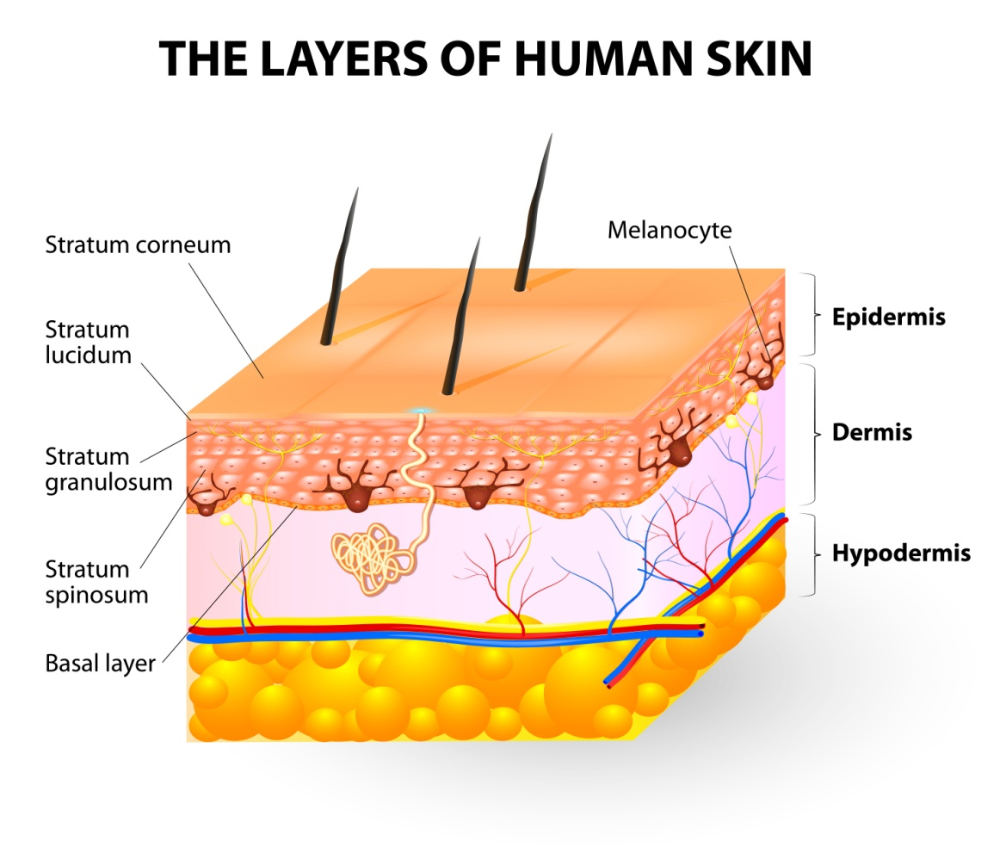
Integumentary system

Slide 18
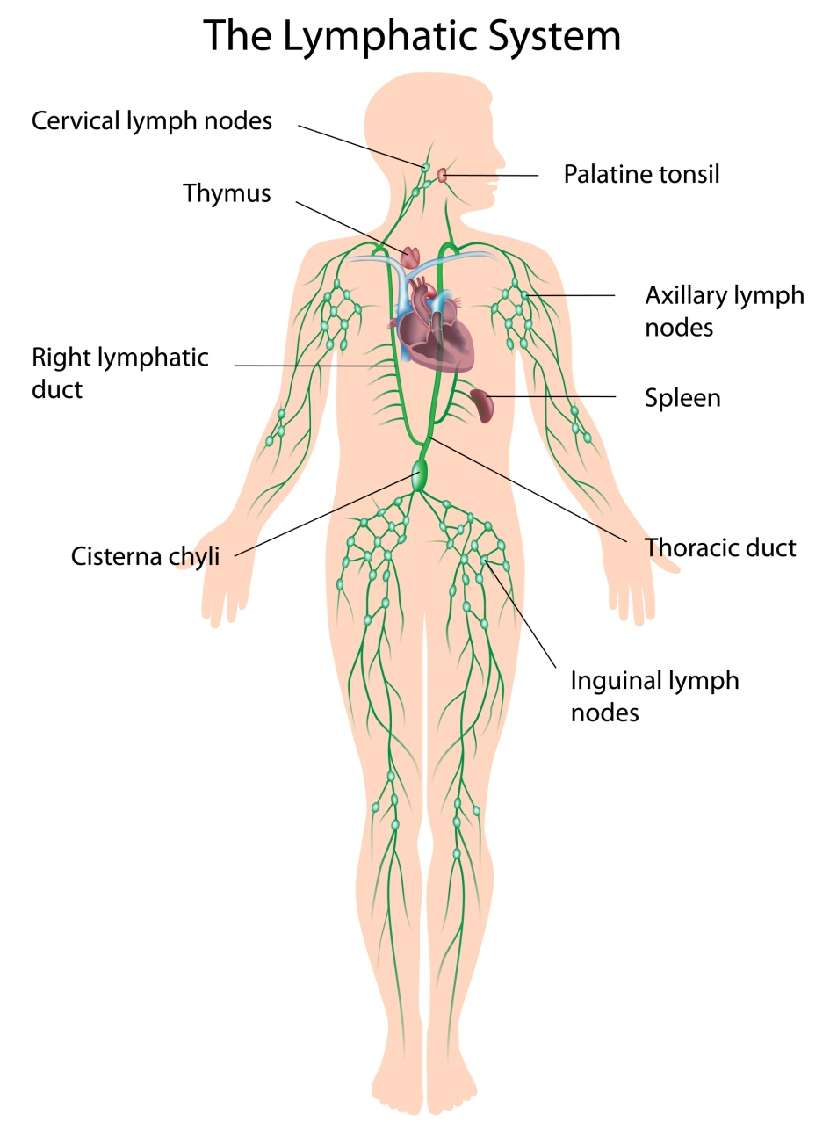
Lymphatic system

Slide 19
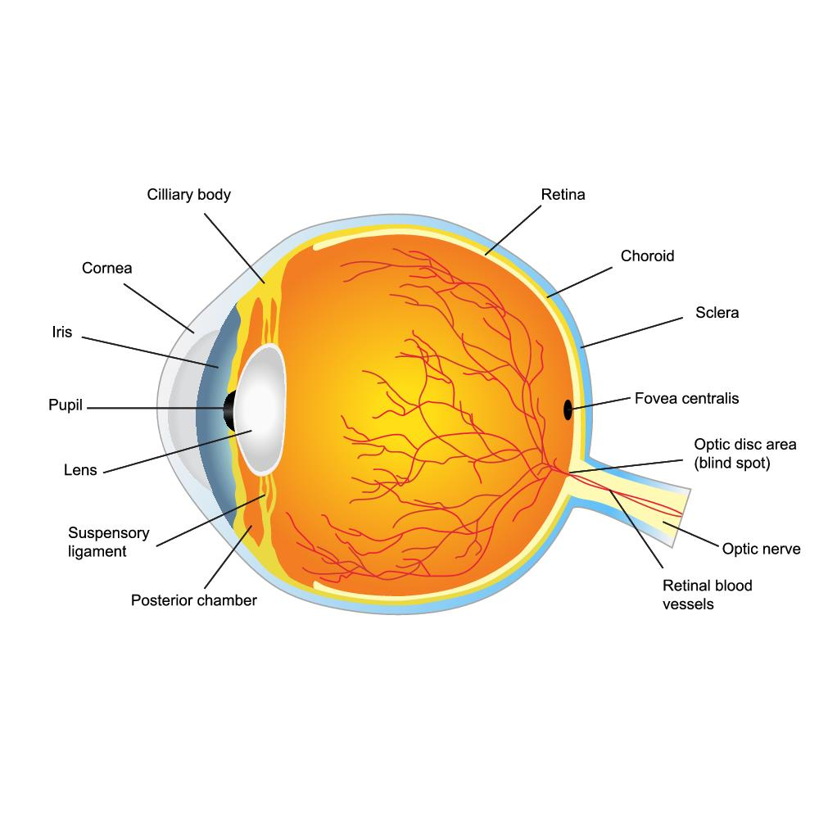
The special senses – vision

Slide 20
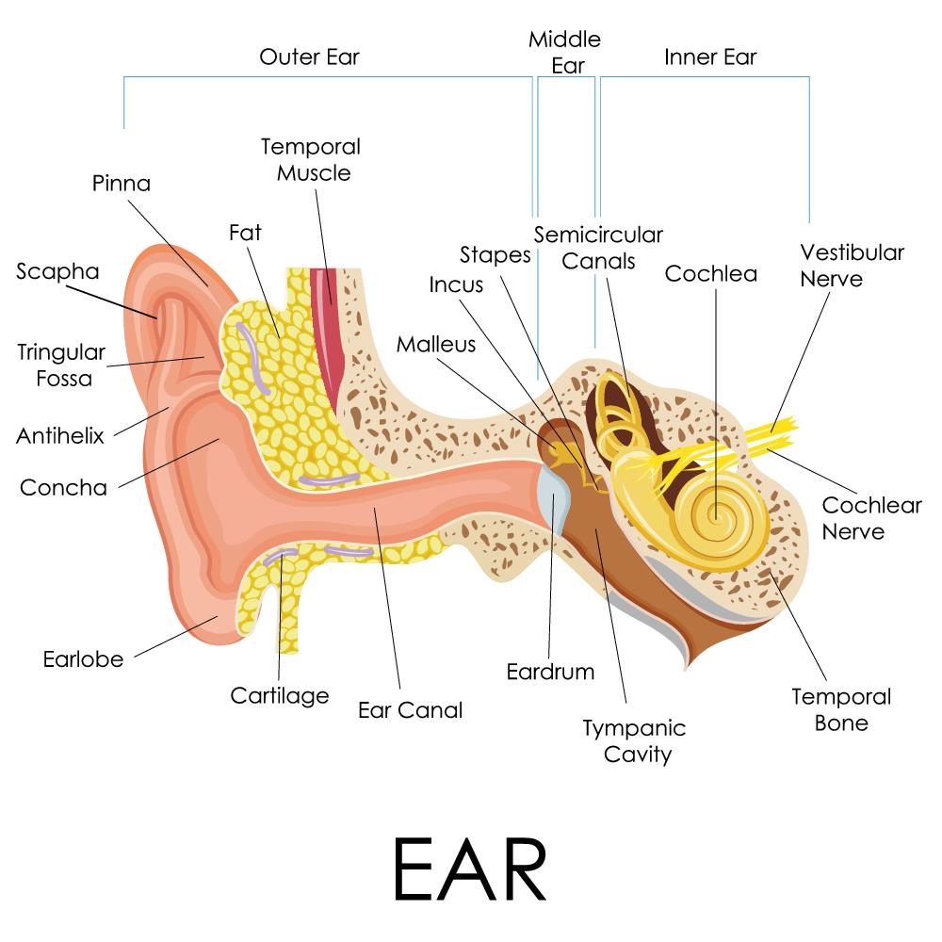
The special senses – hearing and equilibrium

Slide 21
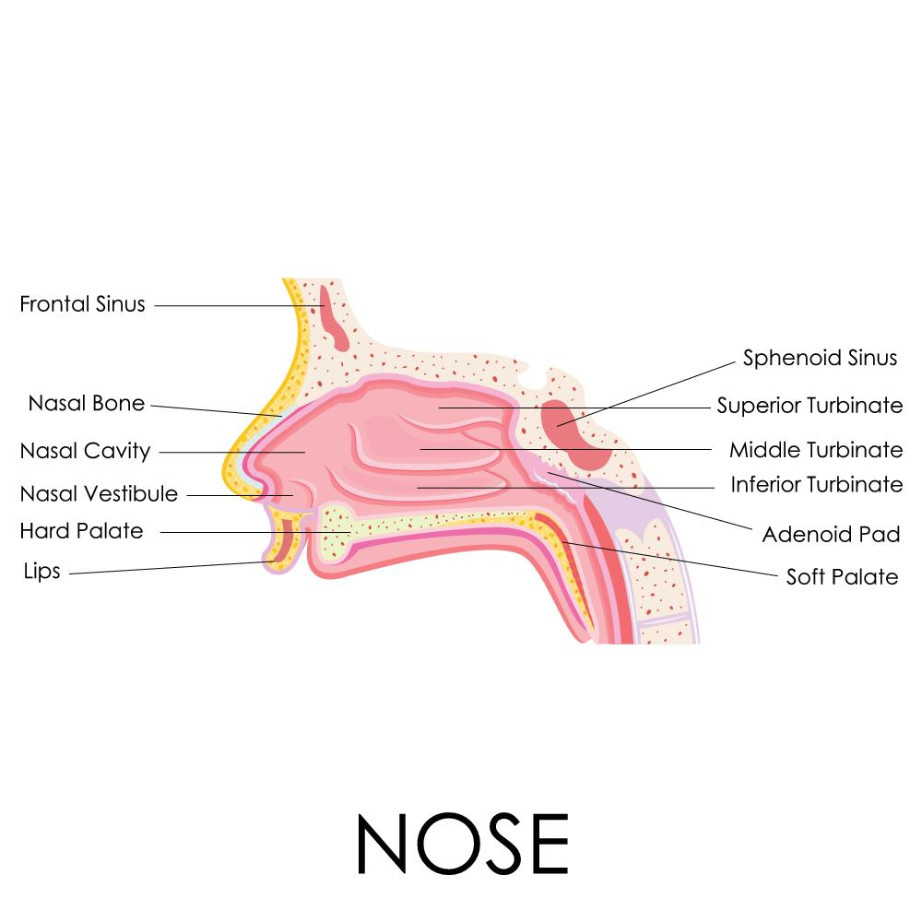
The special senses – smell

Slide 22
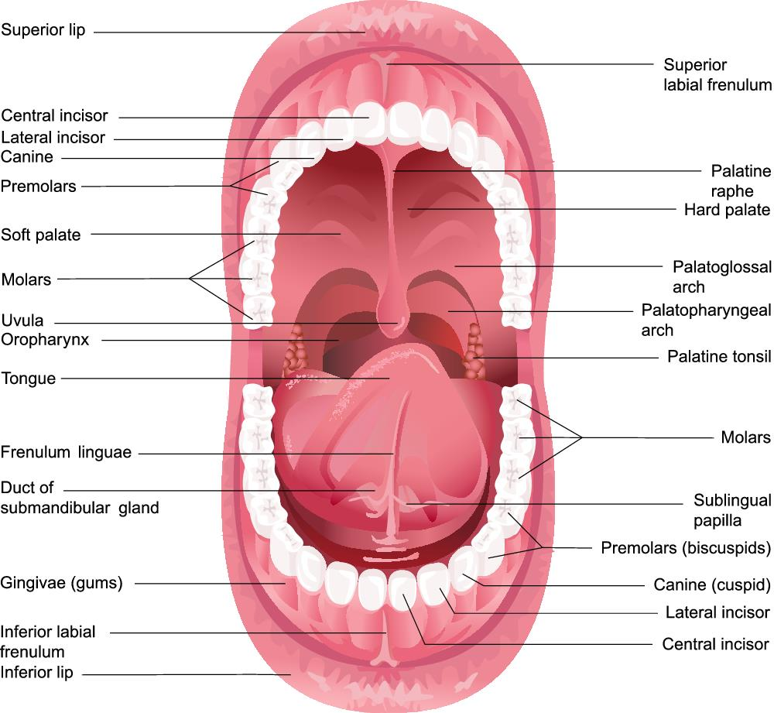
The special senses – taste

Slide 23
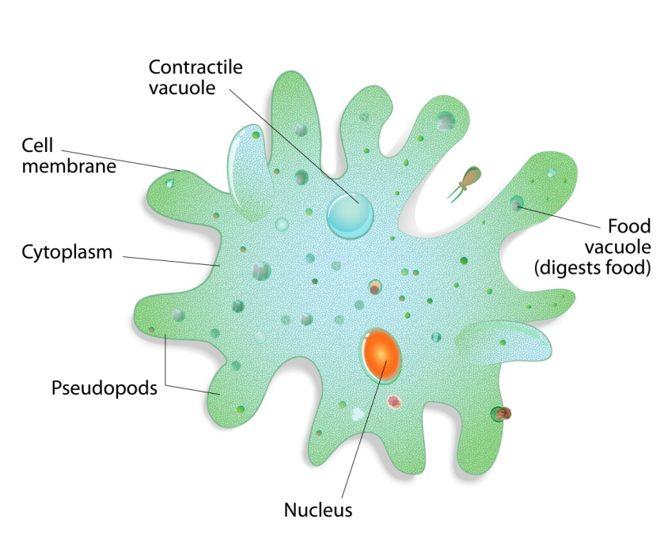
Cells, tissues and organs

Slide 24
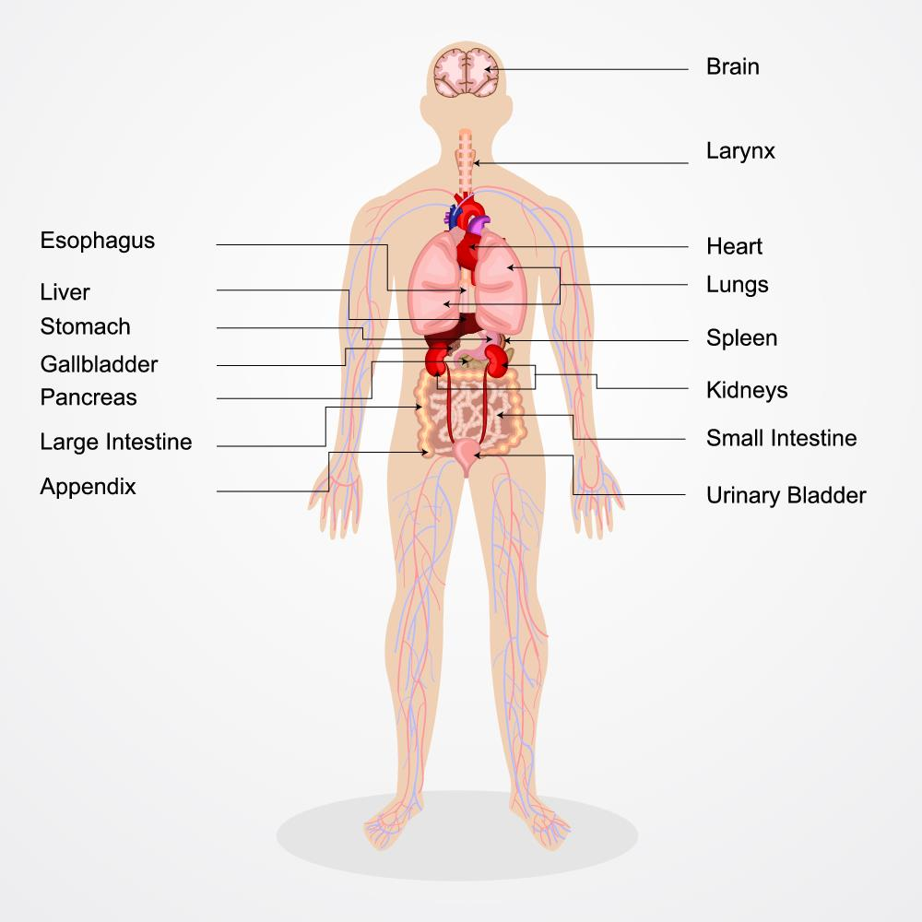
Cells, tissues and organs

Slide 25

Activity 1A

Slide 26
Recognise and promote ways to support healthy functioning of the body
2.1 Review factors that contribute to maintenance of a healthy body

Slide 27
Exercise
Active exercise – this is where there is voluntary movement and force exerted by the muscles of someone – this includes anything from running, to weight lifting, to standing up.
Passive exercise – this is where there is force exerted on muscles involuntarily e.g. range of motion exercises, performed by a nurse or a physio.
Mental exercise – this involves performing mentally stimulating exercises, and can be very effective at delaying the effects or presentation of Alzheimer's disease and dementia (however, it cannot prevent it).

Slide 28
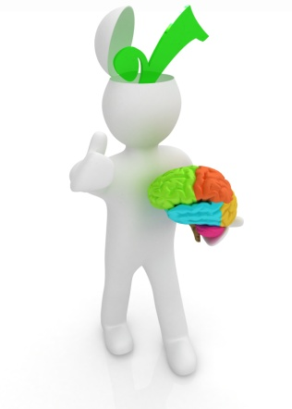
Medical check ups
A complete physical
Dental checkups
Eye exam
Colon exam
Prostate check (for men)
Skin check
Blood pressure check
Electrocardiogram (to test for heart disease)
Cholesterol check

Slide 29

Medical check ups
C-Reactive Protein (CRP)
Mammogram (to detect breast cancer)
Pap smear and pelvic exam
Bone density
Immunisation
Diabetes check
Thyroid check

Slide 30
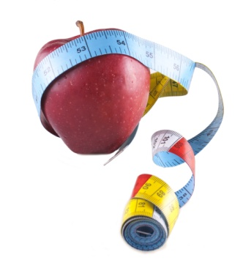
Diet
Carbohydrates
Protein
Fats
Vitamins

Slide 31
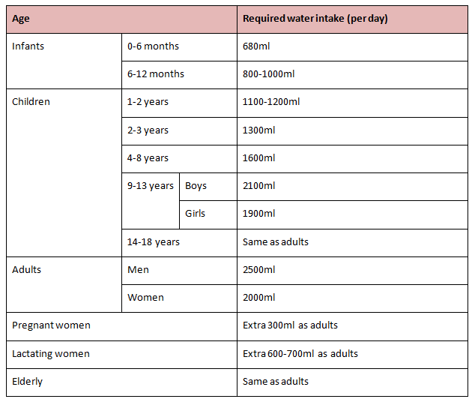
Diet

Slide 32
Maintenance of body temperature
The body needs to maintain a core temperate of between 98 and 100 degrees Fahrenheit (36 to 38 degrees Celsius).
The body's temperature is controlled by the hypothalamus, which contains the control and sensory mechanisms for temperature.
Sweating begins at a skin temperature of 37 degrees Celsius – the rate of sweating rises rapidly as it goes above this temperature. The body's heat production remains constant as skin temperature goes up; if skin temperature drops below 37 degrees Celsius, the body initiates procedures to heat itself/retain heat

Slide 33

Maintenance of blood pressure
To reduce high blood pressure:
Cut salt intake to less than six grams per day
Eat a healthy low fat diet, including lots of fruit and vegetables
Become more physically active
Cut down alcohol intake
Stop smoking
Lose weight
Drink less caffeine-rich drinks
Try relaxation therapies
Take high blood pressure medications

Slide 34
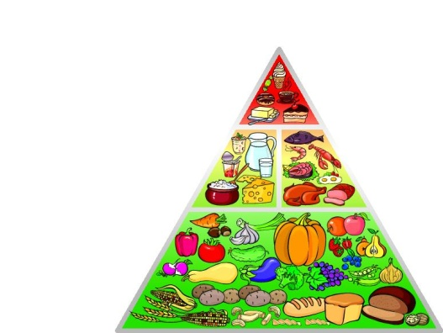
Maintaining the body
There are various strategies that can be employed; they include:
Nutrition
Physical exercise
Mental activity
Sleep
Relaxation

Slide 35
Activity 2A

Slide 36
Recognise and promote ways to support healthy functioning of the body
2.2 Evaluate how the relationships between different body systems affect and support healthy functioning

Slide 37
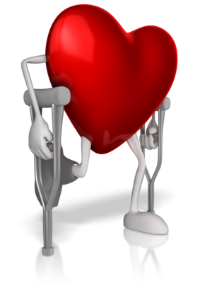
The interdependency of body systems
All of the body's systems work together in order to maintain a state of optimum health. While each system has its own respective job, they must cooperate and facilitate each other for the body to function and move properly. If one of the systems is not working right, it compromises the rest of the body's ability to function.

Slide 38
Activity 2B

Slide 39
Recognise and promote ways to support healthy functioning of the body
2.3 Enhance quality of work activities by using and sharing information about healthy functioning of the body

Slide 40

Using and sharing information about healthy functioning of the body
Work activities can be greatly enhanced by using and sharing information about the healthy functioning of the body.
This can be done via effective communication.
It may be necessary to run training programs to educate colleagues about the healthy functioning of the body. This can be a refresher course, or when there is new information or updated treatment options become recommended.

Slide 41
Activity 2C

Slide 42
Skills and Knowledge Activity

Slide 43
Major Activity
This activity should take anywhere between an 1-2 hours to complete and can be found at the end of your workbook.
Your instructor will let you know whether they wish for you to complete it in session time or your own time.

Slide 44

Summary and Feedback
Did we meet our objectives?
How did you find this session?
Any questions?

Slide 45

Congratulations!
You have now finished the unit…
‘Recognise healthy body systems’

