Slide 1
WHS CONSULTATION & PARTICIPATION PROCESSES

Slide 2
BACKGROUND
What is WHS consultation?
WHS consultation is a two-way process between the PCBU & workers to identify WHS issues, share views and WHS information, participate in decision-making on WHS matters, and receive feedback on outcomes.
Why is WHS consultation & participation important?
Legal requirement
An essential part of managing health and safety risks
Fundamental to the operation of Paynters
A valuable means of decision making regarding HSEQ issues
Paynters aims to establish a working environment where all personnel are encouraged to contribute to the health, safety, environment and quality outcomes for the business.
Notes:
Introduce the topic, explain its relevance & outline Paynters goals.

Slide 3
LEGISLATIVE DUTIES
Duties are outlined in the Work Health and Safety Act 2011
The PCBU (Paynters) is the primary duty holder in relation to consultation and participation in the workplace.
Section 47- 49
PCBU’s are to share relevant information with workers and give workers “a reasonable opportunity to express their views and to raise work health or safety issues”.
Issues and views raised by workers are to be taken into consideration by the PCBU when making decisions.
Any relevant information or decisions are to be shared in a timely manner with workers and any other persons who may be affected by the decision.
Section 49 of the Act outlines when consultation is required:
    When identifying hazards and assessing risks arising from work being carried out or to be carried out
    When making decisions about the ways to eliminate or minimise the risks
    When making decisions about the adequacy of facilities for the welfare of workers
    When proposing changes that may affect the health or safety of workers
    When making decisions about the procedures for resolving health or safety issues, monitoring the health of workers, monitoring conditions at the workplace, providing information or training for workers, or for consultation with workers.
Section 28 (d) of the WHS Act 2022 states that a worker must “co-operate with any reasonable policy or procedure of the person conducting the business or undertaking relating to health or safety at the workplace that has been notified to workers”. This may include the requirement to participate in numerous forms of consultation.

Slide 4
BENEFITS OF
CONSULTATION
Positive working relationships (taking the time to understand the views of others leads to greater cooperation and trust)
Regular, planned and structured discussions about health and safety matters
Encouraging a cooperative & collaborative approach to health and safety
Drawing upon worker experience which may help in identifying hazards and determining practical and effective control measures.
Identify change within the business & response accordingly

Slide 5
FORMS OF CONSULTATION WITHIN PAYNTERS

Slide 6
INTERNAL CONSULTATION
Pre construction meetings
PM Meetings
CA Meetings
Site Staff Meetings
Toolbox Talks
HSEQ Committee
Site HSEQ Committee
Board meetings
Team Meetings
Operational meetings
Executive Leadership Team meetings
Performance reviews
Financial meetings
Casual conversation
Emails
Surveys
Informal catchups
HSEQ Team Meetings
Project handover meetings

Slide 7
ACTION PLAN

Slide 8
PHASE 1
Step | Details | Timeframe | Resources required
1. Identify | Identify the consultation needs of the business List all of the current consultation & participation processes within the business Identify who is required to participate | 2 weeks | HSEQ Team Paynters Procedures
2. Understand | What is entailed in these processes? What do procedures say? When are these processes occurring? Why are these processes required? | 2 weeks | HSEQ Team Paynters Procedures Dept Managers & Supervisors
3. Assess | What are these processes actually achieving? Is it as per written procedure? Are there any consultation gaps in the business? Are there processes occurring that haven’t been documented in a procedure? Obtain feedback from facilitators & participants involved in processes | 1 month | HSEQ Team Dept Managers & Supervisors General staff

Slide 9

FEEDBACK
See explanation of slide in the notes below
Notes:
Paynters are committed to the continual improvement of business policies, procedures & processes
At this point of the presentation, attendees are asked/invited to take out their phone & scan the QR code. This code takes staff to a Microsoft form survey created by the HSEQ Team.
This survey would list all of the internal consultation processes within the business (as per slide 8) and staff filling out the form would select all of the processes they are involved in.
The processes selected will then trigger smart questions such as:
Does the process assist you with completing your job?
Do you get out what you require?
Do you feel you have ample opportunity to contribute?
Is the agenda meaningful?
Helpful?
Areas for improvement?
Limitations?
DO you feel that the appropriate staff are involved (e.g. should a director be involved in the process?)

Slide 10
ACTION PLAN cont.

Slide 11
PHASE 2
Step | Details | Timeframe | Resources required
4. Brainstorm amendments | Collate findings from steps 1-3 Present possible solutions/amendments Consult with relevant stakeholders re the solutions/amendments for their input & ideas | 3 weeks | HSEQ Team Dept Managers & Supervisors General Staff
5. Implement | Formal introduction of new processes (email, guides, tools etc) Training sessions | 2 weeks (but will also be ongoing) | HSEQ Team Dept Managers & Supervisors
6. Monitor | Positive communication Frequent check ins Make note of & manage issues that arise | 8 weeks | HSEQ Team Dept Managers & Supervisors
7. Evaluate | Consolidate findings from the 8 weeks Formalise data & present in a way that is meaningful (e.g. graph or summary) Obtain feedback from facilitators & participants involved in processes | 2 weeks | HSEQ Team Board & Executive Team Dept Managers & Supervisors

Slide 12
PROVIDING UPDATES

Slide 13
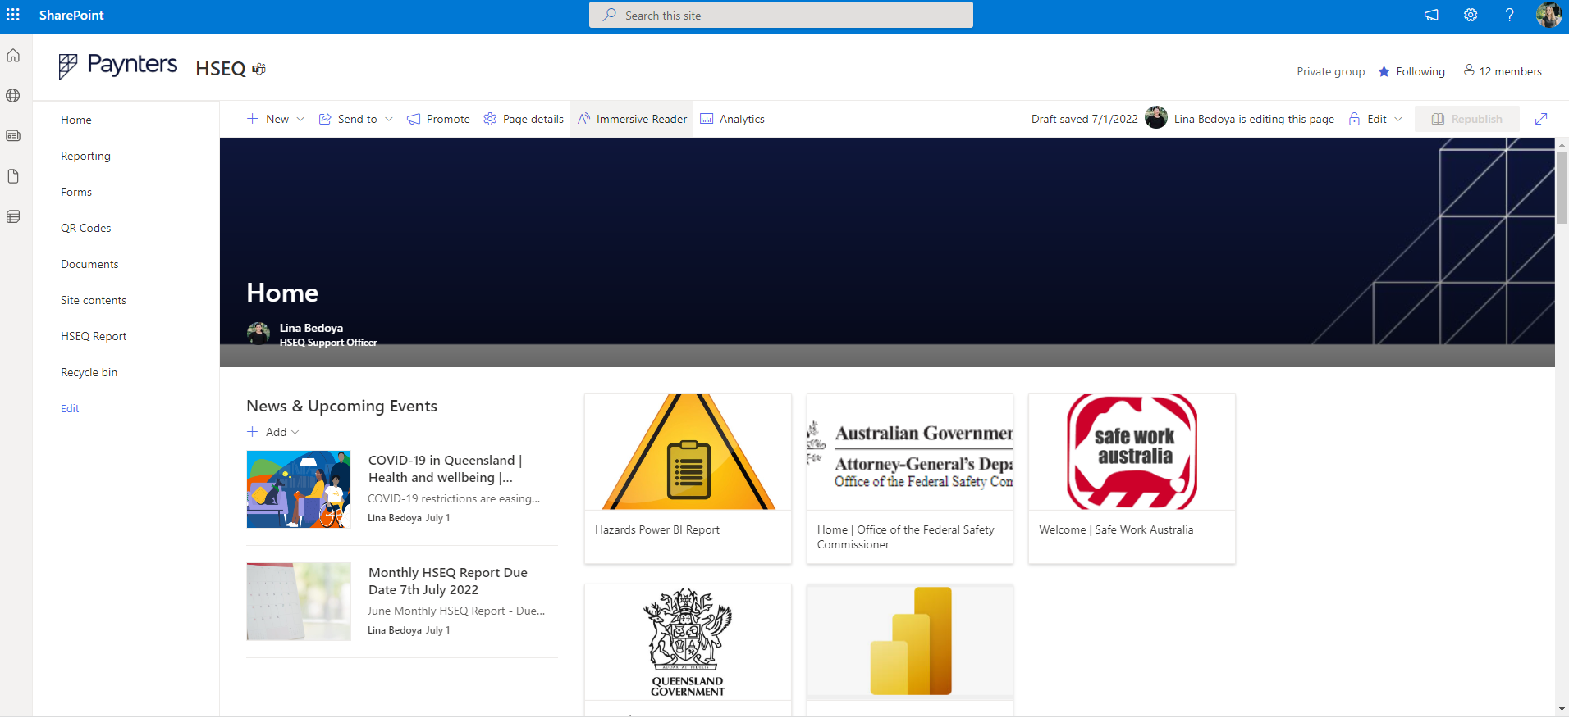
MICROSOFT
SHAREPOINT
See explanation of slide in the notes below
Notes:
In addition to adding an agenda item to all meetings/forums, live updates can be found on Paynters HSEQ SharePoint page. This page is maintained by the HSEQ Team.

