Slide 1
BSBWHS401
Implement and monitor WHS policies, procedures and programs to meet legislative requirements
Presentation 1 of 4

Slide 2
Presentation objectives
At the end of this lesson you will be able to:
Accurately explain to the work team relevant provisions of WHS Acts, regulations and codes of practice
Provide information about the organisation’s WHS policies, procedures and programs, and ensure it is readily accessible to, and understandable by the work team
Regularly provide and clearly explain to the work team information about identified hazards and the outcomes of risk assessment and control

Slide 3
WHS Acts, regulations and codes of practice
To meet health and safety requirements, strategies to deal with both the physical and psychological interactions between workers and management and between workers and their environment should be developed and implemented.
The four hazards of work life and their impact:
High compensation costs
Medical claims
Lost productivity time
Poor productivity
Inefficiency/ ineffectiveness
High worker dissatisfaction
Low job involvement
Physical- psychological
Accident
Disease
Socio-psychological
Low work life quality
Outcomes/ impacts
Application
Hazards
Stress

Slide 4
WHS Acts, regulations and codes of practice
The focus of health and safety legislation is:
improvement of the Australian working environment
reduction of the incidence of occupational death, trauma and disease, with its unnecessary burden on community members (family and friends) and on the national economy.
Everyone in the workplace has an obligation to make sure it is as safe as possible. As a staff member you may need to notify your manager of a potential issue and maintain your space safely as per instructions. As an employer your obligations will be more – make sure you know your obligations.
Under work health and safety legislation, employers are referred to as ‘persons conducting a business or undertaking’ (PCBU) and employees are referred to as ‘workers’.
A PCBU has the primary duty of care for workplace health and safety.

Slide 5
WHS Act and your team
As a PCBU one of your obligations is to make sure your team are informed about certain aspects of the WHS Act for example:
  Hazard reduction.
  Risk assessment.
  Emergency and evacuation procedures.
  First aid.
  Record keeping.
  Duty of care regulations under common law.
  Who to report incidents or hazards to and how.
  Expectations and systems to support the team.
  There may be other areas in your organisation, this information must be shared with the team especially when there are new processes or jobs to be undertaken.

Slide 6
WHS Acts, regulations and codes of practice
Culpability regulates the responsibility and associated penalties for a breach of health and safety legislation and is determined through a judgement of the level of foreseeable risk and negligence in preventing harm.
Each state/territory has a dedicated organisation which enforces and administers health and safety legislation and manages workers’ rehabilitation and compensation legislation.
The intention of health and safety legislation today is to move toward preventative rather than punitive measures

Slide 7
WHS Acts, regulations and codes of practice
Regulations are legal documents made under Acts and specify how legislation is to be implemented
Codes of Practice provide documented advice on methods of achieving the minimum acceptable levels of safety performance
While codes of practice do not have the same legal enforcements as legislation or regulations, they may be used to provide evidence if duty of care or health and safety legislation is breached.

Slide 8
WHS Acts, regulations and codes of practice
Duty of care places into a legal form a moral duty to:
Under their duty of care requirements, PCBUs must ensure safe property, plant, equipment, materials and substances, systems of work and people.
When explaining the process of safe workplaces to your team follow these steps, or similar:
Undertake prompt actions to remove or minimise causes of harm, so far as is reasonably practicable
Anticipate possible causes of injury and illness
Establish a communication log and let everyone know
Hold regular team meetings to keep communication high
Create documents i.e. policy and procedures as needed
Hold training to address gaps in information
Follow up with the team – regular email.

Slide 9
WHS Acts, regulations and codes of practice
Duty of care also applies to workers' rights to work in an equitable workplace with an environment that is according to reasonable assessment free of stress, discrimination and harassment.
Duty of care is not only restricted to activities within organisational boundaries but encompasses externally to:
waste and waste disposal
environmental impact
community impact.

Slide 10
Organisational WHS policies and procedures
Health and safety programs:
Reduce organisational costs.
Increase productivity.
Are an integral part of successful and effective management.
When developing a health and safety program consideration must be given to the type of organisation, type of occupation and individual needs.
Workers who believe their work environment is safe and their organisation cares sufficiently about their welfare to implement compliant health and safety policies will be efficient and effective.
Organisations have many policies and procedures, many of them directed at areas of WHS. These are essential in maintaining a safe environment and demonstrating the importance of this to the staff of the organisation.

Slide 11
Polices and procedures
Organisations have a variety of different polices and procedures for many different reasons, all provide ‘rules’ and instruction in acceptable (an unacceptable behaviour in the workplace). Safety is a large part of the policy of a business.
Example polices/procedures designed to maintain health and safety in the workplace can include, but are not limited to:
  alcohol and drug use at work, including smoking
  incident reporting
  maintenance and operation of equipment, including vehicles and driving skills and training
  employee WHS training plans and programs
  disposal of hazardous chemicals
  notification of incidence.

Slide 12
Polices and procedures
Policies and procedures are living documents which need to be accessible to all staff.
Many organisations have an electronic system for accessing manuals.
Other organisations need physical information and instruction to be available for staff. In these cases policies and procedures are best stored in clearly labelled folders in a relevant location i.e. the staff room or office.
Forms and instructions need to be handy for all staff regardless of their role.

Slide 13
Organisational WHS policies and procedures
The PCBU is responsible for regularly communicating identified hazards and the outcomes of risk assessment and control to workers through:
Emails
Team meetings
Informal discussions with workers
Posters
Signage at hazard site
Intranet sites
Risk registers
Presentations
Minutes of health and safety committee meetings

Slide 14
Presentation summary
Now you have completed this presentation you should be able to:
Accurately explain to the work team relevant provisions of WHS Acts, regulations and codes of practice
Provide information about the organisation’s WHS policies, procedures and programs, and ensure it is readily accessible to, and understandable by the work team
Regularly provide and clearly explain to the work team information about identified hazards and the outcomes of risk assessment and control

Slide 15
BSBWHS401
Implement and monitor WHS policies, procedures and programs to meet legislative requirements
Presentation 2 of 4

Slide 16
Presentation objectives
At the end of this lesson you will be able to:
Communicate to workplace parties the importance of effective consultation mechanisms in managing health and safety risks in the workplace
Apply consultation procedures to facilitate participation of the work team in managing work area hazards
Promptly deal with issues raised through consultation, according to organisational consultation procedures and WHS legislative and regulatory requirements
Promptly record and communicate to the work team the outcomes of consultation over WHS issues

Slide 17
WHS communication and consultation
Consultation is the fundamental element of a positive approach to health and safety in the workplace.
Consultation and participation is specifically referred to in Commonwealth and state legislation and includes directives such as:
requirements for PCBUs and workers to reach agreements on arrangements in the workplace that relate to health and safety
dispute resolution mechanisms
protection for worker consultation, participation and representation rights.

Slide 18
WHS communication and consultation
Communication is hugely importance when working in the area of WHS.
Each member of the team has a responsibility to communicate about the maintenance of a healthy and safe workplace. Consider the following members of a team in the workplace here are some examples of areas of responsibility for four different levels within the organisation.
Team member | Responsible for
Employee | Reporting incidents and hazards. Keeping their area safe and well maintained.
Manager | Investigate incidents and provide responses/solutions to manage the situation and avoid further issues. Ensuring employees participate in the workplace via meetings (formal/informal or WHS), regular performance reviews.
HR manager | Maintain records of incidents and what actions was taken.
CEO | Evaluate recommendations and provide support to all staff who are maintain a safe healthy workplace.

Slide 19
WHS communication and consultation
Consultation can be encouraged through:
Health and Safety Committees (HSCs)
Help develop and distribute policies, practices and procedures that promote health and safety
Health and Safety Representatives (HSRs)
Promote health and safety of workers in their work group
Act as a problem-solving group and help with the identification, assessment and control of hazards in the workplace
Help resolve health and safety issues
Assist with the planning of setting of priorities for controlling hazards
Review the management of injured workers and their rehabilitation programs
Assist in the employment of workers with a disability
Inspect the workplace
Accompany an investigator during an investigation
Represent the members of the work group in health and safety consultations with the PCBU
Investigate health and safety issues and complaints
Initiate emergency stop-work procedures
Issue a provisional improvement notice (PIN)

Slide 20
WHS communication and consultation
Active contribution from workers or their representatives should be included in health and safety programs as it:
encourages ownership, commitment and support
increase respect and relationships
contributes to continuous improvement.
Consultation procedures help facilitate participation of the work team in the management of hazards and thus a worker, HSR or HSC member cannot be victimised or discriminated against because of their role or stance on safety

Slide 21
Dealing with WHS issues
Effective health and safety programs will have specific grievance procedures workers must follow when reporting an issue.
Grievance processes ensure:
Consistency in the steps necessary to rectify issues.
Time and cost savings for all parties involved.
Accurate recording, monitoring and evaluation of issues.
It is in the interests of the organisation to manage and or negotiate grievances and disputes internally before turning to external resources such as arbitration.

Slide 22
Dealing with WHS issues
Some health and safety responsibilities will be found under the heading of industrial issues.
Industrial issues include both the formal and informal dealings of all parties in relation to the employment contract and workplace practice.
Health and safety matters as industrial issues are subject to the rulings, guidelines and frameworks laid down in workplace relations legislation.

Slide 23
Presentation summary
Now you have completed this presentation you should be able to:
Communicate to workplace parties the importance of effective consultation mechanisms in managing health and safety risks in the workplace
Apply consultation procedures to facilitate participation of the work team in managing work area hazards
Promptly deal with issues raised through consultation, according to organisational consultation procedures and WHS legislative and regulatory requirements
Promptly record and communicate to the work team the outcomes of consultation over WHS issues

Slide 24
BSBWHS401
Implement and monitor WHS policies, procedures and programs to meet legislative requirements
Presentation 3 of 4

Slide 25
Presentation objectives
At the end of this lesson you will be able to:
Identify WHS training needs according to organisational requirements and WHS legislative and regulatory requirements
Make arrangements to meet WHS training needs of team members in consultation with relevant individuals
Provide workplace learning opportunities and coaching and mentoring assistance to facilitate team and individual achievement of identified WHS training needs
Identify and report to management the costs associated with providing training for work team, for inclusion in financial and management plans

Slide 26
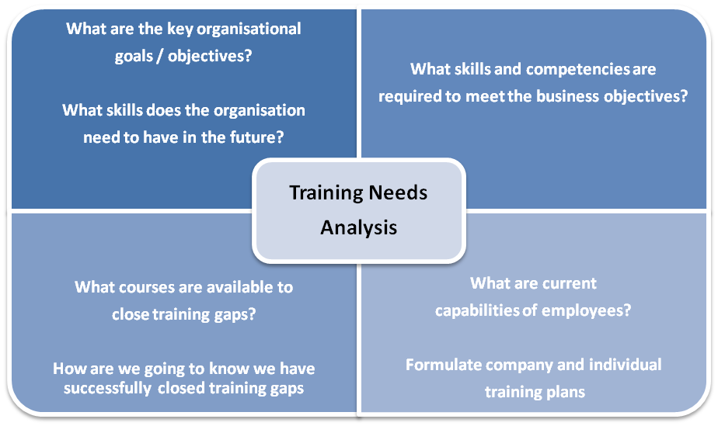
Identify WHS training needs
An effective and efficient process for determining the gap between the current and the required skill and knowledge level of workers to enable them to perform their tasks is a training needs analysis (TNA)

Slide 27
Identify training needs for WHS
How do you know if a member of your team needs training?
Chances are everyone does when they start working for the organisation, or when they take on a new role. Depending on their role in the organisation they may need training in the following (but not limited to):
  Hazard identification.
  Risk assessment.
  Emergency and evacuation procedures.
  Consultation arrangements for workers in work area.
  Use of personal protective equipment.
  Ergonomics.
  First aid.
  Handling of hazardous waste/

Slide 28
Identify WHS training needs
A TNA should be completed by all levels/roles in an organisation so results can be compared for similarities and inconsistencies and identify any issues regarding health and safety
Consultation between managers, supervisors, HSCs, HSRs and workers will help identify individual and work team training needs
Training is part of the health and safety hierarchy of control and is a required activity which complements other safety controls and enables workers to comply with legislative requirements. Conducting training will involve:
Who will provide the training? Select training providers – contact HR.
Plan times for training.
Coordinate post training mentoring to further support the team.
How much will it cost? Is there a budget?
Review final training and mentoring.
Investigate training needs again.

Slide 29
Implement WHS training
When planning and implementing a training program it is important to target specific training needs
Planning should also include determining the best methods for addressing learning needs
Many training initiatives fail because these two vital steps are overlooked:
The methods to be used to implement learning and make it relevant to the organisation
The change management procedures that should support learning

Slide 30
Implement WHS training
The success of health and safety training programs should have a visible and measurable effect on:
demonstrated safe work practice
demonstrated understanding of reasons behind safety procedures
reductions in the number of workplace accidents and incidents
high levels of worker satisfaction
reduced attrition and absenteeism percentages
increased perceptions of PCBU credibility provided training is backed up in policies, procedures, practice and resource allocation.

Slide 31
Determine cost of WHS training
What is the cost of training is often asked, what is the cost of not training? Incidents and injury, lost time and fines…
The benefits of investing in ongoing worker training include:
process improvements
cost savings
improved profitability
performance improvement
behavioural improvements
increased worker satisfaction.
and… the prevention of workplace accidents and incidents
BEWARE: Industrial action or litigation results from health and safety issues can greatly out weigh the costs necessary to properly train workers.

Slide 32
Presentation summary
Now you have completed this presentation you should be able to:
Identify WHS training needs according to organisational requirements and WHS legislative and regulatory requirements
Make arrangements to meet WHS training needs of team members in consultation with relevant individuals
Provide workplace learning opportunities and coaching and mentoring assistance to facilitate team and individual achievement of identified WHS training needs
Identify and report to management the costs associated with providing training for work team, for inclusion in financial and management plans

Slide 33
BSBWHS401
Implement and monitor WHS policies, procedures and programs to meet legislative requirements
Presentation 4 of 4

Slide 34
Presentation objectives
At the end of this lesson you will be able to:
Identify and report on hazards in work area according to WHS policies and procedures and WHS legislative and regulatory requirements
Promptly action team member hazard reports according to organisational procedures and WHS legislative and regulatory requirements
Implement procedures to control risks using the hierarchy of control, according to organisational and WHS legislative requirements
Identify and report inadequacies in existing risk controls according to hierarchy of control and WHS legislative requirements
Monitor outcomes of reports on inadequacies, where appropriate, to ensure a prompt organisational response

Slide 35
Identify and report hazards
A hazard is any source that has the potential to harm life, health, property or the environment
A risk is the chance of something harmful occurring-the likelihood that harm will occur as a result of a hazard
For a hazard to become a risk, a worker must be exposed to the hazard.
Safety inspections/audits identify hazards and assess the associated degree of risk - the likelihood the hazard will cause harm, type of exposure that might cause harm and the degree of harm that might be caused by the hazard.

Slide 36
Identify and report hazards
Types of Hazards
Obvious hazards are a visible and likely cause of accident
Hidden hazards may cause illness, either physical or psychological and are difficult to identify and may not be until after issue occurs
Other hazards include:
Physical
Radiation
Environmental
Psychological
Biological
Chemical
Ergonomic

Slide 37
Identify and report hazards
Once you or your workplace has identified a hazard steps must be taken to address or manage the problem:
Knowing what to do in the case of workplace hazard identification is critical to maintaining a safe, healthy workplace. Examples of hazards include but are not limited to the following:
Heavy unsecured loads, fire, poor training and lack of skills, spillage of hazardous materials, slips, trips and falls, fatigue across many areas of operation,
Secure the areas and remove the hazard if safe - use signage or barricades to prevent access
Do you need to enlist the help of emergency services? Fire, police, ambulance?
Notify your supervisor
Complete an incident report with supervisor.
Complete details of the hazard identified, actions taken and actions still to be taken.

Slide 38
Action hazard reports
Once hazards or potential hazards have been identified and reported an organisation should conduct and document a risk assessment.
An effective approach is to use a risk assessment team comprising of a variety of participants with a range of experience and expertise.
A risk assessment might be conducted if:
An accident, incident, or near miss occurs
A complaint is received from a worker or stakeholder
There are proposed changes in processes, equipment or materials
New guidance material and standards have been published

Slide 39
Action hazard reports
Risk assessment involves a judgement of likelihood and severity.
The assessment process maps the risk of a hazard causing harm against the likelihood of an actual occurrence.
What is the likelihood of the hazard resulting in a harmful incident?
This is matched to the probable severity (damage rating) of the harm.
Factors affecting severity include:
Quantity of people
Height
Distances
Weight
Forces
Speed
Volume

Slide 40
Implement risk controls
Once a control has been implemented, hazard identification should be conducted to make sure the control is effective or its introduction has not caused a new hazard.
If a hazard is found, a fresh risk assessment should be made and control measures implemented
If a hazard is not eliminated but reduced, the hazard should be included in the hazard register and subject to a regular review

Slide 41
Implement risk controls
Hierarchy of Control
Is intended to effectively manage workplace hazards and the risk of injury or illness by prioritising and determining risk elimination or reduction methods
The hierarchy of control should provide the guidelines when planning for safety and designing hazard and risk controls
When implementing workplace changes, refer to the hierarchy to ensure new processes and procedures will not increase worker risk and will comply with industry standards and safety requirements

Slide 42
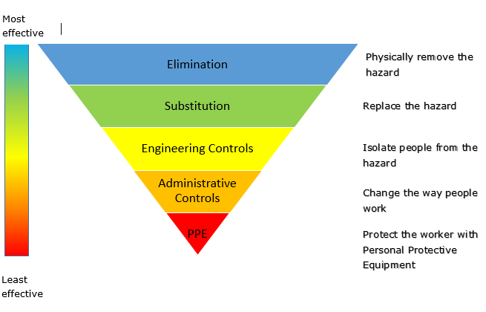
Implement risk controls

Slide 43
Determine inadequacies in existing risk controls
Risk assessments should be constantly reviewed as health and safety monitoring is a constant process.
When reviewing risk control measures, ask the following questions:
Is the control measure still effective?
Has the control measure created a new hazard?
All risk control measures should include a review date to ensure continual improvement and a report resulting from an evaluation.

Slide 44
Presentation summary
Now that you have completed this presentation you should be able to:
Identify and report on hazards in work area according to WHS policies and procedures and WHS legislative and regulatory requirements
Promptly action team member hazard reports according to organisational procedures and WHS legislative and regulatory requirements
Implement procedures to control risks using the hierarchy of control, according to organisational and WHS legislative requirements
Identify and report inadequacies in existing risk controls according to hierarchy of control and WHS legislative requirements
Monitor outcomes of reports on inadequacies, where appropriate, to ensure a prompt organisational response

