Slide 1

BSBSMB401
Establish legal and
risk management requirements of
small business

Slide 2

Housekeeping
Emergency procedures
Mobiles and security issues
Break times and smoking policy
This course is interactive – ask questions
Practise respect and confidentiality
Ground rules

Slide 3
Objectives
Know how to identify and implement business legal requirements
Learn how to comply with legislation, codes and regulatory requirements
Understand how to negotiate and arrange contracts
Identify how to identify and treat business risks
Gain skills and knowledge required to complete this unit

Slide 4

Identify and implement business legal requirements
                1.1. Identify and research possible options for the business legal structure using appropriate sources

Slide 5

Options for the business legal structure
Options for the business legal structures may include:
Company
Cooperative
Corporation
Partnership
Sole trader
Trust
Government owned enterprise
Profit or not-for-profit legal structure

Slide 6

Choosing the best legal structure for your business
In the first instance, this question and its appropriate answer would be sought through the examples given of the appropriate advisors and qualified experts to provide such advice.

Slide 7

Types of business structure
Types of legal structures include:
Sole Trader
Partnership
Proprietary Limited company.

Slide 8
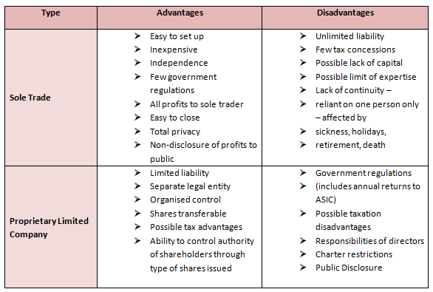
Identify and implement business legal requirements

Slide 9

Activity 1A

Slide 10
Identify and implement business legal requirements
1.2. Determine legislation and regulatory requirements affecting operations of the business under its chosen structure

Slide 11
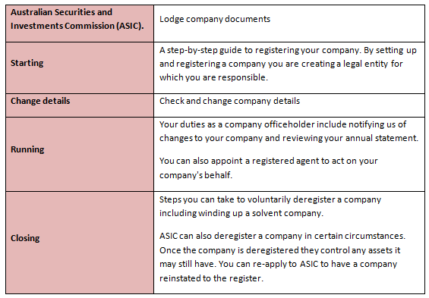
Some basic regulations affecting companies

Slide 12

Type of company
The type of company, its structure and its activities will determine some of the suggested legislative and regulatory requirements.

Slide 13
Identify and implement business legal requirements
                1.3. Develop and implement procedures to ensure full compliance with relevant legislation and regulatory requirements

Slide 14

Comply with general reporting
To comply with general reporting and submitting regulatory returns and documents, you should:
Maintain a register of its members
Keep a record of all directors and members
Record all meeting minutes and resolutions.

Slide 15

Financial reporting
Financial reporting for companies, registered schemes and disclosing entities in Australia is governed by the Corporations Act 2001.

Slide 16
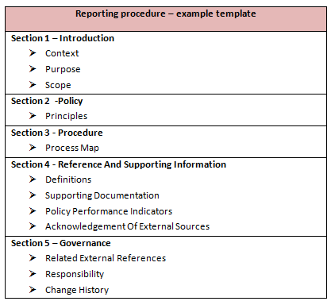
Ensure full compliance
Develop and implement procedures to ensure full compliance:

Slide 17
Activity 1B

Slide 18
Comply with legislation, codes and regulatory requirements
                2.1. Establish systems to ensure legal rights and responsibilities of the business are identified and the business is adequately protected, specifically in relation to work health and safety (WHS), business registration and environmental requirements

Slide 19

Establish systems
.
Establishing systems to ensure the legal rights and responsibilities of the business would require those people tasked with that responsibility to implement systems.
An effective system includes a group of interacting, interrelated or interdependent elements forming a complex whole.

Slide 20

Consumer legislation - ACCC
Companies are required to maintain a number of books, registers, accounts and records. These records must be kept for seven years and be available for inspection by any authorised person within certain time limits.

Slide 21

Operating the business with a duty of care (Law of Torts)
Civil claims are known as torts and are to be distinguished from criminal wrongs. A tort is not a crime, but rather it is an infringement against a person’s individual rights, e.g. a breach of duty of care.

Slide 22
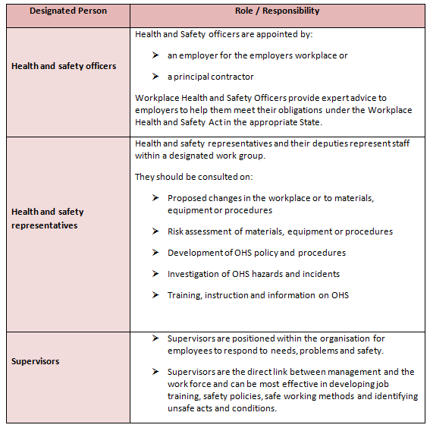
Company management templates

Slide 23
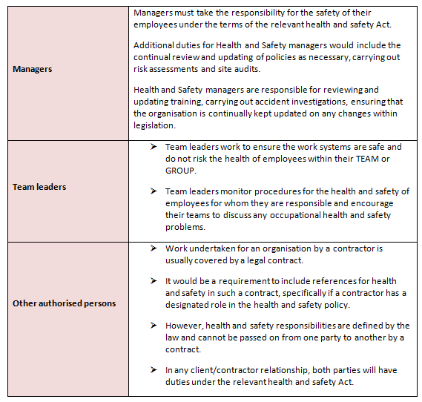
Company management templates

Slide 24
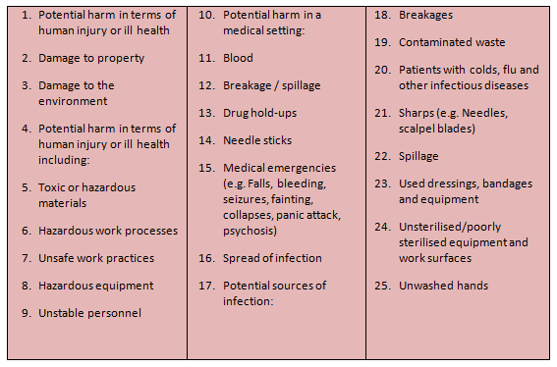
Risks associated with workplace hazards

Slide 25
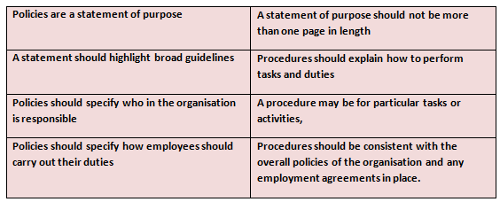
When designing policies
Such as controlling safety and risk/hazard identification, it is important that these documents are clearly understood and what the organisation expects and is trying to achieve.

Slide 26

Environmental requirements
As previously mentioned, it is impossible to group many of these elements under the banner of “small business” as such areas as the environment will impact all Australian businesses who in turn can play a part in environmental management.

Slide 27
Activity 2A

Slide 28
Comply with legislation, codes and regulatory requirements
                2.2. Identify taxation principles and requirements relevant to the business, and follow procedures to ensure compliance

Slide 29

Comply with legislation, codes and regulatory requirements
Taxation principles and requirements may include relevant taxation requirements/obligations for business, tax file number, Australian business number, goods and services tax registration, PAYG and withholding arrangements.

Slide 30
Comply with legislation, codes and regulatory requirements
                2.3. Identify and carefully maintain legal documents and maintain and update relevant records to ensure their ongoing security and accessibility

Slide 31
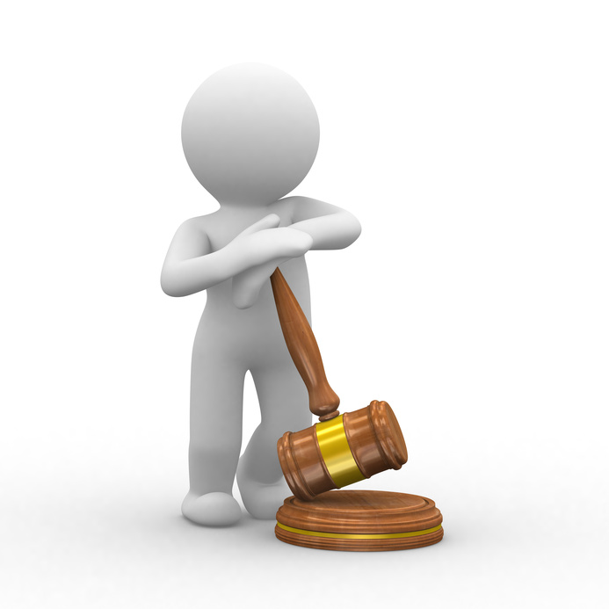
Comply with legislation, codes and regulatory requirements
The law says you need to keep some records for:
Five years for non-company financial records
Seven years for financial records for companies, most employee records
If you store financial records electronically, you must be able to produce a hard copy if the Tax Office or ASIC request it.

Slide 32

Comply with legislation, codes and regulatory requirements
Update relevant records to ensure their ongoing security and accessibility.

Slide 33
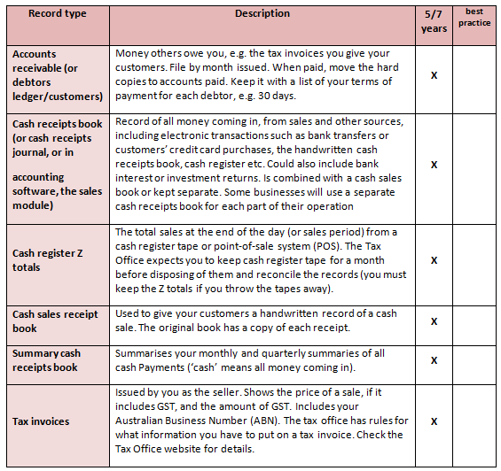
Types of records

Slide 34
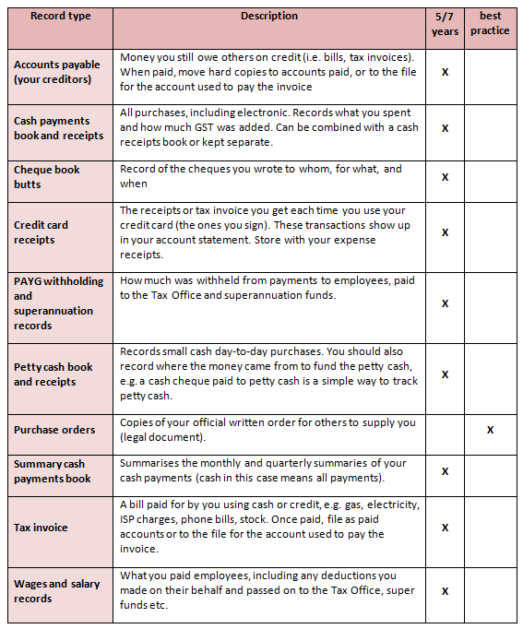
Types of records

Slide 35
Activity 2B

Slide 36
Comply with legislation, codes and regulatory requirements
                2.4. Monitor provision of products and services of the business to protect legal rights and to comply with legal responsibilities

Slide 37

Monitor the provision of products and services
Monitoring may include:
Reviewing on a continuous basis
Monitoring the provision of products and services of the business to protect legal rights
Reviewing the organisations activity or specifics as required, e.g. legal compliance
Taking corrective actions.

Slide 38

What is a contract?
A contract is an agreement between two or more parties by which legal rights and obligations are created, which the law will enforce.

Slide 39

Elements of a contract
For a legally enforceable contract to be formed, a number of elements must exist:
There must be an offer by one party and its acceptance by the other
There must be valuable consideration
There must be certainty as to key terms
The matters agreed must be for a lawful purpose.

Slide 40

The provision of products and services
The provision of products and services are often
subject to tendering arrangements and in
many cases, councils or statutory bodies are
required to issue tenders for contracts over a
certain monetary amount.

Slide 41

Statutes which impact on contracts
There are many statutes which impact on contracts
entered into for the legal provision of products and
services of the business.

Slide 42
Comply with legislation, codes and regulatory requirements
                2.5. Conduct investigations to identify areas of non-compliance with legal and regulatory requirements, and take corrective action where necessary

Slide 43

Encouraging compliance with employees
A good compliance culture is shown by the promotion
of a positive attitude towards legal compliance activity
at all levels within an organisation.

Slide 44
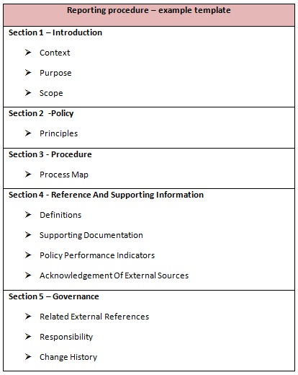
Develop and implement procedures to ensure full compliance

Slide 45
Activity 2C

Slide 46
Negotiate and arrange contracts
3.1. Seek legal advice on contractual rights and obligations, if required, to clarify business liabilities

Slide 47
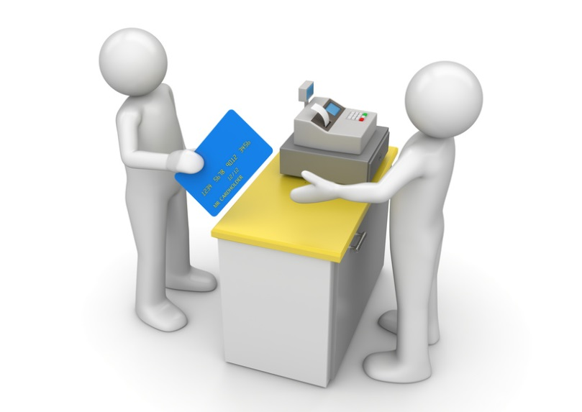
Negotiate and arrange contracts
Contractual obligations may include:
Purchase orders
Supply contracts
Exclusive agency agreements
Partnership agreements
Franchise agreements
Leases
You may need to seek legal advice about them.

Slide 48

The Plain Language Movement
The movement focuses attention on the information needs and the reading abilities of the reader and opposes writer-based prose, which is the tendency to use long sentences, jargon and a formal style as a way to acquire authority, power and credibility.

Slide 49
Activity 3A

Slide 50
Negotiate and arrange contracts
3.2. Investigate and assess potential products or services to determine procurement rights and ensure protection of business interests where applicable

Slide 51

Procurement rights
Procurement is the process of identifying and obtaining goods and services. It includes sourcing, purchasing and covers all activities from identifying potential suppliers through to delivery from supplier to the users or beneficiary.

Slide 52
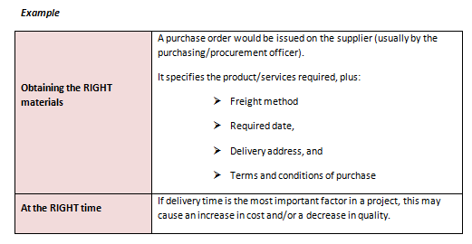
Procurement considerations:

Slide 53
Activity 3B

Slide 54
Negotiate and arrange contracts
3.3. Negotiate and secure contractual procurement rights for goods and services including contracts with relevant people, as required, in accordance with the business plan

Slide 55

Contracts
The organisation may have contracts with:
Any person with whom the business has, or seeks to have, a performance-based relationship
Owners, suppliers, employees, landlords, agents, distributors and customers.

Slide 56
Activity 3C

Slide 57
Negotiate and arrange contracts
3.4. Identify options for leasing/ownership of business premises and complete contractual arrangements in accordance with the business plan

Slide 58

Seek legal advice
It is suggested by the experts in this field that you make the choice to either lease or buy before you actually start looking for premises.
A lease is a legally binding agreement between a landlord and tenant. Leases are generally the most popular choice when it comes to starting a new business.

Slide 59

Benefits of leasing
Together with legal and financial advice, you should also seek business and property advice in order to ensure the lease is based on sound business and property principles.
Leasing is not necessarily a long-term financial commitment, which is beneficial if you are just starting out.

Slide 60
Activity 3D

Slide 61
Identify potential internal and external risks to the business
4.1. Identify potential internal and external risks to the business

Slide 62

Internal and external risks
Internal risks are ones that arise due to the organisation’s normal processes. It typically relates to human factors, technology and physical factors.
External risks are ones that imposed on the organisation from without, such as economic changes, natural disasters or political factors.

Slide 63
Activity 4A

Slide 64
Identify potential internal and external risks to the business
4.2. Assess the probability and impact of identified risks

Slide 65

Probability of risks
You could divide risk probability into categories such as:
Highly unlikely: Could occur in exceptional circumstances, but there is a good chance it never will
Unlikely: Unexpected but there is a slight possibility
Possible: There is a chance of it occurring and similar incidents have occurred in the past
Likely: A strong possibility that it will occur in some form
Certainty: Expected to occur due to past events and is planned around.

Slide 66
Impact of risks
Impact category | Financial impact | Health impact | Business impact
Minor | Minimal financial loss | First Aid needed; no days lost | Barely any impact
Moderate | Some financial loss, may disrupt business | Medical treatment and days lost | Short-term delays and problems (several days)
Major | Large financial loss, unlikely to be covered by insurance | Hospitalisation or permeant injury; large amount of days lost | Delays and problems for up to weeks
Catastrophic | Complete financial loss | Death or severe, permanent injury/disability. | Delays or problems for long-term.

Slide 67
Activity 4B

Slide 68
Identify potential internal and external risks to the business
4.3. Prioritise risks for treatment

Slide 69
Prioritising risks
One method of prioritising risks is a probability-impact matrix (or PIM). This allows you to mathematically calculate which risks need insurance and prevention methods most.
 | Minor (0.2) | Moderate (0.4) | Major (0.6) | Catastrophic (0.8)
Highly likely (0.9) | 0.18 | 0.36 | 0.54 | 0.72
Unlikely (0.7) | 0.14 | 0.28 | 0.42 | 0.56
Possible (0.5) | 0.1 | 0.2 | 0.3 | 0.4
Likely (0.3) | 0.6 | 0.12 | 0.18 | 0.24
Certainly (0.1) | 0.2 | 0.4 | 0.6 | 0.8

Slide 70

Prioritising risks
To establish a PIM, assign each risk probability and impact category a number. For example, minor, moderate, major and catastrophic could be 0.2, 0.4, 0.6 and 0.8. It is important to choose accurate values which reflect the reality of the organisation. Risks can then be plotted accordingly.

Slide 71
Activity 4C

Slide 72
Identify potential internal and external risks to the business
4.4. Develop actions to mitigate risks including identifying insurance requirements and adequate cover

Slide 73

Insurance requirements
Insurance requirements may include:
Comprehensive insurance for vehicles/property
Professional indemnity insurance
Public liability insurance
Third party insurance on motor vehicles
Workers’ compensation.

Slide 74

Insurance requirements
Common types of insurance include:
Burglary
Contract works
Corporate travel
Director’s liability
Fidelity guarantee
Industrial special risks.

Slide 75
Activity 4D

Slide 76

Skills and Knowledge Activity

Slide 77
Major Activity
This activity should take 1-2 hours to complete and can be found at the end of your workbook.
Your instructor will let you know whether they wish for you to complete it in session time or your own time.

Slide 78

Summary and Feedback
Did we meet our objectives?
How did you find this session?
Any questions?

Slide 79

Congratulations!
You have now finished the unit…
‘Establish legal and risk management requirements of small business’

