Slide 1

OCCUPATIONAL HAZARDS - ALCOHOL AND DRUG USE
WORK HEALTH AND SAFETY OFFICER

Slide 2
Assessment criteria
Describe key components of a workplace policy focused on alcohol and drug use
Understand processes for eliminating and minimising risks associated with alcohol and drug use

Slide 3
Alcohol and drug use
Among the significant negative impacts of alcohol and drug use are:
Accidents and injury
Absenteeism
Lower productivity
Staff turnover
Poor morale and working relationships.
Alcohol and drug use presents significant risks to workplace health and safety

Slide 4




Factors that increase risk
Work related stress
Lack of job security
Poor industrial relations
Poor pay
Boredom
Shiftwork and long working hours
Limited supervision
Difficult and dangerous work
Availability of alcohol and drugs
Younger age
Male gender
Worker attitudes and beliefs

Slide 5

Drugs and alcohol policy
Aims and objectives
Scope
Workplace specific content and details
Work sponsored functions
Identification of an affected person
Criteria for identification
Who will identify an affected person
Training
Procedures
Self-assessment by workers.

Slide 6
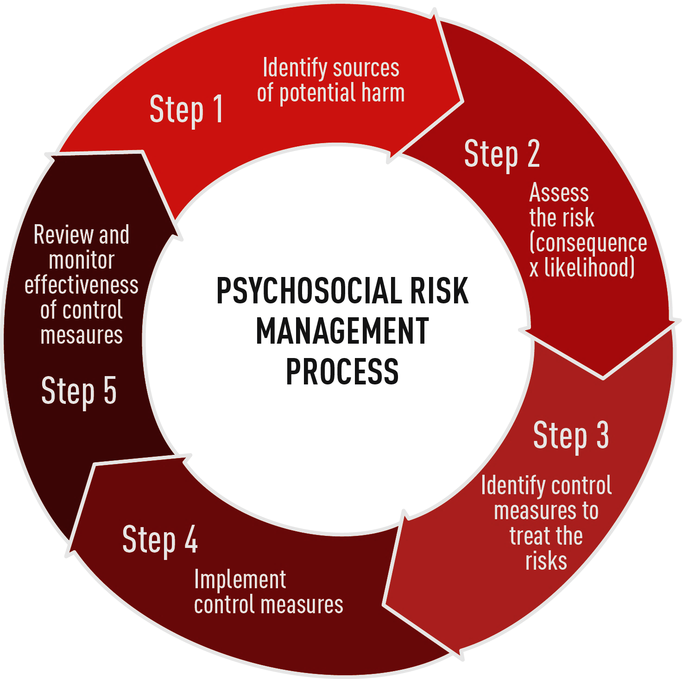
Risk Assessment

Slide 7

Consultation
Steering committee/working group
Health and safety committee
Toolbox talks.

Slide 8

Training and education
Targeted information and education resources
Information about services, programs and assistance available either at the workplace or by external agencies for workers seeking support
Copies of policy should be readily available at the workplace and widely publicised
Information and training sessions at the workplace on the policy.

Slide 9
Testing regime
Voluntary self-testing
Random testing
Upon reasonable belief
Testing after a workplace health and safety incident.

Slide 10
Activity
Working in pairs, develop a flow chart on how you will go about developing and implementing an alcohol and drugs policy in your organisation.
Remember to include relevant stakeholders and key steps that may be included in the policy i.e. risk assessment, employee assistance etc.

Slide 11
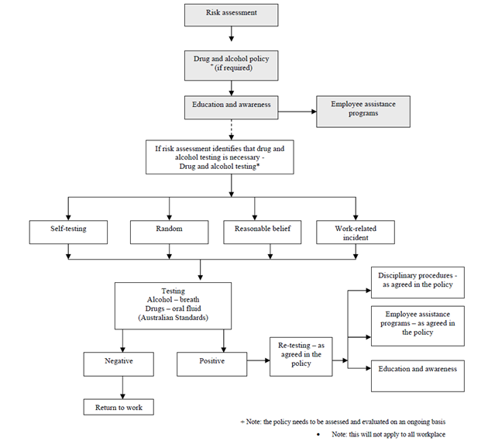
Activity debrief

Slide 12


