Slide 1
Organising Workplace Information
Chad o’neill

Slide 2
Common Ways To Access Information
Method (i.e. computer | Process | Organisational requirements
Computer | Ask the manager to search the database on the computer | Make sure that you have the manager permission from the manager
Printed documents | If the document is in the office make sure to have permission from the manager to go into the office, if you can freely read it | Make sure that you have the managers permission
Through updates and White board | Look at noticeboard to see if anything relevant or new has appeared | None.

Slide 3
COLLECTED INFORMATION
Once you have collected information ensure that the information is clear, accurate and relevant to the task. For example the information needs to be written in a clear and concise way that in which someone outside of the organization is able to read it and correctly understand the information.

Slide 4
Example of effective formats
Organisational features | How does it aid organisation of information
Headers and footers | The may signpost the document and outline what is being addressed as well as displaying information in a formal way
Symbols | This may signpost the reader to particular elements of the analysis. Symbols may represent particular parts of the document that could be cross-referenced, and again, keeps it simple
Graphics and pictures | Images may help colleagues, or whoever is exposed to the information, to see information in a concise way. Sometimes it will convey the information far more effectively than describing data
Tables and charts | As aforementioned, this can be an easy way of displaying data. They are easy to use on the above applications and can be displayed in a variety of ways
Software applications | The software application will depend on your organisation, however plenty of applications are available that can help you organise information. A generic application will allow you to select information, format the data into graphs and charts etc
Legends | Legends can be used to provide more information alongside a chart

Slide 5
What is the purpose of collating information?
Collating information, in the context of business, is when you bring documentation together from a range of sources and compare, arrange and organise the documents.

Slide 6
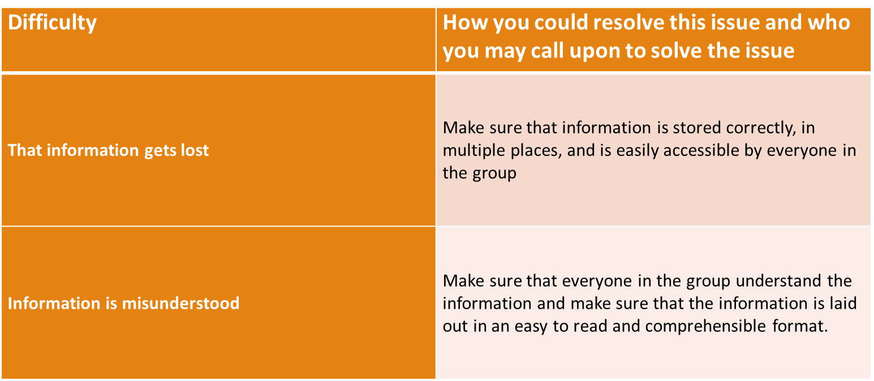
Example of possible difficulties

Slide 7
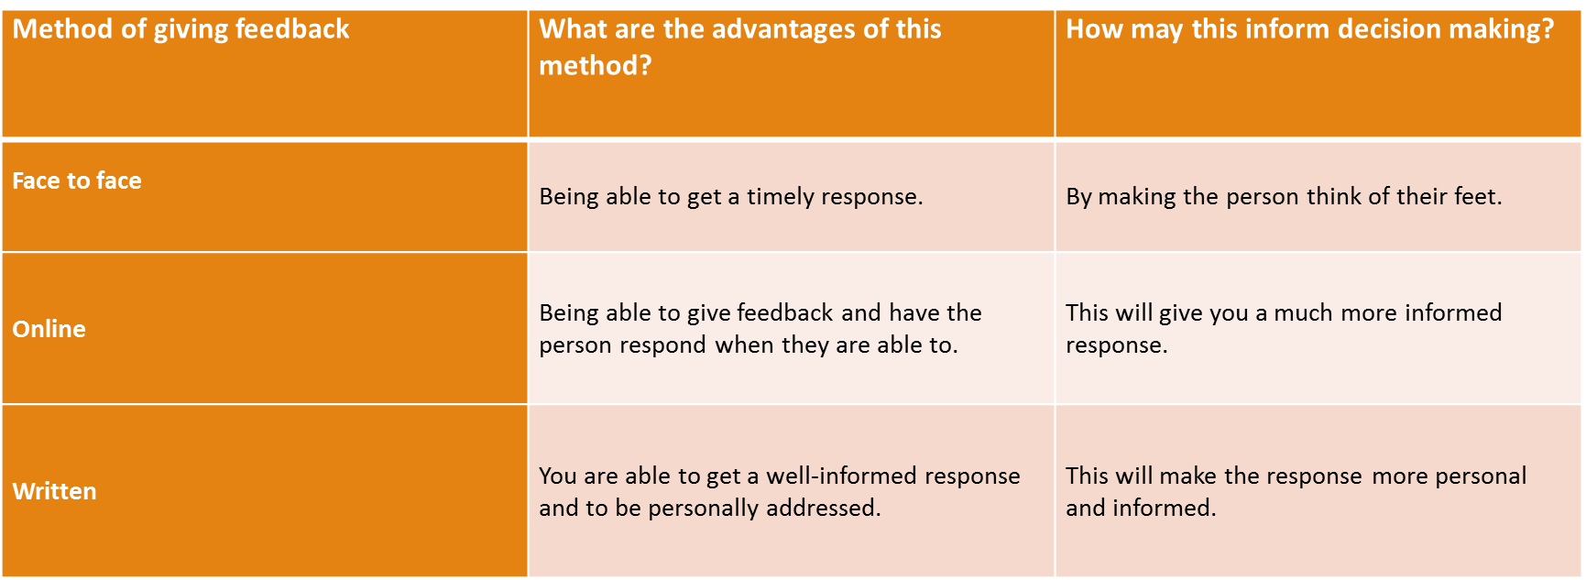
Feedback Opportunities

