Slide 1
Unit 10 prac
Hazardous chemicals.

Slide 2
Incidents leading to hazardous chemical review
On the 09-09-2023 it was brought to the attention of the safety walk that a boilermaker was using a can of spray gal without a mask. Works was halted and we have been asked to do a review and new methodology of how we use this hazardous chemical. Both PCBU and workers will be briefed on the information of this powerpoint.
On the 09-09-2023 it was brought to the attention of the safety comity that a laborer at taringa steel was using pickling paste without safety glasses or a mask, works was halted and a new methodology will be made moving forward in regards to these chemicals. Both pcbu and workers will be briefed on the information of this powerpoint.

Slide 3
Cold gal spray paint msds
https://www.aimsindustrial.com.au/assets/sds/A0084318.pdf Although all information can be found here on the msds, we will summaries it for this presentation
Hazard Classifications Flammable Aerosols –
Category 1 Acute Toxicity - Inhalation –
Category 4 Aspiration Hazard –
Category 1 Skin Corrosion/Irritation –
Category 2 Serious Eye Damage/Irritation –
Category 2A Specific Target Organ Toxicity (Single Exposure) –
Category 3 Narcotic Effects Acute Hazard to the Aquatic Environment –
Category 2 Chronic Hazard to the Aquatic Environment - Category 2
H222 Extremely flammable aerosol.
AUH066 Repeated exposure may cause skin dryness or cracking.
H304 May be fatal if swallowed and enters airways.
H315 Causes skin irritation. H319 Causes serious eye irritation.
H332 Harmful if inhaled. H336 May cause drowsiness or dizziness.
H411 Toxic to aquatic life with long lasting effects.

Slide 4
Cold gal safety data
4. FIRST AID MEASURES
If poisoning occurs, contact a doctor or Poisons Information Centre (Phone Australia 131 126, New Zealand 0800 764 766).
Inhalation: Remove victim from exposure - avoid becoming a casualty. Remove contaminated clothing and loosen remaining clothing. Allow patient to assume most comfortable position and keep warm. Keep at rest until fully recovered. If breathing laboured and patient cyanotic (blue), ensure airways are clear and have a qualified person give oxygen through a facemask. If breathing has stopped apply artificial respiration at once. In the event of cardiac arrest, apply external cardiac massage. Seek immediate medical advice.
Skin Contact: If skin or hair contact occurs, immediately remove contaminated clothing and flush skin and hair with running water. Continue flushing with water until advised to stop by the Poisons Information Centre or a Doctor; or for 15 minutes and transport to Doctor or Hospital. For gross contamination, immediately drench with water and remove clothing. Continue to flush skin and hair with plenty of water (and soap if material is insoluble).
For skin burns, cover with a clean, dry dressing until medical help is available. If blistering occurs, do NOT break blisters. If swelling, redness, blistering, or irritation occurs seek medical assistance. Eye contact: If in eyes, hold eyelids apart and flush the eyes continuously with running water. Continue flushing until advised to stop by the Poisons Information Centre or a Doctor; or for at least 15 minutes and transport to Doctor or Hospital.
Ingestion: Immediately rinse mouth with water. If swallowed, do NOT induce vomiting. Give a glass of water to drink. Never give anything by the mouth to an unconscious patient. If vomiting occurs give further water. Immediately call Poisons Centre or Doctor. Notes to physician: Treat symptomatically.

Slide 5
Cold gal safety data
LARGE SPILLS If safe to do so, shut off all possible sources of ignition. Clear area of all unprotected personnel. Use a spark-free shovel. If safe to do so, isolate the leak. Increase ventilation to assist with dispersion. If contamination of crops, sewers or waterways has occurred advise local emergency services. Dangerous Goods Initial Emergency Response Guide No: 49
Handling: Avoid eye contact and skin contact. Avoid inhalation of vapour, mist or aerosols.
Storage: Store in a cool, dry, well-ventilated place and out of direct sunlight. Store away from foodstuffs. Store away from incompatible materials described in Section 10. Store away from sources of heat and/or ignition. Store locked up. Do not expose to temperatures exceeding 50 °C/122 °F Keep containers closed when not in use - check regularly for leaks.

Slide 6
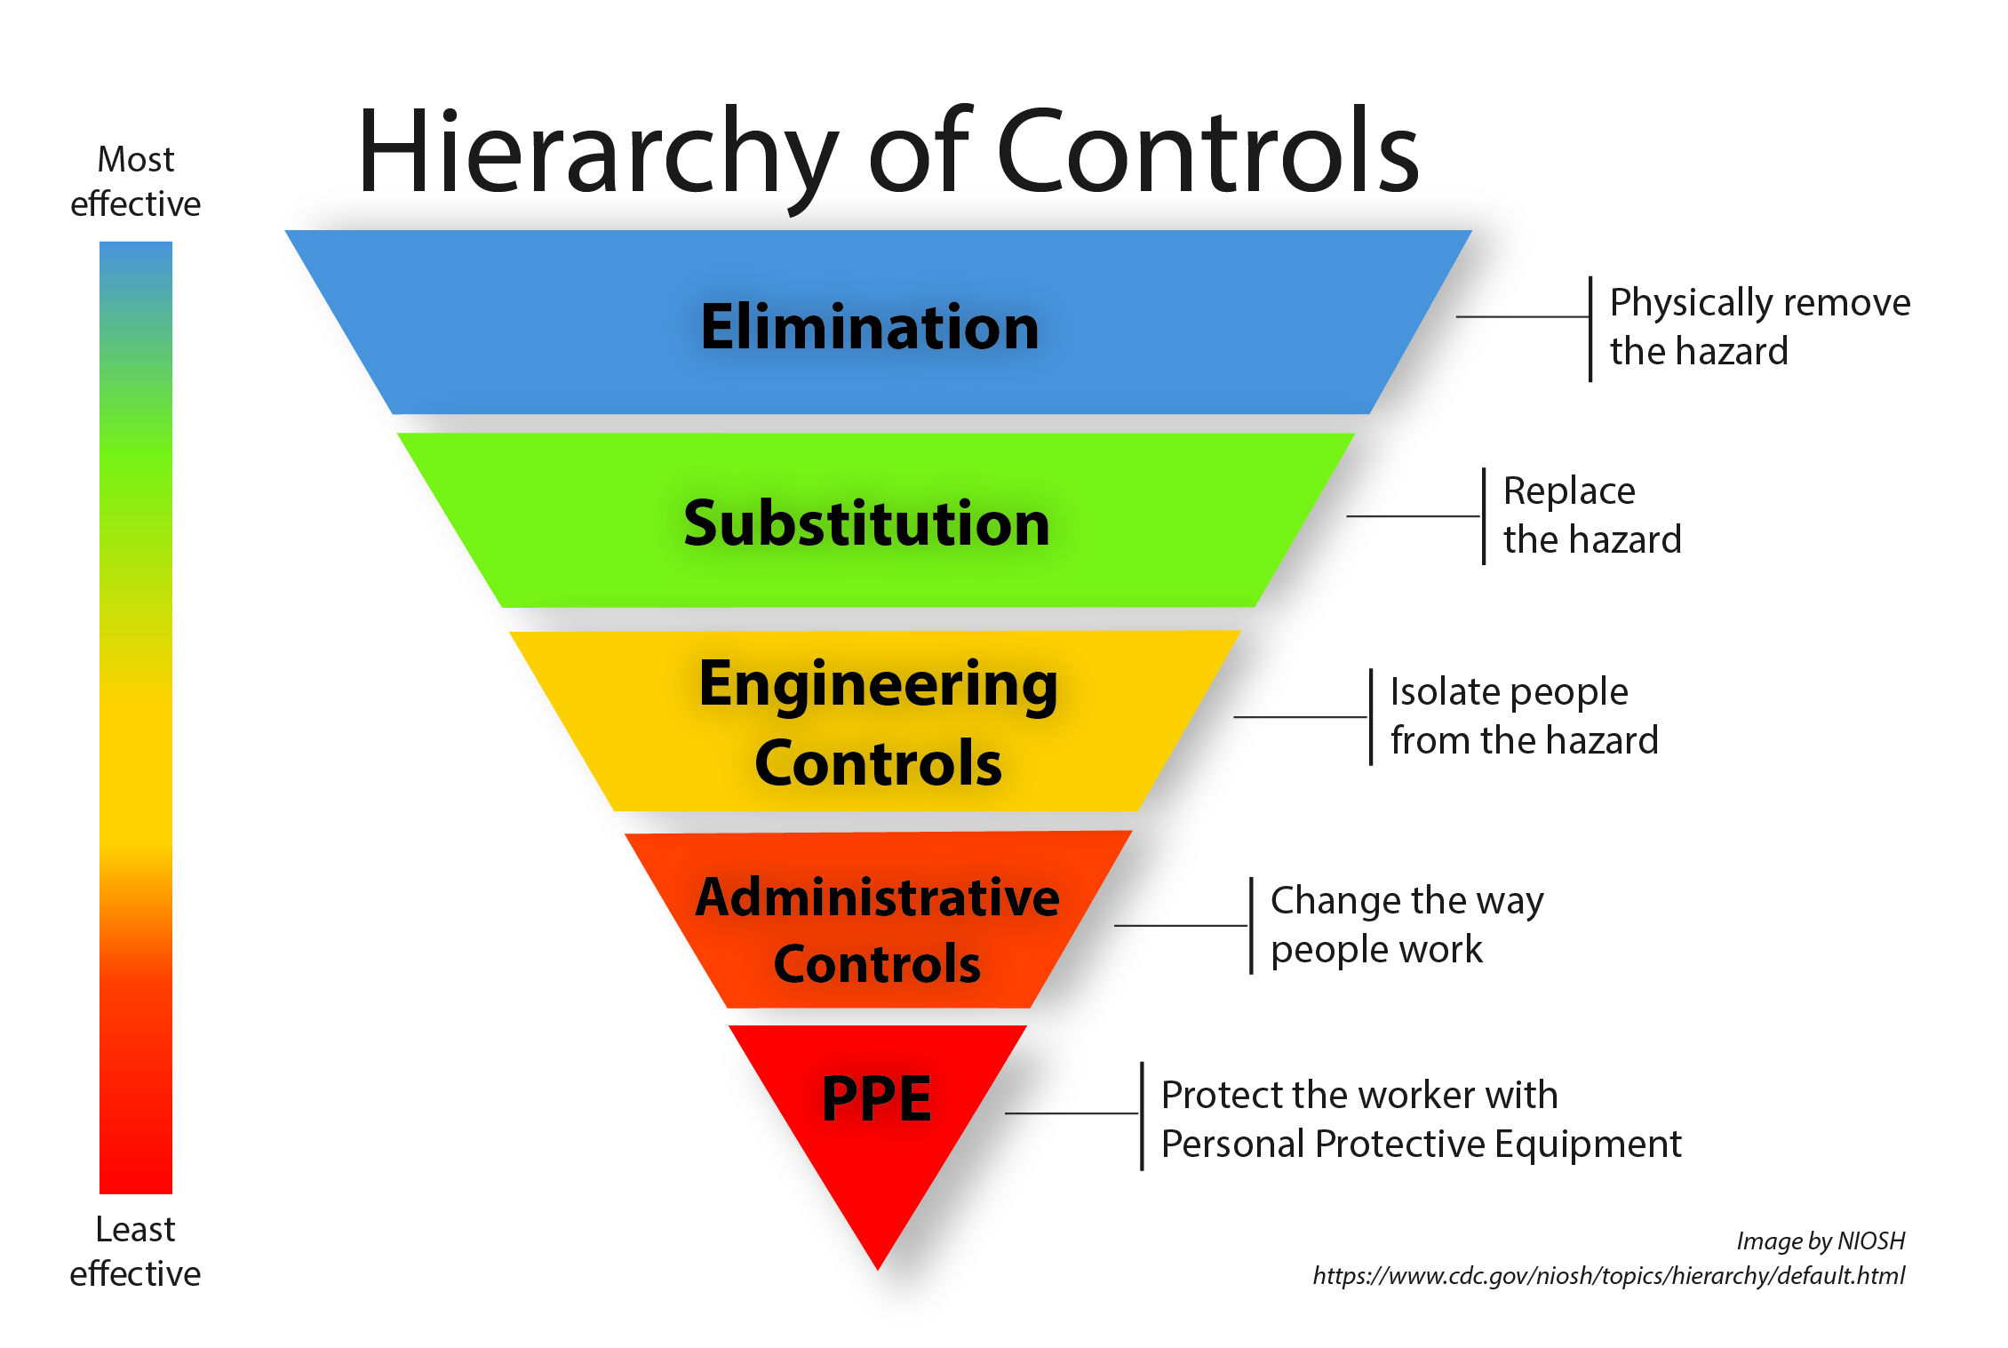
Hierarchy of controls to manage exposure.

Slide 7
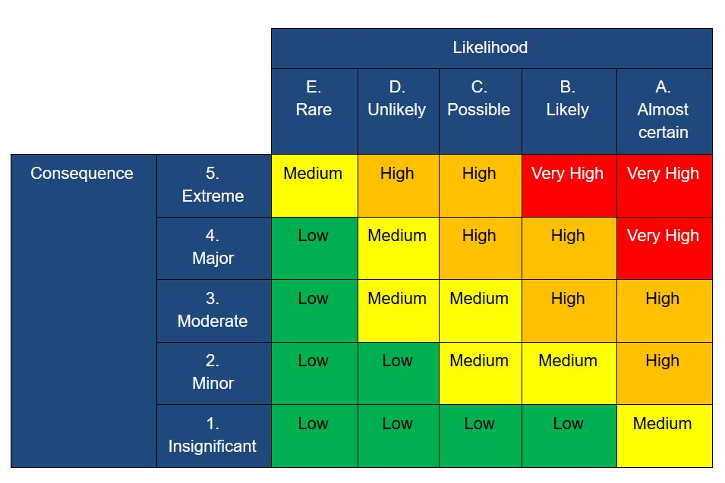
Risk matrix

Slide 8
Risk matrix and hazard control for gal paint.
Although elimination is not possible, there are several adequate control measures that can be put into place to minimize the risk of use down to low. Masks, Eyewear, Gloves, exclusion zones with proper signage

Slide 9
Risk matrix for pickling paste
Although picking paste can be harmful if touched or ingested, there are several ways to minimize the risk of harm occurring.
Eyewear, fit tested masks, gloves, long sleeve clothes and exclusion zones minimize the risk down to low.

Slide 10
Safety control measures required to use cold gal moving forward
Ventilation or outside use. If cannot be made outside a fan must be used to filter in clan breathing air
Mandatory class p2 mask whilst using until paint dries
Protective eyewear and gloves to eliminate skin contact.
Toolbox talk to review powerpoint and resign of the safe work method statement.
Exclusion zones with hazardous substance signs being used at alltimes

Slide 11
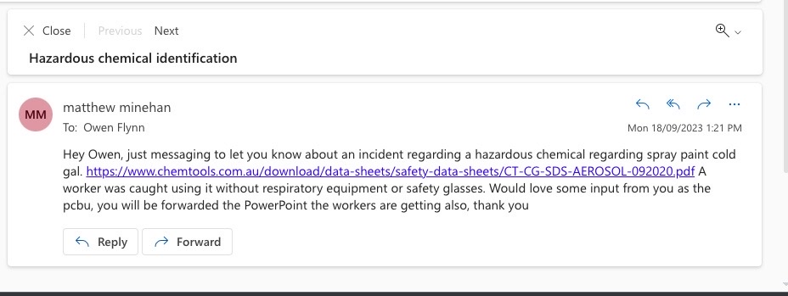
Emails between pcbu

Slide 12
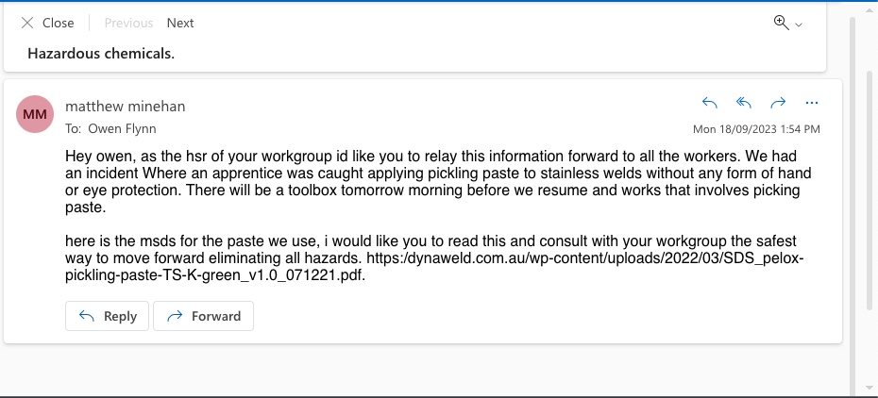
Email between workers.

Slide 13
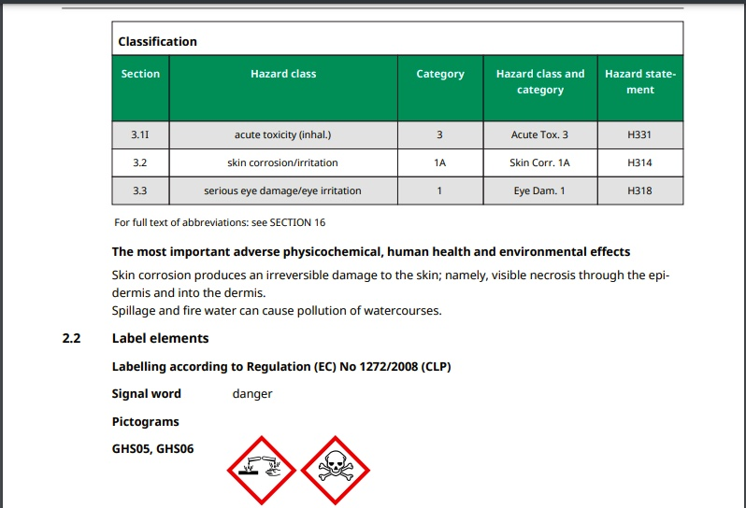
Pickling paste data

Slide 14
Pickling paste first aid measures
4.1 Description of first aid measures General notes Take off immediately all contaminated clothing. In all cases of doubt, or when symptoms persist, seek medical advice. Symptoms may develop several hours following exposure; medical observation therefore necessary for at least 48 hours.
Self-protection of the first aider. Following inhalation Provide fresh air. Mouth to mouth resuscitation should be avoided. Use alternative methods, preferably with oxygen or compressed air driven apparatus. If breathing is irregular or stopped, immediately seek medical assistance and start first aid actions. In case of respiratory tract irritation, consult a physician.
Following skin contact Rub with a gel containing calcium gluconate. Call a physician immediately. Causes poorly healing wounds.
Following eye contact In case of contact with eyes, rinse immediately with plenty of water and seek medical advice. Remove contact lenses, if present and easy to do. Continue rinsing. Rinse copiously with a calcium gluconate solution.
Following ingestion Rinse mouth immediately and drink plenty of water. Do NOT induce vomiting. Call a physician immediately. Notes for the doctor None. 4.2 Most important symptoms and effects, both acute and delayed These information are not available.

Slide 15
Safety control measures for pickling paste Moving forward
All personnel must be wearing protective eye wear
All personnel must be wearing a fit tested p2 mask
All peroneal must be wearing long sleeve shirts
All personnel must be wearing full finger gloves
Picking paste to be used outside when possible, extraction fans a minimum if used inside.
Must be exclusion zones with signage of hazardous chemicals in use

