Slide 1

BSBREL402
Build client relationships
and business
networks

Slide 2

Housekeeping
Emergency procedures
Mobiles and security issues
Break times and smoking policy
This course is interactive – ask questions
Practise respect and confidentiality
Ground rules

Slide 3
Objectives
Learn how to initiate interpersonal communication with clients
Show how to establish client relationship management strategies
Demonstrate how to maintain and improve ongoing relationships with clients
Explain how to build and maintain networks
Gain the skills and knowledge required for this unit.

Slide 4

Initiate interpersonal communication with clients
1.1 Identify and use preferred client communication styles and methods

Slide 5

What is communication?
Transferring information from one place to another
Can be through verbal messages, written words or non-verbal signals
Information must be fully understood by recipient
Essential that you tailor communication to who you are communicating with and their needs
Communication is an important part of building client relationships and business networks
What’s the best way to communicate with
clients?

Slide 6

Communication styles
Particular ways in which people communicate
Chosen style can depend on situation
People usually have a ‘default’ communication style
Example communication styles:
  Assertive
  Aggressive
  Passive-aggressive
  Submissive
  Manipulative.

Slide 7

Communication methods
Particular modes that you use to communicate
Your chosen method will depend on the client you’re communicating with and the nature of the situation
Chose a method that will get the right
message across in a clear, unambiguous way
Two main methods of communication:
  Spoken – use sound and language to
  relay a message through word of mouth
  Written – use written symbols to relay a message.

Slide 8

Understanding client’s preferred style and method
‘The success of communication is the responsibility of the communicator’
Important to communicate in most effective way
Your job is to keep your clients happy
Need to identify and use their preferred communication style and method
If this differs to your usual way of
communicating you will need to make
the necessary adjustments.

Slide 9

Activity 1A

Slide 10
Initiate interpersonal communication with clients
1.2 Establish rapport with clients using verbal and non‑verbal communication processes

Slide 11

What is rapport?
Close and harmonious relationship between you and your clients and involves:
  Getting on well with them
  Having things in common
  Having a mutual understanding
  Creating a bond
Can develop naturally or may need to be built
Can be established through the use of verbal and non-verbal communication processes.

Slide 12
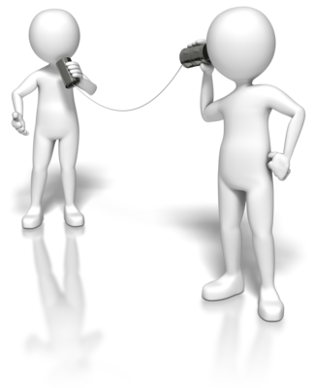
Verbal communication
Refers to any form of communication that involves words (e.g. spoken and written communication)
Establish rapport by:
  Talking about shared experiences or interests
  Not talking about yourself too much
  Asking questions/showing an interest
  Using feedback to clarify
  Being honest and polite
  Avoiding jargon and using appropriate language.

Slide 13

Non-verbal communication
Refers to wordless signals/implicit messages that give clues to the meaning behind verbal communication
Establish rapport by:
  Matching non-verbal signals with client
  Using open body language
  Maintaining eye contact
  Show that you are listening
  Smile
  Using appropriate levels of touch
  Using voice appropriately.

Slide 14
Activity 1B

Slide 15
Initiate interpersonal communication with clients
1.3 Investigate and act upon opportunities to offer positive feedback to clients

Slide 16

What is positive feedback?
There is always a need to educate your clients
Positive feedback is advice, opinions, views and information you can share in order to educate them
Should be useful and beneficial
Your expertise is an important asset
Use it appropriately and effectively
Explore problems with clients and find solutions
Your role will involve identifying opportunities you have to offer this positive feedback to your clients.

Slide 17

Examples of opportunities to offer positive feedback
Routine telephone calls
Newsletters
Forums
Emails
Events
These are only examples – think about the opportunities available within your own organisation
Once you’ve identified an opportunity – ACT ON IT.

Slide 18
Activity 1C

Slide 19
Initiate interpersonal communication with clients
1.4 Use open questions to promote two‑way communication

Slide 20

Two-way communication
Get clients involved and listen to what they say
It allows for questions and clarification
Results in message being thoroughly understood
Can be time consuming
Will avoid distrust and lead to openness
Openness allows a healthy relationships to be built, leading to effective communication
7 steps to two-way communication.

Slide 21

Open questions
Promote two-way communication using open questions
They allow for more creativity and information
They invite long, detailed responses
They allow for elaboration or explanation
Often begin with why, what, how, describe or tell me
Gives control of conversation to the client
Maximise your client’s input
E.g. ‘what is it like doing your job?’

Slide 22

Active listening
Two-way communication involves active listening too
In order to listen effectively, you should:
  Stop talking and show that you’re listening
  Concentrate and focus on the client
  Be patient and let the speaker say
  everything that they need to
  Try to empathise and look at things
  from their perspective
  Link pieces of information together.

Slide 23
Activity 1D

Slide 24
Initiate interpersonal communication with clients
1.5 Identify and act upon potential barriers to effective communication with clients

Slide 25

Potential barriers to effective communication
Important to understand that things can act as a barrier to effective communication
Identify potential barriers and act accordingly to ensure communication is as effective as it can be
What does effective communication involve?
Potential barriers can relate to both verbal and non-verbal communication.

Slide 26

Examples of potential barriers
Individual differences not being addressed
Making false assumptions and acting on stereotypes
Inappropriate word choice
Ineffective non-verbal communication
Failing to listen properly
Lack of contact information available to clients
Organisational factors
Limited times available for clients to get in touch
Lack of voice modulation and articulation
Physical distractions.

Slide 27
Activity 1E

Slide 28
Initiate interpersonal communication with clients
1.6 Initiate communication processes which relate to client needs, preferences and expectations

Slide 29

Initiating communication processes
Many instances in which you’ll need to initiate communication processes with clients
It’s essential that these communication processes relate to client’s needs, preferences and expectations
Do some investigating to identify them
E.g. put yourself in your client’s shoes, do research or simply ask them
Ensure that you meet needs,
preferences and expectations.

Slide 30

Needs, preferences and expectations
Needs – wants and requirements of clients
Preferences – particular ways in which clients like to do something
Expectations – specific things clients expect
Always remain focused on client needs; not your own
Strive to solve their problems (even small ones)
Ensure communication is effective
Clients more likely to be satisfied and loyal.

Slide 31
Activity 1F

Slide 32
Establish client relationship management strategies
2.1 Develop client loyalty objectives focusing on the development of long term business partnerships

Slide 33

Client relationship management strategies
Strategies that enable you to maintain effective and efficient communication with clients
Will enable you to improve relationships with them
Key components include:
  Developing client loyalty objectives
  Assessing client profile information
  Developing loyalty strategies
  Identifying and applying client care and
  client service standards.

Slide 34

Client loyalty
‘Keeping your current clients is much cheaper than finding new ones’
Retention of clients is important for businesses
Develop relationships with clients
Loyal clients:
  Reliable clients that keep coming back
  ‘Partners’ that support your business
  Work with you to achieve common
  goals.

Slide 35

Client loyalty objectives
Aims, goals and intentions in terms of client loyalty
How are you going to maintain a relationship with them and ensure they keep returning?
Focus on development of long term partnerships
Client loyalty objectives may refer to:
  Learning about and understanding clients
  Giving clients attention they deserve
  Sharing information and knowledge
  Being honest and open with clients
  Maintaining regular contact with clients.

Slide 36
Activity 2A

Slide 37
Establish client relationship management strategies
2.2 Assess client profile information to determine approach

Slide 38
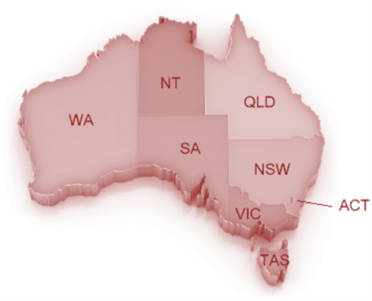
What is a client profile?
Outline, summary or description of client
Contains all relevant information
Includes characteristics such as:
  Age
  Geographic location
  Interests
  Buying patterns
  Information about products they’ve bought
  Communication preferences.

Slide 39

Assessing information within a client’s profile
Assess information within client profiles
What does their profile tell you?
Can help you to:
  Understand their needs and problems
  Understand the way that they work
  Figure out best way to communicate with them and maintain your relationship with them
Match communication attempts to profile – will ensure it’s effective.

Slide 40
Activity 2B

Slide 41
Establish client relationship management strategies
2.3 Develop client loyalty strategies to attract and retain clients in accordance with the business strategy

Slide 42
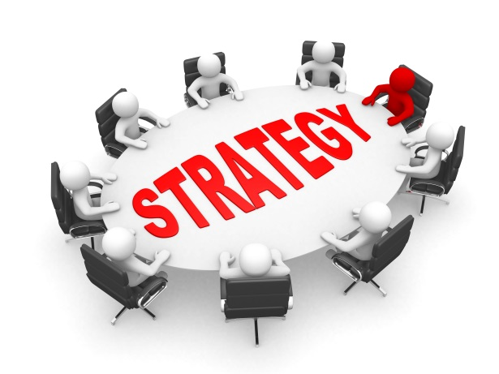
Client loyalty strategies
Loyal clients are valuable assets
Figure out how you can keep them coming back
Many ways to do this (including loyalty strategies)
How can clients benefit from returning?
Provide them with more incentive
Encourage them to buy more things
Show them that they’re the focus of
your business
Show that you care.

Slide 43

Examples of loyalty strategies
Providing the best possible products/services
Providing private or dedicated facilities
Offering credit or discount facilities
Implementing client reward schemes
Developing frequent purchaser programs
Creating client clubs
Sending thank you notes/letters/phone calls
Sending thank you gifts/promotions
Offering discounts
Giving out promotional items
Maintaining regular contact with your best clients
Ensuring access to good, dedicated staff.

Slide 44

Developing loyalty strategies
Strive to be different, unique and exclusive
Try to stand out from your competitors
Tailor them to clients – what’s their idea of a reward?
Develop a strategy that suits majority of clients
Keep them focused – develop objectives
Ensure they’re in accordance with business strategy
Get everyone on board – they need to be willing
Ensure you have the required resources.

Slide 45
Activity 2C

Slide 46
Establish client relationship management strategies
2.4 Identify and apply client care and client service standards

Slide 47

Client care and client service standards
Protocols/principles used to ensure client care and client service provided are of high quality
Ensure clients have a smooth experience
Provide staff members with goals/benchmarks
Should outline what clients should expect from you
Will vary depending on products/services offered
Need to be appropriate and suited to clients
They’ll show that you understand what
clients need, want and expect from you.

Slide 48

Standards should be…
High
Measurable
Realistic
Individual
Achievable
Focused on client service
Written down
Unique
Appropriate
Communicated with clients.

Slide 49

Example: ‘meeting client expectations’
Staff members should do exactly what they tell the client they’re going to do
Enquiries should be dealt with immediately
Contact details should always be provided to clients
Always apologise for any mistakes made
All product/service information should be correct
A complaints procedure should be in place
and they should be dealt with quickly
Clients should not be kept on hold for
longer than necessary.
I’m sorry…

Slide 50
Activity 2D

Slide 51
Maintain and improve ongoing relationships with clients
3.1 Develop strategies to obtain ongoing feedback from clients to monitor satisfaction levels

Slide 52

Feedback
Critical part of maintaining and improving relationships with clients – valuable part of business
Information about a client’s reaction to something
Includes their opinions and views
Refers to what clients think about your products etc.
Can help you to identify areas of improvement
Feedback should be ongoing – you need
to make sure you provide clients with
opportunities to give it.

Slide 53

Using feedback
Obtaining it isn’t enough – you have to actually use it
Using feedback constructively can allow you to:
  Learn from your mistakes
  Achieve organisational goals
  Make the necessary improvements
  Exceed limitations
  Set higher standards
  Ensure client are satisfied
  Improve relationships with clients.

Slide 54

General methods used for obtaining feedback
Sending email requests
Looking into previous complaints
Using focus groups
Calling clients
Sending letters
Sending out surveys and questionnaires
Observations
Providing ‘comments’ sections
Looking at what is being said on client forums
Having a ‘suggestions’ system
Gathering information from staff members
Case studies.

Slide 55

Monitoring satisfaction levels
Satisfaction – gap between what clients expect from you and what you actually deliver
Can measure satisfaction levels using surveys
Can give you snapshot of your general performance
Usually involve a mix of questions and Likert Scales
Example question:
Overall, how satisfied are you with our company?

Slide 56
Activity 3A

Slide 57
Maintain and improve ongoing relationships with clients
3.2 Develop strategies to elicit feedback which provide information in a form that can be used to improve relationships with clients
3.3 Obtain feedback to develop and implement strategies which maintain and improve relationships with clients

Slide 58

Strategies to elicit feedback
Involves drawing feedback out and encouraging clients to share their thoughts and opinions
Choose methods that allow you to communicate personally with clients (e.g. conversations or calls)
Have an opportunity to ask open questions
They allow for elaboration and explanation
Will be able to gain more details; a true insight
into their thoughts
E.g. In what ways do you think our
service could be improved?

Slide 59

Developing and implementing strategies
Obtaining feedback is just the first step; you need to know what to do with the information
Examine findings and translate feedback into actions
Feedback should assist you in developing and implementing strategies that can help you maintain and improve relationships with your clients
Negative feedback is usually most useful
Strategies developed will obviously depend
on feedback you receive
See examples in chapter.

Slide 60
Activity 3B

Slide 61
Build and maintain networks
4.1 Allocate time to establish and maintain business contacts

Slide 62

Build and maintain networks
‘It’s not what you know, it’s who you know’
Networks are groups of interconnected people
Effective way to create business relationships
Involves people that you already know, the people that those people know (and so on and so on)
Relationships don’t have to be close ones
It’s about breadth rather then depth at this stage
The more people you know, the more
effective you’ll be in forming new
business contacts.

Slide 63

Establishing and maintaining business contacts
Business contacts – people within your network
Can be fairly straight forward – but needs to be done effectively (to avoid clients slipping through fingers)
Develop a strategy and allocate time dedicated to establishing and maintaining business contacts
Gather, store and update relevant information
Keep records and develop client profiles
Learn to manage time effectively
Know what to do if you don’t have time right now.

Slide 64
Activity 4A

Slide 65
Build and maintain networks
4.2 Participate in business associations and/or professional development activities to establish and maintain a network of support for the business and to enhance personal knowledge of the market
4.3 Establish communication channels to exchange information and ideas

Slide 66

Business associations
Participate in business associations to create networks with other businesses
Submit your application and become a member
Many associations you’re able to join
Can put you in touch with other businesses
Share your perspectives whilst listening to others’
Can meet new people and make new contacts
Plan; make sure you get what you
want out of it.

Slide 67

Professional development activities
Tasks/events that provide learning opportunities
Strengthening you – expanding skills/knowledge
Can involve company events such as:
  Demonstrations
  Fairs
  Pre-launch activities
  Trade shows/exhibitions
  Industry training or information seminars
  Technical information briefings.

Slide 68

Why bother?
Participating in business associations and professional development activities gives you opportunity to:
Establish/maintain a network of support for business
Enhance your personal knowledge of the market
Learn about your industry
Lead to potential clients
Become an established expert within
your field.

Slide 69

Establishing communication channels
How are you going to keep exchanging information and ideas with people within your network?
What communication channels will you use?
Communication channels – mediums through which you transmit your message to your audience
It’s important to choose the right channel
Can be internal or external
Can be formal or informal.

Slide 70
Activity 4B

Slide 71
Build and maintain networks
4.4 Provide, seek and verify information to the network

Slide 72

Providing, seeking and verifying information
When building/maintaining networks, you’ll need to seek, verify and provide information to everyone
Find relevant information, validate it and offer it
Can form a reputation, build rapport and establish loyalty
Many channels to communicate
through (e.g. memos and meetings)
Take advantage of available technology to ensure effective communication (e.g. websites, blogs, social media and emails.)

Slide 73
Activity 4C

Slide 74
Skills and Knowledge Activity

Slide 75
Major Activity
This activity should take anywhere between 1-2 hours to complete and can be found at the end of your workbook.
Your instructor will let you know whether they wish for you to complete it in session time or your own time.

Slide 76

Summary and Feedback
Did we meet our objectives?
How did you find this session?
Any questions?

Slide 77

Congratulations!
You have now finished the unit…
‘Build client relationships and business networks’

