Slide 1

CHCECE003
Provide care for children

Slide 2

An introduction on the National Quality Framework (NQF)
The National Quality Framework (NQF) was established in 2012 by the government as a measure to raise the quality and standards of early childhood education and care
This is overseen by the Australian Children’s Education and Care Quality Authority (ACECQA), in conjunction with the individual state and territory regulatory bodies.

Slide 3

The NQF includes:
The National Law and National Regulations
The National Quality Standard (NQS)
National learning frameworks
Assessment and quality rating process.

Slide 4

Provide physical care
1.1 Manage toileting accidents in a manner that protects the child’s self-esteem and privacy

Slide 5

Children and toileting
Services will have different guidelines for handling toileting but these should still follow the requirements of the NQF
It is helpful to establish routines as this will help children become more aware of their need to use the toilet and will help prevent toileting accidents.

Slide 6

Toileting accidents
Your organisation should have clear policies
and procedures on all aspects of health and safety at the service; this includes toileting
and how to deal with different
situations concerning this
When dealing with a toileting
accident you should minimise any
cause of embarrassment to the
child as a priority.

Slide 7

Dealing with a toilet accident will include:
Cleaning and changing the child
Removing waste from underwear and bagging up soiled clothes in a sealed bag
Removing any mess from the service area
Cleaning and sanitising the affected area/surfaces
Ensuring the child is comforted and supported as needed.

Slide 8

Privacy
Providing privacy to children includes:
Understanding and respecting children may feel uncomfortable doing certain things in front of adults and other children
Providing a quiet/private space for the
child in personal hygiene and dressing/undressing routines
Not watching them participate in personal routines (if not needed as a matter of safety)
Etc.

Slide 9

The rights of the child
The United Nations Convention on the Rights of the Child (UNCRC) sets out the civil, political, economic, social and cultural rights of children.
There are 54 articles in the convention,
the following four are considered to be
the general principles of the treaty:
Non-discrimination (article 2)
Best interest of the child (article 3)
Right to life survival and development (article 6)
Right to be heard (article 12).

Slide 10

A code of ethics for early childhood
Early Childhood Australia’s Code of Ethics is based on the principles of the UNCRC; this sets out the requirements for behaviours in early childhood professionals and provides guidance in making ethical decisions and in promoting the rights and dignity of all children.

Slide 11

Activity 1A

Slide 12
Provide physical care
1.2 Supervise and engage with children eating and drinking

Slide 13

Supervision of children
Supervising is required for the following reasons:
To ensure children do not have an accident
To direct planned activities
To watch unplanned activities
To help children participate in activities
To facilitate development and learning
experiences
To attend to care needs
To ensure children do not wander off, get lost or taken from the premises without prior consent.

Slide 14

The Educational and Care Services National Regulations
Under the National Regulations (Regulation 84), education and care services must ensure that staff working with children are aware of and follow their obligations for child protection as provided under child protection law in the relevant state/territory.

Slide 15
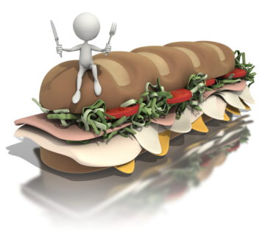
Children eating and drinking
Things to look out for can include:
Children leaving the table in between eating
Children disrupting other children, for example, trying to play at the table or moving/taking foods from other children
Unhygienic eating, such as wiping messy hands on tables or clothes
Children unable to cut foods or eat
larger food pieces on the plate
Etc.

Slide 16

Engaging with children
Using open body language that invites children to interact
Smiling and looking at children as you
engage with them
Speaking clearly, slowly and in a
friendly tone
Not shouting
Inviting their participation, feedback,
thoughts and feelings
Etc.

Slide 17

Duty of care
Duty of care is a legal duty that you have as a worker to take all reasonable care to avoid others from being harmed when in your care and supervision
You also have an obligation to make sure that your colleagues (and other workers) provide
a good standard of care, with due
attention.

Slide 18
Activity 1B

Slide 19
Provide physical care
1.3 Meet individual clothing needs and preferences of children and families within scope of service requirements for children’s health and safety

Slide 20
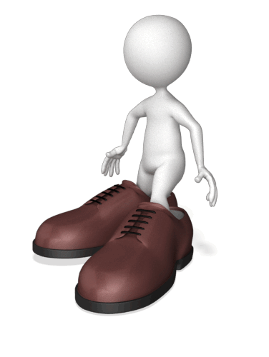
Clothing for children
Clothing for children should be practical, durable and comfortable
At the enrolment stage, families should be informed of any special clothing requirements for their child’s participation at the service
Best clothing may prevent a child from fully participating in active play or activities which may make clothing dirty.

Slide 21

Service clothing items
Your service may provide certain items of clothing to children (in some activities), for example, aprons for crafts, sleepwear and sun hats
This may be as part of the service’s facilities or for emergency use when a child does not have the right clothing to hand.

Slide 22

Clothing to avoid:
Decorations on clothing which may catch
Long strings or necklaces that may cause a child to choke
Delicate fabrics and best clothes which may spoil
Long skirts and higher heeled shoes that my cause girls to trip
Difficult or multiple fastenings which are difficult for a child to use.

Slide 23
Activity 1C

Slide 24
Promote physical activity
2.1 Consistently implement movement and physical experiences as part of the program for all children

Slide 25

Involving children in physical activities
The Department of Health has established guidelines for physical activity in children:
National Physical Activity Guidelines for 0-5 years-of-age
National Physical Activity Guidelines for 5-12 years-of-age.

Slide 26

National Physical Activity Guidelines for 0-5 years-of-age
0-5year-olds should not be kept sedentary for more than one hour at a time, unless they are sleeping
The use of baby walkers and jumpers are not recommended
Children from 1-5 years should also be active for at least three hours each day (spread across the day).

Slide 27

National Physical Activity Guidelines for 5-12 years-of-age
Children between 5-12 years should have at least one hour each day of moderate to vigorous physical activity
This promotes social and confidence benefits in children
Physical activities help prevent bad sedentary habits such as too much television.

Slide 28

The NQF principles for physical and emotional development
Secure, respectful and reciprocal relationships
Partnerships
High expectations and equity
Respect for diversity
Ongoing learning and reflective practice.

Slide 29
Activity 2A

Slide 30
Promote physical activity
2.2 Participate with children in their physical activity

Slide 31

Participate in physical activities
Participating with children will enable you to:
Demonstrate what is required
Lead and facilitate children’s own participation
Ensure all children are included in the activity
Build on cooperation and trust in
relationships
Provide fun learning and social
experiences in physical activities.

Slide 32

Quality area 5 of the NQS includes:
Element 5.1.1 ‘Responsive and meaningful interactions build trusting relationships which engage and support each child to feel secure, confident and included’
Element 5.2.1 ‘Children are supported to collaborate, learn from and help each other’.

Slide 33
Activity 2B

Slide 34
Promote physical activity
2.3 Promote physical activity through planned and spontaneous experiences appropriate for each child

Slide 35

Promoting physical activity
These can be through planned activities or spontaneous experiences; both types should be appropriate to each child.
Let children know that physical
activities are:
Fun
Social
Healthy
Wide-ranging (activities to appeal to
all levels and abilities).

Slide 36

The learning outcomes of the NQF
Outcome 1: Children have a strong sense of identity
Outcome 2: Children are connected with and contribute to their world
Outcome 3: Children have a strong sense of wellbeing
Outcome 4: Children are confident
and involved learners
Outcome 5: Children are effective
communicators.

Slide 37
Promote physical activity
2.4 Encourage each child’s level of participation in physical activities according to the child’s abilities and their level of comfort with activities

Slide 38
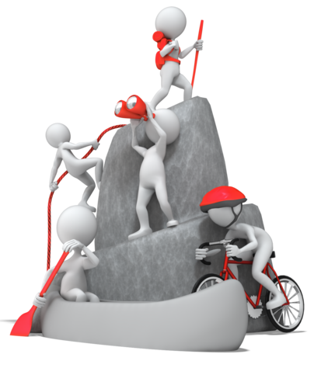
Encourage participation from children
As educator, you can participate with children to bolster confidence or help individuals with special needs to participate. You can also modify
physical activities to enable children
with mixed abilities to join in.

Slide 39
Activity 2C

Slide 40
Promote physical activity
2.5 Engage children in outdoor play

Slide 41
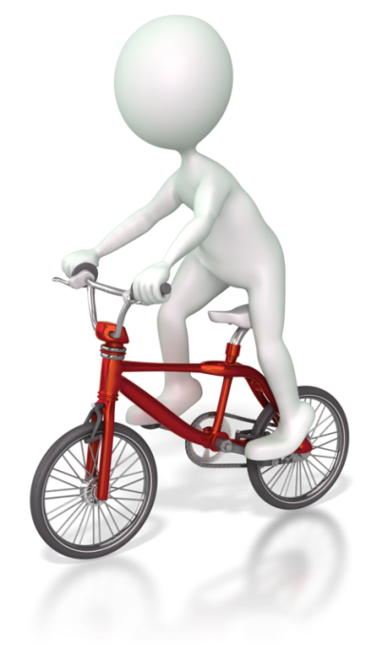
Outdoor play
The benefits of outdoor play include:
Health benefits of exercise and movement
Learning through play experiences
Engaging all the senses
Discovering new things, such as plants in nature
Developing outdoor skills, such as
physical coordination
Etc.

Slide 42
Promote physical activity
2.6 Foster children’s participation in physical activities

Slide 43

Assist children to participate
When children find participation difficult, they should be helped and encouraged to join in physical activities as much as possible
Children with a diagnosed condition may have additional health or medication needs
Children who are not diagnosed with a condition may need additional support to overcome personal challenges.

Slide 44
Activity 2D

Slide 45
Promote physical activity
2.7 Discuss with children how their bodies work and the importance of physical activity to people’s health and wellbeing

Slide 46

Discussions on the human body
Simple discussions can include naming parts of the body and talking about what these do
It can also include looking at the structure of our bodies
There are different kinds of books that can be used to convey concepts and to show simple illustrations of the human body.

Slide 47

Discussions may include:
How we walk and move
What our hands do
The five senses
Things our bodies enable us to do
How to look after our bodies (e.g., feeding and personal hygiene).

Slide 48
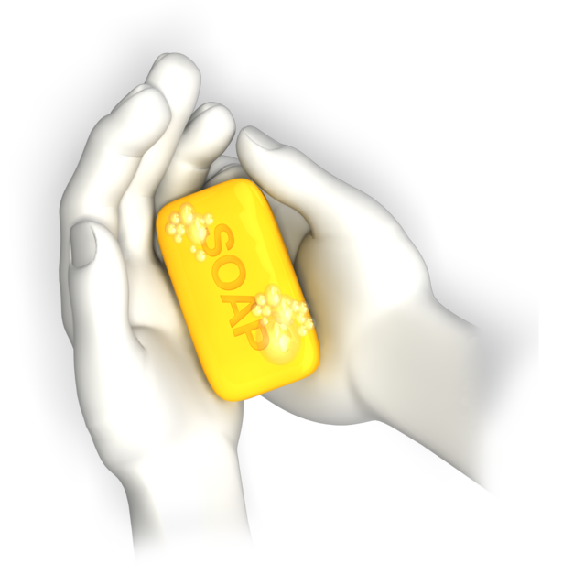
Washing hands
To wash hands you should:
Rinse hands with water to wet them
Apply soap and rub thoroughly for approximately 15 seconds into the front and back of the hands, between fingers and thumbs, the wrists and under nails
Rinse off the water
Dry hands including between fingers and thumbs.

Slide 49

The benefits of being active
The benefits of physical activity in children include:
Building strong muscles and bones
Having a stronger heart and lungs
Better posture
Reduction of blood sugar levels and maintaining a healthy weight
Improved physical development and physical skills
Etc.

Slide 50
Activity 2E

Slide 51
Adapt facilities to ensure access and participation
3.1 Assist in providing challenging elements of outdoor and indoor environments that allow for experiences which scaffold children’s learning and development and offer chances for appropriate risk-taking

Slide 52

Types of environments
Services will have different environments and spaces; these should be well-defined and organised so that children know which spaces they can access and use
Children’s spaces will vary in size and design across services but all should be constructed in child and age-appropriate ways to give children a sense of belonging and familiarity.

Slide 53

Challenges in environments
Challenges in environments should encourage responses such as creativity, problem-solving, collaboration and appropriate risk-taking
These attributes help children to learn, grow, expand on their skills and become more independent beings.

Slide 54

Appropriate risk-taking
This is about encouraging children to try new things regardless of whether they succeed or not. It doesn’t mean sitting back while children fail or injure themselves; it is about letting children develop the important skill of risk-taking.

Slide 55
Activity 3A

Slide 56
Adapt facilities to ensure access and participation
3.2 Promote the sun protection of children to meet the recommendations of relevant recognised authorities

Slide 57

Sun safety
Sun protection includes:
Wearing sun hats
Applying a sun protection lotion/cream
(or sunscreen) of SPF30 or above
approximately 20 minutes before going outside
Reapplying sunscreen every couple of hours and after swimming
Covering, backs, tummies, arms and legs with light clothing
Etc.

Slide 58

Promoting sun safety
Your service should follow sun safety guidelines from reputable sources, such as local government health departments, health organisations and education and care service authorities
Making sun protection a part of your service’s routines and activities will help children to incorporate good habits from an early age.

Slide 59

The SunSmart program
SunSmart is an initiative of the Cancer Council Australia for early childhood care and schools. Programs may differ between states and territories but are about developing effective sun safe policy for services and schools.

Slide 60
Activity 3B

Slide 61
Adapt facilities to ensure access and participation
3.3 Provide a balance of natural and artificial lighting, good ventilation and fresh air

Slide 62

Environmental factors
The environment can influence the wellbeing of children and adults. Indoor environments offer protection from the natural elements but factors such as light, air quality, ventilation, and temperature can affect how individuals feel.

Slide 63

The National Regulations, Regulation 110 (ventilation and natural light)
Indoor spaces used by children at an education and care service must:
Be well ventilated
Have adequate natural light
Be maintained at a temperature that ensures the safety and wellbeing of children.

Slide 64

Appropriate environmental conditions
To maintain health, our environment should be regulated to ensure lighting includes natural daylight to support natural body rhythms, vitamin D and natural light exposure. Ventilation should be used to ensure the air is fresh air and the temperature is comfortable.

Slide 65

Balance the use of indoor and outdoor environments
Your service should include use of both indoor and outdoor environments to ensure a healthy mix of both are used in activities
Activities can be coordinated to suit children’s active times and for when children need to rest
Indoor environments may need to be adjusted to meet these requirements.

Slide 66
Activity 3C

Slide 67
Adapt facilities to ensure access and participation
3.4 Organise indoor and outdoor spaces that ensure children are not always dependent on adults to do things for them and are supported to create their own games and experiences

Slide 68

Organise spaces for children
Service environments should reinforce a sense of belonging, becoming and being (as advocated in the early years learning framework)
Different spaces can be created to support children’s play and learning
Equipment, toys and facilities should be accessible and safe for children to use.

Slide 69

To organise spaces you should:
Define the purpose of the space, this includes understanding how the space may be used and accessed by children
Arrange the physical space with equipment, furnishings and toys, remembering to provide enough space for children to use the area safely
Allow children to interact with the space so they can make it their own.

Slide 70
Adapt facilities to ensure access and participation
3.5 Engage with children in constructing their own play settings/environments and create indoor and outdoor environments that stimulate and reflect children’s interests

Slide 71

Helping children to develop ideas for play environments
Talk with them about their play interests and ideas
Allow them to think about ideas and to make suggestions
Stimulate children’s creativity
Provide them with clear options and possibilities to realise their ideas.

Slide 72
Constructing environments
Create indoor and outdoor environments that children want by:
Asking them what they would like in their spaces
Suggesting ways to arrange spaces and items that they could include
Allowing them to make decisions about their spaces
Making spaces colourful and child-friendly.

Slide 73
Activity 3D

Slide 74
Help children with change
4.1 Prepare children for changes in a supportive and timely manner

Slide 75

Preparing for change
Change includes:
New environments
New routines
Different activities
New people and children.

Slide 76

Children requiring support with change will include those that:
Do not engage with their surroundings
Are quiet and find it difficult to relax
Cling to parents/carers
Are upset and/or distressed
Are crying or showing bad behaviours
Do not want parents/carers to leave them
May have medical or additional learning support needs.

Slide 77

Impact of change on children
Children will take cues from parents/carers and family members when forming their responses to change, therefore, addressing change as a normal occurrence will help to put children at ease. It is important to maximise the positive impacts and to minimise the negative impacts of change on children.

Slide 78
Activity 4A

Slide 79
Help children with change
4.2 Assist in developing meaningful routines, including those to minimise distress at separation of the family and child

Slide 80

The importance of routines
Routines include:
Personal health hygiene routines
Daily routines, such as getting up
the same time each day
Weekly routines, routines for the
working week and weekend
Family routines, routines performed within
the family unit
Work routines for adults and education and care service routines for children.

Slide 81

Routines can be used to:
Help children understand the need to do chores and jobs
Provide an understanding of time and time management
Establish good habits (such as reading at bedtime)
Strengthen relationships within shared
routines (such as family leisure
routines or play activities with
other children at a service).

Slide 82

Routines to minimise distress at separation
Parents staying for an agreed period of time until children are settled and more familiar with the service
Orientation of both family and child into the service environment
Engaging the child in service activities so they
feel included
Etc.

Slide 83

Verbal communications with the family
In your verbal communications you should be understanding of lifestyle and cultural differences and treat all families with equal respect and attention
Be mindful that each person you speak with will have their own views and personal experiences with children and may have different expectations.

Slide 84
Activity 4B

Slide 85
Help children with change
4.3 Identify and respond to children’s feelings openly, appropriately and with respect

Slide 86

Connecting on an emotional level with children
Children’s emotions and feelings can vary widely and will often be expressed openly and sometimes inappropriately in their interactions
With your support, you can help children to understand what it is they are feeling and why
Your responses to children’s feelings should be open and respectful.

Slide 87

Use appropriate responses
When children express their feelings, you should listen with respect and seek understanding of the situation. Take the time to discuss this with them in a calm and caring manner. You can ask questions to help provide focus to their feelings, for example, ‘why are you feeling upset?’

Slide 88

To help children deal appropriately with their feelings you can:
Teach them healthy ways to manage feelings
Identify beneficial ways to express emotions and feelings without them hurting themselves or others
Talking with and listening to the child as
they express their feelings
Helping them to understand what their
feelings are and why they have occurred
Etc.

Slide 89
Activity 4C

Slide 90
Help children with change
4.4 Encourage children to communicate, listen and treat others with respect

Slide 91

Children’s communications
Good communication skills mean that children are able to:
Express feelings, needs, likes and dislikes
Ask questions and engage in meaningful conversations
Interact and connect with others
on a social level
Learn, develop and grow as
individuals and become participating members of the community.

Slide 92

Learning outcome 5: Children are effective communicators
Children interact verbally and non-verbally
with others for a range of purposes
Children engage with a range of texts
and gain meaning from these texts
Children express ideas and make
meaning using a range of media
Children begin to understand how
symbols and pattern systems work
Children use information and communication technologies to access information, investigate ideas and represent their thinking.

Slide 93

The essential components of good communication skills are:
Verbal language that is clear in meaning and non-offensive to others
Friendly body language
Appropriate volume and tone of voice
To speak with respect and awareness of others feelings and viewpoints
To allow others to speak and to listen to them in return.

Slide 94
Help children with change
4.5 Encourage opportunities to express feelings and emotions appropriately

Slide 95

Help children to learn appropriate expression of feelings
Expressing feelings and emotions includes:
Drawing to help release feelings
Role playing activities (e.g., with toys)
Physical activities to release energy from emotions
Relaxation techniques such as deep
breathing and listening to gentle music
Listening to the child and just being there
with them in a safe place where they can express their feeling.

Slide 96
Activity 4D

Slide 97
Settle new arrivals
5.1 Observe families and children for signs of stress/distress on arrival

Slide 98

Observing families and children
Observing includes:
Watching how people behave with you and others
Listening to what families and children are saying
Looking out for behaviours that reveal feelings
and emotions
Having an awareness of the family’s
and child’s situation
Picking up on displays of emotions
Watching how families and children
interact with the service environment.

Slide 99

Signs of stress and distress may include:
Adults:
being agitated or anxious
not being able to relax
avoidance of the issue
headaches and pains
Children:
crying
being clingy
being withdrawn
being aggressive.

Slide 100
Activity 5A

Slide 101
Settle new arrivals
5.2 Begin interaction with the child while family is still present to minimise abruptness of separation

Slide 102

Initiating contact
Welcoming the families and children as they arrive will help to provide a sense of belonging. Interactions with new children should begin when their families are present as children will feel more confident at meeting you with their family.

Slide 103

Abruptness of separation
The experience of separation can become a negative experience if not handled correctly. This should be at a pace that is comfortable for the child.
Ways to minimise issues of separation:
Tell the child what is happening
Establish new routines
Allow the family to spend time
with the child at the service.

Slide 104
Settle new arrivals
5.3 Encourage the family to take as much time as needed to have a relaxed, unhurried separation from their child

Slide 105

Separation of the family and child
Benefits of the family staying to settle the child include:
A quicker and easier transition into the service
Less stress and worry for the child (and family)
Improved confidence in the child
Better engagement in service activities
and with others
Etc.

Slide 106

You/your service should:
Communicate the start of service process when families enrol
Provide written information and guidance about
the service and the role of families in the
learning and development of their child
Encourage family participation in their
children’s learning and development.

Slide 107
Activity 5B

Slide 108
Settle new arrivals
5.4 Respond to child’s distress at separation from the family in a calm reassuring manner

Slide 109

Children’s distress at separation from the family
When a child’s primary caregiver is no longer with them, it can cause them to feel insecure and vulnerable
Distress at separation will usually dissipate within a few weeks when the child becomes familiar with new faces and the service environment
Distress may also occur when a child feels unwell or is worried about something.

Slide 110

Respond to distress in a calm manner
To help children with distress, you should respond to their needs in a calm and comforting manner to communicate all is well for them
You should also speak in a soft and calming voice to ease their anxiety.

Slide 111
Activity 5C

Slide 112
Summative Assessments
Summative assessments consist of:
Skills Activity
Knowledge Activity
Performance Activity.
Your assessor will provide you with further guidance on how and where to complete these assessments.

Slide 113

Summary and Feedback
Did we meet our objectives?
How did you find this session?
Any questions?

