Slide 1

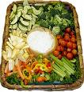

Healthy Eating through the Eat for Health Program
Support healthy eating through the Eat for Health Program
(SISFFIT026)

Slide 2
Sources of Information for Provision of Healthy Eating
Eat for Health
Nutrition Australia
Food Standards ANZ
Australian Dietary Guidelines
Nutrition.gov (USA)
National Institute of Health (USA)
Notes:
Eat for Health: https://www.eatforhealth.gov.au
Nutrition Australia: www.nutritionaustralia.org/
Food Standards: http://www.foodstandards.gov.au/
Australian Dietary Guidelines: https://www.nhmrc.gov.au/guidelines-publications/n55
Nutrition.gov (USA)
National Institute of Health (USA): https://www.nhlbi.nih.gov/health/educational/wecan/tools-resources/nutrition.htm

Slide 3
Eat for Health Program / Educator Guide
Purpose
  support implementation of the Australian Dietary Guidelines
  use concepts such as the Foundation Diet and Total Diet that assist clients to plan healthy eating
Notes:
KE3

Slide 4
Australian Dietary Guidelines
provide information on the types and amounts of foods, food groups and dietary patterns that aim to:
  promote health and wellbeing
  reduce the risk of diet-related conditions
  reduce the risk of chronic disease

Slide 5
Australian Dietary Guidelines
Five food groups
  Grain (cereal) foods, mostly wholegrain and/or high cereal fibre varieties
  Vegetables and legumes/beans
  Lean meats and poultry, fi sh, eggs, tofu, nuts and seeds and legumes/beans
  Milk, yoghurt, cheese and/or alternatives, mostly reduced fat
  Fruit

Slide 6
Australian Dietary Guidelines
Five Guidelines:
  To achieve and maintain a healthy weight, be physically active and choose amounts of nutritious food and drinks to meet your energy needs.
  Enjoy a wide variety of nutritious foods from these five food groups every day
  Limit intake of foods containing saturated fat, added salt, added sugars and alcohol.
  Encourage, support and promote breastfeeding.
  Care for your food; prepare and store it safely

Slide 7
Australian Dietary Guidelines
To achieve and maintain a healthy weight, be physically active and choose amounts of nutritious food and drinks to meet your energy needs.

Slide 8
Guideline #1
Assessment of Healthy Weight
  Body Mass Index (BMI)
    < 18.5 kg/m2 – underweight
    18.5 to 24.9 kg/m2 – healthy weight
    25.0 to 29.9 kg/m2 – overweight
    ≥ 30.0 kg/m2 – obese.
  Waist Circumference
    Women: risk is increased at ≥80 cm and high at ≥88 cm
    Men: increased at ≥94 cm and high at ≥102 cm for men

Slide 9
Guideline #1
Factors associated with risk of overweight and obesity
  Breastfeeding
  Birth weight
  Childhood weight gain
  Parental weight
  Maternal smoking
  Television
  Socioeconomic status
Notes:
Australian dietary Guidelines pages 20-21

Slide 10
Guideline #1
Energy Expenditure
  Total daily energy expenditure: resting energy expenditure and energy expended in physical activity.
  Resting energy expenditure
    Makes up 60–80% of total energy expenditure
  Active energy expenditure
    accounts for up to 20–40% of total energy expenditure
    only aspect of energy expenditure that is under conscious control through physical activity
  energy expenditure per kilogram of body mass declines with increasing BMI

Slide 11
Guideline #1
Dietary Patterns – Foundation Diets
  represent the basis of optimum diets to achieve and maintain a healthy weight as they provide nutrient requirements with minimum energy intake.
  include higher quantities of vegetables, fruit, wholegrain cereals, poultry, fish, eggs and low fat milk, yoghurt and cheese products, and lower quantities of starchy vegetables, refined grain (cereal) foods, higher and medium fat milk, yoghurt and cheese products and lean red meats (latter for men only).
Notes:
Australian dietary Guidelines pages 20-21

Slide 12
Guideline #1: Achieving / Maintaining Healthy Weight
Nutritious foods should be chosen from the five food groups and the unsaturated fat allowance
Discretionary choices should be limited
Taller and/or more active adults in each age and sex group can choose additional serves of foods
Weight and waist circumference should be measured regularly (e.g. every 2 or 3 months)
Recommendations of the Australian physical activity guidelines should be followed

Slide 13
Guideline #1:
Promoting Weight Loss
The Foundation Diets should be adhered to
Weight loss will not be achieved unless energy intake is lower than total energy expenditure
Behavioural change to increase physical activity and improve dietary intake is fundamental

Slide 14
Physical Activity
Levels | Description
Sedentary activities | mainly involve sitting or lying down, using little energy.
Light activities | include standing and moving around in the home, workplace or community.
Moderate activities | require some effort but you can still have a conversation. For example, walking briskly, gentle swimming or social tennis.
Vigorous activities | make you huff and puff, so talking is difficult. Vigorous activities include jogging, aerobics and sports like football and netball.
Notes:
PE4, KE11
Sedentary activities
mainly involve sitting or lying down, using little energy.
Light activities
include standing and moving around in the home, workplace or community.
Moderate activities
require some effort but you can still have a conversation. For example, walking briskly, gentle swimming or social tennis.
Vigorous activities
make you huff and puff, so talking is difficult. Vigorous activities include jogging, aerobics and sports like football and netball.

Slide 15
Benefits of Combining Healthy Eating and Moderate Physical Activity
increasing evidence that a healthy diet reduces the risk of excessive weight gain.
combination of healthy dietary patterns and increasing physical activity is more effective for weight loss and maintenance of weight loss than just restricting energy intake

Slide 16
Benefits of Combining Healthy Eating and Moderate Physical Activity
study led by researchers at Fred Hutchinson Cancer Research Center (2011)
  ‘get the biggest bang for your buck’ by combining a healthy weight-loss diet
    reducing calories by cutting fat intake and boosting the consumption of low-calorie foods -- with regular, moderate-intensity aerobic exercise
  regular exercise helps with balance, strength and fitness
Notes:
PC1.3, KE10

Slide 17
Sedentary and Incidental Physical Activity
Sedentary physical activity (SED)
  any waking activity characterized by an energy expenditure ≤ 1.5 metabolic equivalents and a sitting or reclining posture
  any time a person is sitting or lying down, they are engaging in sedentary behaviour.
  Common sedentary behaviours include TV viewing, video game playing, computer use (collective termed “screen time”), driving automobiles, and reading.
Reference: Sedentary Behaviour Research Centre: http://www.sedentarybehaviour.org/what-is-sedentary-behaviour/
Notes:
PC1.2

Slide 18
Sedentary and Incidental Physical Activity
Incidental physical activity (IPA)
  consists primarily of light physical activity (LPA) and sporadic (i.e., bouts lasting <10 min) Moderate-to-Vigorous Physical Activity (MVPA)
    accrued through activities of daily living (ADLs)
      includes, but is not limited to, activities such as dusting, vacuuming, and raking the lawn
Notes:
PC1.2

Slide 19
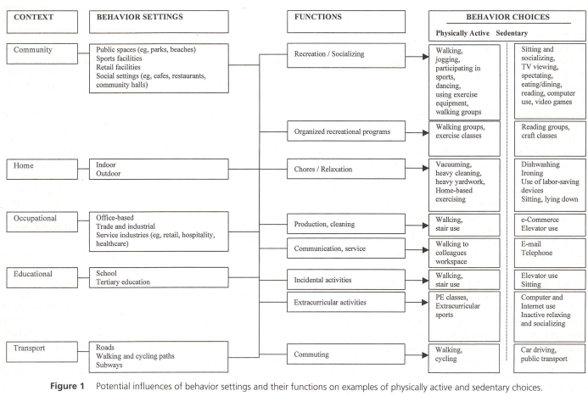
https://www.researchgate.net/profile/Eva_Leslie/publication/12261928_Environmental_determinants_of_physical_activity_and_sedentary_behavior/links/54f7b81a0cf210398e92f618.pdf
Notes:
PC1.2
OWEN, N., E. LESLIE, J. SALMON, and M.J. FOTHERINGHAM. Environmental determinants of physical activity and sedentary behavior. Exerc. Sport Sci. Reo,., Vol.28, No.4, pp 153-158, 2000
https://www.researchgate.net/profile/Eva_Leslie/publication/12261928_Environmental_determinants_of_physical_activity_and_sedentary_behavior/links/54f7b81a0cf210398e92f618.pdf

Slide 20
Influences of Food Choices
Where people live including rural and remote areas
How people live
Income levels
Food security
Foods which are readily available in communities and most heavily advertised
Notes:
Identify at least three (3) influences of food choices using the Eat for Health Educator Guide. [PC2.2]
Where people live and how they live can also influence what is eaten.
It can be difficult for those on limited incomes, as the cheapest foods may not be the best choices for health and wellbeing.
Australians living in rural and remote areas may also have difficulty accessing nutritious foods,
especially perishable items including vegetables and fruit.
Food security may be a challenge for some groups, particularly Aboriginal and Torres Strait Islanders.
Foods which are readily available in communities and most heavily advertised are often discretionary choices which are high in saturated fat, added sugars, added salt and alcohol.

Slide 21
Australian Dietary Guideline # 2
Enjoy a wide variety of nutritious foods from these five food groups every day
  Plenty of vegetables
  Fruit
  Grain (cereal) foods
  Lean meats and poultry, fish, eggs, tofu, nuts and seeds, and legumes/beans
  Milk, yoghurt, cheese and/or their alternatives
Drink plenty of water

Slide 22
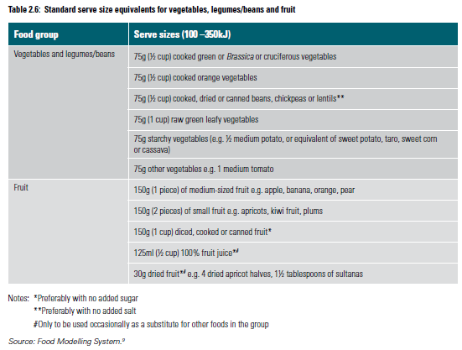

Slide 23
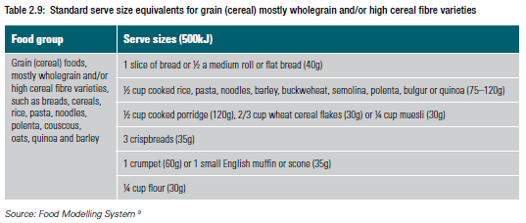
Australian Dietary Guideline # 2
Australian Dietary Guideline # 2
Australian Dietary Guidelines, 2013, p. 47

Slide 24
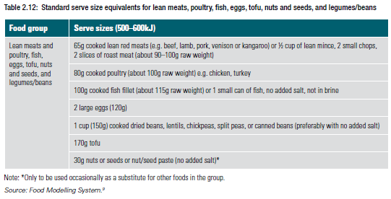
Australian Dietary Guideline # 2
Australian Dietary Guidelines, 2013, p. 53

Slide 25
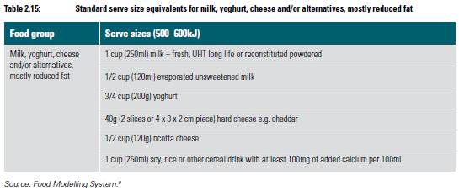
Australian Dietary Guideline # 2
Australian Dietary Guidelines, 2013, p. 59

Slide 26
Australian Dietary Guideline #3
Limit intake of foods containing saturated fat, added salt, added sugars and alcohol
  Limit intake of foods high in saturated fat
  Limit intake of foods and drinks containing added salt.
  Limit intake of foods and drinks containing added sugars
  If you choose to drink alcohol, limit intake.
Notes:
Limit intake of foods containing saturated fat, added salt, added sugars and alcohol.
a. Limit intake of foods high in saturated fat such as many biscuits, cakes, pastries, pies, processed meats,
commercial burgers, pizza, fried foods, potato chips, crisps and other savoury snacks.
• Replace high fat foods which contain predominantly saturated fats such as butter, cream, cooking
margarine, coconut and palm oil with foods which contain predominantly polyunsaturated and
monounsaturated fats such as oils, spreads, nut butters/pastes and avocado.
• Low fat diets are not suitable for children under the age of 2 years.
b. Limit intake of foods and drinks containing added salt.
• Read labels to choose lower sodium options among similar foods.
• Do not add salt to foods in cooking or at the table.
c. L imit intake of foods and drinks containing added sugars such as confectionary, sugar-sweetened soft
drinks and cordials, fruit drinks, vitamin waters, energy and sports drinks.
d. If you choose to drink alcohol, limit intake. For women who are pregnant, planning a pregnancy or
breastfeeding, not drinking alcohol is the safest option.

Slide 27
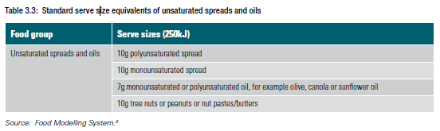
Australian Dietary Guideline # 3
Australian Dietary Guidelines, 2013, p. 72

Slide 28
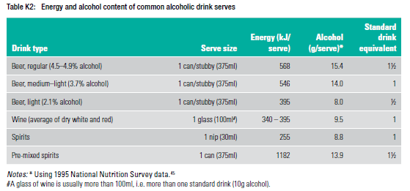
Australian Dietary Guideline # 3
Australian Dietary Guidelines, 2013, p. 142

Slide 29
Australian Dietary Guideline #4
Encourage, support and promote breastfeeding
  unequalled way of providing ideal food for the healthy growth and development of infants
  benefits to infants including reduced risk of infection, asthma and atopic disease and sudden infant death syndrome
  Benefits to mothers include improved bonding with their infant, accelerated recovery from childbirth and progress towards a healthy body weight.
  associated with reduced risk of some cancers.
  Infants should be exclusively breastfed until around 6 months of age when solid foods are introduced.
  Breastfeeding outcomes are improved where the mother has support and encouragement from the infant’s father, other family members, health workers, the hospital and the community. (p. 87)
Reference: Australian Dietary Guidelines, 2013, p. 87

Slide 30
Australian Dietary Guideline #5
Care for your food; prepare and store it safely.
  Incorrect handling of food and storing food at inappropriate temperatures are major causes of food poisoning.
  Particular care should be taken when handling food to be consumed by people who have an increased risk of foodborne illness.
Reference: Australian Dietary Guidelines, 2013, p. 97

Slide 31
Australian Dietary Guideline #5
Main causes of foodborne illness
  inadequate cooking
  improper holding temperatures
  contaminated equipment (such as knives, cutting boards and dishcloths)
  contaminated food storage and preparation areas
  unsafe raw food
  allowing raw foods to make direct contact with ready-to-eat foods
  poor personal hygiene of food handlers
Reference: Australian Dietary Guidelines, 2013, p. 98

Slide 32
Australian Dietary Guideline #5
Foods that can cause problems if not handled correctly
  raw and cooked meat or foods containing raw or cooked meat
  dairy products and foods containing dairy products
  seafood and foods containing seafood
  cooked rice and pasta
Reference: Australian Dietary Guidelines, 2013, p. 98

Slide 33
A LOT of Misinformation in the Marketplace on Nutrition
Use reliable sources for information:
  Nutrition Australia
    http://www.nutritionaustralia.org
  Food Standards Australia New Zealand
    http://www.foodstandards.gov.au
  Heart Foundation
    http://www.heartfoundation.org.au
  Diabetes Australia
    http://www.diabetesaustralia.com.au
Have a great referral network of nutritionists, dieticians
Have a “show me the evidence” attitude

Slide 34
Goals
Goals for healthy eating can related to increasing fruit and vegetable consumption, decreasing alcohol consumption, etc.
Long term Goal example
  To begin implementing healthy eating habits on a daily basis that will increase my overall health.
Short term example
  Eat a dark green vegetable every day this week.
  To eat at least 2 servings a fruit each day.
Notes:
PC1.1, 4.1, PE4, PE7

Slide 35
Role of Medical &
Allied Health Professionals
Dietician
Nutritionist
General Practitioner
Notes:
PC1.5, PE7, KE6

Slide 36
Role of Medical &
Allied Health Professionals
Nutritionist
  A Nutritionist will usually have completed a tertiary qualification in any number of fields, including nutrition, food science and public health.
  main role - to help people achieve optimal health by providing information and advice about health and food choices.
Notes:
PC1.5, PE7, KE6

Slide 37
Role of Medical &
Allied Health Professionals
Accredited Practising Dietitians (APDs)
  experts in food and nutrition
  can advise patients on the specific nutritional management of many heath conditions such as diabetes, overweight and obesity, cancer, gastro-intestinal diseases, food allergies, etc.
  qualified to provide medical nutrition therapy or clinical nutrition consultations
  Referring clients
    Significant weight change
    Failure to meet nutrition needs
    Recent poor food intake, poor appetite, or difficulty preparing or eating food
    Changes in medication
    Periodic review of medical nutrition therapy.
Notes:
PC1.5, PE7, KE6

Slide 38
Roles of Professionals
Situation | Personal Trainer | Nutritionist | Accredited Practising Dietitian | Accredited Sports Dietitian | GP
Provide nutritional advice |  | x | x | x
Prescribing meal plans |  |  | x | x
Provide dietary treatments |  |  | x | x
Weight loss support | x | x | x | x | x
Exercise prescription | x
Notes:
PC1.5, PE7, KE7

Slide 39
Personal Trainers
What you can do …
You can …
  Assess eating habits based on Dietary Guidelines
  Provide practical examples of how to meet the Dietary Guidelines
  Discuss foods to be included in a healthy diet
Notes:
PC1.4, KE8

Slide 40
Personal Trainers
What you can’t do…
You can’t …
  Design or disseminate a daily or weekly meal plan with specific foods, unless developed and endorsed by an ADP
  Nutritional assessment to determine individual nutritional needs and nutritional status and to recommend nutritional intake.
  Provide advice to clients regarding food allergies or intolerances
  Provide advice to take a dietary supplement
  Provide advice to clients to avoid a specific food group.
  Provide specific dietary advice for people with chronic disease.
Notes:
PC1.4, KE8

Slide 41
Referring Clients
Nutrient | Accredited Practising Dietitian | Accredited Sports Dietitian | General Practitioner
Clients with very high volume or high intensity training loads, or participation in organised sport |  | X
when clients have specific questions regarding dieting, diet trends, supplementation, sports foods, ergogenic aids | x | x | X possibly
clients with specific or special dietary needs | x |  | x
clients who are not achieving their goals when following the Australian Dietary Guidelines | x |  | x
clients who need support regarding attitudes towards eating | x |  | x
Notes:
PC1.5, PE7, KE7

Slide 42
Scope of Practice
Just as a person seeking an individualised exercise program is best served by the personal fitness trainer,
a person seeking individualised nutrition information or counseling is best served by the registered dietitian.
Notes:
PC1.4, KE8

Slide 43
Client Groups with Specific Nutritional Needs
pregnant or lactating women
very underweight, overweight or obese
impaired Glucose Tolerance, Impaired Fasting Glucose or strong family history of Type 2 Diabetes
Type 1 or Type 2 diabetes
cardiovascular disease, Renal disease or Liver disease
food allergies and intolerances
diagnosed with, undergoing treatment for, or recovering from cancer
frail elderly
mental illness
high intensity and high volume exercise or sport

Slide 44
Situations When Referral is Required
when individuals ask for specific information regarding weight management or indicate interest in more information on weight loss
when clients have specific questions regarding dieting, diet trends and supplementation
when clients have specific questions regarding the suitability of participating in an available nutrition program when specific health indicators demonstrate increased health risks after pre-exercise screening and client reporting
when the client’s eating patterns are extreme and not meeting nutritional requirements e.g. removing / limiting inappropriately food groups

Slide 45
Situations When Referral is Required
when the client may benefit from attending a structured support program
when the client is having difficulty achieving weight loss goals
when the client has high intensity or high level training or sports performance requirements
when the client needs support regarding attitudes to eating and may benefit from additional assistance

Slide 46
Nutrients
Six classes
  Carbohydrates
  Proteins
  Fats
  Vitamins
  Minerals
  Water
Notes:
Performance Criteria 3.2, 3.3

Slide 47
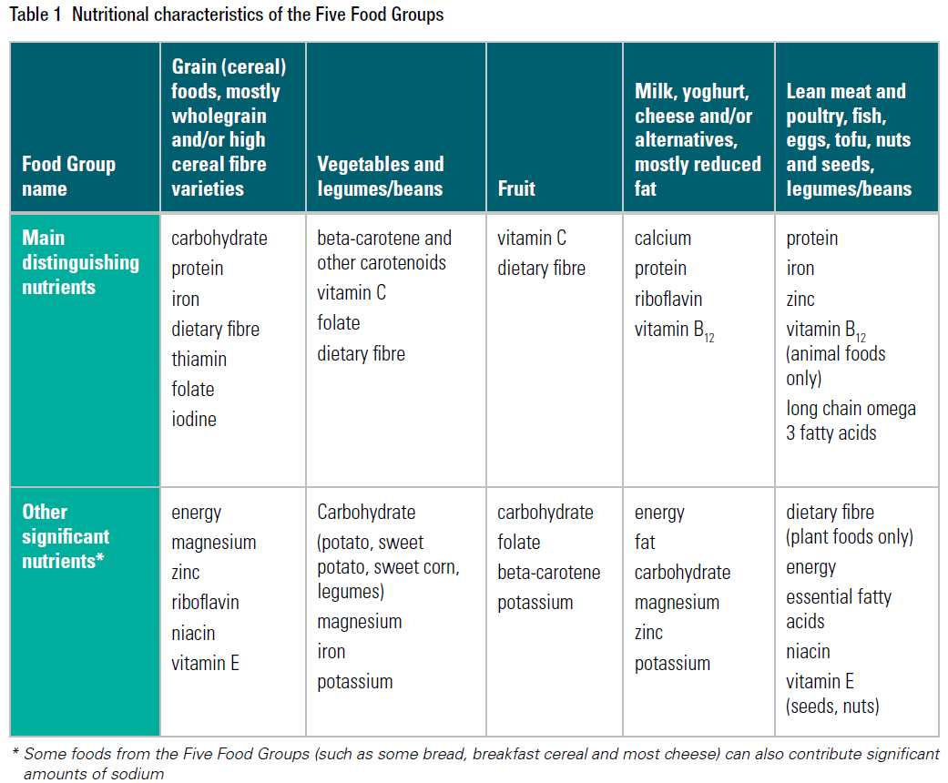
Source: Eat for Health Educators Guide, 2013, p. 7
Notes:
Performance Criteria 3.2, 3.3

Slide 48
Acceptable Macronutrient Distribution Ranges (AMDR)
Related to reduced risk of chronic disease
  45 – 65 % from carbohydrate
  15 – 25% from protein
  Fat = 20 – 35% total energy taken from fat
Source : Australian Dietary Guidelines 2013.
Notes:
PC2.1, 3.2

Slide 49
Types of Carbohydrates
Simple carbs (sugars)
  Glucose, fructose, galactose, sucrose, lactose, maltose
Polysaccharides
Different Activities have different carbohydrate requirements
Walking at brisk pace = 17%
Jogging at medium pace = 50%
Running at a fast pace = 72%

Slide 50
Protein
Best protein supplement
  Few pieces of steak, fish or egg
Functions
  Enzyme and protein synthesis
  Transports nutrients to the right places
  A source of energy
  Hormone production
  Fluid balance
  Acid-base balance
  Growth and tissue maintenance
  Synthesis of non-protein, nitrogen-containing compounds

Slide 51
Fats
Functions
  Source of energy
  Insulation from extreme temperatures
  Cushion against concussive forces
  Satiety control
  Gives food flavour
  Carries essential nutrients

Slide 52
FAT Classifications
Fats and oils
Triglycerides, diglycerides, monoglycerides
Short-chain, medium-chain, and long-chain fatty acids
Polyunsaturated fatty acids
Monounsaturated fatty acids
Saturated fatty acids
Low-density lipoproteins (LDL)
High-density lipoproteins (HDL)

Slide 53
Vitamins
Water-soluble
  Limited storage capacity
  B vitamins
  Vitamin C
Fat soluble
  Delivered with fats and oils
  Vitamins A, D, E, K

Slide 54
Minerals
Work with other nutrients to keep the body functioning properly
Needed for
  Water balance
  Nerve impulse stimulation
  Acid-base balance
  Energy reactions
Various Minerals
  Calcium
  Phosphorus
  Potassium
  Sodium
  Magnesium
  Iron
  Zinc

Slide 55
Maintaining Nutrient Balance
Best strategy for maintaining nutrient balance
  Eat a wide variety of foods
  Regularly consume fresh fruits & vegetables
  Avoid a monotonous intake of the same few foods day after day
Notes:
Performance Criteria 3.2, 3.3

Slide 56

Water / Hydration
Makes up 60% of total body weight
Thirst: delayed sensation that does not occur until the person has already lost 1-2 ltrs of fluid
Water versus Sports Drinks
  Water provides no flavour or electrolytes which causes people to want to drink
  Water has no energy; sports drinks have carbohydrate
  Sodium in sports drinks help to maintain blood volume

Slide 57
Dietary Supplements &
Ergogenic Aids
Dietary Supplements
  Concentrated sources of vitamins, minerals, and energy substrates taken to ‘supplement’ the nutrients derived from food
Ergogenic Aids
  Substances that enhance person’s athletic ability

Slide 58
Sports Drinks for
Fluid Replacement
Sports drinks are considered supplements by the AIS
In many situations, sports drinks are a better choice than water (AIS, 2007)
  Likely to promote better fluid intake than water
  Increase retention of fluid consumed post-exercise by reducing urine losses
  Provide an additional source of fuel that may enhance performance and reduce immune stresses
  sports drinks do not detract from performance compared to water
Used during and after exercise

Slide 59
Sports Drinks for
Fluid Replacement
Hydration for Improving Workouts
Exercisers who work out in warm weather or a hot gym risk dehydration.
  risk increases the longer the workout lasts, or when there is more than one workout in a day
How to prevent dehydration:
  Remember fluids throughout the day
  Hydrate 2 to 3 hours before exercise
  Drink during workouts
Reference: Kundrat, S. Foods & Fluids Series: Volume I, FITNESS. Gatorade Sports Science Institute. http://www.gssiweb.com

Slide 60
Sports Drinks for Fluid Replacement
Concerns Associated with Sports Drinks (AIS, 2007)
  Over-consumption of fluid during exercise
  Overuse of energy-containing fluids may create problems of energy balance or overall nutrient density in a restricted energy diet.
  Improper mixing of sports drinks
  Drinks should be kept cool
  Dehydration increases the risk of gastrointestinal problems during exercise
  Some lobbyists consider sports drinks ‘junk food’.

Slide 61
Relationship Between
Weight and Caloric Intake
Eat more than burn, increase weight
Eat less than burn, decrease weight
Metabolic rate: rate at which you burn calories
A lower metabolic rate results in higher body weight: lose ability to burn calories you eat

Slide 62
Relationship Between
Weight and Caloric Intake
Eat small but frequent meals throughout the day
  Maintains metabolic rate
  Better glucose tolerance
  Lower insulin response
  Lower stress hormone production
  Better maintenance of muscle mass
  Improved physical performance

Slide 63
Eating Behaviours
What you eat
Why you eat
  Journaling / daily log useful
    Food, quantity, time, place, emotional state
Suggestions
  Plan alternatives ahead of time
  Use stick-on notes to post inspirational messages
  Share goals and temptations with a friend / ask for help
  Use smaller plates and bowls so food portions seem larger

Slide 64
More Weight Loss Suggestions
Unsaturated fat over saturated fats
Eat low Glycemic Index (GI) foods
Restrict energy dense foods
Aim for a minimum of 30 gms of fibre each day
Have a ‘colourful’ diet (foods of different colour)
Drink 1-3 liters of water per day
Reduce energy by 200kJ per day (15%-20% reduction)

Slide 65
Changing Shape,
Changing Behaviour
More than 50% of adult women dissatisfied with their weight
Mental image of ideal weight often distorted
Don’t see clients weight as risk factor ~ discuss well-being, body image, social acceptance
Deemphasise absolute measure of weight and/or body composition
Change attitudes

Slide 66
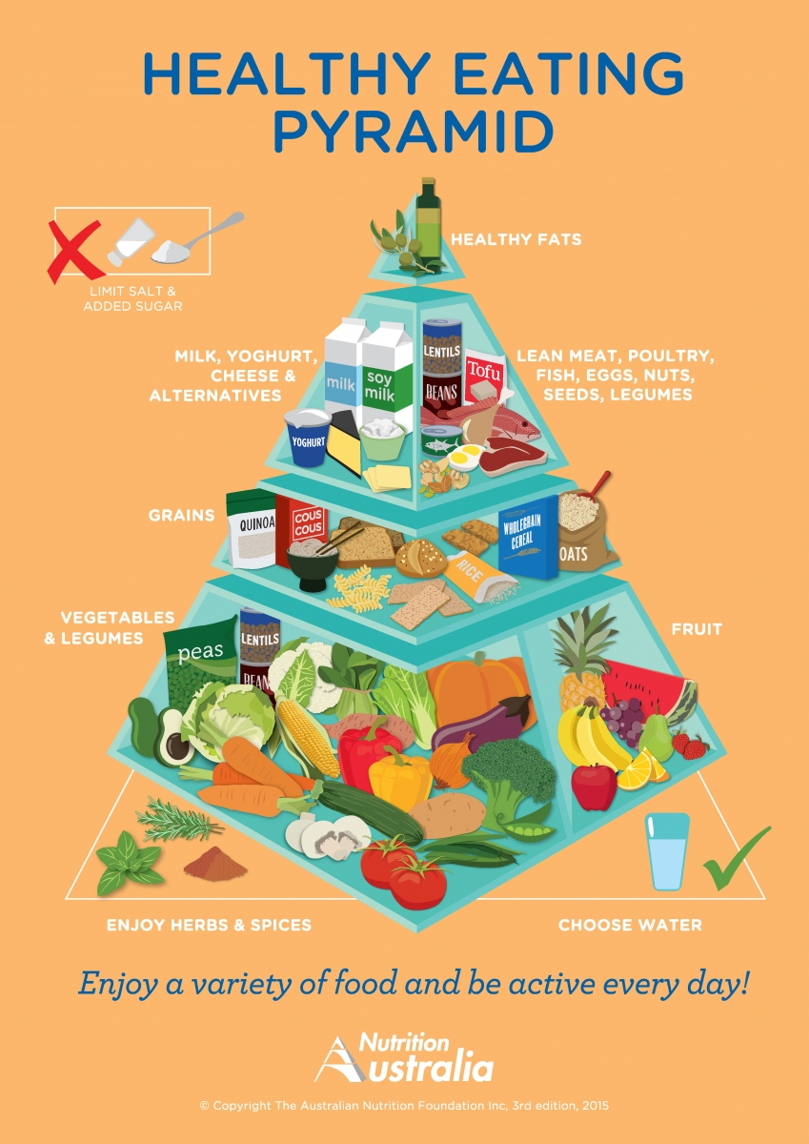
Reference:
http://nutritionaustralia.org/national/resource/healthy-eating-pyramid

Slide 67
Portion Size
amount individuals actually eat
depends on energy requirements.
Individuals who eat portions that are smaller than the ‘serve size’ will need to eat from the food group more often.
Individuals whose portion sizes are larger than the ‘serve size’ will need to eat from that food group less often.

Slide 68
Portion Size
Food Group | Specific Foods | Portion Size | Looks like
Grains | Pasta | 125 ml | ½ baseball
Veg/Fruit | Apple Dried fruit | 1 piece 60 ml | 1 baseball 1 golf ball
Meat, etc | Meat Nuts | 50-100 g cooked 75 ml | Deck of cards Cupped palm of hand
Milk, etc. | Yogurt Cheese | 175 ml 50 g | Yogurt container 3 dominoes
Griffin, J (2006), p. 245

Slide 69
Reading Food Labels
lists how much energy (kilojoules), protein, total fat, saturated fat, carbohydrate, sugar and sodium (salt) is in the product
identifies the key ingredients in a food
All packaged foods must display a nutrition information panel.
  servings per pack
  serving size
can be used to compare between different brands or types of similar food choices.
Some labels use unrealistic serving sizes
Notes:
PC4.2, KE4

Slide 70
Food Labels
Not all foods have to be labelled
  Unpackaged foods such as fresh meat, fruit, vegetables and nuts or food sold in a restaurant.
  Food made and packaged on the premises from where it is sold, for example at a bakers.
  Food packaged in the presence of the customer, for example at a delicatessen or a take-away food shop.
  Packaged whole or cut fresh fruit and vegetables (but not bean sprouts) where you can see the fruit or vegetables through the package.
  Food delivered packaged at the customer’s request, for example home delivered pizza.
  Food sold at a fund raising event for charitable purposes like a school fete.
  Individual serve packages that are sold in a large package such as a 12 pack of corn chips, although the information has to be on the outer package. (Food Standards)
Notes:
PC4.2, KE4

Slide 71
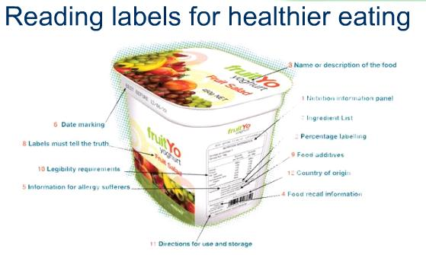
Reference: Food Standards Australia and New Zealand
Notes:
PC4.2, KE4

Slide 72
Reading Food Labels
A food label must show a list of ingredients present (except water).
  listed in descending order of their proportion by weight in the food.
  If water is added, the label should state ‘water added’.
  Added substances are also listed
    identified by a class name or a chemical name or a code number.
    Food additives include colours, flavours, antioxidants, preservatives, and emulsifiers
Notes:
PC4.2, KE4

Slide 73
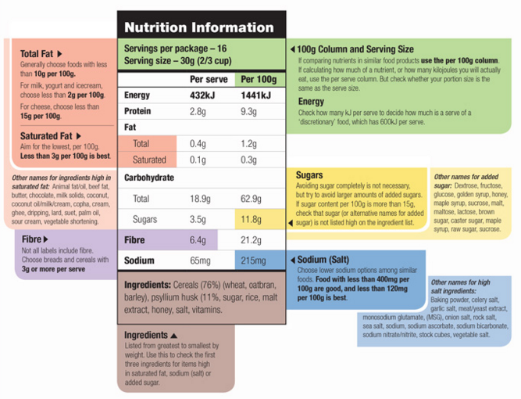
Reading Food Labels
Reference: https://www.eatforhealth.gov.au/eating-well/how-understand-food-labels/food-labels-what-look
Notes:
PC4.2, KE4

Slide 74
Reading Food Labels
Nutrition Information Panel
  offers the simplest and easiest way to choose foods
  can also be used to decide how large one serve of a food group choice or discretionary food would be and whether it’s worth the kilojoules
  Use in losing weight
    can help us decide if a food is really ‘kilojoule worthy’
    Beware of foods that look like a single serve, but actually contain several servings in one packet.
Notes:
PC4.2, KE4

Slide 75
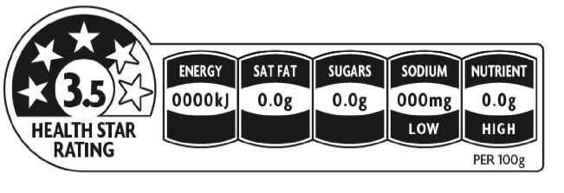
Reading Food Labels
Health Star Rating (HSR) System
  a front-of-pack labelling scheme developed for use in Australia and New Zealand to ‘provide convenient, relevant and readily understood nutrition information and/or guidance on food packs to assist consumers to make informed food purchases and healthier eating choices’.
Reference: https://www.eatforhealth.gov.au/eating-well/how-understand-food-labels
Notes:
PC4.2, KE4
https://www.eatforhealth.gov.au/eating-well/how-understand-food-labels
The Health Star Rating (HSR) system is a front-of-pack labelling scheme developed for use in Australia and New Zealand to ‘provide convenient, relevant and readily understood nutrition information and/or guidance on food packs to assist consumers to make informed food purchases and healthier eating choices’. Health Star Ratings will make it much easier for shoppers to make informed choices about healthier food options.
The HSR on the front of food packages provides an at-a-glance overall rating of the healthiness of the food product (reflected as a star rating), as well as specific nutrient and energy information. The more stars, the healthier the choice.
Generally, the HSR will provide the most useful source of comparison between similar food products (e.g. comparing packaged breakfast cereals). Where the nutrient icons are also displayed, they will provide information about the energy content of a product, as well as the levels of saturated fat, sodium (salt) and sugars, to help you make the best choice to suit your personal circumstances. In some cases, a positive nutrient icon (e.g. fibre) may also be displayed to provide you with additional information to help you choose the right product for you.

Slide 76
Reading Food Labels
Health Star Rating (HSR) System
  provides an at-a-glance overall rating of the healthiness of the food product (reflected as a star rating), specific nutrient and energy information. The more stars, the healthier the choice
Reference: https://www.eatforhealth.gov.au/eating-well/how-understand-food-labels
Notes:
PC4.2, KE4
https://www.eatforhealth.gov.au/eating-well/how-understand-food-labels
The Health Star Rating (HSR) system is a front-of-pack labelling scheme developed for use in Australia and New Zealand to ‘provide convenient, relevant and readily understood nutrition information and/or guidance on food packs to assist consumers to make informed food purchases and healthier eating choices’. Health Star Ratings will make it much easier for shoppers to make informed choices about healthier food options.
The HSR on the front of food packages provides an at-a-glance overall rating of the healthiness of the food product (reflected as a star rating), as well as specific nutrient and energy information. The more stars, the healthier the choice.
Generally, the HSR will provide the most useful source of comparison between similar food products (e.g. comparing packaged breakfast cereals). Where the nutrient icons are also displayed, they will provide information about the energy content of a product, as well as the levels of saturated fat, sodium (salt) and sugars, to help you make the best choice to suit your personal circumstances. In some cases, a positive nutrient icon (e.g. fibre) may also be displayed to provide you with additional information to help you choose the right product for you.

Slide 77
Reading Food Labels
Ingredients must be listed on the label in order
Nutrition Content Claims
  ‘low fat’, ‘reduced salt’ or ‘high fibre’
  can only be used if the food meets certain criteria.
    For example, with a ‘good source of calcium’ claim, the food must contain more than a set amount of calcium.
Reference: https://www.eatforhealth.gov.au/eating-well/how-understand-food-labels
Notes:
PC4.2, KE4

Slide 78
Reading Food Labels
Health Claims
  health claims link a food, or a nutrient or substance in a food, to a health effect.
    General level health claims refer to a nutrient or substance in a food and its effect on a health function.
      For example: calcium is good for bones and teeth.
    High level health claims refer to a nutrient or substance in a food and its relationship to a serious disease or to a biomarker of a serious disease.
      Example: Diets high in calcium may reduce the risk of osteoporosis in people 65 years and over.
      Example of a biomarker health claim is: Phytosterols may reduce blood cholesterol.
Reference: https://www.eatforhealth.gov.au/eating-well/how-understand-food-labels
Notes:
PC4.2, KE4

Slide 79
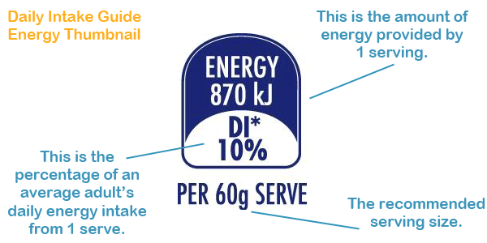
Reading Food Labels
Percentage Daily Intake
  labels also list nutrients in a serve of the product as a percentage of daily nutrient intake.
  can be used to compare the nutrients in one serve of the food with what an ‘average adult’ needs.
Reference: https://www.eatforhealth.gov.au/eating-well/how-understand-food-labels
http://www.mydailyintake.net/
Notes:
PC4.2, KE4

Slide 80
Reading Food Labels
Use the Australian Guide to Healthy Eating
  decide whether a food belongs in the five food groups
  is an ‘everyday’ food for eating regularly or a discretionary food best eaten only sometimes or in small amounts.
use the Nutrition Information Panel to compare similar packaged foods
  decide which product provides less saturated fat, salt (sodium), added sugars and kilojoules per 100gm and more fibre per serve.
Notes:
PC4.2, KE4

Slide 81
Eating on the ‘Run’
Not encouraged but sometimes one has no choice
Try to pack nutrient-dense foods for the trip
Upon arriving at your destination, make a trip to the local store to pick up some essentials.
At restaurants, choose lower fat items

Slide 82



Trends and Fads
Quick Fix Diets
  Low in kjs and vital nutrients
  Inadequate for optimum health
  Weight loss combination of water & muscle bulk
Notes:
KE7

Slide 83
Organisational Policies & Procedures - Referrals
Privacy
consent
communication protocols
records management and security
Notes:
PE6

