Slide 1
RIIMPO402D
Apply the principles of earthworks construction presentation 1

Slide 2
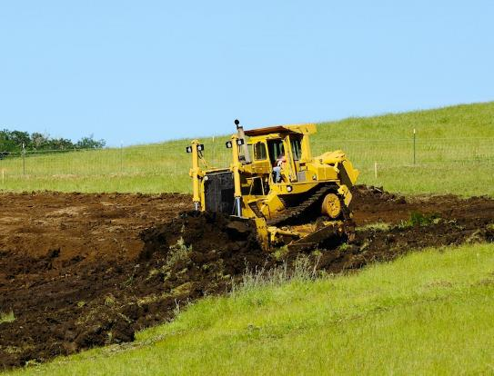
1.1 INTRODUCTION
This course is based on the unit of competency RIIMPO402A: Apply The Principles Of Earthworks Construction.
The materials in this course apply to a supervisor or technical specialist working in earthworks construction within the civil construction industry.

Slide 3

1.1 INTRODUCTION
The course outlines the requirements for ensuring that the following activities are carried out in accordance with accepted industry principles:
Planning and preparing for earthworks construction.
Initiating tasks.
Monitoring and adjusting the execution of tasks.
Reporting on the execution of tasks.

Slide 4
1.1.1 EARTHWORKS CONSTRUCTION
Earthworks construction may include tasks such as:
Earthworks Construction tasks can include:
Land Clearing | Must abide by environmental protection legislation, job specifications and approvals.
Bulk Earthwork | Relates to the movement and working of material on the site, e.g. Cut and fill operations.
Surface Drainage Works | Ensures water always leaves the area, normally down a slope so that it sheets away or runs off.

Slide 5
1.1.1 EARTHWORKS CONSTRUCTION
Earthworks Construction tasks can include:
Water Storage Dam Construction | Ensures a secure water supply so that site operations can be completed to specifications, e.g. A ‘borrow pit’.
Tailings Dam Construction | Used to manage wastewater, which may be treated prior to leaving the site or held in reserve for a set period of time.
Rehabilitation Works | Relates to activities aimed at fixing or upgrading conditions on the site or returning the site to pre-work standards.
Road Works Preparation | Including the sub-grade and placement of base layers – entails the removal of unsuitable materials ensuring a solid foundation for the road works.

Slide 6

1.2 APPLY COMPLIANCE DOCUMENTATION FOR EARTHWORKS
Documentation is essential to all aspects of every worksite. From safety plans and environmental protection requirements through to earthworks construction principles, documentation exists that outlines what to do, when to do it and how it is to be done.

Slide 7

1.2.1 TYPES OF COMPLIANCE DOCUMENTATION
Compliance documentation is the name given to the documents that require tasks to be undertaken in a particular way or to meet a given standard.
The compliance documentation for earthworks construction details every process and is based on legislation and regulations as well as the requirements of the organisation, the client and site operations.

Slide 8

1.2.1 TYPES OF COMPLIANCE DOCUMENTATION
Legislative and regulatory compliance requirements include:
Occupational Health & Safety/Work Health & Safety (OHS/WHS) requirements.
Equal employment opportunity.
Disability discrimination.
These requirements are standard across every industry within all Australian states or territories.

Slide 9

1.2.1 TYPES OF COMPLIANCE DOCUMENTATION
Organisational requirements include policies and procedures covering:
Workplace relations.
Sick leave requirements.
An organisational policy or procedure is standard across the entire organisation regardless of where you are working.

Slide 10
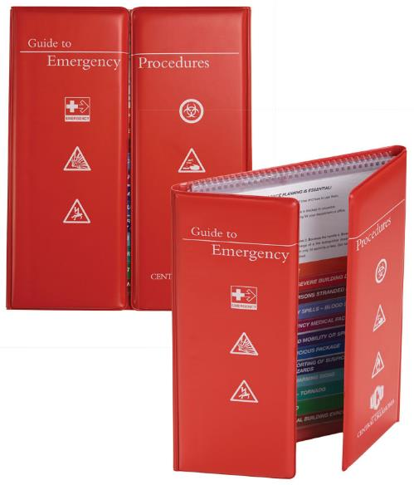
1.2.1 TYPES OF COMPLIANCE DOCUMENTATION
Site-specific policies and requirements generally include:
Emergency response and evacuation procedures – developed to meet the specific hazards, risks or environmental considerations of the site you are working on.
Operational procedures, e.g. work instructions, safe operating procedures (SOPs) and other site and equipment safety requirements.

Slide 11
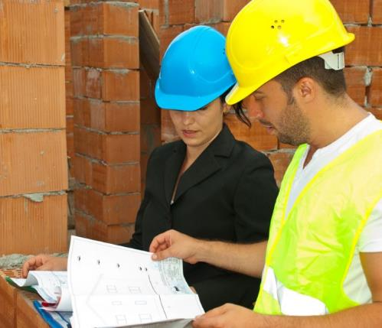
1.2.1 TYPES OF COMPLIANCE DOCUMENTATION
Client requirements involve:
Client standards and expectations.
Planned outcomes of the earthworks construction project.
Your organisation’s quality management program should ensure that these requirements are met safely and consistently.

Slide 12
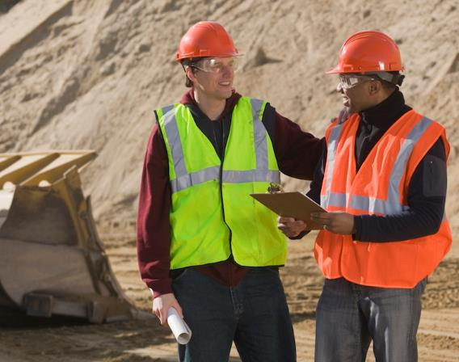
1.2.1 TYPES OF COMPLIANCE DOCUMENTATION
If you are unsure about a procedure or there seems to be a conflict between plans or processes, speak with your project manager directly.
Never approach the client representative on site unless you are authorised to speak for your organisation.

Slide 13

1.2.1 TYPES OF COMPLIANCE DOCUMENTATION
Some other examples of compliance documentation include:
Australian Standards, e.g. AS 3798 – 2007 guidelines on earthworks for commercial and residential developments.
Australian guidelines and specifications, e.g. codes of practice such as WorkCover document 2000 – Excavation work, or National Code of Practice – Managing the risks of plant in the workplace.

Slide 14

1.2.1 TYPES OF COMPLIANCE DOCUMENTATION
Manufacturer’s guidelines and specifications, e.g. pre-start checklists, service requirements, plant and equipment operation manuals.
Vehicle specifications, e.g. operating limitations and capabilities, safe working limits.
Training records, e.g. your own training record or licensing requirements.
Work instructions, such as work plans, procedures or job specifications.

Slide 15
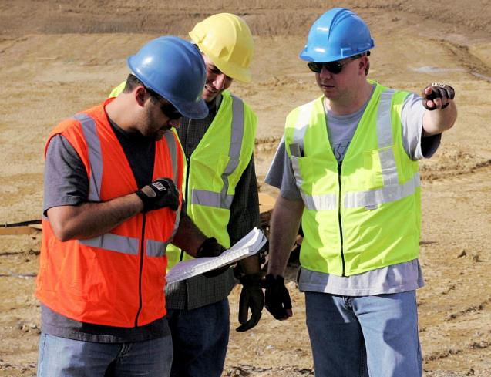
1.2.1 TYPES OF COMPLIANCE DOCUMENTATION
Every worksite will have specific requirements, which will be outlined during the initial induction for each worker. Staff should be notified of any changes to compliance documentation during toolbox meetings, staff newsletters or other established forms of communication used on the site.

Slide 16

1.2.1.1 STATUTORY COMPLIANCE
You should check your site documents for any statutory compliance procedures that may apply to current work activities.
These will often involve reporting back to the relevant government agencies or statutory authorities such as:
WorkCover.
EPA.
RTA.

Slide 17

1.2.1.1 STATUTORY COMPLIANCE
Any statutory requirements that cannot be met should be identified early so that alternative arrangements can be made. These actions will need to be approved by organisational and site management and the statutory regulatory body involved.

Slide 18
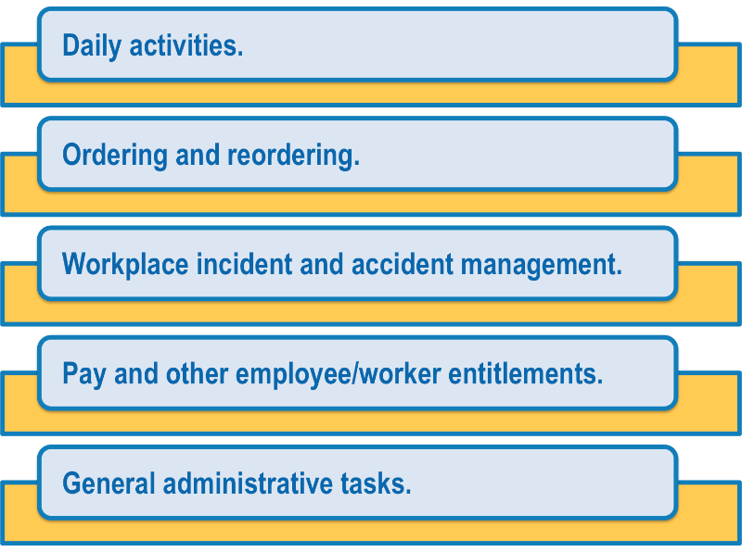
1.2.1.2 ADMINISTRATION
Each worksite will have administrative documentation that needs to be completed daily, weekly and monthly. This paperwork could relate to:

Slide 19

1.2.1.2 ADMINISTRATION
Try to stay on top of your administrative duties at all times. It is easier to complete one-day’s worth of paperwork than to allow the tasks to pile up and try to complete them once a week.
Speak with the administrative officers for the site to determine how the paperwork should be completed and submitted in line with your organisation’s requirements.

Slide 20

1.2.2 OCCUPATIONAL HEALTH & SAFETY/WORK HEALTH & SAFETY (OHS/WHS) LEGISLATION
State or territory legislation and regulations include Occupational Health & Safety/Work Health & Safety (OHS/WHS) requirements that will affect the way all operations are conducted on a worksite.
All requirements for site and equipment safety, including excavation/trench work, confined space entry, materials handling and all other work activities, are based on OHS/WHS legislation.
The aim of the legislation is to ensure the safety of everyone working on or visiting the site.

Slide 21

1.2.2 OCCUPATIONAL HEALTH & SAFETY/WORK HEALTH & SAFETY (OHS/WHS) LEGISLATION
Harmonisation of Work Health & Safety Legislation
In response to industry calls for greater national consistency, the Commonwealth, states and territories have agreed to implement nationally harmonised Work Health & Safety (WHS) legislation to commence on 1 January 2012.
While not all states and territories have actually implemented the model WHS legislation as of the start of 2012, it is important to be aware of these changes, as all states and territories will eventually implement them.

Slide 22

1.2.2 OCCUPATIONAL HEALTH & SAFETY/WORK HEALTH & SAFETY (OHS/WHS) LEGISLATION
Harmonisation aims to develop consistent, reasonable and effective safety standards and protections for all Australian workers through uniform WHS laws, regulations and codes of practice.

Slide 23

1.2.2 OCCUPATIONAL HEALTH & SAFETY/WORK HEALTH & SAFETY (OHS/WHS) LEGISLATION
Key Elements Of The Work Health & Safety Legislation
The following key elements of the WHS legislation will impact the way you do your job, and the responsibilities of your workplace:
There is a primary duty of care requiring persons conducting a business or undertaking (PCBU) to ensure, so far as is reasonably practicable, the health and safety of workers and others who may be affected by the carrying out of work.
1
2
A requirement that officers of corporations and unincorporated bodies exercise due diligence to ensure compliance.
3
Workers must exercise reasonable care that their acts or omissions do not adversely affect the health and safety of persons at a workplace.

Slide 24

1.2.2 OCCUPATIONAL HEALTH & SAFETY/WORK HEALTH & SAFETY (OHS/WHS) LEGISLATION
The legislation also outlines requirements for:
The reporting requirements for notifiable incidents.
Licences, permits and registrations (e.g. for persons engaged in high risk work or users of certain plant or substances).
Provision for worker consultation, participation and representation at the workplace.
Provision for the resolution of health and safety issues.
Protection against discrimination.

Slide 25

1.2.2 OCCUPATIONAL HEALTH & SAFETY/WORK HEALTH & SAFETY (OHS/WHS) LEGISLATION
Many specific details relating to WHS will be negotiated within the workplace in accordance with the legislation.
It is important that you speak with your Health and Safety Representative or supervisor for more information on how these elements will effect your day-to-day operations, or if you have any concerns relating to health and safety.

Slide 26

1.2.2 OCCUPATIONAL HEALTH & SAFETY/WORK HEALTH & SAFETY (OHS/WHS) LEGISLATION
Duty of Care
Everyone on a worksite has a legal responsibility under Duty of Care to do everything reasonably practicable to protect others from harm.
This is done by complying with safe work practices, including activities that require licences, tickets or certificates of competency or any other relevant state and territory OHS/WHS requirements.

Slide 27
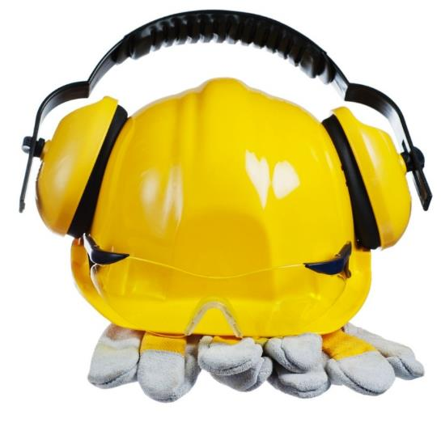
1.2.2.1 SITE AND EQUIPMENT SAFETY REQUIREMENTS
All workers and visitors on a construction site must observe site and equipment safety requirements and procedures. These are outlined in the site safety plan and generally follow OHS/WHS guidelines.
Site and equipment safety requirements and procedures cover such things as:
Selecting and using Personal Protective Equipment (PPE) and clothing required for various tasks or the entire site.
Management of hazards and risks.

Slide 28
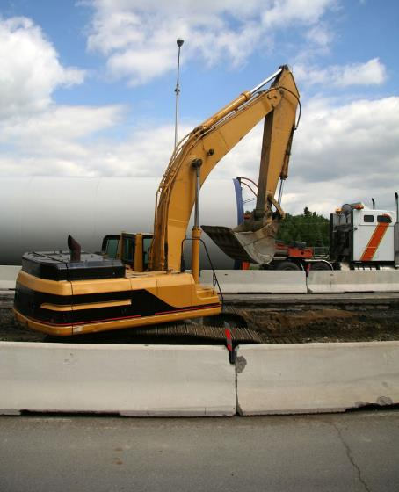
1.2.2.1 SITE AND EQUIPMENT SAFETY REQUIREMENTS
Selecting and using tools, plant and equipment.
Safety documentation including Safe Work Method Statements (SWMS), Material Safety Data Sheets (MSDS).
Safe Operating Procedures (SOPs).
Emergency procedures.
Anything that is faulty or looks like it could create a hazard must be reported at once to your supervisor, team leader or OHS/WHS officer.

Slide 29
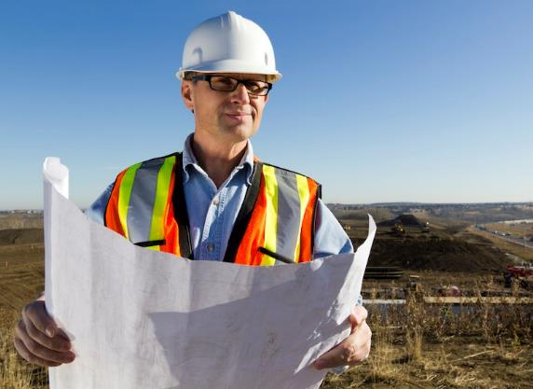
1.2.3 PROJECT QUALITY MANAGEMENT
Quality management is an ongoing aspect of site operations.
If tasks are not completed in line with the stated objectives, they may not be acceptable to the client. Unsatisfactory work will need to be redone, costing significantly more time and money.
Quality management plans, requirements and procedures will detail exactly what you are expected to achieve and the standards you and your team are expected to reach.

Slide 30

1.2.3 PROJECT QUALITY MANAGEMENT
They may include factors such as:
Dimensions and tolerances of tasks.
Material standards.
Work standards.
Documentation requirements.
Project specifications and drawings.
Client standards and expectations.

Slide 31

1.2.3 PROJECT QUALITY MANAGEMENT
As a supervisor you should always determine the quality management plans and procedures before any tasks are started.
It is also essential that your work team knows, understands and adheres to these quality requirements and each member follows instructions and procedures exactly.
This will make it easier for the team to incorporate the quality requirements into their activities instead of making them an additional step to be completed at the end of the task.

Slide 32

1.2.4 ENVIRONMENTAL MANAGEMENT
All organisations play an important role in environmental management, however the legislation that affects them directly differs depending on the activities they undertake.
Federal, state and local governments jointly administer the environmental protection legislation in Australia through bilateral agreements.
At the federal level, the Environment Protection and Biodiversity Conservation Act 1999 covers the assessment and approval processes of national environmental and cultural concerns.

Slide 33

1.2.4 ENVIRONMENTAL MANAGEMENT
The Act is administered by the Department of Sustainability, Environment, Water, Population and Communities.
The Department also administers other Acts relating to the sea, importing, heritage issues, hazardous wastes and fuels.
Environmental protection requirements are part of every worksite. You must be able to identify the environmental management plans, requirements and constraints, confirm any aspect of the environmental management plan you are unsure of, and apply the project environmental protection requirements to all the tasks you do on the site.

Slide 34

1.2.4 ENVIRONMENTAL MANAGEMENT
Environmental protection plans can include requirements for:
An organisational or project environmental management plan.
Noise and vibration management.
Dust management.
Waste/clean-up management.
Water quality protection.

Slide 35
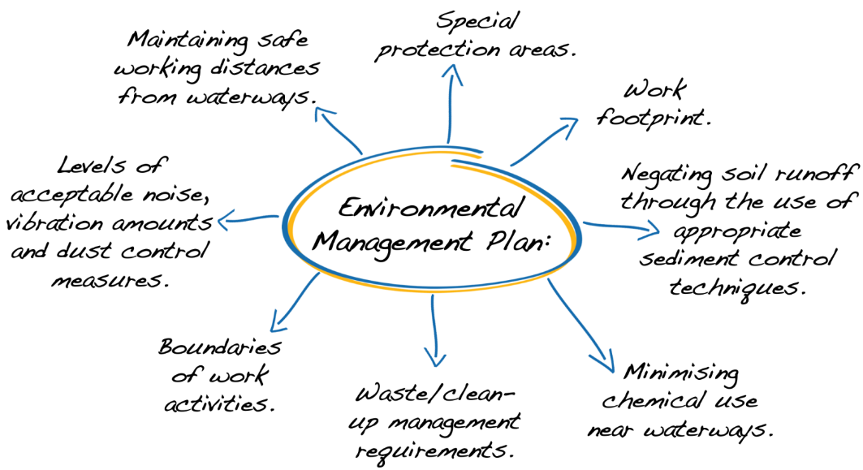
1.2.4.1 ENVIRONMENTAL MANAGEMENT plan
This is the overarching plan that outlines the main environmental achievement goals of the organisation and how these goals will be achieved. It may detail items such as:

Slide 36
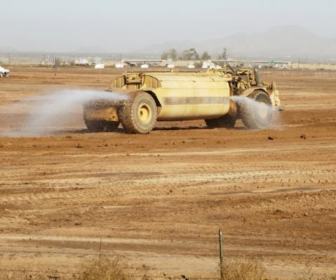
1.2.4.1 ENVIRONMENTAL MANAGEMENT plan
Some common aspects within the overall plan may include:
Dust monitoring and dust suppression measures to be put in place, i.e. water carts.
Stability or structural reports on buildings in the area to monitor vibration results.
Noise management requiring hearing protection, or strict work times, e.g. no work before 7am or after 6pm.

Slide 37
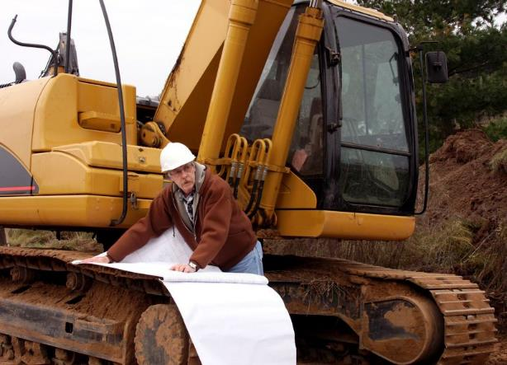
1.2.4.1 ENVIRONMENTAL MANAGEMENT plan
The site requirements and constraints will be clearly and completely outlined in this plan and must be followed exactly.
Requirements are the things that must be done. Constraints are the things that either must not be done or must be done is a particular way.

Slide 38
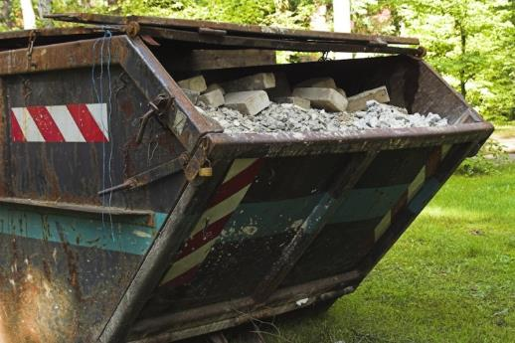
1.2.4.2 waste/clean-up management plan
The waste/clean-up management plan outlines how the waste materials and rubbish from the site will be disposed of.
It also provides guidelines for recycling from the site and the re-use of waste materials.
This plan may have sub-plans for hazardous wastes, chemical wastes and other classes of waste as appropriate for the worksite you are working on.

Slide 39
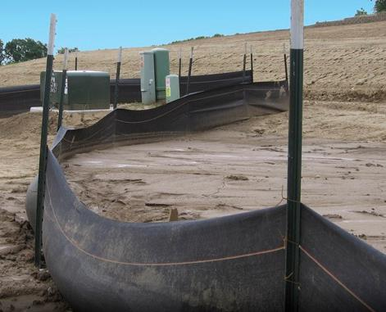
1.2.4.3 WATER QUALITY PROTECTION PLAN
This plan provides the steps that will be used to protect the water in adjacent areas.
It will detail items like silt fences, diversion drains and sediment ponds.
This plan can have a sub-plan for any wetlands or low-lying areas if these will impact on the work zone.

Slide 40
1.2.5 WORK ZONE TRAFFIC MANAGEMENT
It is often necessary to control the movement of traffic and people around and through the work zone and the entire site. Requirements and procedures for controlling traffic, vehicles and pedestrians on your worksite will be outlined in the 3 different types of traffic plans:
Types Of Traffic Plans: | Description:
Traffic Management Plan | Deals with traffic moving through the site, including traffic on public roads and members of the public.

Slide 41
1.2.5 WORK ZONE TRAFFIC MANAGEMENT
Types Of Traffic Plans: | Description:
Vehicle Management Plan | Deals with on-site vehicle movements, haul circuits and dump runs, and material routes. Under this plan, larger vehicles will have right of way unless site plans say otherwise. Road rules still apply and directional signs need to be obeyed.
Site Isolation Plan | Outlines are how the site will be isolated from the general public. It could detail barricades and fences but also how specific areas of the site will be isolated to keep the construction crews safe from traffic such as moving machinery (generally through the use of concrete barriers) and other hazards, e.g. excavations and trenches.

Slide 42
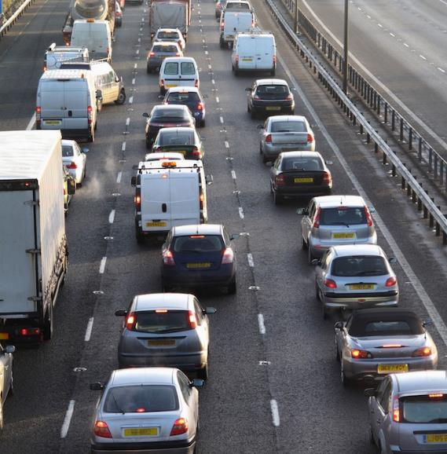
1.2.5.1 TRAFFIC CONTROL DEVICES
Traffic control devices are used in a variety of traffic conditions such as:
Congested urban environments.
Pedestrian areas.
Parking sites.
Buildings.
Low traffic rural areas.
Off-road un-trafficked areas.

Slide 43
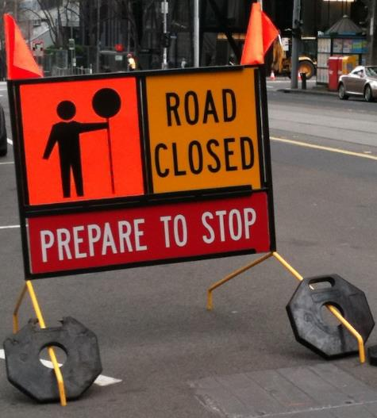

1.2.5.1 TRAFFIC CONTROL DEVICES
To ensure the safety of personnel/workers and the general public, traffic management signs and devices may be used. These can include:
Traffic signs, for example:
Workmen ahead.
Reduce speed.
Speed limits, e.g. 60km, 40km.
Speed zones are enforceable.
Changed traffic conditions ahead.

Slide 44

1.2.5.1 TRAFFIC CONTROL DEVICES
Traffic and regulatory cones.
Escort vehicle or other vehicle-mounted signs, signals and directions.
Highway traffic signs.
Guide and warning signs.
Hazard markers, flashing lights.
Portable traffic lights and signals.

Slide 45
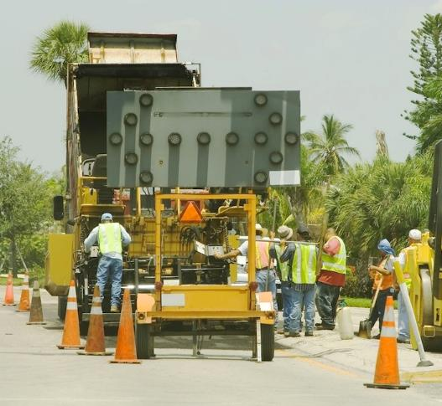
1.2.5.1 TRAFFIC CONTROL DEVICES
Arrow boards, message boards.
Barricades, bollards and barrier boards.
Site safety signage.
In the traffic or vehicle management plan, the type of signs and the distances between them will be listed. These distances must be maintained unless you receive approval to vary the traffic management plan.

Slide 46
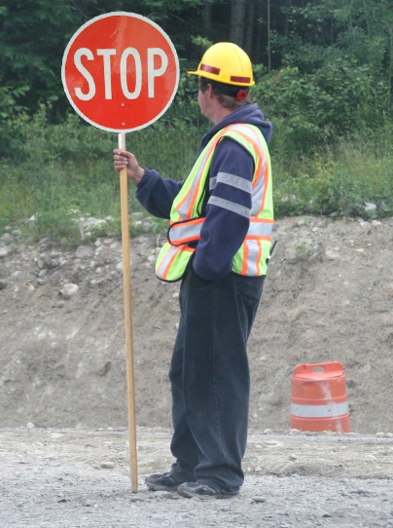
1.2.5.2 TRAFFIC CONTROL LICENSING AND ACCREDITATIONS
In most states of Australia, traffic management is covered under specialised traffic control training.
The 4 different levels of traffic control training are:
Using stop slow bat.
Applying or implementing traffic control plan.
Selecting and modifying traffic management plans.
Designing and inspecting traffic management plans.

Slide 47
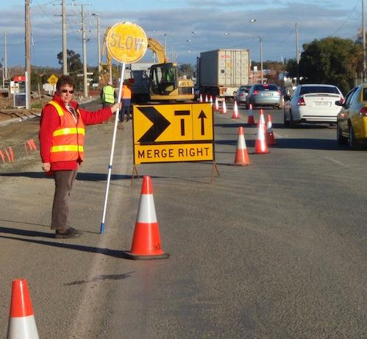
1.2.5.2 TRAFFIC CONTROL LICENSING AND ACCREDITATIONS
To comply with the regulations, anyone who is required to work with traffic control must have the specific traffic control training that is appropriate for the task being undertaken.
This can be obtained through a Roads and Traffic Authority (RTA) approved training organisation. Your WorkCover or RTA office will be able to advise if specialised training is needed and who provides it.

Slide 48

1.2.5.3 APPROVAL OF TRAFFIC MANAGEMENT PLANS
Traffic management plans may need to be approved by the road management authority (e.g. RTA) or local council in your state or district.
Most large worksites will have a traffic management engineer who you should speak with if you believe the traffic signage or placements don’t suit the work or environmental conditions. The engineer will then be able to assess the requirements in the field and determine a course of action.
If the site is too small for a dedicated traffic engineer, you should consult with your manager, the project manager/engineer or another authorised person about any issues or concerns with the traffic management plans.

Slide 49

1.2.6 RISK MANAGEMENT
Risk management is the process of reducing or managing the risks when working with a hazard or in a hazardous situation and should take into consideration the context of the organisation and worksite.
Risk management must be conducted in accordance with:
Legislative, organisation and site requirements/procedures.
Australian Standards (AS/NZS ISO 31000:2009).
Codes of Practice.
Employment and workplace relations legislation.
Equal employment opportunity and disability legislation.

Slide 50
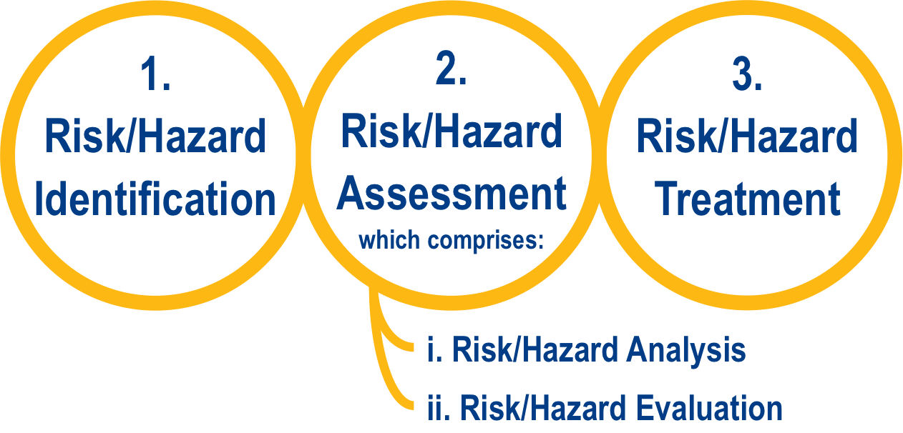
1.2.6 RISK MANAGEMENT
Risk management is made up of the following stages:

Slide 51
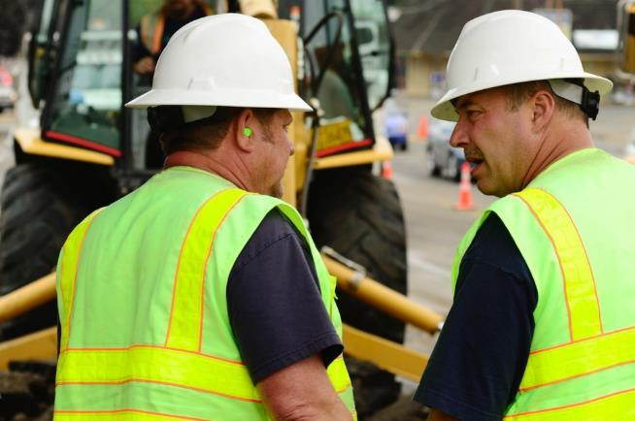
1.2.6 RISK MANAGEMENT
Consultation and communicating with others and monitoring and review should be planned for and carried out at every stage of the risk management process.

Slide 52

1.2.6.1 CONSULTATION AND COMMUNICATING WITH OTHERS
Consultation and communicating with others is an important part of the risk management process and should take place at all stages.
Identifying risks and hazards and coming up with ways of controlling them includes talking to the people with knowledge of the situation, or who are directly affected by any action you may take.

Slide 53
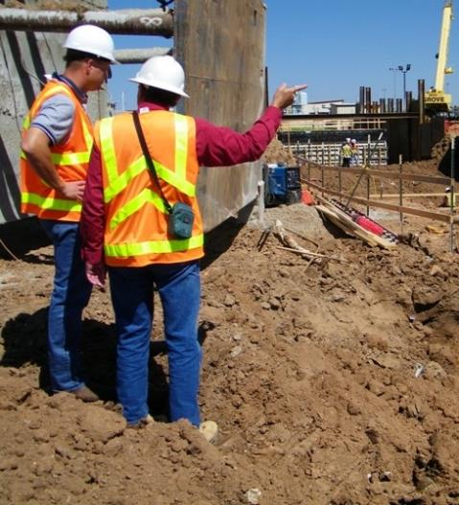
1.2.6.1 CONSULTATION AND COMMUNICATING WITH OTHERS
You should always talk to any workers involved in the hazard control measures as well as the OHS/WHS officer or supervisor.
This will help ensure that risks and hazards are not only effectively identified but that those involved with controlling and treating them are clear of their role and responsibilities in the risk management process.

Slide 54
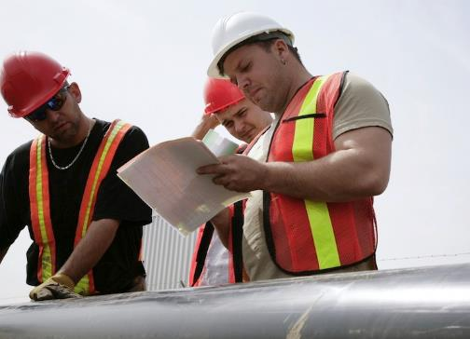
1.2.6.1 CONSULTATION AND COMMUNICATING WITH OTHERS
It also allows different skills, expertise and views to be brought together to enhance and support the risk management process. It is important that different views and concerns are identified and recorded as part of the consultation and then taken into account during the decision-making process.
Controlling a hazard can be a team effort and it’s important that everybody knows what they need to do and how/if they need to change their work process to suit.

Slide 55

1.2.6.2 RISK/HAZARD IDENTIFICATION
A RISK is the chance of a hazard hurting you or somebody else or causing some damage.
A HAZARD is the thing or situation that causes injury, harm or damage.
If you can remove or at least control a HAZARD you can reduce the RISK involved.
Checking for hazards is the first step in risk management.

Slide 56

1.2.6.2 RISK/HAZARD IDENTIFICATION

Slide 57

1.2.6.2 RISK/HAZARD IDENTIFICATION
Before commencing work on a site you should consult with safety officers, supervisors, site engineers, managers responsible for the site or other relevant workplace personnel/workers.
They can inform you of any site-specific hazards and ground conditions and ensure that you adhere to any workplace policies and site-specific procedures.

Slide 58
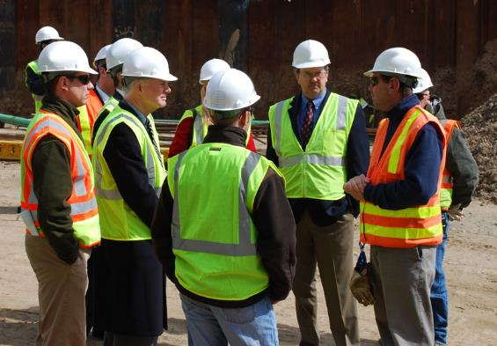
1.2.6.2 RISK/HAZARD IDENTIFICATION
A site induction needs to inform you of any hazards which exist on site.
Some of these hazards can be removed through staff training, better equipment and safe work methods. Talk to the OHS/WHS officer for more information.

Slide 59

1.2.6.2 RISK/HAZARD IDENTIFICATION
Each worksite will have specific risk management procedures, safety systems and information, and procedures for communication, reporting and record keeping.
Before conducting a risk assessment at a worksite, check to see what systems and procedures are in place as they may affect the outcomes of the risk assessment.
It is important that suitably knowledgeable personnel/workers are involved in the risk identification process.

Slide 60
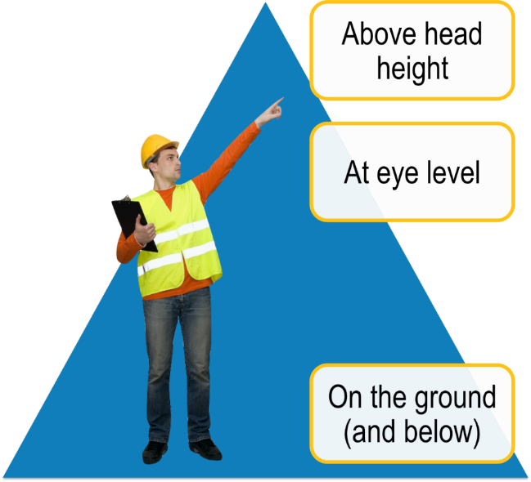
1.2.6.2 RISK/HAZARD IDENTIFICATION
Identify Hazards
Part of your job is to look around to see if you can find any hazards before operations begin. A good tip is to check:

Slide 61

1.2.6.2 RISK/HAZARD IDENTIFICATION
Potential Hazards And Risks
Potential hazards and risks that may be identified during the inspection of the work area may include:
Weather conditions, e.g. storms, heat, humidity.
Structural hazards, e g. fences, bridges, facilities, buildings, poles, work zones.
Working at heights or in confined spaces.
Hazardous materials and substances, e.g. fuel, chemicals, contaminants, gases.
Manual handling or lifting issues.

Slide 62
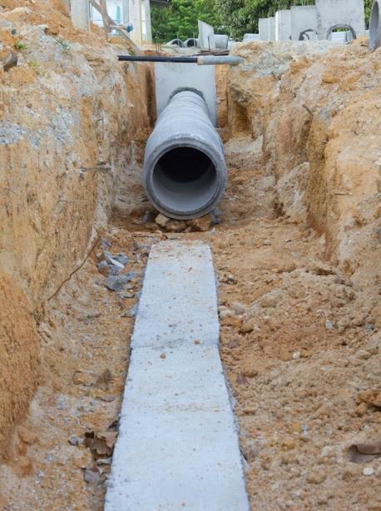
1.2.6.2 RISK/HAZARD IDENTIFICATION
Environmental hazards – unstable or uneven terrain, holes, excavations, trenches, cuttings, embankments, over-hanging rocks, trees, dust and noise, unstable faces or areas.
Damage to finished work areas.
Water damage due to insufficient or in adequate drainage.
Height of fill areas and embankment slopes.
Plant rollover.
Rotating plant (e.g. mixers) and revolving plant (excavator swing zones).

Slide 63
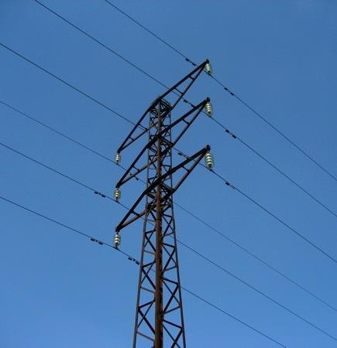
1.2.6.2 RISK/HAZARD IDENTIFICATION
Overhead and underground services.
Worksite traffic, plant, machinery and vehicle interaction and people.
Refuelling (in case of environmental damage).
Equipment in use or unattended.
Damaged or defective equipment.
Other aspects that may be specific to a task or location.

Slide 64

1.2.6.3 RISK/HAZARD ASSESSMENT
A risk assessment involves completing a risk analysis and a risk evaluation.
By assessing the likelihood and consequence of the risk, you are able to understand the situation better and respond in an appropriate way.

Slide 65
1.2.6.3 RISK/HAZARD ASSESSMENT
Risk/Hazard Analysis
Risk analysis involves considering what the causes and sources of risks are and comprises of 3 factors:
Consequence | What would be the outcome of the event occurring? How severe would the outcome be?
Likelihood | What is the chance of the event/consequence occurring? Has the event happened before? Is it likely to happen again?
Risk Level | The combined result of likelihood and consequence.

Slide 66
1.2.6.3 RISK/HAZARD ASSESSMENT
Using a table similar to the one shown here you can analyse how high the risk level is.
LIKELIHOOD | CONSEQUENCE
 | Insignificant | Minor First Aid Required | Moderate Medical Attention and Time Off Work | Major Long Term Illness or Serious Injury | Severe Kill or Cause Permanent Disability or Illness
Almost Certain | M | H | H | VH | VH
Likely | M | M | H | H | VH
Possible | L | M | H | H | VH
Unlikely | L | L | M | M | H
Rare | L | L | M | M | M

Slide 67

1.2.6.3 RISK/HAZARD ASSESSMENT
Risk/Hazard Evaluation
Risk evaluation is based upon the outcomes and results of the risk analysis.
Risk evaluation involves making decisions about which risks need to be treated and the order in which they should be treated. It should take into consideration the context of the risks in relation to:
The organisation.
The worksite.
The relevant laws.
Regulations.
Other policies, procedures and requirements.

Slide 68
1.2.6.3 RISK/HAZARD ASSESSMENT
Using a table similar to the one shown you can evaluate how soon you should act to remove or control the hazard to achieve an acceptable level of risk.
RISK LEVEL | ACTION
VERY HIGH | Act immediately: The proposed task or process activity must not proceed. Steps must be taken to lower the risk level to as low as reasonably practicable using the hierarchy of risk controls.
HIGH | Act today: The proposed activity can only proceed, provided that: The risk level has been reduced to as low as reasonably practicable using the hierarchy of risk controls. The risk controls must include those identified in legislation, Australian Standards, Codes of Practice etc. The risk assessment has been reviewed and approved by the Supervisor. A Safe Working Procedure or Safe Work Method has been prepared. The supervisor must review and document the effectiveness of the implemented risk controls.

Slide 69
1.2.6.3 RISK/HAZARD ASSESSMENT
RISK LEVEL | ACTION
MEDIUM | Act this week: The proposed task or process can proceed, provided that: The risk level has been reduced to as low as reasonably practicable using the hierarchy of risk controls. The risk assessment has been reviewed and approved by the Supervisor. A Safe Working Procedure or Safe Work Method has been prepared.
LOW | Act this month: Managed by local documented routine procedures, which must include application of the hierarchy of controls.
Any task with a Very High risk level is absolutely unacceptable to carry out. Steps must be taken to reduce the risk level.

Slide 70

1.2.6.4 RISK/HAZARD TREATMENT
Once risks have been identified, analysed and evaluated, risk treatment options need to be considered and applied.
Risk treatment involves selecting one or more options to modify a risk and then implementing the selected option/s. These should be recorded in a risk treatment plan.
Once an option has been implemented it may be referred to as a risk control.

Slide 71
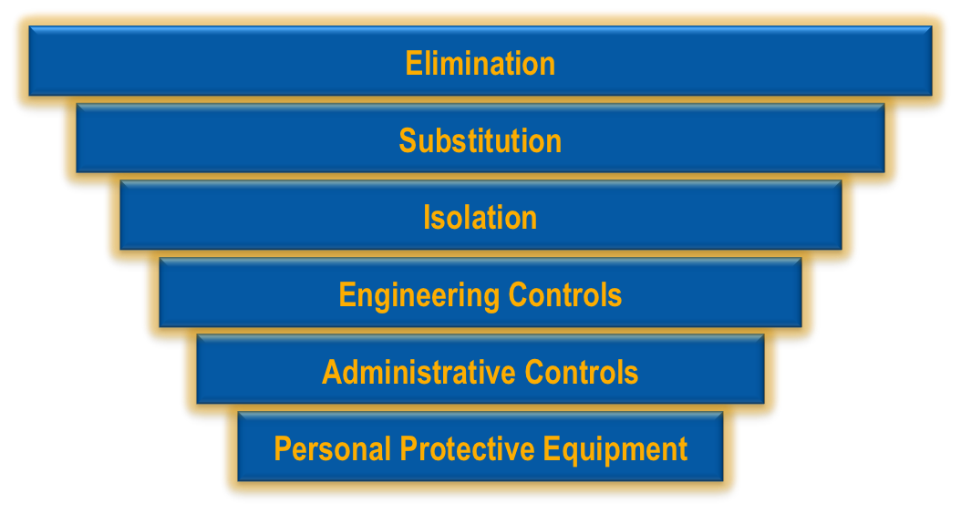
1.2.6.4 RISK/HAZARD TREATMENT
Consider Hazard/Risk Control Strategy Options
The Hierarchy of Hazard Control is the name given to a range of control methods used to eliminate or control hazards in the workplace. The Hierarchy has 6 levels:

Slide 72
1.2.6.4 RISK/HAZARD TREATMENT
It is important that you understand what each level in the hierarchy stands for and how they can be implemented. Hazards should be re-assessed after the implementation of control measures to review whether the risk has been reduced enough.
1. Elimination | This is the best kind of hazard control. Eliminating or removing the hazard completely reduces any risk connected to it. An example of eliminating a hazard would be removing dangerous materials from the site, or repairing defective equipment.
2. Substitution | This is where you swap a dangerous work method or situation for one that is less dangerous. An example of this would be to use a group of people to move an item instead of trying to move it on your own (where the item cannot be broken down into smaller loads).

Slide 73
1.2.6.4 RISK/HAZARD TREATMENT
3. Isolation | This is where you isolate the hazard. This might mean fencing off an area or restricting access to the hazard in some other way.
4. Engineering Controls | This is where you use an engineering or mechanical method of doing the job. An example would be installing ventilation, or using a piece of equipment to move a load instead of moving it by hand.
5. Administrative Controls | This is where site rules and policies attempt to control a hazard. It can include working in teams, setting specific break times and frequent rotations for repetitive work or using signage to warn of hazards.
6. Personal Protective Equipment | This is your last line of defence and the least effective control – it should be used in conjunction with other hazard control methods. PPE includes any safety equipment worn on your body. Workplaces often have mandatory PPE requirements to go on site.

Slide 74

1.2.6.4 RISK/HAZARD TREATMENT
Follow all appropriate standards when deciding hazard control strategies including:
Codes of practice.
Legislation.
Australian Standards.
Manufacturer's specifications.
Industry standards (where applicable).

Slide 75

1.2.6.5 MONITORING AND REVIEW OF THE RISK MANAGEMENT PROCESS
Monitoring and review is an important part of the risk management process and should be planned for at every stage.
This involves regular surveillance and checking and responsibilities concerning it should be clearly defined.
Monitoring and review should:
Ensure that treatments and controls are effective and efficient.
Aim to improve risk assessment through obtaining further information.

Slide 76

1.2.6.5 MONITORING AND REVIEW OF THE RISK MANAGEMENT PROCESS
Be used to analyse events and changes that have occurred through the implementation of the process and any lessons that may be learned from this.
Be used to detect any changes, including changes to risks, which may require revision of treatments, or the emergence of new risks.
It is important that monitoring and review results are recorded and reported according to organisational policies and procedures.

Slide 77
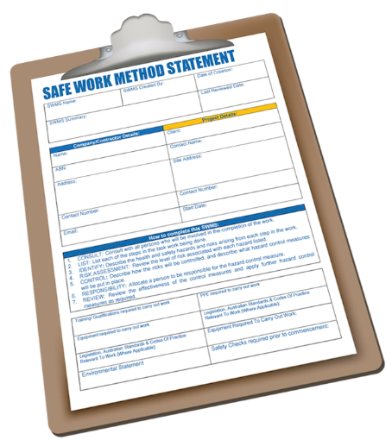
1.2.6.6 REPORTING AND RECORD KEEPING
Make sure you record any action you’ve taken and talk to your supervisor and OHS/WHS officer about the control strategies in place.
Reports and records could include:
Safe Work Method Statements (SWMS).
Risk Assessment Reports.
Incident Reports.
Job Safety Analysis (JSAs).

Slide 78

1.2.6.6 REPORTING AND RECORD KEEPING
Keeping records is important as they can help ensure that any risk management activities are traceable. Records also provide a basis for improving methods and tools in the risk management process, as well as improving the overall process.

Slide 79
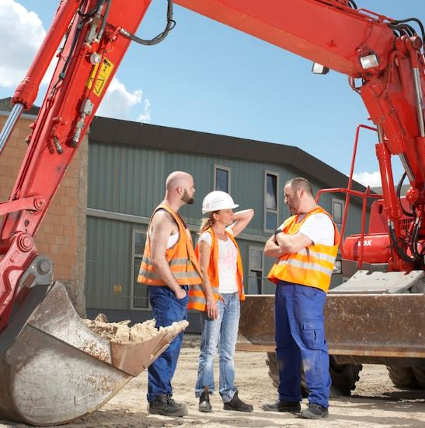
1.2.7 INTERPRETING AND APPLYING EARTHWORKS DOCUMENTATION
Being able to access, interpret and apply the requirements of the documents is part of any job on a civil construction worksite. During your site induction you will be told how to access the documentation relevant to your site and duties.
It is essential that you are able to read and accurately interpret your workplace policies and procedures so that you can work efficiently and safely, meeting organisational and client expectations.

Slide 80

1.2.7 INTERPRETING AND APPLYING EARTHWORKS DOCUMENTATION
Take the time to read through all the relevant documentation. Make notes about any points you aren’t clear about and then clarify them later.
Read or listen to all instructions and follow them carefully. Check the wording of any labels, codes or markings.
Interpretation of compliance documentation is getting the key information out of the document that allows you to make correct decisions for each situation.

Slide 81
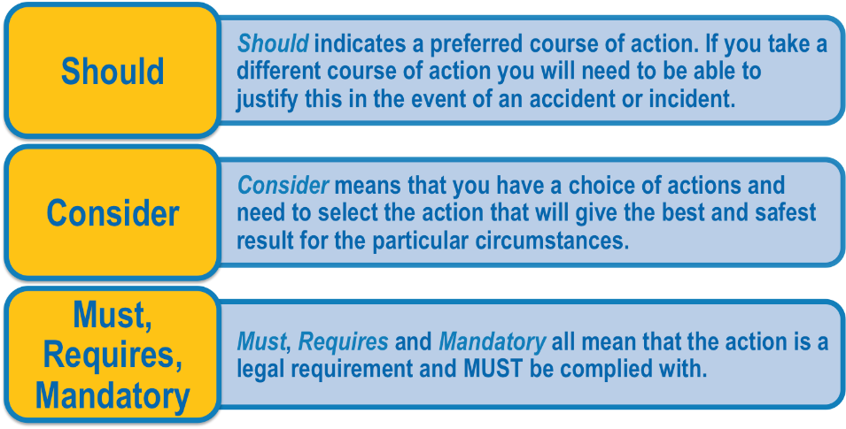
1.2.7 INTERPRETING AND APPLYING EARTHWORKS DOCUMENTATION
When interpreting documents it is vital that you understand the difference between words such as should, consider and must.
If you have any difficulties interpreting and/or applying requirements or you don’t understand something, speak to your supervisor or team leader. It is always better to ask than to go ahead and possibly disrupt operations and/or cause a safety issue.

Slide 82
RIIMPO402D
Apply the principles of earthworks construction presentation 2

Slide 83

2.1 CONFIRM SPECIFIC TASK INFORMATION AND REQUIREMENTS
Before any earthworks construction work can begin you will need to obtain and understand the information and requirements specific to the project and to each task.

Slide 84
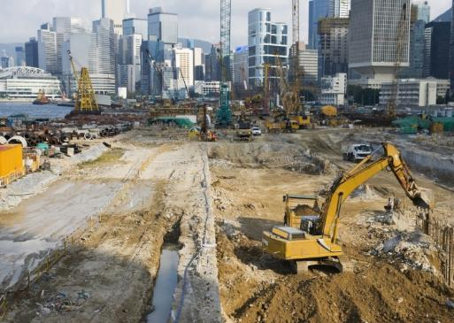
2.1.1 EARTHWORKS AND CIVIL CONSTRUCTION TERMINOLOGY
The civil construction industry has language standards or terminology that can vary between states, locations or worksites.
Individual earthworks tasks and activities on a worksite may have a set of terms or phrases with specific meanings.

Slide 85

2.1.1 EARTHWORKS AND CIVIL CONSTRUCTION TERMINOLOGY
Tools and equipment may be known by various names, and jargon or local slang words could also be used occasionally.
Familiarise yourself with the terminology used on your site and for specific tasks.

Slide 86
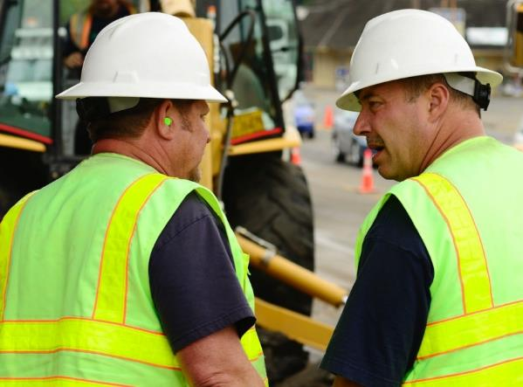
2.1.1 EARTHWORKS AND CIVIL CONSTRUCTION TERMINOLOGY
If you aren’t sure about the meaning of a particular term, phrase or word you should seek further clarification at team meetings or speak directly with your manager.
This is important when you are interpreting specific task information and requirements, issuing work instructions to your team and carrying out your supervisory duties in general.

Slide 87
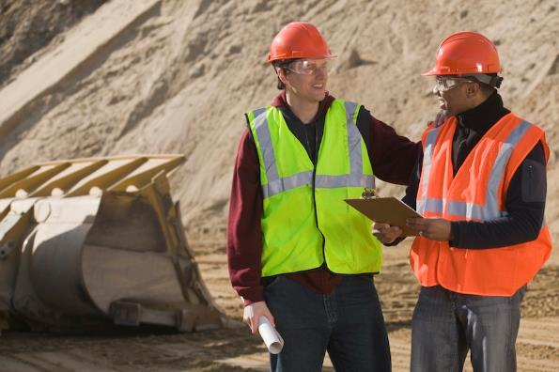
2.1.2 COMMON TASK SPECIFICS
You will need to read and interpret all of the specific information so that you know what needs to be done and are aware of any factors that could impact the completion of tasks.
As a supervisor it is essential to make sure you have the correct details and clearly understand all specific requirements and procedures.
Clarify any points you are not sure about by speaking with your manager, the site project officer or engineer.

Slide 88
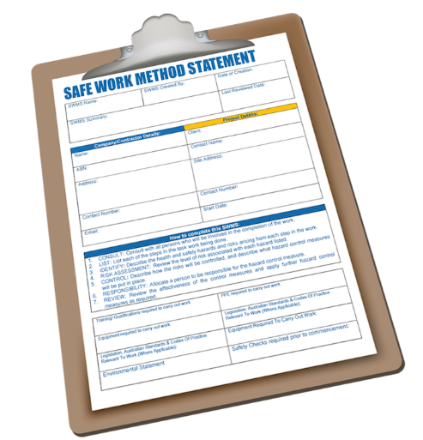
2.1.2 COMMON TASK SPECIFICS
Common information and requirements specific to earthworks projects and tasks that you will need to work with may include:
Relevant Safe Work Method Statement (SWMS) or Job Safety Analysis (JSA).
Sources of materials.
Known and potential site hazards, constraints and conditions.
Site cultural and heritage information.

Slide 89
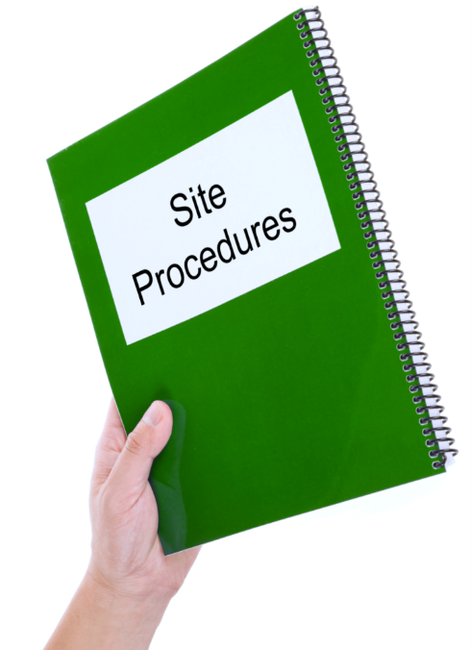
2.1.2 COMMON TASK SPECIFICS
Organisational and/or site procedures.
Other organisations and contractors involved in the task or related tasks.
Coordination, timing and budgeting requirements.
Task procedures – will normally be very specific and require minimal interpretation but always clarify anything you do not understand.

Slide 90

2.1.2 COMMON TASK SPECIFICS
Other task specifics you might need to interpret may include:
Geotechnical, Geological And Survey Data.
Hydrological Data.
Meteorological Data.
Task Drawings, Plans And Specifications.

Slide 91

2.1.2.1 GEOTECHNICAL, GEOLOGICAL AND SURVEY DATA
Geotechnical data for the project and site involves the principles of soil and rock mechanics.
These are used to:
Identify soil and rock types and characteristics.
Check conditions and materials on and under the ground surface.
Determine their physical/mechanical and chemical properties.
Evaluate the stability of natural slopes and man-made soil deposits.

Slide 92
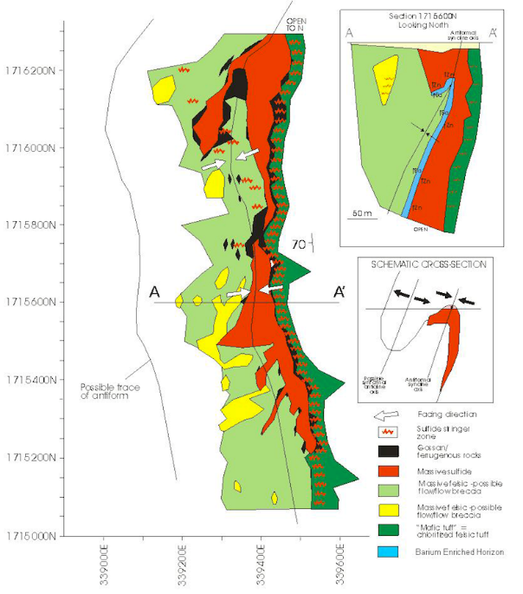
2.1.2.1 GEOTECHNICAL, GEOLOGICAL AND SURVEY DATA
Soil or geological data is the information about the materials and the environment in which the work will take place, for example:
Defining material types.
Identifying wet and dry areas.
Identifying broken ground, faults and joints.
Locating water tables.
Showing compaction levels.

Slide 93
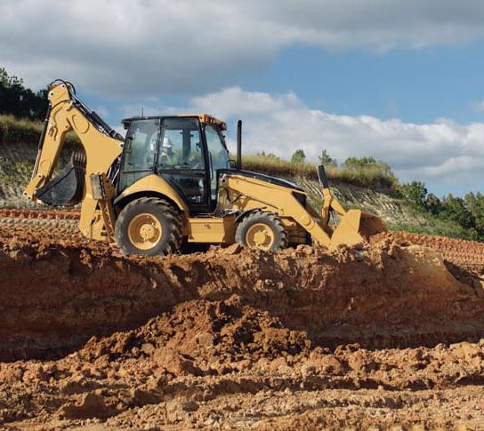
2.1.2.1 GEOTECHNICAL, GEOLOGICAL AND SURVEY DATA
Survey and engineering information is used to define work areas and zones, for example:
Floor heights.
Bench heights and widths.
Floor and bench grades.
Voids and underground situations.
Road profile requirements.

Slide 94

2.1.2.1 GEOTECHNICAL, GEOLOGICAL AND SURVEY DATA
Application of the correct engineering survey data will ensure compliance within the specified tolerances for the work.

Slide 95
2.1.2.1 GEOTECHNICAL, GEOLOGICAL AND SURVEY DATA
Rock And Soil Types
Identification of the different types of rock and soil is essential to the successful completion of most civil construction projects.
Soil and rock types may include:
Rock Types: | Metamorphic | Rocks are heavy and hard.
 | Igneous | Rocks are volcanic and can be hard, but may also be very light
 | Sedimentary | Rocks and shales could peel out when cut and removed.

Slide 96
2.1.2.1 GEOTECHNICAL, GEOLOGICAL AND SURVEY DATA
Soil and rock types may include:
Soil Types: | Sandy | Soils will require a lot of stabilisation
 | Clay | Soils are harder to work with due to the physical hardness of the soil and the ability of these soils to hold water for long periods of time.
Soil and rock types will have been identified during the site engineering surveys. Interpretation of this data allows for successful planning and preparation on the worksite.

Slide 97

2.1.2.2 hydrological data
Hydrological data mainly concerns surface water and ground water on the site and it is critical to the success of earthworks operations.
Hydrological data helps to determine the properties, distribution and effects of water, moisture content and exposures on the project/site soil, rocks and atmosphere.
These factors must be known to ensure all tasks are completed using the correct materials and processes.

Slide 98
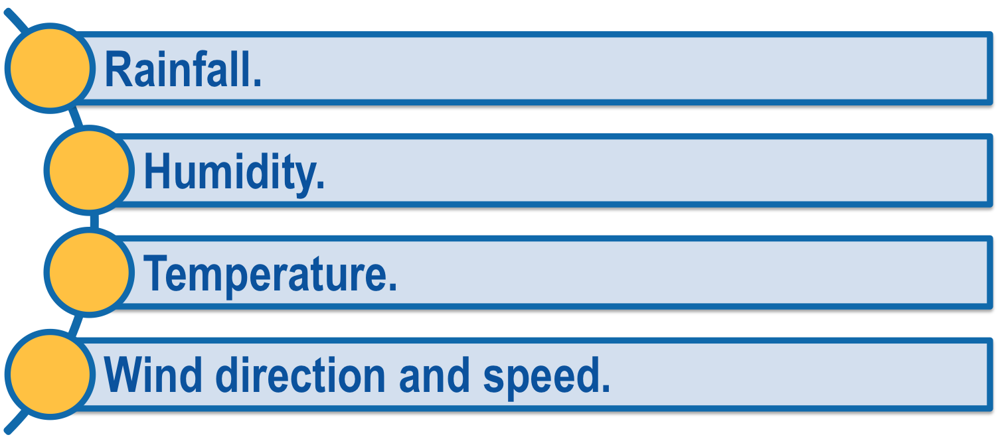
2.1.2.3 meteorological data
Meteorological data is used to determine the weather conditions that will impact how and when tasks will be completed. Meteorological data includes factors such as:

Slide 99
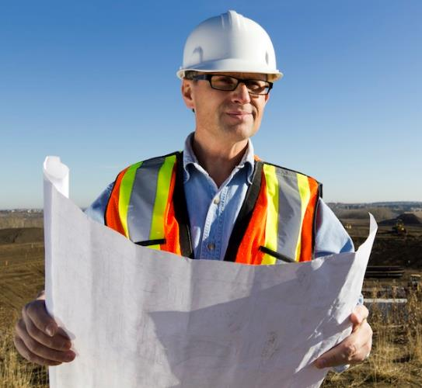
2.1.2.4 task drawings, plans and specifications
Project plans and drawings provide an overview of the site including, for example:
Location of the site and earthworks in relation to the surrounding area.
The position of structures, roads, access areas.
Layout of drainage lines.
Foundation details and landscaping features.

Slide 100

2.1.2.4 task drawings, plans and specifications
Depending on the project, drawings may be very detailed or they could be simple sketches.
You should be familiar with the conventions and symbols used in the plans and drawings so you can understand what the information means.
You also need to be able to interpret, clarify and apply the project and task specifications to ensure all activities are conducted correctly and in compliance with safety and quality requirements.

Slide 101
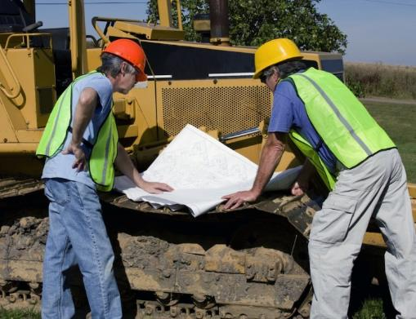
2.1.2.4 task drawings, plans and specifications
Project and task specifications list the types and characteristics of particular earthworks tasks to be carried out.
They may be presented in the quality requirements, project drawings, notes and descriptions, or outlined in work instructions.

Slide 102

2.1.2.4 task drawings, plans and specifications
They also detail how activities will be completed and may include:
Materials and quality of work – for example, testing, sampling, finished tolerances, and material properties.
Information about the soil and other materials you will be working with.
Quality assurance requirements – may be specific to the organisation, job or client, and may have to comply with Australian Standards or relevant codes of practice.

Slide 103
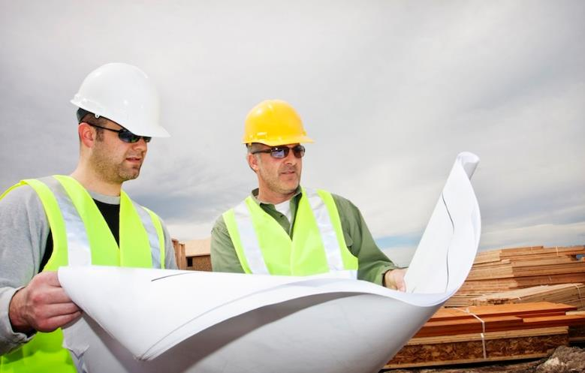
2.1.2.4 task drawings, plans and specifications
Incorrect plans and drawings or misinterpretation can cause major complications. If you need assistance in interpreting, clarifying or applying drawings and job specifications, speak to your manager or other senior project staff.

Slide 104
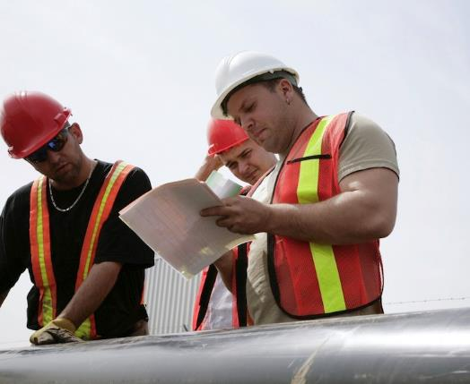
2.1.3 identifying site issues
As a supervisor you need to be aware that various problems or unplanned situations can arise during earthworks projects.
Some of these issues may involve:
Drainage requirements.
Unidentified soil and rock types.
Acid sulphate.

Slide 105
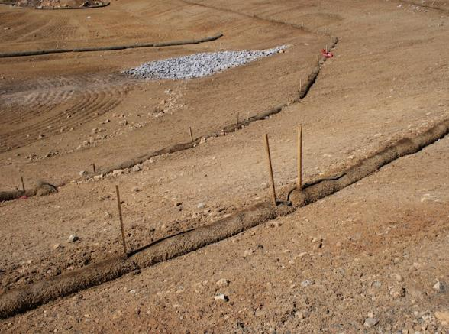
2.1.3.1 DRAINAGE REQUIREMENTS
Drainage and dewatering refers to any activities that move water from the worksite in a controlled manner.
Drainage and dewatering requirements may involve:
Any form of erosion or sediment controls.
Pumping out of sumps or pits.
Shifting water from one location to another using the site controls or water transfer devices such as pumps.

Slide 106

2.1.3.1 DRAINAGE REQUIREMENTS
Drainage on a worksite can apply to areas such as:
Creeks.
Surface water.
Bores.
Coffer dams.
Springs.
Wetland water.
Seepage water in trenches and pits.
Low lying natural ground where water may not escape.

Slide 107
2.1.3.1 DRAINAGE REQUIREMENTS
Drainage is essential to the success of any task in earthworks.
Once drainage issues have been identified, they will need to be managed promptly and effectively in line with environmental protection legislation and site requirements.

Slide 108
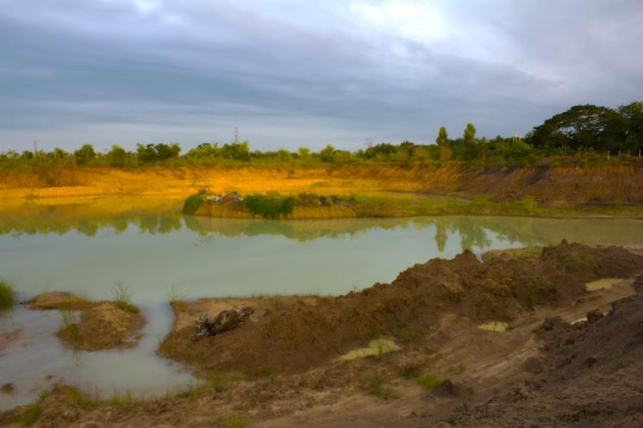
2.1.3.1 DRAINAGE REQUIREMENTS
The most important part about draining and dewatering a construction site is that no dirty or contaminated water or pollution must leave the site. If this happens, severe penalties can apply that can be imposed by federal, state and local government authorities.

Slide 109

2.2 PREPARE A JOB PLAN
As most earthworks projects have strict timelines to be met it is important to have a job plan or program of work.
In your role as supervisor or technical specialist you need to ensure the availability of a job plan that makes the most efficient use of the resources on site and meets all task requirements.

Slide 110
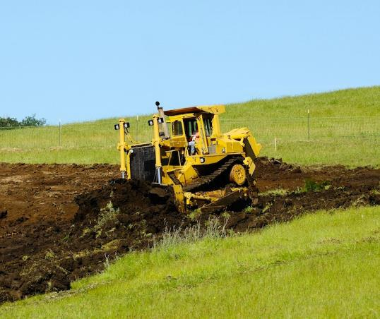
2.2.1 SCHEDULING EARTHWORKS ACTIVITIES
Earthworks construction includes a variety of different work activities. It is common for several operations to be occurring at a similar time, for example:
Clearing and grubbing.
Removal of unsuitable materials.
Grading tracks.
Drainage.

Slide 111
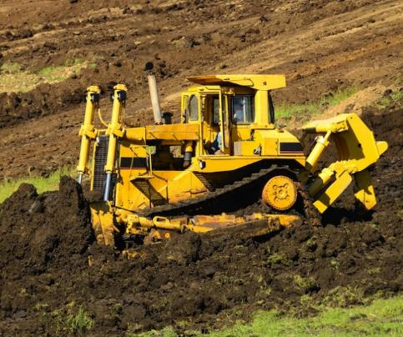
2.2.1 SCHEDULING EARTHWORKS ACTIVITIES
Removal of topsoil.
Placement of fill materials (backfilling).
Other concurrent worksite activities.
Scheduling all of these activities will ensure that processes are conducted in the correct order or sequence and that the appropriate resources are available when they are needed.

Slide 112

2.2.1 SCHEDULING EARTHWORKS ACTIVITIES
In addition to the machinery, plant, equipment and personnel/workers needed for each task, resources also include the correct materials in the correct quantities.
Not all of the resources will be required at the same time.
Generally, there are procedures in place to make sure that workers are on hand, equipment is available and the delivery of materials can be scheduled according to the relevant activities.

Slide 113

2.2.1 SCHEDULING EARTHWORKS ACTIVITIES
To get a clear picture of the activities involved in the project you are supervising, you will need to determine the properties and characteristics of earthworks materials before work is started.

Slide 114
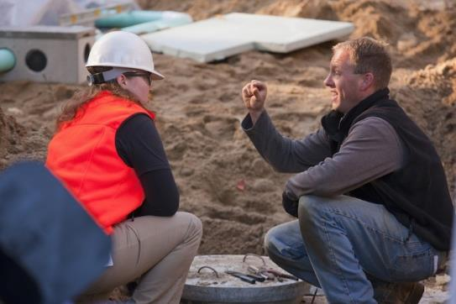
2.2.1.1 CONSTRUCTION MATERIAL PROPERTIES AND TESTS
In most cases, the material properties have been tested through a geotechnical laboratory prior to the start of works.
Sometimes it may also be necessary to conduct tests during work processes as materials or conditions change.
The test results from the materials analysis will provide details of any additional treatments that may be required to meet the specification requirements.

Slide 115
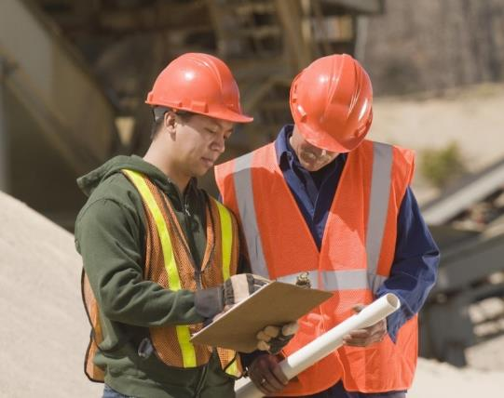
2.2.1.1 CONSTRUCTION MATERIAL PROPERTIES AND TESTS
In some cases additives such as lime, cement, fly ash, or other blends may be necessary to ensure the material is stable to use in earthworks construction.
Always follow your organisation’s procedures for material sampling and testing and if you are unsure check with the relevant personnel/workers.

Slide 116
2.2.1.1 CONSTRUCTION MATERIAL PROPERTIES AND TESTS
Some common civil construction material properties and test results that you may need to interpret include:
Material Properties And Test Results: | Description:
Soil Density/Moisture Relationship | To gain adequate compaction it is necessary to have the density and moisture in balance. If the material moisture is too high then it can become difficult to work or simply turn to mud. If the moisture content is too low the material will not bind and therefore will not compact properly. Density and moisture testing is routinely carried out on all earthworks construction activities.

Slide 117
2.2.1.1 CONSTRUCTION MATERIAL PROPERTIES AND TESTS
Material Properties And Test Results: | Description:
Plasticity Index | The plasticity index (PI) determines how the materials can be shaped and will relate to the clay content within the material. High clay content material or high PI may be very difficult to work on its own and may require additives to allow suitable construction. Generally construction materials have to fall within a certain PI to be able to be used in the works. In some cases it may be necessary to blend materials so the PI is modified.

Slide 118
2.2.1.1 CONSTRUCTION MATERIAL PROPERTIES AND TESTS
Material Properties And Test Results: | Description:
Particle Size Distribution | It is important to have the right balance of particle sizes to ensure the correct construction of layers. There must be the correct balance of particle sizes for the materials to meet specification requirements. Particle size distribution is very important when backfilling structures so that no damage occurs to the structure. Particle size distribution becomes more important as earthworks layers are constructed. Seek advice from geotechnical testers if the particle size distribution is incorrect for the work activity.

Slide 119

2.2.1.2 CALCULATING MATERIAL QUANTITIES
Calculating quantities is an important part of any earthworks activity. Knowing how to do this efficiently and effectively helps ensure the job is completed correctly and in line with job requirements.
You should always keep a copy of your calculations to verify your results or if you have to go back and check or change things later.
Accuracy is important as incorrect figures could be costly in terms of materials, resources, scheduling, and potential re-work.

Slide 120

2.2.1.2 CALCULATING MATERIAL QUANTITIES
Some common quantity calculations for the execution of earthworks tasks include:
Volume
In some cases it may be relevant to know how to convert material weights from tonnes to cubic metres. For this you need to know the relevant densities of the materials. This information can be sourced either from the supplier or from the geotechnical testing technicians. In most cases earthworks quantities are measured in cubic metres of volume, for example, length x width x depth.

Slide 121

2.2.1.2 CALCULATING MATERIAL QUANTITIES
Area
This is calculated by multiplying width x length, usually in metres.

Slide 122
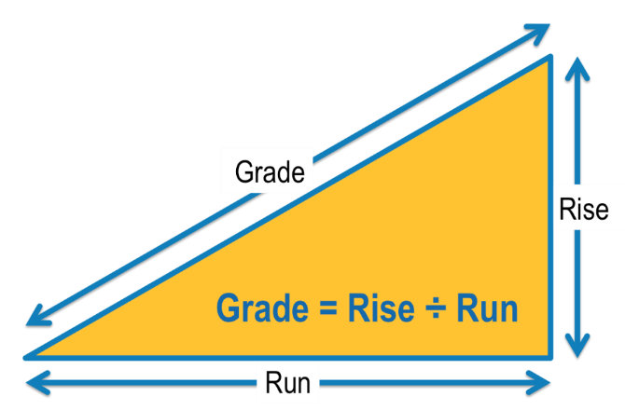
2.2.1.2 CALCULATING MATERIAL QUANTITIES
Grade
Often calculated as rise divided by run. In some cases it is also known as the slope.
Specific grades will be indicated on the project and site plans and drawings. Where GPS control is used, grade details will be imported into the machine. In some cases it may be necessary for surveyors to mark out the appropriate grade.

Slide 123

2.2.1.2 CALCULATING MATERIAL QUANTITIES
Percentages
In some circumstances percentages are also known as cross fall. This is generally the slope placed on earthworks to ensure water can drain off the work area. For example, a 3% cross fall would equate to a 3 metre rise across a 100 metre area.
Some types of earthmoving plant and machinery are able to self adjust to create the appropriate cross fall percentage.

Slide 124

2.2.1.2 CALCULATING MATERIAL QUANTITIES
Resource Consumption
Resource consumption, including required supply rates, refers to how much material is used or consumed and how quickly it can be resupplied, either from another location on the worksite or from an external supplier.
It is important to know supply times from external suppliers as there may be a delay to the works if materials are not available when needed.

Slide 125

2.2.1.2 CALCULATING MATERIAL QUANTITIES
Daily production figures will often be used as a guideline to work out consumption rates. Be aware, however, that not all materials are consumed at the same rate and supply rates may differ from worksite to worksite.
If you are unsure about how to correctly calculate any of these quantities or interpret resource consumption figures, your manager will be able to help you.

Slide 126

2.2.1.3 PLANNING AND SEQUENCING OF CIVIL WORKS
As a supervisor you may be involved in planning which civil construction work activities will be completed and in what order. You therefore need to understand the relationship between the different areas of civil works and the sequences of the tasks involved.
Always ensure that all base activities or sub-tasks are completed. These are the things that need to be completed prior to the commencement of other activities. You will need to consider all of the activities and deadlines on the site.

Slide 127

2.2.1.3 PLANNING AND SEQUENCING OF CIVIL WORKS
For example, in pouring concrete for a culvert, the planning would cover:

Slide 128

2.2.1.3 PLANNING AND SEQUENCING OF CIVIL WORKS
Remember that few tasks are completed in one step.
Always factor in the completion of each sub-task when planning work activities.
By breaking the work into smaller component tasks you will have a better chance of completing each task on time and on budget.

Slide 129

2.2.1.3 PLANNING AND SEQUENCING OF CIVIL WORKS
Common sequences that you will have to supervise during the earthworks project may include the following:
Earthworks:
Mark out the work area.
Clear and grub (remove vegetation).
Remove the topsoil.
Create contours or drains, or carry out the next step in the construction process.

Slide 130

2.2.1.3 PLANNING AND SEQUENCING OF CIVIL WORKS
Roadworks Construction:
Construction of roads follows the steps for earthworks and then:
Formation of drain lines or contours.
Cutting and filling to the required level.
Carrying out compaction activities.
Finishing pavement layers.

Slide 131

2.2.1.3 PLANNING AND SEQUENCING OF CIVIL WORKS
Drainage:
Drainage includes the steps for earthworks then:
Forming drain lines.
Forming out the work area, that is building the frame to hold the drain system.
Laying pipes, box drains or culverts.
Backfilling.
Landscaping as appropriate.
In scheduling it is important that you are aware of the specific timelines or sequences in which activities need to be completed on your site.

Slide 132

2.2.2 job plan drafting and administration
For the project to run smoothly the job plan must cover all aspects of the tasks and activities being undertaken on the site.
In drafting the plan you also need to allow some flexibility to account for any changes in circumstances while still ensuring that the project targets and objectives are achieved.

Slide 133
2.2.2 job plan drafting and administration
The job plan being drafted should include sub-plans that address requirements for:
Job Plan Drafting Requirements:
Human resources. | Plant and machinery.
Construction materials, including quality and delivery. | Occupational Health & Safety/Work Health & Safety (OHS/WHS).
Sub-contractor support. | Communication and coordination.
Activity scheduling. | Material delivery.
Risk management. | Traffic management.
Quality management, including testing schedules. | Environmental management, including waste disposal.
Task and performance monitoring. | Reporting.

Slide 134

2.2.2 job plan drafting and administration
Each one of these smaller plans will contribute to the site management plan and each plan must be adhered to.
All organisations have their own administration procedures and requirements, depending on the scope of operations.
In most cases they will be outlined in company policies and procedures.

Slide 135

2.2.2 job plan drafting and administration
Administration procedures and requirements may cover:
Staff requirements such as leave timesheets, wages or other documentation.
Reporting achieved targets or productivity.
Procurement.
Supply agreements.
Sub-contractor engagements.
Accounts procedures.
Other requirements specific to the project and/or site.

Slide 136

2.2.2.1 CONTRACT MANAGEMENT
The contract is the document that will outline exactly how your organisation will complete all project tasks on time and within the designated budget.
The contract will determine the success or failure of the job and is crucial to the financing of all activities.
Each section of the contract will outline who is responsible for what and at what cost.

Slide 137

2.2.2.1 CONTRACT MANAGEMENT
It is important to correctly interpret the requirements of the project contract to ensure that all earthworks plans, client requirements and quality standards are known, understood and achieved.
Depending on the structure of your organisation and your role within it, the level of your involvement in contract management can vary.
You may be required to estimate the costs and/or time factors for a job.

Slide 138

2.2.2.1 CONTRACT MANAGEMENT
The principles of estimation are relatively easy to understand but it can take some time and practice to apply them accurately and effectively.
Basically, to estimate the cost of completing a task you add the cost of production to the cost of materials.

Slide 139

2.2.2.1 CONTRACT MANAGEMENT
To estimate the completion time of a job, you work out how long each individual activity should take from start to finish.
You then determine how many activities need to be completed. The total of these two figures should give an estimate of the total hours.

Slide 140

2.2.2.1 CONTRACT MANAGEMENT
Most organisations will have designated contract managers whose sole task is ensuring that all contract requirements are met and procedures are followed.

Slide 141
RIIMPO402D
Apply the principles of earthworks construction presentation 3

Slide 142

3.1 CONFIRM AVAILABILITY OF RESOURCES
To ensure that earthworks construction tasks can be initiated, it is important to confirm that the correct resources are available.

Slide 143

3.1.1 EARTHWORKS CONSTRUCTION RESOURCES
Necessary resources for earthworks construction may include:

Slide 144

3.1.1 EARTHWORKS CONSTRUCTION RESOURCES
Having the appropriate resources available and ready will allow your team to maintain the required levels of productivity through efficient work practices.
It also means you can be certain that personnel/workers have the right tools and equipment for the job, ensuring safety and effectiveness throughout operations.

Slide 145

3.1.2 RESOURCE REQUIREMENTS AND PROCEDURES
Each project will have its own resource requirements based on the tasks and specifications involved.
You will need to confirm that you have accounted for these by checking the project and task documentation.
You should also confirm that the relevant organisational procedures for procuring the equipment have been followed in the planning and allocating of resources for the task.

Slide 146

3.1.2 RESOURCE REQUIREMENTS AND PROCEDURES
In determining the correct resources for the activities, you need to confirm that plant and equipment is suitable for the task.
This will mean checking the intended application or use of each item is in line with its capabilities and limitations.

Slide 147

3.1.2 RESOURCE REQUIREMENTS AND PROCEDURES
You may need to refer to the machine specifications and other details listed in the individual operator’s manuals or your site documentation.
Prior to work starting, make sure that personnel/workers know how to use each tool and piece of equipment or plant correctly, in line with site and equipment safety requirements.
Also check that the appropriate operational checks have been carried out to ensure all items are serviceable and safe to use.

Slide 148

3.1.2 RESOURCE REQUIREMENTS AND PROCEDURES
The resources for the activity should be checked and confirmed with the relevant personnel/workers such as supervisor/managers, engineers or project management staff to ensure that resource requirements and procedures have been adhered to.
This will help to avoid any safety issues or other potential problems.

Slide 149

3.1.2 RESOURCE REQUIREMENTS AND PROCEDURES
Be aware that resource requirements may change once earthworks tasks begin as conditions or other factors can differ from when the job was planned.
You may need to procure alternative materials and types of equipment or source additional labour to get the job done.

Slide 150

3.2 PROVIDE INSTRUCTIONS AND LEADERSHIP TO WORK TEAM
In applying the principles of earthworks construction it is vital to make sure that all team members have received clear and timely instructions.
You will therefore need to follow your organisation’s requirements and procedures for communication and teamwork, and apply your skills in supervision and leadership.

Slide 151

3.2.1 COMMUNICATING WITH TEAM MEMBERS
Team members and others who may be involved in the earthworks activities under your supervision may include:
Personnel/Workers directly involved in the task.
Other members of the organisation's management team.
Supplier’s representatives.
Sub-contractors representatives.
Supervisors or managers of other organisations who are involved in related tasks.

Slide 152

3.2.1 COMMUNICATING WITH TEAM MEMBERS
Engineering staff.
Administrative staff.
Other people necessary to the operations.
In some cases, a subject matter expert will be brought in to be part of the team and may act as a technical adviser.

Slide 153

3.2.1 COMMUNICATING WITH TEAM MEMBERS
Clear and effective communication is essential in any workplace.
Your site will have procedures covering every aspect of communication, including recording and reporting.
Site communication requirements and procedures may detail factors such as:
Documentation requirements, e.g. verbal or written reports.
Protocols for using communications equipment.

Slide 154

3.2.1 COMMUNICATING WITH TEAM MEMBERS
Communications equipment and methods to be used on site, including:
Two-way radios.
Mobile phones.
Landline phones.
Email.
Instant messaging.
Message boards.
Hand signals and symbols – used due to the high levels of background noise.

Slide 155

3.2.1 COMMUNICATING WITH TEAM MEMBERS
To ensure that activities are completed in line with the specific task requirements safely, effectively and on time, clear and timely instructions are given to personnel/workers by the supervisor.
These instructions may be passed down the line from management or other staff overseeing the project.
Instructions and other information may be communicated through:
Briefings – information provided both before the work begins and during the task or operations.

Slide 156

3.2.1 COMMUNICATING WITH TEAM MEMBERS
Site Meetings – site meetings are conducted for various reasons. They may be with management, workers, client representatives, or other key staff on the worksite. The meetings may be specific to a particular aspect, inspections, planning, or in response to incidents or actions on the site.
Work Orders – some organisations have a work order process that has to be followed prior to beginning a task. This may include compliance or contractual requirements that must be observed to complete the task.

Slide 157

3.2.1 COMMUNICATING WITH TEAM MEMBERS
Toolbox Meetings – these could range from individual work teams to the entire worksite, depending on the information content. On some sites a pre-start toolbox meeting is conducted at the start of each shift or work day, and a weekly toolbox meeting may be held to provide a broader range of information to workers.
Handovers – critical information regarding activities or processes that may be handed over to another crew or work team.

Slide 158


3.2.1 COMMUNICATING WITH TEAM MEMBERS
Briefings, handovers and toolbox, and site meetings are vital in aiding communications on the site.
They allow interaction between management, supervisory staff, workers, subcontractors, and any other people involved in the activities.
As a supervisor you need to ensure that thorough preparation goes into these briefings and meetings so that appropriate and relevant information is conveyed to the team.

Slide 159

3.2.1 COMMUNICATING WITH TEAM MEMBERS
It’s important that the work team or teams are kept informed of issues that may relate to safety, quality, environment, traffic management, or general work activities.
The level of information that is given out will be suitable to work operations and the people involved.
In providing instructions for work teams, you also need to be able to prepare short messages that are clear, concise, and easy to understand.

Slide 160

3.2.1 COMMUNICATING WITH TEAM MEMBERS
When preparing messages or instructions, make sure they are appropriate and not confusing for the receiver. It helps to remember the target audience you’re aiming your message at.
Always give the receiver the opportunity to confirm the instruction or message and to ask questions if necessary.

Slide 161

3.2.2 DEVELOPING WORKPLACE RELATIONSHIPS
Communication is essential to a successful relationship between team members and supervisors.
A good leader keeps communication channels open to encourage productivity and information sharing.
Effective leaders should be able to understand what each worker actually does. This is achieved by staying in touch with the team and stepping in to operational roles to assist when needed.

Slide 162

3.2.2 DEVELOPING WORKPLACE RELATIONSHIPS
Developing and maintaining workplace relationships is an important part of being a leader or supervisor.
It promotes a good work environment and encourages effective interactions between team members, supervisors, management, and any additional people that may be involved with the work activities.
It is important to make sure that everyone observes organisational and site requirements for working and interacting with others.

Slide 163

3.2.2 DEVELOPING WORKPLACE RELATIONSHIPS
If you are unsure or require assistance with workplace relationships, talk to your supervisor/manager or other senior staff.

Slide 164

3.2.2.1 LEADERSHIP AND SUPERVISION
Good leadership promotes harmony within the team and enhances productivity.
To be a good leader you have to be able to give instructions and coordinate activities, as well as listen to suggestions or input from your team.

Slide 165

3.2.2.1 LEADERSHIP AND SUPERVISION
Your style of leadership will depend on your team members, organisational requirements, work procedures, and the type of earthworks construction being undertaken.
The leadership techniques you adopt will depend on the nature and dynamics of the group and also the experience level of the people concerned.

Slide 166

3.2.2.1 LEADERSHIP AND SUPERVISION
It is important to make good use of the skills and knowledge within your team and ensure that everybody can contribute when required.
Giving feedback to individuals and the team as a whole is an important part of leadership. It should always be constructive and helpful, where possible.

Slide 167

3.2.2.1 LEADERSHIP AND SUPERVISION
As a supervisor you are providing leadership. You need to be able to:
Communicate.
Organise.
Plan.
Manage people and resources.
Liaise with both management and your work team.

Slide 168

3.2.2.1 LEADERSHIP AND SUPERVISION
Supervision also involves being able to deal with issues that may be related to work tasks, personnel/workers, subcontractors, suppliers, or other aspects of earthworks operations.
Being a supervisor means trusting in your team and leading by example.

Slide 169

3.2.2.1 LEADERSHIP AND SUPERVISION
If you are having difficulty with any aspects of your supervisory role, speak to your supervisor/manager or mentor.
Your organisation may be able to provide training or other support.

Slide 170

3.2.2.2 MENTORING
In supervising your work team you may be required to provide guidance and assistance to individuals throughout their tasks, and assist them to take responsibility for their own actions.
You could do this by giving general advice or through the use of mentoring.
By being a mentor you are sharing your skills, knowledge or expertise in order to foster the professional growth of another person. The focus of mentoring is on changing behaviour.

Slide 171

3.2.2.2 MENTORING
Five techniques commonly used in mentoring are:

Slide 172

3.2.2.2 MENTORING
As a supervisor and a mentor you require patience, understanding and the ability to communicate clearly and concisely.
You need to understand what is involved in the process or procedure or be able to consult with subject matter experts to give the appropriate response.

Slide 173

3.2.2.2 MENTORING
It is always best to work with the skills and experience that you have within your team and in many cases experienced workers or operators can be used to assist in mentoring less experienced people.
Some organisations have mentoring programs or have specific procedures that need to be followed.

Slide 174

3.3 SUPERVISE TASK SET OUT
Setting out tasks is the process of preparing work areas in a manner that ensures effective completion of the required work.

Slide 175

3.3.1 SETTING OUT PROCESSES
While set out principles are the same across the civil construction industry, procedures and requirements for task set out will be determined by the type of earthworks being carried out and the specifications you are working under.
Procedures will be established at the beginning of the project but you may have to adjust or modify them according to the work location or geographical features of the site.
They can also change with the needs of the tasks during the project. Always check the relevant set out requirements and procedures before the job starts.

Slide 176
3.3.1.1 SET OUT REQUIREMENTS AND PROCEDURES
Set out requirements and procedures include:
Requirements And Procedures: | Description:
Establishing Control Lines | Control lines are the base line for measuring from. They vary from site to site but could comprise boundary lines, fences, string lines, defined work areas, or other details as indicated in plans or drawings.
Establishing Cleared Width | The cleared width generally indicates the level of clearing that must be undertaken for the earthworks tasks. It ensures that the work stays within a defined footprint and aims to minimise environmental damage that may occur.

Slide 177
3.3.1.1 SET OUT REQUIREMENTS AND PROCEDURES
Requirements And Procedures: | Description:
Determining Batters | Batters are the slopes that may be naturally formed as part of the work location, for example in a cut area or embankment fill areas. Batters often have specific set out requirements to meet slope and grade dimensions.
Establishing Construction Offsets | Before any project begins, it is important that the boundaries or clearance zones are determined and marked out.

Slide 178

3.3.1.1 SET OUT REQUIREMENTS AND PROCEDURES
This is necessary to prevent confusion and to ensure that the earthworks project is marked out in line with relevant plans, specifications, design drawings or other relevant details.
Offsets refer to how far from a control line an activity is to take place or an area is to be cleared.
A negative number means the offset is to the left of the line, a positive number means the offset is to the right of the line.

Slide 179

3.3.1.1 SET OUT REQUIREMENTS AND PROCEDURES
By varying the amount of movement between the right and left of the line, you are able to establish or create different shapes in the final product.
In establishing construction offsets, quite often survey markers and level pegs are used to define the work area.
In many cases these pegs or markers are placed at an offset value to where the works are being conducted to prevent them from being hit or damaged during the work processes.

Slide 180

3.3.1.1 SET OUT REQUIREMENTS AND PROCEDURES
Offsets can include a number of factors such as formation width, measurement and survey pegs, benchmarks or other job specific details.

Slide 181

3.3.1.2 ROAD GEOMETRY
For roadwork projects, it is important that set out is completed to ensure the correct road geometry is achieved. Road geometry can include factors such as:

Slide 182

3.3.1.2 ROAD GEOMETRY
The road geometry required for a roadwork project will be defined in site drawings and plans.
The relevant specifications will also outline any factors that may be relevant to the project.
To achieve the required road geometry, procedures must be followed and compliance obtained with relevant survey and compaction tolerances.

Slide 183

3.3.2 SETTING UP AND USING LEVELLING DEVICES
Levelling devices are used in many different aspects of the setting out process, such as:
Determining drainage grades.
Determining gradients, batters and benches.
Measuring offsets.
Helping with road geometry.

Slide 184

3.3.2 SETTING UP AND USING LEVELLING DEVICES
Earthworks and civil construction projects involve the use of several different types of levelling devices.
These may include:
Laser levelling equipment.
GPS equipment.

Slide 185

3.3.2 SETTING UP AND USING LEVELLING DEVICES
Spirit levels.
Dumpy levels.
Specified survey equipment.
Level staffs.
Or other site-specific equipment.

Slide 186

3.3.2 SETTING UP AND USING LEVELLING DEVICES
For basic earthworks, it is necessary to have an understanding of how to set up the types of levelling devices appropriate for your worksite.
This will often come with experience or relevant training in the use of the devices.
To ensure effective operation of the levelling equipment and devices it is necessary for all items to be correctly calibrated before use.

Slide 187

3.3.2 SETTING UP AND USING LEVELLING DEVICES
Calibration is done in different ways, depending on the brands and models of the equipment so you should refer to the relevant operator’s manual, product specifications and/or manufacturer’s instructions.
When setting up the levelling device, make sure you have positioned it in accordance with the manufacturer’s specifications. Each leg of the tripod should be adjusted to ensure a level platform for the device.

Slide 188

3.3.2 SETTING UP AND USING LEVELLING DEVICES
Make sure you read the owner or operator manual that comes with the equipment to ensure you are aware of what you need to do to use the equipment correctly.
If you are having trouble in setting up devices for levelling, seek guidance from your supervisor/manager, the site engineers or other relevant people.

Slide 189
RIIMPO402D
Apply the principles of earthworks construction presentation 4

Slide 190

4.1 MONITOR EARTHWORKS CONSTRUCTION TASKS
A major part of a supervisor’s job is overseeing the execution of earthworks construction tasks.
Overseeing involves the monitoring and inspection of the performance of work being done and the safety of all personnel/workers on the site.
Consistent monitoring and inspection allows you to ensure that all tasks are carried out safely and efficiently and that the required outcomes are achieved.

Slide 191

4.1.1 PROJECT AND TASK MONITORING
The monitoring process you need to follow is generally outlined in the project and task specifications as well as organisational procedures. Monitoring includes the following aspects:
Ongoing risk assessment and management.
Engineering survey.
Sampling and testing.
General supervision, observation and recording.

Slide 192

4.1.1.1 ONGOING RISK ASSESSMENT AND MANAGEMENT
Risk assessment and management is an important part of any earthworks activity. The complexity of tasks and other work going on in the area can determine the level of risk that may exist.

Slide 193

4.1.1.1 ONGOING RISK ASSESSMENT AND MANAGEMENT
Risk on a worksite can relate to a number of factors including:

Slide 194

4.1.1.1 ONGOING RISK ASSESSMENT AND MANAGEMENT
Each area of the worksite requires constant risk assessment based on the activities being undertaken.
Conditions and circumstances may change as the work progresses so it is important to continually assess risks to safety, quality and environment and anything that may have an impact on the works or people on site.

Slide 195

4.1.1.1 ONGOING RISK ASSESSMENT AND MANAGEMENT
The level of risk should be analysed on a holistic basis for the project as well as on a work activity basis.
While the basics of risk management apply to all workplaces, each organisation and/or site will have different risk management processes to suit their specific situation.
It is therefore very important that you familiarise yourself with the relevant procedures and requirements before you start work on a new site and prior to the commencement of each earthworks construction task.

Slide 196

4.1.1.2 ENGINEERING SURVEY
All earthworks projects are set out to required tolerances and standards.
These are generally based on engineering survey principles to ensure earthworks construction is being done correctly, with correct layer formation and within the specified tolerances.
It is important that all earthworks operators are aware of the relevant engineering survey principles that apply.

Slide 197

4.1.1.2 ENGINEERING SURVEY
The principles may be relatively simple or quite complex depending on the tasks being undertaken. They will be defined in the project specifications and organisational procedures.
Remember that not all work will be set out by surveyors, and in some cases it will be the supervisor or the operators of plant and machinery who will have to get compliance with specified tolerances for the earthworks.

Slide 198

4.1.1.2 ENGINEERING SURVEY
At the completion of earthworks layers a final survey must be done to ensure compliance.

Slide 199

4.1.1.3 SAMPLING AND TESTING
Sampling and testing will occur in every level of earthworks construction from the foundation to the top of sub-grade material. Conformance details regarding sampling and testing will be contained in the specifications and standards relevant to the job.

Slide 200

4.1.1.3 SAMPLING AND TESTING
Material properties and test results
Before starting any earthworks project it is important to understand the material properties that you are working with.
In the initial stages of the job, testing should be undertaken so that the properties are known and understood to allow for additional treatments when necessary.

Slide 201

4.1.1.3 SAMPLING AND TESTING
The soil and rock types and characteristics will determine the construction methods to be used and the degree of compaction required.
The testing results will indicate material variances throughout the works. Test results are also used to ensure levels of compaction are achieved based on specifications.

Slide 202

4.1.1.4 GENERAL SUPERVISION, OBSERVATION AND RECORDING
Supervision of any project is necessary to ensure that all tasks are carried out in compliance with safety, quality and environmental requirements.
As a general rule, you will make observations and record details in the field using various guidelines, checklists, data sheets, registers, and other relevant organisation documents.
Some projects require a high level of monitoring while others may be smaller, with less overseeing and fewer inspections necessary.
Check the contract documents and task specifications for the guidelines you need to follow.

Slide 203

4.1.2 REQUIRED OUTCOMES AND MONITORING
It is important with any earthworks project to know and understand the required objectives and outcomes so that you and your team can work towards them.
Required outcomes for projects and tasks may include:
Task specifications requirements.
Task drawings requirements.
Activity scheduling requirements.

Slide 204

4.1.2 REQUIRED OUTCOMES AND MONITORING
Waste management requirements.
Coordination requirements.
Unit cost requirements.
Overall task cost requirements.

Slide 205

4.1.2 REQUIRED OUTCOMES AND MONITORING
Other objectives and outcomes may also include:
Health and safety targets.
Environmental management targets or requirements.
Quality assurance objectives.
Performance indicators.
Organisational objectives.
Other project-specific targets or objectives as required.

Slide 206

4.1.2.1 MONITORING METHODS
Every earthworks job has some form of performance task monitoring that will be undertaken.
Often this will be based on the specification requirements or contract documentation.
Monitoring requirements can vary between organisations, worksites and individual contracts so it is important to know what procedures and processes you need to follow prior to the commencement of each task.

Slide 207

4.1.2.1 MONITORING METHODS
Monitoring the performance of tasks will relate to certain criteria, such as:
Compaction.
Layer thickness.
Particle size.
Clay content.
Homogenous lot area (completed using the same production technique and using similar materials).
Other site-specific requirements.

Slide 208

4.1.2.1 MONITORING METHODS
Some methods for monitoring may include:
Field checklists.
Inspection and test plans.
Site inspections that may be daily, weekly, or based on a particular work area.
Survey and level checks.
Geotechnical testing.
Material analysis.
Other methods suitable to the site or work activities.

Slide 209

4.1.2.2 INSPECTION REQUIREMENTS
Earthworks operations involve routine inspections to ensure compliance with Occupational Health & Safety/Work Health & Safety (OHS/WHS) legislation, contractual obligations and requirements specific to the project and the worksite.
In some cases it may also be necessary to refer to relevant national and industry standards to ensure compliance.

Slide 210

4.1.2.2 INSPECTION REQUIREMENTS
The inspection requirements for each work task will be outlined in the specifications for the project and should also be in line with organisational procedures for the work activity.
Inspections may be in the form of observations, formal inspections, testing, survey, or other appropriate measures.
The timeframe for these inspections will be dependent on the works in progress and your organisation’s procedures.

Slide 211

4.2 ADJUST EARTHWORKS PRACTICE OR JOB PLAN
During the performance of the earthworks tasks you may find that an aspect of the job plan is not appropriate or that some adjustments to certain construction methods are necessary.

Slide 212

4.2.1 EARTHWORKS CONSTRUCTION PRACTICE
Earthworks construction practice may include methods and operational techniques for the following:
Site preparation.
Extraction.
Load and haulage.
Placement.
Distribution.
Surface finishing.
Line, grade and level control.

Slide 213

4.2.1 EARTHWORKS CONSTRUCTION PRACTICE
Compaction.
Water application.
Sedimentation control.
Other methods or techniques appropriate to the work activity or site location.
Industry standards usually apply across all earthworks construction sites, however some organisations require different operational techniques to be used in certain cases.

Slide 214

4.2.1.1 OPERATIONAL TECHNIQUES
The operational techniques for the earthworks construction project you are working on will be outlined in the relevant procedures for the work activity.
The project and task specifications should also indicate what operational techniques apply to the various types of tools, plant and equipment to be used.
Whatever earthworks construction practices are engaged, it is important that they allow for safe and effective production with appropriate use of available resources.

Slide 215

4.2.1.1 OPERATIONAL TECHNIQUES
Sometimes it may be necessary to initiate changes to a technique or to develop new procedures based on changing conditions or circumstances.
In the application or adjustment of operational techniques always make sure that the safety of personnel/workers is maintained at the highest level and that no damage is caused to equipment or the environment.

Slide 216
4.2.1.2 GROUND SURFACE TREATMENTS
The job plan may include treating and finishing the ground surface. Ground surface treatments can include but are not limited to:
Ground Surface Treatment: | Description
Proof Rolling | A plant item such as a roller, loaded truck, or other nominated item may be used to see if there is any movement in the ground underneath. Movement under the wheels could indicate unsuitable or insufficiently compacted material in lower layers. In some cases further testing such as deflection monitoring may need to be carried out or unsuitable material removed before continuing.

Slide 217
4.2.1.2 GROUND SURFACE TREATMENTS
Ground Surface Treatment: | Description
Stabilisation | Additional materials, mixes or other appropriate measures may be placed into the earthworks to improve the quality of product or to meet specifications.
Blending | Different materials are combined together to give a better quality product. Blending in some cases also allows for more efficient construction techniques.
Usually ground surface treatments will be outlined in the geotechnical information for the project as well as task specifications.

Slide 218

4.2.2 INITIATING CHANGES
Before initiating any changes to the job plan or relevant earthworks construction practice you should consult with the operators and other personnel/workers involved in the task.
Getting their input and putting useful ideas forward will assist in giving ownership to the task.
If you do have to go ahead and make adjustments, make sure that you inform the relevant people. Also, make sure they understand what has been changed and why.

Slide 219

4.2.2 INITIATING CHANGES
This can be done through:
Written communication – plans, sketches and drawings, work instructions or other documentation.
Oral communication – briefings, toolbox meetings, verbal instructions, discussions with operators, team meetings, or relevant conversations based on the activity.
Always follow the communication requirements and procedures for the project and for your site.

Slide 220

4.3 OVERSEE PLANT, EQUIPMENT AND TOOL MAINTENANCE
Always follow the communication requirements and procedures for the project and for your site.

Slide 221

4.3.1 MAINTENANCE ACTIVITIES
Maintenance activities on a worksite will vary depending on the:
Type of plant, machinery, tool or equipment.
Manufacturer’s specifications and instructions.
Servicing requirements.
Level of maintenance training required.

Slide 222

4.3.1 MAINTENANCE ACTIVITIES
It is not uncommon for earthworks construction operators to undertake basic operator maintenance tasks on the tools, plant and equipment they have used.
Maintenance tasks may include:
Servicing and monitoring, e.g. changing filters, topping up oils and hydraulic fluids.
Cleaning and checking for damage before and after use.

Slide 223

4.3.1 MAINTENANCE ACTIVITIES
Fitting and removing attachments.
Minor repairs, e.g. replacing ripping teeth or boots.
Helping the mechanics with maintenance and repairs.
Recording and reporting of damage, defects or faults.

Slide 224

4.3.1 MAINTENANCE ACTIVITIES
Make sure your team members conduct all of these maintenance activities according to site procedures and the manufacturer’s specifications for each item.
You may need to create a schedule to ensure that regular times are allocated to your team for cleaning, checking, repairing and carrying out other maintenance tasks.
Keeping equipment in the best possible condition prolongs its working life and ensures it is safe to use.

Slide 225

4.4 COMPLETE AND SUBMIT REPORTS
Reports and records are used extensively in earthworks construction for many reasons including:

Slide 226

4.4.1 TYPES OF RECORDS AND REPORTS
Some earthworks construction projects have a large number of reports that need to be created and submitted at regular intervals.
To find out the relevant requirements, procedures and reporting intervals, check your site documents, policies and procedures regarding documentation and reporting.

Slide 227

4.4.1 TYPES OF RECORDS AND REPORTS
The types of records that may need to be kept will vary depending on the nature of the earthworks being completed but they could include:
Logs, logbooks and diaries – used to track daily and weekly activities. Logbooks are often used to verify the number of hours an operator has worked on a machine, training that has been completed or other task-related information.
Job reports.
Completion reports.

Slide 228

4.4.1 TYPES OF RECORDS AND REPORTS
Checklists, e.g. for tasks, OHS/WHS, environmental management, quality assurance (QA), training.
Shift documentation, e.g. end of shift, end of process, despatch dockets, delivery dockets, activity reports.
Resource reports – used to track the quantities of resources being used on the site, e.g. fuel, chemicals, concrete, soil, bitumen or any other product or material being used.

Slide 229

4.4.1 TYPES OF RECORDS AND REPORTS
Incident reports, e.g. accident forms, records of environmental incidents, OHS/WHS investigation reports.
Planning and activity documentation, e.g. specifications, activity plans, job plans, diaries, QA reports, environmental management policies and procedures, OHS/WHS plans, policies and procedures.

Slide 230

4.4.1 TYPES OF RECORDS AND REPORTS
Organisational and/or site reporting requirements and procedures will outline:
How and when reports are to be completed.
Who completes the reports.
What supporting documentation is required for each report.
How the report is presented and submitted.

Slide 231

4.4.1 TYPES OF RECORDS AND REPORTS
By following these requirements you will also ensure that the correct report is submitted to the right person within the designated timeframes.
Normally workplace documents and reports will be completed and then paper-based copies will be scanned into the site computer system.
Reports may also need to be submitted to one person or to multiple personnel/workers.

Slide 232

4.4.2 PREPARING AND PRESENTING JOB REPORTS
When preparing and presenting job reports the primary focus is to give clear and concise information as succinctly as possible.

Slide 233

4.4.2.1 REPORT PREPARATION
Reports are written to convey information and the requirements of the information will determine the length and style of the report.
These requirements will generally include:
Objectives of the report.
Overview of the situation.
Research and information collection methodology used and why this methodology was chosen.

Slide 234

4.4.2.1 REPORT PREPARATION
Analytical criteria used during the investigation.
Findings – will be in two categories: essential findings and contributing factors.
Any recommendations.
Required or suggested follow up actions.
Appendices, which detail and examine relevant evidence, if applicable.

Slide 235

4.4.2.1 REPORT PREPARATION
When preparing your report, particularly a technical one, it is important to remember the following simple guidelines:
Keep it clear and concise – use a style of language that is simple enough to be read quickly but technical enough to meet the needs of the audience.
Pay attention to your grammar and make sure the information is clear.
Proofread it – errors in your report reduce your credibility as well as that of your organisation.

Slide 236

4.4.2.1 REPORT PREPARATION
Check for errors, e.g. spelling, typing, information inconsistencies, formatting or simply illogical placement of graphic or other information.
Remember that your computer spell checker won’t pick up misused words, incorrect words, technical jargon that is badly used or sentence structure and construction problems.

Slide 237

4.4.2.1 REPORT PREPARATION
Include any significant risks and explain how you are dealing with them.
Present the most important information first.
Present the least important information at the end of the report.
Use basic report formats.

Slide 238
4.4.2.1 REPORT PREPARATION
Most organisations have templates for the job reports you will be required to complete. These will guide you in what information needs to be included and where in the report it should go.
Basic Report Format:
Title Page | Stating the name of the report, name of the person creating the report and other essential details.
Summary Or Executive Summary | This summarises the entire report. An executive should be able to read the summary and get enough information to make judgements on the usefulness of the information. An executive summary should comprise 10% of the final report.
Table Of Contents And Diagrams | In digital documents these should be hyperlinked to allow skipping through the document to the required heading.

Slide 239
4.4.2.1 REPORT PREPARATION
Basic Report Format:
Introduction | This can also be called the scope statement or the terms of reference statements. Again it should be no more than 10% of the final document and give exact reasons for the document. Reports for readers who are unfamiliar with the topic may require a longer introduction to give adequate background information for the report to make sense.
Main Body | This is where the information you need to convey will be included. You should use tables, graphs, diagrams, photos and graphics if they enhance your report and make it easier to read. Do not include them just for the sake of decoration.
Findings/ Recommendations | This is where you say what options are available to respond to the problems or situations discussed.

Slide 240
4.4.2.1 REPORT PREPARATION
Basic Report Format:
Conclusion | This is another summary of the report but with a different focus. It is your last opportunity to ‘sell’ your findings, recommendations and to urge prompt action. The conclusion should also comprise approximately 10% of the final report.
References, Thanks, Acknowledgements And Bibliography | These should be organised in a logical order with as much detail as possible to allow the readers to confirm your information with your sources.
Appendices | This is the most underused area of a report. Appendices make your report easier to read, more logical and allow for a better flow of information. They can include information that is a requirement for a specific group of readers, or additional information that doesn’t fit the report but is useful in making decisions.

Slide 241

4.4.2.1 REPORT PREPARATION
While reports are the most common form of documents that you will be expected to create, it is difficult to apply a single, rigid formula to the process.
This is because reports contain many different types of information and are required to meet the needs of a wide range of readers.
Communicating in writing should not be considered a difficult task. It is the form of communication that allows you to take the time to say the correct thing in the right way to achieve the best result.

Slide 242

4.4.2.2 REPORT PRESENTATION
Each organisation will have standards for presenting documents and reports.
These requirements reflect current industry and enterprise practices as well as the needs of the people working with the documentation.
The presentation conventions and requirements for your site will be found in your organisational style guide, documentation policies or reporting procedures.

Slide 243

4.4.2.2 REPORT PRESENTATION
Well-designed presentations can be used in group situations and can also be put on CDs and provided to employees/workers working shifts or in different locations.
You can contract a professional to create your presentation, or you can create it in-house.

Slide 244

4.4.2.2 REPORT PRESENTATION
When preparing a presentation yourself, there are some basic principles to keep in mind.
Keep the presentation relevant and lively.
Create notes and hand these out at the end. Inform attendees at the start that they will receive notes. This way they can stay focused on what you are saying rather than taking notes.

Slide 245

4.4.2.2 REPORT PRESENTATION
Explain at the beginning how you will take and respond to questions, either as they come up at the end of topics or at the end of the presentation.
Don’t create overheads or PowerPoint slides that simply repeat what you are saying.
Use graphics that illustrate what you are saying. Use any knowledge of screen design and apply this to your slides. This includes knowing appropriate colours, fonts and letter sizes to fit the audience.

Slide 246


4.4.2.2 REPORT PRESENTATION
Watch the reaction of the attendees during your presentation and react by slowing down if they look confused or speeding up if they look bored.
You should make your presentation in accordance with your plan but be prepared to deviate if necessary to answer questions from the audience or respond to feedback. Your presentation plan is the framework you are working within, but it should be a flexible framework that is able to adapt and change to meet the needs of the audience and the situation you are facing.

Slide 247

4.5 RECOMMEND CHANGES AND IMPROVEMENTS
During the execution of earthworks construction tasks, you and your team might see some room for changes or improvements in terms of safety, effectiveness or efficiency.

Slide 248

4.5.1 PROVIDING RECOMMENDATIONS
Most organisations encourage staff to come up with suggestions or recommendations for improving the way operations are carried out.
If you or a member of your team can see a better, safer, more efficient, more effective method of completing an earthworks construction task, you need to speak up.

Slide 249

4.5.1 PROVIDING RECOMMENDATIONS
Improvements could relate to:

Slide 250

4.5.1 PROVIDING RECOMMENDATIONS
Discuss it with the team and determine if the suggestion will work on your current site.
Often what has been done in one location may not translate well to another site. For example, a method of doing something in one state may not be accepted in another state.
This is often a good time to develop individual workers or the team as a whole. Team building exercises can be created in any situation where change is needed.

Slide 251

4.5.1 PROVIDING RECOMMENDATIONS
By listening and considering ideas and suggestions, you as a supervisor are building and developing the individuals and teams in your charge.
If you are approachable and open to suggestions, your team will function at a higher level and team morale will be enhanced.

Slide 252

4.5.1 PROVIDING RECOMMENDATIONS
When recommending changes to senior management for improving the safety and effectiveness of the tasks being undertaken you need to:
Summarise the situation.
Clarify why you are providing advice.
Outline all the considerations.
Explain the risks or hazards.
Provide details as to how the risks or hazards could be controlled.
If possible, provide options.
Give a final preferred option.

Slide 253

4.5.1 PROVIDING RECOMMENDATIONS
You should also check with someone that the recommended change complies with legal and quality requirements.
Recommendations or suggestions from your work team could then be submitted through formal reports and presentations, at planning meetings or site meetings.

