Slide 1
RIICWM401D supervise civil works
Presentation 2

Slide 2
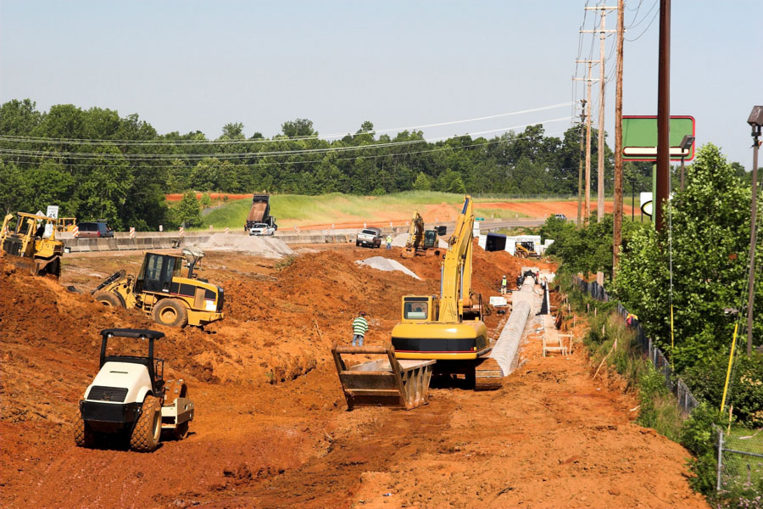
2.1 ACQUIRE RESOURCES FOR THE TASKS
Once you have planned your civil works tasks effectively, you are able to initiate the tasks in order to complete them.
You will need to acquire and make available the resources necessary to complete the tasks safely and efficiently.

Slide 3

2.1 ACQUIRE RESOURCES FOR THE TASKS
The resources that you may need to acquire and allocate include:
Haulage Vehicles
These include dump trucks, haul trucks and other large vehicles that are required to move loads either on highways or during highway construction activities.

Slide 4

2.1 ACQUIRE RESOURCES FOR THE TASKS
Personnel/Workers
These people could come from your own site staff or labour hire companies.

Slide 5
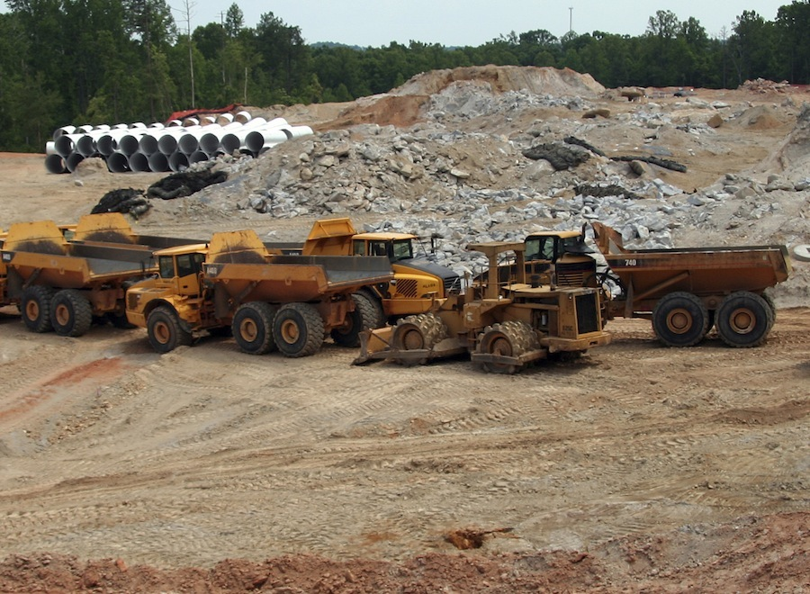
2.1 ACQUIRE RESOURCES FOR THE TASKS
Plant, Equipment And Tools
Each task will have its own requirements for plant, equipment and tools.
This equipment may be owned by the company or may be leased for the term of the activity. Most large plant items are leased due to the costs involved with the purchasing of the items.

Slide 6

2.1 ACQUIRE RESOURCES FOR THE TASKS
Some of the plant will come with a driver or operator but some will come ‘bare’ and you will need to organise the personnel/workers to operate the machinery.
It is essential that you as the supervisor know the capabilities and limitations of all types of plant and equipment used on the site.
This is so that you can allocate the most appropriate equipment for the safe, effective and efficient conduct of the tasks.

Slide 7

2.1 ACQUIRE RESOURCES FOR THE TASKS
Sub-Contractors
One method of achieving specialist tasks is to use sub-contractors.
A sub-contractor is someone your organisation employs and pays to complete tasks that your company is responsible for under the terms of your contract.
On many smaller civil works projects, the entire project will be completed by teams of sub-contractors with only minimal staffing from the principle contracting agency being onsite to supervise.

Slide 8

2.1 ACQUIRE RESOURCES FOR THE TASKS
Construction Materials
Without the correct materials in the correct grades and quantities, it is impossible to complete the task to the specifications.
As a supervisor you may be required to order materials or you may be required to notify a purchasing officer of the material requirements.
You are also required to ensure materials used are appropriate and available and are used correctly in accordance with site specifications.

Slide 9

2.1 ACQUIRE RESOURCES FOR THE TASKS
Once you have determined the resources that will be required, it is necessary for you to allocate them to where they are needed for safe, efficient and effective completion of tasks.
Ensure all personnel/workers working with the resources have the appropriate accreditations, licenses, skills and knowledge to undertake the tasks required of them.

Slide 10

2.1.1 PROCUREMENT REQUIREMENTS
Procurement is the process of buying or sourcing materials and labour that meets the needs of the project.
The procurement officer will normally work with the contracts manager.
On small projects the contract manger and the procurement officer could be the same person.

Slide 11
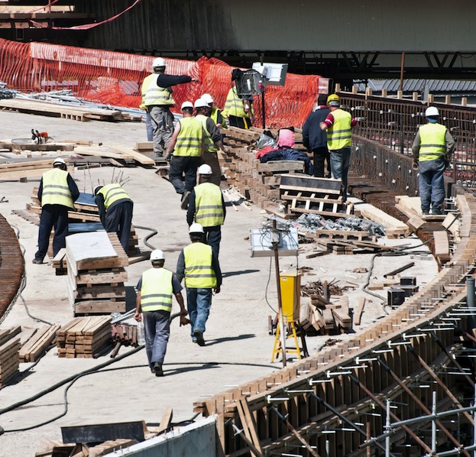
2.1.1 PROCUREMENT REQUIREMENTS
Each site and each organisation will have a different process for procurement but every site will have a requirement for well-documented, auditable and transparent procurements.
Depending on the size of your company and the project you are working on, the procurement process could be simple, with a set number of quotes being needed before a purchase can be made.
Large projects could require the issuing of tenders to ensure the best supplier is found and purchases only being made from suppliers on the list.

Slide 12

2.1.1 PROCUREMENT REQUIREMENTS
When conducting procurements it is not necessarily the cheapest price that should be the governing factor.
In some cases, the cheapest initial cost will be the largest ongoing cost because of the amount of man hours required in monitoring the supplier and having rework done.

Slide 13

2.1.1 PROCUREMENT REQUIREMENTS
The development of a tender checklist that details what is essential for a supplier to have is a good idea.
Often supervisors will be involved in reading the tender documentation.

Slide 14

2.1.1 PROCUREMENT REQUIREMENTS
Unless your company policy states otherwise, always evaluate suppliers on more than the final cost.
Look at items such as reliability, auditability, tracing of orders, policies, procedures and document trails.
Detailed procedures should be in place within your company that will outline the process for evaluation of tenders and other procurement issues.

Slide 15

2.2 ISSUE INSTRUCTIONS TO TEAM MEMBERS AND PERSONNEL/WORKERS
Issuing instructions to your team will need to be done in a manner that enables each member of the team to be aware of what they need to do and how they are expected to complete the tasks.
Clear instructions to team members ensure safe, effective and efficient conduct of tasks and activities.

Slide 16
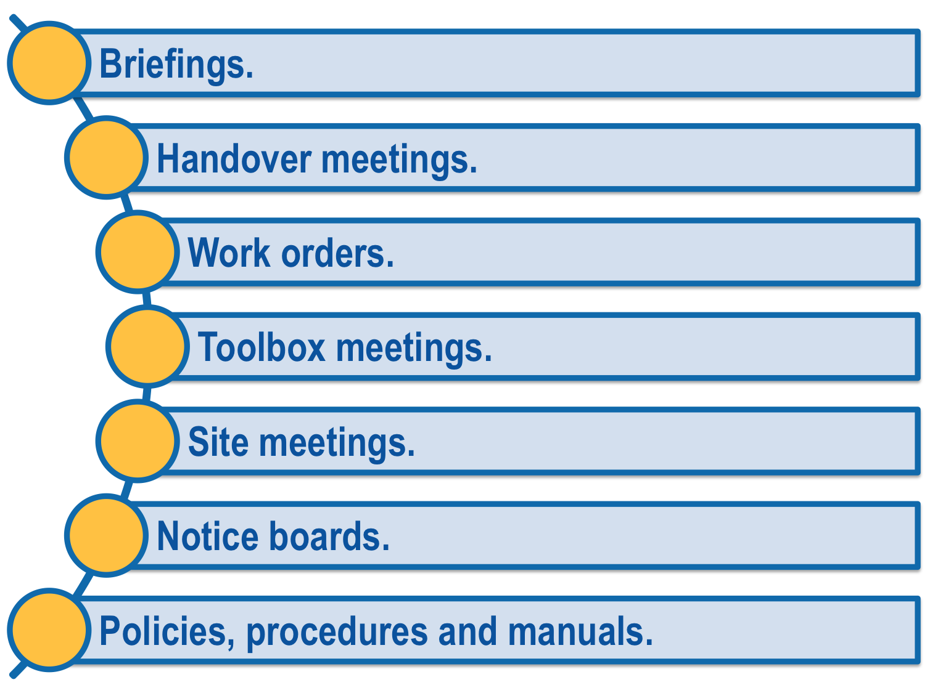
2.2 ISSUE INSTRUCTIONS TO TEAM MEMBERS AND PERSONNEL/WORKERS
Instructions can be given in many formats depending upon the needs of the worksite, including:

Slide 17

2.2.1 EFFECTIVE PREPARATION
Preparing for meetings involves planning what information needs to be conveyed and identifying the best manner in which to convey the information.
A well-planned and considered meeting will be more effective at conveying the required information than a meeting that is unplanned.

Slide 18

2.2.1 EFFECTIVE PREPARATION
Items that you may need to prepare before a meeting could include:
Short messages.
Job reports.
Log books.
Diaries.
Briefing notes.

Slide 19

2.2.1 EFFECTIVE PREPARATION
When preparing any of these forms of communications, ensure you consider the organisational requirements you need to comply with, your personal management style and your comfort levels with presenting information.
If you are comfortable presenting information, you may not feel compelled to prepare comprehensive notes.

Slide 20

2.2.1 EFFECTIVE PREPARATION
Any written documentation will need to meet the needs of the organisation, the information and the intended audience.
Job reports may require presentation after you have completed them.
Ensure you meet the requirements of your site and give full information when presenting job reports.

Slide 21

2.2.1 EFFECTIVE PREPARATION
Log books and diaries should be maintained at all times when working on civil construction sites to keep track of when tasks have been completed and any issues that have been dealt with.

Slide 22

2.2.2 EFFECTIVE COMMUNICATIONS
Clear communication is essential when issuing instructions and discussing workplace activities.
This ensures that all personnel/workers know what they are required to do, when they need to do it and how they need to do it.

Slide 23
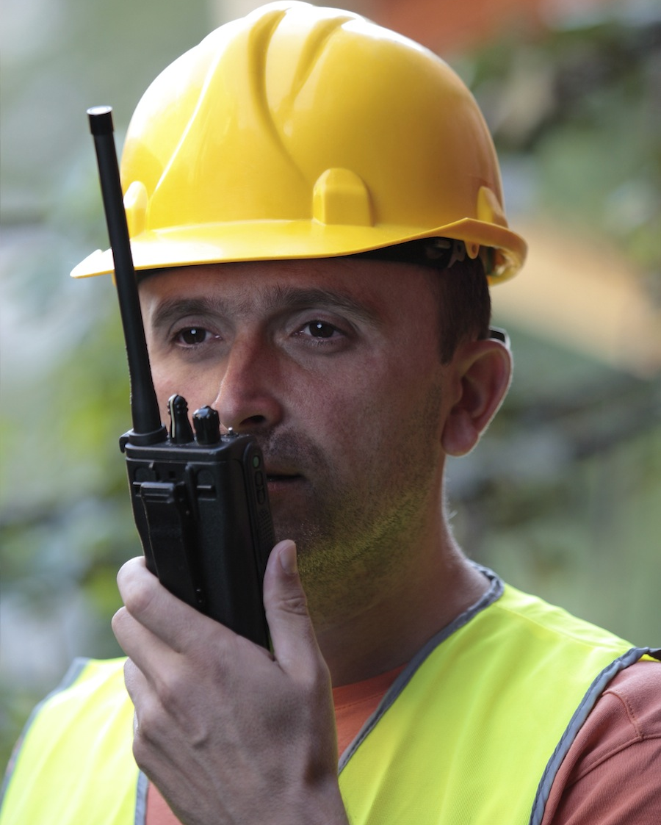
2.2.2 EFFECTIVE COMMUNICATIONS
Using site communication methods could include using a variety of communications equipment such as:
Two-way radios.
Mobile phones.
Landline phones.
Email.
Instant messaging.
Message boards.
Hand signals and symbols – used due to the high
levels of background noise.

Slide 24

2.2.2 EFFECTIVE COMMUNICATIONS
Without clear communication procedures in place it can be difficult to share information, receive information and plan work activities.
Communication is essential to ensuring the safety of personnel/workers and visitors to the site.
Without clear and consistent communications, it is difficult to make sure that all personnel/workers are aware of problems, risks, issues or control measures.

Slide 25

2.3 SET OUT TASKS
Setting out tasks is the process of preparing work areas in a manner that ensures effective completion of the required tasks.
Tasks that may need to be set out include:
Establishing control lines.
Establishing the cleared width.
Determining batters.
Establishing offsets.

Slide 26
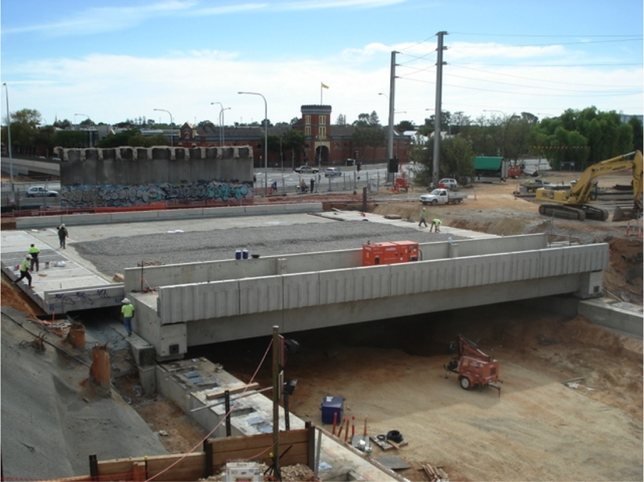
2.3 SET OUT TASKS
The procedures and requirements for site set out will be determined by site factors and the specifications you are working under. These will be established at the beginning of the project but may change depending on the needs of the tasks during the project.

Slide 27

2.3.1 ESTABLISH OFFSETS
Control lines are the base line for measuring from. These control lines may run from any pre-determined point on the site to another.
Offsets are how far from that control line an activity is to take place or an area is to be cleared.
A negative number means the offset is to the left of the line, a positive number means the offset is to the right of the line.

Slide 28

2.3.1 ESTABLISH OFFSETS
By varying the amount of movement between the right and left of the line, you are able to establish or create different shapes in the final product.
When you are establishing offsets, you will need to obtain your offset figures from the site construction plan.

Slide 29

2.3.2 LEVELLING DEVICES
Levelling devices are used in many different aspects of the setting out processes – to determine gradients, batters, benches if required, to measure offsets, to determine drainage grades and to help with road geometry.
To ensure effective use of the levelling equipment and devices it is necessary to ensure the equipment is correctly calibrated before using it.
How this is done will vary between different brands and models of the equipment. You will need to use the operator’s manuals, product specifications and manufacturer’s instructions to determine the method for calibration of your equipment.

Slide 30
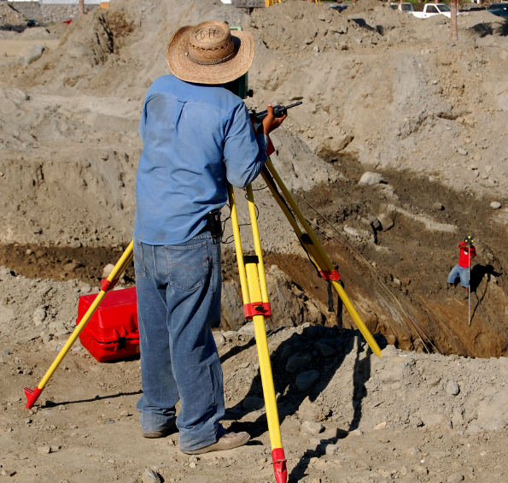
2.3.2 LEVELLING DEVICES
When setting out the levelling equipment, ensure you have positioned the equipment in such a way that it meets the manufacturer’s specifications. Each leg of the tripod should be adjusted to ensure a level platform for the levelling equipment.
Each new item of levelling equipment or levelling devices will be different to the last one you used.
Make sure you read the owner or operator manual that comes with the equipment to ensure you are aware of what you need to do to use the equipment correctly.

Slide 31

2.4 MONITOR TASK PERFORMANCE
Monitoring tasks to ensure the work meets the required outcomes is a large component of supervision on civil construction worksites.
Some of the monitoring tasks that you will need to complete include:
Risk Assessments
This includes both ongoing risk assessments and pre-start risk assessments.

Slide 32
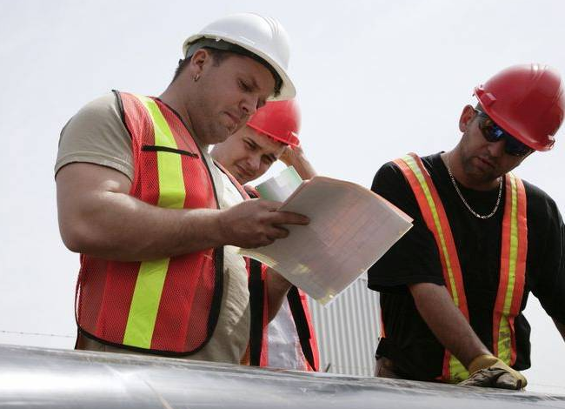
2.4 MONITOR TASK PERFORMANCE
Engineering Survey Monitoring
This is aimed at ensuring work is being conducted in accordance with the engineering requirements.

Slide 33
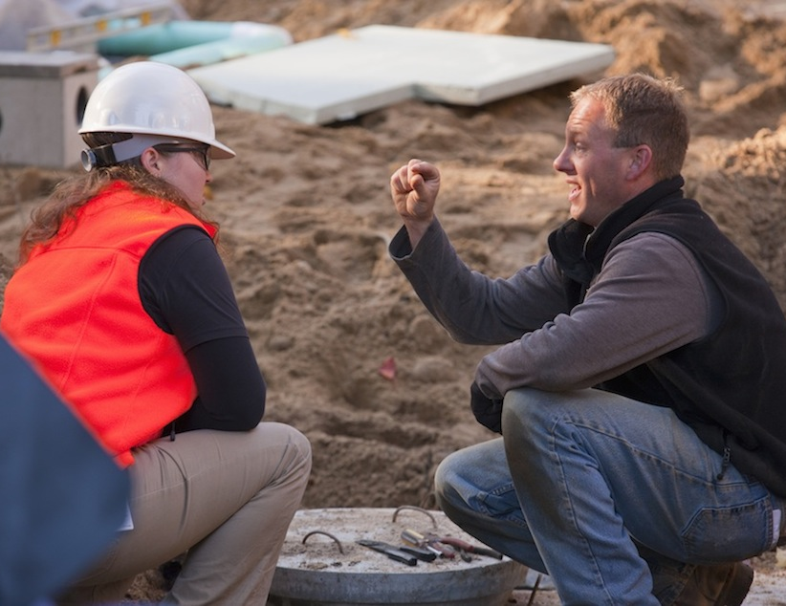
2.4 MONITOR TASK PERFORMANCE
Sampling And Testing
While you may or may not be required to do the testing yourself, you will have to arrange for the testing to be conducted.
You will need to monitor work to ensure it meets the base levels for testing and sampling and ensure adequate planning is undertaken so that you are allowing enough time between the testing and the next task.

Slide 34

2.4 MONITOR TASK PERFORMANCE
Recording And Observing Construction Practices
This includes ensuring procedures are adhered to or adjusted to meet the site practices.
Recording can be done in reports, diaries, logs or procedural documentation.

Slide 35

2.4 MONITOR TASK PERFORMANCE
General Supervision
This is the day-to-day task of ensuring your team is doing the expected tasks in the expected manner.
Your monitoring requirements will vary depending on your level of responsibility and the tasks you are undertaking.

Slide 36

2.4 MONITOR TASK PERFORMANCE
Monitoring of tasks assists to determine whether required outcomes are being achieved. Your outcomes can be derived from the following requirements:
Task specifications – the specifics of how the tasks are to be completed.
Drawings requirements.
Coordination requirements – this could be between individual members or between different teams or groups.

Slide 37
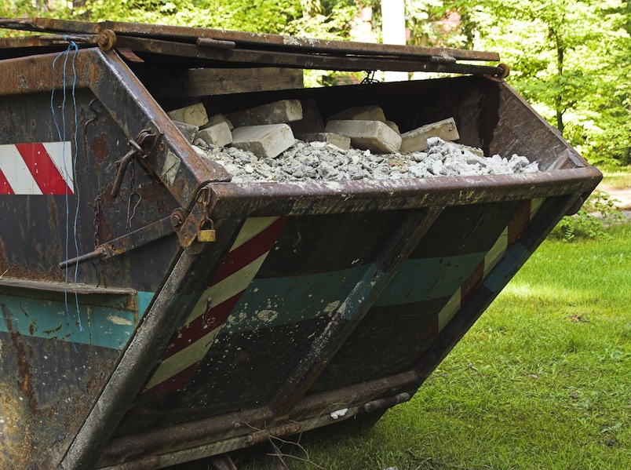
2.4 MONITOR TASK PERFORMANCE
Waste management requirements.
Activity scheduling – to ensure tasks are being completed on time to allow for the next task in the sequence to start on time.
Cost requirements – both individual costs for different tasks and activities and for the costs of the overall project.

Slide 38

2.4.1 MONITORING METHODS
Monitoring methods will vary between tasks, sites and organisations. Some of the common monitoring methods include:
Observation of the tasks and activities.
Monitoring completion times.
Task inspection and reporting.
Individual assessment.
Interpretation of test results.
How you conduct your monitoring will vary depending on the needs of the site, the tasks being undertaken, your organisational requirements and your own individual management style.

Slide 39

2.4.1 MONITORING METHODS
Inspection Requirements
Inspections are a daily part of life for a supervisor on civil construction sites.
Each day will require different inspections, depending upon the types of tasks and activities that are being undertaken on the site.
Each different inspection type could have a different procedure that will need to be followed.

Slide 40

2.4.1 MONITORING METHODS
Each inspection will have different reporting, observation and recording procedures that need to be known and followed.
These could include checklists, inspection logs or registers and site-specific requirements.
Each individual site you work on will also have different requirements. As you start your position as a supervisor, you must identify the requirements for inspections that you need to meet.

Slide 41
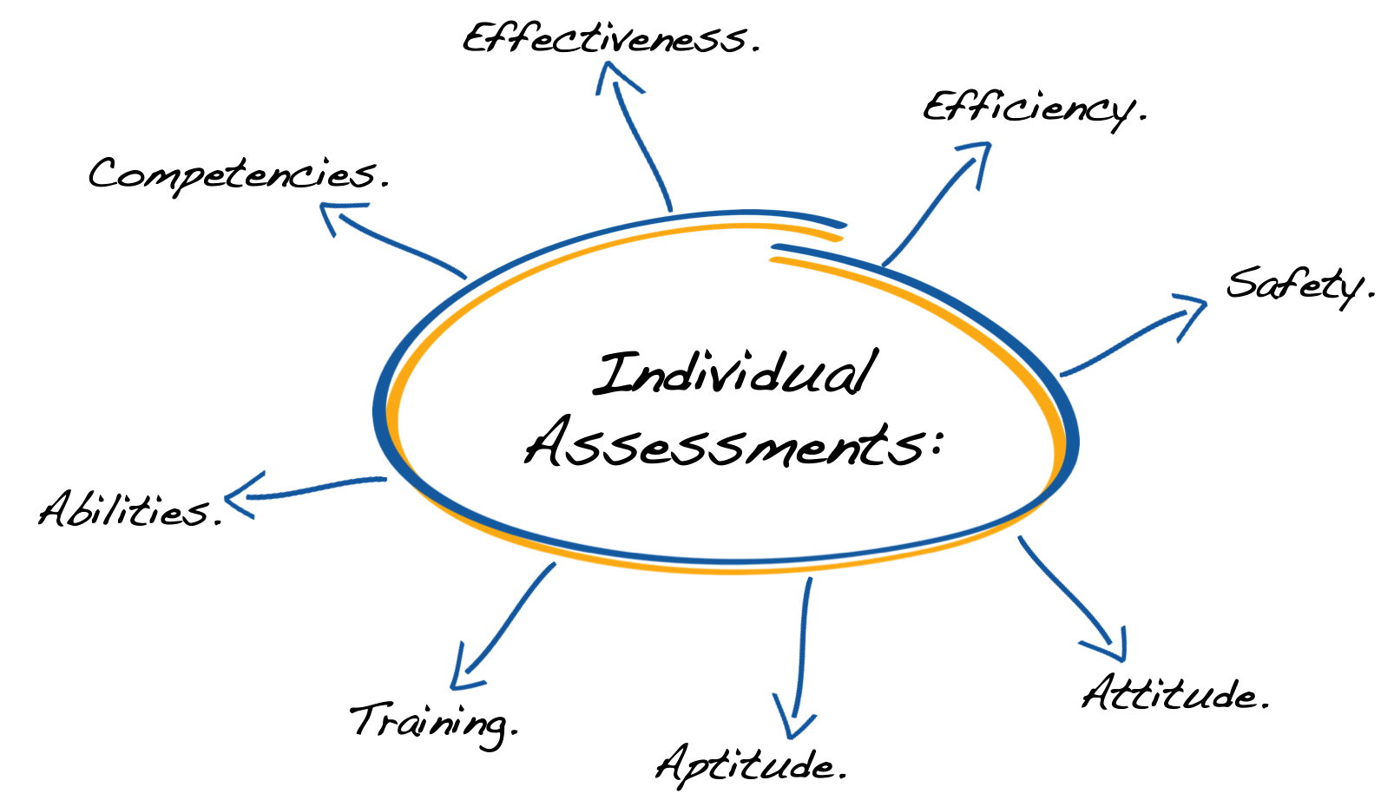
2.4.1 MONITORING METHODS
Individual Assessments
Another task that a supervisor must undertake is assessments of both individual team members and assessments of teams. When undertaking individual assessments you are assessing how that person is performing tasks and activities. You will be examining the performances against a pre-determined checklist that will examine:

Slide 42

2.4.1 MONITORING METHODS
These evaluations should be used as an opportunity for you, the supervisor, to look at how to develop skills and attitudes within your team that will help the team to achieve goals and targets more easily.
Often performance reviews are seen as a difficult or confronting aspect of a supervisor’s tasks.
Try to look at them more as an opportunity for improvement and as a team developing exercise.

Slide 43

2.4.1 MONITORING METHODS
When conducting performance review meetings try to be optimistic, pleasant and allow the individual an opportunity to speak as well.
Two-way dialogue can allow for more improvement in weak areas than a lecture on performance gaps or failures to meet expectations.
Once you have completed the evaluation, it is necessary for you to share this evaluation with both the individual and your human resources department or manager.

Slide 44


2.4.1 MONITORING METHODS
Task performance monitoring can be a difficult task at times, but it is necessary to ensure all members of the team are aware of where they are meeting or exceeding expectations and where they need to improve.
This monitoring can be done in any way that meets company requirements and your own individual management style.

Slide 45

2.4.1 MONITORING METHODS
Interpretation Of Test Results
Test results on materials, areas and processes will need to be read, understood and acted upon.

Slide 46

2.4.1 MONITORING METHODS
These actions could include:
Reworking failed areas or processes.
Proceeding to the next task when test results are
positive.
Changing processes to the meet the needs of the
tasks if test results show processes are a
problem.
Changing materials if test results show a material
change is warranted.
Most test results will not require interpretation. They will simply show that quality specifications have or have not been met.

Slide 47

2.4.1 MONITORING METHODS
It is the actions that you undertake when you have the test result that is important.
Your actions when you have received the test results will need to conform with the requirements of the worksite and higher management requests.
Test results that show negative compliance will need to be discussed immediately with your supervisor or the site quality assurance officer to determine the next step in the process.

Slide 48
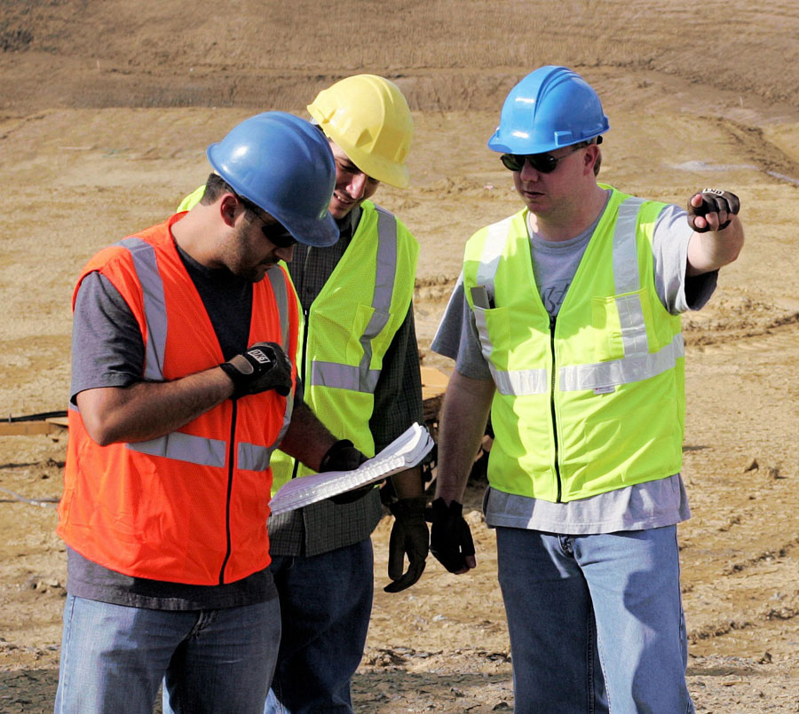
2.4.2 team building and leadership
In the monitoring of tasks you may be required to provide feedback, guidance or assistance to team members.
It is essential that you provide leadership to the team and develop the abilities of each team member to ensure they are able to perform within the team to the best of their abilities.
Development of workplace relationships is essential to building teams that are effective and efficient and able to function well in all situations.

Slide 49

2.4.2 team building and leadership
You may be required to provide guidance and assistance to members of your team throughout their tasks.
This may be through the communication of general advice or it may be through the use of mentoring.
Working closely with and guiding personnel/workers is an effective training tool and is also an effective team-building tool.

Slide 50

2.4.2 team building and leadership
As a mentor you require patience, understanding and the ability to communicate clearly and concisely.
In order to be an inspirational team leader you will need to show positive examples of empathy, compassion, effectiveness, efficiency, and listening and communication skills.

Slide 51
2.4.2 team building and leadership
Other common leadership techniques include:
Leadership Techniques:
Active Listening. | By actively listening to the members of your team you are able to identify problems or issues before they become difficult to manage.
Time Management. | Good time management allows for achievement of goals and tasks without pressuring the members of the team. By allocating the correct amount of time to complete a task, you are ensuring the task is completed properly while still ensuring the members of your team are not overloaded, overwhelmed or stressed unnecessarily.
Decision Making. | Making the right decision at the right times is essential to the completion of all tasks. Follow the procedures and policies of your organisation, make solid decisions and stand by them. Take into consideration all information available and analyse the consequences of decisions made (or not made) before implementing them.

Slide 52
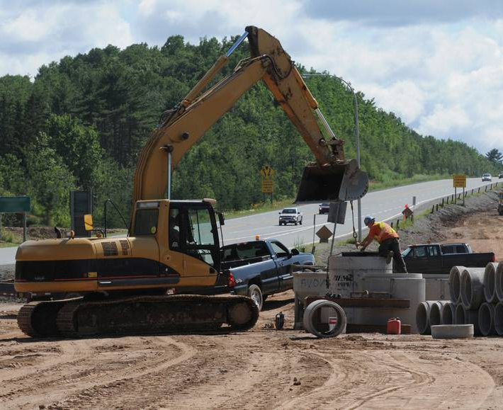
2.5 INITIATE ADJUSTMENTS TO PRACTICES OR PLANS
Civil works will at times require adjustments to be made to ensure the safety of the personnel/workers onsite or to achieve required outcomes.
These adjustments may be made spontaneously, in response to developing site conditions or may be planned adjustments.
Spontaneous adjustments may be conducted verbally. These are commonly done in response to changing site conditions or safety concerns.

Slide 53
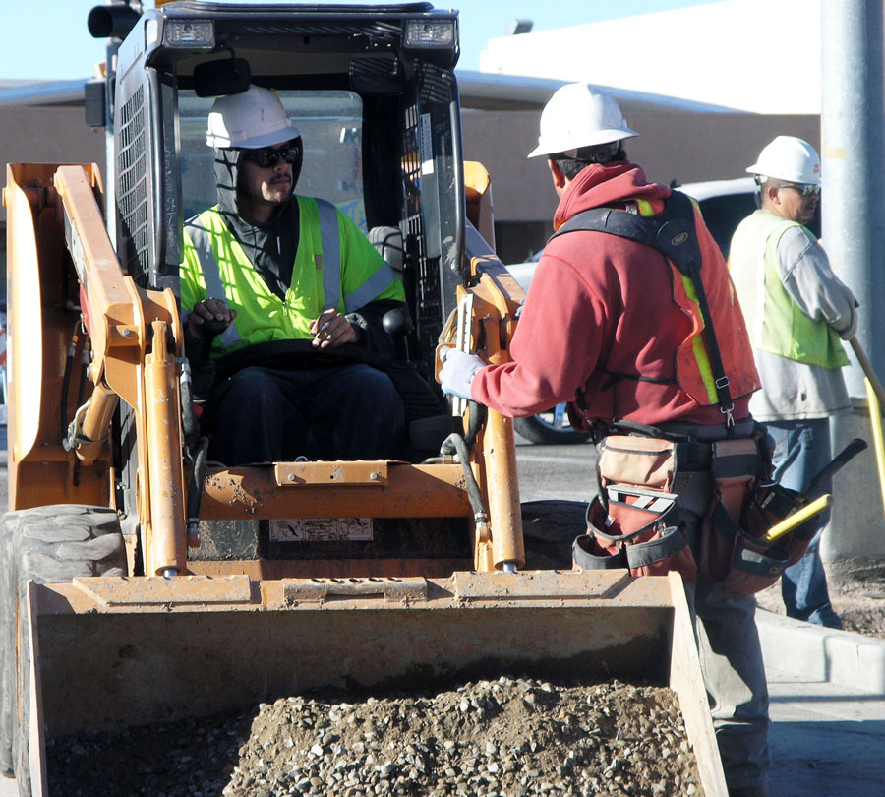
2.5 INITIATE ADJUSTMENTS TO PRACTICES OR PLANS
Planned adjustments are those that are normally done because of:
Equipment changes.
Personnel/workers changes.
Safety concerns.
Changes in materials.
Changes in processes.
Any other change onsite known in
advance.

Slide 54

2.5 INITIATE ADJUSTMENTS TO PRACTICES OR PLANS
These planned adjustments can be initiated in a more controlled manner and are normally completed in a written format.
Often procedures, Safe Work Method Statements (SWMS), work instructions or process directions will need to be re-written to accommodate these adjustments.
When initiating adjustments you may be required to speak with your supervisor or site management before making the changes or you may have the authority to make the changes yourself.

Slide 55

2.5 INITIATE ADJUSTMENTS TO PRACTICES OR PLANS
Your duty statement will outline if you have the authority to make the adjustments without prior approval from your manager.
Normally, spontaneous adjustments made in response to changing safety situations can be made by any supervisor, but changes to procedures, materials or equipment will need to be discussed first.

Slide 56

2.6 ENSURE EQUIPMENT MAINTENANCE REQUIREMENTS ARE CARRIED OUT
As the supervisor, it is your responsibility to ensure that all plant, equipment and tools are maintained as required and that the maintenance records and logs are completed in accordance with site requirements and manufacturer’s specifications.
In order to do this effectively you should ensure that you are aware of the maintenance requirements for each item of plant, piece of equipment and tool that is being used by your team.

Slide 57

2.6 ENSURE EQUIPMENT MAINTENANCE REQUIREMENTS ARE CARRIED OUT
This can be a difficult task, so using a computerised reminder system (such as an outlook calendar) that will alert you when an item is ready for maintenance is a good idea.
Writing the name or identifying number of the item that requires maintenance in a diary is also effective.
You may be required to schedule activities and tasks around the maintenance schedule or to ensure that equipment and plant is available to the maintenance department when they request it.

Slide 58

2.6 ENSURE EQUIPMENT MAINTENANCE REQUIREMENTS ARE CARRIED OUT
It can be easy to put production ahead of maintenance tasks when working to tight deadlines and when you are receiving pressure to achieve targets and productivity.
However, you need to remember that good maintenance of plant, equipment and machinery will ensure minimal downtime, less breakdowns and therefore greater long term efficiencies, safety and productivity.

Slide 59

2.7 COMPLETE AND SUBMIT REPORTS
As a supervisor, a large component of your time will be spent creating and completing reports.
These reports will cover every aspect of the tasks your team has been completing.
The reports that will commonly need to be created and completed may include:
Productivity reports.
Material used reports.

Slide 60

2.7 COMPLETE AND SUBMIT REPORTS
Environmental reports.
Machinery maintenance reports.
Quality assurance reports.
Safety reports.
Each of these reports will need to contain information that is specific to the needs of the report and the requirements of your audience.

Slide 61

2.7 COMPLETE AND SUBMIT REPORTS
Some of the reports you will be required to compile will be pre-formatted, so all you need to do is fill in the blanks with the required information.
These pre-populated forms make the reporting process quicker, but they can also lead to important information being left out of the report.

Slide 62

2.7 COMPLETE AND SUBMIT REPORTS
When you have this issue, ensure you add an appendix to the pre-populated report or create a written report that deals with the issue directly.
When creating a report, ensure you understand your audience needs to identify the most important information and analyse the information itself.

Slide 63

2.7 COMPLETE AND SUBMIT REPORTS
The information that needs to be delivered to the audience will help to determine the length and complexity of the report.
If you are creating a report for an audience that is unfamiliar with the processes that are used on your site, you should give a brief overview of what has been done and why.

Slide 64

2.7 COMPLETE AND SUBMIT REPORTS
If the audience is aware of your organisation’s processes, you can focus more on the information you need to covey with minimal background information.
Every organisation, site and task has differing needs and requirements and you will need to adjust your reporting procedures to meet these requirements.

Slide 65

2.7 COMPLETE AND SUBMIT REPORTS
It is possible that each day, week or month you will need to adjust how you are reporting site conditions.
You are most likely to need to use a combination of both pre-populated and created reports. Your organisational requirements and procedures will dictate this.

Slide 66
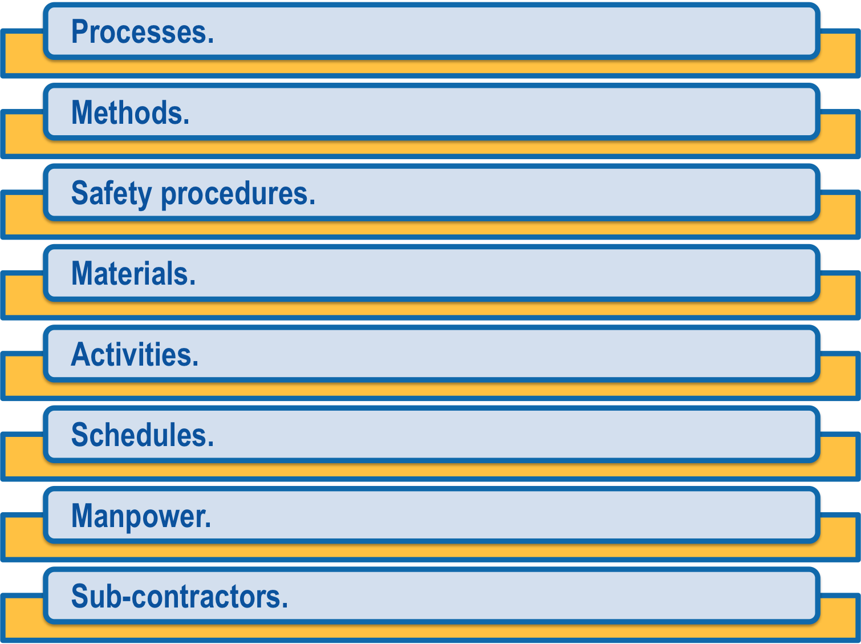
2.8 RECOMMEND CHANGES
As a supervisor, on occasions, you will need to recommend changes in:

Slide 67

2.8 RECOMMEND CHANGES
You may need to recommend changes to these areas in order to improve the safety, efficiency and effectiveness of the civil works programs and tasks you are trying to achieve.
When making recommendations you will have more success if you are logical, emotionless and thorough in your presentation of the recommendation.
Major change recommendations should be made in a written format, while minor changes, such as operator changes, can be made verbally.

Slide 68
2.8.1 WRITTEN RECOMMENDATIONS
When making written recommendations you will need to present your argument in a logical and sequential manner. The basic layout of the report should meet the requirements of your organisation but will most likely follow the a format similar to the one below.
Basic format of a report:
1. State the purpose of the report.
2. Outline what is not working efficiently or safely.
3. Present your argument. This should include as many details as are known. If you have more than one possible course of action that will solve the problem, present your preferred option first. Ensure you give all the benefits of adopting your suggestion clearly. The stronger your argument, the more benefits that are to be gained, the more likely your recommendation is to be successful.
4. Costing of your suggestions.
5. Present your conclusions. Here is your last opportunity to ‘sell’ your preferred option.

Slide 69

2.8.1 WRITTEN RECOMMENDATIONS
Some organisations will require you to write an executive summary of the report.
This is a paragraph that is normally 10% of the final report.
This paragraph summarises the entire report, stating the problem, the solution and the benefits of the solution.

Slide 70

2.8.1 WRITTEN RECOMMENDATIONS
When you see something that is not working safely, efficiently or effectively as it could be, it is your responsibility as a supervisor to attempt to fix the problem.
Often this can only be done through the use of a recommendation report.

