Slide 1

CHCAGE001
Facilitate the empowerment of older people

Slide 2

Housekeeping
Emergency procedures
Mobiles and security issues
Break times and smoking policy
This course is interactive – ask questions
Practise respect and confidentiality
Ground rules

Slide 3
Objectives
Discover how to develop relationships with older people
Know how to provide services to older people
Learn how to support the rights of older people
Understand how to promote health and re-ablement of older people
Gain the skills and knowledge required for this unit

Slide 4

Develop relationships with older people
1.1 Conduct interpersonal exchanges in a manner that promotes empowerment and develops and maintains trust and goodwill

Slide 5

Interpersonal exchanges
Try and find something you have in common
Use positive, confident and co-operative language
Be interested in what people are saying
Interpret non-verbal and verbal messages
Try to be accommodating and adapt your style
Be aware of cultural differences.

Slide 6

Non-verbal cues
Pauses
Gestures
Bargaining
Eye contact
Length of response
Pitch and tone of voice.

Slide 7

Empowering phrases
These may include:
‘It sounds like…’
‘You seem to be…’
As I understand…’

Slide 8

Negative/disempowering phrases
Attempting to rescue client from problems
Too many questions (can act as a barrier to conversation)
Commands such as ‘stop worrying’, ‘don’t be so upset’ etc.
Threatening comments
Not paying attention
Changing the subject.

Slide 9

Activity 1A

Slide 10
Develop relationships with older people
1.2 Recognise and respect older people’s social, cultural and spiritual differences

Slide 11

Social, cultural and spiritual differences
You may come across a number of cross cultural issues, all of which should be handled with great sensitivity, care and respect
As a carer, you should provide equal services to older people, regardless of their race, cultural background, spiritual beliefs or sexual preferences.
Use discrimination legislation as a guide.

Slide 12

'Living Longer Living Better'
This is an aged care reform package announced on April 20 2012.
It is a ten year plan that aims to make aged care fairer, more effective and more nationally consistent.
It aims to provide older people with greater choice, control and easier access to aged care services.

Slide 13
Activity 1B

Slide 14
Develop relationships with older people
1.3 Maintain confidentiality and privacy of the person within organisation policy and protocols

Slide 15

Ensuring information is kept confidential
Confidentiality is required by law in certain respects; the privacy of client records is a highly important aspect of confidentiality.
Failure to maintain privacy of client records is punishable by law and organisations can be sued by the client.

Slide 16
Guidelines for maintaining confidentiality
Never discuss client information in social circles.
Documented information should only ever relate to service delivery and related factors.
Confidential documents must be stored securely.
Client information should never be disclosed to external agencies.
Names and details of clients should not be disclosed in public.

Slide 17
When can it be breached?
There are cases where confidentiality can be broken:
If the person is at serious risk of harm
Where there is an imminent, serious threat to the public or a specific person
Where there is a police request for information under the Police Powers and Responsibilities Act 2000
For use by healthcare professional (as long as a recognised standard of treatment is being delivered).

Slide 18
Activity 1C

Slide 19
Develop relationships with older people
1.4 Work with the person to identify physical and social enablers and disablers impacting on health outcomes and quality of life

Slide 20

Enablers and disablers
Enablers are those factors that encourage elderly people to do something – for example, attend a class.
Disablers are those factors that discourage elderly people from doing something.

Slide 21

Disablers
Health problems
Fear of falling
Inconvenience
Transport issues
Lack of friends or support
Self-esteem
Tiredness.

Slide 22

Enablers
The expectation of positive outcomes, for example:
  Social benefits
  Health benefits
Social support e.g. if attending as part of friendship group
Easily accessed, for example:
  If individual drives
  If there is a bus service
  If it is not far away
  If wheelchair access/lifts etc.

Slide 23
Key issues facing older people
Some key issues along with a possible solution:
Stereotypes and ageist attitudes – education on elderly people
Financial hardship – grant and community schemes
Grief – counselling
Living too remotely to receive services – residential care
Physical and psychological disabilities – home adaptations and medical assistance

Slide 24
Activity 1D

Slide 25
Develop relationships with older people
1.5 Encourage the person to adopt a shared responsibility for own support as a means of achieving better health outcomes and quality of life

Slide 26

Shared responsibility
You will need to discuss responsibilities of all parties involved with the client’s care.
This is so that you can establish who will do what and when.
It is important to remember that these may well change over time as your client’s needs change.

Slide 27

Client responsibilities
Client’s responsibilities will be unique to each client. You will need to agree what it is that they are willing and able to do for themselves.
For example; the client needs help with transport to and from places, but makes and keeps appointments, such as doctors, dentists, vets etc. themselves.

Slide 28
Activity 1E

Slide 29
Provide services to older people
2.1 Identify and discuss services which empower the older person

Slide 30

Services to empower
Assistive equipment
Taking clients shopping
Taking clients to visit places
Treating clients with respect and as adults
Domestic personal assistance (home help)
Financial planning assistance
Home modifications
Financial aid.

Slide 31
Activity 2A

Slide 32
Provide services to older people
2.2 Support the older person to express their own identity and preferences without imposing own values and attitudes
2.3 Adjust services to meet the specific needs of the older person and provide services according to the older person’s preferences

Slide 33

Gathering information
Information on client preferences can be gathered through:
An informal chat with the client.
Friends and family.
Observations
A questionnaire
ACAT assessment.

Slide 34

Client preferences
Clients should be consulted as much as possible on aspects of their care and lifestyle; this empowers them and allows them to live more comfortably and happily.
You should write these down in client’s care plan.
Over time, it is good practice to confirm that clients’ preferences are still accurate.

Slide 35

Adjusting services
Think about anything that could prevent the client from obtaining that service. You may need to adjust:
Times
Equipment
The type of service
Location.

Slide 36
Activity 2B

Slide 37
Provide services to older people
2.4 Provide services according to organisation policies, procedures and duty of care requirements

Slide 38

Following policy and procedures
Only perform duties that fall within your job role
You should never attempt to carry out or provide professional advice on something that you are not qualified to.
You should also know what to do when you are unsure of your job role and work instructions.

Slide 39

Duty of care
Duty of care is written legally into the Workplace Health and Safety Act 1995
It is a moral duty to anticipate possible hazards and causes of injury and do everything reasonably practicable to prevent/remove/minimise these causes.

Slide 40

Legislation
Legislation may include:
Aged Care Act 1997
Aged Care (Bond Security) Act 2006
Age Discrimination Act 2004
The Residential Care Manual

Slide 41
Activity 2C

Slide 42
Support the rights of older people
3.1 Assist the older person to understand their rights and the complaints mechanisms of the organisation

Slide 43
Protecting the client's rights
Privacy
Confidentiality
Access to information on themselves
Respect and dignity
Have their social, physical and cultural needs met
Complain about improper service
Informed choice
Be informed about service, policy, procedures, expectations and conditions of the service
Freedom of association
A right to express ideas and opinions
An agreed standard of care

Slide 44

Complaints
The government has an Aged Care Complaints Scheme
This is a free service for anyone to raise concerns about the quality of care/services delivered to any aged care services subsidised by the Australian government.

Slide 45

Complaint topics
Quality of care
Choice of activities
Catering
Personal care
Physical environment
Communication quality.

Slide 46
Activity 3A

Slide 47
Support the rights of older people
3.2 Deliver services ensuring the rights of the older person are upheld

Slide 48

Principles for older persons
They are based upon the following five principles:
Independence
Participation
Care
Self-fulfilment
Dignity.

Slide 49

Equality
All clients of aged care should be treated fairly and equally regardless of:
Disabilities
Different cultural backgrounds
Different financial backgrounds
Different geographical locations
Different genders
Different beliefs
Sexual orientation.

Slide 50
Activity 3B

Slide 51
Support the rights of older people
3.3 Recognise signs consistent with financial, physical or emotional abuse or neglect of the older person and report to an appropriate person
3.4 Identify breaches of human rights and respond appropriately

Slide 52
Report violation of human rights
You may need to report to:
Supervisor
Member of senior management
Colleagues
Carers
Health professionals
External agencies (complaints and advocacy services and professional registering authorities)
Law enforcement officer.

Slide 53

Abuse
Elderly abuse is any instance where someone takes advantage of an elderly person. It can include:
Physical abuse
Emotional abuse
Sexual abuse
Neglect/abandonment
Healthcare fraud.

Slide 54
Symptoms of abuse
There are many different symptoms but they can be difficult to recognise as they may mirror those of dementia or frailty.
Frequent arguments between elderly person and another e.g. carer, relative etc.
Changes in personality of the elderly person e.g. tearful
Physical signs e.g. bruises, unclean etc.
Odd/unusual/different behaviour.

Slide 55
Activity 3C

Slide 56
Support the rights of older people
3.5 Assist the person to access other support services and the complaints mechanisms as required

Slide 57

Complaining
The first process should be to lodge a complaint with the service provider (this is the quickest and most direct resolution to the problem).
If discussion with aged service providers is impossible or proves unproductive, the next stage is to lodge a complaint with a government complaints scheme.

Slide 58

Who can complain?
Care recipients
Representatives of care recipients
Family members
Friends
Legal representatives
Aged care staff
Volunteers
Health professionals.

Slide 59

Three steps
Talk to the people directly involved with the complaint, to attempt to solve the problem
Take the issue higher up, if initial discussions are unproductive
Take the complaint to an agency or refer the client to an advocacy service.

Slide 60
Activity 3D

Slide 61
Promote health and re-ablement of older people
4.1 Encourage the older person to engage as actively as possible in all living activities and provide them with information and support to do so

Slide 62

What are living activities?
Living activities are those activities that a client will need to partake to live independently:
Cooking and feeding oneself
Cleaning oneself/bathing
Dressing
Grooming
Household chores
Leisure.

Slide 63
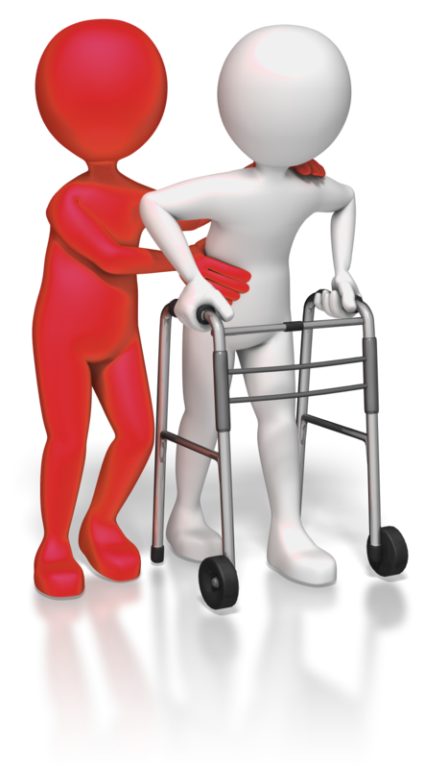
Reablement
Reablement involves helping people learn or relearn the skills they need for everyday living.
Older people may have lost these skills through the deterioration of health and their reliance on support.
Carers guide client’s on tasks, doing them with the client instead of doing them for the client.

Slide 64
Activity 4A

Slide 65
Promote health and re-ablement of older people
4.2 Assist the older person to recognise the impact that changes associated with ageing may have on their activities of living

Slide 66

General physical changes associated with ageing
Vision
Hearing
Taste and smell
Immunity
Hair and nails
Hormones
Teeth and gums
Face
Body shape
Skin
Bones, joints and muscles.

Slide 67
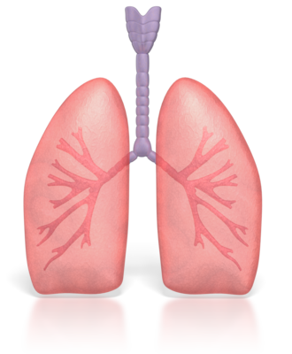
Common conditions for elderly
Arthritis (though considered not a natural part of ageing) and other musculoskeletal problems
Diabetes
Frailty and deconditioning
Heart and lung disease
Incontinence
Skin disorders (including skin cancers)
Stroke
Vascular disease (thickening of the artery lining from fatty deposits)

Slide 68
Activity 4B

Slide 69
Promote health and re-ablement of older people
4.3 Identify strategies and opportunities that maximise engagement and promote healthy lifestyle practices

Slide 70

Encouraging healthy lifestyle
A healthy lifestyle is important to preventing and managing many of the debilitating conditions associated with ageing.
Social and recreational activities are vital to an individual’s general health and wellbeing as they help to keep them fit, active and ‘keeps the mind working.’

Slide 71

Strategies for healthy living
Taking regular exercise
Maintaining a healthy diet
Mental stimulation
Hobbies
Embrace variety
Engage with remaining family members
Learn new things
Take a class/join a club
Travel (if possible)
Get vaccinations for common infections.

Slide 72

The five food groups
Vegetables and legumes/beans
Fruit
Grain (cereal) foods, wholegrain and /or high cereal fibre varieties
Lean meats and poultry, fish, eggs tofu, nuts and seeds and legumes/beans
Milk, yoghurt, cheese and/or alternatives.

Slide 73

Exercising
Makes you feel good
Can provide an opportunity to have fun/socialise
Helps to prevent weight gain that is unhealthy
Helps you to relax
Reduces risk of diseases
Encourages healthy growth and development
Helps build strong bones, muscles and joints.

Slide 74
Activity 4C

Slide 75
Promote health and re-ablement of older people
4.4 Identify and utilise aids and modifications that promote individual strengths and capacities to assist with independent living in the older person’s environment

Slide 76

Identifying aids and modifications
Home modifications:
  Walk in shower or bath
  Stair lifts
  Handrails
  Slopes and ramps
  Wide access for wheelchair
  Emergency alarms.
Aids such as:
  Wheelchairs
  Walking sticks
  Walking frames
  Hearing aids
  Guide dogs.

Slide 77

Financing aids and modifications
The Australian Government provides funds or subsidies
Though be prepared to contribute to the cost of your care or modifications (if your circumstances permit)

Slide 78
Activity 4D

Slide 79
Promote health and re-ablement of older people
4.5 Discuss situations of risk or potential risk associated with ageing

Slide 80

Potential risk associated with ageing
As clients get older they may be prone to:
Accidents, such as:
  Falls
  Road accidents
Getting lost
Victims of crime.

Slide 81

Types of communication
Verbal communication
Brochures
Leaflets
Posters
Online
Advertising.

Slide 82
Activity 4E

Slide 83
Skills and Knowledge Activity

Slide 84
Major Activity
This activity should take anywhere between an 1-2 hours to complete and can be found at the end of your workbook.
Your instructor will let you know whether they wish for you to complete it in session time or your own time.

Slide 85

Summary and Feedback
Did we meet our objectives?
How did you find this session?
Any questions?

Slide 86

Congratulations!
You have now finished the unit…
‘Facilitate the empowerment of older people’

