Slide 1
RIIGOV401D Apply, monitor and report on compliance systems
PRESENTATION 1

Slide 2

1.1 INTRODUCTION
Welcome to this unit RIIGOV401D: Apply, Monitor And Report On Compliance Systems.
This unit covers applying, monitoring and reporting on compliance systems in the resources and infrastructure industries.

Slide 3

1.1 INTRODUCTION
This unit is appropriate for those working in a supervisory role or as a technical specialist, at worksites within:
Civil construction.
Coal mining.
Drilling.
Extractive industries.
Metalliferous mining.

Slide 4

1.1 INTRODUCTION
The unit includes:
Identifying, sharing, planning and implementing legislation, codes, standards and business requirements.
Monitoring, revising and reporting performance to ensure legal and contractual compliance.

Slide 5

1.2 ACCESS AND APPLY COMPLIANCE DOCUMENTATION
Documentation is essential to all aspects of every worksite. From environmental plans through to extrication plans, documentation exists that outlines what to do, when to do it and how it is to be done.

Slide 6

1.2.1 CATEGORIES OF COMPLIANCE DOCUMENTATION
Compliance documentation is the name given to the documents that require you to undertake tasks in a particular way or to meet a given standard.
Some of the categories of compliance documentation that you may need to access and apply during your work activities are discussed below.

Slide 7

1.2.1.1 LEGISLATIVE REQUIREMENTS
Compliance documentation related to legislative requirements covers a wide range of areas.
These requirements are standard across every industry within the state or country.
There are many legislative requirements that may affect business operations.

Slide 8

1.2.1.1 LEGISLATIVE REQUIREMENTS
Occupational Health & Safety/Work Health & Safety (OHS/WHS) Requirements
Safety in the workplace is critical to every organisation. Any work conducted should be undertaken in a safe manner.
There are various federal, state and territory legislation and regulations surrounding OHS/WHS.

Slide 9

1.2.1.1 LEGISLATIVE REQUIREMENTS
Environmental Issues
All organisations play an important role in maintaining environmental practices. However, the legislation that directly affects each company will differ depending on the activities they undertake.
Federal, state and local governments jointly administer environmental protection legislation in Australia through bilateral agreements.
State and territory acts can apply to certain business activities and often involves the issuing of environmental licenses and permits.

Slide 10

1.2.1.1 LEGISLATIVE REQUIREMENTS
Equal Employment Opportunities (EEO) And Anti-Discrimination
Laws about anti-discrimination are made at both the Commonwealth and state or territory levels. These laws provide a range of grounds for a person to lodge a complaint if they feel they have been discriminated against on the basis of:
Race.
Age.
Sex.
Disability.

Slide 11

1.2.1.1 LEGISLATIVE REQUIREMENTS
EEO legislation ensures that everyone has equal access to available employment. The principles of EEO are to:
Ensure that workplaces are free from discrimination and harassment.
Provide programs to assist people to overcome disadvantage.
Anti-discrimination legislation ensures that no person is discriminated against in the areas of employment, public education, delivery of goods and services including banking, health care and property.

Slide 12
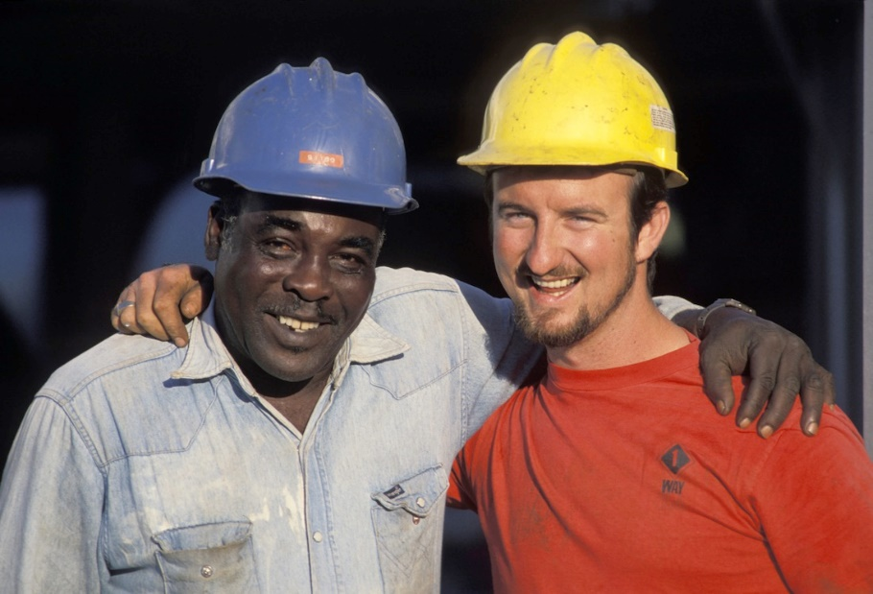
1.2.1.1 LEGISLATIVE REQUIREMENTS
The principles of anti-discrimination are:
It is unlawful to discriminate based on race, sex, disability, marital status and age.
The promotion of equal opportunity for all people.

Slide 13

1.2.1.1 LEGISLATIVE REQUIREMENTS
Business Registration and Licensing
Depending on your worksite and/or the activities you are undertaking, you may need to hold a current ticket or certificate of competency. Licences, permits, and registrations are also required for personnel/workers who may have to perform high risk work or use certain plant or substances.
For example, personnel/workers operating plant or heavy vehicles need an ‘A’ class licence for plant up to 4.5 tonnes and ‘C’ class licence for plant over 4.5 tonnes (i.e. Australian heavy vehicle licence).

Slide 14
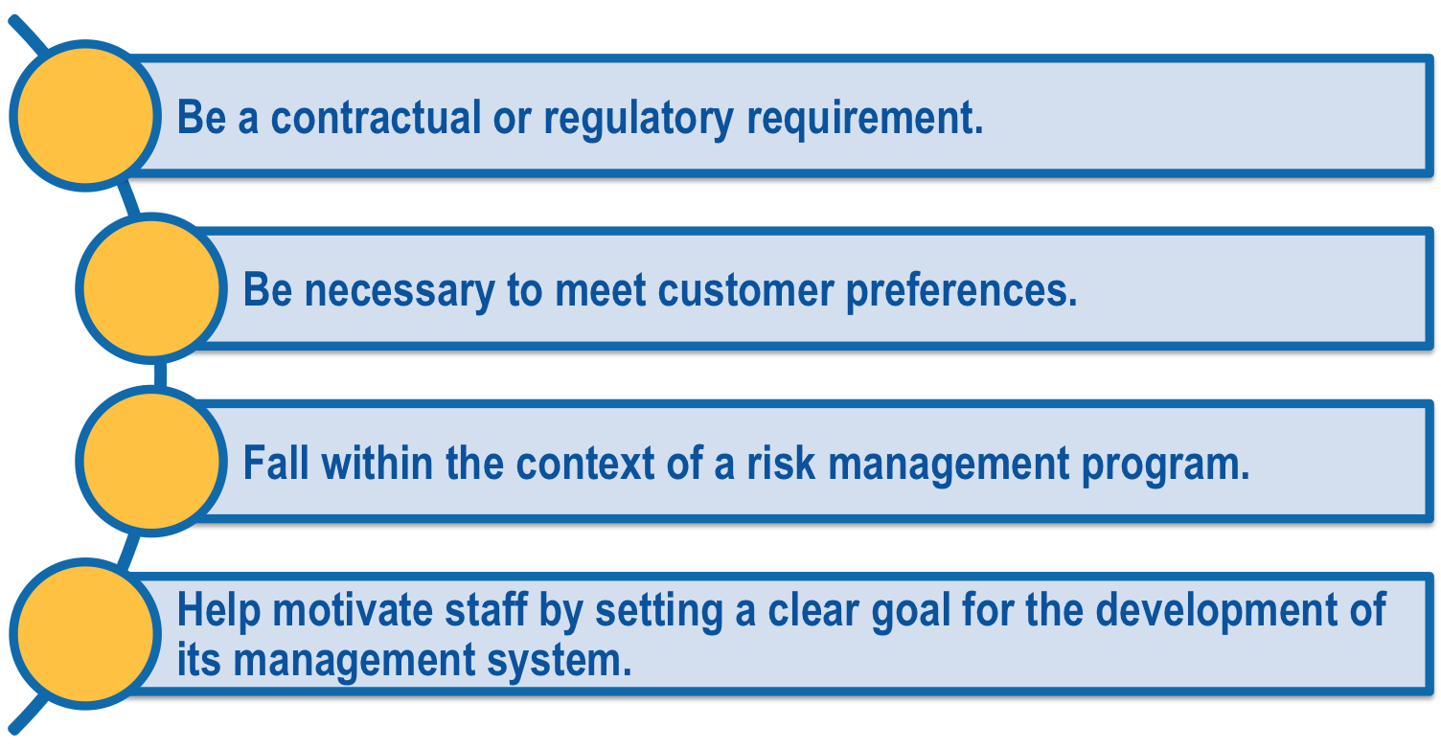
1.2.1.1 LEGISLATIVE REQUIREMENTS
Companies and organisations may also have to meet certification requirements as it may:

Slide 15

1.2.1.1 LEGISLATIVE REQUIREMENTS
Alternative Ownership Structures
Alternative ownership structures for businesses can include private ownership, investor owned and public ownership, such as cooperatives and mutuals.
These ownership structures will inherently have varying legislative requirements that apply.

Slide 16

1.2.1.1 LEGISLATIVE REQUIREMENTS
Industrial Relations
It is important to be familiar with, and understand the industrial relations legislation, including award and/or enterprise agreements that apply to your workplace.
Awards cover a whole industry or occupation, while the terms and conditions of employment in enterprise agreements can be tailored to meet the needs of the workplace.

Slide 17

1.2.1.1 LEGISLATIVE REQUIREMENTS
The enterprise agreement may include:
Employment conditions.
Rates of pay.
Consultative processes and dispute resolution procedures.

Slide 18

1.2.1.1 LEGISLATIVE REQUIREMENTS
Within industrial relations legislation it is important to understand the laws surrounding recruitment and dismissal of employees/workers.
This will include the laws surrounding equal employment opportunity, dispute resolution in the workplace, and employee/worker resignation and dismissal procedures.

Slide 19
1.2.1.1 LEGISLATIVE REQUIREMENTS
Workplace Legal Compliance
It is important that each site and the organisation monitor and maintain legal compliance at all times.
Workplace legal compliance requirements may cover areas such as:
Maintenance and confidentiality of records of non-compliance.
Maintenance of records of breaches of the contractual or legal compliance requirements.
Provision of information and training to members of the workplace.
Compliance with hazard identification and management.
Issue resolution procedures and management processes.
Committees and workplace representation by workgroups.

Slide 20

1.2.1.1 LEGISLATIVE REQUIREMENTS
Legal compliance must be fully documented and managed in accordance with the requirements of your organisation.
If you need clarification of these requirements, speak with the legal department for your organisation.

Slide 21
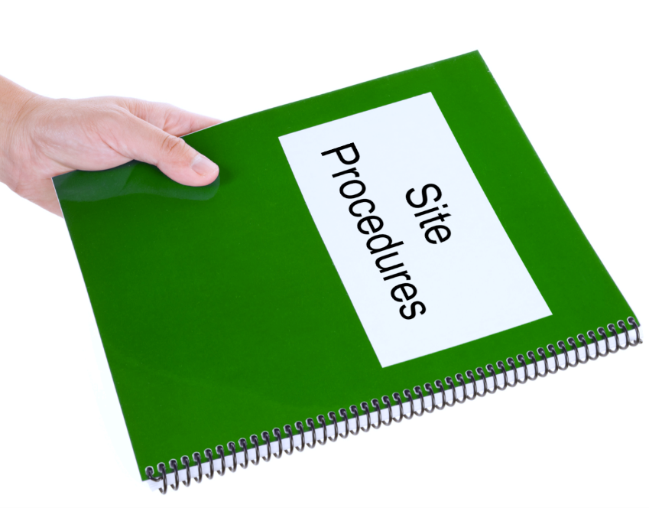
1.2.1.2 policies and PROCEDURES
Policies and procedures could be organisational or site specific.
Organisational policies and procedures are standard across the entire organisation regardless of where you are working.
Examples include workplace relations, and personal leave requirements.

Slide 22
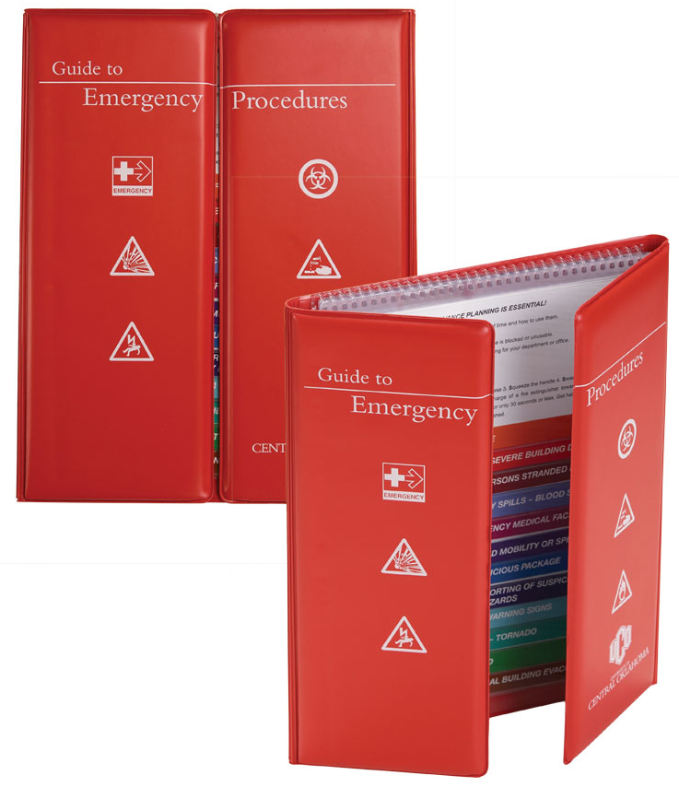
1.2.1.2 policies and PROCEDURES
Site-specific policies and procedures have been developed to meet the hazards, risks or environmental considerations of the site.
These policies and procedures cover only the site you are working on.
Examples include emergency policies, site safety plans, and evacuation procedures.

Slide 23
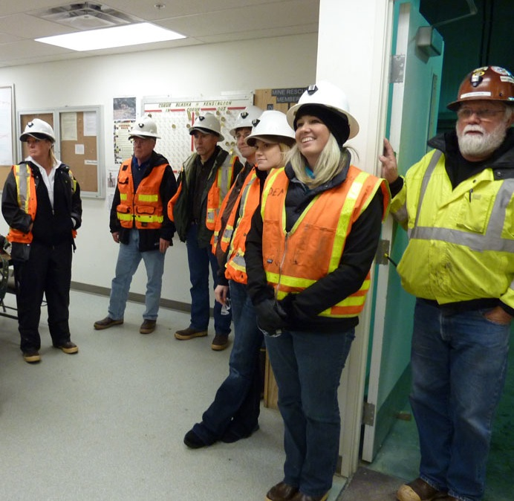
1.2.1.2 policies and PROCEDURES
Every mining or civil construction worksite will have organisational and site-specific requirements that will be outlined during your initial induction.

Slide 24
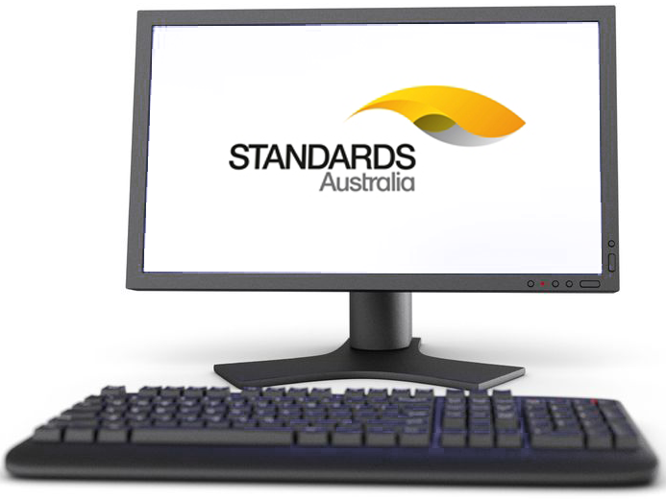
1.2.1.3 OTHER CATEGORIES
Other categories of compliance documentation that you may need to access and utilise includes:
Australian Standards, e.g. AS/NZS 4240.2:2009 Remote control systems for mining equipment – Operation and maintenance for underground metalliferous mining.
Australian guidelines and specifications, e.g. codes of practice. For example WorkCover document 1213 – Moving plant on construction sites.

Slide 25

1.2.1.3 OTHER CATEGORIES
Manufacturer’s guidelines and specifications, e.g. pre-start checklists, service requirements, vehicle operations manuals.
Training records, e.g. your own training record or licensing requirements.
Staff should be notified of changes to compliance documentation during toolbox meetings, staff newsletters or other established forms of communication used on the site.

Slide 26
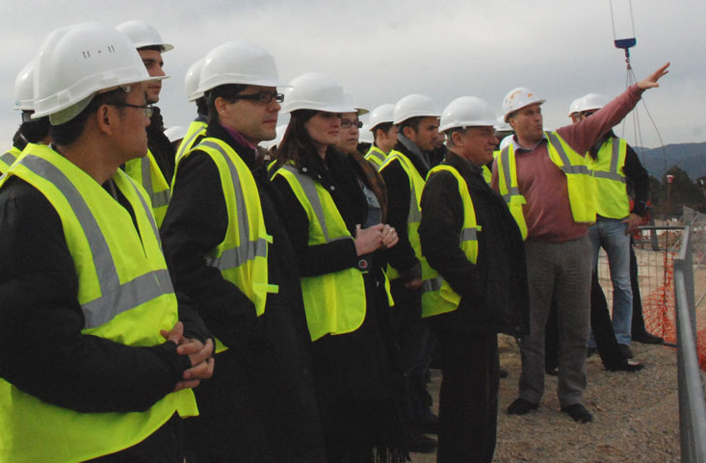
1.2.2 ACCESSING, INTERPRETING AND APPLYING DOCUMENTATION
Being able to access, interpret and apply the requirements of the compliance documents is essential to any role within the workplace.
During your site induction you will be told how to access the documentation relevant to your site and duties.

Slide 27

1.2.2 ACCESSING, INTERPRETING AND APPLYING DOCUMENTATION
Interpretation of compliance documentation involves getting the key information out of the documentation.
This allows you to make correct decisions for each situation and help you to understanding what is required of you and how you are expected to perform the tasks.

Slide 28
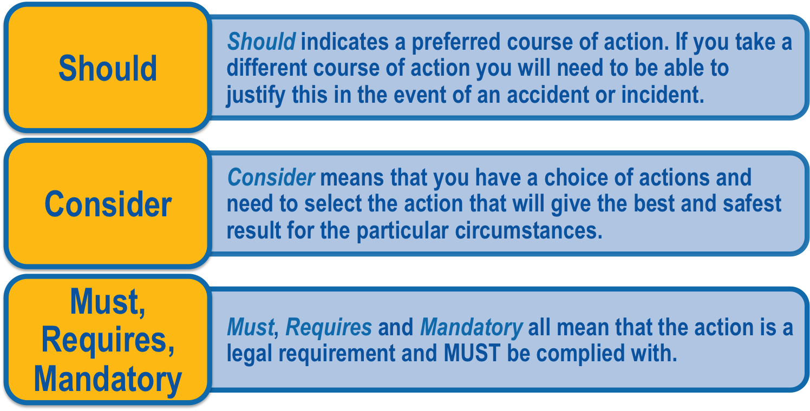
1.2.2 ACCESSING, INTERPRETING AND APPLYING DOCUMENTATION
When interpreting compliance documentation it is vital that you understand the difference between words such as should, consider and must.
Applying the information contained within compliance documentation refers to following the directions in the documents.

Slide 29

1.2.2.1 CONVEY INFORMATION
Information on compliance will need to be provided to all members of the workplace. As a supervisor it is your responsibility to ensure that information is in a format that is easily understood.
When determining how information should be provided you will need to consider:
Language – appropriate to both the information and the audience.

Slide 30

1.2.2.1 CONVEY INFORMATION
Style Of Presentation – for documents, use of written or graphic format.
Format Of Presentation – how the information is going to be best understood and utilised.
Legal And Contractual Obligations For Information Presentation – privacy, confidentiality, documentation requirements.

Slide 31

1.2.2.1 CONVEY INFORMATION
Commonly information on worksites is presented in:
Reports.
Documentation such as policies and procedures.
Inductions and induction booklets.
Toolbox meetings.
Pre-start meetings.
Formal and informal meeting processes.

Slide 32

1.2.2.2 EFFECTIVE COMMUNICATION
It is essential that your communication skills are effective and appropriate. This ensures that all people in the workplace are able to understand you.
Your communication skills will need to be effective to ensure you are able to:
Report necessary information.
Consult with others.
Negotiate mutually acceptable outcomes.
Listen and resolve issues.

Slide 33
1.2.2.2 EFFECTIVE COMMUNICATION
Effective communication will require the ability to:
Speak clearly and concisely. | ☐
Use terminology relevant to your audience. | ☐
Maintain awareness of your audience. | ☐
Actively and critically listen. | ☐
Apply questioning and effectively answer questions. | ☐
Maintain positive and confident body language and gestures. | ☐
Each of these abilities helps your site meet the legal and contractual obligations for consultation and communications with the workforce.

Slide 34

1.2.2.2 EFFECTIVE COMMUNICATION
All information that is presented on the site will need to be documented so that you can provide evidence that the information has been delivered, to meet the legal obligations. Documentation could take the following formats:
Minutes of meetings.
Copies of documents and reports.
Attendance records and agendas from toolbox or pre-start meetings.
Audio files and recording of the meetings.
Other site acceptable methods.

Slide 35

1.3 CLARIFY IMPLICATIONS OF NON-COMPLIANCE
Non-compliance with any legal or contractual requirements will have implications for the success and safety of the workplace as a whole.
As a supervisor, it is your responsibility to ensure each member of the workplace is aware of the implications of non-compliance.
The implications of non-compliance can be wide ranging and affect an individual, a workgroup, a workplace, or the organisation as a whole.

Slide 36
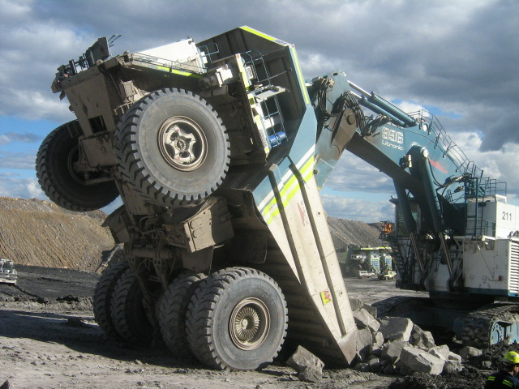
1.3 CLARIFY IMPLICATIONS OF NON-COMPLIANCE
Implications of non-compliance may include:
Injuries and accidents.
Re-scheduling of work or non-completion of tasks.
Contractual termination.
Financial implications for the workplace.
Legal implications for the workplace.

Slide 37
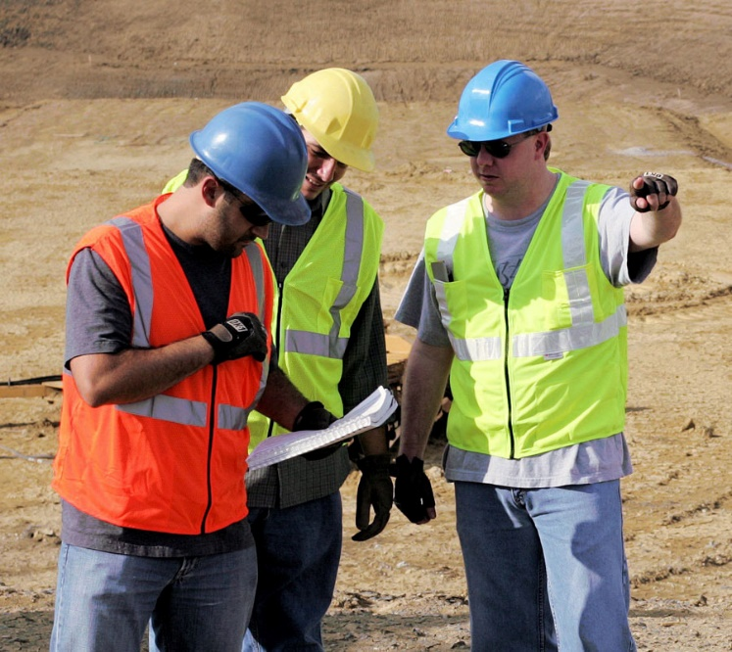
1.3 CLARIFY IMPLICATIONS OF NON-COMPLIANCE
The implications of non-compliance will vary, depending upon the industry, the workplace and the type of activities conducted.
Members of the workplace must be informed of the requirements for maintaining and following compliance. Any concerns surrounding non-compliance must be clarified as necessary.
This will ensure that all personnel/workers in the workplace are fully informed, and able to perform their work roles effectively.

Slide 38

1.4 PLAN SYSTEMS OF WORK
Before any task or project can start, you will need to plan the systems of work to be used.
That is, plan out what you are going to do, the order in which you will do it, and the methods used to achieve your goals.
When planning the systems of work to be used, you must take into consideration the legislation, codes, standards and business requirements that must be complied with.

Slide 39

1.4 PLAN SYSTEMS OF WORK
Commonly you will need to comply with:
Australian or international standards.
Codes of practice.
Standards of quality and safety.
Designated standards of work.
Insurance requirements.

Slide 40

1.4 PLAN SYSTEMS OF WORK
Environmental protection requirements.
OHS/WHS legislation and regulations.
Business registration and structuring requirements.
Taxation requirements (as necessary).

Slide 41

1.4 PLAN SYSTEMS OF WORK
When determining your systems of work to meet compliance requirements, you will need to work closely with colleagues and others involved in the process.
This may include liaising with supervisors and managers, such as project managers, business managers or quality managers.

Slide 42

1.4 PLAN SYSTEMS OF WORK
Ensure that consultation occurs effectively, and that colleagues and relevant others are given the opportunity to provide input into the appropriate systems of work.
This will not only provide you with a greater range of ideas and viewpoints, but will also assist colleagues and workers to feel valued and part of the processes of the workplace.

Slide 43

1.4 PLAN SYSTEMS OF WORK
Identify and gather the relevant compliance documentation. Examine the documentation and clearly identify the primary and secondary compliance requirements.
The primary requirements are those that must be met. The secondary requirements are those that should be met.
Once you have identified the compliance requirements to be met, you can then work to develop effective systems of work that will achieve the goals of the required tasks, as well as meeting the necessary compliance requirements.

Slide 44

1.5 IMPLEMENT SYSTEMS OF WORK
Once you have developed effective systems of work, you will need to ensure that the systems are communicated to, and discussed with all personnel/workers. The systems of work can then be implemented.
Implementing a system of work means putting the necessary steps into place to ensure that work can be conducted and required goals can be met.

Slide 45

1.5 IMPLEMENT SYSTEMS OF WORK
These steps must also comply with relevant legislative and business requirements. Once the steps are in place, work can be carried out, using the correct processes and methods.
It is during the implementation of systems of work that compliance problems and issues can occur. For this reason it is essential that compliance is made a priority, monitored and managed effectively.

Slide 46

1.6 IDENTIFY AND SUPPORT TRAINING NEEDS
In order to meet compliance requirements and business standards, workplaces must regularly identify the training needs of employees/workers, and support them in undertaking the training required.

Slide 47

1.6.1 IDENTIFYING TRAINING NEEDS
Training needs can be identified using a number of different methods. These may include:
Skill gap analysis.
Training requests.
Issues in the workplace, such as safety issues, quality issues, or morale problems.
Repeated breaches in compliance with policies or procedures.
Injuries and accidents.

Slide 48

1.6.1 IDENTIFYING TRAINING NEEDS
The methods used in your workplace may vary depending on the size and structure of the workplace, the resources available and the workplace policies and procedures.
Once the training needs of colleagues have been identified you will need to assist individuals or groups in locating or developing appropriate training options.

Slide 49

1.6.1 IDENTIFYING TRAINING NEEDS
The training options may include activities conducted internally within the workplace, or may make use of external training organisations.
Appropriate training to meet the needs of individuals and groups will be discussed in a later section.

Slide 50

1.6.2 MANAGING LEGAL RIGHTS AND RESPONSIBILITIESZ
Training needs of employees/workers must be supported while managing the legal rights and responsibilities of the workplace. These legal rights and responsibilities may include:
Marketing the business in accordance with consumer legislation.
Operating the business with an appropriate duty of care, in accordance with the Law of Torts.
Fulfilling obligations imposed by the choice of business structure.

Slide 51
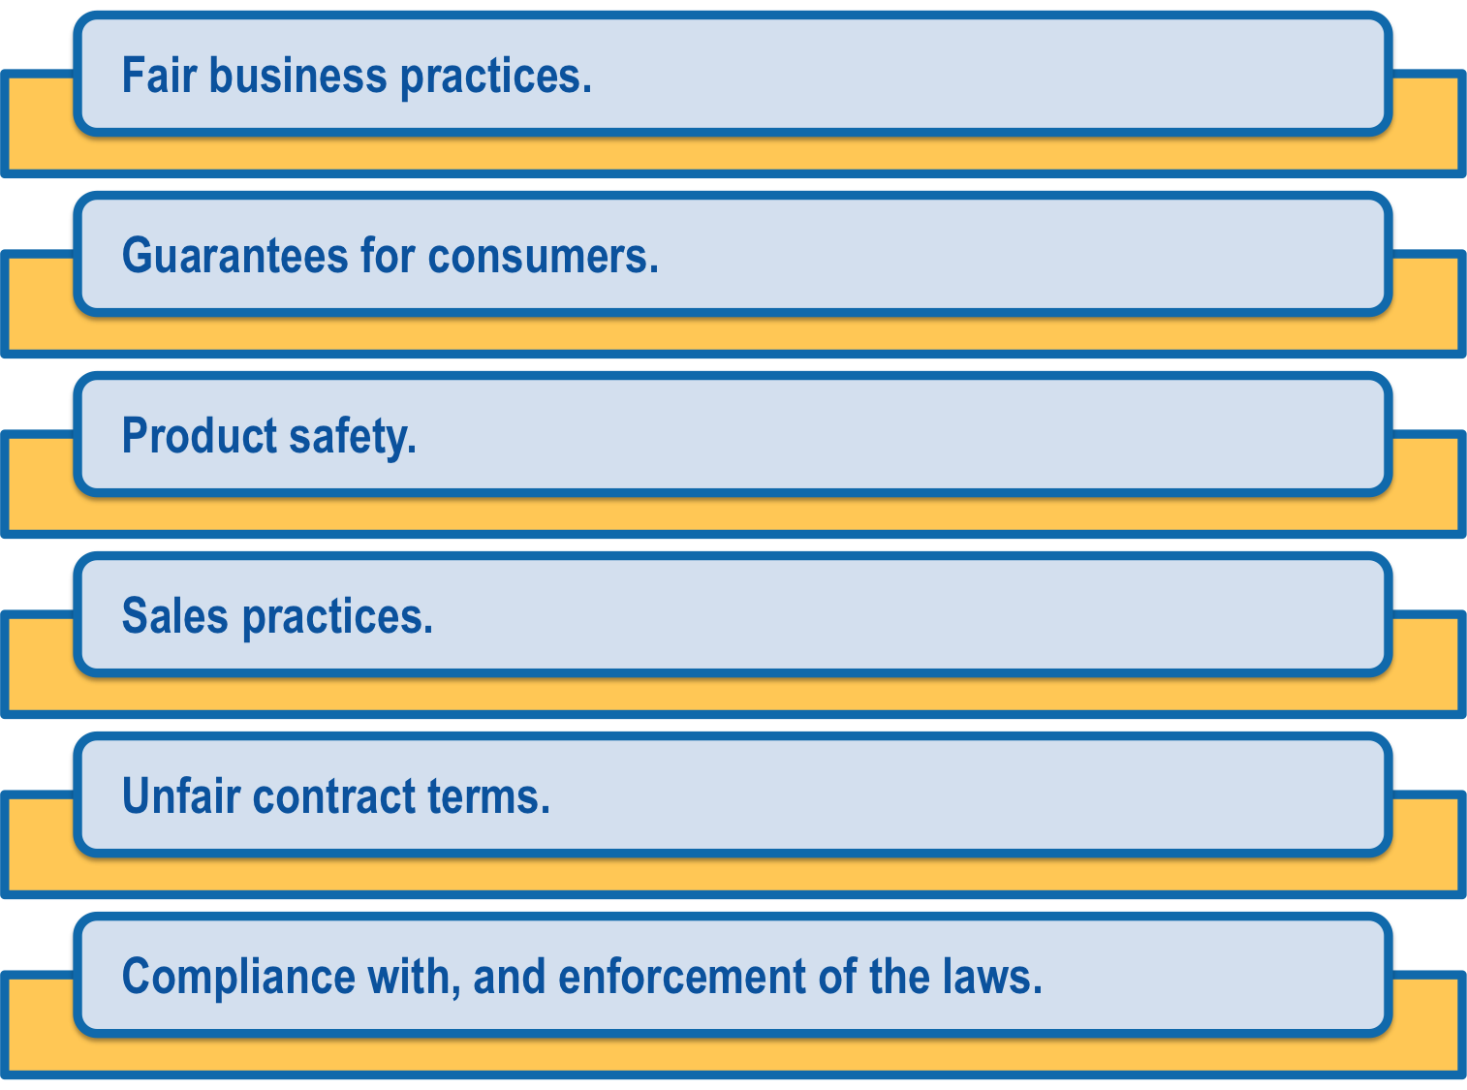
1.6.2.1 CONSUMER LEGISLATION
On 1 January 2011 the Australian Consumer Law (ACL) commenced. It applies in all states and territories and to all Australian businesses. The ACL outlines the laws related to areas such as:

Slide 52
1.6.2.1 CONSUMER LEGISLATION
It is essential that your workplace is familiar with ACL, and how they must operate to ensure compliance with its requirements.

Slide 53
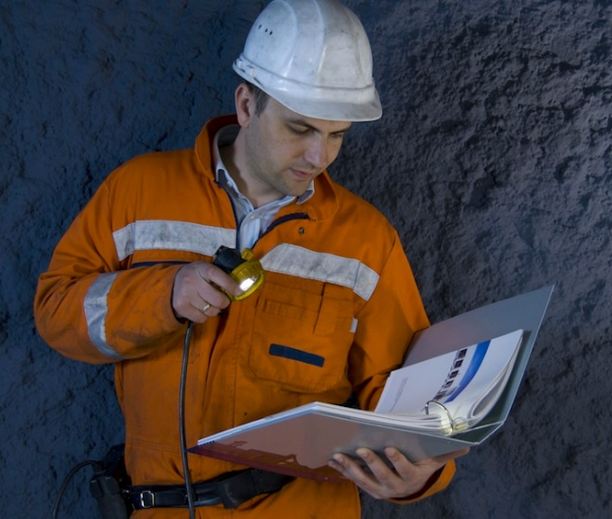
1.6.2.2 LAW OF TORTS
Law of Torts is common law based on precedents and legislation that is applicable within Australia.
The duty of care as imposed by the Law of Torts, states that all people must take reasonable care of their own health and safety, as well as the health and safety of others in the workplace.
This duty of care is defined in OHS/WHS policies and procedures for every organisation. It is essential you know, understand and apply this duty of care to all others within your workplace.

Slide 54
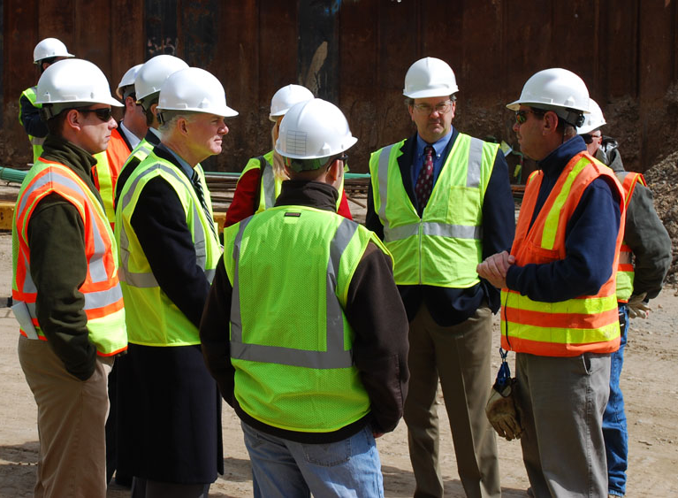
1.6.2.3 OBLIGATIONS RELATED TO BUSINESS STRUCTURE
The choice of business structure will directly influence the legal rights and responsibilities, the obligations of the workplace and the individuals or groups within the workplace.
Business structures can include sole traders, partnerships, trusts, companies, and alternative structures such as cooperatives and mutuals.

Slide 55

1.6.2.3 OBLIGATIONS RELATED TO BUSINESS STRUCTURE
Your workplace will have detailed documentation related to the structure of the business and the legal rights, responsibilities and obligations of every person within the workplace.
This may be accessed in organisational policies and procedures and employee/worker manuals.

Slide 56
RIIGOV401D Apply, monitor and report on compliance systems
PRESENTATION 2

Slide 57

2.1 IDENTIFY AND REPORT PROBLEMS
When monitoring compliance with legal and contractual requirements, it is essential that actual and potential problems be identified.
Most workplaces will encourage you to report all potential problems so that you can respond proactively, rather than having to work reactively.
Problems could be any issues or situations that have impacted, or have the potential to impact, any aspect of the workplace.

Slide 58
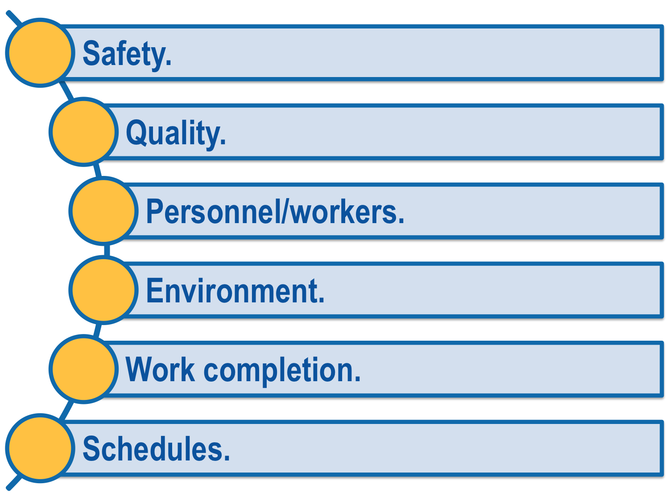
2.1 IDENTIFY AND REPORT PROBLEMS
This may include aspects of the workplace such as:

Slide 59

2.1 IDENTIFY AND REPORT PROBLEMS
Any actual or potential problems that you have identified must be reported promptly.
This is so that corrective action can be developed and implemented as soon as possible, to maintain compliance.
The method of reporting problems will vary depending upon the workplace.

Slide 60

2.1 IDENTIFY AND REPORT PROBLEMS
You may be required to submit a written report, report verbally, or utilise a computerised system.
Ensure that you are familiar with the reporting methods that must be applied in your workplace.
Each workplace will have a predetermined timeframe for reporting.

Slide 61
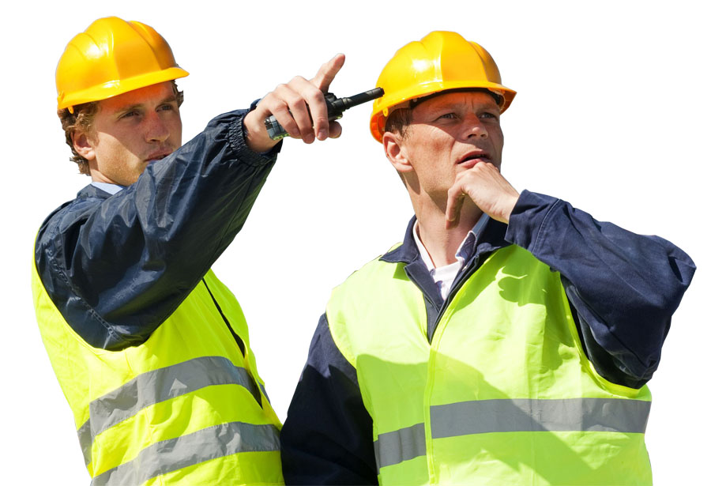
2.1 IDENTIFY AND REPORT PROBLEMS
As problems will need to be managed promptly, ensure that you understand your workplace’s reporting timeframes and adhere to them. If you are unsure of the reporting methods or timeframes for your worksite, speak with a supervisor.

Slide 62

2.2 MANAGE ACTIVITIES
All activities conducted within the workplace must be managed and monitored to ensure maximum legal and contractual compliance. This will in turn protect the interests of the business.

Slide 63

2.2.1 PLANNING AND ORGANISATIONAL SKILLS
Planning and organising skills will assist you to manage activities. Some planning and organising skills may be to:
Plan ahead and manage your time.
Organise your own work.
Organise and support the work of team members.
Monitor performance, tasks and people in a logical, effective way.

Slide 64

2.2.1 PLANNING AND ORGANISATIONAL SKILLS
Facilitate problem solving.
Ensure that outcomes are achieved as planned.
Maintain relevant records and ensure all documents are completed and stored appropriately.

Slide 65

2.2.2 ORGANISING WORK ACTIVITIES
Organising work activities is about scheduling your daily and weekly tasks in order to complete all assigned tasks in the best, most efficient manner while still meeting worksite requirements.
As well as sorting out your own work tasks you may be required to organise the activities of plant and machinery operators.

Slide 66

2.2.2 ORGANISING WORK ACTIVITIES
This could involve:
Prioritising and sequencing of activities.
Booking machinery hires.
Sourcing appropriately trained operators.

Slide 67

2.2.2 ORGANISING WORK ACTIVITIES
Flexibility is important when organising your work activities, as it will allow you to reorganise if a higher priority task needs to be completed.
However you schedule activities, it is necessary to ensure you keep a written record of what you have done and why.
Some people prefer a handwritten checklist, others use a computerised diary entry. Using the method that works best for you is the most important thing.

Slide 68

2.2.3 TIME MANAGEMENT
In order to effectively manage the activities conducted in the workplace, you will need to possess sound time management skills, including:
Setting goals or targets.
Planning and organising activities.
Prioritising activities.
Scheduling timelines.
Allocating and delegating tasks.
Monitoring progress and making adjustments.

Slide 69

2.2.3 TIME MANAGEMENT
How you apply your time management skills and manage activities within the workplace may vary depending on the work to be conducted and its complexity, the number of workers involved, and your workplace policies and procedures.
When planning activities ensure that you keep legal and contractual compliance as the main considerations, as well as the set targets or goals.

Slide 70

2.3 SUBMIT RECOMMENDATIONS
Part of the monitoring process includes identifying and submitting recommendations for improvements to compliance with legal and contractual requirements.
Recommendations for improvements will need to be made whenever non-compliance is identified in an individual, a work process or a system of work.
You may also identify ways to improve currently effective work processes and work systems that could have the potential to become non-compliant.

Slide 71
2.3 SUBMIT RECOMMENDATIONS
Recommendations for improvements will need to be made in the correct format for your workplace.
The format will be detailed in your workplace quality assurance policies and procedures.
The pre-determined format for making recommendations will have been developed to ensure that all recommendations are made in a manner that reflects the legislative and organisational requirements for the workplace.

Slide 72

2.4 SECURE PROCUREMENT RIGHTS
Contract management is a specialist area within mining and civil construction, which ensures all aspects of the contractual obligations are met at all times.
Part of the role of a contract manager is to secure procurement rights for goods and services.
Procurement contracts set an agreement in which a buyer agrees to acquire goods and services from a seller.

Slide 73
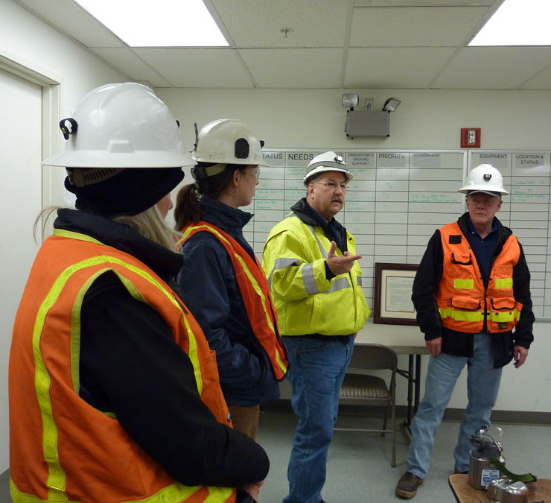
2.4 SECURE PROCUREMENT RIGHTS
How you secure contractual procurement rights for any goods and services will vary depending upon workplace policies and procedures, the goals and needs of the organisation, as well as the needs and goals of the other party.
Once contractual arrangements have been made, all members of the workplace should be made aware of the arrangements to ensure the correct use of the contract.

Slide 74

2.4.1 CONTRACT NEGOTIATION
In order to secure procurement rights you will need to conduct negotiations with the other party. A win-win negotiation outcome is the desired result.

Slide 75

2.4.1.1 WIN-WIN NEGOTIATION
As the name suggests, each party wins, or achieves part or all of what they set out to achieve from the negotiation.
The process for a win-win approach is to listen to the other party and their position, opinions and goals, and then present your own.
If each side has planned correctly, they will know where they are prepared to compromise to achieve their goal/s.

Slide 76

2.4.1.1 WIN-WIN NEGOTIATION
Creating a written negotiation plan with alternatives, details of what must be achieved and what you are willing to compromise on will help you stay on track to achieving the best result.

Slide 77

2.4.1.1 WIN-WIN NEGOTIATION
Negotiation plans are particularly important if you are trying to achieve exclusive use of goods or services for your project.
By using a negotiation plan, you are more likely to achieve the desired result because you will have determined how much your organisation is prepared to pay for the rights.
Other less desirable outcomes from negotiation include a win-lose outcome, and a lose-lose outcome.

Slide 78

2.4.2 CREATION AND TERMINATION OF LEGAL CONTRACTS
Most organisations will have lawyers and solicitors who create and terminate all legal contracts.
Your organisation may allow minimal creation or termination of legal contracts for small matters.
If they do, you will need to use to appropriate templates and formats that have been developed.
The legal department of your organisation will have developed these templates. They will require no modification or adaptation.

Slide 79

2.4.2 CREATION AND TERMINATION OF LEGAL CONTRACTS
To terminate services or contracts you will need to use the termination processes stated in the original contract.
If the original contract does not state how termination can occur, you will need to consult with your legal department before taking any action.
Do not attempt to create or terminate legal contracts without permission from management and the input of the legal department.

Slide 80

2.5 MAINTAIN RECORDS AND REPORTING PROCEDURES
In order to monitor for developing problems and maintain legal and contractual requirements, you will need to manage the documentation for the workplace.
This includes maintaining the systems, records and reporting procedures.
Effectively managing the documentation, including records and reports could include:
Identifying the records that must be completed for specific work tasks, and generally in the workplace.

Slide 81

2.5 MAINTAIN RECORDS AND REPORTING PROCEDURES
Inputting data in a timely manner.
Collecting data in a verifiable manner.
Storing data in a usable manner.
Ensuring data is accessible.
Following all reporting procedures.
Supporting colleagues in the maintenance of records and reports.

Slide 82

2.5 MAINTAIN RECORDS AND REPORTING PROCEDURES
Each business will have a different system for storage of data. It is essential that you work with the system already in place and meet the workplace requirements.

Slide 83

2.5.1 MAINTAIN RECORDS AND BOOK KEEPING
The book keeping and record keeping requirements will be detailed in your workplace policies and procedures.
The policies and procedures will be used to ensure the record keeping and book keeping activities meet the minimum financial and legal requirements.
The book keeping and record keeping you are required to maintain will vary. This may depend on your role, level of authority, your responsibilities and duties, and your amount of delegation responsibility.

Slide 84
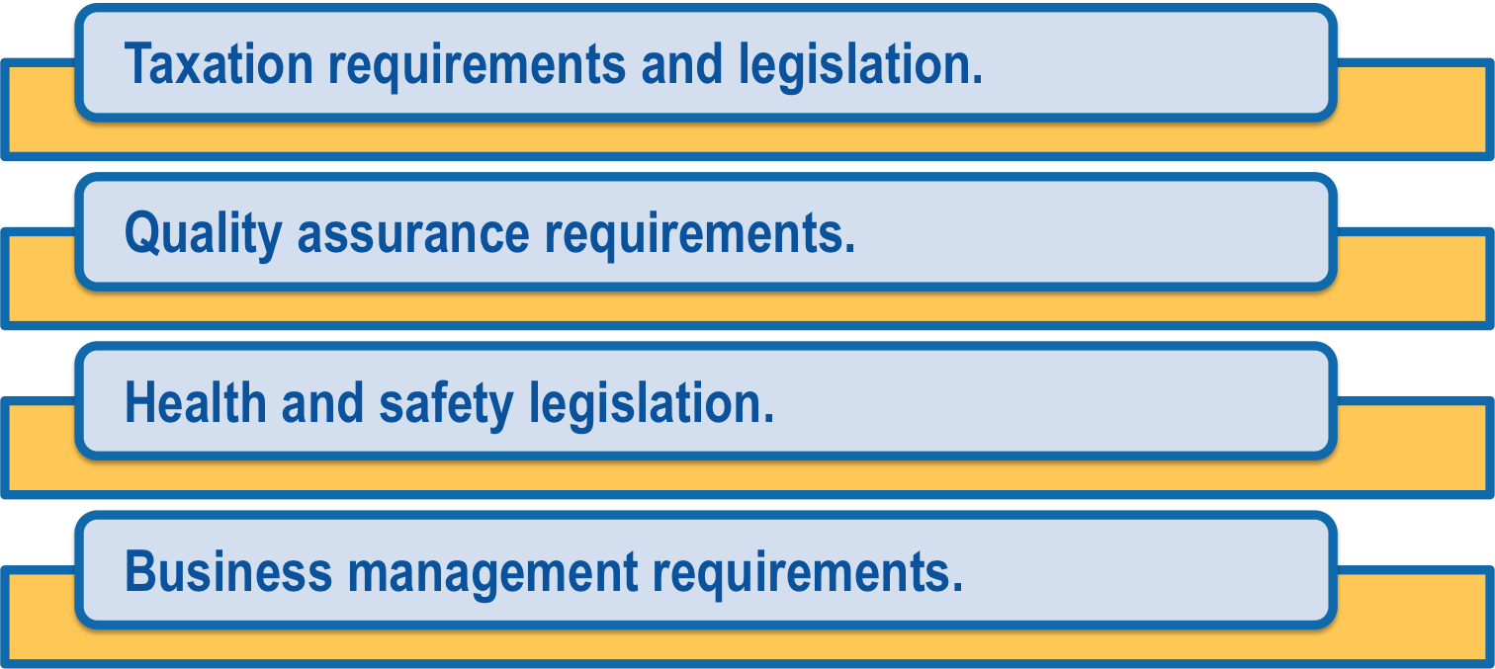
2.5.1 MAINTAIN RECORDS AND BOOK KEEPING
Commonly records will relate to:

Slide 85

2.5.1 MAINTAIN RECORDS AND BOOK KEEPING
How you keep records and books will also vary depending upon the system being used by your workplace and by your organisational policies, procedures and processes.
If you are extensively involved with book keeping for your workplace, you should have a comprehensive knowledge of the taxation legislation and requirements that relate to your organisation.

Slide 86
2.5.1 MAINTAIN RECORDS AND BOOK KEEPING
These requirements could include:
Income tax.
Business or company taxes.
Fringe benefit taxes.
Goods and services tax.
State taxes.
Federal taxes.

Slide 87

2.5.1 MAINTAIN RECORDS AND BOOK KEEPING
There is a multitude of relevant legislation that governs how businesses operate in Australia. If you have any questions or queries, you should speak with your organisation’s accounting department.

Slide 88

2.5.2 WRITING PROCEDURES, INSTRUCTIONS AND REPORTS
As part of documentation management, you may be required to write procedures, instructions and reports.

Slide 89

2.5.2.1 PROCEDURES AND INSTRUCTIONS
Well written procedures and instructions increase workplace accountability and transparency. When writing procedures and instructions you will need to meet legislative requirements and workplace policies.
Some considerations when writing procedures and instructions include:
The procedures should be based on the policies of the workplace.
Instructions should flow on from policies and procedures.

Slide 90

2.5.2.1 PROCEDURES AND INSTRUCTIONS
Follow the standard format for the workplace.
Provide specific step-by-step directions.
Include what needs to be done, when, by who, and what records are to be kept.
Write clearly and directly, in plain English.
Include written and pictorial information if required, e.g. flow charts.

Slide 91

2.5.2.1 PROCEDURES AND INSTRUCTIONS
Always double check you have included all legal requirements and workplace policies in your instructions and procedures.
If required, have other personnel/workers review a draft and refine the procedure or instruction as necessary.

Slide 92

2.5.2.2 WRITING REPORTS
Your workplace may have report templates that you are required to use.
Whether a template exists or not, your report should:
Be written in clear, easy to read, plain English.
Be easy to understand.
Contain complete, but concise information.
Flow in a logical order.

Slide 93
2.6 INVESTIGATE AND ACT ON NON-COMPLIANCE
Compliance requirements change regularly. It is necessary for you and your organisation to keep current with these changes and implement any new procedures, equipment requirements or other systems that will assist you in maintaining compliance.
Compliance may need to be maintained for:
Environmental protection requirements.
Workplace activities.
Quality requirements.
Safety legislation.
Financial safeguards and measures.
Organisational requirements.

Slide 94

2.6 INVESTIGATE AND ACT ON NON-COMPLIANCE
You will need to use your investigative skills in order to identify any issues surrounding non-compliance in the workplace.
These skills include:
Asking questions.
Making observations.

Slide 95

2.6 INVESTIGATE AND ACT ON NON-COMPLIANCE
Researching possibilities.
Discussion with colleagues and experts.
Reading legislation, codes of practice and other supporting documentation.
Keeping current with developing trends within your industry.

Slide 96
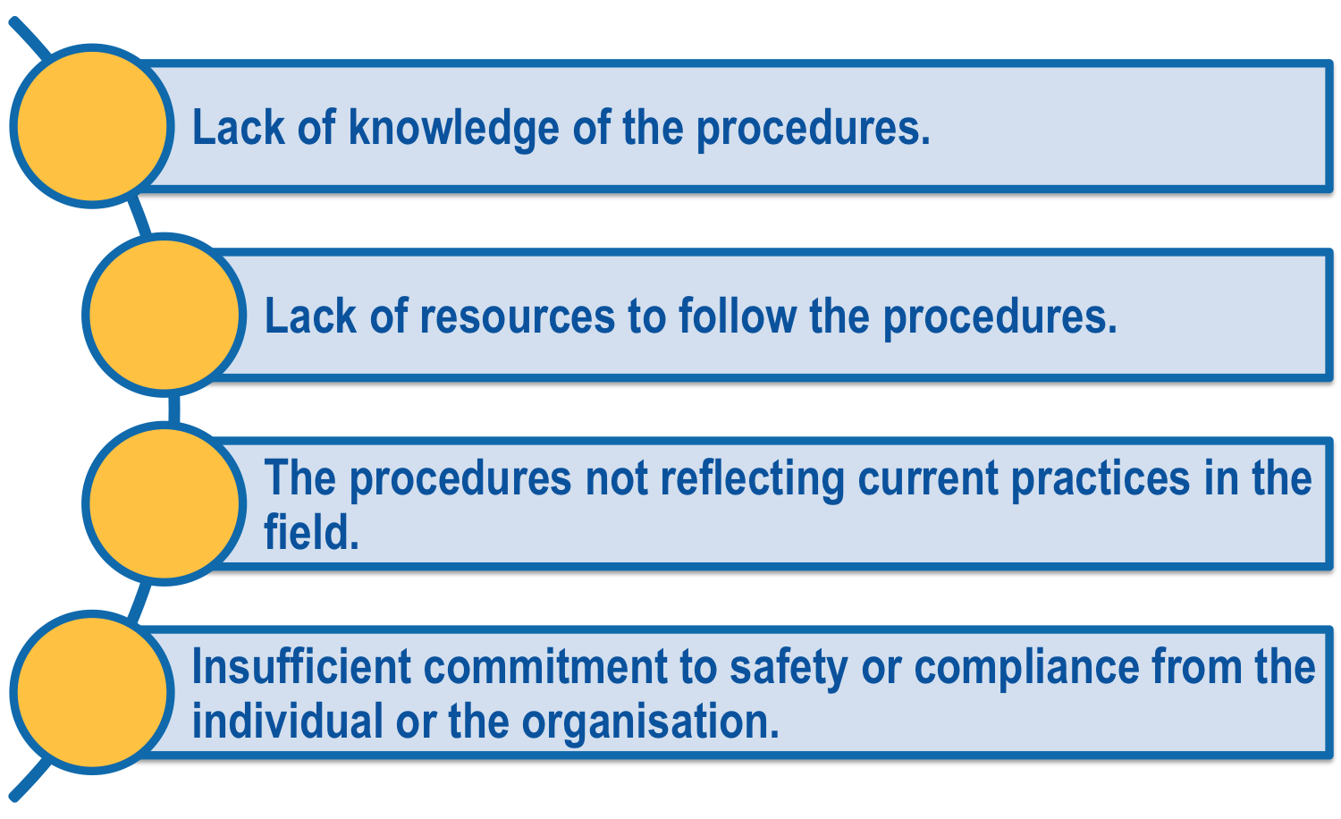
2.6 INVESTIGATE AND ACT ON NON-COMPLIANCE
Non-compliance could occur for many reasons such as:

Slide 97
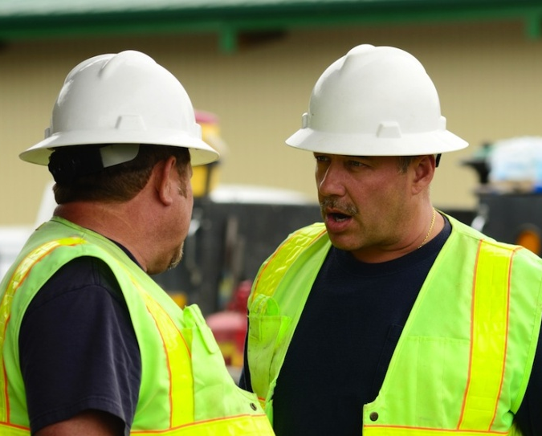
2.6.1 REPORT AND DOCUMENT NON-COMPLIANCE
Any issues of non-compliance identified will need to be dealt with appropriately.
The correct measures for dealing with the issue of non-compliance will depend on the type and severity of non-compliance, as well as the legal and workplace policies and procedures in place.

Slide 98
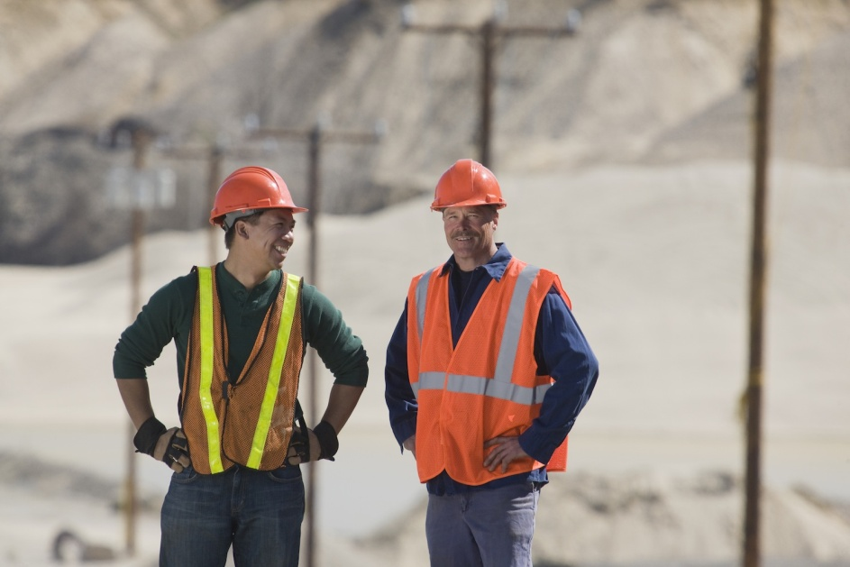
2.6.1 REPORT AND DOCUMENT NON-COMPLIANCE
Your first step may be to report the issue of non-compliance to the relevant supervisors, management or other personnel/workers.
Ensure you know the procedures for reporting of non-compliance for your workplace.

Slide 99
2.6.1 REPORT AND DOCUMENT NON-COMPLIANCE
Non-compliance will also need to be documented in a format acceptable to your workplace.
When documenting non-compliance, be as specific and detailed as possible.
This will assist you to identify why compliance has not been met and develop the correct solutions to deal with the issue.

Slide 100

2.7 IDENTIFY AND IMPLEMENT TRAINING NEEDS
The training needs of all personnel/workers must be monitored and if necessary, addressed. This could take place through internal training onsite or by utilising external training resources.

Slide 101

2.7.1 IDENTIFY TRAINING NEEDS
Any issues of non-compliance identified can be used to determine the training needs of personnel/workers.
This allows people to gain the competencies required to meet compliance standards.
As discussed in an earlier section, there are also other methods for determining the training needs of personnel/workers that could be used.

Slide 102

2.7.1 IDENTIFY TRAINING NEEDS
Once you have determined a training need, you will need to identify the most appropriate training to develop the required competencies.
The training provided needs to be integrated into the workplace wherever possible and relevant to your workplace procedures and operations.
Two internal methods that could be used are coaching and mentoring.

Slide 103
2.7.2 IMPLEMENT TRAINING PROGRAMS
Training programs and workplace practices should be used to ensure non-compliance issues are not repeated. This can be done through formal training or more informal training such as mentoring.

Slide 104

2.7.2.1 FORMAL AND INFORMAL TRAINING
Training programs could include both formal and informal training. Formal training results in certification or accreditation. This training is recognised outside of your workplace and will benefit you when you change organisations.
Informal training can include internal methods such as coaching and mentoring. Informal training does not result in certification or accreditation.

Slide 105

2.7.2.1 FORMAL AND INFORMAL TRAINING
To ensure successful training programs, you will need to plan the programs, with defined goals and key indicators of success. Once you have implemented a training program, you will need to monitor and evaluate the program to ensure that it is meeting the defined expectations.
If you find the goals of the training are not being achieved, you may need to re-examine how the training is being conducted and make adjustments as necessary.

Slide 106

2.7.2.2 COACHING AND MENTORING
Coaching and mentoring are similar training methods that are used within the workplace to enhance performance, and to develop competencies.
Coaching follows a more formal approach to learning compared to mentoring.
A senior staff member can be used to identify problems or concerns with the performance of an individual or team.

Slide 107
2.7.2.2 COACHING AND MENTORING
Experienced staff can use their experience and skills to assist the individual/team to improve their skills and provide the correct procedures as required.
Mentoring can be conducted more informally. This approach encourages the learner/s to observe and be guided by more experienced personnel/workers.
They can then ask questions, perform tasks and be provided with immediate feedback.

