Slide 1

WORKPLACE HAZARDS
Electrical Safety

Slide 2


What is a Hazard? A situation or thing that can cause harm.
What is a Risk? The possibility of harm when exposed to the hazard.
Introduction

Slide 3
Responsibilities
WORKERS
PCBU
Responsible for taking reasonable care of your own health and safety in the workplace.
Responsible for taking reasonable care of the health and safety of others.
Follow reasonable health and safety instructions from your employer.
You must only use tools and equipment that have been tested and tagged.
To provide and maintain a work environment without risks to health and safety.
Provide and maintain safe plant and structures.
Provide and maintain safe systems of work.
Must ensure all electrical equipment is electrically safe, inspected, tested and tagged regularly.

Slide 4
Legal and Organisational Responsibilities
These responsibilities are outlined in the Electrical Safety Act 2002 and the Work Health and Safety Act 2011 (Qld) for the health and safety of every worker, bystander and visitor.
The purpose of the act is to eliminate the human cost to individuals, families and the community of death, injury and destruction that can be caused by electricity. www.worksafe.qld.gov.au
We must identify hazards by talking to the workforce and observe how they use electrical equipment.
Carry out regular inspections and testing of equipment.
Look at labels and manufacturers instructions to ensure correct use.
Talk to suppliers, industry and electrical safety specialists and review incident reports.

Slide 5

Identify the Hazards
We must be aware of our surroundings, so look up and down for the location of powerlines.
Is your equipment safe, tested, tagged.
Is your equipment damaged? Cables in good condition?
Are powerboards overloaded? Is the wiring correct? Safety switches in place?
What are the conditions the equipment is being used in? Wet, well lit, heat etc

Slide 6
Risk Assessment
We must measure the risk by assessing and decide how urgently action needs to be taken.
What harm could the hazard cause?
What is the likelihood of it happening?

Slide 7
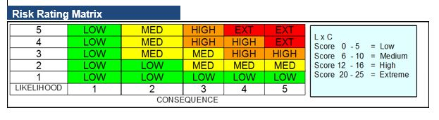
This Photo by Unknown Author is licensed under CC BY
If my leads are in poor condition and I’m working in a wet area, what is the likelihood and consequence of electrocution? EXTREME!!

Slide 8
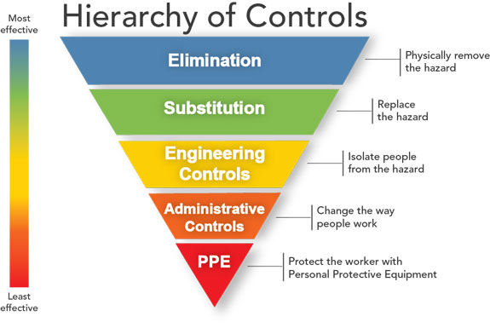
Risk Management and Controls
This Photo by Unknown Author is licensed under CC BY-SA

Slide 9

Control Measures
These controls must comply with the Aus/NZ standards.
We must plan works ensuring operators and workers are aware of overhead and underground lines.
Ensure exclusion zones are specified.
Follow electrical safety Codes of Practice.
Consider if the control measure created a new hazard.
Consult with workers and provide training
Develop safe work practices.

Slide 10
Reviews of Controls
Under Work Health and Safety Laws we must review our controls regularly and when:
A control is not working.
If the control creates a new risk.
You find a new hazard/risk.
A report from a worker or HSR’s request a review.
We must continually inspect our workplace, consult with people, testing and reviewing records and data.

Slide 11
In conclusion
Ensure that tools, testing and PPE are regularly inspected maintained and tested
Ensure all electrical works are carried out by licensed persons
Ensure signed exclusion zones, safety switches, cable hooks, work areas are maintained
Emergency plans and first aid are clearly defined and all persons are familiar with them
You must notify Work Safe QLD if anyone is exposed to an electric shock

