Slide 1
WHSMS Implementation
Notes:
The attendees of this meeting:
Directors
Department Managers
HSEQ Staff

Slide 2

Introduction
What is a Work Health & Safety Management System? (WHSMS)
AS/NZS 4804:2001
“The overall management system which includes the organisational structure, planning activities, responsibilities, practices, procedures, processes and resources for developing, implementing, achieving, reviewing and maintaining the WHS policy, and so managing the WHS risks associated with the business of the organisation.”

Slide 3
Introduction
Why is a WHSMS required?
To fulfil the legislative duties found in the WHS Act QLD 2011
Section 19 (1), (2) & (3) requires the PCBU to:
Ensure the health & safety of workers
Ensure the health and safety of other persons is not put at risk from work carried out by the business
Ensure the provision & maintenance of safe systems of work

Slide 4
Introduction
Aim of a WHSMS
Manage work health and safety in a guided systematic approach
Prevent work-related injury and ill health to workers
Provide safe & healthy workplaces
Continually improve WHS performance

Slide 5
Key Stakeholders & Responsibilities - Legislative
Stakeholder | Legislative Duty
PCBU | WHS Act QLD 2011 Section 19 3(c) Ensure “the provision and maintenance of safe systems of work.” Duty holders (general) WHS Act QLD 2011 Section 46 “Each person with the duty must…consult, co-operate and co-ordinate activities with all other persons who have a duty in relation to the same matter."
Workers | WHS Act QLD 2011 Section 28 (c) & (d) comply with any reasonable instruction that is given by the PCBU co-operate with any reasonable policy or procedure of the PCBU relating to health or safety at the workplace
Other persons at the workplace (e.g. clients & visitors) | WHS Act QLD 2011 Section 29 (c) comply with any reasonable instruction that is given by the PCBU

Slide 6
Key Stakeholders & Responsibilities - Organisational
Stakeholder | Legislative Duty
Board & Executive Team | Provide information regarding upcoming or current areas of change within the business. • Participate in the change management process, and providing information, resources and direction.
HSEQ Manager and Department | Supervise the WHSMS and its implementation. • Approve changes to the WHSMS • Ensure that the any changes to the WHSMS have been documented using the pre determined method • Direct a review of the WHSMS & monitor the success of amendments
Relevant Managers and Supervisors | Managers may include Operations, Projects, Development, Technical, Shared Services Managers or similar • Implementation of the WHSMS including any amendments made • Ensuring that communication and consultation takes place.
Workers | comply with the WHSMS Contribute to the development, evaluation & amendment of the WHSMS

Slide 7
WHSMS Implementation Plan, Timeframes & Resources required
Step | Details | Timeframe | Resources required
Prepare | Understand legislative requirements Determine scope | 1 week | HSEQ Team Board & Executive Team
Plan | Map out WHSMS Consult with stakeholders to determine needs & expectations | 1 month | HSEQ Team Board & Executive Team Dept Managers & Supervisors General staff
Implement | Formal communication of the WHSMS to all staff Training sessions | 2 weeks (but will also be ongoing) | HSEQ Team Board & Executive Team
Monitor | Make not of & manage issues that arise | 6 weeks | HSEQ Team Dept Managers & Supervisors
Evaluate | Consolidate findings from the 6 weeks Formalise data & present in a way that is meaningful | 1 week | HSEQ Team Board & Executive Team Dept Managers & Supervisors
Notes:
Outline the steps, what they entail & the approx. time period to be completed in

Slide 8
Potential Barriers
Office & site locations
Workers feeling unsupported by upper management
Staff fearful of providing feedback
Limited or unconstructive response/feedback from workers
Low attendance at trainings sessions
Resistance to change
Stress
Staff are time poor. Introducing new elements/responsibilities may be overwhelming.
Site Staff vs Office staff
Staff will not want to listen to information that does not (or seems to not) directly involve/effect them (e.g. information would have to be filtered/presented to ensure relevance whilst also providing enough context)
Notes:
If attendees mention more barriers & I do not have a solution for them on the spot, I will take note & provide a date they will be answered by.

Slide 9
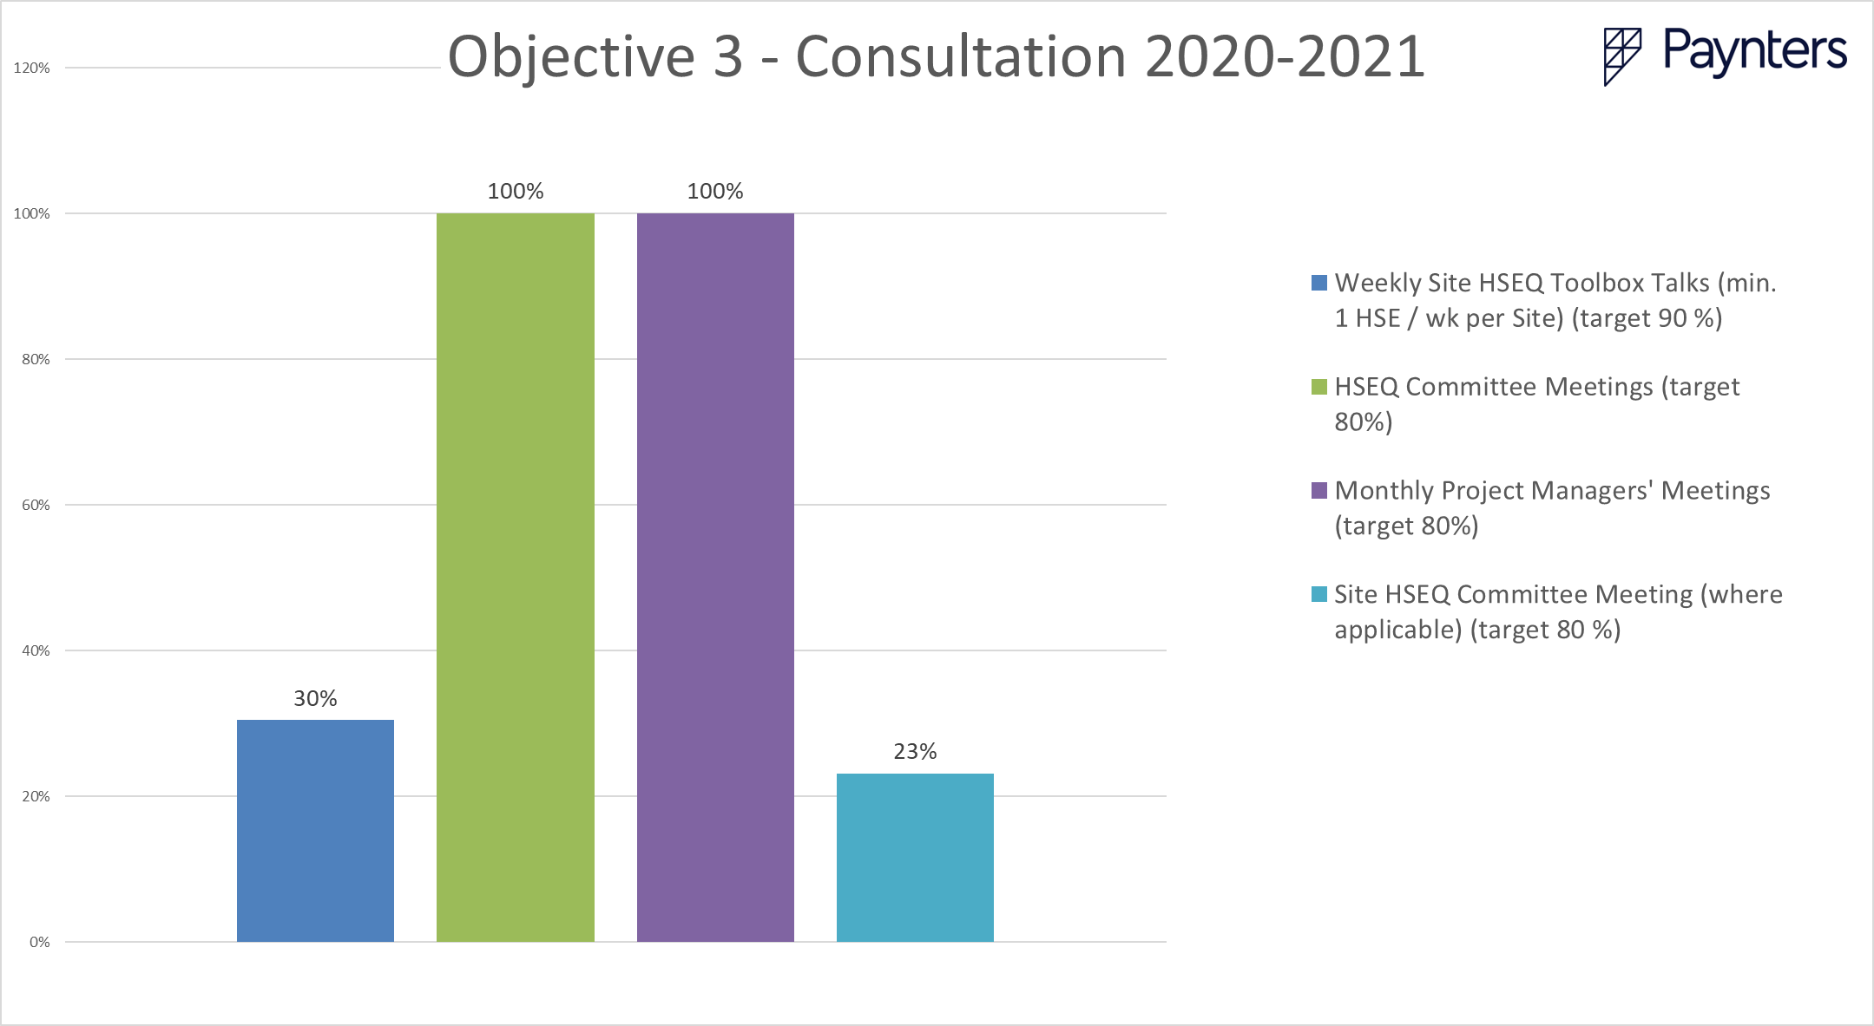
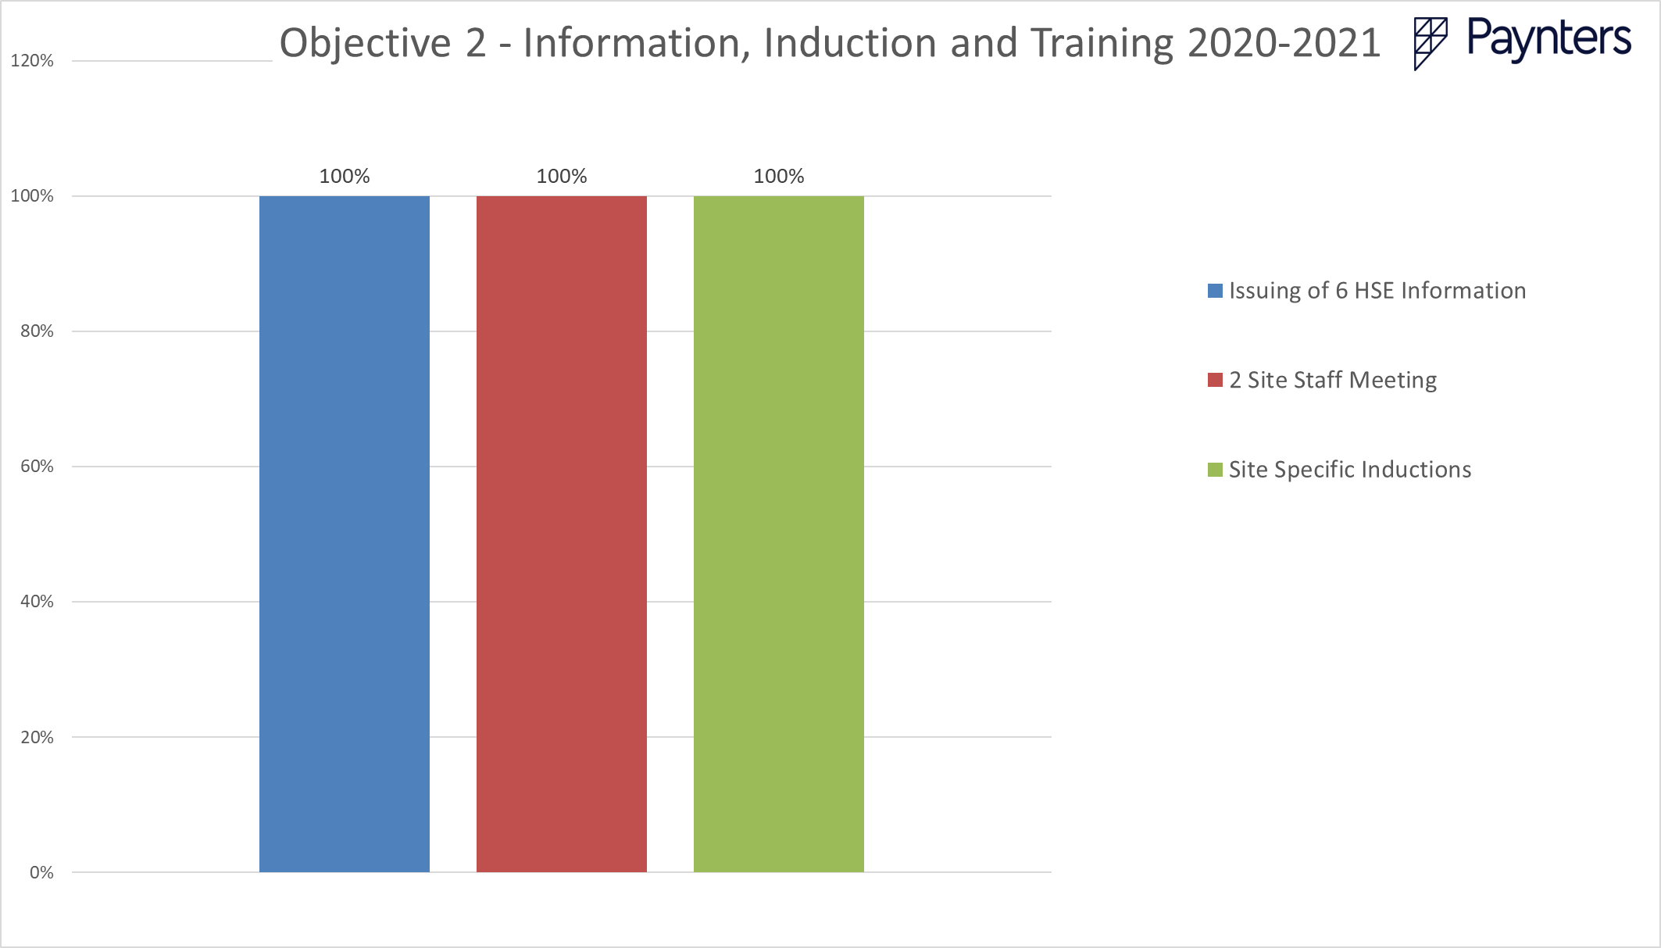
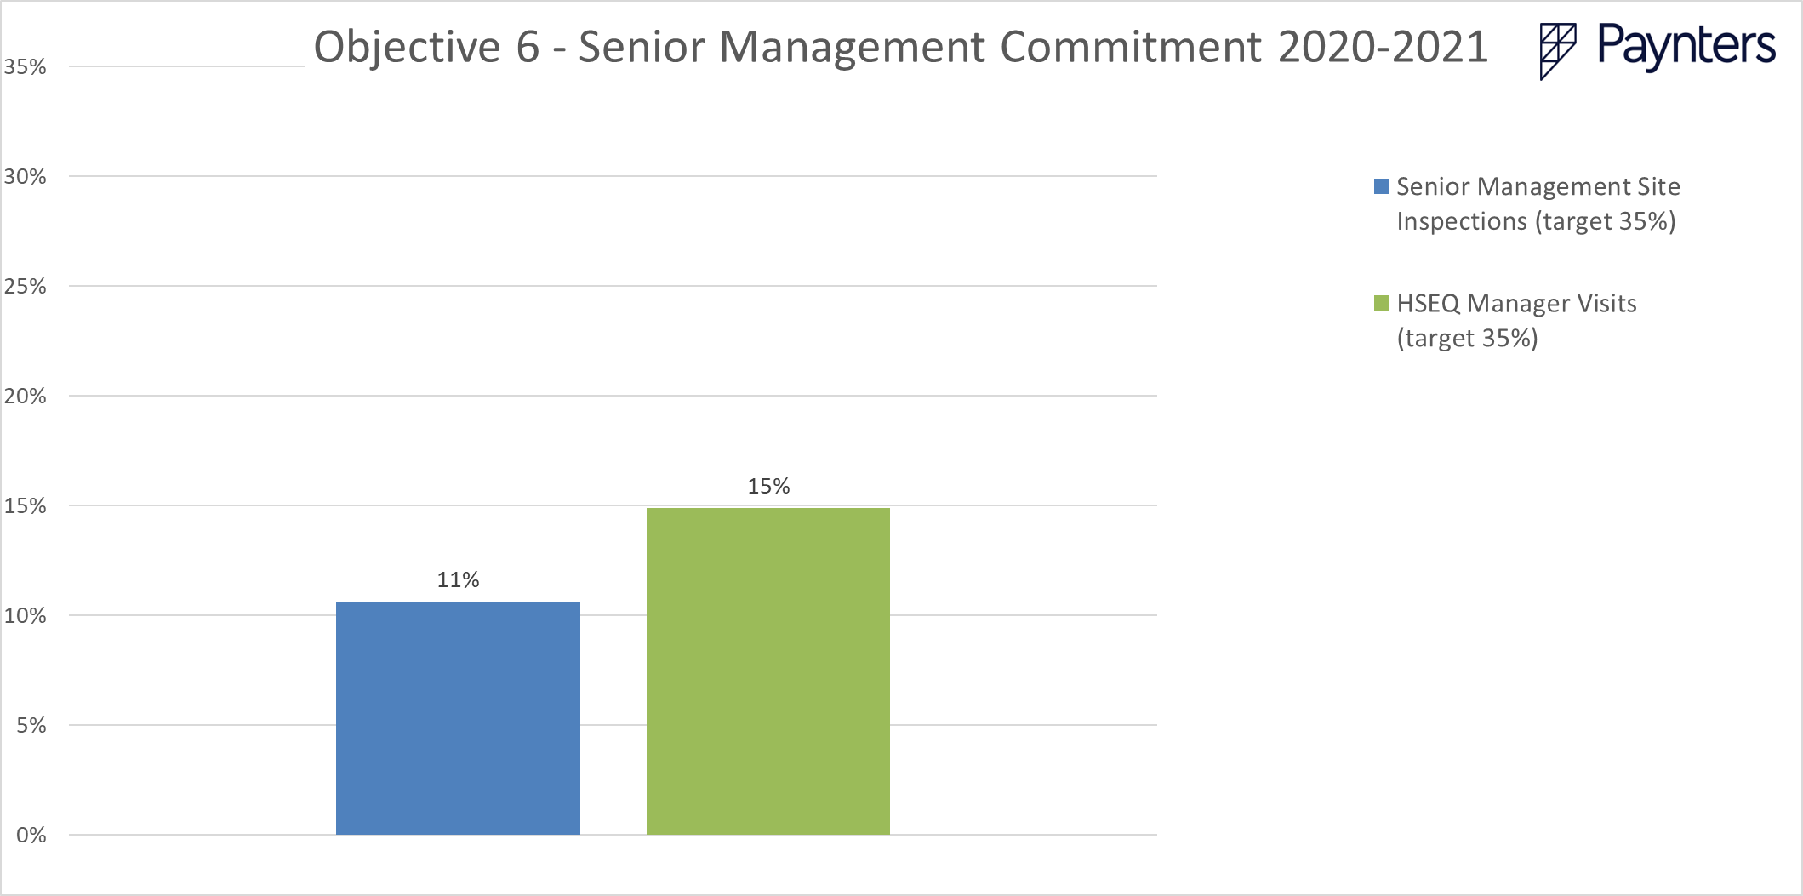
Historical Data
Notes:
Here I would discuss how Paynters have been going with achieving set KPI’s over the last reporting year (1 July – 30 June). The results of each graph would be discussed, including the KPI’s significance in determining WHSMS performance across the business. (e.g. few senior management inspections would indicate that upper management is not involved enough in the implementation of the WHSMS). Historical data can act as a base line for determining where we can improve as a business.

Slide 10
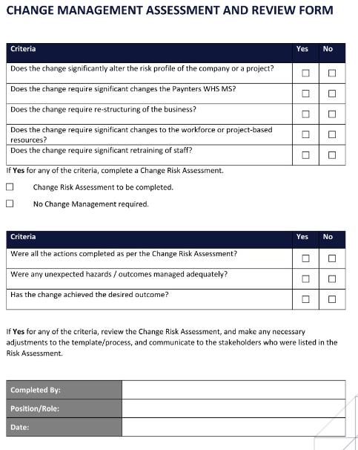
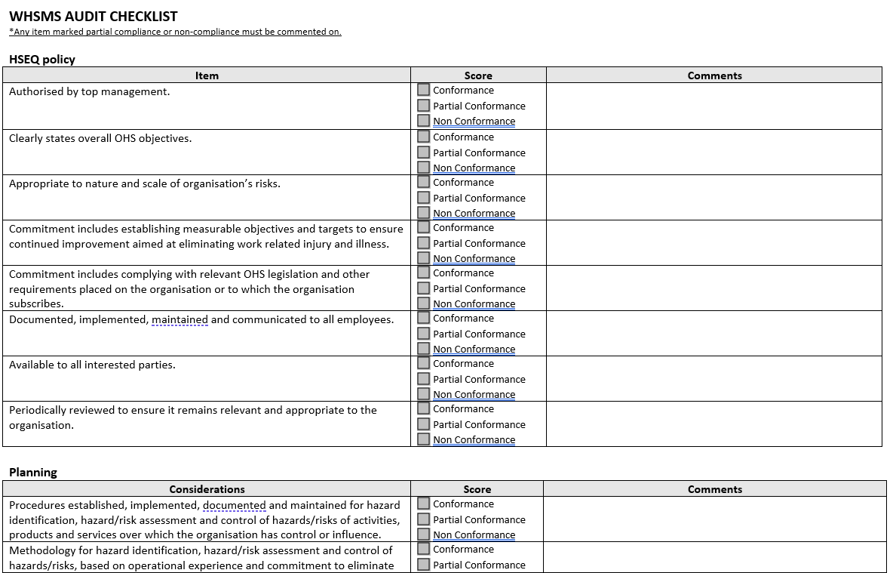
Monitor & Evaluate WHSMS Implementation
Notes:
Discuss the formal procedures, processes & tools in place/available. Advise who is to use these tools, when & how.
* Mention WHSMS Audit Check sheet – distribute to attendees

Slide 11
Areas of Improvement
Establish regular communication between departments & HSEQ teams re changes to (e.g. department is to advise the HSEQ Team when they have changed how they complete a task so that this can be reflected in organisation procedures & processes)
Health & Safety must be first on the agenda in every meeting
A representative from upper management must be present at all WHSMS Meetings
Scheduled training sessions to be added into Paynters Corporate Calendar & reoccurring calendar invites sent out to staff
Each department to nominate one department manager to champion WHSMS implementation
Establish a formal notification process regarding the release of new, superseded or obsolete documents
Member of the HSEQ Team to make a bi-monthly trip to a regional office/site
HSEQ Team member to accompany Construction Manager when inducting a new staff member
Notes:
Meeting attendees would be invited to share their thoughts on the above & discuss any areas of improvement they have come across.

Slide 12
The HSEQ Team are here to help!
Support Available
Notes:
Outline the HSEQ’s team commitment to providing ongoing support to staff throughout the implementation process

