Slide 1

LADDERS
WORK HEALTH AND SAFETY OFFICER

Slide 2
Assessment Criteria
Identify the various types of ladders and their uses.
Describe the statutory and minimum requirements relating to the use, maintenance and inspection of ladders.
Describe the statutory minimum provisions relating to access and egress.

Slide 3
Portable Ladders
A ladder is used for gaining access to areas above or below the ground, or other levels not provided with permanent access.
Portable ladders should comply with the requirements of the relevant Australian Standard and must be marked for ‘Industrial Use’ for use in a construction workplace

Slide 4
Portable Ladders
General rules:
All ladders should be adequately supported at the base
A ladder should never be ‘walked’ by a person standing on the ladder
Set the ladder at a slope of approximately 4 in 1
One ladder, one person
Never climb higher than the third rung from the top of the ladder
Fully enclosed slip resistant footwear should always be worn
Ladders should be stored under cover

Slide 5
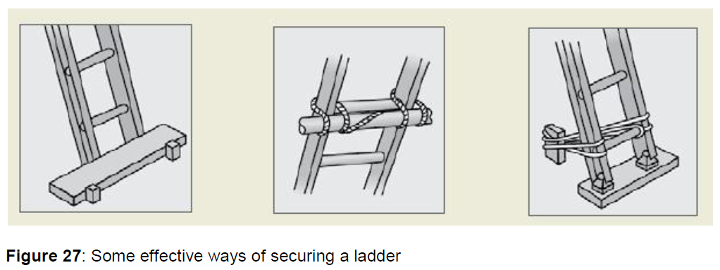
Positioning ladders
Any ladder used at a workplace must be set up on a solid and stable surface, and set up so as to prevent the ladder from slipping. Single and extension ladders can be prevented from slipping by:
placing ladders at a slope of 4:1, and setting up stepladders in the fully opened position
securing ladders at the top or bottom, or if necessary, at both ends (see Figure 27).

Slide 6
Access or egress
Where fixed or extension ladders are used for access or egress, you should check that:
there is a firm, stable work platform, free from obstructions, to step onto from the ladder
the ladder extends at least one metre above the stepping-off point on the working platform
fall protection is provided at the stepping-off point where people access the working platform.

Slide 7
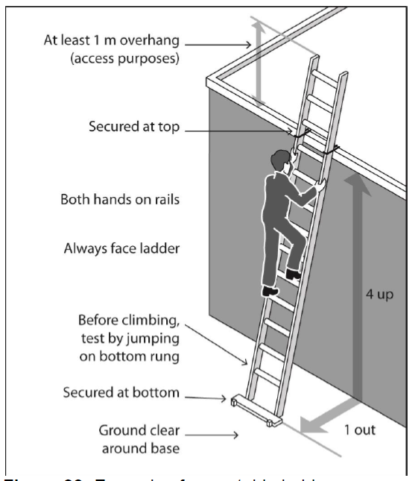
Safe use of ladders

Slide 8
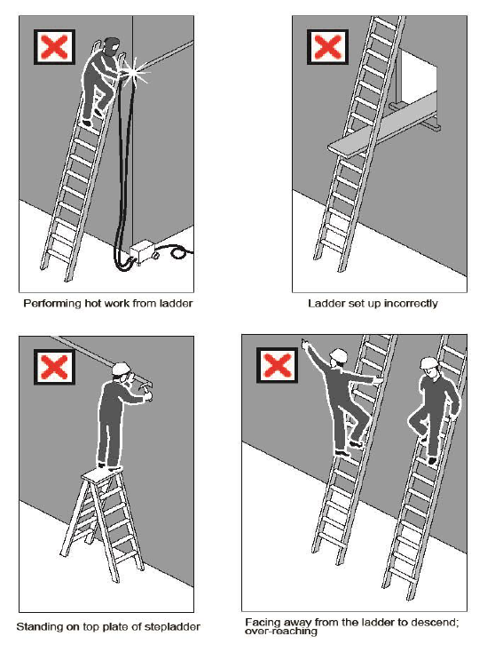
Safe use of ladders
When using ladders, it is not safe to:
use metal or metal reinforced ladders when working on live electrical installations
carry out work such as arc welding or oxy cutting
work over other people
allow anyone else to be on the ladder at the same time.

Slide 9
Types of ladders
Extension ladders
Step ladders
Multipurpose ladders
Domestic ladders should NOT be used in an industrial environment.

Slide 10
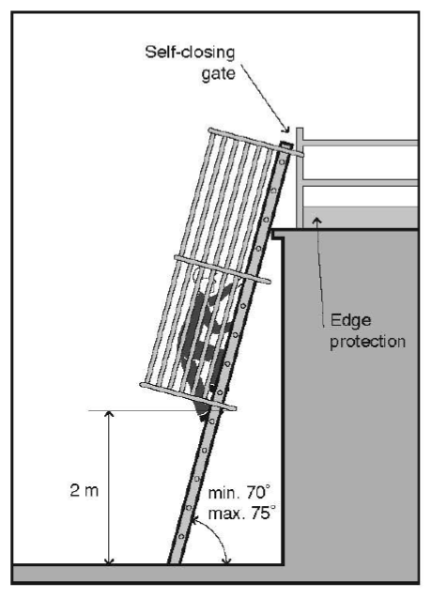
Fixed ladders

Slide 11
Maintenance & Inspection
Ladders should be regularly inspected by a competent person in accordance with the manufacturer’s recommendations.
A thorough ladder inspection should be made:
when originally purchased, received and put into service;
before each use;
after mishaps, drops and impacts; and
periodically.

Slide 12
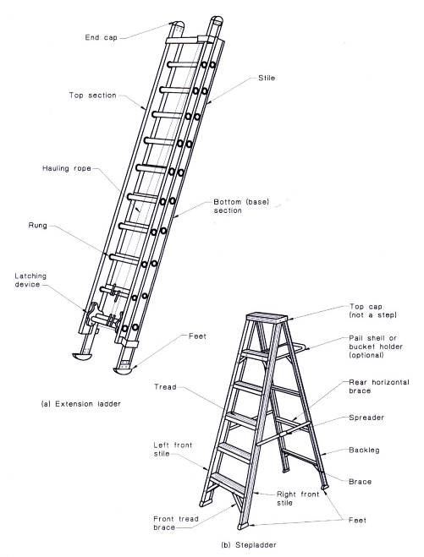

Slide 13
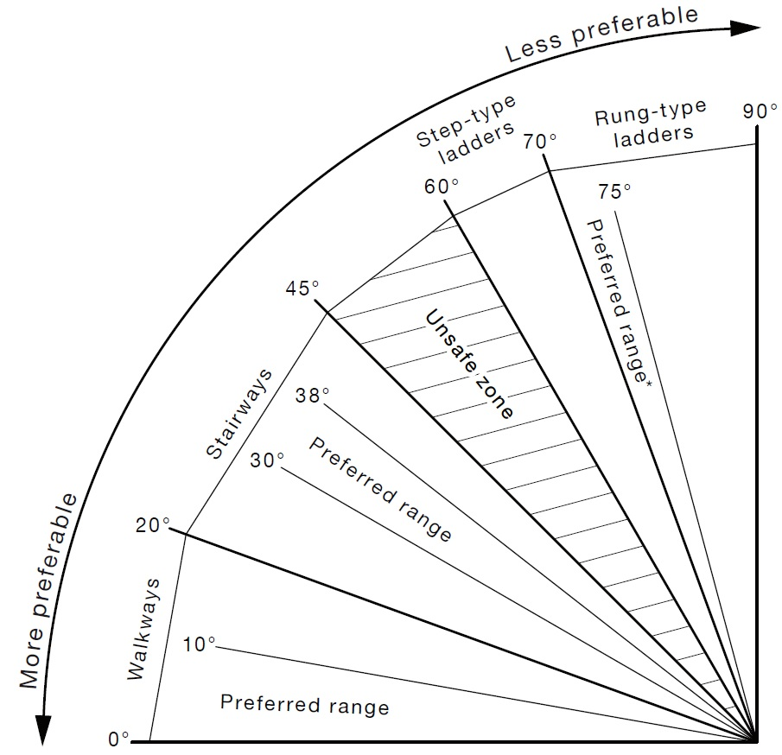
Stairways

Slide 14


