Slide 1

CHCECE018
Nurture creativity in children

Slide 2

Foster creativity through the physical environment
1.1 Select and promote the use of a range of open-ended, natural and found materials and make them available to children
1.2 Choose and promote the use of a range of materials to encourage creative expression and make them accessible to children

Slide 3

National Quality Framework for Early Childhood Education and Care (NQF)
NQF framework includes:
National Quality Standard
National legislative framework
National quality rating and assessment process.

Slide 4

National Quality Standard (NQS)
National Quality Standards include:
Educational program and practice
Children’s health and safety
Physical environment
Staffing arrangements
Relationships with children
Collaborative partnerships with
families and communities
Governance and leadership.

Slide 5

Objectives of the NQF under the National Law
The objectives are to:
Ensure the safety, health and wellbeing of children attending education and care services
Improve the educational and developmental outcomes for children attending education and care services
Promote continuous improvement
in the provision of quality
education and care services.

Slide 6

Objectives of the NQF under the National Law
The objectives are to:
Establish a system of national integration and shared responsibility between participating jurisdictions and the commonwealth in the administration of the national quality framework
Improve public knowledge, and access to information, about the quality of
education and care services
Reduce the regulatory and
administrative burden.

Slide 7

Educational program determined by the National Law and Regulations
The educational program:
Is based on an approved learning framework
Is delivered in accordance with that framework
Is based on the developmental needs, interests and experiences of each child
Takes into account the
individuality of each
child.

Slide 8

Educational program outcomes
Educational outcomes are intended to ensure:
Children have a strong sense of identity
Children are connected with and contribute to his or her world
Children have a strong sense of wellbeing
Children are confident and
involved learners
Children are effective
communicators.

Slide 9

Open-ended, natural and found materials
Open-ended, natural and found materials include:
Old clothing and other materials
Empty and discarded packaging
Waste paper
Kitchen wares
Adhesives
Natural materials including
leaves and feathers.

Slide 10

Benefits of using open-ended materials
The benefits of using open-ended materials include:
Sense of well-being and competence
Understanding is enhanced by direct experience
Creative group work supports team work and learning from peers
Children learn literacy, maths and
science whilst experimenting with
materials
Children learn to make their own
connections.

Slide 11
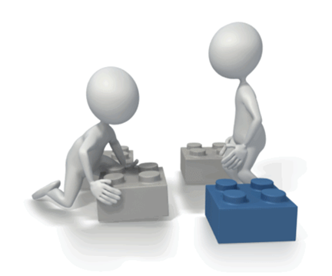
Health and safety
You should consider:
Number of children
Ages of children
Abilities of children
Skills and experience of educators
The nature of the activity and the
materials being used
Potential risks and hazards
Educators’ knowledge of each
child’s needs and abilities.

Slide 12

Activity 1A

Slide 13
Foster creativity through the physical environment
1.3 Introduce children to a range of examples of creative expression in art, architecture, inventions, music and dance, and promote the use of creative expression

Slide 14

Introducing art to children
Methods of introducing art include:
Showing them examples of art on the internet
Displaying art in the educational setting
Looking at art in books within the library
Visiting art galleries and museums
locally, nationally and
internationally
Inviting artists into the
educational setting to
exhibit their work.

Slide 15

Introducing architecture to children
Methods of introducing architecture include:
Walking around the building you occupy
Viewing architectural plans and designs
Visiting historical monuments and buildings
Viewing on the internet well-known
international buildings and
constructions
Comparing the architecture of
different styles and time
periods.

Slide 16

Introducing inventions to children
Questions to ask children include:
What is the purpose of the invention?
Why was it needed?
What existed before it was invented, if anything?
How does it benefit humans or the environment?
Is it harmful to humans and/or
the environment and why?
What is it made of and why?
What does it do that is
different to other similar
inventions and how?

Slide 17

Introducing music to children
Methods of introducing music to children include:
Watching music videos and musicals
Visiting theatres to watch musical performances
Using music as part of an activity (e.g. musical chairs, musical statues)
Giving them musical instruments
Teaching them to read music
Singing
Dancing.

Slide 18

Introducing dance to children
Methods of introducing dance to children include:
Incorporating freestyle dancing into activities such as musical bumps and musical statues
Teaching them a choreographed dance
Dancing as part of physical activity
Watching dancers on the
television/internet
Visiting the theatre
Using computer games
that involve dancing.

Slide 19

Excursions
Excursions may require:
Risk assessment
Written consent from parents/carers
Consideration of increased educator to child ratio.

Slide 20
Activity 1B

Slide 21
Foster creativity through the human environment
2.1 Support children to feel a sense of ownership and responsibility for equipment and materials

Slide 22

Supporting ownership and responsibility in children
To support responsibility in children, you should:
Start young
Let them help you
Model responsibility
Praise them
Don’t criticise
Avoid rewards
Provide structure and routine
Use consistent consequences.

Slide 23
Activity 2A

Slide 24
Foster creativity through the human environment
2.2 Role-model creativity by improvising with equipment and materials

Slide 25
Improvisation
Examples of improvisation include:
Potato printing
Turning a classmate into a robot/spaceman
Re-enacting an historic battle
Turning an object into another object
Making musical instruments.

Slide 26
Activity 2B

Slide 27
Foster creativity through the human environment
2.3 Encourage children to pursue their own original ideas, interpretations and expressions
2.4 Invite children to ask questions and assist them to find their own answers

Slide 28

Activities for children to pursue their own original ideas
Activities for children to pursue original ideas include:
Role playing and dressing up
Drama, dance and/or musical performance
Creating their own town, farm, castle, space, beach etc.
Create their own game
Messy play
Construction.

Slide 29
Activity 2C

Slide 30
Foster creativity through the human environment
2.5 Engage children in talking about their creations and ask them open-ended questions
2.6 Share enthusiasm for creative work with children
2.7 Encourage children to respect and appreciate the creative effort of their peers

Slide 31

Open-ended questions
Open ended questions to ask include:
What materials did you use to make it?
Why did you choose those materials?
Where did you get the idea to make that?
Who helped you to make it?
When did you know it was
finished?
How did you make it?

Slide 32

Display creative work
You could display creative work:
On the walls of the learning environment
In the dinner hall
In the reception area of the establishment
In corridors of the establishment
In public libraries
Having an exhibition/production
for parents/carers to attend.

Slide 33

Encourage children to respect the creative work of their peers
You could encourage respect by:
Encouraging children to think about
what they say regarding the creative
work of others before they say it
Asking children to consider how they would feel if someone said the same
about their work.

Slide 34
Activity 2D

Slide 35
Foster creativity through a learning framework
3.1 Allow time for children to be creative and encourage efforts to extend over days or weeks

Slide 36

Encourage creative efforts to extend over time
To encourage creative efforts, you can:
Schedule in a creative project that will last over a period of days or weeks
Dedicate sessions to project work
Ask children to develop the project in each session
Formally present the end product
Complete evaluations.

Slide 37
Activity 3A

Slide 38
Foster creativity through a learning framework
3.2 Teach children techniques when using materials and equipment

Slide 39

Creative materials and equipment
Creative materials and equipment may include:
Painting supplies
Illustration supplies
Sculpting and modelling supplies
Craft supplies.

Slide 40
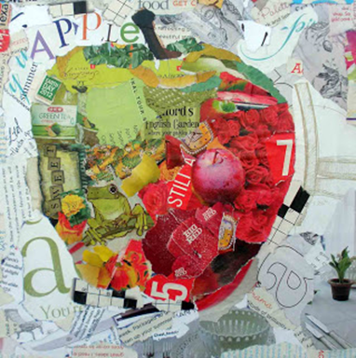
Creative techniques
Creative techniques may include:
Printing
Collages
Painting
Stencilling
Papier mâché.

Slide 41
Activity 3B

Slide 42
Foster creativity through a learning framework
3.3 Plan and create opportunities for children to collaborate creatively with each other

Slide 43

Collaboration
Examples of collaborative activities include:
Singing
Composition
Dancing
Drama
Invention.

Slide 44
Activity 3C

Slide 45
Foster creativity through a learning framework
3.4 Involve children in critical reflection and solving real problems

Slide 46

Critical reflection
Help children to:
Reflect ON action – looking back on a past experience – The what?
Reflect IN action – considering action taken at various stages during the activity – So what?
Reflect FOR action – considering
what action they might wish to
take in future activities –
Now what?

Slide 47
Activity 3D

Slide 48
Foster creativity through a learning framework
3.5 Display children’s work in meaningful ways

Slide 49

Importance of displaying children’s work
Displaying children’s work:
Is visually appealing
Communicates to parents, peers and visitors
Demonstrates value
Demonstrates processes
Provides inspiration.

Slide 50

Ways of displaying children’s work
You can display children’s work:
On the walls of the learning environment
Notice boards
In the dinner hall
In the reception area and corridors of the establishment
In public libraries
In exhibitions for
parents/carers
To the children’s peers.

Slide 51
Activity 3E

Slide 52
Foster creativity through a learning framework
3.6 Design a flexible framework that can respond to children’s interests as they arise

Slide 53
Flexible framework
A flexible framework should have the following outcomes:
Children have a strong sense of identity
Children are connected with and contribute to their world
Children have a strong sense of wellbeing
Children are confident and involved learners
Children are effective communicators.

Slide 54
Flexible framework
A flexible framework should follow these principles:
Secure, respectful and reciprocal relationships
Partnerships with families
High expectations and equity
Respect for diversity
Ongoing learning and reflective practice.

Slide 55
Activity 3F

Slide 56
Provide experiences
4.1 Identify and provide a range of experiences used to nurture creativity
4.2 Provide opportunities for children to practise developing skills in music, movement, construction, visual art and dramatic play in both indoor and outdoor environments

Slide 57

Indoor environments
Indoor environments may include:
Classroom
Music room/recording suite
Theatre/dance studio
Gymnasium/sports centres and facilities
Technology work shop
Kitchen
ICT suite
Scientific laboratory
Museums
Libraries.

Slide 58
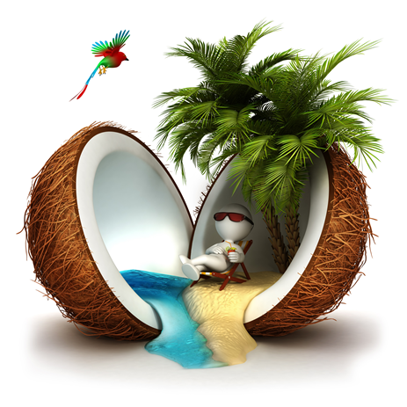
Outdoor environments
Outdoor environments may include:
Playground
Parks and woodland areas
Beach
Local community
Multi-sensory gardens
Mazes
Visits to historical monuments
Field trips.

Slide 59
Activity 4A

Slide 60
Evaluate experiences
5.1 Use a range of methods to evaluate children’s learning from the implemented creative experiences

Slide 61

Assessment of learning
The development of the child’s needs, interests, experiences and level of participation in the educational program, or simply the level of engagement they demonstrate
The academic progress of the
child measured against the
learning outcomes of the
educational program.

Slide 62

Assessment methods
Assessment methods include:
Written assessments
Question papers
Multiple choice tests
Picture tests
Oral assessment
Practical assessment
Listening tests.

Slide 63
Activity 5A

Slide 64
Evaluate experiences
5.2 Reflect on the evaluations and make ongoing modifications to the curriculum to stimulate interest and involvement in creative activities

Slide 65

Modifications to curriculum
Modifications to the curriculum may include:
Learning environments
Number of children in a group
Ratio of educator to child
Duration of activity
Difficulty of activity
Number of elements/tasks
within an activity
Assessment methods
Materials and equipment used
Topics and subject matter of activities.

Slide 66
Activity 5B

Slide 67
Summative Assessments
Summative assessments consist of:
Skills Activity
Knowledge Activity
Performance Activity.
Your assessor will provide you with further guidance on how and where to complete these assessments.

Slide 68

Summary and Feedback
Did we meet our objectives?
How did you find this session?
Any questions?

