Slide 1


Workplace Hazards
Ladder Safety

Slide 2

Introduction
What is a hazard?
A hazard is a thing or situation with the potential to harm a person.
What is a risk?
A risk is the possibility of harm (death, injury, damage or illness) occurring if someone was exposed to a hazard.

Slide 3

Responsibilities
Workers
You have a responsibility to take reasonable care of your health and safety.
Take reasonable care for the health and safety of others.
You must co-operate and comply with your employers WHS instructions.

Slide 4
Responsibilities
PCBU
You have a responsibility to ensure the health and safety of your workers.
You must provide and maintain a safe work environment.
Provide and maintain safe plant and structures and safe systems of work.
Provide information, training, instruction and supervision.

Slide 5
When looking into hazard identification, risk assessment and risk control, these sources can assist.
Legal
Legislation, Regulations, Codes of Practice
Australian Standards
Organisational
WHS Policies and Procedures
Safe Work Method Statements
Manufacturer
Operating Manuals
Manufacturer Specifications

Slide 6
Nature and Scope
WHAT IS THE MOST COMMON HAZARD OF LADDER USE? FALLS !!
Therefore there is a significant hazard and risk of serious injury and we must identify, assess and control this to protect our workforce.
We must consider our work environment, the tasks, materials we are using, talk to others such as safety officers, site managers, workers, supervisors, HSR’s etc. Continually inspect our work areas and consistently review information from regulators, manufacturer’s, SWMS and workplace incidents to ensure safety is maintained in the workplace.

Slide 7

Hazard Identification Ladders
Poor Condition
Material of Ladder
Use of the Ladder
Placement / Area
Type of Ladder

Slide 8
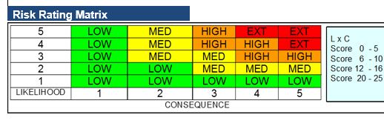
Risk Assessment
This Photo by Unknown Author is licensed under CC BY
CONSEQUENCE
How bad will it be if the hazard causes harm
LIKELIHOOD
What is the chance of the hazard causing harm

Slide 9
What can we do?
Is there an Alternative?
No Alternative!
Change the task
Scissor Lifts
Scaffolding
Portable Scaffolding
Man Cage Forklift
Meet Australian Standards
Material, Type, Weight Limits
Inspect before use, damaged?
Ground Placement/ Work Area
Maintain Points of Contact/ Avoid overreaching

Slide 10
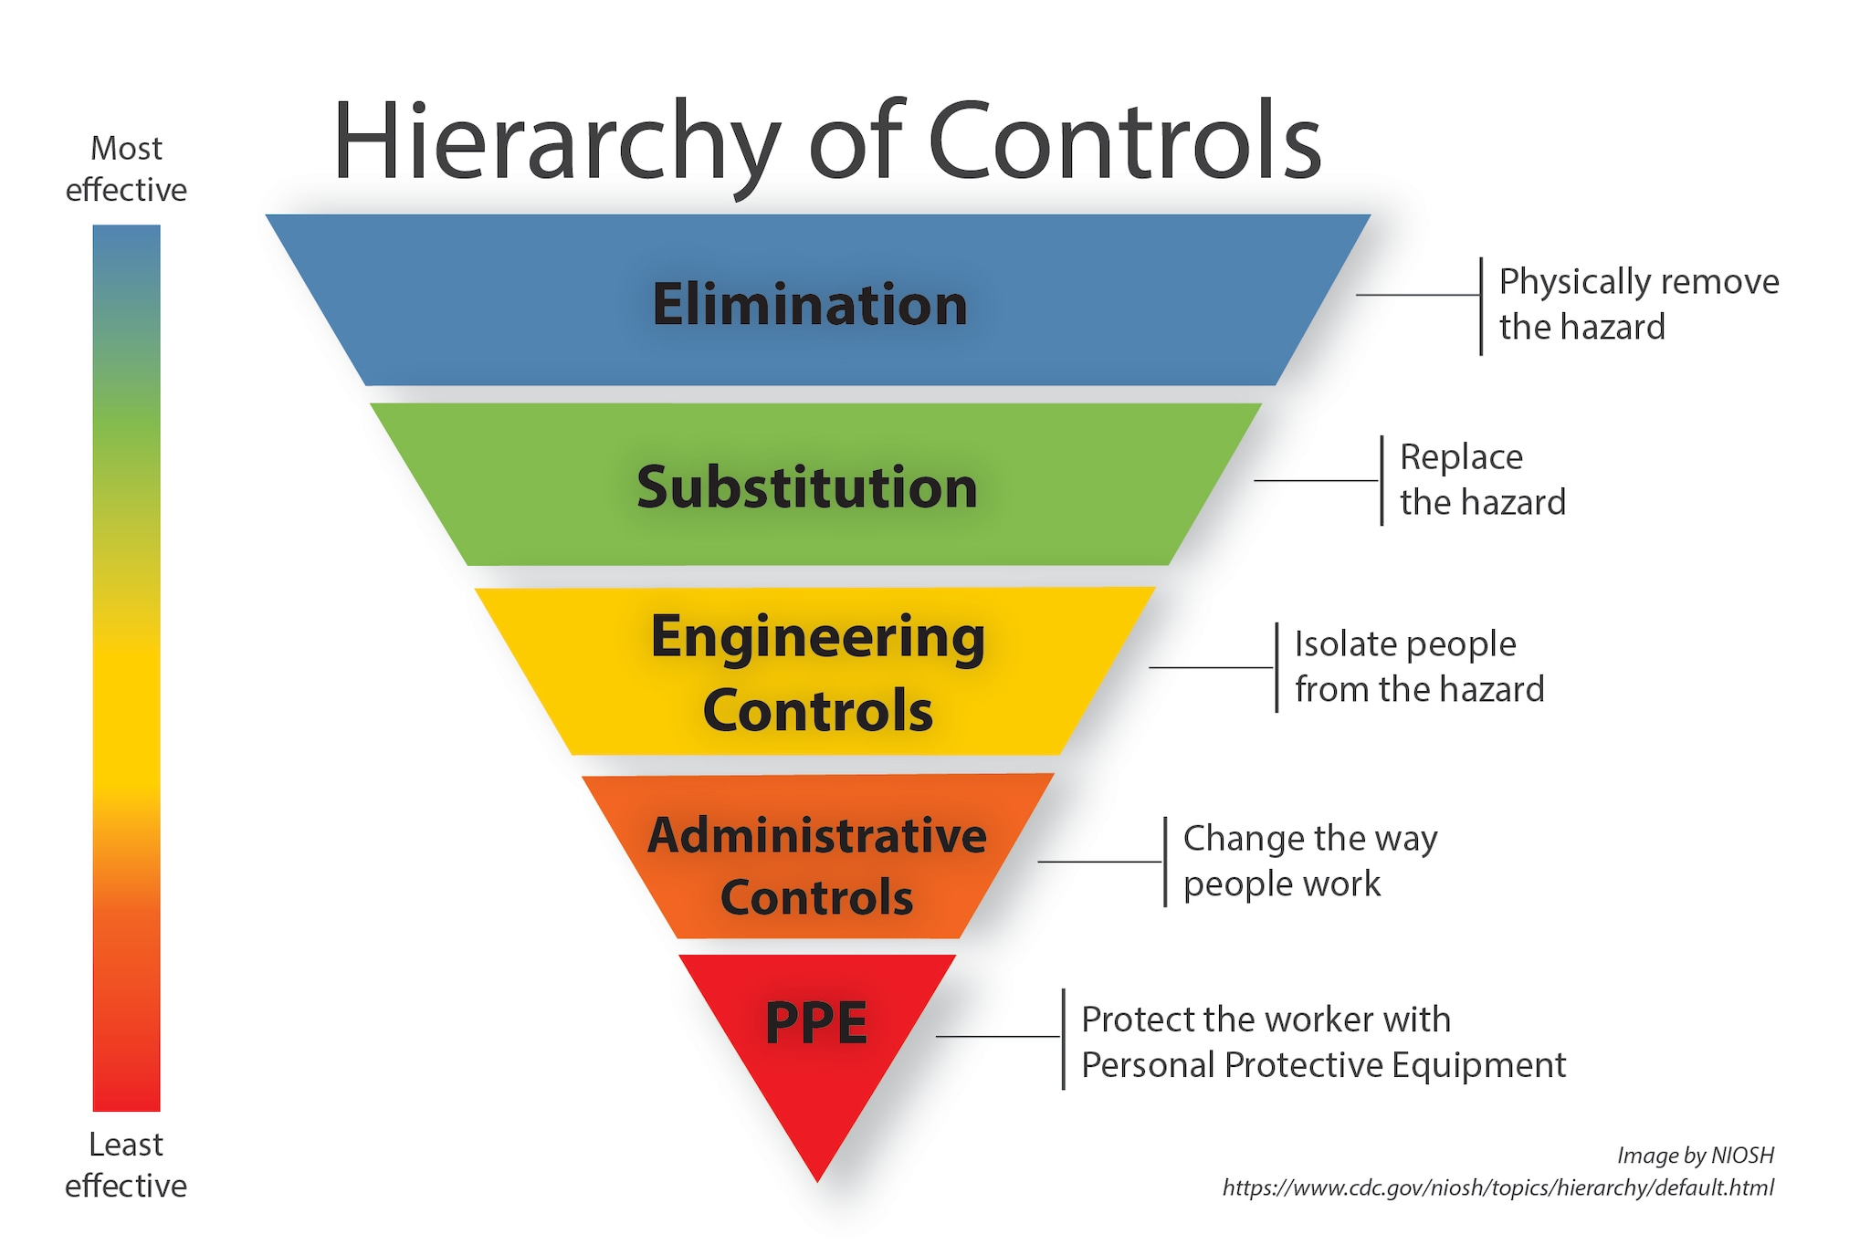
This Photo by Unknown Author is licensed under CC BY-NC

Slide 11
Evaluation of Controls
A PCBU must put additional controls in place to manage the risk of falls – www.worksafe.qld.gov.au
Regular reviews of controls must be conducted - consider
Did the controls introduced create another hazard?
Were the controls effective?
Have they been communicated and documented?

