Slide 1

HLTWHS003
Maintain work health and safety

Slide 2

Contribute to workplace procedures for identifying hazards and controlling risks
1.1 Identify existing and potential hazards and record them according to workplace procedures

Slide 3

WHS at work
Workplace procedures exist to guide and protect all staff in their work tasks, health and safety, and appropriate courses of action for the working environment.
Workplace Health and Safety (WHS) legislation exists to provide legal guidance for businesses and employers.

Slide 4

Hazards in the work environment
Hazards in the work environment may include:
Chemical hazards
Biological hazards
Workplace/physical hazards
Ergonomic hazards.

Slide 5

Identifying hazards
Inspect the workplace
Assess incident and accident reports
Consult with employees
Observe the workplace.

Slide 6

Workplace emergency procedures
There should be clear and up-to-date guidance for dealing with all kinds of emergency situations. These should be reviewed at regular intervals to ensure that they still meet safety requirements.

Slide 7

Activity 1A

Slide 8
Contribute to workplace procedures for identifying hazards and controlling risks
1.2 Contribute to the development of strategies for implementing risk controls in line with workplace procedures and policies

Slide 9

Risk assessment process
Once you have identified the hazards, you should conduct a workplace risk assessment. A risk assessment is vital to identifying the possible effects that hazards and potential hazards may have in the workplace.

Slide 10

Workplace policies and procedures for WHS
A requirement for work health and safety legislation is to provide a consultation process with employees on health and safety risks.

Slide 11

Risk categorisation
All risk should be categorised on:
The likelihood of the risk happening:
  rare
  unlikely
  likely
  most likely
The consequence of the risk occurring:
  low risk
  medium risk
  high risk

Slide 12

Strategies for controlling risk
Strategies to control risk include:
Stop the risk
Treat the risk
Transfer the risk
Tolerate the risk.

Slide 13
Activity 1B

Slide 14
Contribute to workplace procedures for identifying hazards and controlling risks
1.3 Implement risk controls in line with the hierarchy of risk control and workplace and legislative requirements

Slide 15

Implementing risk controls
The required changes will need to be made in line with workplace and legislative requirements; they must make safe the areas of concern so that employees are not put into situations of risk.

Slide 16

Hierarchy of risk controls
In order of effectiveness:
Elimination
Substitution
Isolation
Engineering controls
Administration controls
Personal protective equipment (PPE).

Slide 17

Specific risk controls
Hazardous manual tasks/lifting
Repetitive strain
Infection control
Chemical use
Using machinery.

Slide 18
Activity 1C

Slide 19
Contribute to workplace procedures for identifying hazards and controlling risks
1.4 Identify and report issues with risk controls, including residual risk, in line with workplace and legislative requirements

Slide 20

Assess your risk controls
Are the risk controls working as expected?
How has work tasks/work performance been affected by the risk controls?
Has the risk been taken away or lessened?
Are there occurrences of residual risk?

Slide 21

Residual risk
Residual risk is defined as the risk that remains after risk controls are put in place.

Slide 22

Reassess your risk controls
Determine the results of the implemented risk controls and for any residual risk.
To adjust any ineffective risk controls, it will be necessary to make a further risk assessment
The risks will need to be re-assessed and a new strategy of risk control will be required.

Slide 23
Activity 1D

Slide 24
Implement policies and procedures into work team processes
2.1 Regularly provide information about WHS policies and procedures to the work team

Slide 25

Work health and safety duties
The appointed person, responsible for health and safety duties at work will need to have a full understanding of work health and safety matters and to maintain/update their knowledge regularly
All workers should take reasonable care over their own and others health and safety at work.

Slide 26

Duty of care
The PCBU/employer should equip all staff with the correct knowledge and awareness of WHS policies and procedures for taking care in the workplace
Make sure you communicate health and safety procedures and any changes that may come into force.

Slide 27

Duty of care in law
Duty of care is written legally into the Workplace Health and Safety Act 1995 – it is a moral duty to anticipate possible hazards and causes of injury and do everything reasonably practicable to prevent/remove/ minimise these causes.

Slide 28
Activity 2A

Slide 29
Implement policies and procedures into work team processes
2.2 Provide information about identified hazards and the outcomes of risk assessment and risk controls to the work team

Slide 30

Communicating information to the work team
Discuss the hazards with your team and inform them of the processes that have been undertaken
Communicate regularly with them during the process of risk controls so that they are aware of when changes are being made and how successful these are.

Slide 31

Your team
Make sure your team:
Follow risk controls
Understand why the risk controls are in place
Know the outcomes that need to be achieved
Provide information and feedback on the controls as needed.

Slide 32

What should you provide?
You should provide:
Clear documented policies and procedures
The expectations required from your team/employees
Procedures when faced with situations of risk
Support and guidance on health and safety issues.

Slide 33
Activity 2B

Slide 34
Implement policies and procedures into work team processes
2.3 Monitor housekeeping practices to ensure that WHS policies and procedures are followed

Slide 35

Demonstrate safe housekeeping practices
Housekeeping at work is the practice of looking after and maintaining day-to-day work activities
You also need to make sure that your team follow correct daily work tasks to WHS policies and procedures.

Slide 36

Following procedures
You/your team may need to be involved in:
Purchasing of supplies and equipment
Maintenance of machinery/equipment
Responsibility of equipment, e.g. switching off computers
Keeping desks tidy and replacing items used, such as paper file copies or equipment
Re-stocking paper or stationery supplies.

Slide 37

Other housekeeping duties
As part of your duties to check that your team are following correct procedures and working as tasked, it may be necessary to take action to sort issues at work. These issues may involve changes within the work environment, management of workloads or issues of misconduct/bad behaviour.

Slide 38
Activity 2C

Slide 39
Implement policies and procedures into work team processes
2.4 Maintain WHS incident records in the work area according to workplace procedures and legislative requirements

Slide 40

Workplace incident records
Recording incidents within the workplace is necessary so that accurate documentation is made and kept
This is also a legal requirement and may need to be provided to work health and safety regulators, or other authorised bodies.

Slide 41

Records for emergency procedures
Records are needed as part of the emergency procedure and as part of the WHS legislative requirements; you must record all incidents and accidents, including those which do not result in injury.

Slide 42
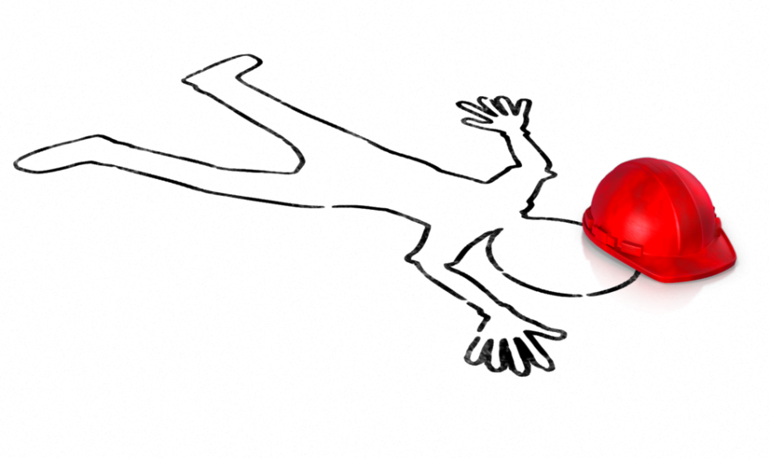
Workplace incident reports
Incidents that need reporting to work health and safety regulators are known as ‘notifiable incidents’. These are only the most serious of occurrences, and as such, require further direction from the regulator.

Slide 43
Activity 2D

Slide 44
Support consultation, cooperation and communication
3.1 Support workplace consultative procedures by encouraging work team participation in consultative activities

Slide 45

Consultation for work health and safety issues
Consultation is needed between duty-holders sharing work health and safety matters and between the employer and employees (WHS Act Part 5, 6 and 7).

Slide 46

Consultations
Consultations may include:
PCBU
Duty-holder(s)
Health and safety representatives (HSRs)
Health and safety committee
Management and employees.

Slide 47

Consultation for all employees
A consultation offers the chance to:
Talk about current work health and safety issues
Listen to others comments
Raise concerns
Sharing of information and viewpoints
Understanding the role of work health and safety in relation to the worker.

Slide 48
Activity 3A

Slide 49
Support consultation, cooperation and communication
3.2 Report health and safety issues in line with workplace procedures and legislative requirements

Slide 50

Keeping records
Legislative requirements for record-keeping and reporting are important to any organisation or workplace
Records will show accurate accounts and relay facts and statistics on incidents encountered
Records serve to protect both the organisation and employee from misrepresentation.

Slide 51

Report procedures
All health and safety records of incident and accidents should be checked and confirmed by those involved
After initial reports are made, take a record of the outcome
The organisation should keep their records safe and secure.

Slide 52

Issue resolution
If no written agreed procedure for issue resolution exists at your organisation, the default issue resolution process, as set out in the model WHS Regulations Part 2.2, should be followed.

Slide 53
Activity 3B

Slide 54
Support consultation, cooperation and communication
3.3 Encourage and assist work team members to contribute to WHS

Slide 55

Working together
Safety at work is best achieved when employer/ management work together with employees on making the workplace a safer environment.

Slide 56

Contribute to WHS at work
You should:
Ensure employer/management collaborate on WHS issues with staff
Plan effectively to remove production safety issues
Be respectful to all workers and show that all contributions on WHS matters are valued
Regularly communicate to all on health and safety concerns.

Slide 57

Industry-specific requirements
Regulatory requirements relevant to the particular industry/type of work you are involved with also need to be considered and factored in for health and safety.

Slide 58
Activity 3C

Slide 59
Summative Assessments
Summative assessments consist of:
Skills Activity
Knowledge Activity
Performance Activity.
Your assessor will provide you with further guidance on how and where to complete these assessments.

Slide 60

Summary and Feedback
Did we meet our objectives?
How did you find this session?
Any questions?

