Slide 1

CHCDIV001
Work with diverse people

Slide 2

Housekeeping
Emergency procedures
Mobiles and security issues
Break times and smoking policy
This course is interactive – ask questions
Practise respect and confidentiality
Ground rules

Slide 3
Objectives
Discover how to reflect on own perspectives
Know how to appreciate diversity and inclusiveness, and their benefits
Learn how to communicate with people from diverse backgrounds and situations
Understand how to promote understanding across diverse groups
Gain skills and knowledge required for this unit

Slide 4

Reflect on own perspectives
1.1 Identify and reflect on own social and cultural perspectives and biases

Slide 5
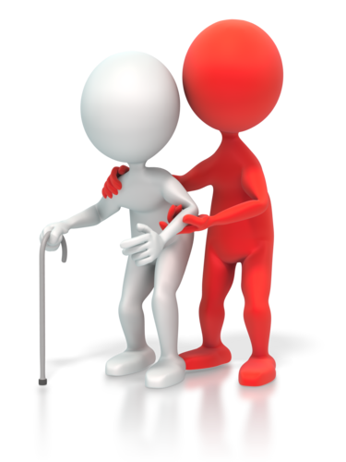
Your own social and cultural perspectives and biases
You have biases on the following:
Culture
Race
Age
Language
Sexuality
Appearance
Socio-economic standing
Cultural customs
Religion.

Slide 6

Activity 1A

Slide 7
Reflect on own perspectives
1.2 Work with awareness of own limitations in self and social awareness
1.3 Use reflection to support own ability to work inclusively and with understanding of others
1.4 Identify and act on ways to improve own self and social awareness

Slide 8
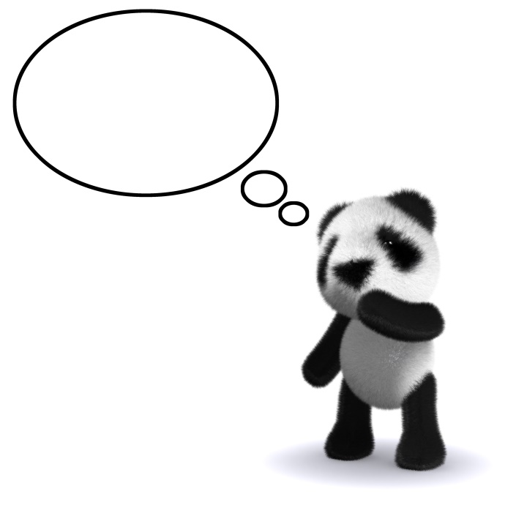
Awareness of your own limitations
Having awareness of self and social limitations will help you work more effectively with diverse people. This is because you are aware of your lack of understanding of other cultures.
This then means that, when you are faced with cultural behaviour and customs
different from your own, you will
likely react with more understanding
and a desire to educate yourself on
such customs and behaviours.

Slide 9

Identifying gaps in knowledge
You must realise the following:
The exclusion of certain cultures
Stereotypes
Cultural biases
Social attitudes
Culture shock
The history of different cultures, especially Aboriginal and Torres Strait Islander people
Cultures present in your environment
The experiences of your colleagues and clients
The origin of stereotypes and biases.

Slide 10
Activity 1B

Slide 11
Appreciate diversity and inclusiveness, and their benefits
2.1 Value and respect diversity and inclusiveness across all areas of work

Slide 12

Individual differences
Individual differences may include:
Ability
Age
Belief systems/values
Culture
Expertise/experience/working styles
Gender
Interests
Interpersonal style
Etc.

Slide 13

Appropriate behaviours
There are some working principles that can be considered:
Openness
Attentiveness
Empathy
Positive thinking
Awareness
Discovery
Body language
Sensitivity
Etc.

Slide 14

Case study – Cultural difference

Slide 15
Activity 2A

Slide 16
Appreciate diversity and inclusiveness, and their benefits
2.2 Contribute to the development of work place and professional relationships based on appreciation of diversity and inclusiveness

Slide 17

Developing workplace and professional relationships
One of the key issues is to make sure that company and organisational policies support change in working with a diversity of people.
With projected growth in the multi-cultural workforce in Australia, policies to facilitate change in the area of culture diversity will be essential.

Slide 18
Case study – Sponsored migration

Slide 19

Celebration of culture
By becoming an Australian citizen, a migrant is demonstrating their commitment to the Australian nationality and way of life.
The connection between citizenship and culture in Australia is celebrated annually on January 26 – a day known as Australia Day. Many citizenship investiture ceremonies are held on this day.

Slide 20
Affirmative action
'Affirmative action' is a policy approach to systemic discrimination against women within organisations and workplaces.
Affirmative action is the name given to a wide range of programs undertaken by organisations to achieve equal employment opportunities for women.
The approach of this policy model is to remove structural inequity that has become embedded in organisational practices and culture.

Slide 21
Case study – Females in engineering

Slide 22
Activity 2B

Slide 23
Appreciate diversity and inclusiveness, and their benefits
2.3 Use work practices that make environments safe for all

Slide 24

Creating an emotionally safe environment
In the field of cultural diversity, emotional safety is an important obligation because of the potential for conflict between cultural groups living within Australia.
With such a broad cultural picture, emotional safety cannot be left to chance or hope. In general terms, there is an obligation on the employer/organisation to be proactive in fulfilling their obligations.

Slide 25
Case study – Emotional safety

Slide 26
Activity 2C

Slide 27
Communicate with people from diverse backgrounds and situations
3.1 Show respect for diversity in communication with all people

Slide 28

Communication
You can expect to deal with a wide range of cultural and ethnic issues.
At times, these will be issues of difference; at other times, they will be issues arising from misunderstandings.

Slide 29
Activity 3A

Slide 30
Communicate with people from diverse backgrounds and situations
3.2 Use verbal and non-verbal communication constructively to establish, develop and maintain effective relationships, mutual trust and confidence

Slide 31

Establish, develop and maintain effective relationships, mutual trust and confidence
Establish rapport
Exchange information
Facilitate resolution of issues and defuse potentially difficult situations
Verbal communication issues
Non-verbal communication issues

Slide 32
Activity 3B

Slide 33
Communicate with people from diverse backgrounds and situations
3.3 Where a language barrier exists, use effective strategies to communicate in the most efficient way possible

Slide 34

Develop trusting relationships
You can do this by:
Working hard
Showing respect
Having a positive attitude
Co-operation
Keeping your word
Loyalty
Following all social, ethical and business standards.

Slide 35

Barriers to communication
Barriers to communication and individual issues can be a result of:
Lack of training
Lack of experience
Confidence issues
Cultural or language issues
Low morale
Negative attitudes
No incentives or recognition
Work overload
Personal issues.

Slide 36
Activity 3C

Slide 37
Communicate with people from diverse backgrounds and situations
3.4 Seek assistance from interpreters or other persons according to communication needs

Slide 38

Interpretation and translation
The Translating and Interpreting Service (TIS National) could potentially provide an appropriate service for staff and clients who do not speak English and need help communicating with you.
Further information on this service can be found at: http://www.tisnational.gov.au

Slide 39
Activity 3D

Slide 40
Promote understanding across diverse groups
4.1 Identify issues that may cause communication misunderstandings or other difficulties
4.2 Where difficulties or misunderstandings occur, consider the impact of social and cultural diversity

Slide 41

Causes of communication misunderstandings or other difficulties
Discrimination
Stereotypes
Language barriers
Personal issues
Different perspectives
Personal opinions
Past experiences.

Slide 42
Case study – Parent at work

Slide 43
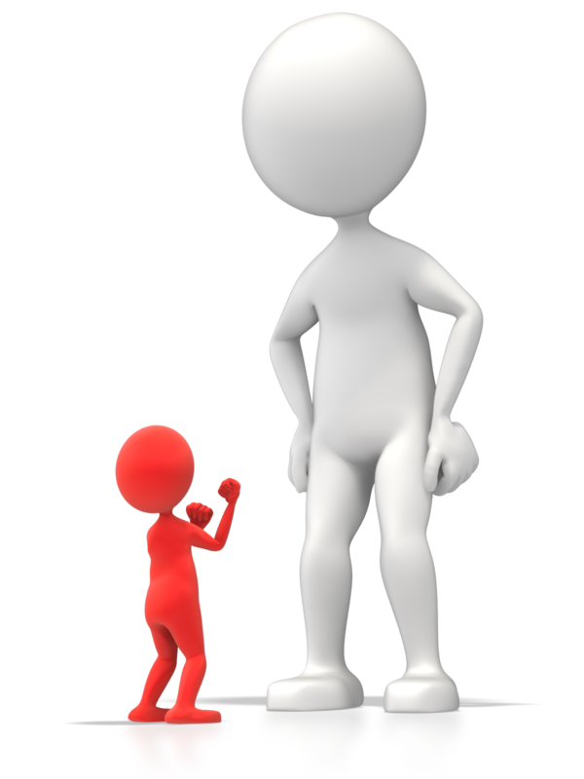
Barriers to effective relationships
Include:
Knowledge
Attitudes
Experience
Cultural dominance

Slide 44
Activity 4A

Slide 45
Promote understanding across diverse groups
4.3 Make an effort to sensitively resolve differences, taking account of diversity considerations

Slide 46
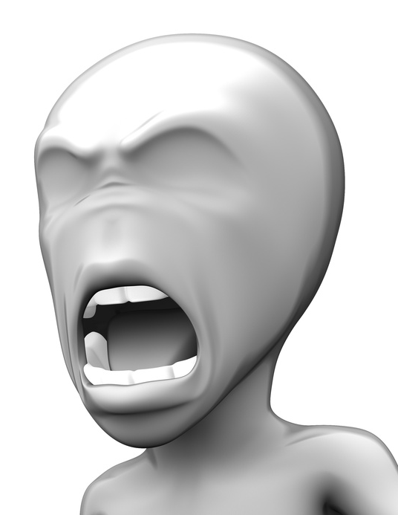
Conflict resolution tools
They include:
Identify the presenting problem(s)
Discover the key stakeholders
Understand legal compliance obligations
Consider the depth of feeling around the issues
Decide on an informal or formal approach
Determine who will lead the resolution process
Gain the agreement of the parties to participate in problem-solving
Etc.

Slide 47
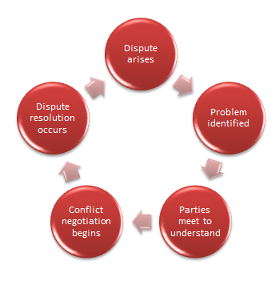

Slide 48
Activity 4B

Slide 49
Promote understanding across diverse groups
4.4 Address any difficulties with appropriate people and seek assistance when required

Slide 50

Dealing with difficulties
Closed or unreceptive attitudes
Mistrust or misunderstanding of people, organisations, systems and/or processes
Emotional states, such as fear, anger and frustration
Mistrust and conflict
Support
Interpersonal conflict
Intragroup conflict

Slide 51
Activity 4D

Slide 52
Skills and Knowledge Activity

Slide 53
Major Activity
This activity should take anywhere between an 1-2 hours to complete and can be found at the end of your workbook.
Your instructor will let you know whether they wish for you to complete it in session time or your own time.

Slide 54

Summary and Feedback
Did we meet our objectives?
How did you find this session?
Any questions?

Slide 55

Congratulations!
You have now finished the unit…
‘Work with diverse people’

