Slide 1

Pinnacle Incentive
Weekend
Present BY Precision Planning INC.

Slide 2


Objectives

Slide 3
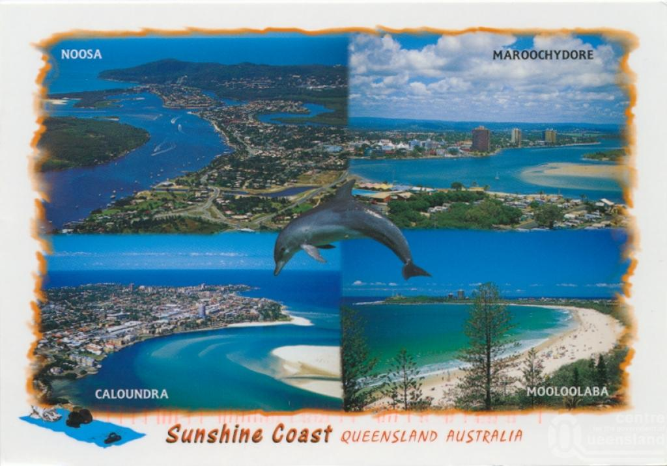
Location Choice
The Sunshine Coast was chosen as the ideal location for the Pinnacle Incentive Weekend for Fuji Xerox’s employees to have the best possible time.
The attitude of the Coast’s various attractions and Stunning coastal Beaches

Slide 4

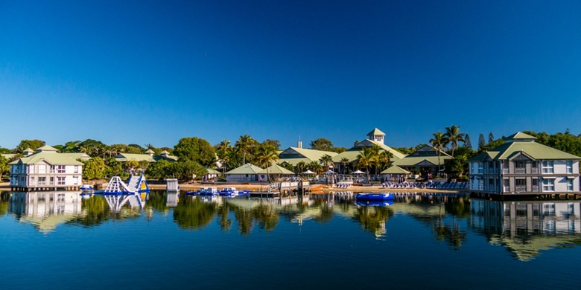
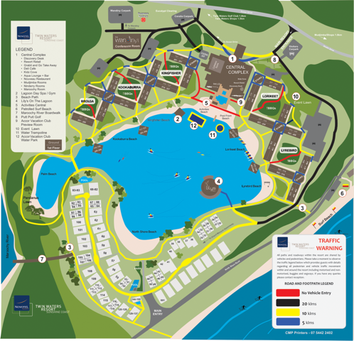
Accommodation Choice
http://www.novoteltwinwatersresort.com.au/

Slide 5
Day 1 Explained

Slide 6
Day 2 Reasoning
MUST HAVES:
Awards Cenermony, Dinner(Most Likker
.

Slide 7
Day 2 Proposal 1

Slide 8
Day 2 Proposal 1

Slide 9
Day 2 Proposal 2

Slide 10
Day 2 Proposal 2

Slide 11
Day 3 Explained

Slide 12
Partners

Slide 13
Administration And Organization

