Slide 1
Paynters Hazard Review –
Mobile Plant & Falling Objects
Identification, Risk Assessment & Review of Control Measures
Notes:
Introduce the meeting & explain it’s purpose. This company wide hazard review will be conducted over numerous meetings so that 2-3 hazards can be focused on each time. These meetings include senior managers & representatives from each position in the company (e.g. PM, CA, Foreman, Site Manager etc)

Slide 2
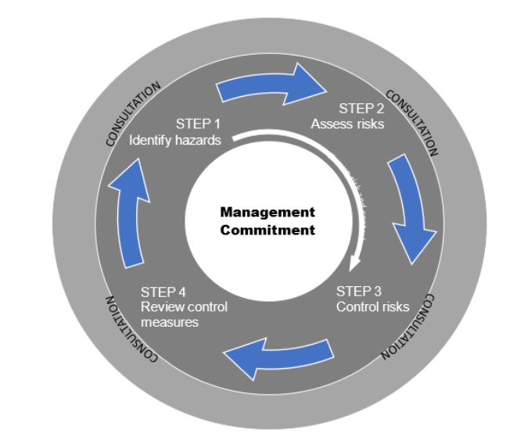
Risk Management Process
Notes:
Paynters risk management process is explained by using the above diagram. The importance of consultation in the risk management process is highlighted to attendees.

Slide 3
References
Legislation | Organisational (Paynters)
Work Health & Safety Act 2011 | HSEQ Policy
Work Health and Safety Regulation 2011 | Risk Management Standard
Australian Standard 4801:2001 | Risk Management Policy
How to manage work health & safety risks COP | HSEQ Management Plan
Managing the risks of plant in the workplace COP
Falling Objects Fact Sheet (Safe work Australia)
Notes:
The legislation & organisational policies, procedures & processes are outlined here so attendees know what Paynters are governed by & where they can go for further information.

Slide 4
Legal & Organisational Requirements
 | Legal | Organisational (Paynters)
Hazard Identification | PCBU have a duty to identify hazards PCBU to ensure appropriate processes are in place for receiving information regarding incidents, hazards and risks The organisation shall establish, implement, and maintain documented procedures for hazard identification, Consultation is required when identifying hazards | Identify hazards/aspects - find out what could cause harm through engagement with the workforce in a variety of ways. - Any new hazards/aspects identified during construction or design by subcontractors, consultants, or Paynters staff are to be recorded on the HSEQ Hazard Log. Copies of the HSEQ Hazard Log are to be returned to the HSEQ Department monthly
Notes:
Key legal & organisational requirements are summarised & put in terms that are easily understood. Having this side by side will help demonstrate how Paynters has implemented legal requirements.

Slide 5
Legal & Organisational Requirements
 | Legal | Organisational (Paynters)
Risk Assessment | PCBU have a duty to assess risks PCBU to establish, implement, and maintain documented procedures for risk assessment Consultation is required when assessing risks PCBU to refer to regulator publications, industry publications, fact sheets etc A risk assessment should be done when: there is uncertainty about how a hazard may result in injury or illness The work activity involves a number of different hazards and there is a lack of understanding about how the hazards may interact with each other Changes at the workplace occur that may impact on the effectiveness of control measures Risk assessment is to include: the likelihood of the hazard occurring & the degree of harm that might result, | To fulfil Paynters legal requirements surrounding risk management Assess risks in a systematic and structured way Assess risks/impacts – understand the nature of a hazard, how serious the consequences could be and the likelihood of it happening. Develop an organisational risk matrix & risk scoring system Project specific risk assessment to be completed before commencing any works Subcontractor risk assessment to be completed before onboarding
Notes:
Key legal & organisational requirements are summarised & put in terms that are easily understood. Having this side by side will help demonstrate how Paynters has implemented legal requirements.

Slide 6
Legal & Organisational Requirements
 | Legal | Organisational (Paynters)
Risk Control | A PCBU is required to— (a) eliminate risks to health and safety, so far as is reasonably practicable; and (b) if it is not reasonably practicable to eliminate risks to health and safety, to minimise those risks so far as is reasonably practicable. Consultation is required when making decisions on how to eliminate or minimise risks The organisation shall establish, implement, and maintain documented procedures for the control of the risks of activities, products and services All risks identified through the risk assessment process must be controlled through the hierarchy, based on reasonable practicality. Any specific requirements under the WHS regulation for the management of risk must be complied with (e.g. a duty to implement a specific control measure) Refer to information about suitable controls for many common hazards (e.g. codes of practice and guidance material, manufacturers and suppliers of plant, substances and equipment used in the workplace & industry associations and unions) | Ensure the risk management process implements control measures based on the hierarchy of control, with preference given to higher order controls (Controls are implemented from the top down)
Notes:
Key legal & organisational requirements are summarised & put in terms that are easily understood. Having this side by side will help demonstrate how Paynters has implemented legal requirements.

Slide 7
Legal & Organisational Requirements
 | Legal | Organisational (Paynters)
Monitoring Control Measures | PCBU to inspect the workplace PCBU to establish, implement & maintain documented procedures to monitor and measure performance & effectiveness of controls. PCBU to monitor control measure conformance with legislative & organisational requirements PCBU must review and, as necessary, revise control measures implemented under the WHS regulations to maintain, so far as is reasonably practicable, a work environment that is without risks to health or safety. PCBU must review measures if the control measure does not control the risk it was implemented to control so far as is reasonably practicable; | Review control measures to ensure they are working as planned Control Measures are evaluated for their effectiveness in a number of ways: Project Risk Assessments are evaluated through the Weekly HSEQ Site Inspections Internal audits Three monthly reviews of the Project Risk Assessment. Safe Work Method Statement’s are evaluated through the Task Observation Form The company HIRAC process is reviewed as part of the internal audit schedule, and at Senior Management level
Notes:
Key legal & organisational requirements are summarised & put in terms that are easily understood. Having this side by side will help demonstrate how Paynters has implemented legal requirements.

Slide 8
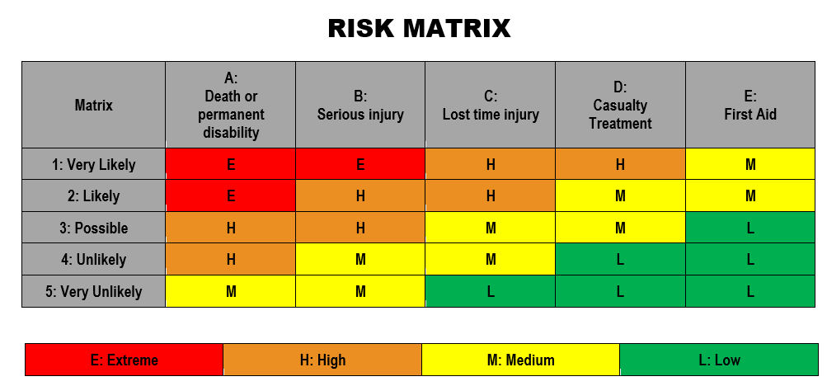
Common Scenarios & Associated Risk Assessment
Notes:
Attendees are then presented with the above scenarios. These have been chosen based off the most common hazards we see on our sites in the Mobile Plant & Falling Object categories. Notice that the control measures have not been included yet. Attendees will be asked to list & brainstorm suitable control measures shortly.

Slide 9
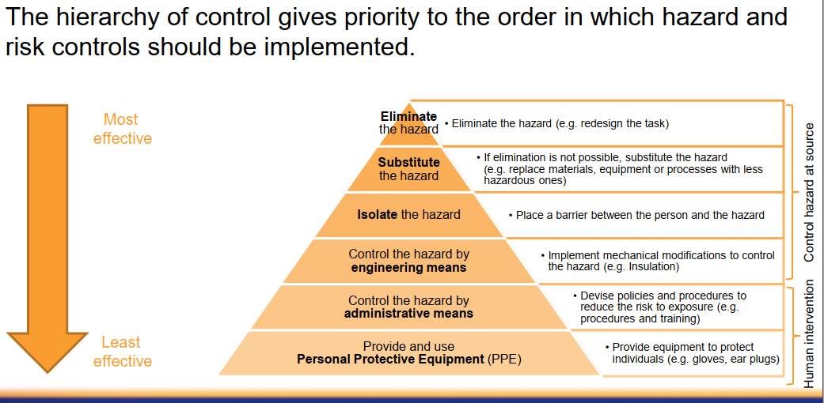
Hierarchy of Control
Notes:
The Hierarchy of Controls & Paynters risk appetite is explained to attendees (preference given to most effective controls).

Slide 10
Group Discussion
Notes:
10-15 mins of open discussion will be initiated where attendees will list/brainstorm appropriate control measures for the two scenarios presented.

Slide 11
Base Control Measures to be Implemented
Mobile Plant | Falling objects
Traffic control (where applicable) | Exclusion zones
Develop, maintain & comply with site Vehicle Movement Plan. Plan to be displayed in prominent location on site and communicated during inductions. | Containment screening
A designated construction site entry and exit is to be established. Ensure one-way travel of earthmoving plant wherever practicable. | Exclusion zones
An Information Handout is to be provided to truck drivers, clients, consultants and visitors to ensure they are aware of general on site hazards and rules. | Tool restraints (e.g. lanyards)
Appropriate licence / training of each mobile plant operator to be sighted & verified by site staff | Use tool bags and tool lanyards to minimise free-handling of items that could be dropped onto others below
In addition to the site compound, exclusion zones to be established to prevent mobile plant / personnel interactions. | PPE (hardhats)
Subcontractors to provide adequate supervision (e.g. spotter) to be provided where exclusion zone unable to be used | Subcontractor or worker is to consult with the PCBU before the control measures are implemented and the works starts to ensure highest level of control.
A delineated site compound (site sheds, amenities, storage containers, light vehicle parking) is to be maintained as an excluded area to that of general on site construction works. | An Information Handout is to be provided to truck drivers, clients, consultants and visitors to ensure they are aware of general on site hazards and rules.
Redirection of personnel (e.g. footpath closures) | Store material away from edges
Speed limit (10km) | Fastening materials down
 | Catch platforms
 | Closing a footpath way or road or adjoining area
Outline specific COP & fact sheets for 2 hazards
Outline HSEQ Management plan base requirements
Reference docs: Paynters HSEQ Management Plan, How to manage work health & safety risks COP, Falling Objects Fact Sheet, Managing the risks of plant in the workplace COP
Notes:
Attendees are shown the control measures that Paynters have already implemented. Any additional control measures raised by attendees during the group discussion will be addressed. The controls that sit higher on the hierarchy of controls will be highlighted.

Slide 12
KPI’s
Notes:
To further communicate Paynters risk appetite.

Slide 13
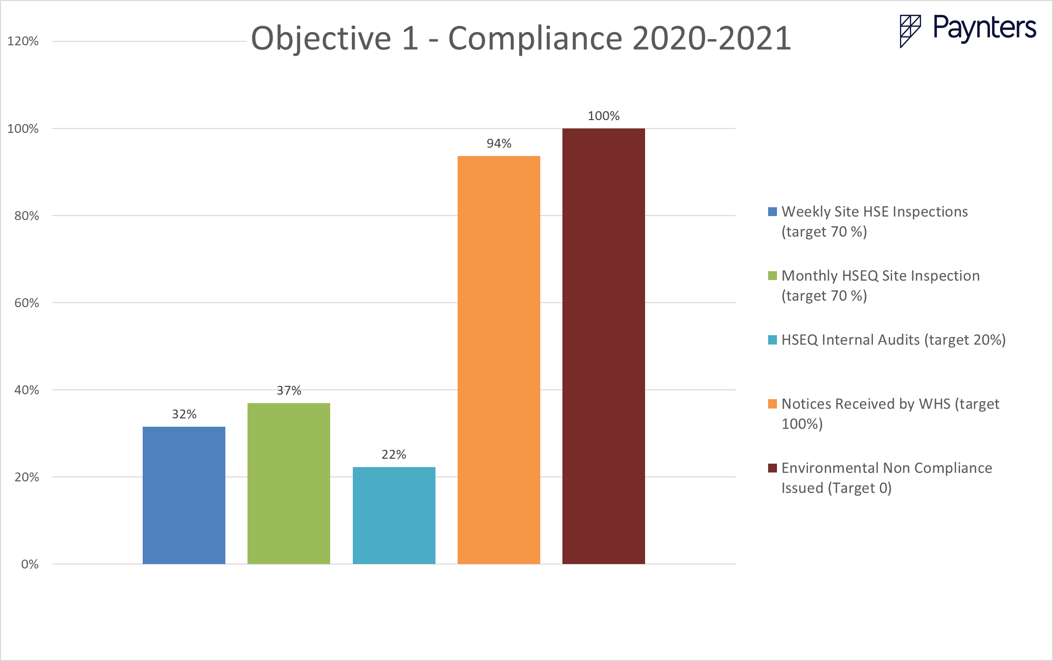
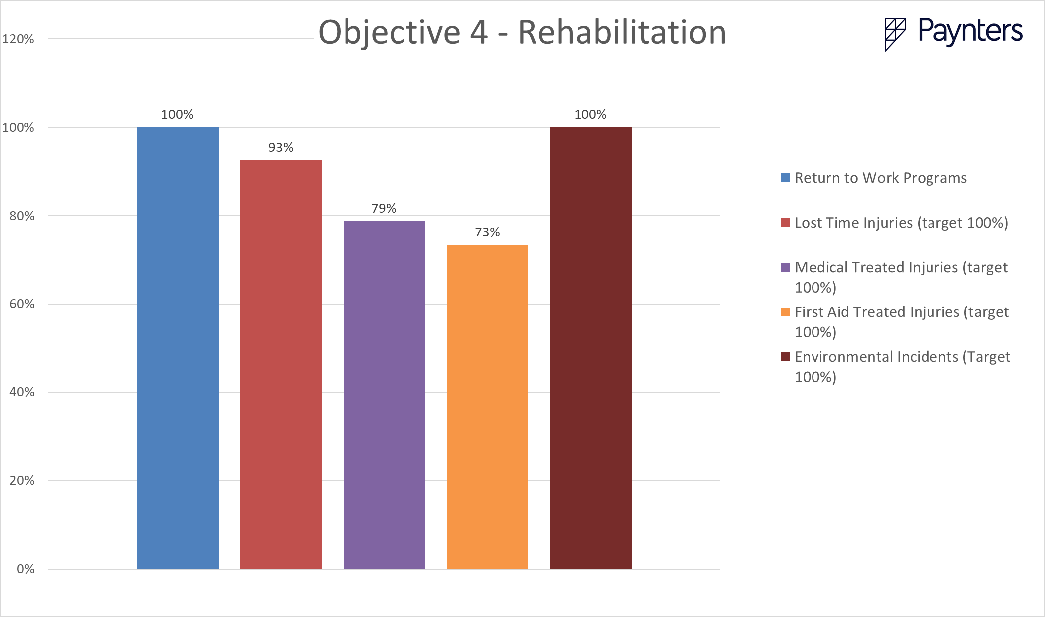
2020-2021 KPI Actual Achievement
Notes:
These graphs demonstrate how Paynters actually performed against some of their KPI’s in the last reporting year (July 2020-June 2021).
Note: These graphs have been created off of mock data

Slide 14
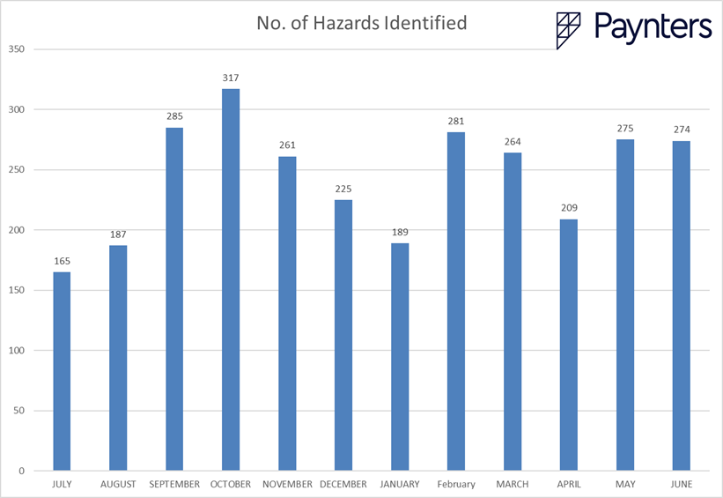
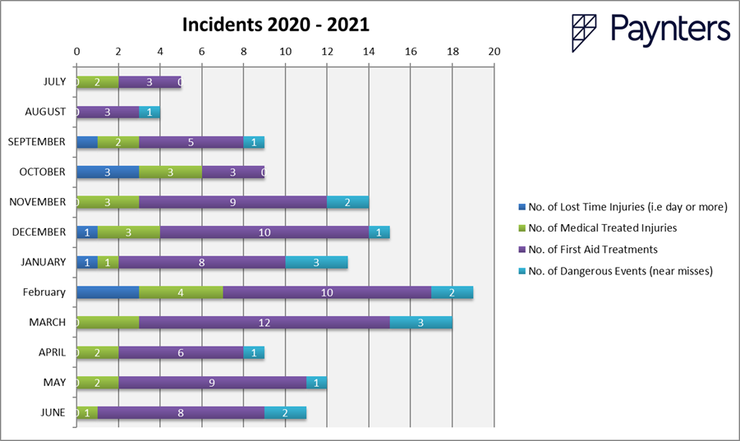
Statistics – Lead Indicators
Notes:
Use of real time data. Data trends & direct correlation between lead & lag indicators will be discussed. For example – hazard reporting was high in September & October resulting in less incidents. There are many other factors that can influence this data; hours worked, number of workers, type of work being conducted (HRW), no. of inspections conducted, no. of corrective actions raised. key statistics would be displayed in graphs & discussed with the group. Essentially, I would aim to communicate to staff that control measures do positively impact safety outcomes.
Note: These graphs have been created off of mock data

Slide 15
Responsibilities
Internal Reference Docs
HSEQ Management Plan - General
HSEQ Management Plan – Appendix B
Risk Management Procedure
HSEQ Policy
Position Specific Responsibility Statements
Subcontract Order
Notes:
The PCBU responsibilities have been noted/addressed throughout this whole presentation so this slide is focusing on the responsibilities of individuals within the company. To avoid an information overload/hundreds of slides, staff are referred to numerous internal documents that outline their responsibilities (all staff have access via Paynters intranet). Additionally, meeting minutes will be kept throughout this presentation & distributed to attendees. Any specific actions that have been created & assigned during the meeting will be addressed on the meeting minutes & assigned a completion date.

Slide 16
Next Meeting
Notes:
Staff are invited to ask questions and contact me if there are any ongoing questions/concerns. Staff are thanked for their attendance & advised that meeting minutes are to be distributed in the next few days (including a copy of this slideshow for reference).

