Slide 1
HSEQ RISK MANAGEMENT TOOLS UPDATE

Slide 2
BACKGROUND
Paynters are committed to the continual improvement of business policies, procedures & processes
In 2021, the HSEQ Team will focus on 2 risk management tools every quarter to determine their suitability to the workplace & if any improvements can/need to be made
This initiative is intended to involve all staff within the business.
Notes:
Explain the importance of staff involvement - to obtain an accurate representation of how a tool is used & live feedback on the success of any amendments/improvements

Slide 3
QUARTER 1
HAZARD LOG & SCAFFOLD REMOVAL CHECKLIST

Slide 4
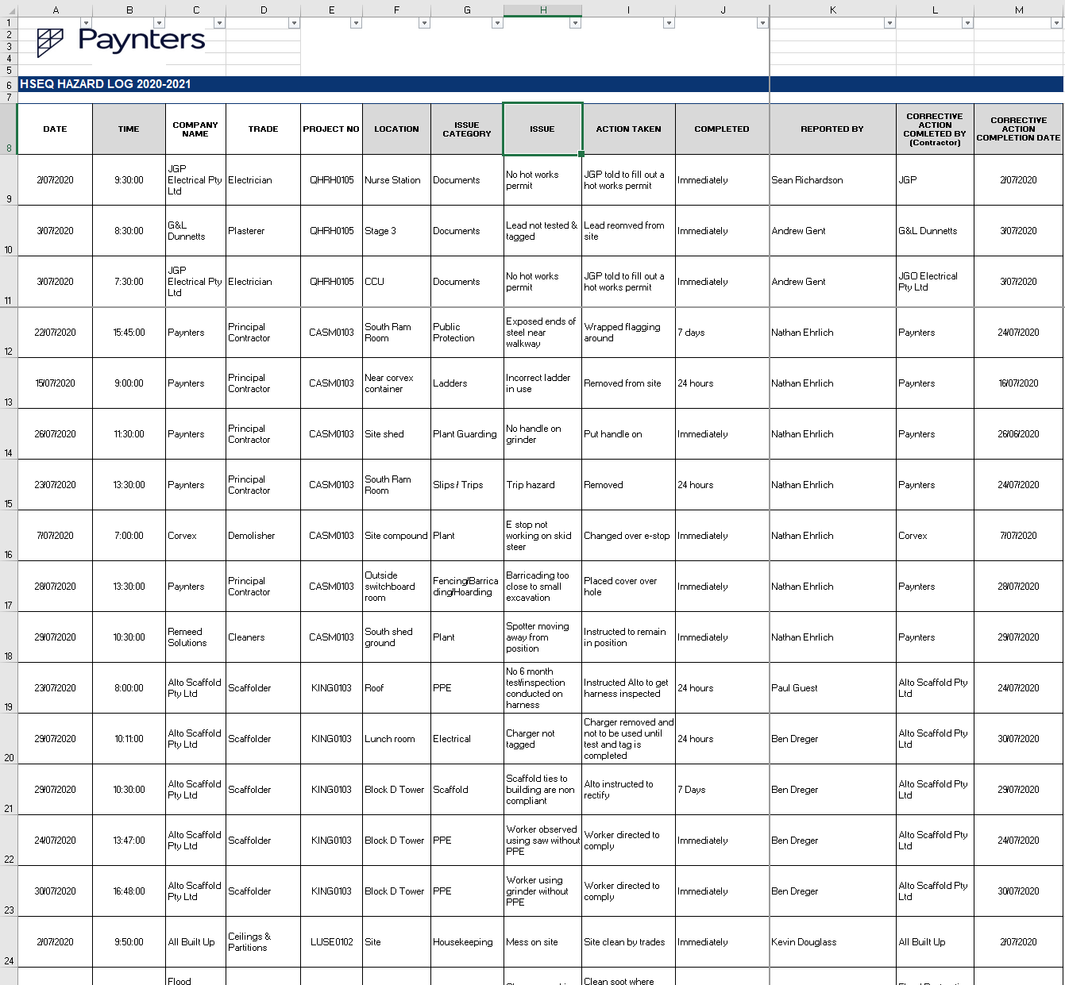
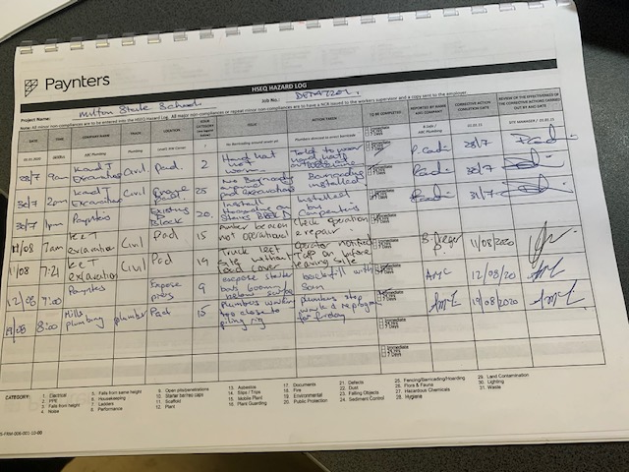
Hazard Log
In 2019-2020 a total of 2951 hazards were reported
Notes:
In this slide I would run through the current hazard reporting process (site staff record hazards in the paper log stored on site, paper log is submitted to the HSEQ Team every month as part of the HSEQ statistics)

Slide 5
Hazard Log Limitations
Time consuming
Hazards need to be manually entered into an excel spreadsheet by a member of the HSEQ Team
Resulting in approx. 50 hours of work throughout the year
Human error
E.g difficulty reading hand writing, missing a hazard when entering into the spreadsheet
Usability of data
Data cannot be finalised until the end of the year as there is often a lag in the data entry
Notes:
I would discuss the what happens after site staff submit their hazards every month (member of the HSEQ team has to manually enter hazards into a centralised excel spreadsheet).
This is particularly beneficial for site staff to know as its unlikely they’d realise how much work is needed after hazards were submitted. Some staff probably wouldn’t even question where their hazards go or what they are used for.

Slide 6
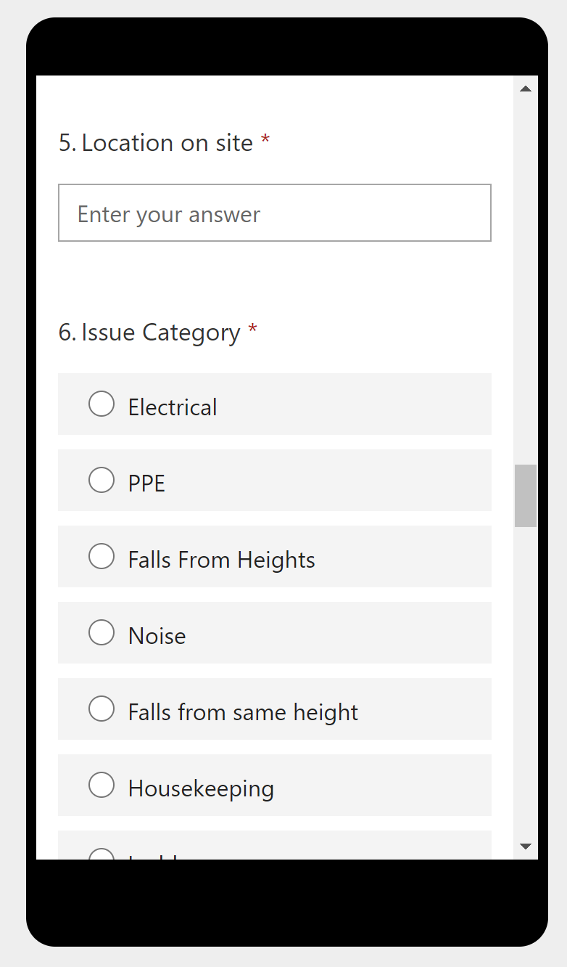
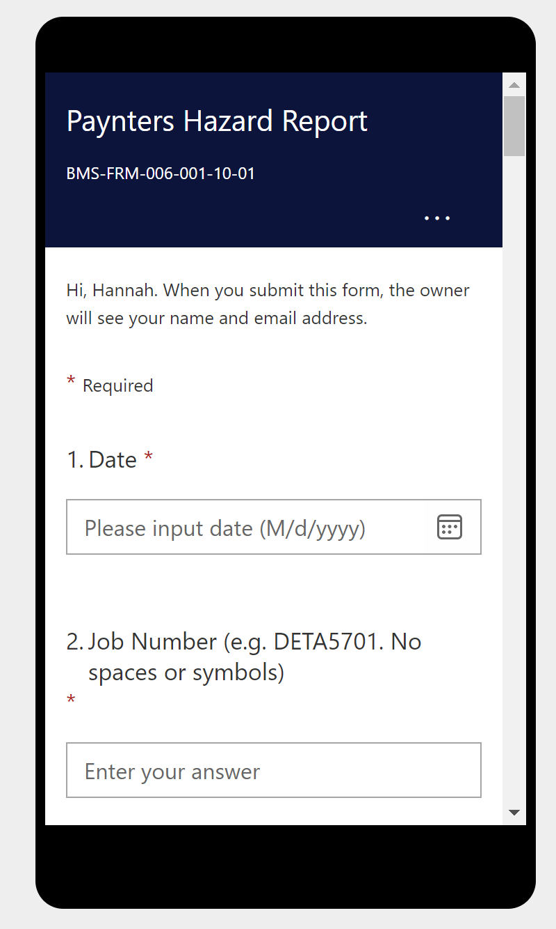
Hazard Log QR Code
Notes:
Here I would introduce the new process of entering hazards.

Slide 7
HOW TO USE THE QR CODE – MICROSOFT FORMS GUIDE
Notes:
I would invite all participants to get out there phone & use the following slides to step them through how to use the new hazard form.

Slide 8
Hazard Log - QR Code
1. Scan the QR code to open the Hazard form in your internet browser

Slide 9
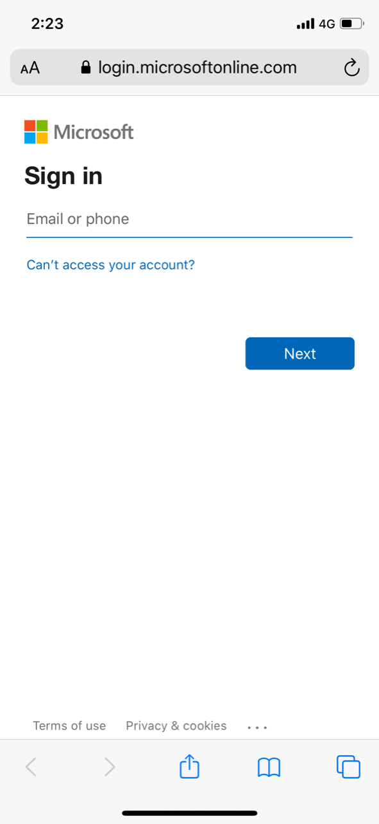
Signing into Microsoft
  2. The following screen may appear. Enter your Paynters email address & press “Next”.

Slide 10
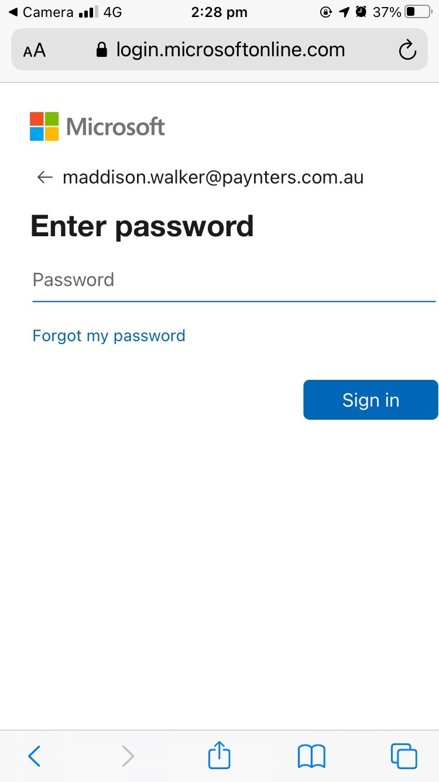
Signing into Microsoft
  3. Enter the password you use to log in to your computer & press “Sign in”

Slide 11
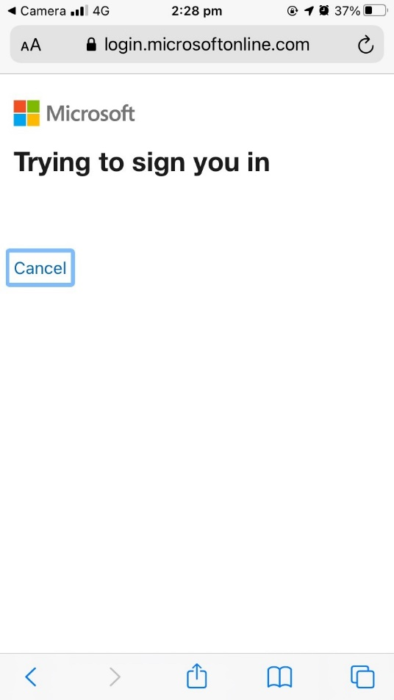

Signing into Microsoft
  4. It may take a minute to log in.

Slide 12
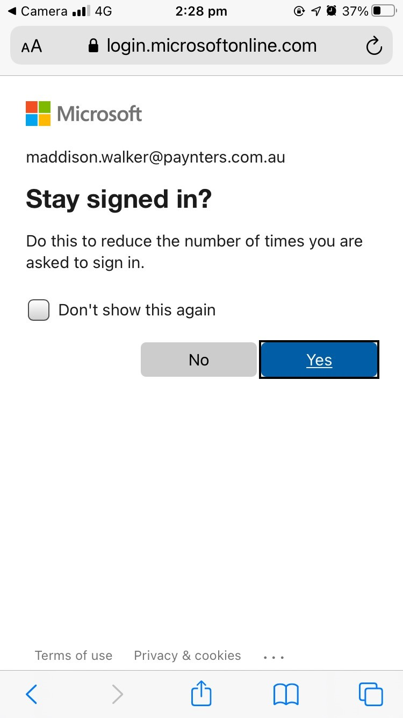
Signing into Microsoft
5. The following screen may appear. Press “Yes”.
After you complete this step, you should be redirected to the form.

Slide 13
ADDING A HOME SCREEN ICON

Slide 14
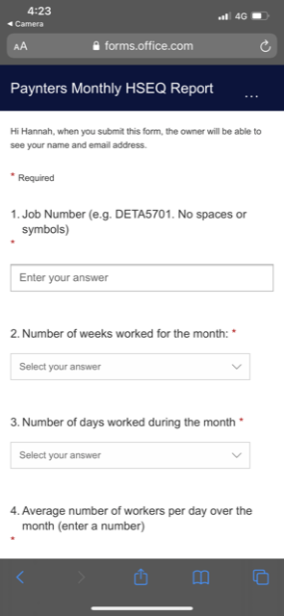
iPhone/iPad
1. Click the middle icon at the bottom of the screen.

Slide 15
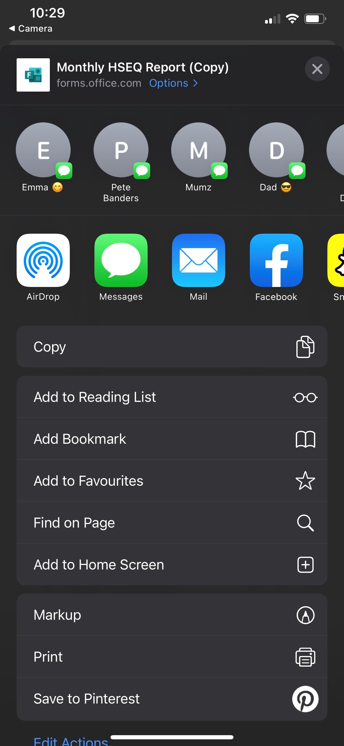
iPhone/iPad
2. A menu will appear. Scroll down and press “Add to Home Screen”.

Slide 16
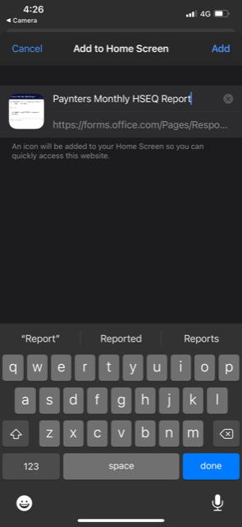
iPhone/iPad
3. Name the icon & press “Add”.

Slide 17
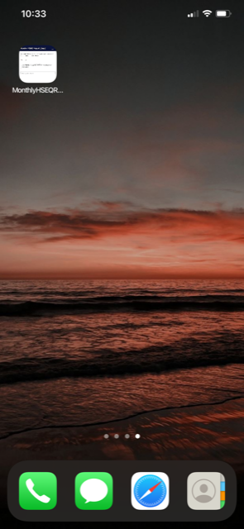
iPhone/iPad
4. You should now have a new icon on your home screen.

Slide 18
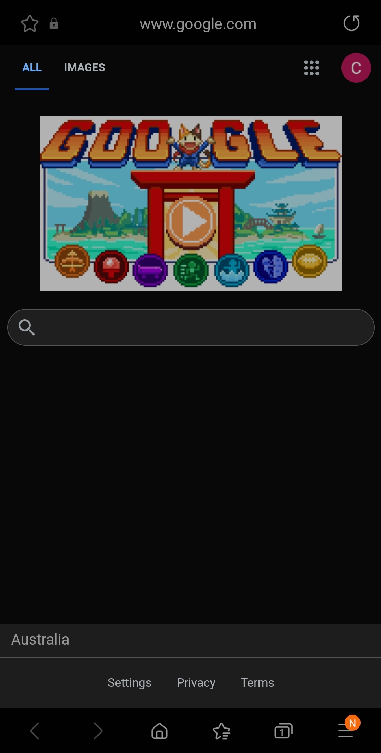
Android
1. Click the icon on the bottom right of your screen

Slide 19
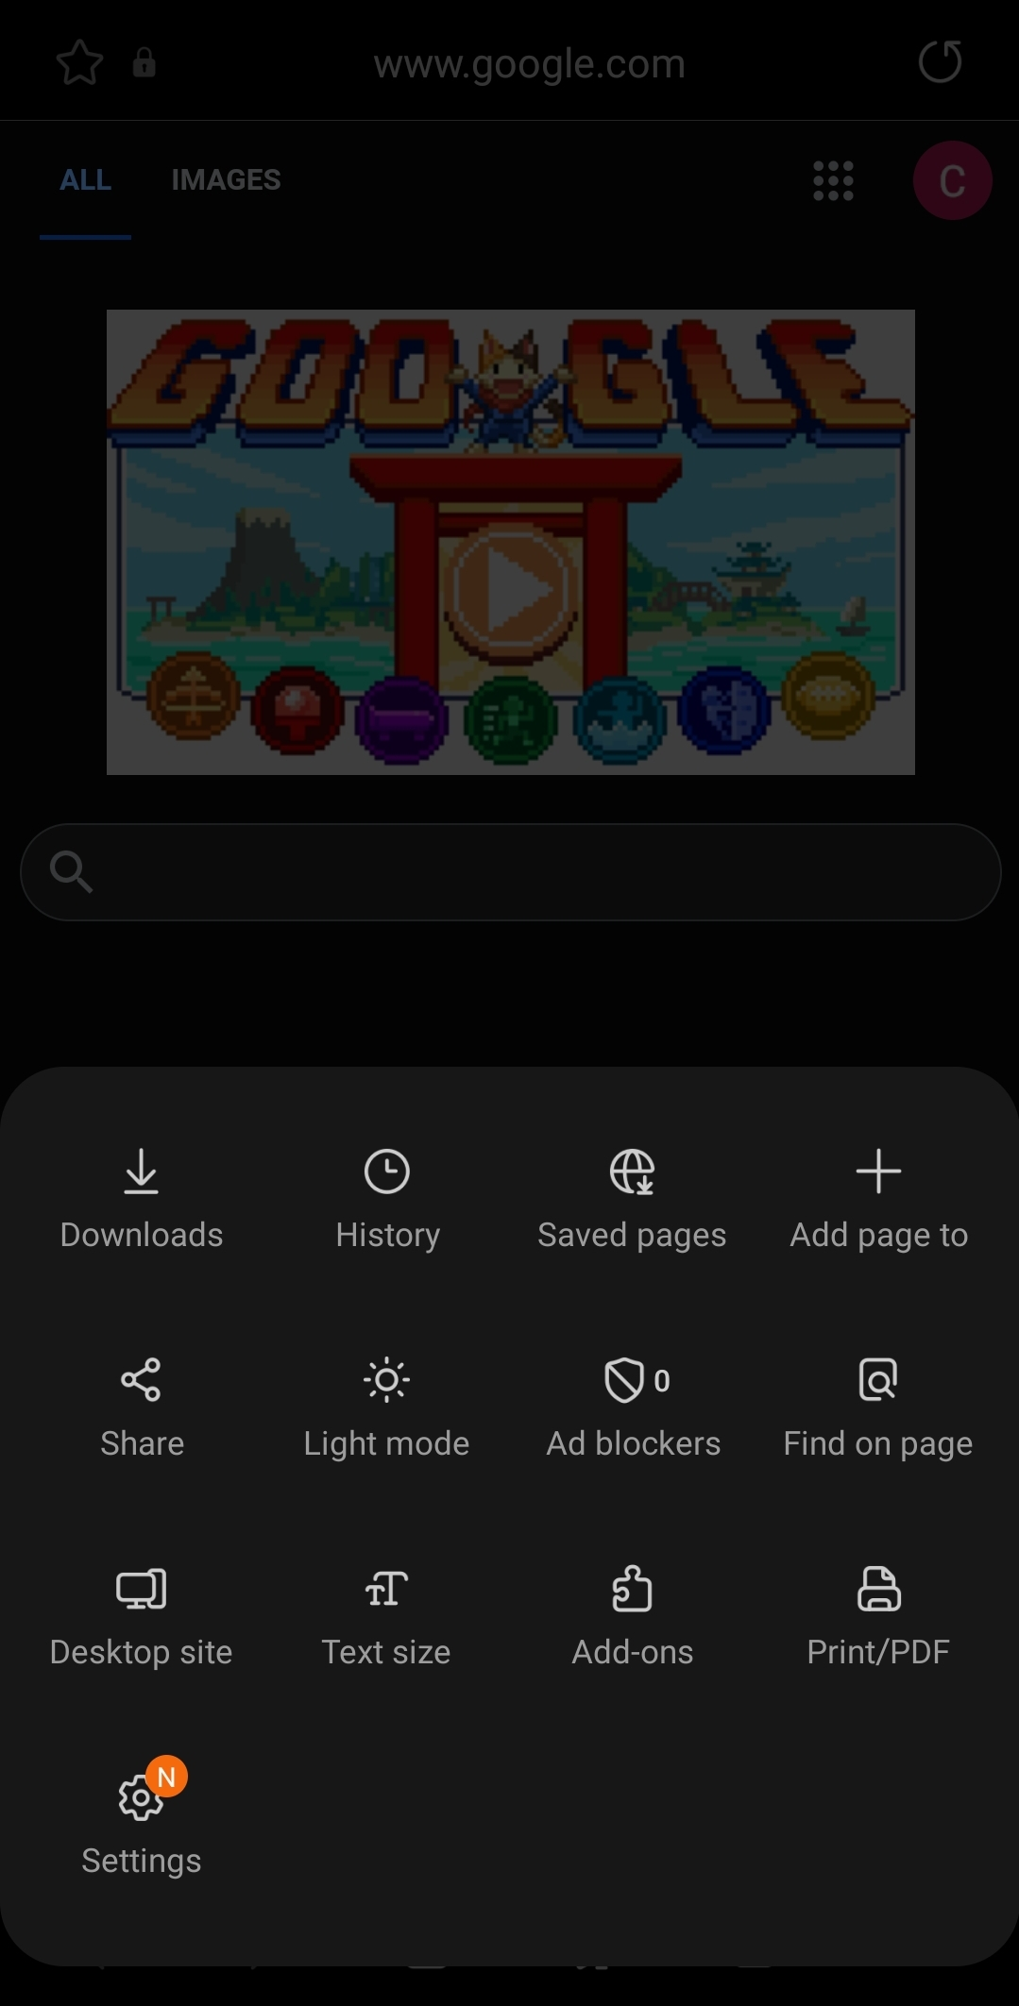
Android
2. Click “Add Page To”.

Slide 20
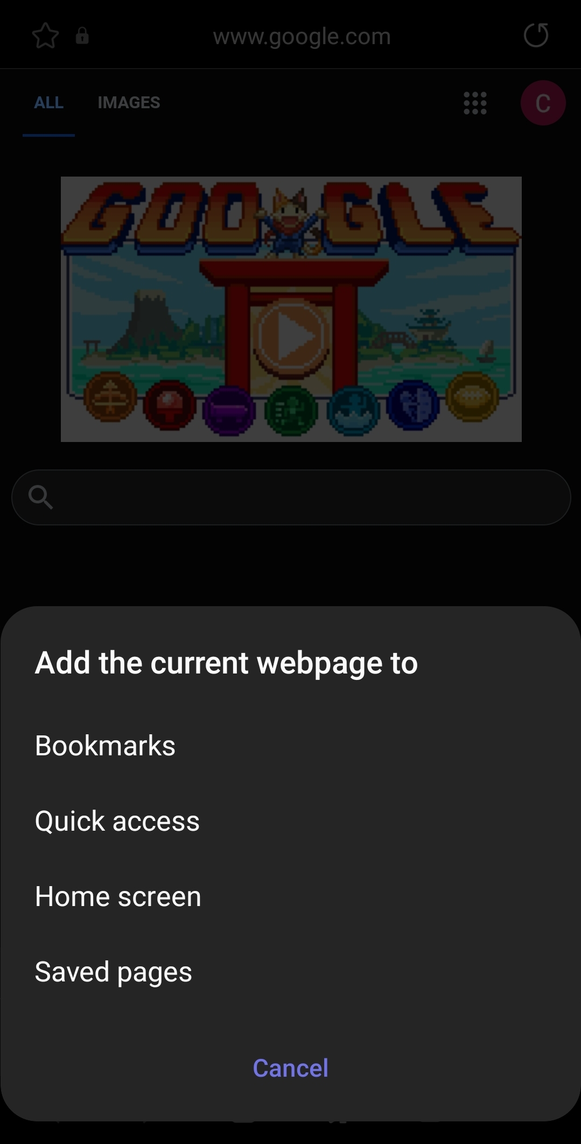
Android
3. A menu will appear. Press “Home screen”.

Slide 21
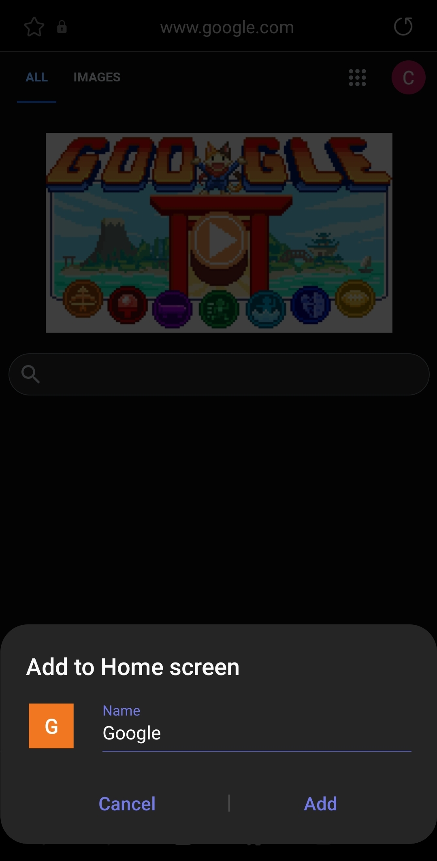
Android
4. Give the home screen icon a name (e.g. Hazard Log) and press “Add”.

Slide 22
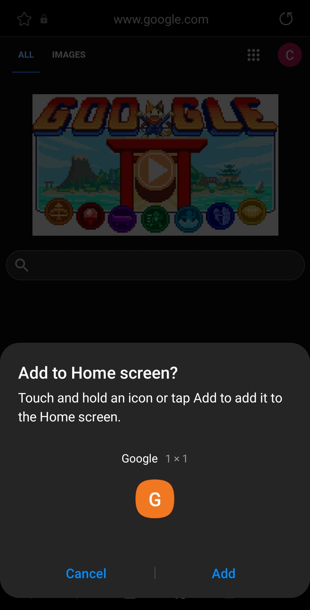
Android
5. Click “Add”.
You should now have an icon on your home screen.

Slide 23
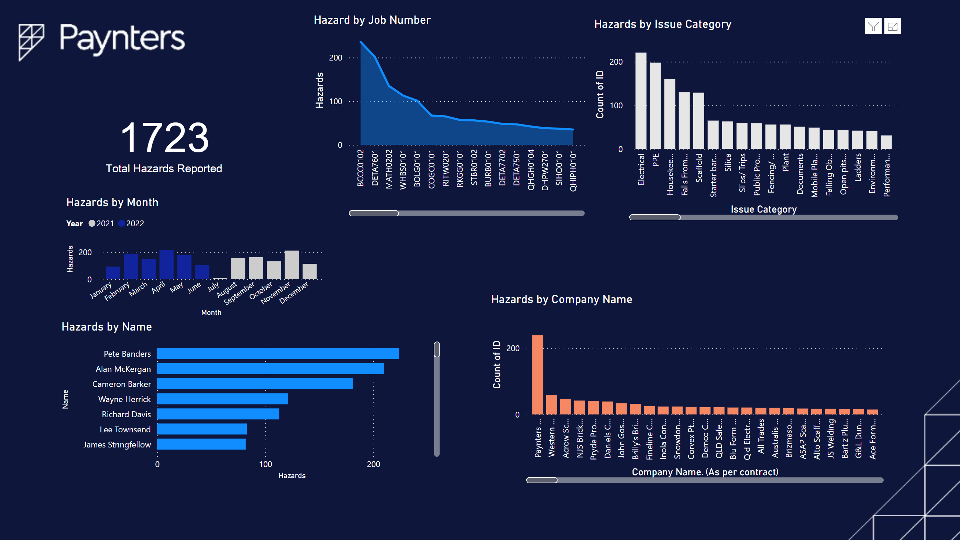
Benefits
Hazards identified across all sites will be displayed using Power BI
Staff can log hazards anywhere on site
Data is able to be used instantly (no manual data entry)
Subcontractors can log hazards
Sites can determine what their top hazards are & implement control measures accordingly

Slide 24
Roll out
The following resources will be distributed to staff:
A copy of this PowerPoint
A copy of the Hazard Report QR poster
Staff are to print the Hazard Report QR poster & display it in the site office
Trial/transition period of 1 month starting 1st July 2021
Paper hazards will be accepted during this period
Contact the HSEQ Team for any assistance
Any feedback on the form is appreciated

Slide 25
QUARTER 1
HAZARD LOG & SCAFFOLD REMOVAL CHECKLIST

Slide 26
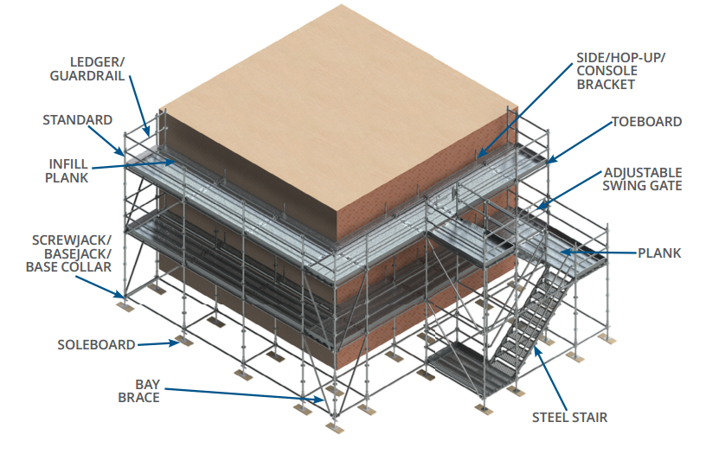
Scaffold Inspection Checklist
Non-compliant scaffold has been identified as a reoccurring non-conformance across the business.
To address this issue all site staff are encouraged to utilise the iAuditor Scaffold inspection checklist
Notes:
In this slide I would run through the current hazard reporting process (site staff record hazards in the paper log stored on site, paper log is submitted to the HSEQ Team every month as part of the HSEQ statistics)

Slide 27
Scaffold Inspection Checklist Limitations
Checklist is available on ASITE but is never used
Difficult to track results (no scoring system or obvious indication of a non-conformance)
Results aren’t shared or discussed with the project Team and HSEQ Team
Can’t attach photos
Notes:
In this slide I would run through the current hazard reporting process (site staff record hazards in the paper log stored on site, paper log is submitted to the HSEQ Team every month as part of the HSEQ statistics)

Slide 28
HOW TO USE THE iAUDITOR SCAFFOLD INSPECTION CHECKLIST
Notes:
I would invite all participants to get out there phone & use the following slides to step them through how to use the new hazard form.

Slide 29

iAuditor
Go to https://app.safetyculture.com/& click “Login”

Slide 30
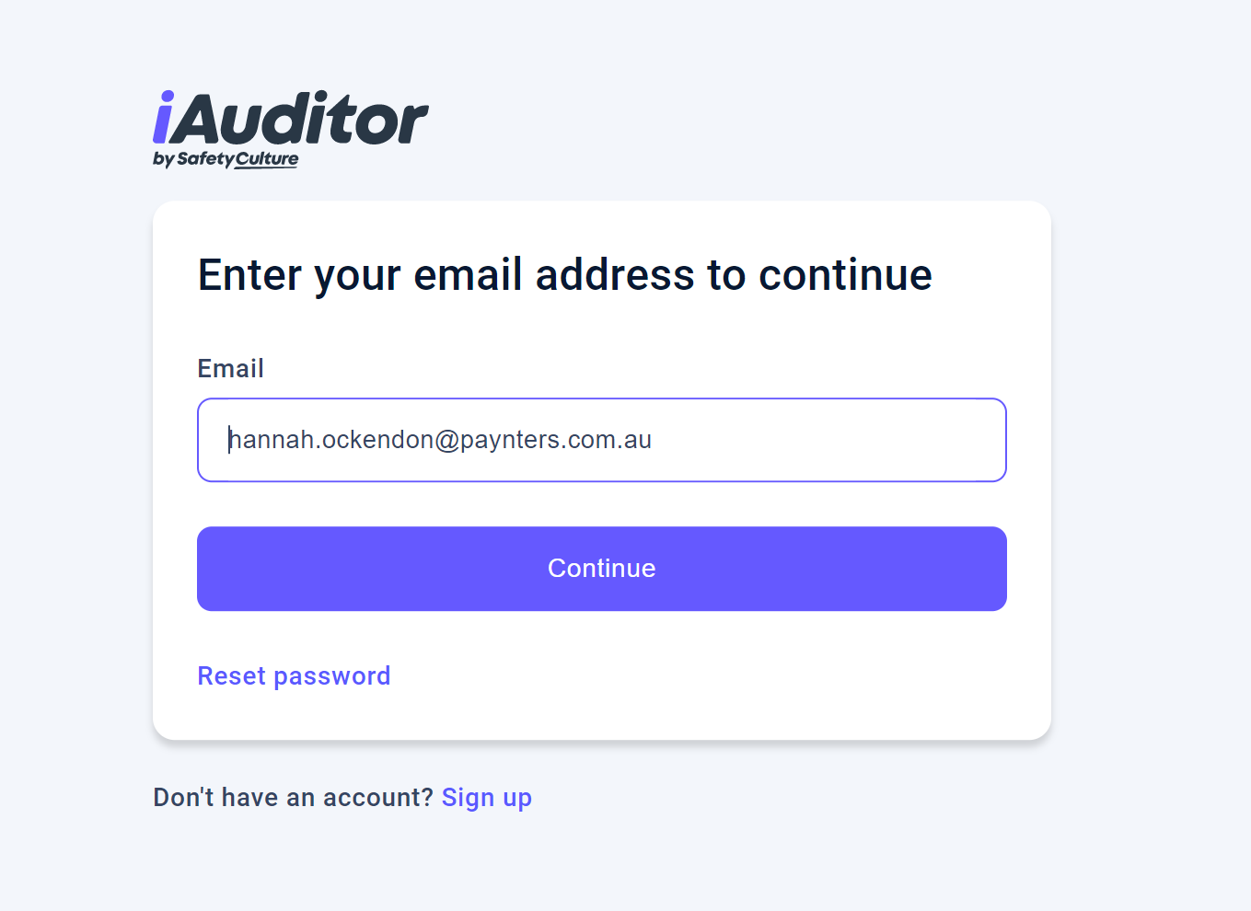
iAuditor
2. Enter your Paynters email address & click “Continue”

Slide 31
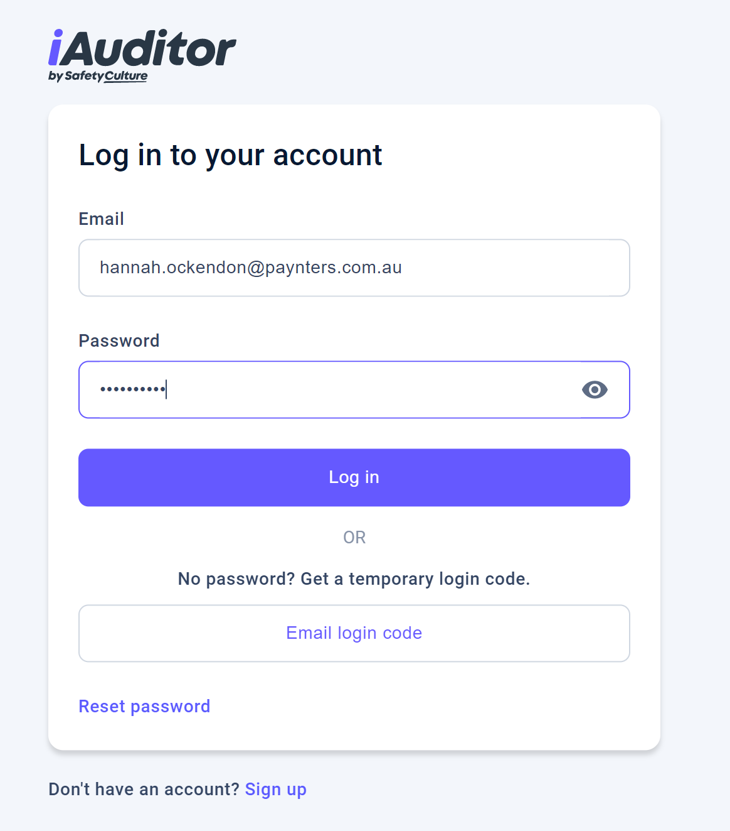
iAuditor
3. Enter your password & click “Log in”

Slide 32
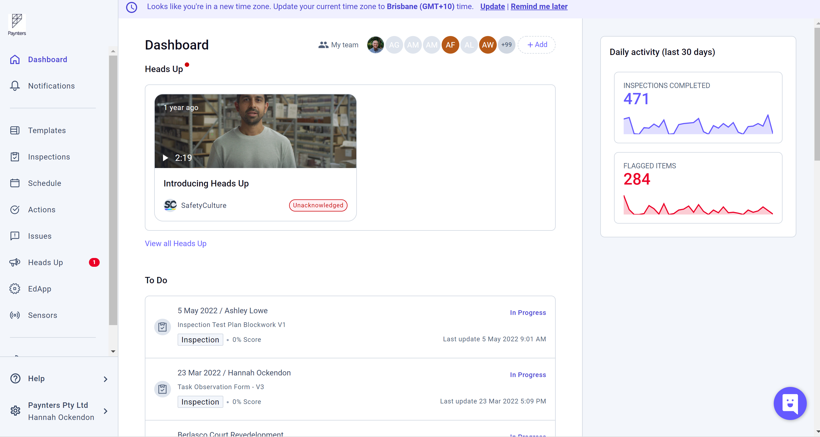
iAuditor
4. Once logged in, you will be taken to your iAuditor dashboard

Slide 33
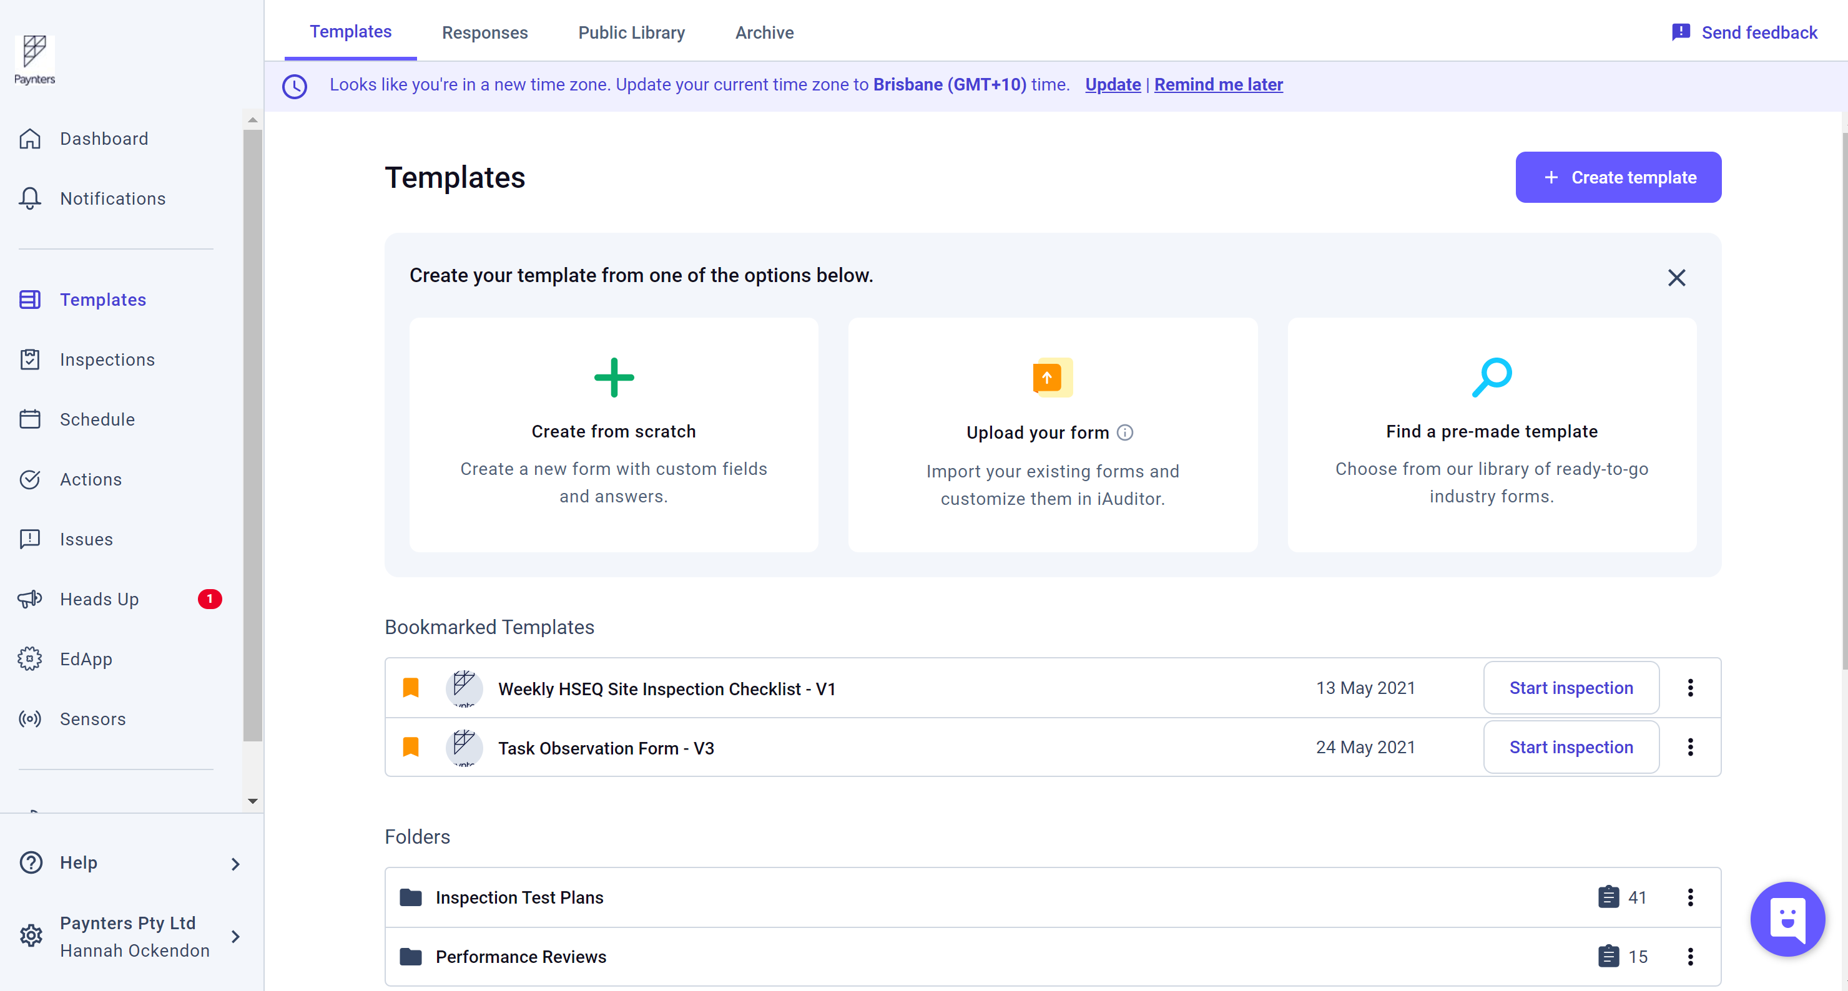
iAuditor
5. To access the Scaffold inspection checklist,
click on “Templates”

Slide 34
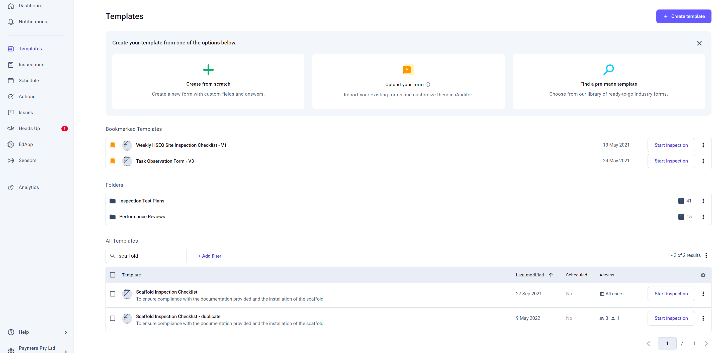
iAuditor
6. Scroll down until you see the search bar. Type “Scaffold” & press enter. The scaffold inspection checklist will appear
7. Click “Start inspection”

Slide 35
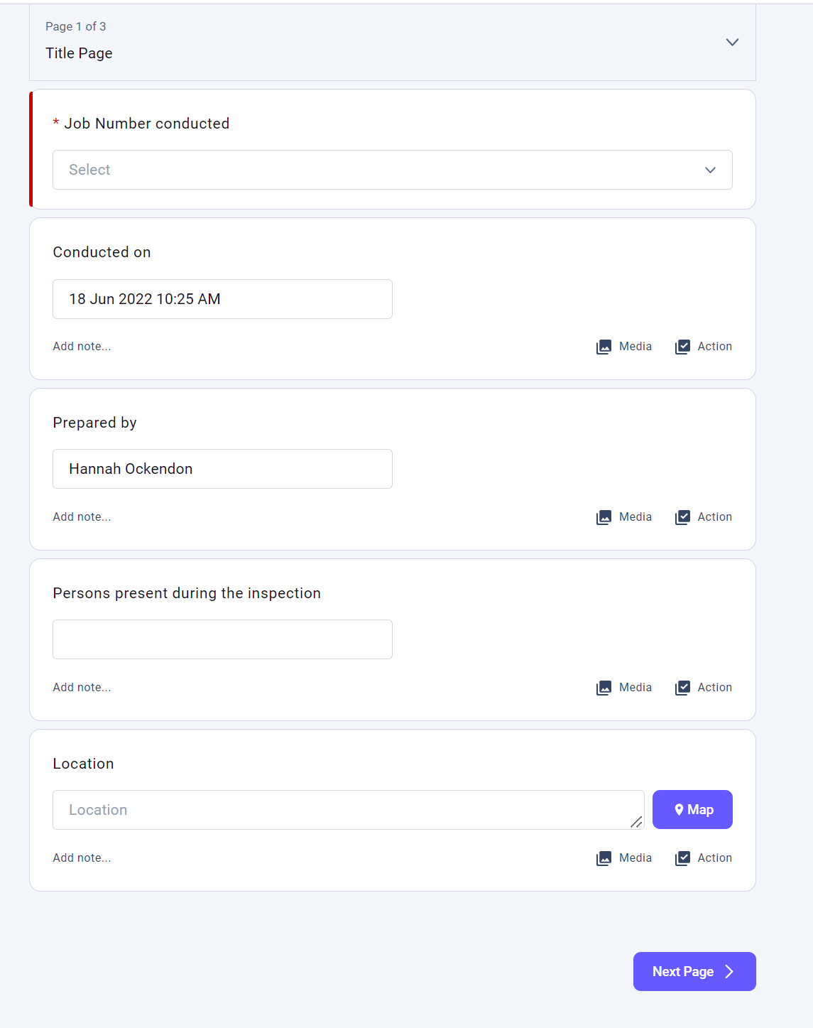
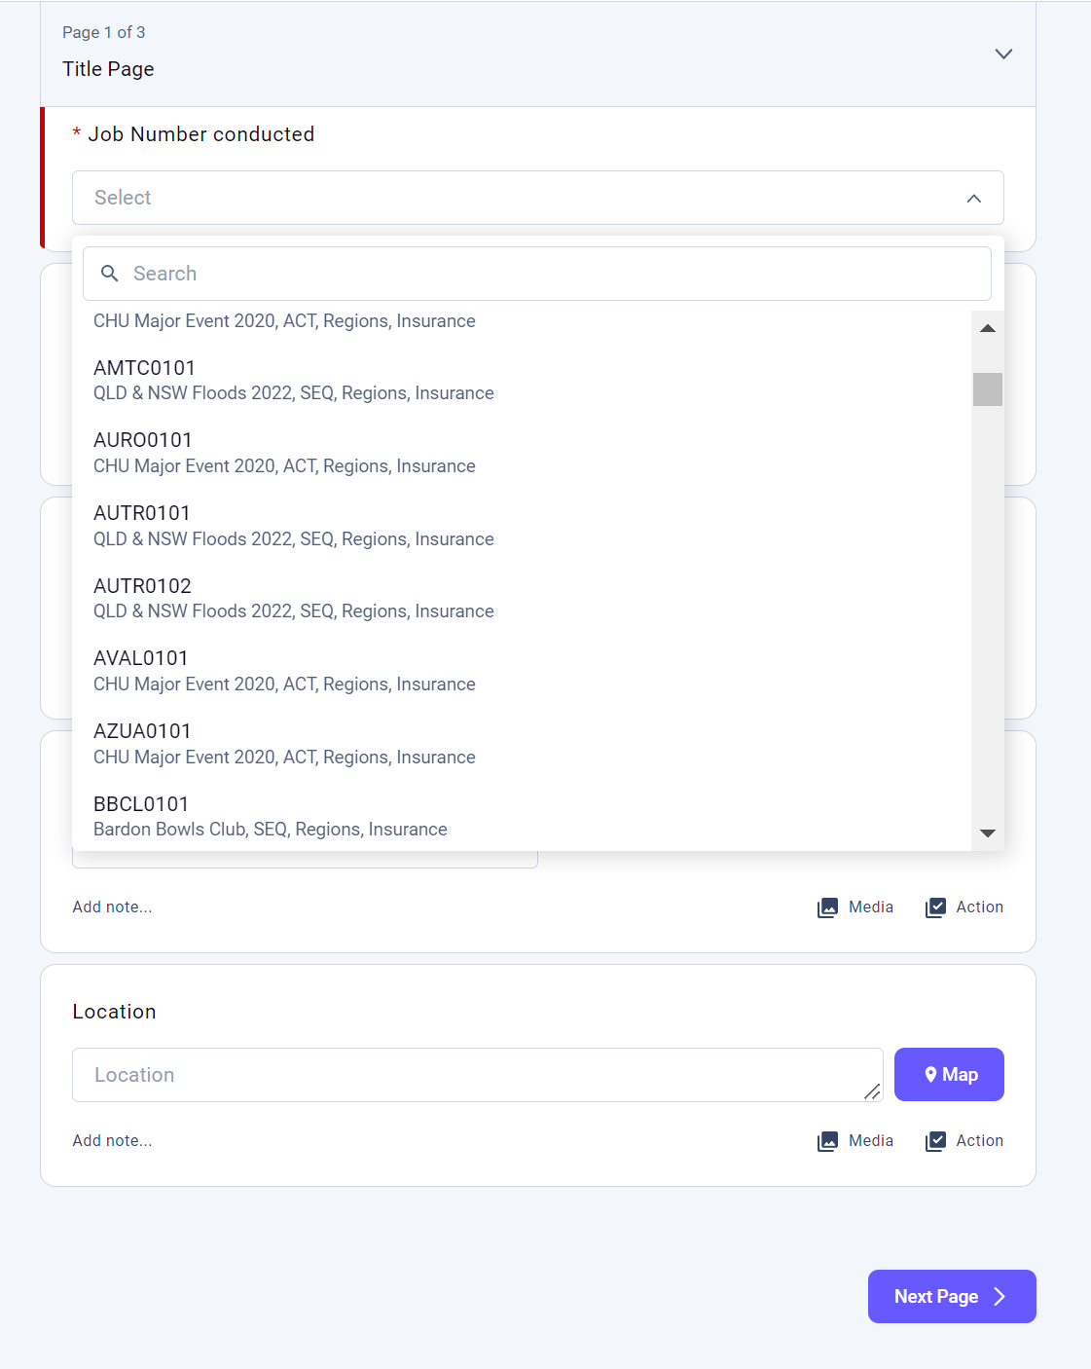
iAuditor
8. This is the inspection title page. Use the “Job number conducted” drop down menu to find your project

Slide 36
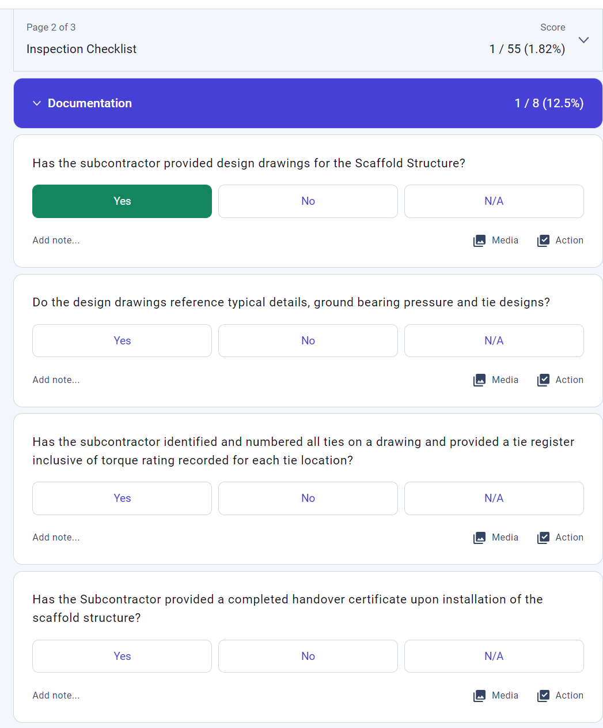
iAuditor
9. For each question users will have 3 answers to choose from
10. Users are encouraged to also add comments & photos

Slide 37
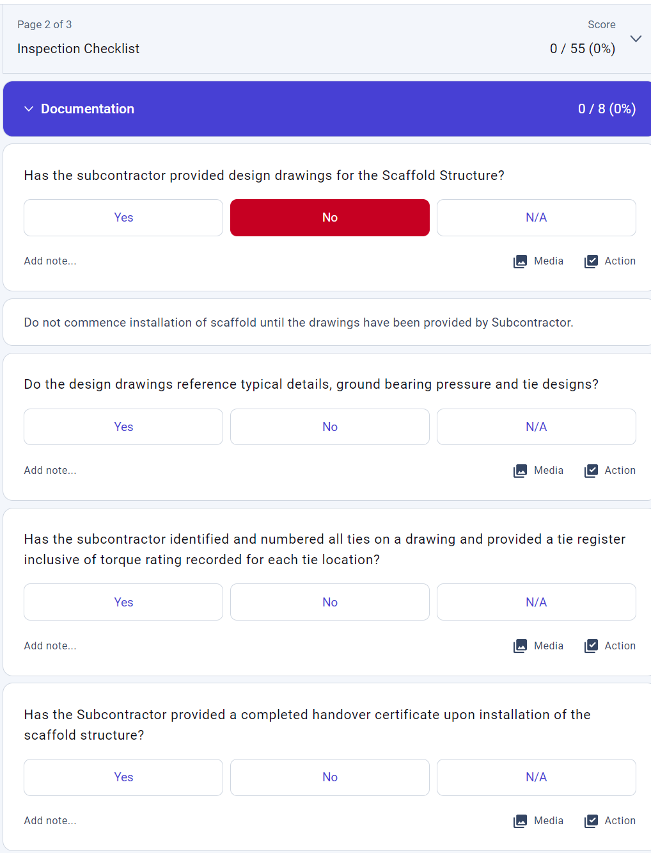
iAuditor
11. When “No” is selected, users are to adhere to the instruction that appears & assign an action.

Slide 38
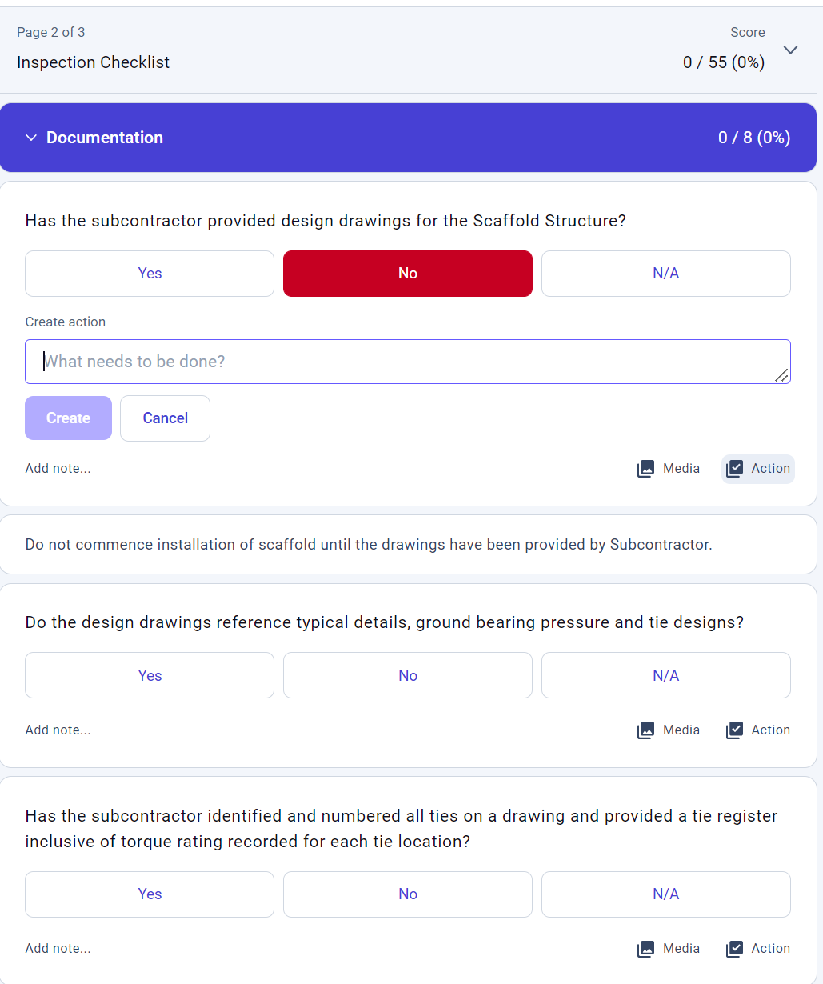
iAuditor
12. To create an action, click on the “action” button.
A text box will appear. Give the action a heading.

Slide 39
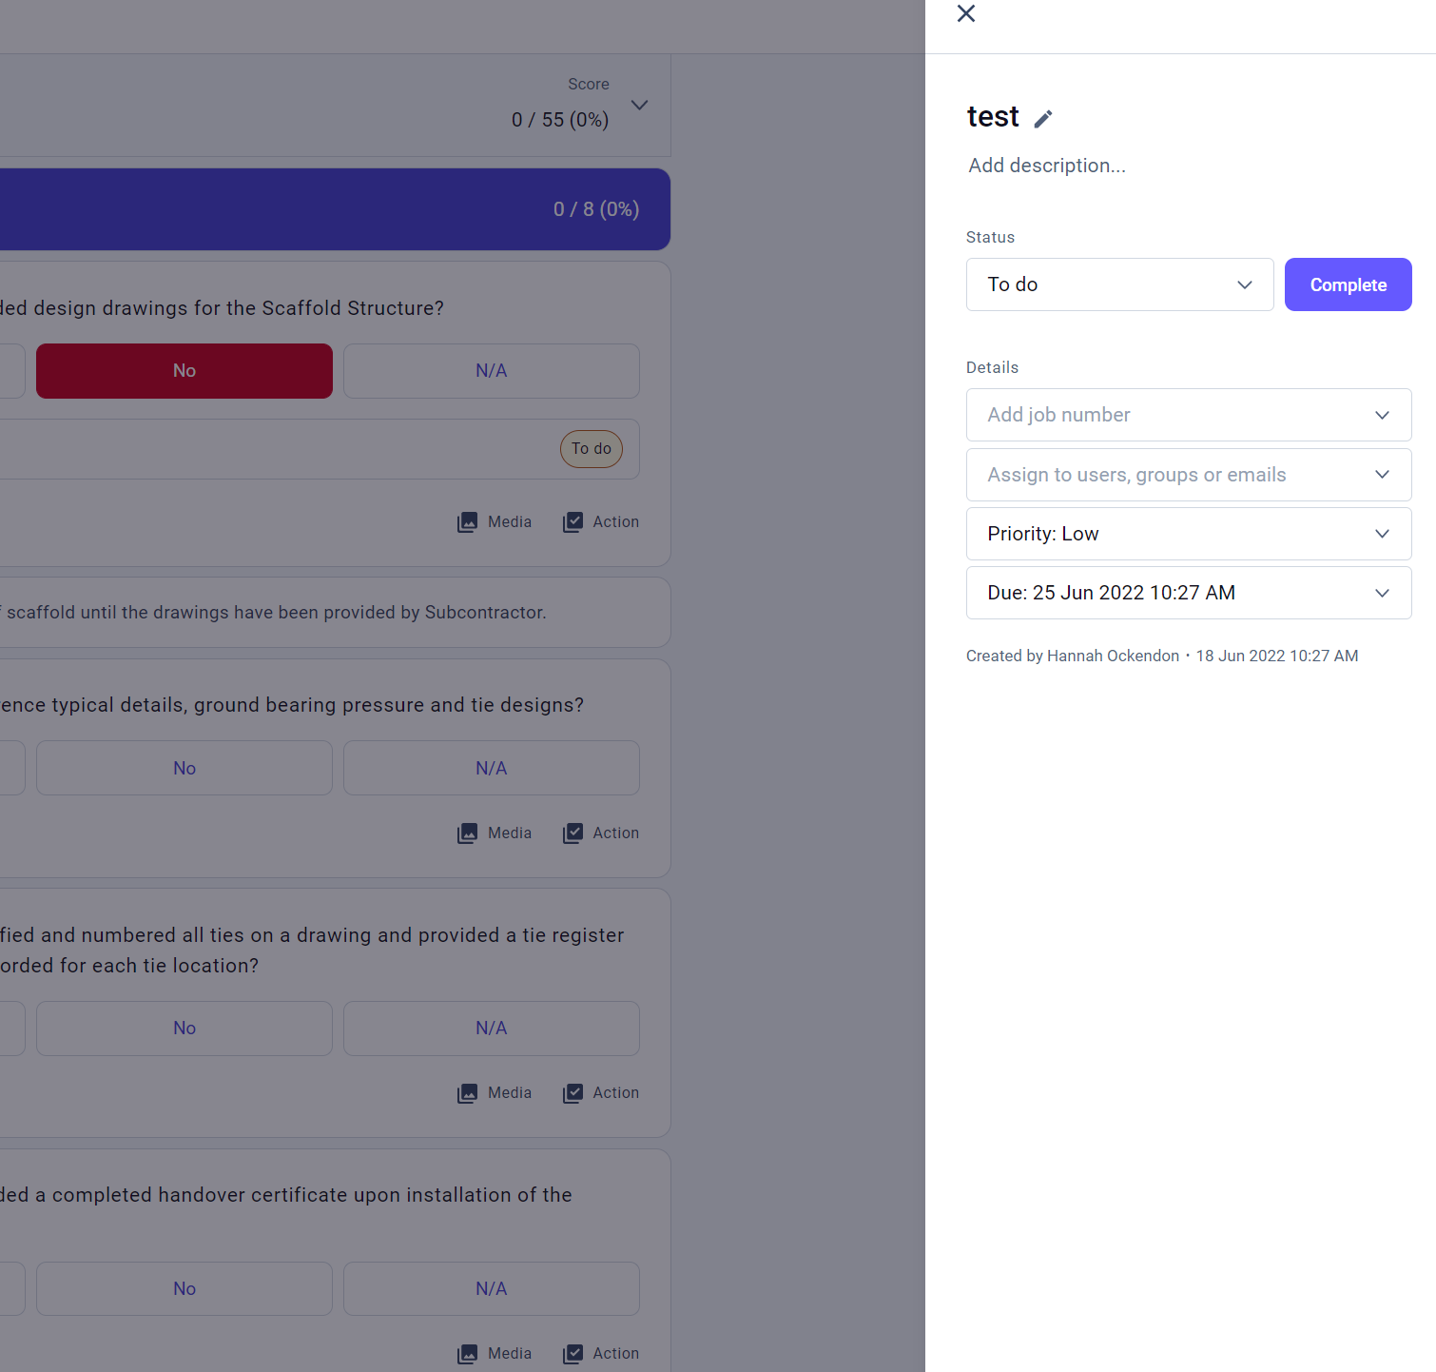
iAuditor
13. Once you have an action heading, click “Create”
14. A side panel will appear.
Use this panel to:
Add further detail
Assign the action to someone
Mark the priority of the action
Assign a due date

Slide 40
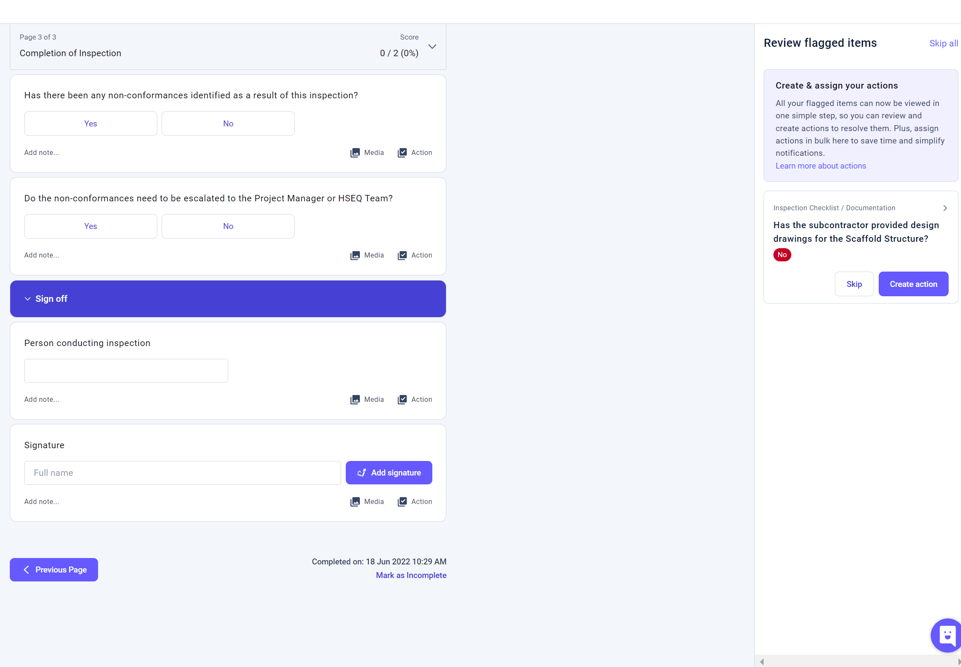
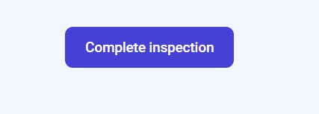
iAuditor
15. On the last page of the inspection a user will be prompted to review flagged items & assign an action if not done so already.
16. Once complete, sign the form & press “Complete inspection”

Slide 41
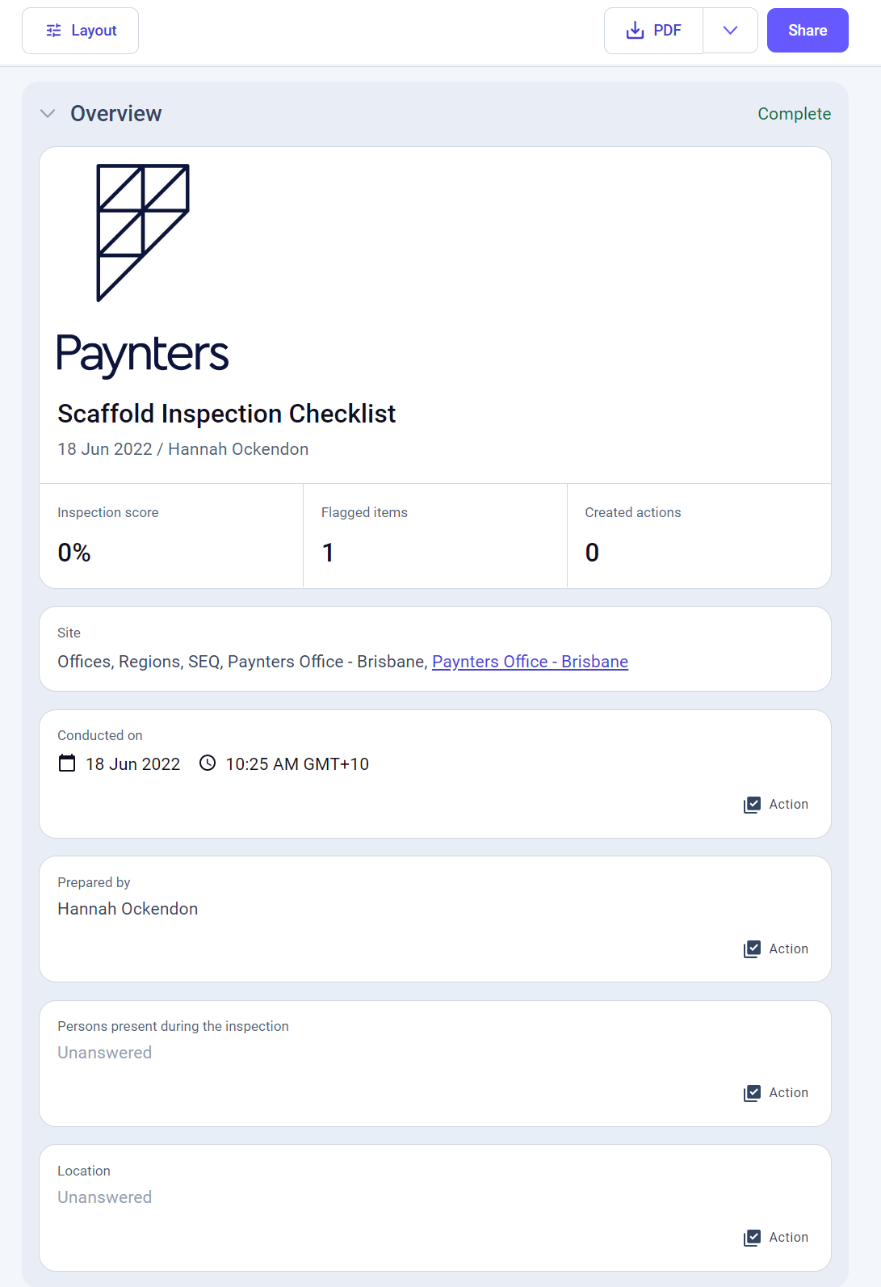
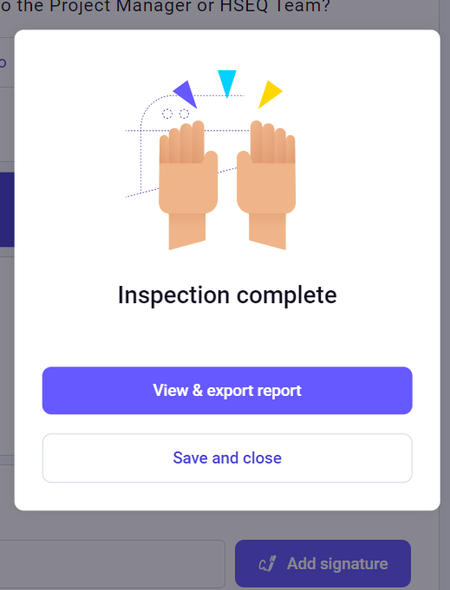
Viewing a completed
inspection
17. Once the inspection is complete, the user will be asked to choose one of two options.
18. If “View & export report” is selected, the user will be directed to an overview of their report

Slide 42
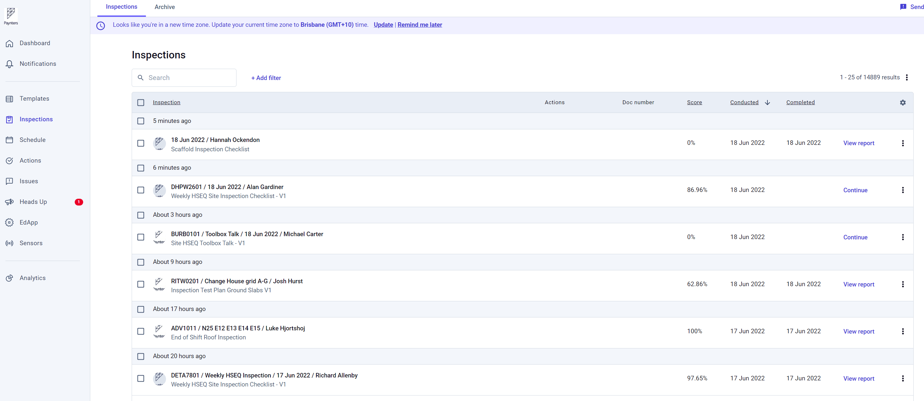
Viewing a completed
inspection
19. Once the inspection is complete, the user will be asked to choose one of two options.
20. If “Save & close” is selected, the user will be directed to their inspections dashboard where they can click “View Report”.

Slide 43
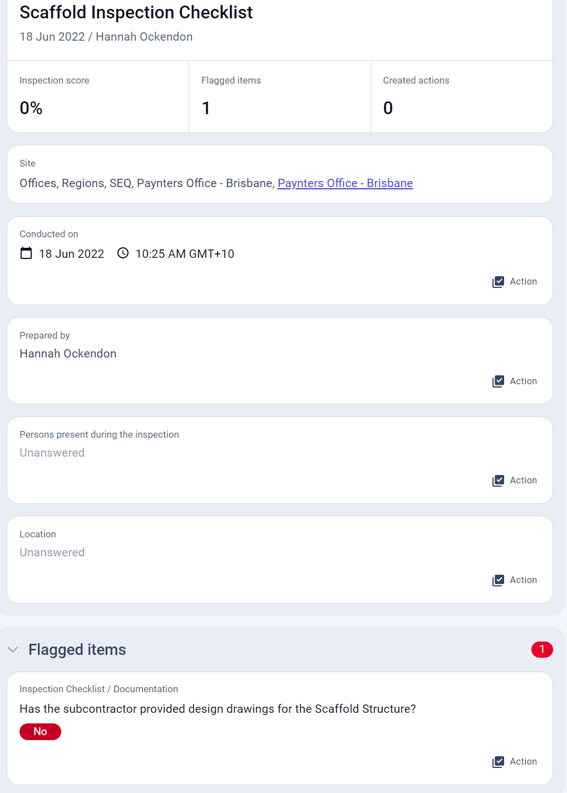
iAuditor
21. Any failed/flagged items will be displayed at the top of the inspection overview

Slide 44
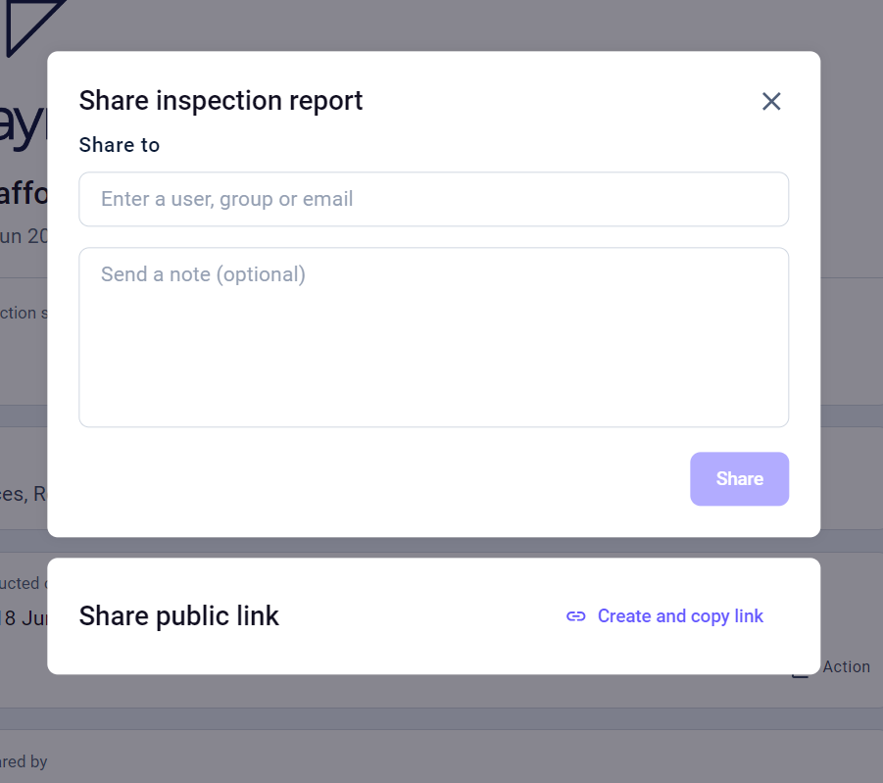
Sharing a completed
inspection
An inspection can be shared two ways.
22. Whilst viewing the inspection overview, click “Share”.
23. A screen will appear prompting the user to enter who they want to share the inspection with.
24. Once this information is entered, the “Share” button can be clicked.

Slide 45
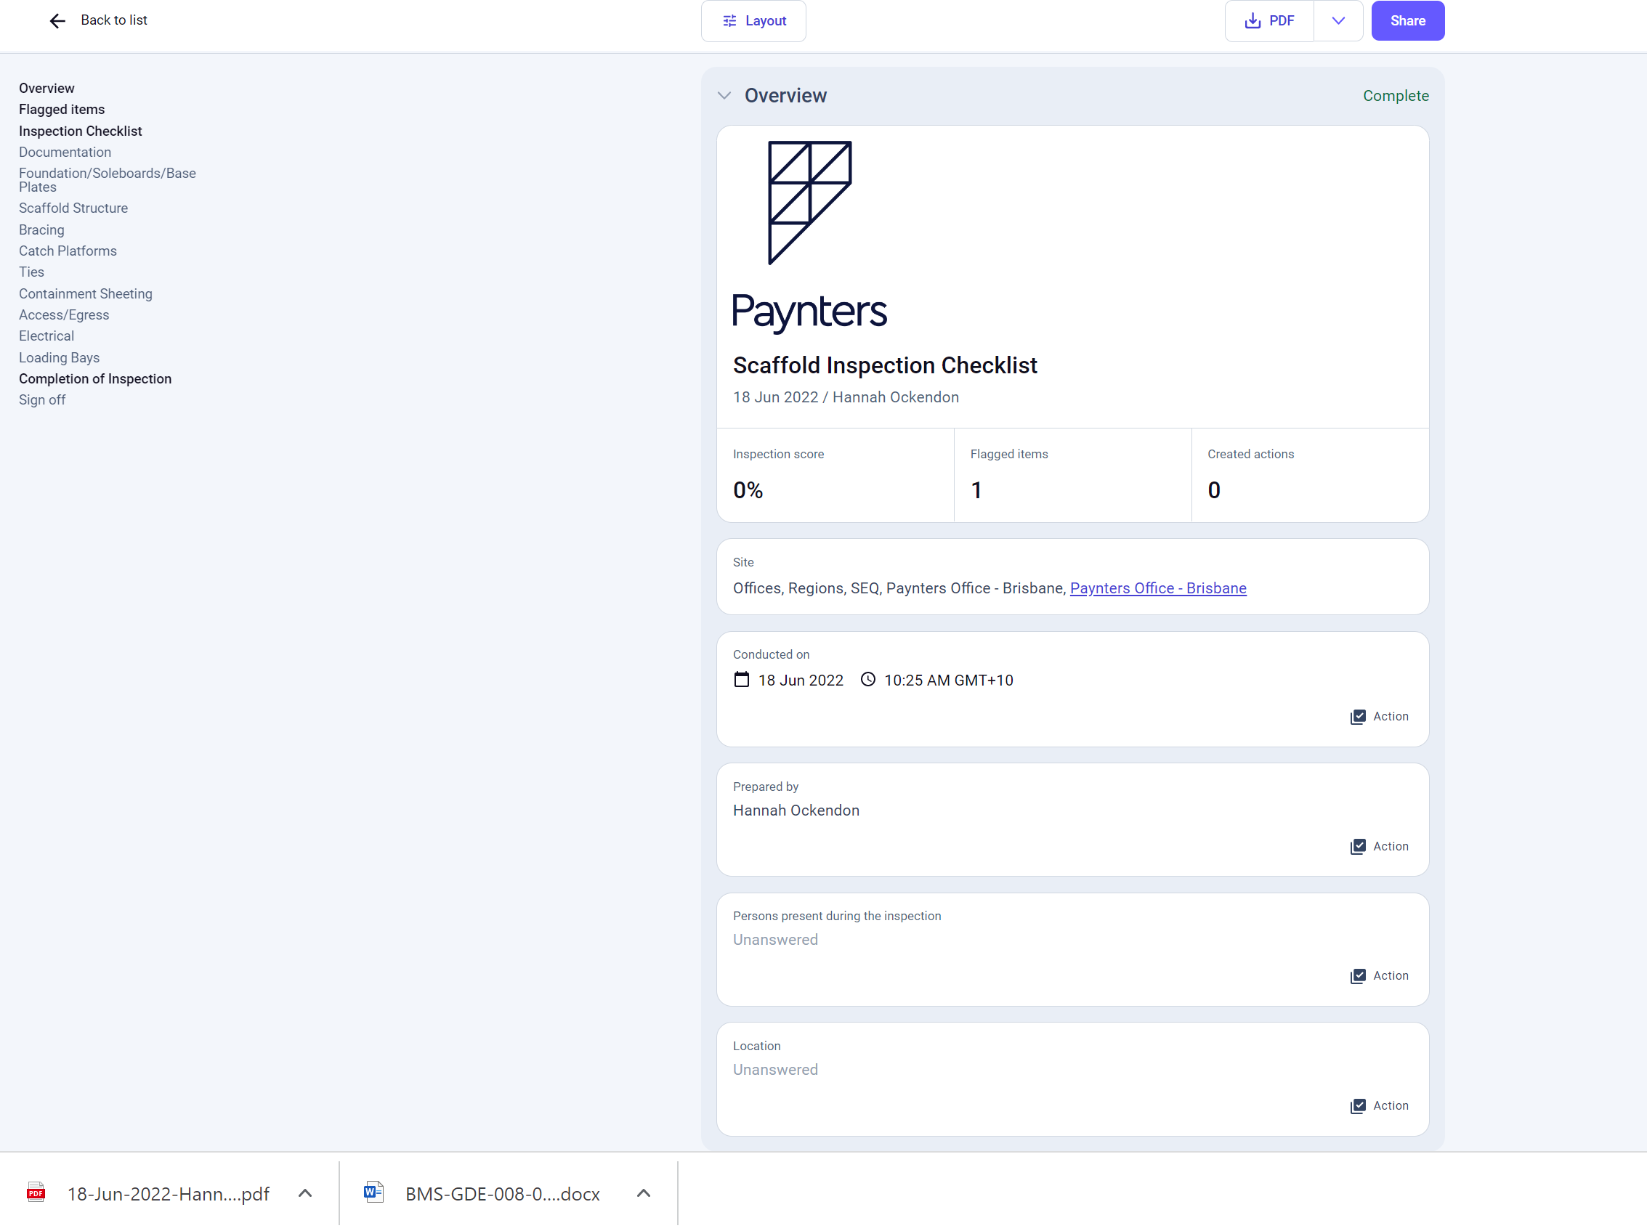
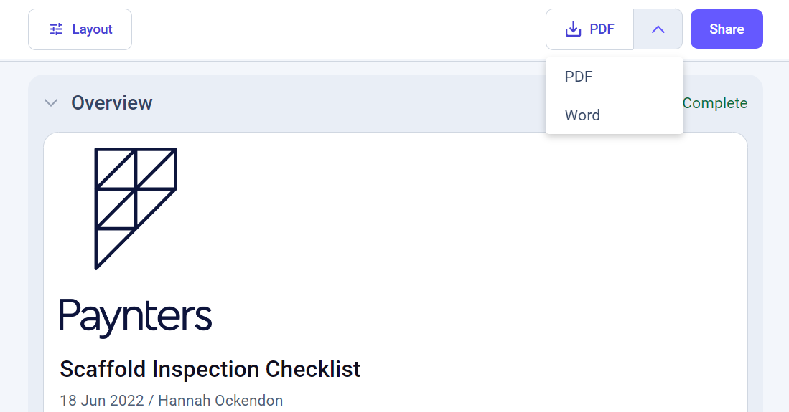
Sharing a completed
inspection
An inspection can be shared two ways.
25. Whilst viewing the inspection overview, click “PDF”.
26. A pdf copy of the inspection will be downloaded to your device.

Slide 46
Roll out
Staff are encouraged to use the new checklist.
A copy of this PowerPoint will be distributed.
All staff have access to the Scaffold inspection checklist on iAuditor
The old scaffold inspection checklist is no longer available on ASITE
Contact the HSEQ Team for any assistance
Any feedback on the inspection is appreciated

Slide 47
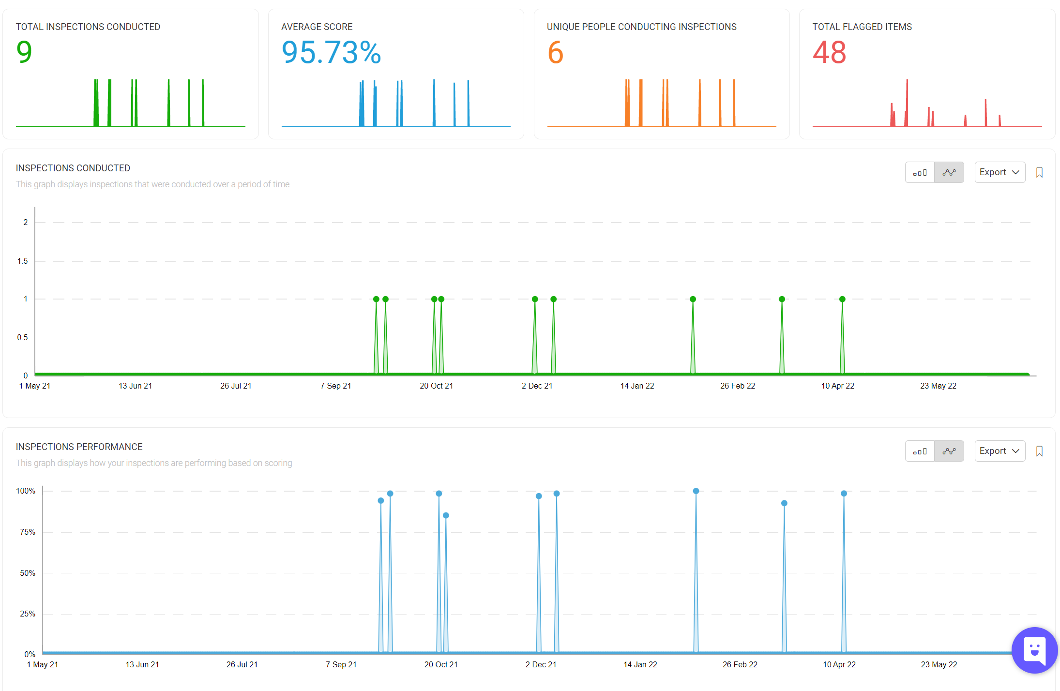
Benefits
Results are clearly displayed.
- Non conformances are marked in red
Scoring system
Easy to distribute to subcontractor (e.g. if rectification is required)
Ability to upload photo evidence
Ability to assign actions

Slide 48
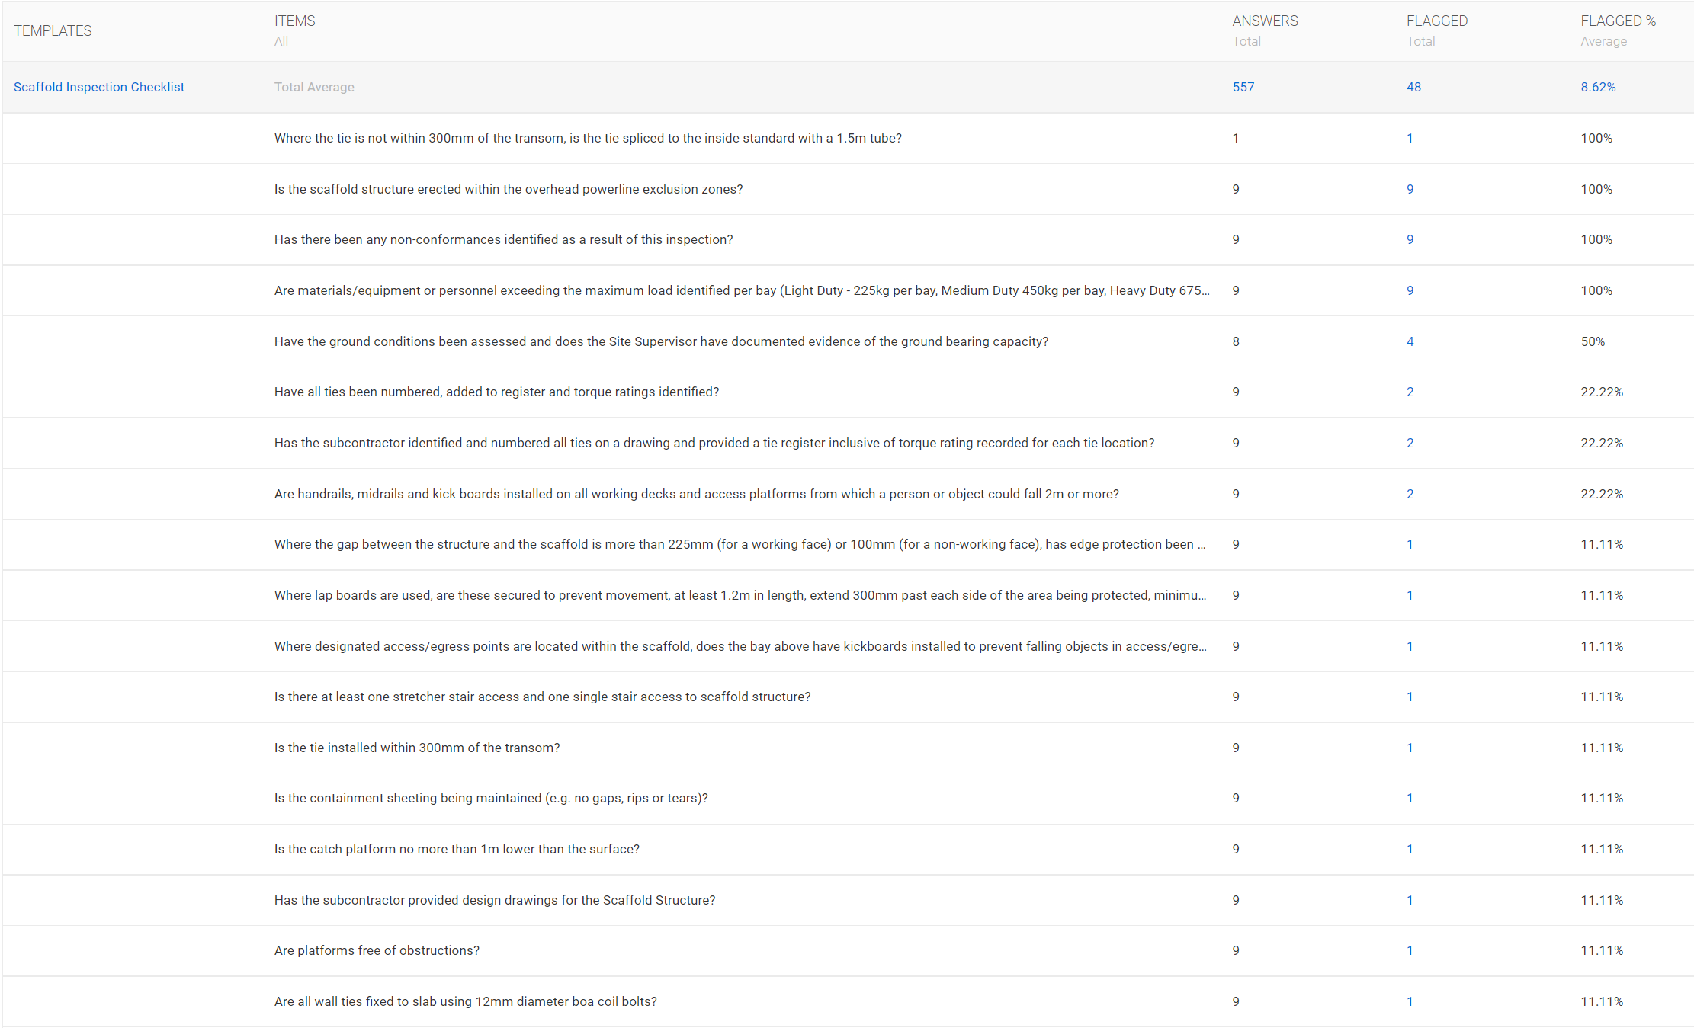
Benefits
A non conformance summary is produced by iAuditor
This will assist the business with determining areas of common non conformance thus providing direction on where to focus risk control efforts.

