Slide 1

TAELLN411 Address
Adult Language,
Literacy and Numeracy
Skills

Slide 2

Housekeeping
Emergency Procedures
Mobiles, Security Issues
Break times / Smoking policy
This course is “interactive” – ask questions
Respect, Confidentiality, Practice
Ground Rules

Slide 3
Objectives
Know how to analyse LLN requirements
Understand how to select and use resources and strategies to address LLN skill requirements
Learn how to use specialist LLN support where required
Discover how to evaluate effectiveness of learning support and assessment strategies in addressing LLN requirements
Gain the essential skills and knowledge required for this unit

Slide 4

Analyse LLN requirements
1.1. Determine LLN skill requirements of the training specification

Slide 5
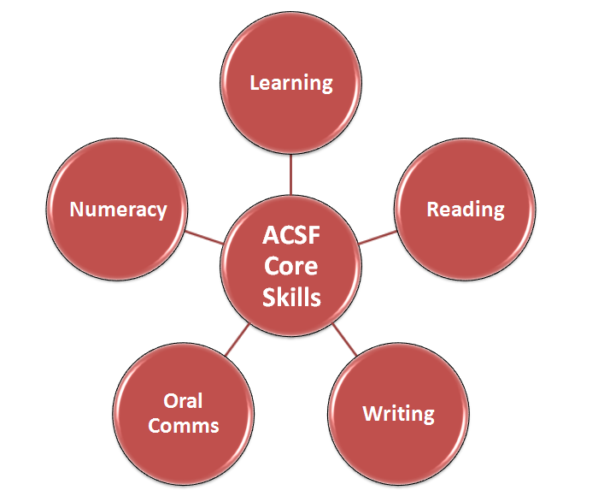
The Five Core Skills

Slide 6

Research
Visit www.innovation.gov.au and spend some time researching the core skills and the accompanying information.

Slide 7

Required Skills
If a learner doesn’t have all of the core LLN skill requirements, it does not necessarily mean they cannot pursue the course, it just means you will have to find out what skills they need to develop and to what degree. Then you can begin to assess their needs and take appropriate action to build upon the skills they already have.

Slide 8

Class Activity 1
Depending on your instructor’s wishes, work individually, in pairs or in small groups.
Using a training specification that you have worked with either in the past or currently, discuss/note how you went about determining the LLN skills.

Slide 9

Activity 1A

Slide 10
Analyse LLN requirements
1.2. Identify and analyse the LLN skill requirements essential to workplace performance

Slide 11

Training Context
On the job
In a classroom
Community setting
Training Organisation

Slide 12

Abilities
Every skill has differing levels so it is important to consider what skill levels are required for the environment you are.
Each of your learners will have different levels and abilities; this is why you will need to create individual learning plans and even differentiate learning resources.

Slide 13

Assessment of Levels
Using the ACSF, you can determine your learner’s skill levels.
Each Core Skill is broken down into five levels and each level has 2 (3 in Numeracy) Learning Indicators.

Slide 14
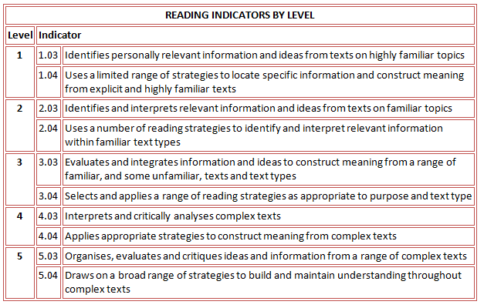
Example

Slide 15
Class Activity 2
Discuss in pairs or small groups how you would go about determining your learner’s levels.
How have you done this in the past?
What assessments or activities have you used?

Slide 16

Depending on environments, hazards may include:
Exposed wires from computers
Slippery surfaces
Electrical fires
Chemical spills
Moving vehicles
Trip hazards

Slide 17
Emergency Procedures:
Signing in and out of the building
Fire exits
Security codes
Appropriate personnel to report to

Slide 18
Class Activity 3
In small groups or pairs, discuss training environments you have worked in and why you were required there.
Were there any OHS requirements?

Slide 19
Activity 1B

Slide 20
Analyse LLN requirements
1.3. Determine the LLN skills of the learner group from validated tools and other sources

Slide 21

Validated tools and other sources of information:
Resume
Assessments
Discussions
Activities
Any relevant tests
ACSF Level Indicators
Information provided by employer
Tools based on the ACSF
Information gained from an LLN specialist

Slide 22

Assess your learner
Your learner may not have a specific qualification to indicate their existing skills and therefore you will need to assess them to discover what skills they may have accumulated through work, for example.

Slide 23

Issues you may encounter:
Language
Confidence Issues
Equality and Diversity

Slide 24
Class Activity 4
In pairs or small groups, discuss issues or situations you have encountered as mentioned above.
What did you do to overcome it?
What was the outcome?

Slide 25
Activity 1C

Slide 26
Select and use resources and strategies to address LLN skill requirements
2.1. Identify resources to support LLN skill development
2.2. Use learning and assessment materials to support identified LLN requirements, customising where necessary
2.3. Apply learning support strategies in training delivery appropriate to LLN requirements and learner group
2.4. Determine assessment strategies appropriate to LLN requirements and learner group

Slide 27

Assessment methods/materials may include:
Questions
Discussions
Observations
Third Parties
Research
Presentations

Slide 28

Differentiation
Not only will your learner’s have different preferred learning styles but they may also have different learning abilities.
If you are going to produce class resources, you need to ensure it is accessible to all.

Slide 29
Class Activity 5
In pairs or small groups, discuss what assessment materials you have developed/used and how you have adapted them to suit your learner’s needs, training specification and context.

Slide 30

Learner Support Strategies can include:
Demonstrating LLN practices to be learned in a workplace context
Using English appropriate for the learner
Using audio recording of texts
Using video and/or audio material to support the training

Slide 31

Development
Even though the point of learning strategies is to support your learners with what they are doing, it is also important that you look beyond that.
You want the support you give to build your learners confidence and help them to achieve their goals and objectives in work and their training.

Slide 32

How will you monitor your learner’s progress?
Assessments
Meetings
Discussions
Feedback from employer or specialist practitioner
Phone calls
Email

Slide 33

How will you determine areas for improvement?
Assessments
Regular Contact
Feedback

Slide 34
Activity 2A and 2B

Slide 35
Use specialist LLN support where required
3.1. Review course demands and learner profile to determine if specialist LLN support is required

Slide 36
Specialist core LLN assistance can include:
Specialist Numeracy, Literacy and Language Teachers
Adult Tutors
WELL (Workplace English Language and Literacy)
LLNP (Language, Literacy and Numeracy Program)
AMEP (Adult Migrant English Program)
Specialist in-house support services
Team teaching approaches
Mentoring
Government and community support services

Slide 37

WELL

Slide 38
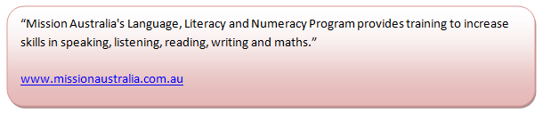
LLNP

Slide 39
How can LLNP help you?
The courses are guided by qualified and experienced professional staff
Learning resources are aligned to the work environment and are provided by Mission Australia
Work experience can be arranged as part of the training, this will give your learner more confidence
The length of training depends on individual needs, so can be adapted to your learner’s requirements
The staff provide updates and feedback on progress to you as the referral source

Slide 40

AMEP

Slide 41
The 2006 ALLS revealed that:
approximately seven million Australians (46 per cent) had literacy scores below the minimum level needed to function fully in life and work
approximately 7.9 million (53 per cent) had numeracy scores below the minimum needed
Australian Bureau of Statistics (2008), Adult Literacy and Life Skills Survey, Australia. Summary results, Cat no.4228.0 (2006 reissue) p.5 taken from the March 2010 ‘Australian Workforce Futures’ Report by the Australian Workforce and Productivity Agency

Slide 42

What is the solution?
It is partly your responsibility to help combat the issues of LLN.
Even though there will always be a need for specialist support, the fact that the learner’s are getting the help they need means there is a solution to the problem.

Slide 43

Social Inclusion
People with developed skills in all areas are not only more likely to have a job but are also more likely to participate with their colleagues and socially.
Confidence and self esteem are a key issue as those with less developed skills will feel embarrassed to interact with others, especially when their skills might be required.

Slide 44
Maslow’s Hierarchy of Needs
Self
Actualisation
Safety
Basic Needs
Self Esteem
Love
Family, Friends, Workgroup
Achievement, Responsibility, Status
Growth and fulfiment; morality, creativity, problem solving, no prejudice
Food, Water, Sex, Sleep
Body, Health, Employment, Family

Slide 45
Activity 3A

Slide 46
Use specialist LLN support where required
3.2. Access specialist LLN support where available
3.3. Integrate specialist LLN support into training or assessment practice where required

Slide 47

Support
Numeracy, Literacy and Language Practitioners
Adult Tutors
WELL (Workplace English Language and Literacy)
LLNP (Language, Literacy and Numeracy Program)
AMEP (Adult Migrant English Program)
Mentor
  What do they do?
  How can they help?
  What strategies can you use?

Slide 48
Class Activity 6
In pairs or small groups, discuss the specialist assistance you may have encountered.
Have you worked with any of them and if so, what strategies were implemented?

Slide 49
Activity 3B

Slide 50
Evaluate effectiveness of learning support and assessment strategies in addressing LLN requirements
4.1. Seek feedback on learning support provided and assessment strategies used

Slide 51

Who could you seek feedback from?
The learner
Management
Learners management
LLN Specialists

Slide 52
Class Activity 7
In pairs or small groups, discuss why it is important to gain feedback on the learning support and assessment strategies you have provided/used.

Slide 53
Activity 4A

Slide 54
Evaluate effectiveness of learning support and assessment strategies in addressing LLN requirements
4.2. Evaluate learning support and assessment strategies used
4.3. Determine areas for improvement based on evaluation

Slide 55

How can you evaluate learning support and assessment strategies used?
Through feedback
Outcomes of learning
Learner discussion
Individual learner needs
Testing knowledge

Slide 56

How could you make improvements based on evaluation?
Research new assessment strategies
Try different strategies with different learners
Find new techniques to support learning

Slide 57
Class Activity 8
In pairs or small groups, discuss the techniques used to support learning and the assessment strategies you could use.

Slide 58
Activity 4B

Slide 59

Skills and Knowledge Activity

Slide 60
Major Activity
This activity should take anywhere between an 1-2 hours to complete and can be found at the end of your workbook.
Your instructor will let you know whether they wish for you to complete it in session time or your own time.

Slide 61

Summary and Feedback
Did we meet our objectives?
How did you find this session?
Any questions?

Slide 62

Congratulations!
You have now finished the unit…
‘Address Adult Language, Literacy and Numeracy Skills’

