Slide 1
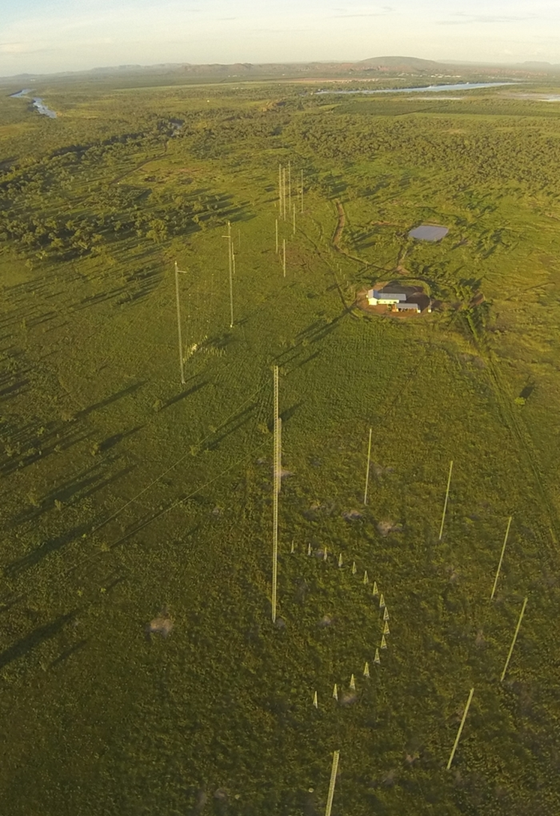
Apply the principles of civil concrete structures construction
RIICSG401D

Slide 2
Unit Overview
This unit will cover:
Plan and Prepare Tasks
Implementing Job Plan
Oversee the execution of tasks
Report on execution of tasks
Notes:
LG - Contents Page_p3

Slide 3
Presentation objectives
Section 1: (LG Chapt. 3)
Plan and Prepare tasks Slides 04-20
Section 2: (LG Chapt. 4)
Implementing Job Plan Slides 21-41
Section 3: (LG Chapt. 5)
Oversee the execution of tasks Slides 42-53
Section 4: (LG Chapt. 6)
Report on execution of tasks Slides 54-61

Slide 4

Section 1
Plan and Prepare Tasks

Slide 5
Legislation (LG pg. 10-13)
WH&S
  SWMS
  Principle Contractor (PC)
  Construction Safety Plan
  Communication
  Compliance with all relevant documentation
  Risk management plans
  Access to site

Slide 6
Key concerns for concrete construction (LG pg. 14)
Some of the key aspects for concrete structures that must be managed as core risk controls include:
Security of the footings
Load bearing capacity of equipment
The compaction rate of earthen foundations
The weight of the concrete
Weather effects on concreting
Concrete mix and type
Durability of formwork
Curing rate of concrete
Engineering approval
Injuries to workers
Notes:
Assessment Q1

Slide 7

3 Queensland Codes of Practice relevant to construction of concrete structures:
Concrete Pumping Code of Practice 2005
Tilt-up and Pre-cast Construction Code of Practice 2003
Formwork Code of Practice 2006
(LG pg. 15)

Slide 8
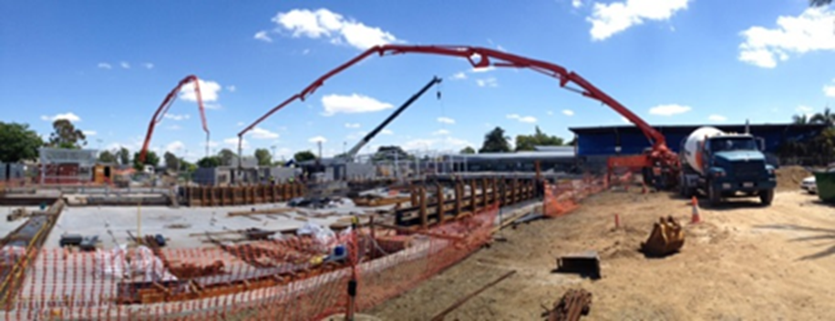
(LG pg. 15)
The Concrete Pumping Code of Practice 2005 specifically addresses:
Risks associated with concrete pumping plant
Planning and preparation
Risk controls for concrete pumping plant
Inspection and maintenance requirements
Safety equipment
Training and supervision

Slide 9
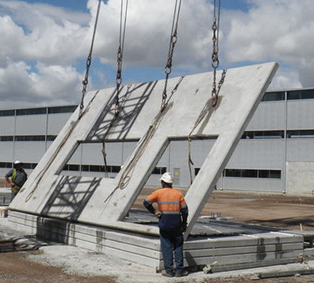
(LG pg. 15)
The Tilt-up and Pre-Cast Construction Code of Practice specifically addresses:
Panel design
Drawings
Braces
Wind loading
Deadman design
Drill–in type anchors
Engineering and verification issues
Non–standard panels
Delivery and storage of panels and elements
Crane issues
Proximity to overhead powerlines
Panel lifting and erection
Operation of plant near braces and panels
Working at height
Work systems
Licensing issues

Slide 10
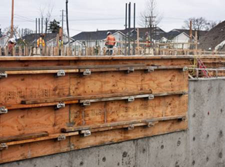
(LG pg. 16)
The Formwork Code of Practice 2006 specifically addresses:
Design
Coordination and administration
Formwork erection
Stripping formwork
Crane and load handling systems
Use of ladders
Falling objects
Health risks
Special requirements for wall and column forms
Samples and examples of engineers certification, construction checklists, pre-pour certificates, and defects commonly found in formwork systems
Notes:
Assessment Q2

Slide 11

Australian standards (LG pg. 16)
Information relating to concrete structures can be found within several Australian Standards including:
AS 3600-2009 Concrete structures
AS 3610.1—2010 Formwork for concrete
Standards are developed for a number of
purposes, including:
Voluntary or mandatory applications
Regulatory compliance
Contractual purpose
Guidance

Slide 12
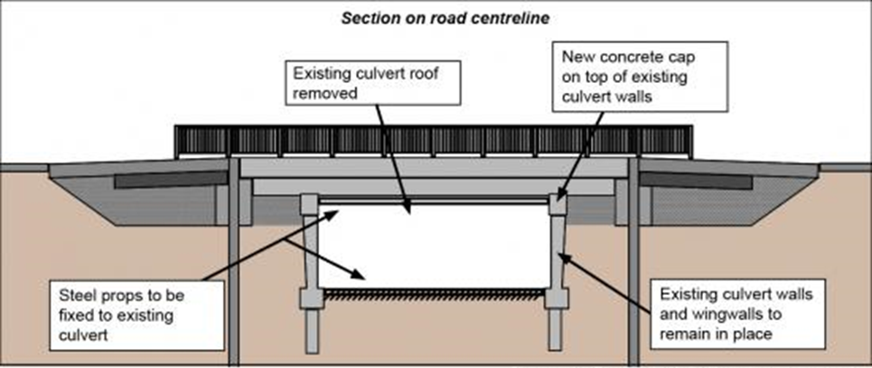
Drawings and construction plans (LG pg. 17)
Information about the design of the structure usually is found within technical drawings and construction plans and are developed specific to the project at hand.

Slide 13

Industry organisations (LG pg. 17)
The role of CCAA is to:
Build an understanding of industry and its role with stakeholders
Maintain existing and develop new markets for members’ products
Advocate for and influence the application and use of members’ products
Influence development of codes and standards to support the use of member’s products
Demonstrate the industry’s sustainability credentials
Encourage collaboration and networking across the industry
Supply and share information to support the industry

Slide 14
Where to find information
(LG pg. 18)
Other information:
Company policies, procedures and plans
Business targets for safety & productivity
Project Tender documents (if applicable)
The Project Plan
OEM’s
Notes:
Assessment Q3

Slide 15
Where to find information
(LG pg. 18)
Many projects will have a ‘Job Pack’ prepared for the specific scope of work, the Job Pack may include:
Project description
Project Risk Assessment
Scope related SWMS’s
Construction Plans & Drawings
Staff profiles
Equipment registers
Project schedule of works
Registers
Forms
Plant & Equipment OEM’s
Notes:
Assessment Q4 & 5

Slide 16
Planning and preparing the construction task (LG pg. 19)
Engineering survey principles include:
Provision of the initial framework via a thorough survey of the job
Plan the job to ensure that all risks are identified and minimised and define the job
Ensure that sufficient independent checks are built into the project phases to eliminate or minimise errors
Safeguarding – the process of ensuring that the survey results can be replicated if accidental, or other, damage occurs to the survey markers or field observations
Notes:
Assessment Q6

Slide 17
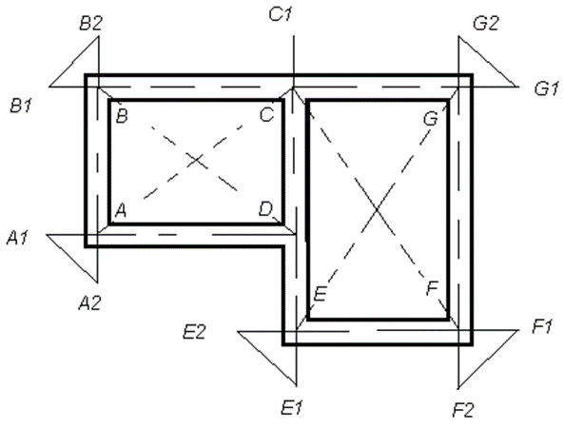
Planning and preparing the construction task (LG pg. 19)
Setting out
Example plan to be set out on the ground
Notes:
Assessment Q7

Slide 18

Measuring material quantity requirements (LG pg. 20)
The formula for calculation of materials for required volume of concrete is given by:
V = Absolute volume of fully compacted fresh concrete
W =Mass of water
C = Mass of cement
Fa = Mass of fine aggregates
Ca = Mass of coarse aggregates
Sc, Sfa and Sca are the specific gravities of cement, fine aggregates and coarse aggregates respectively.
The air content has been ignored in this calculation.

Slide 19
Scheduling the delivery of materials (LG pg. 21)
Some key considerations regarding the scheduling of material delivery include:
The ability to receive the materials using plant & equipment and/or personnel
The storage location – so as to not require relocating due to works
The duration that the goods will be stored – so as to not hold up other works
Weather conditions
Skills of personnel to utilise the materials in a ‘just in time’ principle
Quality check of the materials received
Notes:
Assessment Q8

Slide 20
Section 2
Implementing job plan

Slide 21
Section 2 Implementing job plan
The following areas are covered in this presentation:
Necessary Resources
Information and Instructions
Developing the Job Plan
Work Instructions
Safe Work Method Statements (SWMS)
Leading, Managing & Supervising
Phases of Construction
Delegating Work to others

Slide 22


Necessary Resources (LG Pg. 22 )
Resources for the job should include:
Plant and equipment
Where the plant will be sourced from
Personnel & skills required
Safety information that should be in the Job Plan includes:
PPE
Risk assessment requirements
Requirements for Safe Work Method Statements (SWMS) and what the activity they need to address
Specific qualifications and licensing for each task
Incident reporting and notification information
monitoring strategy including frequency
Contact details for key personnel

Slide 23



Scenario 1
(LG Pg. 23)
Mike has a project to remove an old concrete culvert on a small country road and construct a new concrete culvert. Mike does not have an excavator within his own business so needs to hire one for the job. The work that Mike needs to do with the excavator is just before the concrete is booked in to arrive.
Mike calls the hire company…
A 2t excavator arrives on site on the day, and the delivery truck returns to town.
Mike soon realises that the excavator that has been delivered won’t be suitable for the job as it is not big enough to lift the precast components of the new culvert.
”Hi Bob, I need a little ‘digger’ for project next week, can I book one please and it be delivered to site next Tuesday?”.
Mike is now faced with a few problems as a result of the poor planning.

Slide 24
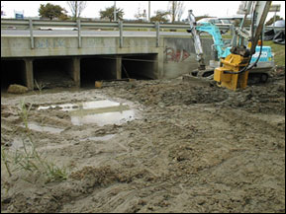

Scenario 2
(LG Pg. 24)
Mike has a project to remove an old concrete culvert on a small country road and construct a new concrete culvert. Mike does not have an excavator within his own business so needs to hire one for the job. Mike calls the hire company…
…”Hi Bob, I need an excavator to lift some pre-cast culvert component which weigh 6t project next week, can I book one please and it be delivered to site next Tuesday? The area around the existing culvert is very congested and I think it will be hard to remove the required material”.
Bob suggests that Mike use a multi-combination bucket for that area. Bob books in the equipment for Mike.
The excavator arrives on site on the day along with the multi-combination bucket, and the delivery truck returns to town. Mike is confident that he has arranged for the right equipment for the job.
The excavator work is completed efficiently with no problems, the concrete arrives and the job is completed on time and on budget. Mikes client is happy that the job is finished to a high quality on time and on budget, and thanks Mike for his great work.

Slide 25
Information and Instructions
(LG Pg. 25)
Type of communication | Effectiveness factor | Tips and recommendations to help improve
Verbal | Clear | Speak at a pace that’s easy for someone to understand. The most common problem effecting communication is speaking too fast Avoid mumbling Speak about an issue in a logical manner, making sure that you provide adequate and relevant background and context so the receiving person is able to establish a clear picture of what you are talking about
 | Concise | Talk only about the issue at hand and only give enough information for the receiving person to understand what you are talking about. Giving more information than is required can be very frustrating to the receiving person
Written | Clear | Choose words deliberately Construct sentences carefully and thoughtfully Using correct grammar. Writing clearly allows your audience to easily comprehend your message
 | Concise | Remove words that are not needed in a sentence Remove sentences that are not needed in a paragraph Be aware of needing to ensure clauses or phrases are constructed in a way that is simple and as short as possible.
Verbal and Written | Timely | When responding to an issue or a discussion, your response needs to follow soon after. When this doesn’t occur, the receiving person may be confused about what you are talking about as they may not be able to link your response to the issue or discussion that prompted it.

Slide 26
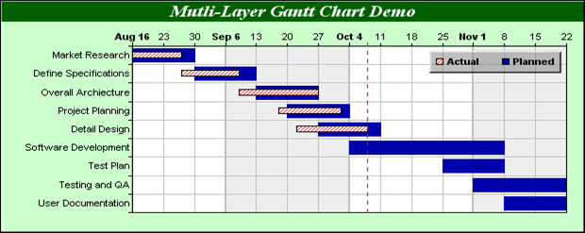
Developing the Job Plan (LG Pg. 26)
Explain the project plan to key stakeholders and discuss its key components.
Define roles and responsibilities..
Develop a scope statement.
Notes:
Assessment Q9

Slide 27

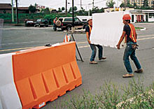

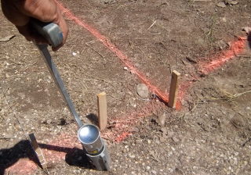

Work Instructions (LG Pg. 27)

Slide 28

Work Instructions (LG Pg. 28)
Sources:
Supervisors
Managers
Engineers
Quality Management System

Slide 29

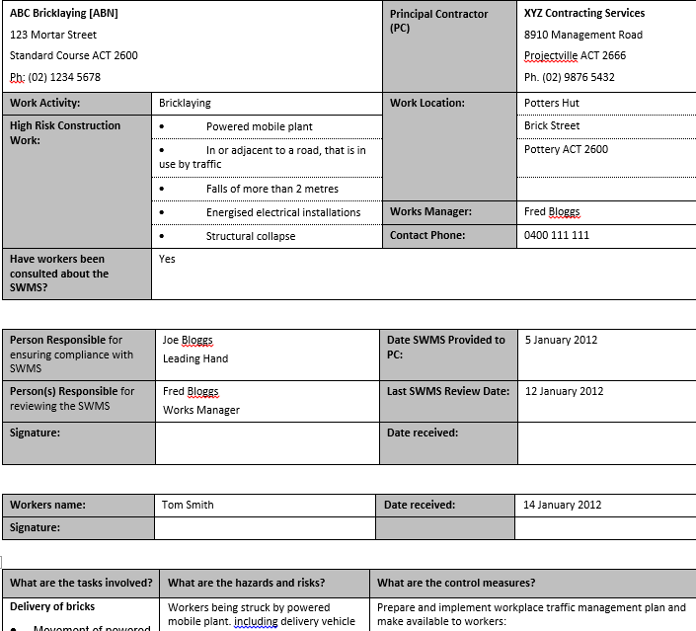
Safe Work Method Statement (SWMS) (LG Pg. 28)
Sets out the work activities in a logical sequence
Identifies hazards & controls
DEFINITION: A SWMS is a document that sets out the high risk construction work activities to be carried out at a workplace, the hazards arising from these activities and the measures to be put in place to control the risks
Notes:
An example SMWS was provided in Figure 1 on page 11 of the Learner Guide.

Slide 30
Leading, Managing and Supervising (LG Pg. 28-29)
Six (6) Principles for Construction Leadership:
Demonstration of safety
Promote the design for safety in all engineering solutions
Communicate safety & project related information
Manage risk
Seek continuous improvement
Embed safety practices
Notes:
Assessment Q10

Slide 31
10 Phases of Construction (LG Pg. 29)
1
Planning of the work
2
Preparation of the work environment
3
Ground surface treatment
4
5
Preparation of foundation works
Set up of formwork
Notes:
Assessment Q11

Slide 32
10 Phases of Construction
(LG Pg. 29)
Laying the concrete
8
9
10
7
Testing of concrete
6
Erection and stabilisation of the concrete structure
Updating engineering drawings and service plans
Housekeeping, cleaning up and de-mobilising from the work area
Notes:
Assessment Q11

Slide 33
Delegating work (LG Pg. 30 - 32)
Why does the task need to be completed?
What is involved in the task?
Where does it need to be done?
What is the timeframe for doing it?
Who has the required skills, knowledge and training to complete the task?
What is the priority?
These questions will help you decide what tasks should be completed by which team members
Delegation is an art – and done well, it can prove a most effective tool for a manager to multi-task and complete work in a highly efficient and engaging manner.

Slide 34
Delegating work (LG Pg. 31)
Competency | Induction | Work at Height | Confined Space | Trade Qual | Excavator Licence | Skid steer Licence | HR Licence | MR Licence | HC Licence | Car Licence
Personnel
Bob
Mike
Jim
Tom
Key
 | Completed, has the required item/licence/ticket etc
 | In training for the item/licence/ticket etc

Slide 35

Delegating Work (LG Pg. 32)
What is the priority?

Slide 36
Daily Tasks (LG Pg. 32)
Site inspection for hazards, damage or other issues of concern
Inventory control to ensure no unexpected overuse of materials
Authorising overtime
Providing required explanations for the builders and other professionals associated with the project,
Coordinating and collaborating with the architects, engineers, client and specialists.
Pre-start meeting attendance
Review of previous days reports, progress and incidents
Maintain open communication with authorities and the client
Notes:
Assessment Q12

Slide 37
SECTION 3
Oversee the execution of tasks

Slide 38
SECTION 3: Oversee the execution of tasks
The following areas are covered in this presentation:
Monitoring
Methods of concrete placement
Ground Condition Testing
Implement adjustments to work processes if required
Establish programs for maintenance and record keeping

Slide 39

Monitoring (LG Pg. 33)
How?
On the job supervision
Formal Quality Assurance inspections against the specification and drawings
Formal general inspection of the work using a checklist
Informal inspection of the work
Why?
Engineering (hard) controls
Personnel (soft) controls
Compliance with plans, drawings and specifications
Safety practices
Identify hazards & implement controls
Identify issues (negative impact/delays)
Track materials usage
Notes:
Assessment Q13

Slide 40
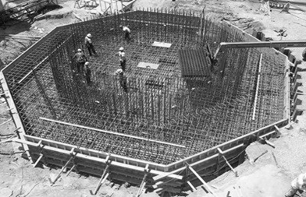
concrete placement (LG Pg. 33-34)
Before any concrete is placed, the following should be taken to consideration
  Equipment
  Layout
  proposed procedures
  methods
No concrete poured until the formwork is inspected and found suitable for placement.

Slide 41
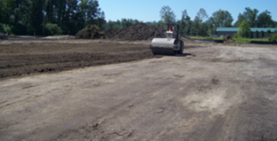
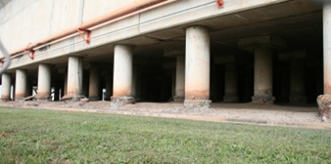

Ground Surface treatment
(LG Pg. 35-36)
Proof Rolling
Compacting Materials
Acid Sulphate Soil Testing
Pavement Drainage
Notes:
Assessment Q14 & 15

Slide 42
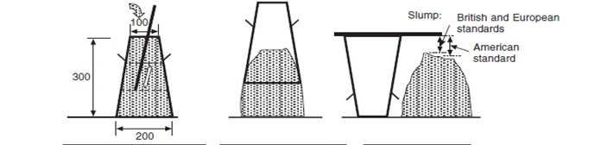
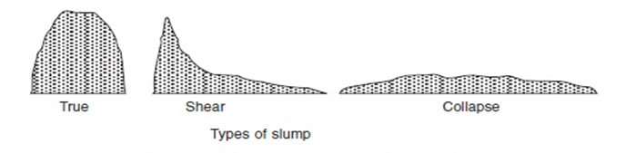
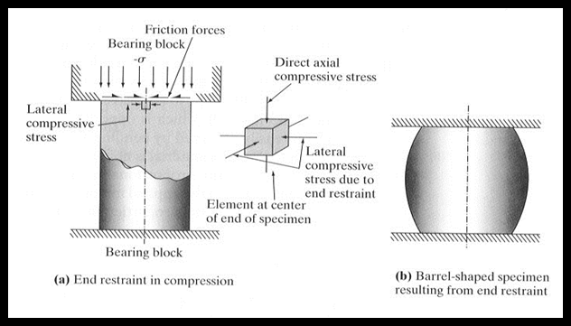
Concrete works testing & inspection (LG Pg. 36-37)
The SLUMP Test
  The measured slump must be within a set range (tolerance) from the specified slump.
The CYLINDER (Compression) Test
  Measures concrete strength in a hardened state
  Conducted off-site in a laboratory
  Measured in Megapascals (MPa)
  Provides an indication of the
  concrete’s resistance to loads
  Compressive strength is
Notes:
Assessment Q16

Slide 43

Implement adjustments to work processes if required
(LG Pg. 38)
During the conduct of monitoring the task or work being carried out, there may be issues identified that create a need to change or modify the work plan.
Examples:
Plant and equipment breakdowns
Personnel being absent from work
Materials not arriving on time
Materials being delivered that don’t meet the specification required by the designs
Update work plan
Communicate changes to all stakeholder groups

Slide 44
Establish programs for maintenance and record keeping
LG Pg. 38-39
Purpose:
Ensure that risks are identified and managed
Schedule plant & equipment for regular maintenance and service checks (as per OEM)
Records:
Historical
Analyse total utilisation
Audit trail in the event of an incident
Track misuse & corrective actions

Slide 45
SECTION 4
Report on execution of tasks

Slide 46
SECTION 4 Report on execution of tasks
The following areas are covered in this presentation:
Complete and submit written reports as required
Recommend changes to improve safety, efficiency and effectiveness

Slide 47
Complete and submit written reports as required (LG Pg. 40)
There is an old saying ‘If you measure something, then you can control it’… the results of your measuring and monitoring must be kept for historical purposes for a number of reasons, including:
  Providing an audit trail in the case of a query or investigation
  Providing a reference point for future works and comparison
  To comply with legislation, corporate and client requirements
  To enable the Project Manager to maintain effective control of the project
Types of data:
  Measurements used for ordering materials
  Test results of materials
  Photographs of the project
  Diary notes

Slide 48
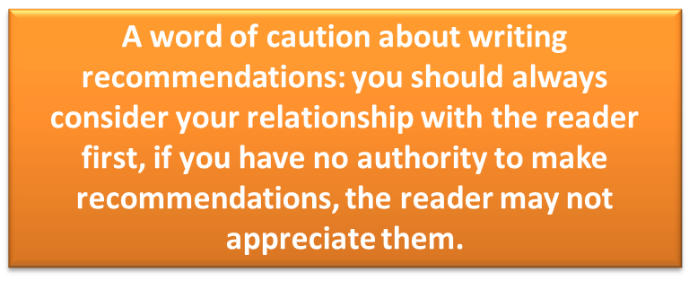
Recommend changes to improve safety, efficiency and effectiveness
(LG Pg. 40-44)
What?
  Cost over-runs
  Deviations from the plan
  Incidents
  Trends in safety
  Opportunities for gaining greater efficiency
  Opportunities for gaining greater effectiveness
  Opportunities for improving the overall project performance
Effective recommendations:
Suggest courses of action
Action statements
Clear & specific
Expressed in order of importance
Based on the body of the report

Slide 49
Conclusion
You have now covered:
Plan and Prepare Tasks
Implementing Job Plan
Oversee the execution of tasks
Report on execution of tasks
You now need to study the material in your learner guide to reinforce this information

