Slide 1

Consultation and Participation
ALISON RADFORD 2024

Slide 2
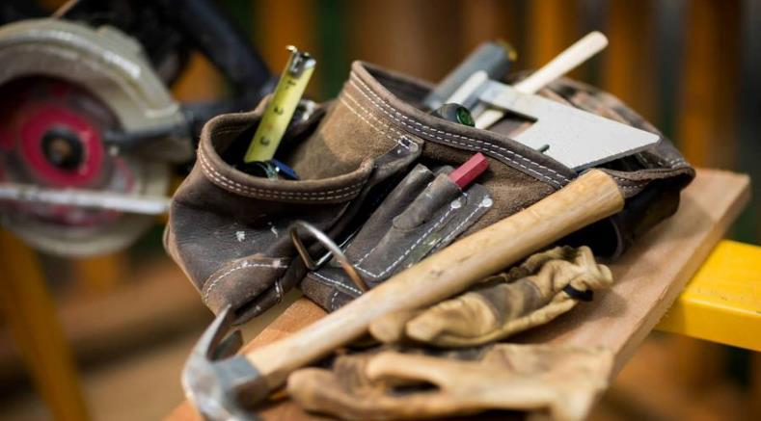

Presentation
We are here today to meet with you all to go over a few things regarding consultation and participation in our workplace. The roles, rights and responsibilities of myself, you and a chance to provide some feedback for our employers.

Slide 3
EHS Role
INFORM
INFORM DUTY HOLDERS AND WORKERS OF THEIR ROLE
COMMUNICATE THE LOCATION AND NATURE OF HIGH-RISK WORKS, ACTIVITIES AND AREAS WHERE RISKS COULD IMPACT OTHERS
ASSIST
ASSIST IN THE CREATION OF AN EHS MANAGEMENT PLAN
ASSIST IN CREATING SAFETY COMMITTEES
ASSIST TO IMPROVE EHS AND WELLBEING STANDARDS
FACILITATE
RESPONSIBLE TO FACILTATE COMMUNICATION AND CONSULTATIONIN THE WORKPLACE
PROVIDING PARTICIPATION OPPORTUNITIES FOR ALL AND SEEKING FEEDBACK TO FACILITATE CHANGES
VERIFY
TRAINING AND COMPETENCE
WORKING CONDITIONS
IDENTIFYING AND VERIFYING POTENTIAL BARRIERS CONSULTING AND COMMUNICATING OUTCOMES
DOCUMENT
DOCUMENT ALL OUTCOMES OF DISCUSSIONS AND MEETINGS SUCH AS THE ISSUE, WHO IT WILL AFFECT, PERSONS INVOLVED IN COLSULTATION, THE DECISIONS ANY ACTION TAKEN AND TIME ACTION OCCURED

Slide 4
Workers Role
ROLE
TO LOOK AFTER THE SAFETY OF YOURSELF ENSURING YOU ARE NOT WORKING IN A WAY THAT COULD IMPACT YOURSELF OR THAT OF OTHERS AROUND YOU
DUTIES
TO LOOK AFTER YOURSELF AND OTHERS
SPEAK UP ABOUT SAFETY CONCERNS THAT COULD IMPACT YOU OR OTHERS
RIGHTS
YOU HAVE A RIGHT TO REPRESENTATION
TO BE BREIFED ON WORKS GIVEN A CHANCE TO OFFER INPUT
TO BE CONSULTED OF ANY CHANGES TO AGREED METHODS OF WORKS
RESPONSIBITIES
YOU HAVE A RESPONSIBILITY TO PARTICIPATE IN HEALTH AND SAFETY MATTERS
STOP AND REPORT ANY UNSAFE WORKS
REPORT ANY ISSUES OR INJURIES
REMEMBER
YOU HAVE THE RIGHT TO SPEAK UP
YOU HAVE A RIGHT TO HAVE A SAFE WORK ENVIRONMENT
YOU INPUT AND PARTICIPATION ASSISTS IN REDUCING WORK RELATED HEALTH AND SAFETY ISSUES

Slide 5
CURRENT CONSULTATION AND PARTICIPATION PROCESSES
EHS COMMITTEE
TOOLBOX/PRESTART
Facilitates co-operation between PCBU and the workers, developing and participating in EH&S matters.
Conducting site safety walks and inspections, conducting meetings and documenting findings.
Communicating outcomes with work-groups inviting feedback.
Daily meeting with subcontractors and their workers.
Communicating the days programmed works and potential changes to schedules.
Inviting feedback, ideas or concerns involving processes, work areas and safety issues. Communicating resolved work, health and safety outcomes.

Slide 6
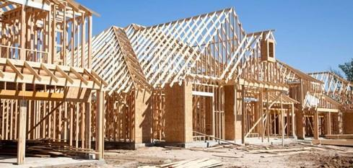


FEEDBACK
So, as we’ve all found here today, we value your participation in our workplace and invite you to provide some feedback regarding potential barriers to our processes, or any other issue’s you may feel impact our workplace when it comes to health and safety.
Does anyone have any ideas, input or concerns they would like to raise?
Thankyou so much for your time.

