Slide 1
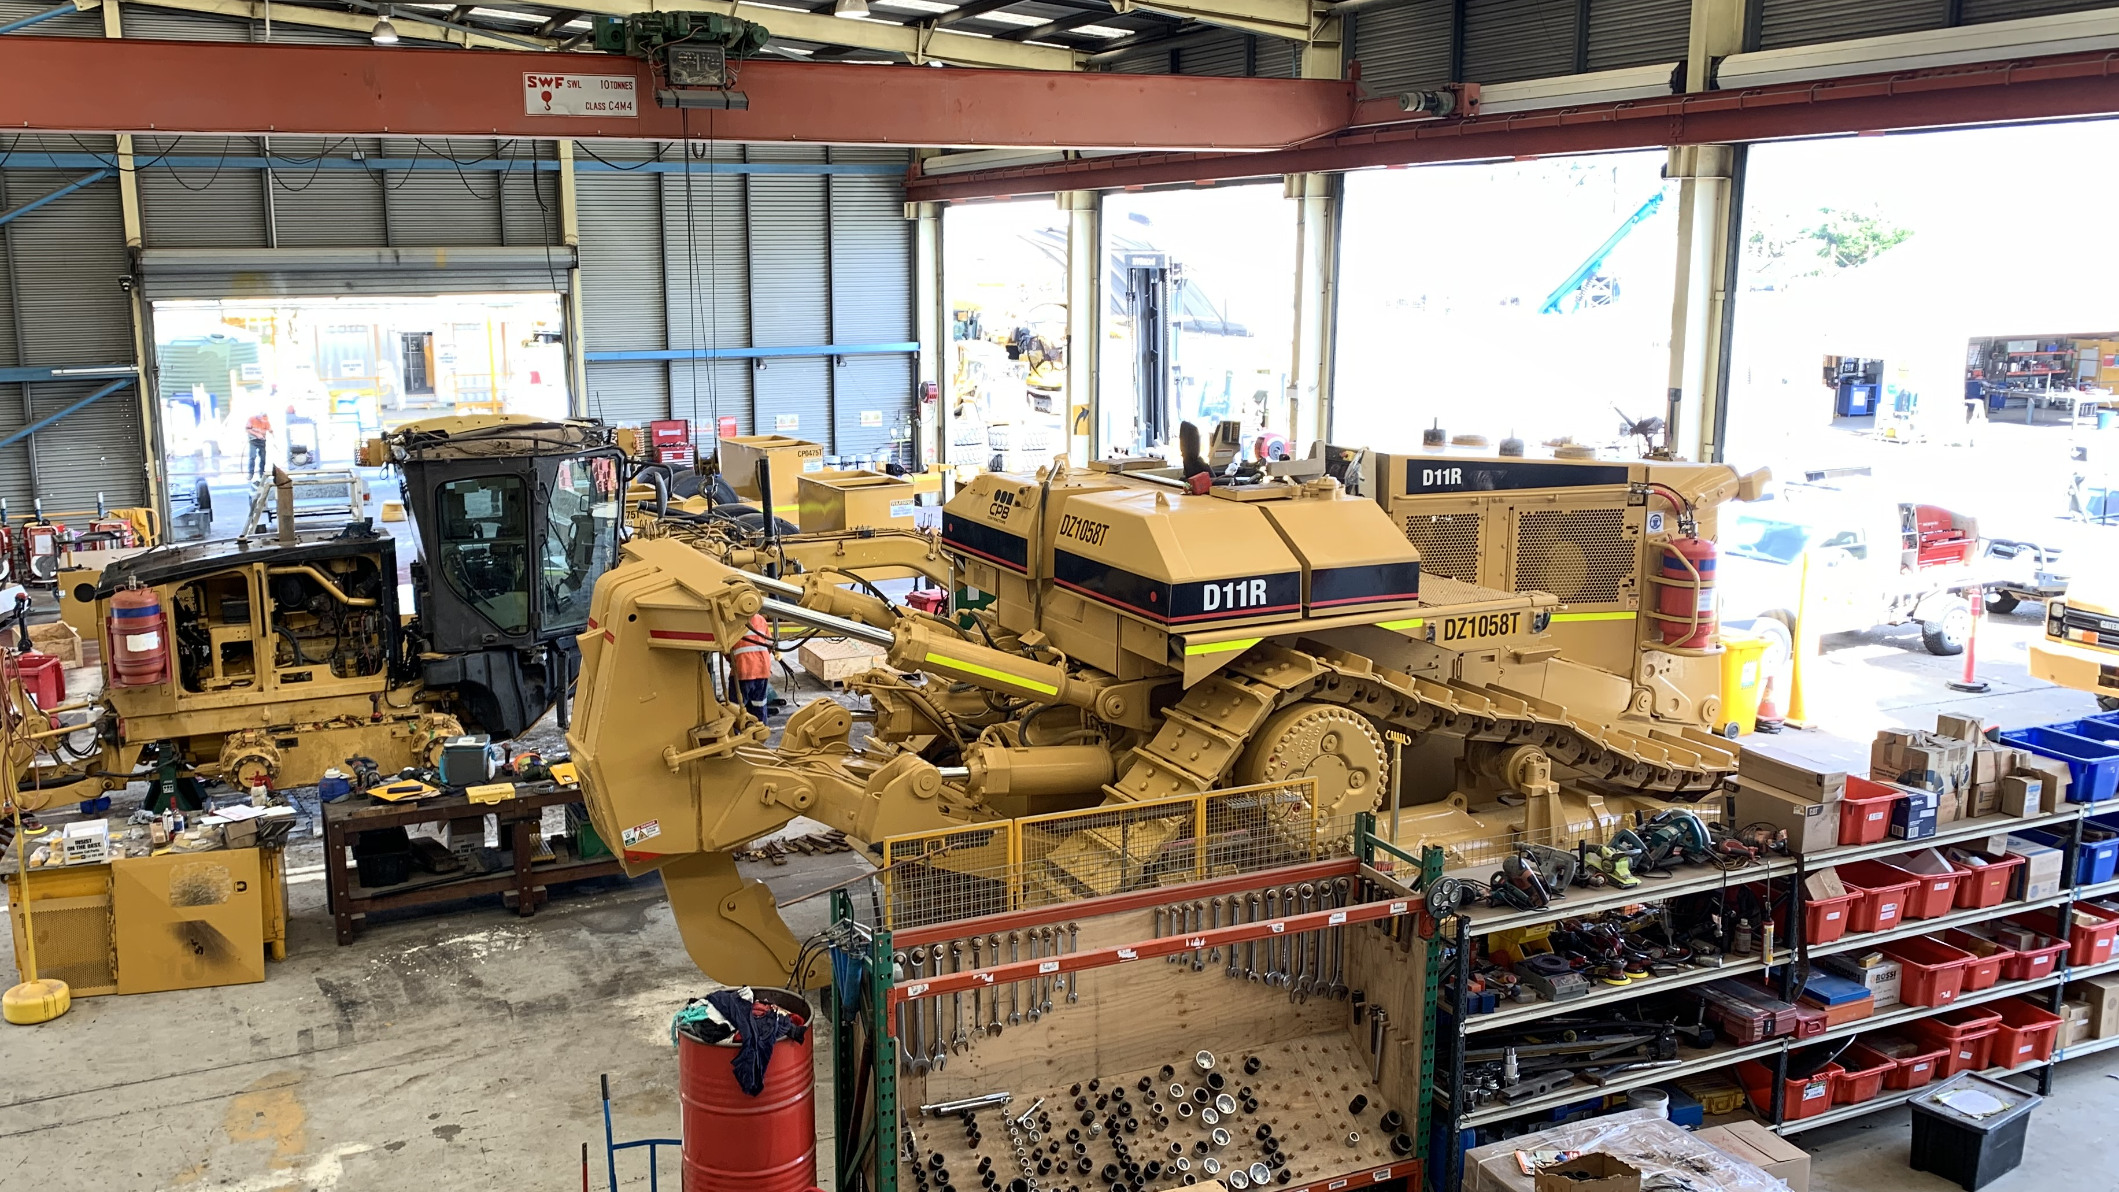
Work Health and Safety
Management Systems –
WHSMS Plan
Plant Yard

Slide 2
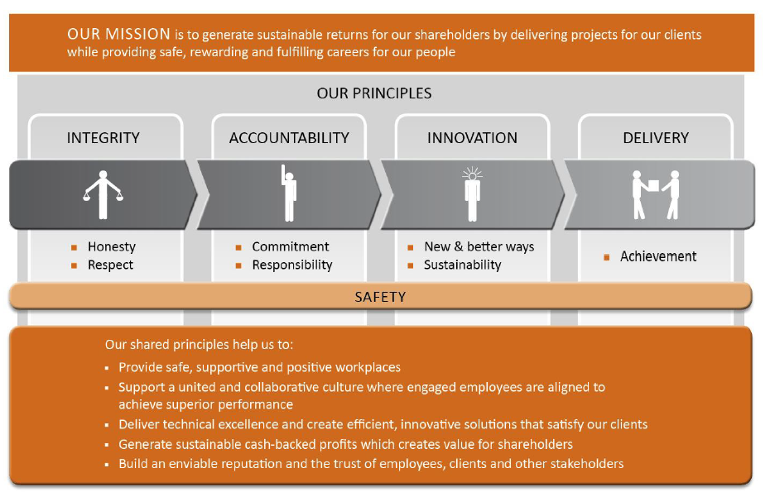
Our Mission and Principles

Slide 3
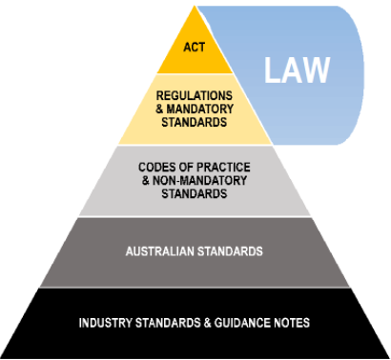
Legislative Framework

Slide 4
References
Work Health and Safety Act 2011: https://www.legislation.qld.gov.au/
Work Health and Safety Regulations 2011: https://www.legislation.qld.gov.au/
Occupation health and safety management systems (OHSMS) - AS/NZS ISO 45001:2018: https://www.comcare.gov.au/
Work Health and Safety (Construction Work) Code of Practice 2018: https://www.legislation.qld.gov.au/
Model Code of Practice (Construction Work) 2018: SafeWork Australia: https://www.safeworkaustralia.gov.au/
CMS internal policies and procedures:
Return to work program
Work Health Safety Management Systems – Injury Management
CIMIC Group - injury post incident
Manage Injury Post Incident CPB Contractors

Slide 5

PCBUs Duties, Rights and Obligations – Work Health Safety Act (Cth) 2011
The Work Health and Safety (WHS) Act 2011 (Cth) is an Australian law that addresses the requirements for health and safety management systems in all workplaces. It highlights that employers must provide a safe working environment for all employees and people, and it outlines a range of responsibilities and obligations that all parties (PCBU and workers) must follow to ensure that health and safety risks are identified and managed in the workplace.
The Act requires PCBUs to maintain a health and safety management system that is appropriate for their business including but not limited to;
Policies and procedures
Risk management
Incident reporting
Consultation with workers
Providing information and training
Supervision
Workers to comply with all reasonable instructions from a PCBU and
Worker to cooperate with all reasonable policies or procedures from a PCBU regarding health and safety
Workers to take reasonable care for themselves and others
The Act is intended to promote a safety culture in the workplace by establishing clear responsibilities and obligations for all people (PCBU, workers and the public) in the identification and management of health and safety risks

Slide 6
PCBUs Duties, Rights and Obligations – Work Health Safety Act (QLD) 2011
The WHS Act 2011 (qld) is very similar to the WHS Act Cth, however it is specified to qld only. It has been established to help protect the workers (and all other people who may be affected) well-being whilst at work.
It clearly defines duties for all workers, including taking reasonable care for their own health and safety and the health and safety of others both during work and during work breaks while they are at the workplace of the PCBU. The WHS Act of QLD has also added an exceptions section under number 34 regarding volunteers and rules regarding manslaughter.
The WHS Act (qld) 2011 clearly defines the requirements for a health and safety management systems to include, but not limited to:
Policies and procedures
Risk management
Incident reporting
Consultation with workers
Providing information and training
Supervision
Communication and participation
Workers to comply with all reasonable instructions from a PCBU and
Worker to cooperate with all reasonable policies or procedures from a PCBU regarding health and safety
Workers to take reasonable care for themselves and others
This legislation provides the frame work for a safety culture and workplace in defining clear roles, responsibilities and obligations for both workers and PCBUs for identifying and implementing WHS management systems

Slide 7
PCBUs Duties, Rights and Obligations – Code of Practice 2018
Code of Practice (Construction) 2018.
This code of practice outlines the safest practices and procedures for effective management within the construction industry in Australia. It highlights the following key elements:
Identifying hazards
Assessing the risks
Controlling the risks
Maintaining and reviewing control measures
Safe Work Method Statements (SWMS)
WHS management plans for construction
Information, training, instruction and supervision
Specific duties (all)
Communication and consultation
General workplace construction management i.e., PPE, work areas, lighting, essential services etc.
The Code of Practice for Construction Work 2018 is designed to promote safety and highlight the essential of risk management for construction.

Slide 8
PCBUs Duties, Rights and Obligations – Occupation Health and Safety Management Systems – AS/NZS ISO 45001:2018
Occupation health and safety management systems (OHSMS) is an international standard that provides the basis for preventing injuries, work-related illnesses, and fatalities in the workplace.
The standard requires PCBUs to establish and maintain management systems that focus on identifying and controlling occupational health and safety risks and hazards however, it highlights the obligations that all legal and legislation requirements be meet above the standards.
This standard can be used to support PCBUs in improving their health and safety performance and clearly defining their objectives regarding controlling and reviewing all risk and hazards.
It highlights the importance involving workers and relevant stakeholders in communication and participation in the development and implementation of the OHSMS, helping engage and empower all workers to contribute will create a safety culture in the workplace.

Slide 9
PCBUs Duties, Rights and Obligations – Guidance Material
The Safety Management System in QLD outlines results of an audit to conduct a safety management system in Qld. The audit intends to see if the safety management system being evaluated needs any improvement.
The document highlights who the audit is for and who will be auditing them. It acknowledges the cooperation of staff and ensures confidentiality. The audit provides a summary of the process, procedures used and how it records the findings.
It may offer recommendations and corrective action along with compliance in the conclusion if necessary.
Overall, the Safety Management System is an objective way to evaluate how effective the management system is and improve safety practices.

Slide 10
PCBUs Duties, Rights and Obligations – Organisational Requirements
CPB Contractor’s policy on returning to work and injury management that intends to keep the works and contractors safe. CPB Contractors policy highlights that:
Early intervention and the importance of appropriate care and support as quickly as possible is essential
CPB offers individualised support as it recognises that each injury is unique and therefore needs differing support
Communication and collaboration between all parties involved including the external service providers
Rehabilitation and return to workplaces are put into place as soon as possible (where appropriate), tailored to the needs to the injured worker
Injury prevention. Identifying what caused the hazard / risks in the workplace and how can they prevent injuries from occurring again (or in the first instance)

Slide 11
PCBUs Duties, Rights and Obligations – Organisational Requirements
CPB Contractor’s procedure for managing return to work and injury management is designed to help provide support to any workers who have had an injury or become ill whilst at work. The procedures are:
Assist with ongoing medical treatment
Propose Return to Work Plan (RTW)
Implementation of agreed RTW Plan
Review RTW Plan
Monitor Worker
CPB Contractor’s procedure for managing return to work and injury management is designed to help provide support to any workers who have had an injury or become ill whilst at work. The procedures are:
Notification and initial response – Employees and workers are encouraged to notify their boss as soon as possible after an injury or illness occurs. The injury management process is initiated by the supervisor completing an injury notification form and providing care to the injured person/s.
An assessment and referral are required to determine the appropriate medical treatment and support and the worker may be taken to an external service is needed.
Rehabilitation and return to work planning is the next step. The injury management coordinator (usually a member of the safety team) and the supervisor will develop a return to work plan that is tailored to the workers needs and what their capabilities are. The plan will go into detail about the steps that will be taken to help the employee return to work safety as soon as possible.
Monitoring and reviewing the injured workers progress is monitored through the whole process. This requires regular reviews and assessment to ensure the plan is effective and if needed, adjustments are made
Injury prevention is included in this procedure to identify and hazards and risks and provide any training and or support needed to all workers to avoid the injury occurring again.

Slide 12

Injury Management Plan

Slide 13
Injury Management
CPB Contractor’s policy on injury management that intends to keep the workers and contractors safe.
CPB Contractors policy highlights that:
Early intervention and the importance of appropriate care and support as quickly as possible is essential
CPB offers individualised support as it recognises that each injury is unique and therefore needs differing support
Communication and collaboration between all parties involved including the external service providers
Rehabilitation and return to work procedures are put into place as soon as possible (where appropriate), tailored to the needs to the injured worker
Injury prevention: Identifying what caused the hazard / risks in the workplace and how can they prevent injuries from occurring again (or in the first instance)
CPB Contractor’s procedure for managing return to work and injury management is designed to help provide support to any workers who have had an injury or become ill whilst at work. The procedures are:
Assist with ongoing medical treatment
Propose Return to Work Plan (RTW)
Implementation of agreed RTW Plan
Review RTW Plan – see WHSMS checklist
Monitor Worker
Communicate
Save information correctly

Slide 14
Injury Management
CPB Contractor’s procedure for managing injury management is designed to help provide support to any workers who have had an injury or become ill whilst at work. The procedures are:
Notification and initial response – Employees and workers are encouraged to notify their boss as soon as possible after an injury or illness occurs. The injury management process is initiated by the supervisor completing an injury notification form and providing care to the injured person/s.
An assessment and referral are required to determine the appropriate medical treatment and support and the worker may be taken to an external service is needed.
Rehabilitation and return to work planning is the next step. The injury management coordinator (usually a member of the safety team) and the supervisor will develop a return to work plan that is tailored to the workers needs and what their capabilities are. The plan will go into detail about the steps that will be taken to help the employee return to work safety as soon as possible.
Monitoring and reviewing the injured workers progress is monitored through the whole process. This requires regular reviews and assessment to ensure the plan is effective and if needed, adjustments are made
Injury prevention is included in this procedure to identify and hazards and risks and provide any training and or support needed to all workers to avoid the injury occurring again.

Slide 15
Injury Management Policy and Procedure
Below lists the steps that are in place for CPB Contractors WHSMS Injury Management (please refer to the full document that can be found on our CMS under the same name).
Workplace Planning
Response to Injury
Return to Work Management Plan
Review and Improvements

Slide 16
Return to Work Plan

Slide 17
Return to Work Plan
CPB Contractor’s policy on returning to work that intends to keep the works and contractors safe.
CPB Contractors policy highlights that:
Early intervention and the importance of appropriate care and support as quickly as possible is essential
CPB offers individualised support as it recognises that each injury is unique and therefore needs differing support
Communication and collaboration between all parties involved including the external service providers
Rehabilitation and return to workplaces are put into place as soon as possible (where appropriate), tailored to the needs to the injured worker
Injury prevention. Identifying what caused the hazard / risks in the workplace and how can they prevent injuries from occurring again (or in the first instance).
CPB Contractor’s procedure for managing return to work is designed to help provide support to any workers who have had an injury or become ill whilst at work. The procedures are:
Assist with ongoing medical treatment
Propose Return to Work Plan (RTW)
Implementation of agreed RTW Plan
Review RTW Plan - see WHSMS checklist
Monitor Worker
Communication
Save information correctly

Slide 18
Return to Work Plan
CPB Contractor’s procedure for managing return to work and injury management is designed to help provide support to any workers who have had an injury or become ill whilst at work. The procedures are:
Notification and initial response – Employees and workers are encouraged to notify their boss as soon as possible after an injury or illness occurs. The injury management process is initiated by the supervisor completing an injury notification form and providing care to the injured person/s.
An assessment and referral are required to determine the appropriate medical treatment and support and the worker may be taken to an external service is needed.
Rehabilitation and return to work planning is the next step. The injury management coordinator (usually a member of the safety team) and the supervisor will develop a return to work plan that is tailored to the workers needs and what their capabilities are. The plan will go into detail about the steps that will be taken to help the employee return to work safety as soon as possible.
Monitoring and reviewing the injured workers progress is monitored through the whole process. This requires regular reviews and assessment to ensure the plan is effective and if needed, adjustments are made
Injury prevention is included in this procedure to identify and hazards and risks and provide any training and or support needed to all workers to avoid the injury occurring again.

Slide 19
Return to Work Policy and Procedure
Below lists the steps that are in place for CPB Contractors WHSMS Return to Work (please refer to the full document that can be found on our CMS under the same name).
Return to work planning
Return to work plan
Approved rehabilitation providers
Return to work monitoring
Return to work risk review
Return to work finalisation
Managing return to work disputes
Communication
Storing and saving data

Slide 20
Emergency Procedures

Slide 21
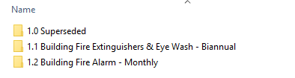
Emergency Procedures
The emergency evacuation plan has been developed for the Plant Yard and can be found along with a list of all emergency contacts throughout the site and following locations:
Office / Reception
Crib rooms
Workshop
Sheds
Ground floor office
Level one office
Male and female toilets
Kitchens
As per CPB Contractors requirements, all testing and tagging of fire extinguishers and eye wash stations will be tested biannually and with the building fire alarm tested each month. This is then entered into the registers saved on the network drive:

Slide 22
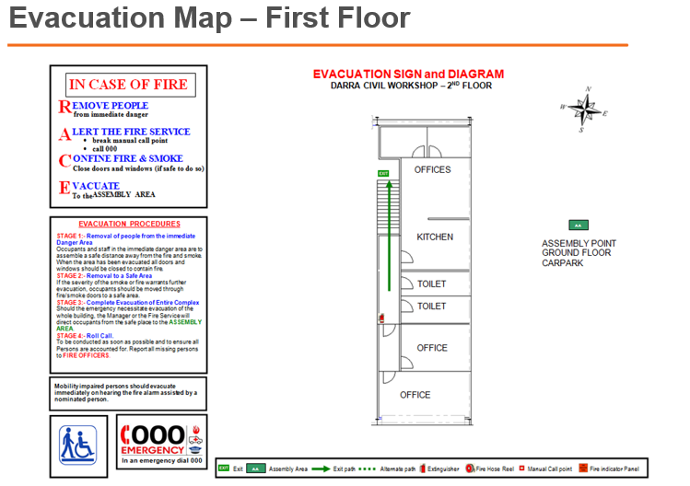
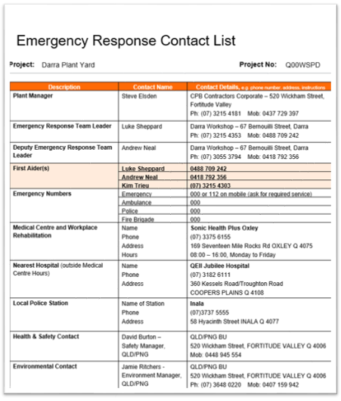
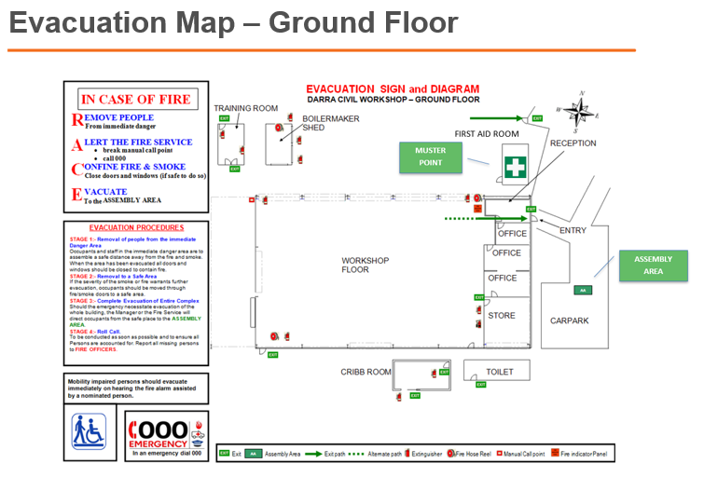
Emergency Response
CPB Contractors always updates the emergency contacts and evacuation maps which can be found all over the Plant Yard. During our emergency drills, workers must point these out.

Slide 23
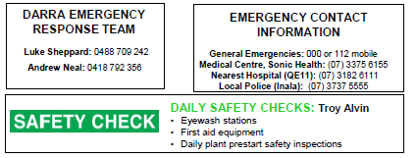
Emergency Response
Emergency response team and contact information is always included in our Daily Prestart. The local medical centre, hospital and police station are also listed.
Daily safety checks are conducted by a different worker each week.
The Legal Obligations
All workers, visitors and members of the public who may be within a building or site at CPB are obligated under State & Federal Acts to comply with ALL instructions given to them by any member of an Emergency Response Team (ERT) during an evacuation or containment.
ERT have authority under the following Legislative Acts, Regulations and Standards:
  Work Health & Safety Act 2011
  Fire & Rescue Act
  Building Fire Safety Regulation
  AS/NZS 3745

Slide 24

Emergency Response
Emergency response drills are often conducted either during Daily Prestart or toolbox talks. CPB Contractors follow the below in an emergency situation:
In the event of an emergency the site emergency procedure shall be followed:
Stop work, ensure your safety.
Call "emergency, emergency, emergency" on your radio over the UHF work channel or using the PA system on the fire alarm.
Await a response, and give the following information:
  Your name
  Your location
  The nature of the emergency
  Number of people involved
  Resources required
  Any other hazard information
Stay on the radio and await further instructions.
Other people onsite stop work, maintain radio silence and be prepared to evacuate or offer assistance pending instruction from CPB supervisors.

Slide 25
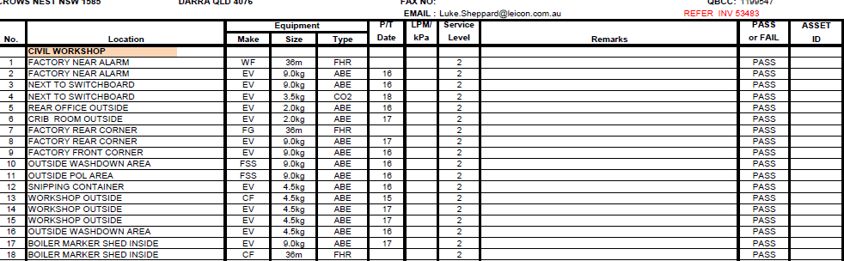
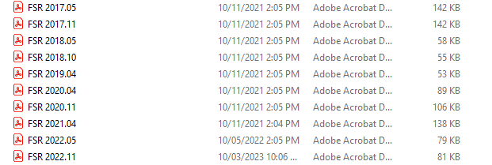
Saving Documentation
All invoices must be scanned into the network drive as a record of when these tests were complete.
It is then saved on our network drive in date order.

Slide 26

Specific WHS Requirements – Safety Essentials

Slide 27
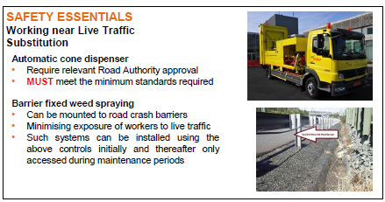
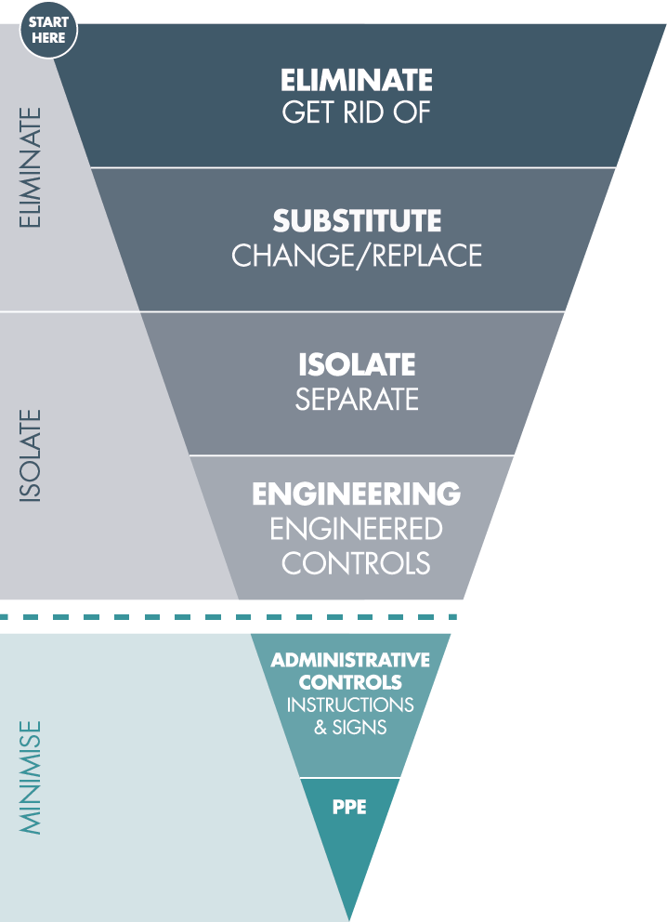
Specific WHS Requirements – Safety Essentials
As CPB Contractors is a civil construction industry we are considered high risk work and require the Safety Essentials, Hierarchy of Controls, One HSE Culture and Active 8 to be in place at all times.
CPB Contractors has 6 high-risk Safety Essentials that we rotate for the workers, they include;
Electrical work
Mobile cranes and lifting operations
Work near mobile plant
Working near live traffic
Working with live services
Working at heights
Above the Line:
“Whenever performing a Safety Essentials task you MUST have an Above the Line Control as the primary control. If you do not have that you must have a Safety Essentials Exception signed by the Business Unit (BU) General Manager.”

Slide 28
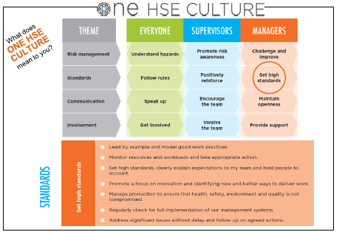
Safety Essentials – One HSE Culture
CPB Contractors created One HSE Culture to guide all workers behaviour and create a positive culture within CPB Contractors. It is designed to highlight the roles and expectation for workers, supervisors and managers.

Slide 29
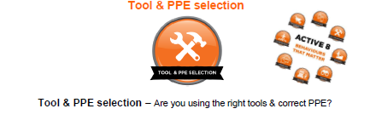
Safety Essentials – CPB Contractors Policies
CPB Contractors have also created the Active 8 which is also rotated for workers and includes;
Eyes on hands
Tool & PPE selection
Eyes on path
Assess area
Line of fire
Communication
Look before moving
Controlled physical movement

Slide 30
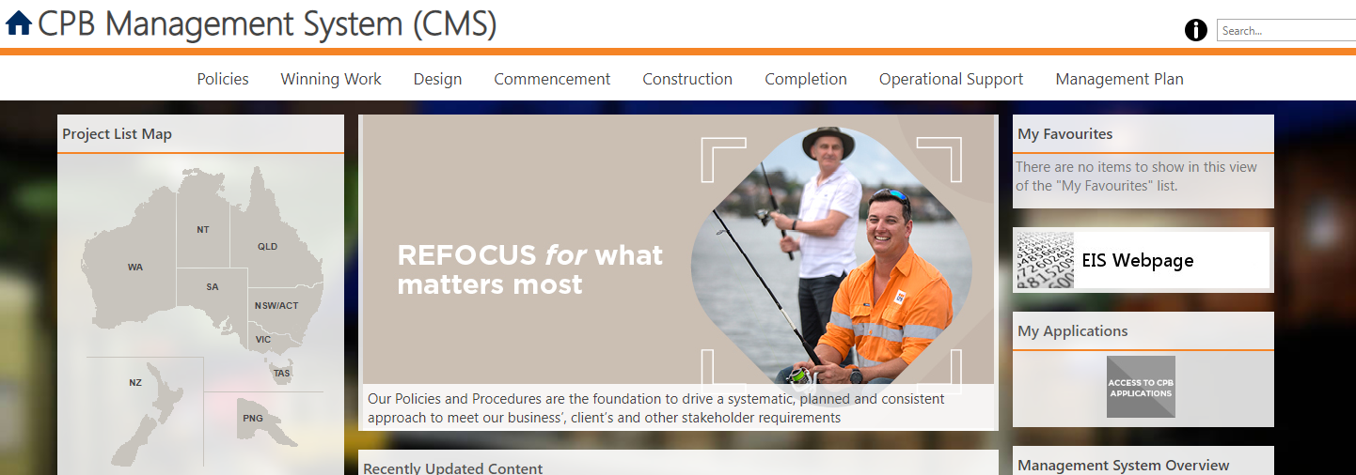
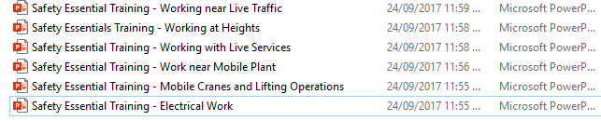
Saving Documentation
If any of the high risk Safety Essentials are updated by a qualified WHS Representative / Safety team, they can be found on our CMS intranet to be downloaded as needed
It is then saved on our network drive in date order.

Slide 31
Training

Slide 32
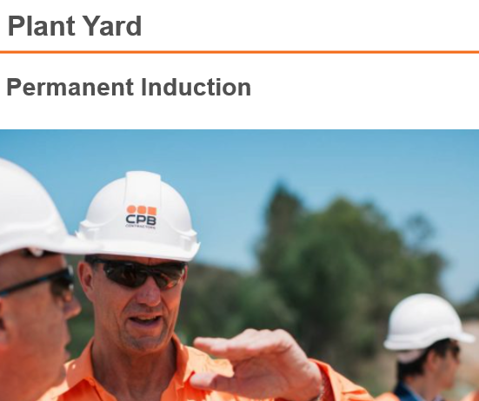
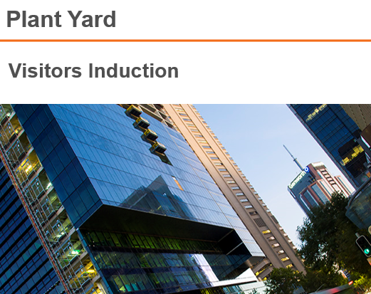
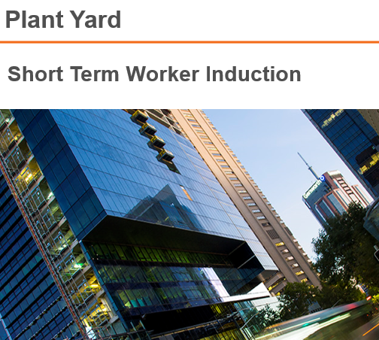
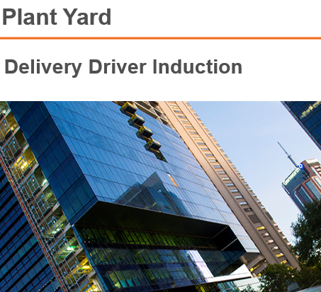
Training
Training starts at the point of induction at CPB Contractors. We have just implemented a system called Damstra where all training modules and lessons are sent directly to all workers including, visitors, subcontractors, delivery drivers and permanent workers. These inductions and modules / lessons are designed to guide and inform each individual before they arrive at our work sites.

Slide 33
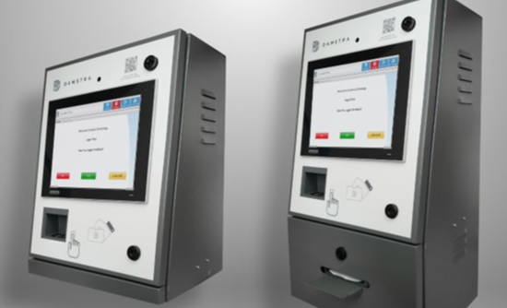
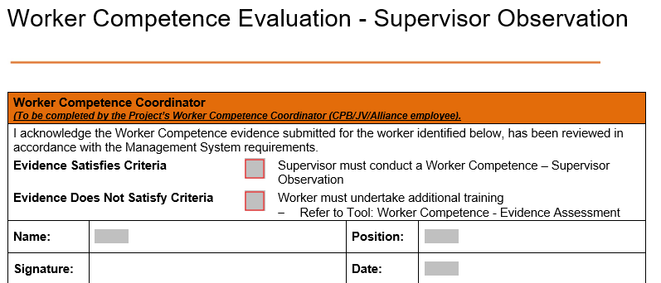
Training Requirements
With he help of Damstra, no person (including the public) is able to enter site unless competency assessments have been completed:
All licences and other relevant qualifications have been submitted and approved via Damstra
An Employee Competence Evaluation form has been completed by the worker and signed off by the employer
Supervisor Observation Form has been completed before being able to work on site

Slide 34


Training and Education
With the help of Damstra and being able to see any holes in our workers training requirements, we are able to book each worker into complete up to $1,500.00 worth of training each year. This, along with the grants from the QLD government (relating to large infrastructure projects) means, CPB Contractors is able to provide their staff with ongoing training and education in all areas, especially WHSMS and how to work safer.
For any staff seeking training, please contract your direct line manager to discuss all the options.

Slide 35

Feedback & Recommendations

