Slide 1
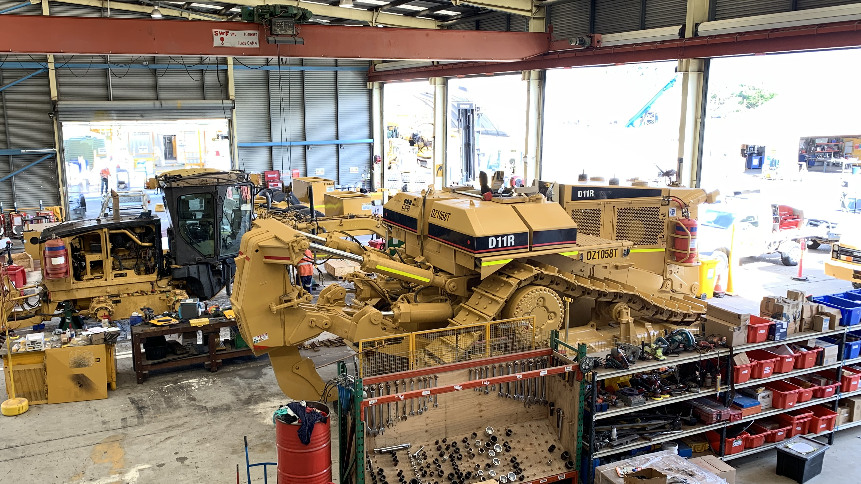
Work Health and Safety Non-Compliance from contractors (2)

Slide 2
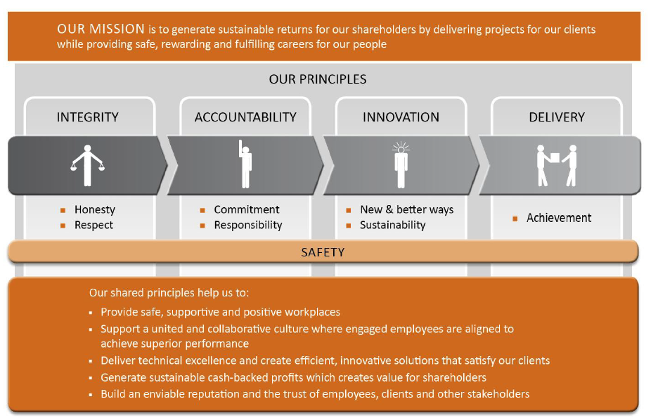
Our Mission and Principles

Slide 3
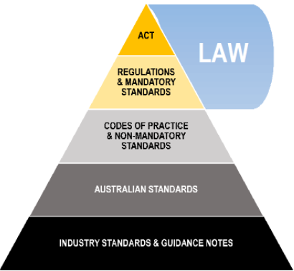
Legislative Framework

Slide 4
References
Work Health and Safety Act 2011: https://www.legislation.qld.gov.au/
Work Health and Safety Regulations 2011: https://www.legislation.qld.gov.au/
Occupation health and safety management systems (OHSMS) - AS/NZS ISO 45001:2018: https://www.comcare.gov.au/
Work Health and Safety (Construction Work) Code of Practice 2018: https://www.legislation.qld.gov.au/
Model Code of Practice (Construction Work) 2018: SafeWork Australia: https://www.safeworkaustralia.gov.au/
WorkSafe Qld: Home | WorkSafe.qld.gov.au
Managing the risks of falls at workplaces code of practice 2021: https://www.worksafe.qld.gov.au/
How to manage work health and safety risks code of practice 2021: https://www.worksafe.qld.gov.au/
Fire & Rescue Act: https://www.legislation.qld.gov.au/
Building Fire Safety Regulation 2008: https://www.legislation.qld.gov.au/
Planning for emergencies in facilities, AS/NZS 3745: https://ablis.business.gov.au/
CPB Contractors CMS internal policies and procedures: internal home intranet

Slide 5
Contractors Duties & Rights – Where to find them
Workers Duties:
Take reasonable care for their own safety and health, take steps to ensure their actions or omissions do not harm the health and safety of others
Comply, if able, with any reasonable instruction from the person conducting business
Cooperate with any policy or procedure that is reasonable, from the person conducting business regarding health or safety that the worker/s has been told about
Work Health and Safety Regulation 2011, section 28; Work Health and Safety (Construction work) Code of Practice 2015, Section 2.3 & 2.4; Work Health and Safety Act 2011, Section 84
Workers Rights:
A worker may refuse to carry out or cease work if the worker has a genuine concern that the work could expose them to serious risk or the workers’ health and safety, from contact with an immediate hazard
The right to a safe and healthy workplace, include safe machinery and structures
Workers’ compensation
Be given training
Consultation about safety in the workplace
Worksafe Qld; Work Health and Safety Regulation 2011, section 83-89

Slide 6
Contractors Obligations - Where to find them
Workers Obligations:
Take reasonable care of yourself and others
Follow WHS instructions
Follow workplace WHS polices and procedures
Work safely
Use personal protective equipment (PPE) as correctly trained and not mistreat anything provided for your health and safety at work.
Report injuries and unsafe situations to a supervisor or health and safety representative
Construction card induction training card must be available for inspection
Workers must comply with, so far as is reasonable, instructions given by the PCBU to comply with WHS laws
Cooperate with any reasonable procedure or policy from the PCBU regarding health and safety in the workplace
Respond to incidents
Provide first aid
Help investigators / investigations
Implement risk control measures
Worksafe Qld; Work Health and Safety (Construction work) Code of Practice 2015, Section 2.3

Slide 7
PCBUs Duties, Rights and Obligations –
Work Health Safety Act 2011
The PCBU, as the primary duty of care, so far as is reasonably practicable:
Ensure the health and safety of workers
Provide procedures and policies regarding health and safety in the workplace
Implement risk control measures
Respond to incidents
Provide first aid
Help investigators / investigations
Notify the regulator if:
Death occurs
Serious injury or illness
Dangerous incident
Preserve sites where the incident/s occur

Slide 8

PCBUs Duties, Rights and Obligations – Work Health Safety Act (QLD) 2011
The WHS Act 2011 (qld) is very similar to the WHS Act Cth, however it is specified to qld only. It has been established to help protect the workers (and all other people who may be affected) well-being whilst at work.
It clearly defines duties for all workers, including taking reasonable care for their own health and safety and the health and safety of others both during work and during work breaks while they are at the workplace of the PCBU. The WHS Act of QLD has also added an exceptions section under number 34 regarding volunteers and rules regarding manslaughter.
The WHS Act (qld) 2011 clearly defines the requirements for a health and safety management systems to include, but not limited to:
Policies and procedures
Risk management
Incident reporting
Consultation with workers
Providing information and training
Supervision
Communication and participation
Workers to comply with all reasonable instructions from a PCBU and
Worker to cooperate with all reasonable policies or procedures from a PCBU regarding health and safety
Workers to take reasonable care for themselves and others
This legislation provides the frame work for a safety culture and workplace in defining clear roles, responsibilities and obligations for both workers and PCBUs for identifying and implementing WHS management systems

Slide 9
PCBUs Duties, Rights and Obligations – Occupation Health and Safety Management Systems – AS/NZS ISO 45001:2018
Occupation health and safety management systems (OHSMS) is an international standard that provides the basis for preventing injuries, work-related illnesses, and fatalities in the workplace.
The standard requires PCBUs to establish and maintain management systems that focus on identifying and controlling occupational health and safety risks and hazards however, it highlights the obligations that all legal and legislation requirements be meet above the standards.
This standard can be used to support PCBUs in improving their health and safety performance and clearly defining their objectives regarding controlling and reviewing all risk and hazards.
It highlights the importance involving workers and relevant stakeholders in communication and participation in the development and implementation of the OHSMS, helping engage and empower all workers to contribute will create a safety culture in the workplace.

Slide 10
PCBUs Duties, Rights and Obligations – Guidance Material
The Safety Management System in QLD outlines results of an audit to conduct a safety management system in Qld. The audit intends to see if the safety management system being evaluated needs any improvement.
The document highlights who the audit is for and who will be auditing them. It acknowledges the cooperation of staff and ensures confidentiality. The audit provides a summary of the process, procedures used and how it records the findings.
It may offer recommendations and corrective action along with compliance in the conclusion if necessary.
Overall, the Safety Management System is an objective way to evaluate how effective the management system is and improve safety practices.

Slide 11
PCBUs Duties, Rights and Obligations – Organisational Requirements
CPB Contractor’s policy on returning to work and injury management that intends to keep the works and contractors safe. CPB Contractors policy highlights that:
Early intervention and the importance of appropriate care and support as quickly as possible is essential
CPB offers individualised support as it recognises that each injury is unique and therefore needs differing support
Communication and collaboration between all parties involved including the external service providers
Rehabilitation and return to workplaces are put into place as soon as possible (where appropriate), tailored to the needs to the injured worker
Injury prevention. Identifying what caused the hazard / risks in the workplace and how can they prevent injuries from occurring again (or in the first instance)

Slide 12
PCBUs Duties, Rights and Obligations – Organisational Requirements
CPB Contractor’s procedure for managing return to work and injury management is designed to help provide support to any workers who have had an injury or become ill whilst at work. The procedures are:
Assist with ongoing medical treatment
Propose Return to Work Plan (RTW)
Implementation of agreed RTW Plan
Review RTW Plan
Monitor Worker
CPB Contractor’s procedure for managing return to work and injury management is designed to help provide support to any workers who have had an injury or become ill whilst at work. The procedures are:
Notification and initial response – Employees and workers are encouraged to notify their boss as soon as possible after an injury or illness occurs. The injury management process is initiated by the supervisor completing an injury notification form and providing care to the injured person/s.
An assessment and referral are required to determine the appropriate medical treatment and support and the worker may be taken to an external service is needed.
Rehabilitation and return to work planning is the next step. The injury management coordinator (usually a member of the safety team) and the supervisor will develop a return to work plan that is tailored to the workers needs and what their capabilities are. The plan will go into detail about the steps that will be taken to help the employee return to work safety as soon as possible.
Monitoring and reviewing the injured workers progress is monitored through the whole process. This requires regular reviews and assessment to ensure the plan is effective and if needed, adjustments are made
Injury prevention is included in this procedure to identify and hazards and risks and provide any training and or support needed to all workers to avoid the injury occurring again.

Slide 13

Shotcrete Australia (Contractor 1)

Slide 14
Shotcrete Australia (Contractor 1)
Shotcrete Australia offer a range of services:
They offer support to larger companies for supporting infrastructure including, the rail corridor, tunnelling, road cuttings, canal lining, shafts, dive structures and drainage.
Shotcrete Australia have complete hundreds of shoring packages to assist the safe construction of deep excavation basements. Typical shoring designs include a piling system along with temporary anchors and a shotcrete wall. Shotcrete Australia offer a full package shoring wall system including:
Piling
Capping Beam
Anchors
Shotcrete
Design & Construct
They also offer a fully owned range of modern plant and equipment. This fleet includes two spray rigs, a piling rig, and another anchor rig. This will allow Shotcrete Australia to increase the range, quantity and quality of service we a providing to our clients. We are excited to expand our offerings in the construction industry.

Slide 15
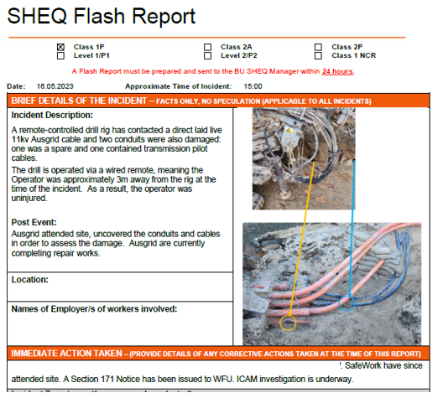
Non-Compliance
The attached SHEQ Flash Report relates to a Potential Class-1 incident that occurred on Tuesday 16th May 2023, at the WFU project.
What Happened?
• A remote-controlled drill rig has contacted an underground 11kv (live) Ausgrid cable causing property damage. No injuries were sustained.
Action: Please distribute and discuss this SHEQ Flash Report at relevant Project Management Meetings and Toolbox Talks to further inform personnel about the incident and discuss CPB’s Safety Essential requirements for Manage Work Near Live Services. Refer to the CMS: Manage Work Near Live Services – Safety Essential
Please encourage Everyone to:
• Understand the hazards and take time to make sure that all controls are in place before commencing and during any work
• Follow the rules and familiarise themselves with the way that the job has been planned
• Speak up if the controls identified are not working as planned
• Get involved and contribute to every safety discussion
Keeping people safe is our absolute priority and the most important thing that we do.

Slide 16
Non-Compliance – Discussion (Contractor 1)
CPB Contractors would follow these steps when address an issue of non compliance:
Identification of non-compliance
Documenting non-compliance
Communication with the contractor
Share documentation
Clarifying expectations
Collaborative problem-solving
Setting deadlines for actions to be completed
Monitoring the progress
Providing support and resources
Documentation of resolution
Regarding the incident of the remote-controlled drill rig contacted an underground 11kv (live) Ausgrid cable, CPB Contractors would work with the contractor to identify the root issue that cased the incident and develop appropriate solutions. One of these solutions would be to provide more training (refresher training) on using service locating methods like pot-holing with hydrovac trucks to expose services. CPB Contractors would set a meeting and discuss the issues, actions for the contractor to implement by certain dates would be the probable outcome of the meeting/s.

Slide 17
Reviewing Codes of Practice
CPB Contractors agree upon work health safety (WHS) key performance indicators with all contractors. Below is an idea of what would be agreed upon with Shotcrete Australia (please note, this does not cover all key performance indicators).
Concrete Strength and Quality – Shotcrete would need to ensure they used in all CPB Contractors construction projects meet the required strength and quality standards. This indicator could also involve testing procedures, quality control measure and compliance with relevant standards and specifications.
Personal Protective Equipment (PPE) – all appropriate PPE must be worn, and all PPE is provided by CPB Contractors if not supplied by the contractor themselves. This indicator would monitor the proper usage of PPE such as helmets, googles, masks, gloves and protective clothing.
Equipment Safety and Maintenance – Shotcrete must ensure all of their equipment is properly maintained, regularly inspected and safe to use. This indicator would involve maintenance schedules, inspection records and adherence to manufacturer guidelines and safety standards. This is what we primarily do at the Plant Yard, all inspections of contractor plant and equipment must be inspected by CPB Contractors and given a sticker with an ID number to show it is allowed to be on site. I process all the paperwork side of plant and equipment for QLD projects.
Incident and Injury rates – Tracking and reducing the number of work related incidents, injuries and illnesses would be a key indicator of WHS performance. This would include both lost time injuries and non-lost time injuries.
Hazard Identification and Risk Assessment – CPB Contractors requires regular assessments to be conducted on identifying workplace hazards regarding WHS, these are submitted monthly to everyone (both CPB staff and contractors) directly to Synergy.

Slide 18
Reviewing Codes of Practice - Continued
CPB Contractors agree upon work health safety (WHS) key performance indicators with all contractors. Below is an idea of what would be agreed upon with Shotcrete Australia (please note, this does not cover all key performance indicators).
Training and Competency – Workers must receive appropriate training and possess the necessary competencies for each role. This indicator also measures the completion rates of required (mandatory) training and certifications.
Compliance with legislation and Australia Standards – CPB Contractors requires all contractors to monitor compliance rates and implement corrective actions for any non-compliance.
Safety Inspections and Audits – Regular safety inspections and audits must be conducted to help identify potential hazards and ensure safety measures are in place. This indicator might also focus on the number of inspections and audits conducted as well as how fast the implementation of corrective actions was managed.
Near Miss Reporting – CPB Contractors puts a lot of emphasis on encouraging the tracking of all near misses and reporting potential hazards before they can cause harm. All data is entered into Synergy.
Worker Engagement and Consultation – Involving workers in decisions and processes is crucial in regards to safety.
Emergency Preparedness – CPB Contractors has emergency response plans in place and conducts regular drills and simulations for all workers (including contractors). These are vital for lowering potential risk. This indicator can also include developing and testing how the emergency plans and response work for all workers.

Slide 19
BT Scaffolds (Contractor 2)

Slide 20
BT Scaffolds (Contractor 2)
BT Scaffolds provides a full range of scaffolding and worksite access equipment for hire and whatever your needs, we’re here to ensure you and your crew remains safe on the job. Commercial development, the right scaffolding is essential to protect workers and the public.
Comprehensive Range of Scaffolding Equipment:
BT Scaffolds offer a comprehensive range of scaffolding and worksite access equipment in the Brisbane area with a strong focus on OH&S. BT Scaffolds offer an extensive range of scaffolding, fencing, ladders and accessories. BT scaffolding comes in easy, foldable mobile solutions through to larger platforms for multi-level work. From narrow to wide, short and tall.
They offer:
Mobile scaffolding
Independent scaffolding units
Cage scaffolding
Cantilevered scaffolding
They have experience in the civil construction industry and have completed work in hotels, hospitals, courthouses, schools and commercial building projects.

Slide 21
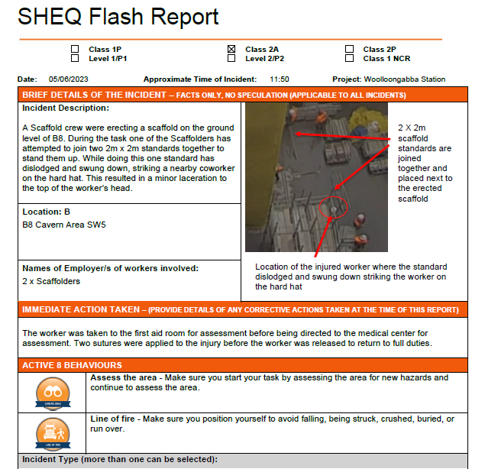
Non-Compliance
The attached SHEQ Flash Report relates to a Potential Class-2A incident that occurred on Monday 5th June 2023 at the CCR Project.
What Happened?
• A Scaffold crew were erecting a scaffold on the ground level of B8. During the task one of the Scaffolders has attempted to join two 2m x 2m standards together to stand them up. While doing this one standard has dislodged and swung down, striking a nearby co-worker on the hard hat. This resulted in a minor laceration to the top of the worker’s head.
Action: The worker was taken to the first aid room for assessment before being directed to the medical centre for assessment. Two sutures were applied to the injury before the worker was released to return to full duties.
Please encourage Everyone to:
• Assess the area - Make sure you start your task by assessing the area for new hazards and continue to assess the area.
Line of fire - Make sure you position yourself to avoid falling, being struck, crushed, buried, or run over.
Keeping people safe is our absolute priority and the most important thing that we do.

Slide 22
Non-Compliance – Discussion (Contractor 2)
CPB Contractors would follow these steps when address an issue of non compliance:
Identification of non-compliance
Documenting non-compliance
Communication with the contractor
Share documentation
Clarifying expectations
Collaborative problem-solving
Setting deadlines for actions to be completed
Monitoring the progress
Providing support and resources
Documentation of resolution
Regarding the incident of the scaffolding incident, CPB Contractors would work with the contractor to identify the root issue that cased the incident and develop appropriate solutions. Two of these solutions would be to follow the Active 8 safety awareness policies:
Assess the area - Make sure you start your task by assessing the area for new hazards and continue to assess the area
Line of fire - Make sure you position yourself to avoid falling, being struck, crushed, buried, or run over
CPB Contractors would set actions for the contractor to be implemented by a certain date (if applicable).

Slide 23
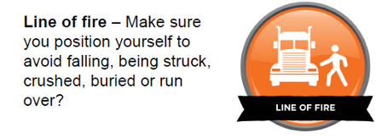
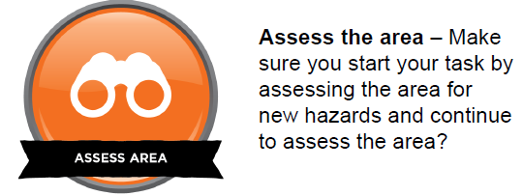
Safety Essentials – CPB Contractors Policies
CPB Contractors have also created the Active 8 which is also rotated for workers and includes:
Eyes on hands
Tool & PPE selection
Eyes on path
Assess area
Line of fire
Communication
Look before moving
Controlled physical movement

Slide 24
Reviewing Codes of Practice
CPB Contractors agree upon work health safety (WHS) key performance indicators with all contractors. Below is an idea of what would be agreed upon with BT Scaffolds (please note, this does not cover all key performance indicators).
Scaffold Inspection Compliance – CPB Contractors enforces all scaffolding structures are regularly inspected by competent individuals and that they comply with all relevant standards and regulations. This indicator also measures the frequency of the inspections and the rate of compliance with inspection schedules.
Fall Prevention Measures – BT Scaffolds must implement and enforce adequate fall prevention measures such as guardrails, harnesses and safety nets. This indicator will also assess the proper use of fall prevention equipment and make sure they are practicing safe working at heights practices from legalisation and CPB Contractors requirements.
Hazard Identification and Risk Assessment – CPB Contractors requires regular assessments to be conducted on identifying workplace hazards regarding WHS, these are submitted monthly to everyone (both CPB staff and contractors) directly to Synergy.
Training and Competency – Workers must receive appropriate training and possess the necessary competencies for each role. This indicator also measures the completion rates of required (mandatory) training and certifications.
Compliance with legislation and Australia Standards – CPB Contractors requires all contractors to monitor compliance rates and implement corrective actions for any non-compliance.
Incident and Injury rates – Tracking and reducing the number of work related incidents, injuries and illnesses would be a key indicator of WHS performance. This would include both lost time injuries and non-lost time injuries.

Slide 25
Reviewing Codes of Practice - Continued
Hazard Identification and Risk Assessment – CPB Contractors requires regular assessments to be conducted on identifying workplace hazards regarding WHS, these are submitted monthly to everyone (both CPB staff and contractors) directly to Synergy.
Emergency Preparedness – CPB Contractors has emergency response plans in place and conducts regular drills and simulations for all workers (including contractors). These are vital for lowering potential risk. This indicator can also include developing and testing how the emergency plans and response work for all workers.
Safety Inspections and Audits – Regular safety inspections and audits must be conducted to help identify potential hazards and ensure safety measures are in place. This indicator might also focus on the number of inspections and audits conducted as well as how fast the implementation of corrective actions was managed.
Near Miss Reporting – CPB Contractors puts a lot of emphasis on encouraging the tracking of all near misses and reporting potential hazards before they can cause harm. All data is entered into Synergy.
Worker Engagement and Consultation – Involving workers in decisions and processes is crucial in regards to safety.

Slide 26

Induction & Training

Slide 27
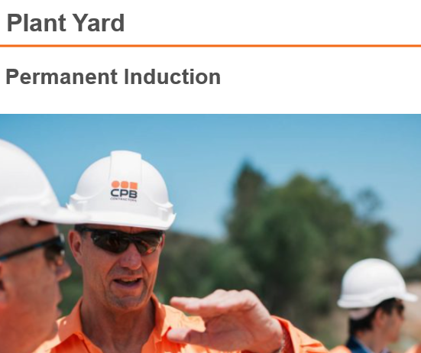
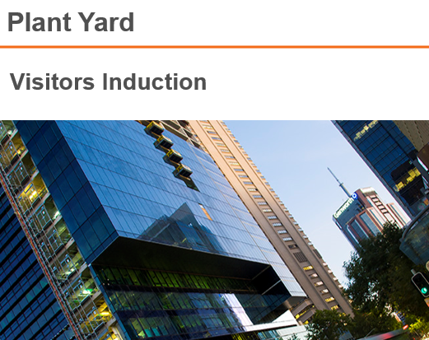
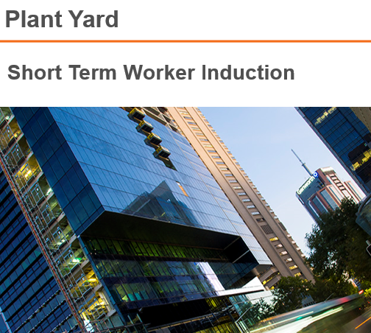
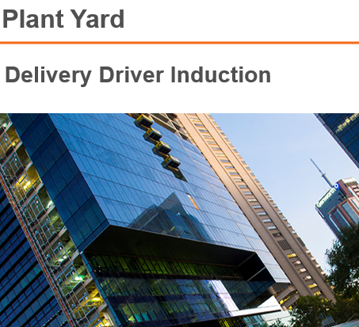
Induction & Training
Training starts at the point of induction at CPB Contractors. We have just implemented a system called Damstra where all training modules and lessons are sent directly to all workers including, visitors, subcontractors, delivery drivers and permanent workers. These inductions and modules / lessons are designed to guide and inform each individual before they arrive at our work sites.

Slide 28
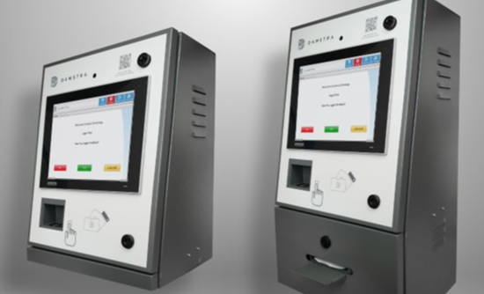
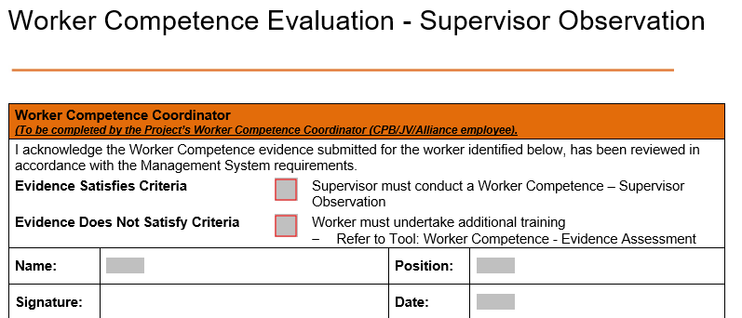
Training Requirements
With the help of Damstra, no person (including the public) is able to enter site unless competency assessments have been completed:
All licences and other relevant qualifications have been submitted and approved via Damstra
An Employee Competence Evaluation form has been completed by the worker and signed off by the employer
Supervisor Observation Form has been completed before being able to work on site

Slide 29
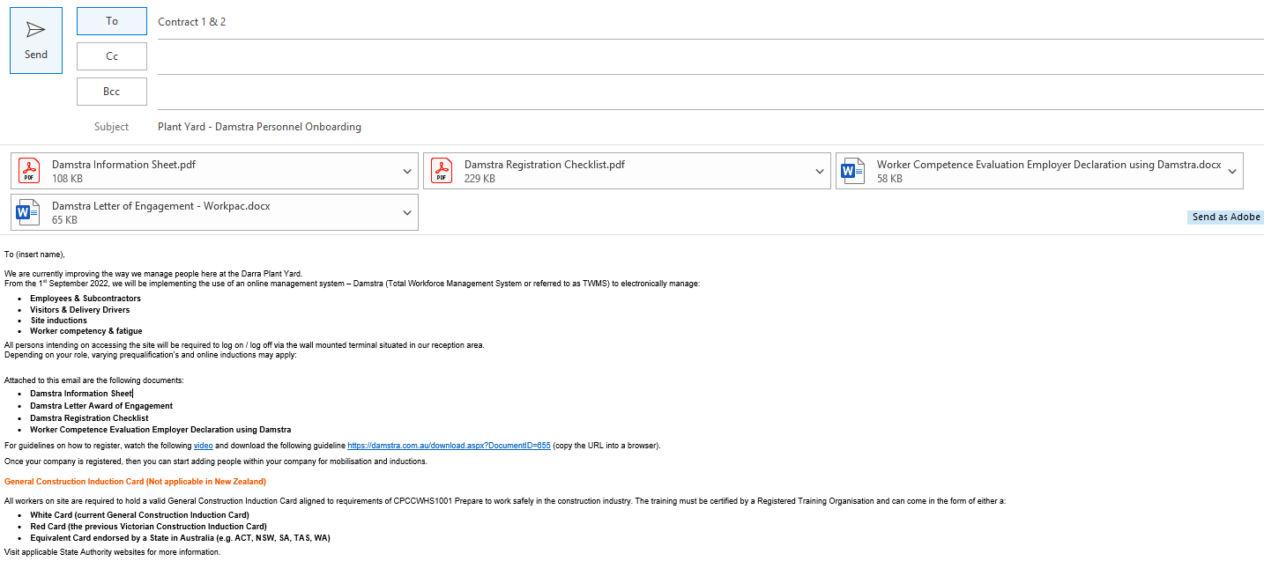
Induction Process
Please note, each induction process can differ slightly depending on the project site, scope of works and location. This induction process is for the Plant Yard only.
I will be contacted by either the contractor directly or my boss asking me to organise a company or induvial to be inducted for the Plant Yard. I will send them back the below email, along with the attachments of how they start this process through our Damstra portal:

Slide 30
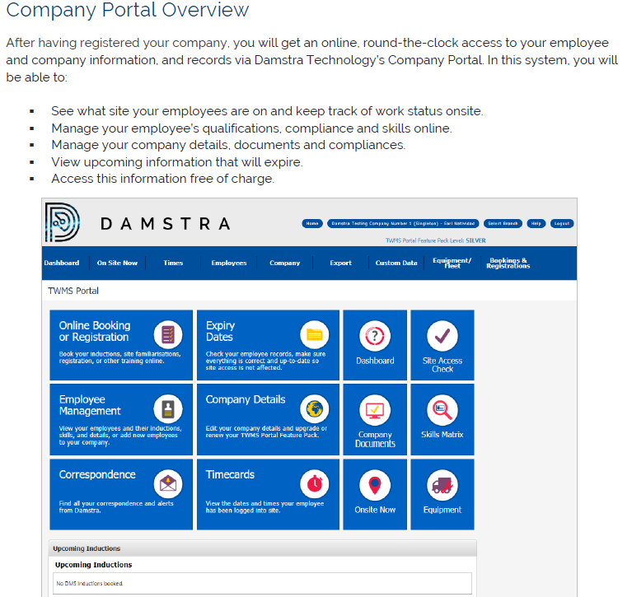
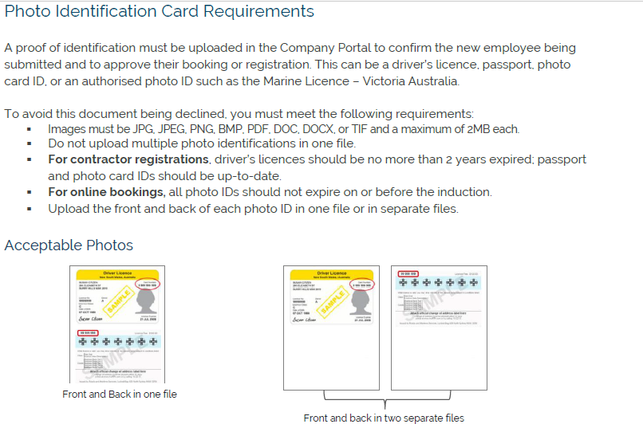
Induction Process Continued
Each contractor must register their company and register each individual worker and have valid ID and certification that follows both legislative requirements and the CPB Skills Matrix. The use of the CPB Skills Matrix helps everyone following the same guidelines and ensures compliance across all sectors throughout all project sites within CPB Contractors.

Slide 31
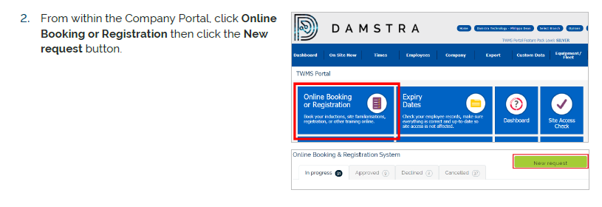
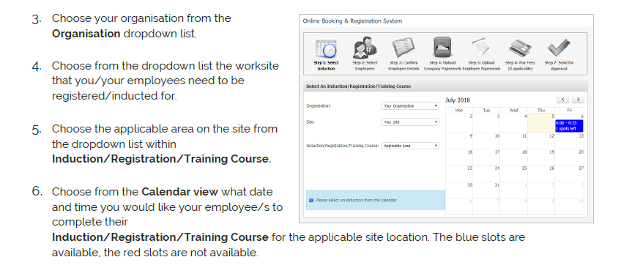
Induction Process Continued
Once a worker/s has been registered, the contractor can book their inductions to suit the workers schedule. Depending on the project, online inductions are available (this is what is used at the Plant Yard).

Slide 32
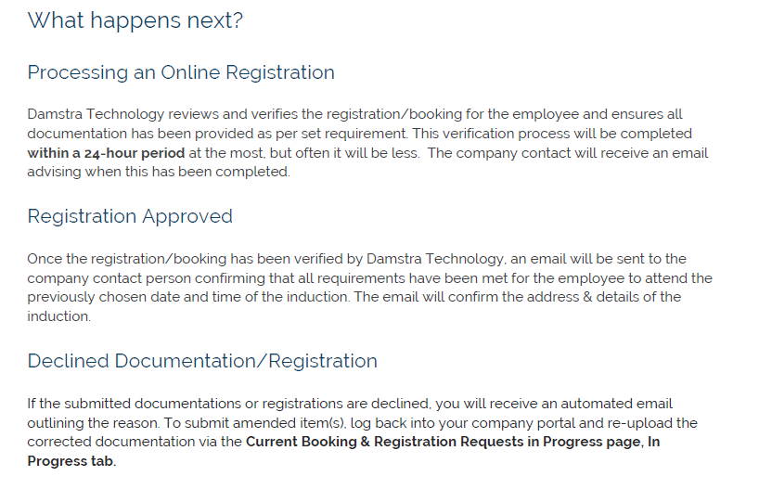
Induction Process Continued
Once the contractor has followed all the booking and registration steps, Damstra staff process the registration either approving or declining based on information supplied.

Slide 33
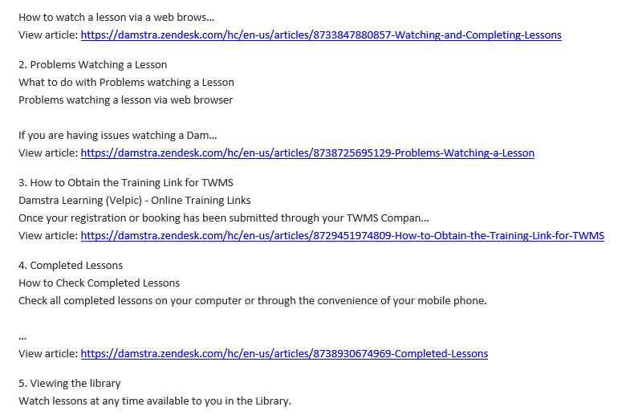
Induction Process Continued
If the registration is approved, the worker will be emailed with their lessons or modules to complete and their online induction. The worker must click on the links provided and complete 4 tests and 14 learning modules. The email that is sent looks like this:

Slide 34
Induction Process – Evidence of Completion
Please see evidence of both companies registering their workers that were involved in the non-compliance issues listed above. When I receive the email from Damstra regarding the worker completing their induction, I log into the EPP (Global) Damstra portal and can view all inducted workers for Plant Yard. It looks like this:
Plant Yard inductions are only valid for 2 years if you are coming to site every 3 months. If you don’t log into the Damstra machine on site within 6 months, a new induction must be taken.

Slide 35
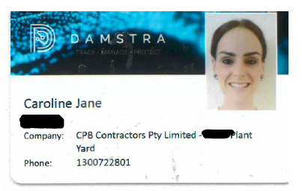
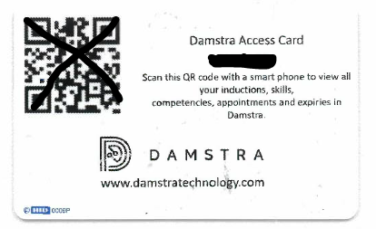
Induction Process Continued
Once the worker has completed all their lessons, I am sent an email to say (name of worker) has successfully completed their Plant Yard induction. At this point a Damstra card is sent to the workers location of work. They use this card / Damstra ID number to sign in and out of the Plant Yard. This Damstra card / Damstra ID is only valid for the projects that worker has been inducted for.

Slide 36


Training and Education
With the help of Damstra and being able to see any holes in our workers training requirements, we are able to book each worker into complete up to $1,500.00 worth of training each year. This, along with the grants from the QLD government (relating to large infrastructure projects) means, CPB Contractors is able to provide their staff with ongoing training and education in all areas, especially WHSMS and how to work safer.
For any staff seeking training, please contract your direct line manager to discuss all the options.

